Slide 1
ALIBABA CLOUD AI HACKATHON PAKISTAN 2026
One decision loop
Rabta-e-Hayat
01
See demand before it becomes a shortage
Blood should expire nowhere while compatible demand goes unmet.
02
Find compatible stock before it expires
03
Recommend a feasible movement
A governed blood-supply operating network for Pakistan
04
Require accountable human approval
05
Track every named unit to receipt
PREDICT
RESCUE
TRANSFER
TRACE
FAHEEL ANJUM · TEAM RABTA-E-HAYAT AI
Notes:
Open with the outcome: this is a decision-and-execution network, not a generic inventory dashboard.
[Sources]
- Local product release and repository
[/Sources]

Slide 2
THE PROBLEM
Blood is perishable. Operations are fragmented. Demand is uncertain.
SHORTAGE
96%
A facility may need compatible blood now.
EXPIRY
of measured blood-product wastage in one Lahore tertiary hospital was attributed to expiry.
Another may be holding usable stock with little shelf life.
FRICTION
Consent, compatibility, reserve, travel and custody make transfer hard.
13.5% overall wastage across 9,406 donations in the same 2022–2023 study.
Counting units is not enough; the system must close the loop.
02
Notes:
Use the local evidence carefully: this is one Lahore tertiary hospital, not a national prevalence estimate. Then frame the system problem as a coordination gap.
[Sources]
- https://www.pjms.org.pk/index.php/pjms/article/view/13958
- https://pubmed.ncbi.nlm.nih.gov/33484539/
- https://www.emro.who.int/emhj-volume-24-2018/volume-24-issue-8/availability-and-safety-of-blood-transfusion-during-humanitarian-emergencies.html
[/Sources]

Slide 3
THE SOLUTION
One governed loop—from donor registration to network receipt.
1
2
3
4
5
6
DONOR +
COLLECTION
→
TEST +
RELEASE
→
LIVE
INVENTORY
→
FORECAST +
RISK
→
OPTIMIZE +
APPROVE
→
DISPATCH +
RECEIVE
PREDICTION
CONSTRAINTS
AUTHORITY
ACCOUNTABILITY
P10 / P50 / P90
CP-SAT plan
Human decision
Named-unit custody
Uncertainty stays visible.
Only feasible routes survive.
No autonomous blood movement.
Every hand-off is traceable.
03
Notes:
Walk left to right. The key innovation is continuity: forecast and optimization connect directly to an accountable physical workflow.
[Sources]
- Local repository README and domain workflow implementation
[/Sources]

Slide 4
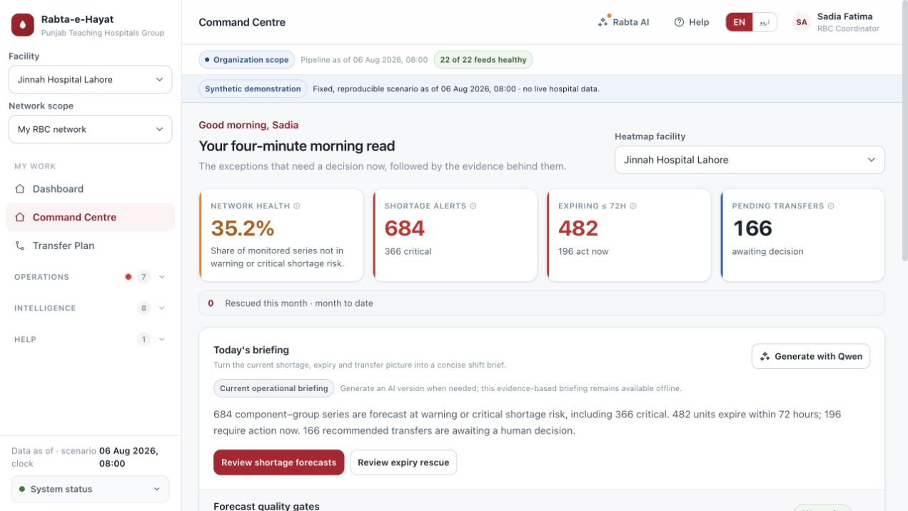
OPERATIONAL FOUNDATION
A complete blood-bank workflow is already underneath the intelligence.
VEIN TO VEIN
Every recommendation starts from governed operational facts.
Eligibility + deferral
Collection + processing
TTI test + independent release
Request + crossmatch + issue
Transfusion + return + discard
Live product view · synthetic scenario
04
Notes:
Establish credibility before showing AI. The intelligence layer is built on donor, laboratory, inventory and clinical workflow state rather than isolated mock charts.
[Sources]
- Local live application screenshot captured 3 September 2026
- Local repository domain models and workflows
[/Sources]

Slide 5
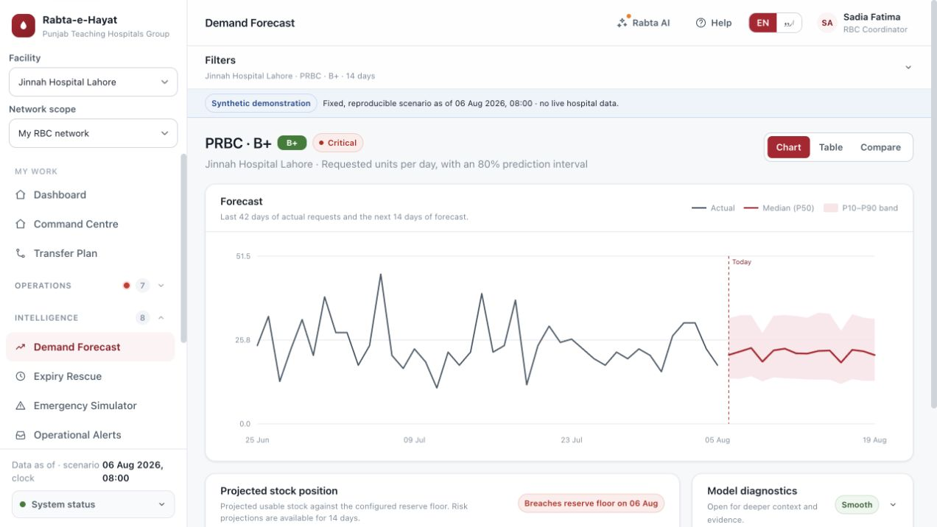
DEMAND INTELLIGENCE
Forecast ranges expose uncertainty—then prove whether the model helps.
P10
low-demand bound
P50
expected demand
P90
high-demand guardrail
Evidence gate
LightGBM is promoted only when backtesting beats the baseline; sparse series fall back safely.
05
Notes:
Point out the forecast band and evidence gate. The system avoids false precision and keeps baseline fallbacks for weak series.
[Sources]
- Local live application screenshot captured 3 September 2026
- Local forecasting engine and release tests
[/Sources]

Slide 6
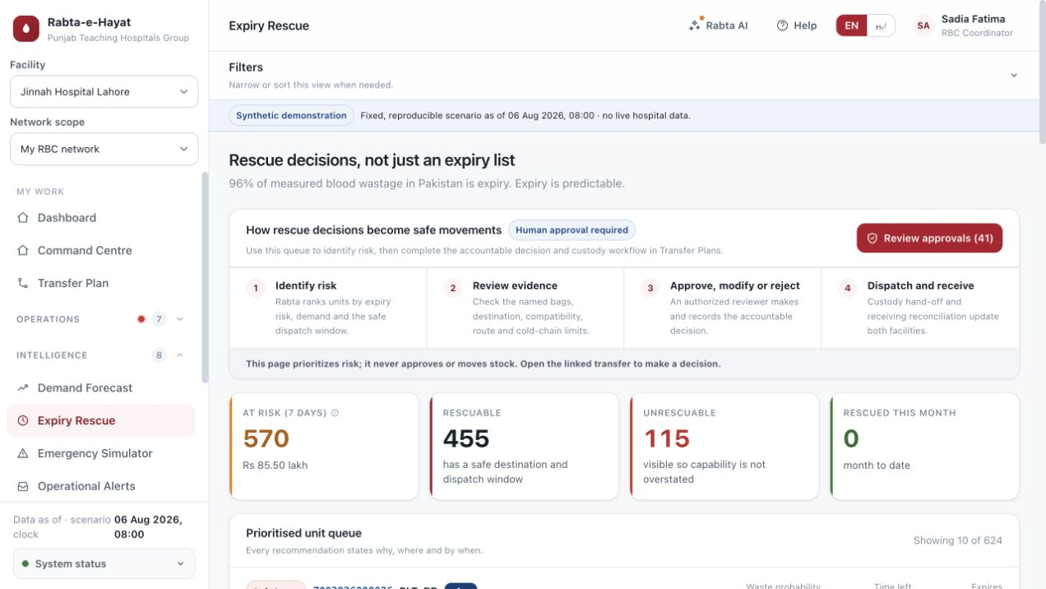
EXPIRY RESCUE
A complex risk becomes a clear four-step operational decision.
1
Find the risk
Which units expire soon?
2
Check feasibility
Where can they help safely?
3
Review evidence
What constraints shaped this?
4
Decide
Approve, modify or reject.
Risk → feasible destination → human gate → named-unit transfer
06
Notes:
Show how the redesigned page removes ambiguity. A coordinator can see the process before taking an action, and approval remains explicit.
[Sources]
- Local live application screenshot captured 3 September 2026
- https://www.pjms.org.pk/index.php/pjms/article/view/13958
[/Sources]

Slide 7
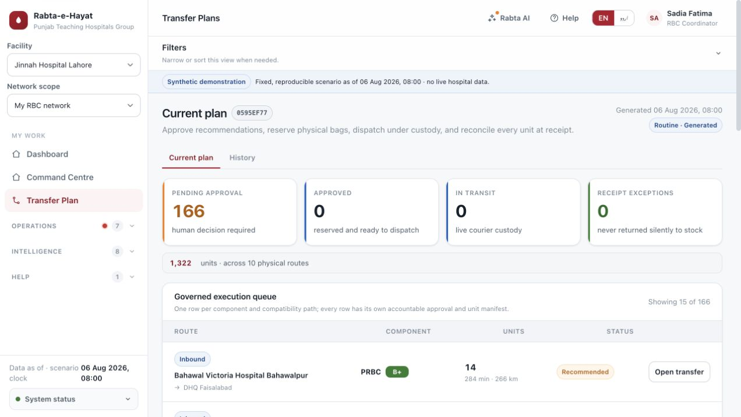
FROM RECOMMENDATION TO CUSTODY
The optimizer proposes. People authorize. The ledger proves what moved.
HARD CONSTRAINTS
ABO/Rh · reserve floor · shelf life · route time · cold chain
HUMAN GATE
Authorized coordinator approves, modifies or rejects with reason.
PHYSICAL TRUTH
DIN manifest · reservation · seal · courier · receipt · exceptions
No recommendation moves blood automatically.
07
Notes:
The distinction matters: optimization is not autonomy. Show the decision record and custody chain as the bridge between analytics and real operations.
[Sources]
- Local live application screenshot captured 3 September 2026
- Local OR-Tools optimizer and transfer state machine
[/Sources]

Slide 8
RESPONSIBLE AI ARCHITECTURE
Use the right intelligence for each job—and put Qwen behind guardrails.
PREDICT
LightGBM + TSB
Demand ranges and sparse-series fallback
Qwen authority boundary
Scoped, de-identified facts
OPTIMIZE
OR-Tools CP-SAT
Feasible transfers under hard constraints
Schema + numeric traceability
Timeout, budget + circuit breaker
Deterministic fallback without a key
EXPLAIN
Qwen / DashScope
Briefs and explanations from validated facts
Never mutates clinical or custody state
Submission state
API-ready Qwen gateway + verified deterministic fallback; no external key is configured today.
08
Notes:
Be explicit and honest: the integration and governance path are implemented, while the current demo uses deterministic fallback because no external key is configured.
[Sources]
- https://docs.modelstudio.console.alibabacloud.com/en/model-studio/what-is-model-studio
- https://www.alibabacloud.com/help/en/model-studio/qwen-api-via-openai-responses
- Local governed AI gateway, policies and tests
[/Sources]

Slide 9
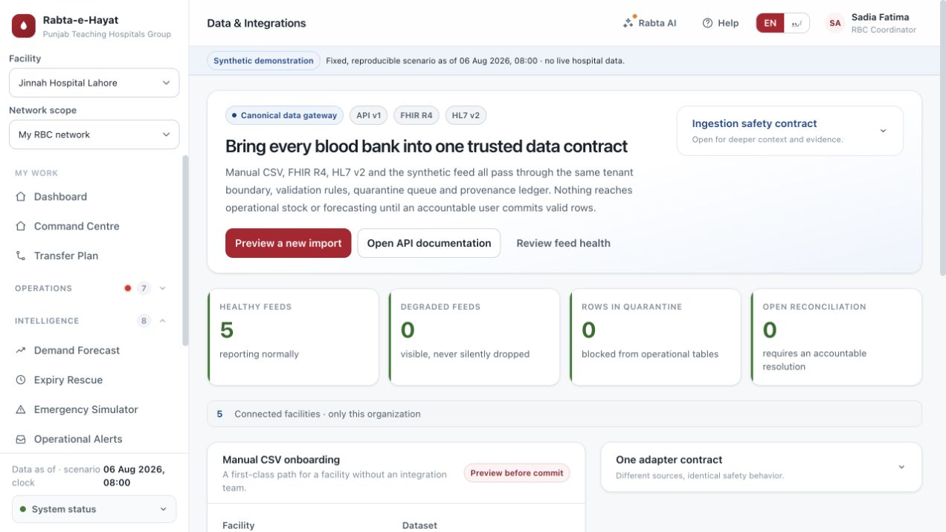
DESIGNED TO SCALE WITHOUT ERASING LOCAL OWNERSHIP
One data contract supports four operating models and disconnected starting points.
01
Standalone hospital
02
Hospital group
03
RBC hub + spoke
04
Province oversight
ONE INGESTION CONTRACT
CSV · FHIR R4 · HL7 v2 · API
Validate → quarantine → reconcile → commit
09
Notes:
The system works for institutions at different digital maturity levels. Every source passes through the same validation, provenance and accountability controls.
[Sources]
- Local live application screenshot captured 3 September 2026
- Local interoperability adapters and operating model documentation
[/Sources]

Slide 10
BUILT, INTEGRATED AND DEMONSTRABLE
A complete synthetic MVP—with evidence, not a concept slide.
603
169/169
30
36,899
automated tests
live role + permission probes
synthetic facilities
synthetic blood units
What judges can verify now
The next step
End-to-end role workflows
Connect a Qwen key, run the final clean Docker launch, and submit the public release.
Forecast + expiry + transfer decision loop
English/Urdu and responsive guidance
Audit trail, health checks and deterministic rebuild
Rabta-e-Hayat turns foresight into accountable action.
10
Notes:
Close with verification and the outcome. Do not overclaim production readiness; this is a complete synthetic demonstration MVP and a credible foundation for clinical validation and pilots.
[Sources]
- Local automated test suite and release smoke report
- Local deterministic synthetic release database
[/Sources]

