Slide 1

SYMBIOSIS INSTITUTE OF TECHNOLOGY, PUNE
CA 2 — DevOps
ForgeFlow: An AI-Native End-to-End Software Development Lifecycle Automation Platform
Group Number: Group – 04
Raghav Sonchhatra – PRN 23070122172
Sanidhya Awasthi – PRN 23070122192
Faheemuddin Sayyed – PRN 23070122196
CA-2 DevOps | Department of Computer Engineering | Academic Year 2025–26
Notes:
Title slide. CA-2 DevOps for ForgeFlow, Group 04. ForgeFlow takes a web-app idea through requirements, design, build, test with self-healing repair, deploy and live validation. This deck covers how ForgeFlow itself is delivered: CI/CD with GitHub Actions, Ansible, Docker and k3s, and Prometheus/Grafana monitoring on an Oracle Cloud VM with 3 OCPU and 16 GB RAM.

Slide 2
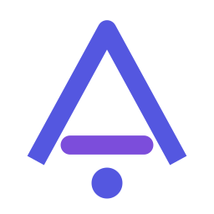
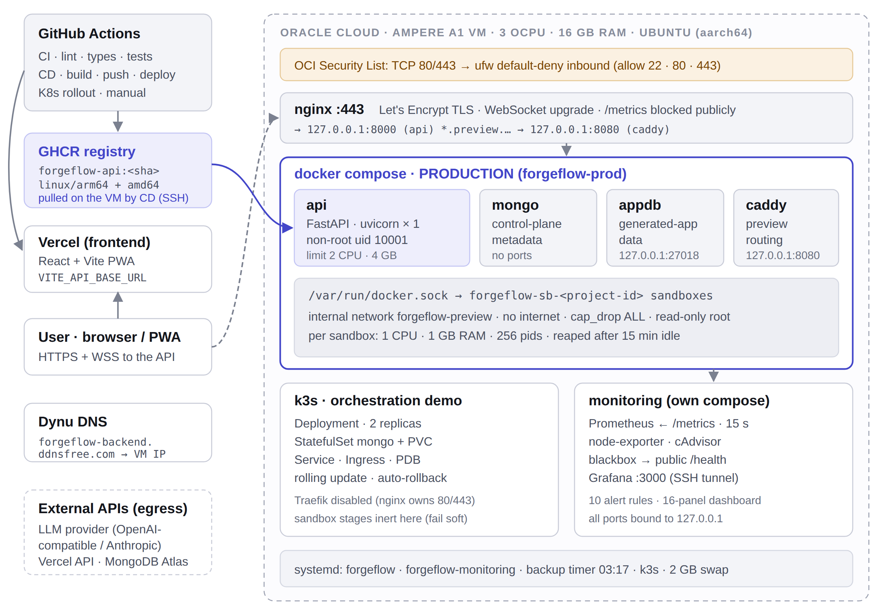
ForgeFlow CA-2 DevOps
02 / 07
DEPLOYMENT ARCHITECTURE
Two runtimes, for one specific reason
ForgeFlow runs untrusted generated code in a Docker container per project and routes previews to those containers by name over Docker’s embedded DNS. That single fact decides the whole topology.
Why not Kubernetes for production
A Docker socket mounted into a pod solves sandbox creation, not routing: a pod cannot resolve forgeflow-sb-<id>. Fixing it means changing the app, not the deployment.
So the split is deliberate
Compose serves production with every stage working. k3s carries the orchestration deliverable. A failed demo can never take production down.
One API replica, on purpose
WebSocket subscribers, the replay ring and rate limiters live in process memory. --workers 2 would halve the limits and drop half the subscribers.
ORACLE VM
CONTROL PLANE
IMAGE
PROVISIONING
INGRESS
3 OCPU · 16 GB · arm64
FastAPI · Python 3.11
multi-arch · non-root
Ansible · 7 roles
nginx → 127.0.0.1:8000
Notes:
Architecture. GitHub Actions builds a multi-arch image into GHCR and deploys it to the Oracle Ampere VM (3 OCPU, 16 GB) over SSH; Vercel serves the PWA. On the VM nginx terminates TLS and forwards to the Docker Compose production stack: api, two MongoDB instances, the Caddy preview proxy and per-project sandboxes. k3s and the monitoring stack run alongside. Production stays on Compose because sandbox previews are routed by Docker container name, which a Kubernetes pod cannot resolve.

Slide 3
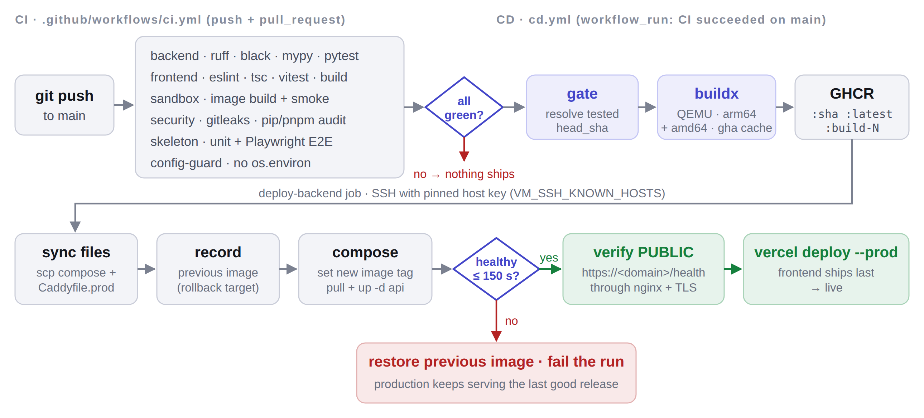
ForgeFlow CA-2 DevOps
03 / 07
PIPELINE FLOW
CI proves it. CD ships it — or puts it back.
workflow_run, not push
A push-triggered deploy races CI and can serve traffic while the test that would fail it is still running.
Immutable SHA tags
If the VM tracked latest, rolling back after a bad deploy would roll back to the bad deploy.
Health is polled, not slept on
The deploy watches the image’s own HEALTHCHECK and treats the 150 s timeout as failure.
Two health checks
Six CI jobs on every push · CD only after CI is green · frontend ships last
Loopback proves the container is up; the public HTTPS check proves a user can reach it.
Notes:
Pipeline. CI runs backend lint, types and 1,648 tests; frontend lint, types, tests, build and PWA check; a sandbox image smoke test; gitleaks and dependency audits; a config guard; and the generated-app skeleton with Playwright. Only if all are green does CD run: it resolves the tested commit, builds arm64 and amd64 images, pushes SHA tags to GHCR, records the running image, deploys over SSH, polls health for up to 150 seconds and rolls back automatically if unhealthy. It then verifies the public HTTPS endpoint and finally deploys the frontend to Vercel.

Slide 4
ForgeFlow CA-2 DevOps
04 / 07
CHALLENGES
Every config parsed correctly while being wrong
The WebSocket that isn’t
Oracle Cloud has two firewalls
A standard nginx proxy_pass block does not forward the upgrade handshake. REST works, no error is logged, and live build streaming silently never connects.
Oracle’s Ubuntu image ends its INPUT chain in a blanket REJECT. ufw writes to a different chain, so ufw allow 443 succeeds, ufw status shows it open, and packets are still dropped.
The playbook deletes those rules by specification, not by index (by index removes the wrong rule, the one keeping SSH open), then purges iptables-persistent so they never return. The OCI Security List is a separate firewall no playbook can reach.
Tested both ways against a real nginx, same request:
With proxy_http_version 1.1 + Upgrade + Connection
101 Switching Protocols
Identical config, those three lines removed
200 OK
Caddy label indexing
Caddy bound :443
Metric cardinality
Blank when healthy
arm64 under emulation
Host labels count right-to-left, so a fixed index hit the TLD on a real domain. Re-anchored the regex on the left.
With auto_https off, a bare hostname still listens on 443 and never saw nginx’s plain HTTP. Pinned http://.
Raw paths mint a series per project or per scanner probe. The label is the route template; misses go to <unmatched>.
No 5xx means an empty vector, and empty ÷ anything is empty: "No data". Fixed with or vector(0).
Runners are amd64, the VM aarch64: amd64 images die with exec format error. QEMU + buildx + layer cache.
Notes:
Challenges. The WebSocket case: we tested the exact request against real nginx with and without the three upgrade lines; without them the handshake silently degrades to 200 OK. Oracle firewalls: the hidden iptables REJECT rule overrides ufw; the Ansible role removes it by specification and purges iptables-persistent. The five smaller bugs were all found by sending real requests or running real queries, not by linting.

Slide 5
ForgeFlow CA-2 DevOps
05 / 07
LESSONS LEARNED
Validate by execution, not by inspection
A throwaway k3s cluster and a real Prometheus took about an hour to set up and found five genuine bugs that every linter had passed.
“Zero downtime” is a measurement
A deploy that returns is not a deploy that worked
A rolling update that looks fine proves nothing. 807 requests, 0 failures across an update, a failed release and a rollback is a claim; watching pods change colour is an anecdote.
kubectl set image and compose up -d return before anything serves. Every deploy path waits on a real health signal, and that timeout is what makes automatic rollback possible.
The Caddy label bug, the :443 bind, the missing WebSocket headers, the blank error panel and the cAdvisor relabel collision: all syntactically valid, all obvious within seconds of a real request.
real, v1.31.4
5
0
Make the dangerous thing loud
Be a good neighbour on a shared box
Regenerating FERNET_KEY would make every stored credential undecryptable. The playbook reads the existing key back instead of re-templating it. Idempotency is the difference between a re-run and data loss.
The VM already runs another project. The nginx role writes exactly one file, never touches nginx.conf, validates before reloading, and reloads rather than restarts.
k3s cluster
bugs found
found by linting
Notes:
Lessons learned. Validation by execution found five bugs no linter caught. Zero downtime is a measured number: 807 requests and zero failures. Every deploy waits on a health signal, which is what makes rollback possible. Dangerous operations such as regenerating the Fernet key are prevented by design, and the automation is additive on a VM that is shared with another project.

Slide 6
ForgeFlow CA-2 DevOps
06 / 07
VERIFIED RESULTS
Executed, not asserted
807 / 0
CHECK | TOOL | RESULT
Workflow syntax + embedded shell | actionlint | 0 findings
Kubernetes manifests | kubeconform -strict | 9 / 9 valid
Ansible, production profile | ansible-lint | 0 / 0
Prometheus config + rules | promtool | 10 rules
nginx config, both variants | nginx -t | valid
WebSocket upgrade | live handshake | 101
Production image | docker run | healthy
Rolling update | real k3s | 0 dropped
Broken release | real k3s | auto-rolled back
Monitoring targets | prometheus | 5 / 5 up
Grafana dashboard | provisioned | 16 panels
Backend test suite | pytest | 1,648 passed
Requests served / failures, measured by an in-cluster probe every 0.2 s across a rolling update, a deliberately broken release and the rollback.
maxUnavailable: 0 plus a readiness probe meant the broken pod never became Ready, so it was never added to the Service endpoints and never received a single request.
Known limitation, stated up front
Sandbox-backed stages (build, preview, test, deploy) are inert in the k3s demo; production runs them on Compose. Mongo is a single instance in both runtimes.
Raw output committed under docs/devops/evidence/.
Notes:
Verified results. Every configuration was executed: actionlint, kubeconform, ansible-lint, promtool, nginx -t, a live WebSocket handshake, the production image, a real k3s rolling update with 807 requests and zero failures, an automatic rollback of a broken release, five of five Prometheus targets up, a provisioned 16-panel dashboard and 1,648 passing backend tests.

Slide 7
ForgeFlow CA-2 DevOps
07 / 07
BONUS · EXTERNAL CHALLENGE
IBM Bob 2.0 Hackathon, ForgeFlow submitted
EVENT
TEAM
HACKATHON
IBM Bob 2.0 Hackathon — “Your code meets your new AI dev partner.”
FS
SA
RS
PLATFORM
lablab.ai, with IBM
Faheemuddin Sayyed
Sanidhya Awasthi
Raghav Sonchhatra
faheem219
sanidhya_awasthi
raghav18
DATES
25–27 September 2026 · kick-off 8:30 PM IST
SUBMISSION
Forgeflow
FORMAT
Online · 48-hour build
“ForgeFlow turns a web-app idea into a verified live URL. It writes tests from your acceptance criteria, fixes failures in a bounded, diff-aware repair loop …”
PRIZE POOL
US $12,000
LINK
lablab.ai/ai-hackathons/ibm-bob-2-hackathon
Project submitted
Event finished · proof on lablab.ai team page
Notes:
Bonus. We entered ForgeFlow in the IBM Bob 2.0 Hackathon on lablab.ai, an online 48-hour event from 25 to 27 September 2026 with a 12,000 dollar prize pool. Team: Faheemuddin Sayyed, Sanidhya Awasthi and Raghav Sonchhatra. Our submission, Forgeflow, turns a web-app idea into a verified live URL with a bounded, diff-aware repair loop.

