Slide 1
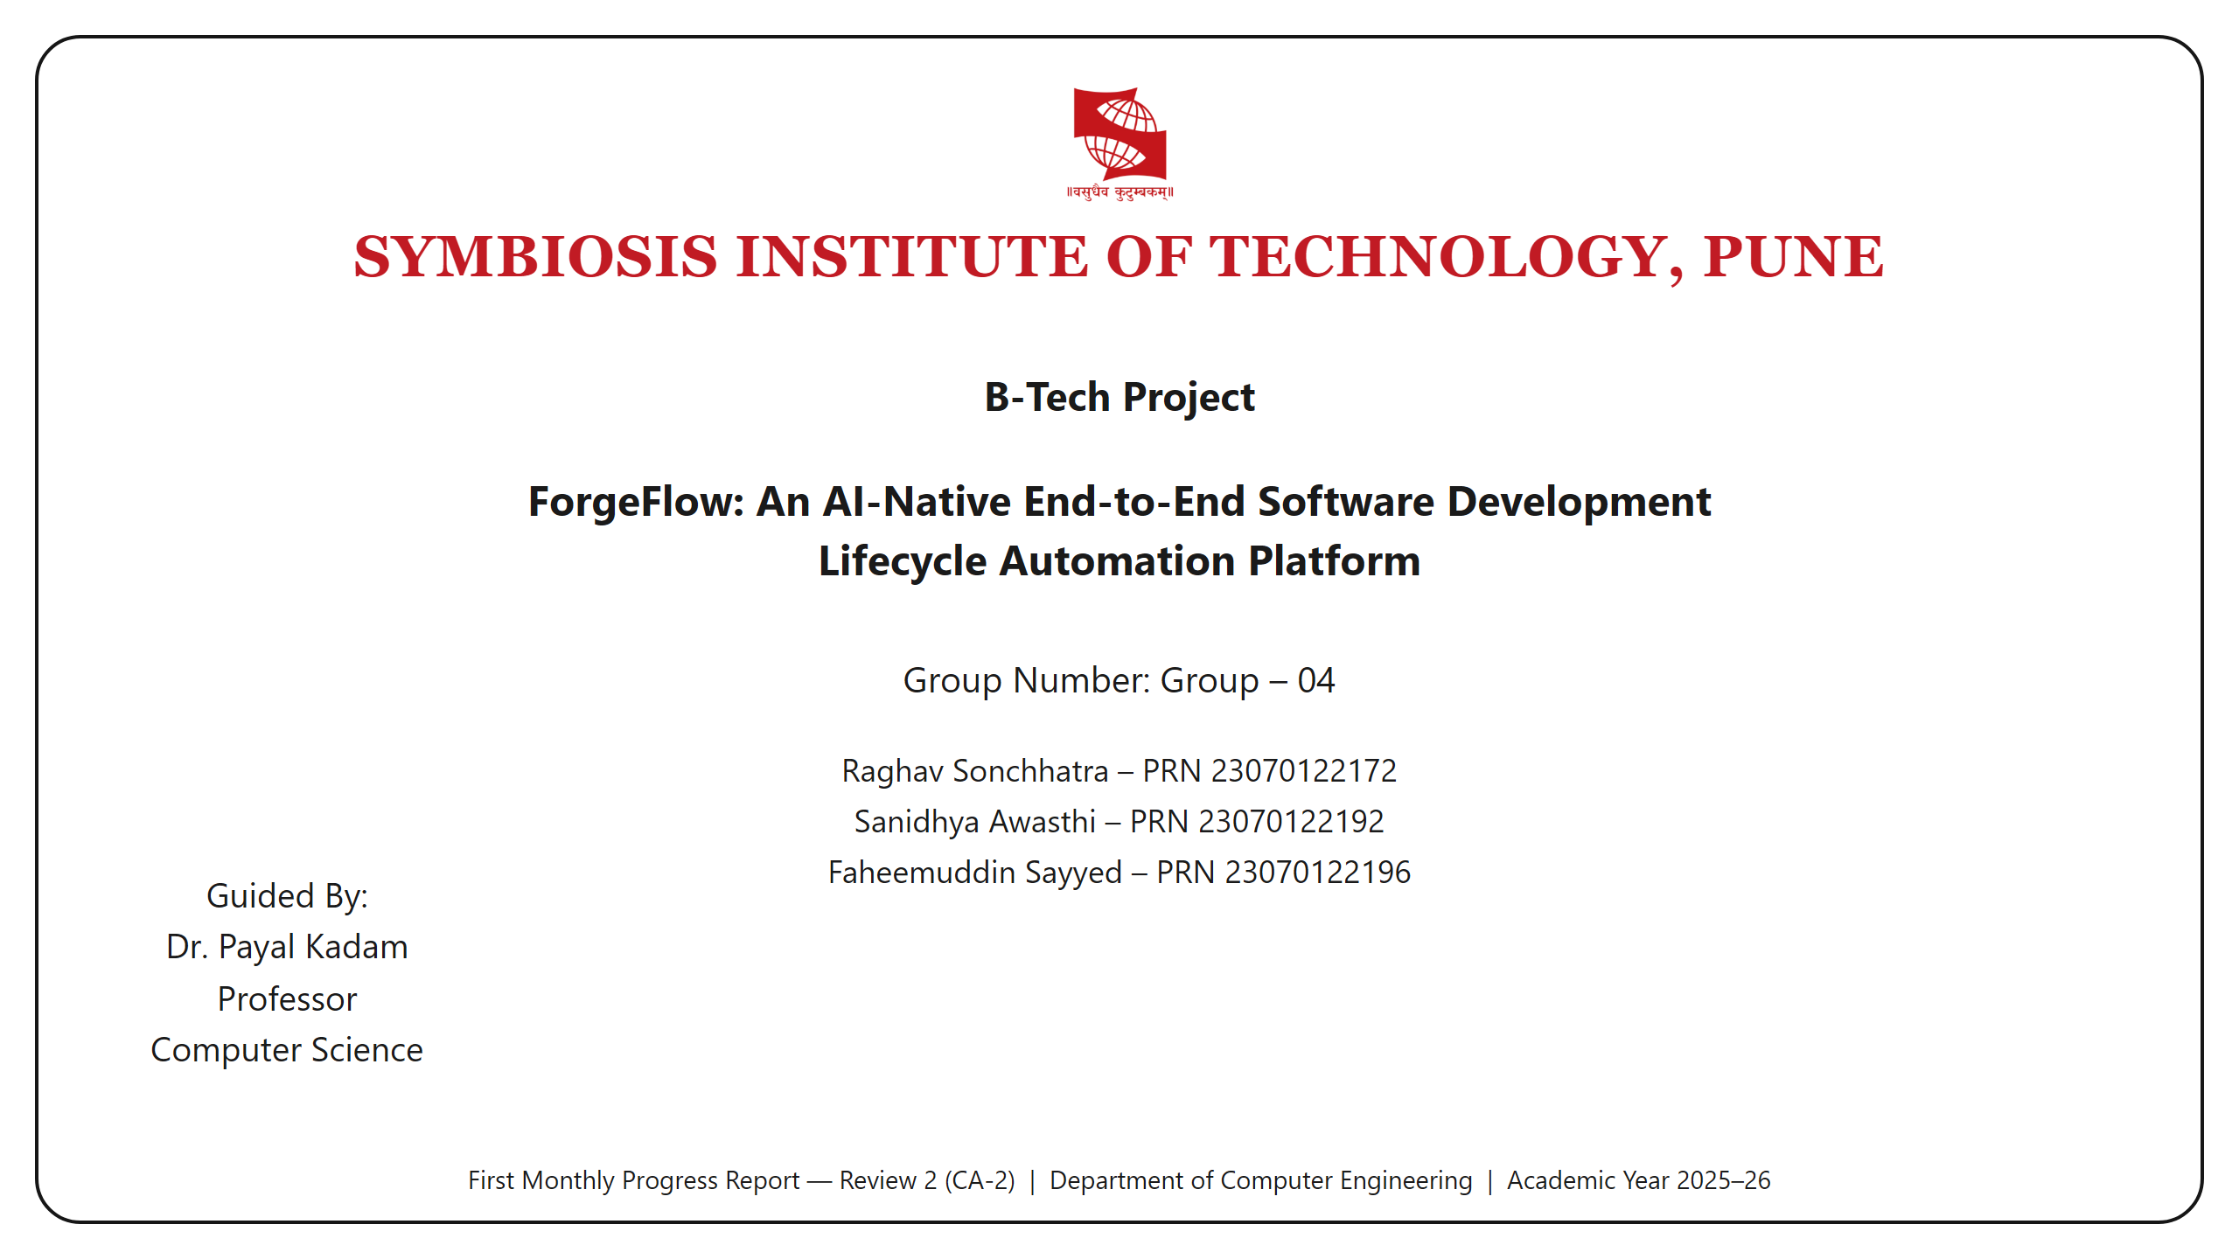
Notes:
Title. Group 04 — ForgeFlow. First Monthly Progress Report, Review 2 (CA-2).

Slide 2
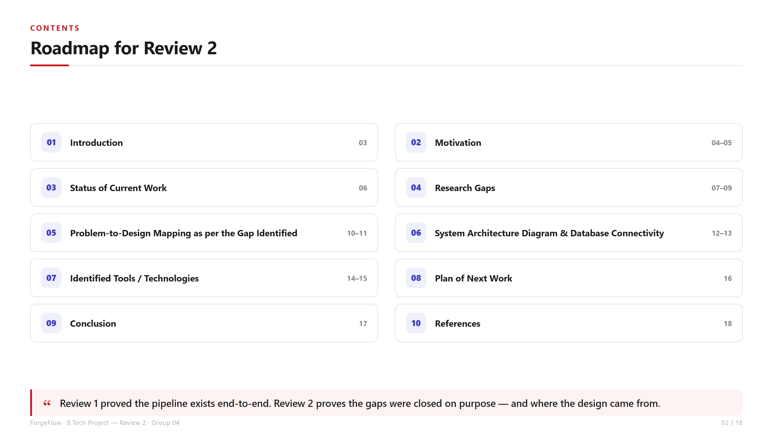
Notes:
Contents. Ten sections in the required order. Slides 10-11 cover problem/requirements-to-design mapping, 12-13 the architecture and database connectivity, 14-15 the tool justifications.

Slide 3
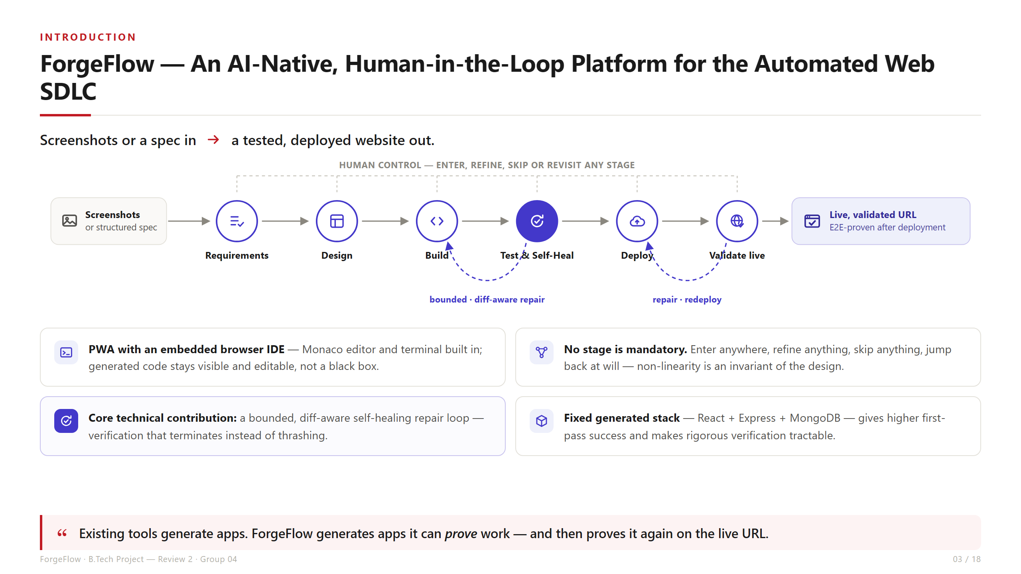
Notes:
Introduction. Screenshots or a spec in, a tested and deployed website out. Note the stage order: Requirements -> Design -> Build -> Test -> Deploy -> Validate. Core contribution is the bounded, diff-aware self-healing repair loop.

Slide 4
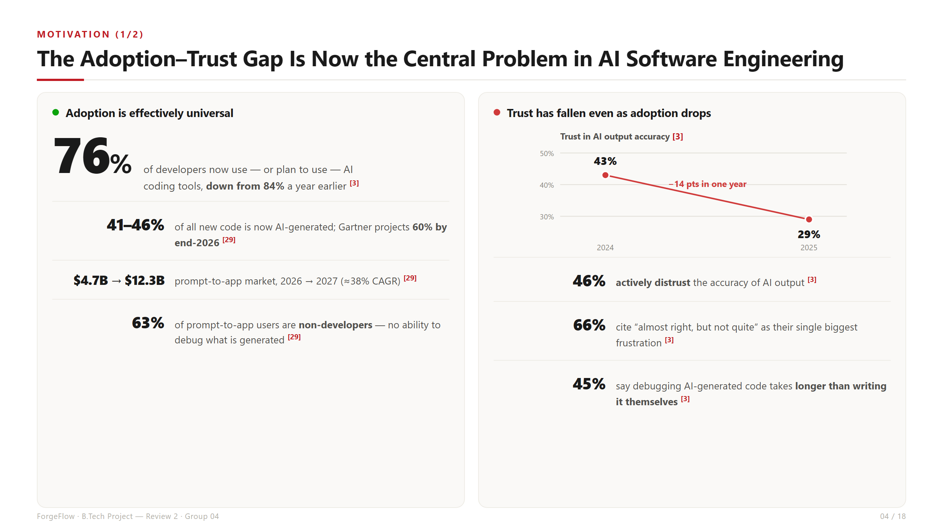
Notes:
Motivation 1/2. Adoption fell 84% -> 76% year on year while trust in AI accuracy fell to 29%. Adoption is high but confidence is collapsing.

Slide 5
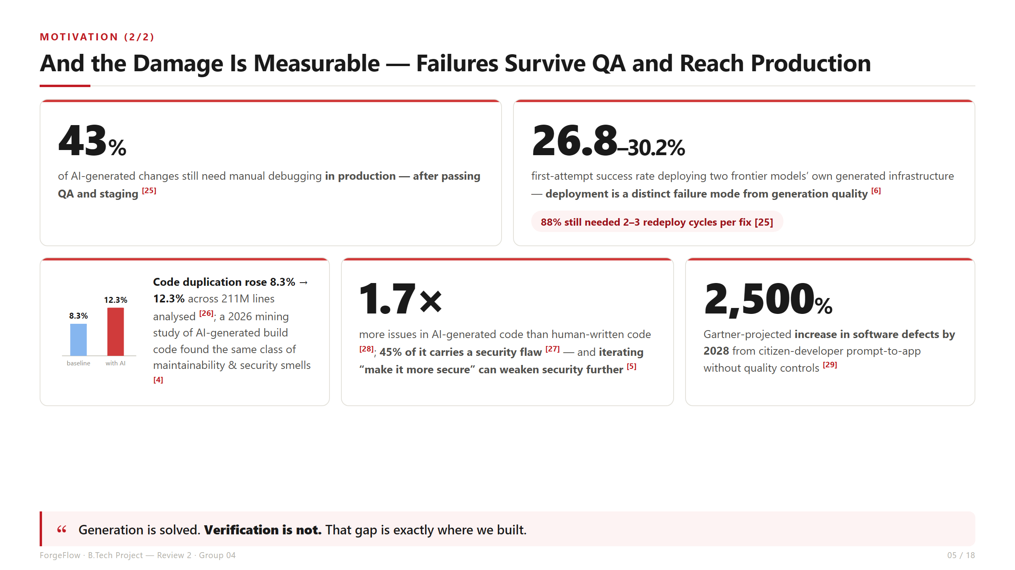
Notes:
Motivation 2/2. The damage is measurable: 43% of AI changes still need production debugging, 45% of AI-generated code carries a security flaw, and first-attempt deployment of model-generated infrastructure succeeds only 26.8-30.2% of the time. Generation is solved; verification is not.

Slide 6
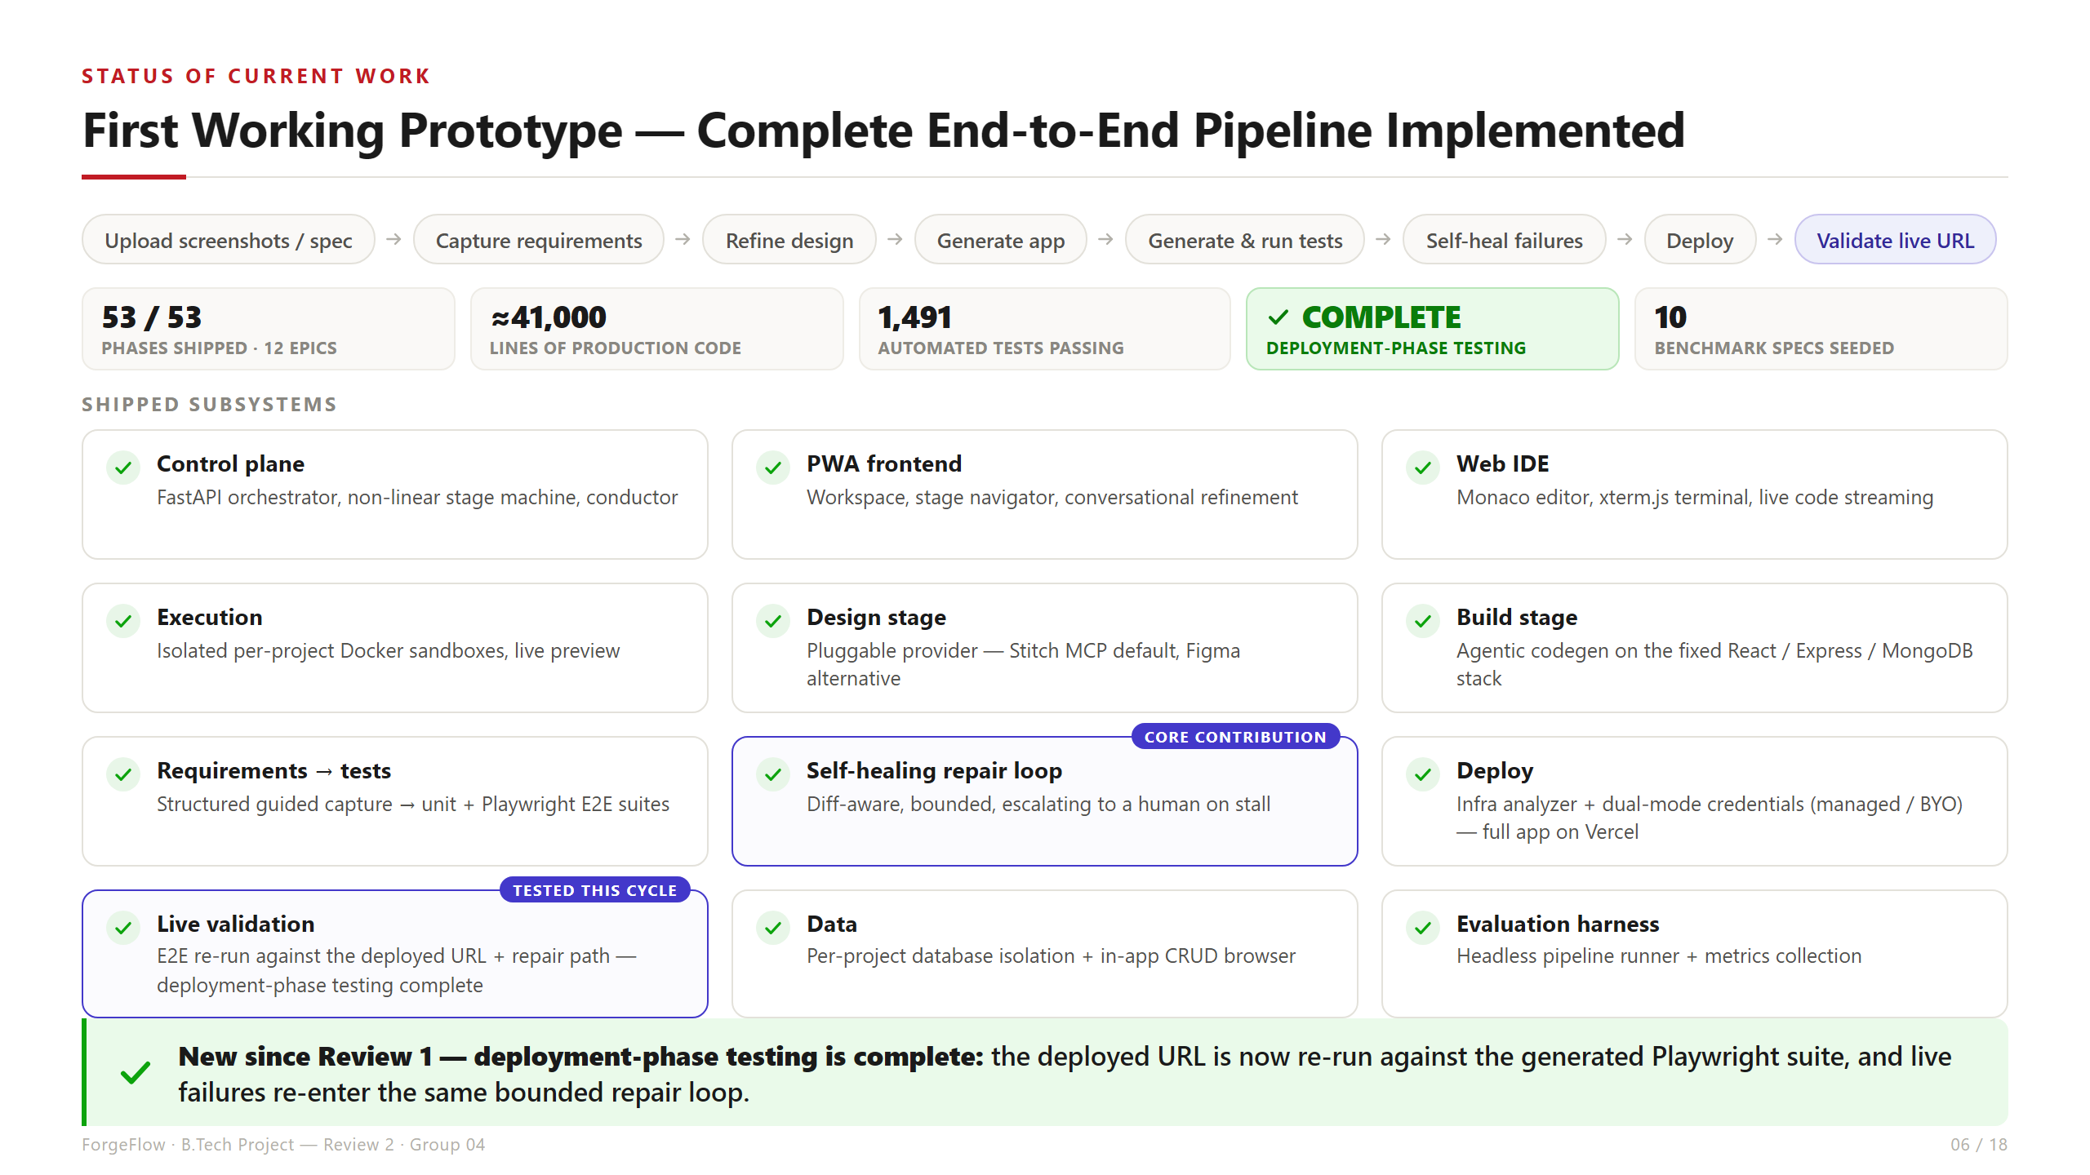
Notes:
Status of Current Work. 53/53 phases across 12 epics, ~41,000 lines, 1,491 automated tests. KEY UPDATE: deployment-phase testing is COMPLETE — the deployed URL is re-run against the generated Playwright suite and live failures re-enter the bounded repair loop.

Slide 7
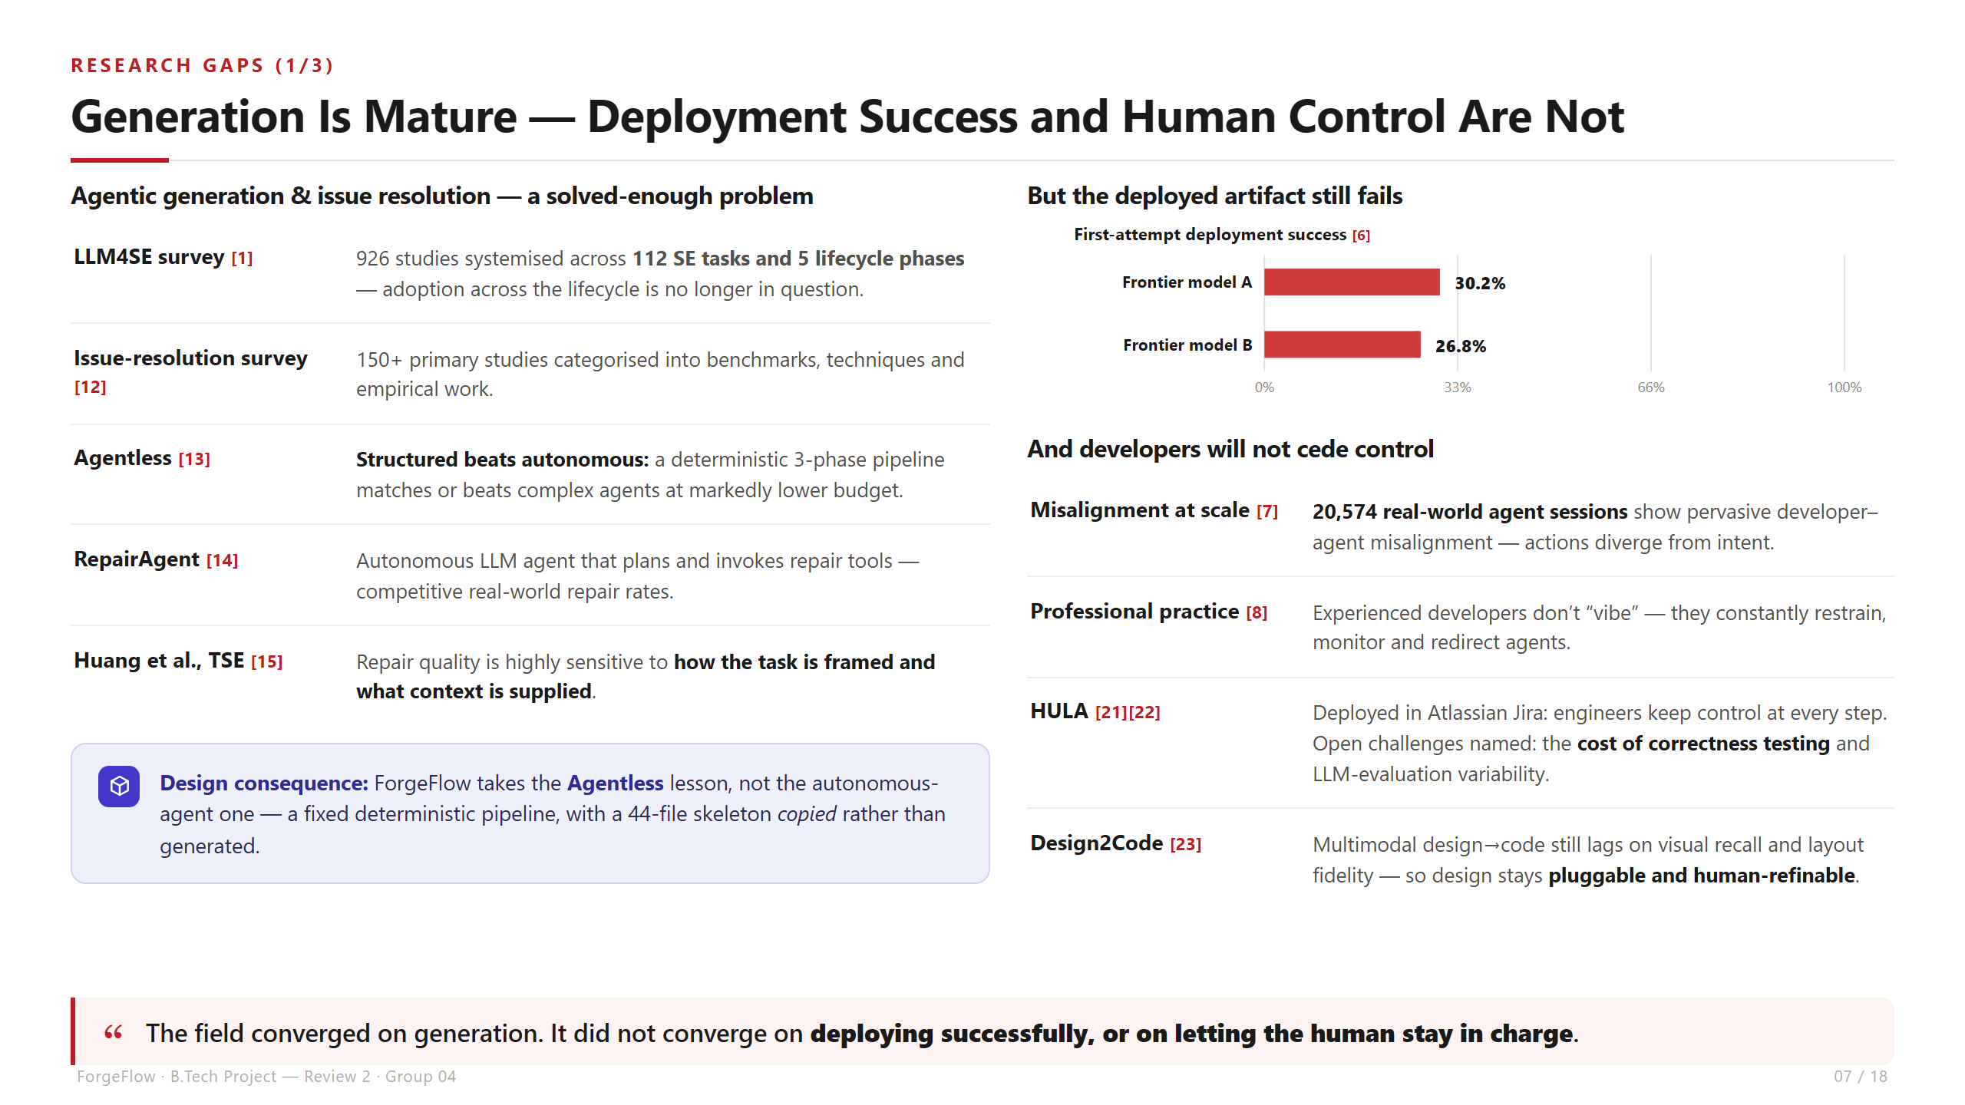
Notes:
Research Gaps 1/3. Agentic generation and issue resolution are mature (926 studies, 112 SE tasks). Agentless shows structured pipelines beat autonomous agents at lower cost — that is why our pipeline is fixed and the skeleton is copied, not generated. But deployment still fails 70% of the time on first attempt, and 20,574 sessions show developers will not cede control.

Slide 8
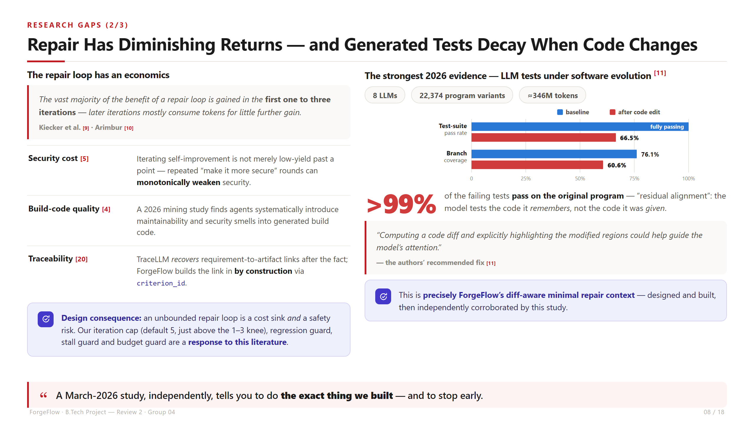
Notes:
Research Gaps 2/3. Repair loops plateau after 1-3 iterations and iterative self-improvement can actively weaken security — hence our caps and guards. Then the strongest 2026 evidence: generated tests decay when code changes, and >99% of new failures still pass on the original program. The authors recommend a highlighted diff — exactly our diff-aware repair context.

Slide 9
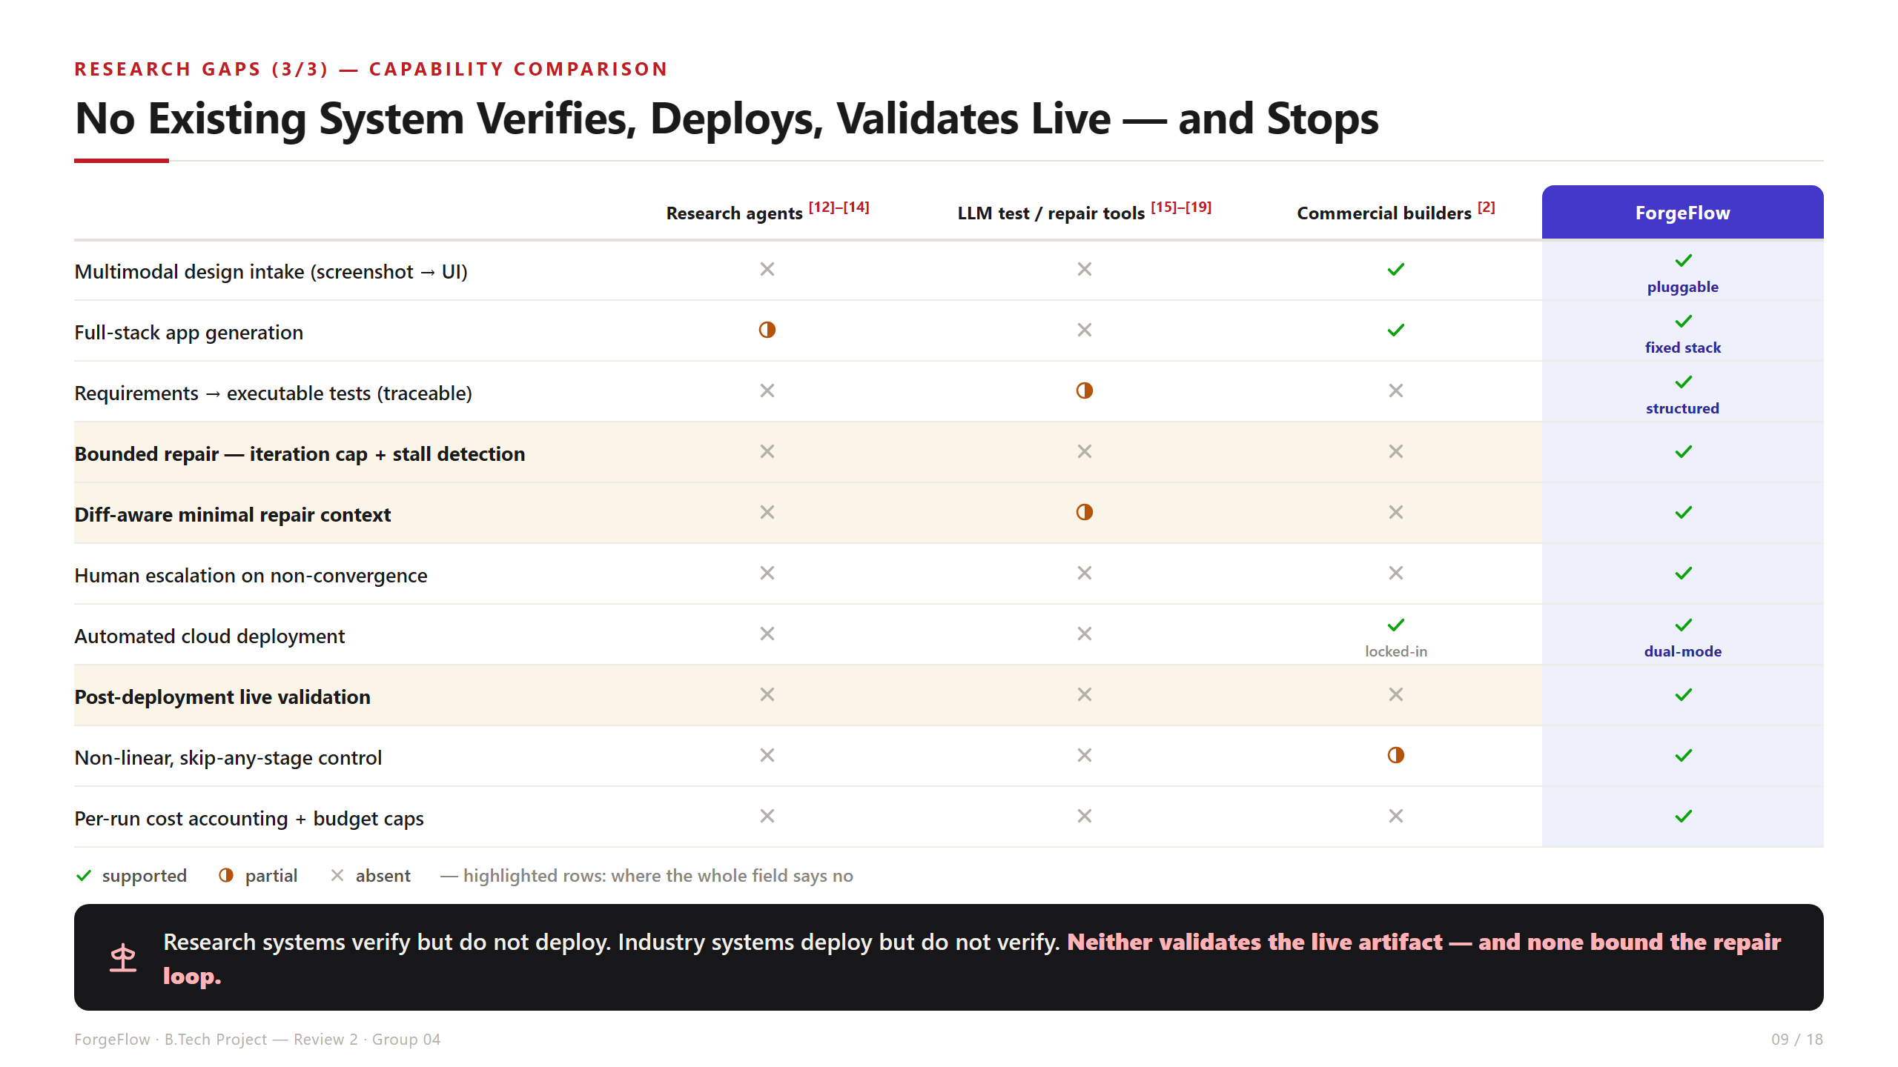
Notes:
Research Gaps 3/3. Capability comparison. Research systems verify but do not deploy; commercial builders deploy but do not verify. Nobody validates the live artifact, and nobody bounds the loop. The highlighted rows are where the entire field says no.

Slide 10
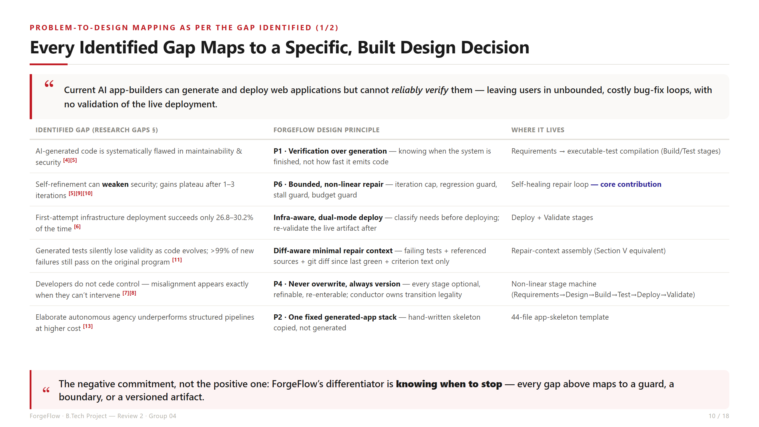
Notes:
RUBRIC — Problem-to-design mapping (3 marks), part 1. Each identified gap maps to a specific, built design decision, with the module it lives in.

Slide 11
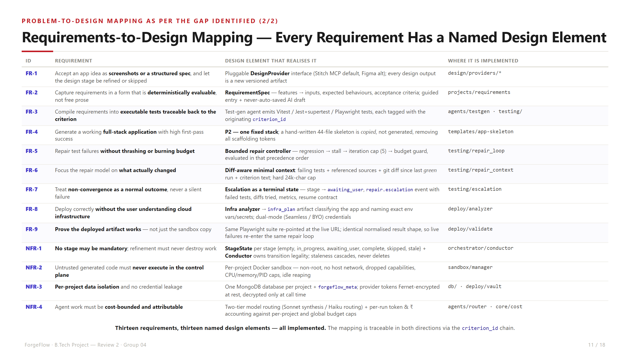
Notes:
RUBRIC — Requirements-to-design mapping (3 marks), part 2. Thirteen requirements (FR-1..FR-9, NFR-1..NFR-4), each mapped to a named design element and its implementation path. Traceable in both directions via the criterion_id chain.

Slide 12
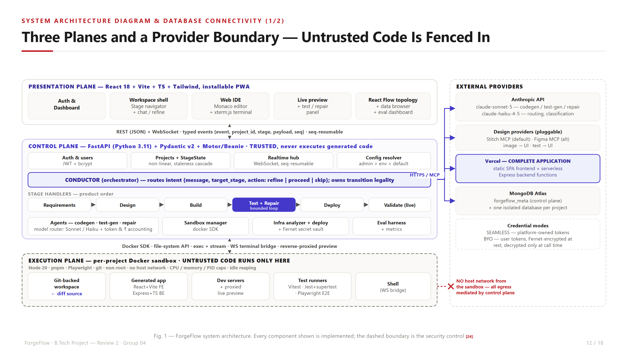
Notes:
RUBRIC — System architecture diagram (4 marks), part 1. Three planes plus the provider boundary. Walk: presentation -> REST/WebSocket -> control plane (conductor owns transition legality, six stage handlers) -> Docker SDK -> execution sandbox. Untrusted code runs ONLY in the sandbox, which has no host network.

Slide 13
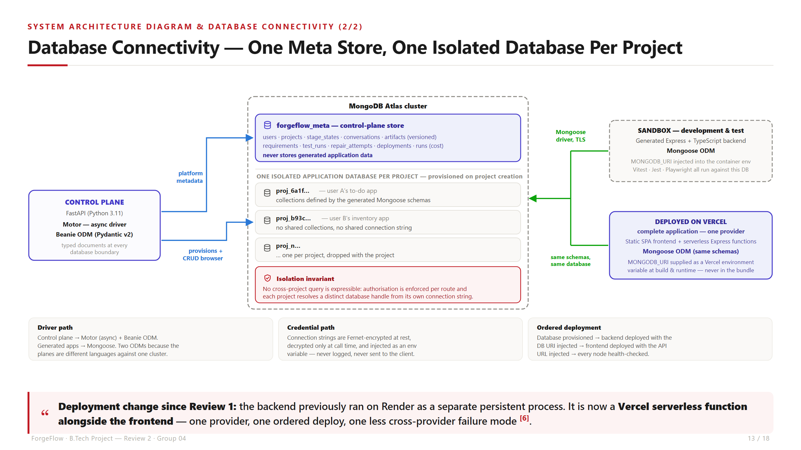
Notes:
RUBRIC — Database connectivity (4 marks), part 2. Control plane uses Motor + Beanie to reach forgeflow_meta and to provision one isolated database per project. Generated apps use Mongoose — same schemas in the sandbox and on Vercel. DEPLOYMENT CHANGE: backend moved off Render; the complete application is now hosted on Vercel.

Slide 14
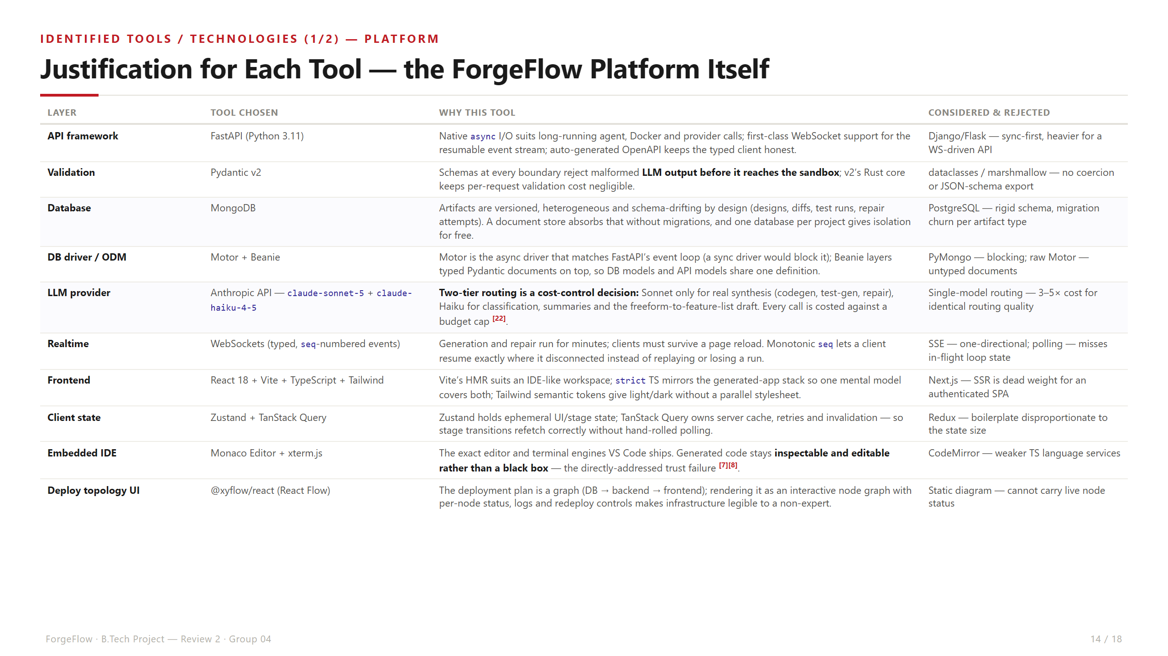
Notes:
RUBRIC — Tool justification (3 marks), part 1: the platform. Every tool has a reason and a rejected alternative. Highlight MongoDB (versioned heterogeneous artifacts), the two-tier model routing as cost control, and seq-numbered WebSocket events for resumability.

Slide 15
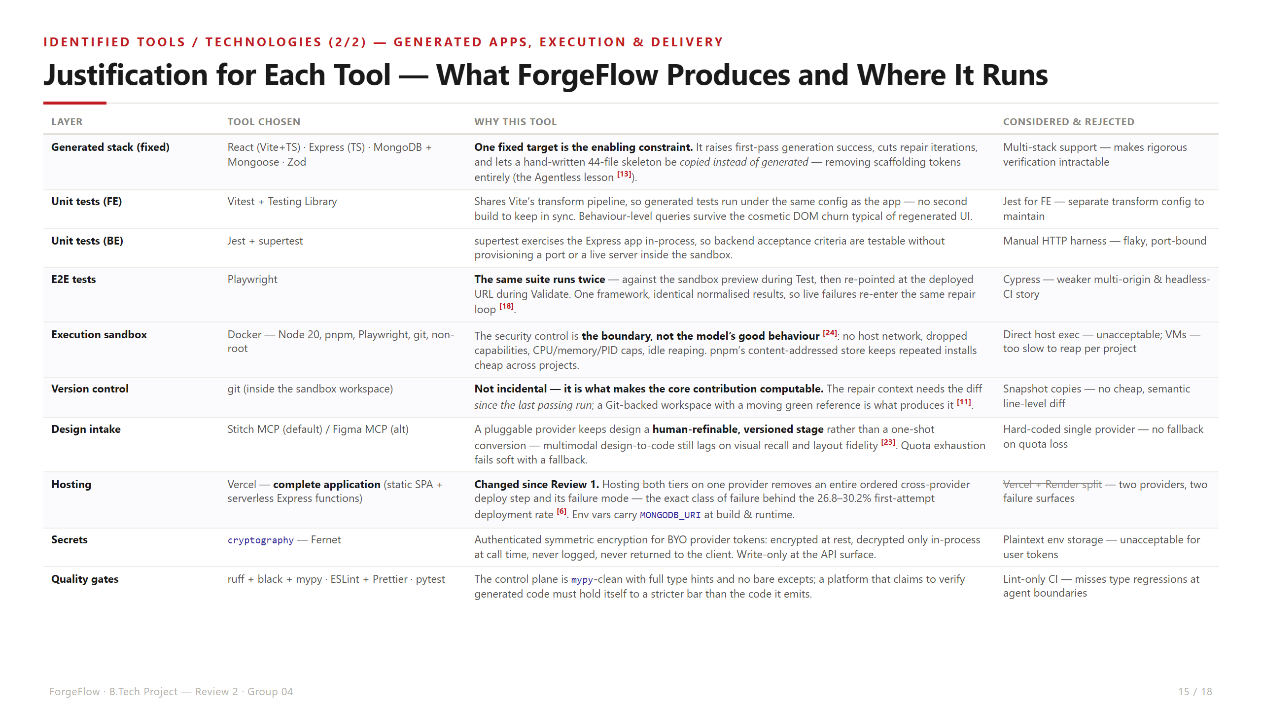
Notes:
RUBRIC — Tool justification (3 marks), part 2: generated apps, execution and delivery. Highlight git: not incidental — it is what makes the diff-aware repair context computable. And Vercel now hosts the complete application, removing a cross-provider failure mode.

Slide 16
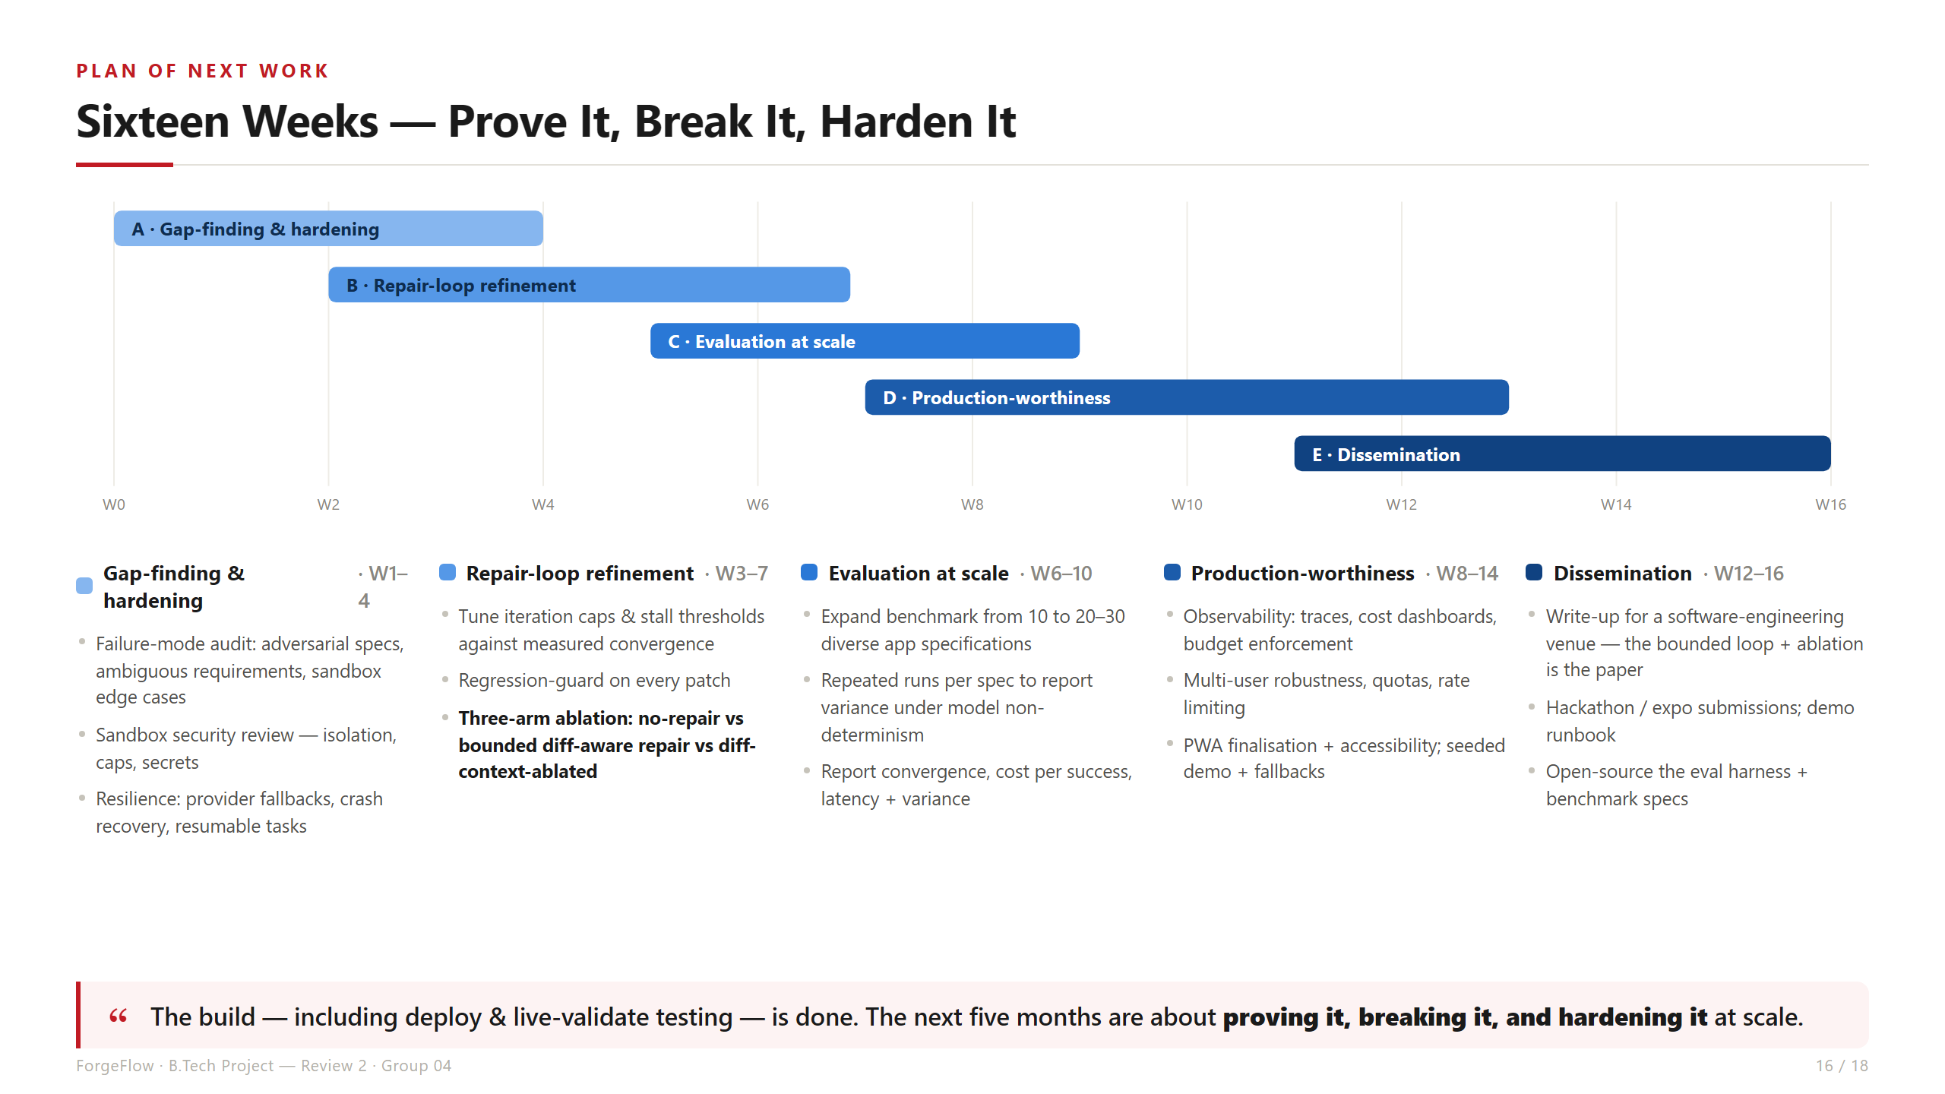
Notes:
Plan of Next Work. Sixteen weeks: hardening, repair-loop refinement with the three-arm ablation, evaluation at scale (10 -> 20-30 specs), production-worthiness, dissemination.

Slide 17
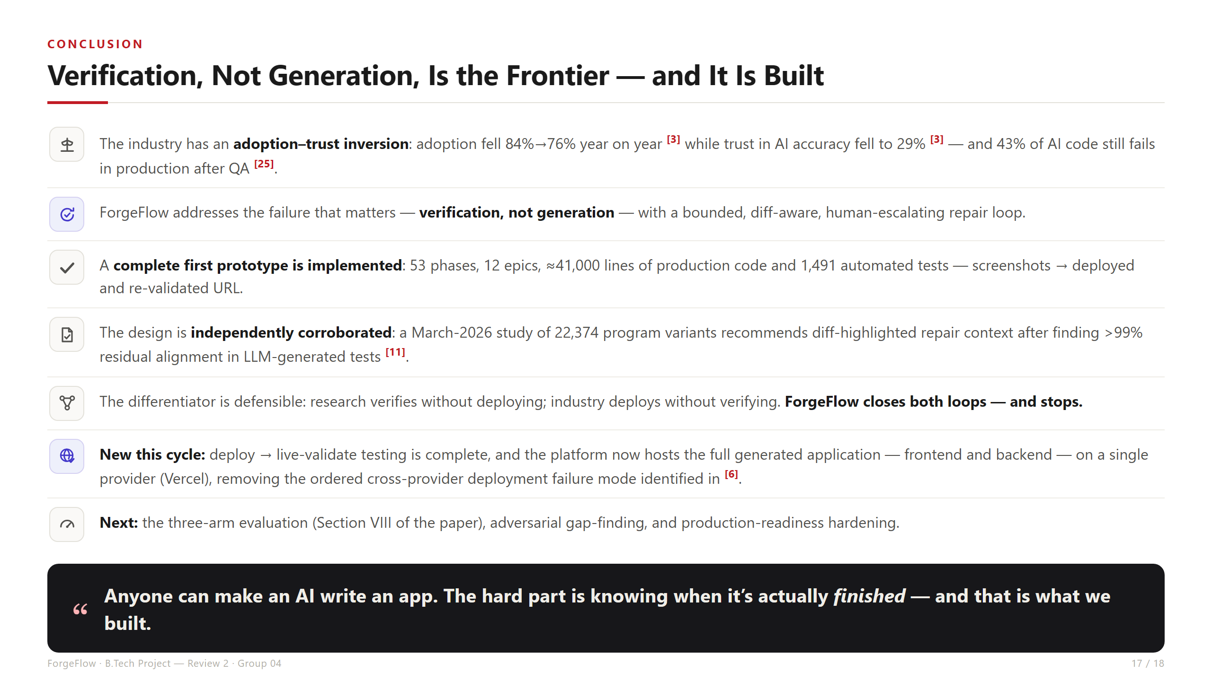
Notes:
Conclusion. Verification, not generation, is the frontier. Prototype complete, design independently corroborated, deployment testing done and now single-provider on Vercel. The differentiator is the negative commitment: the system knows when to stop.

Slide 18
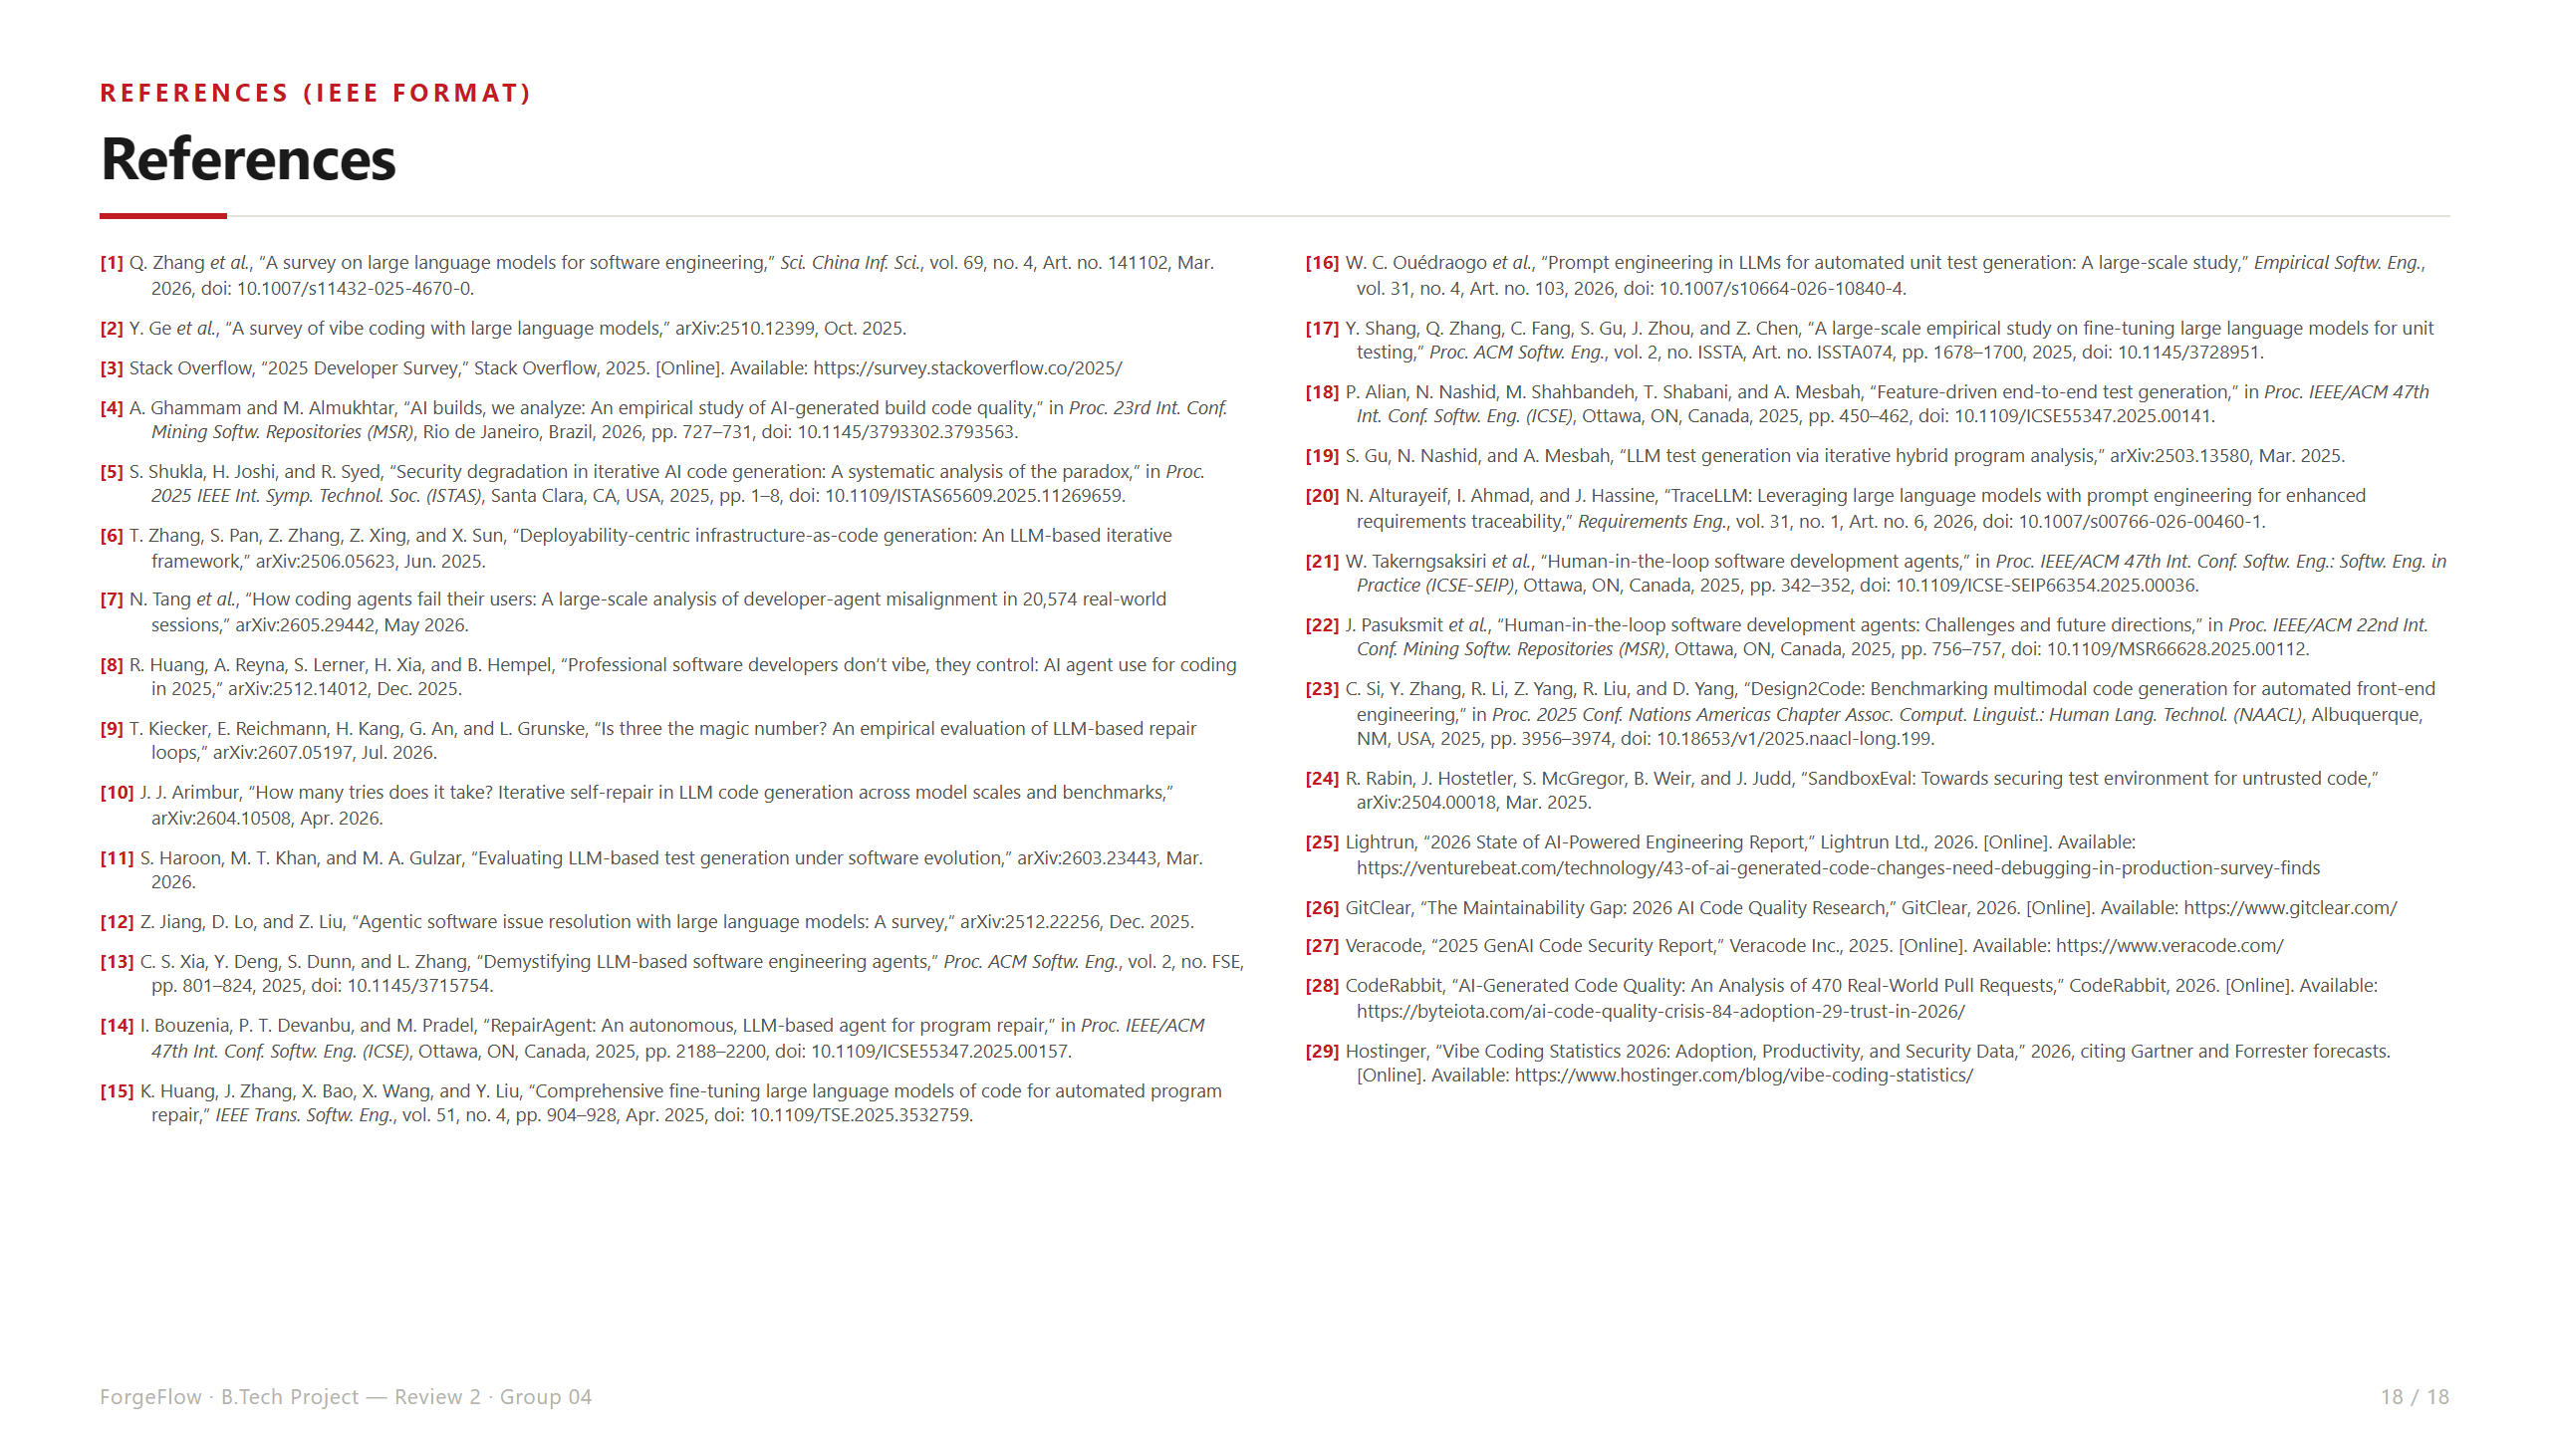
Notes:
References. 24 peer-reviewed/preprint sources from the IEEE conference paper draft, plus 5 industry data sources for the motivation statistics.

