Slide 1

Btech Project: End Sem Exam
“ForgeFlow: An AI-Native End-to-End Software
Development Lifecycle Automation Platform”
Group Number: Group – 04
Raghav Sonchhatra – PRN 23070122172
Sanidhya Awasthi – PRN 23070122192
Faheemuddin Sayyed – PRN 23070122196
Guided By:
Dr. Payal Kadam
Professor, Computer Science
Industry / Organization: N/A
Industry Mentor: N/A
Department of Computer Engineering | Academic Year 2026–27

Slide 2
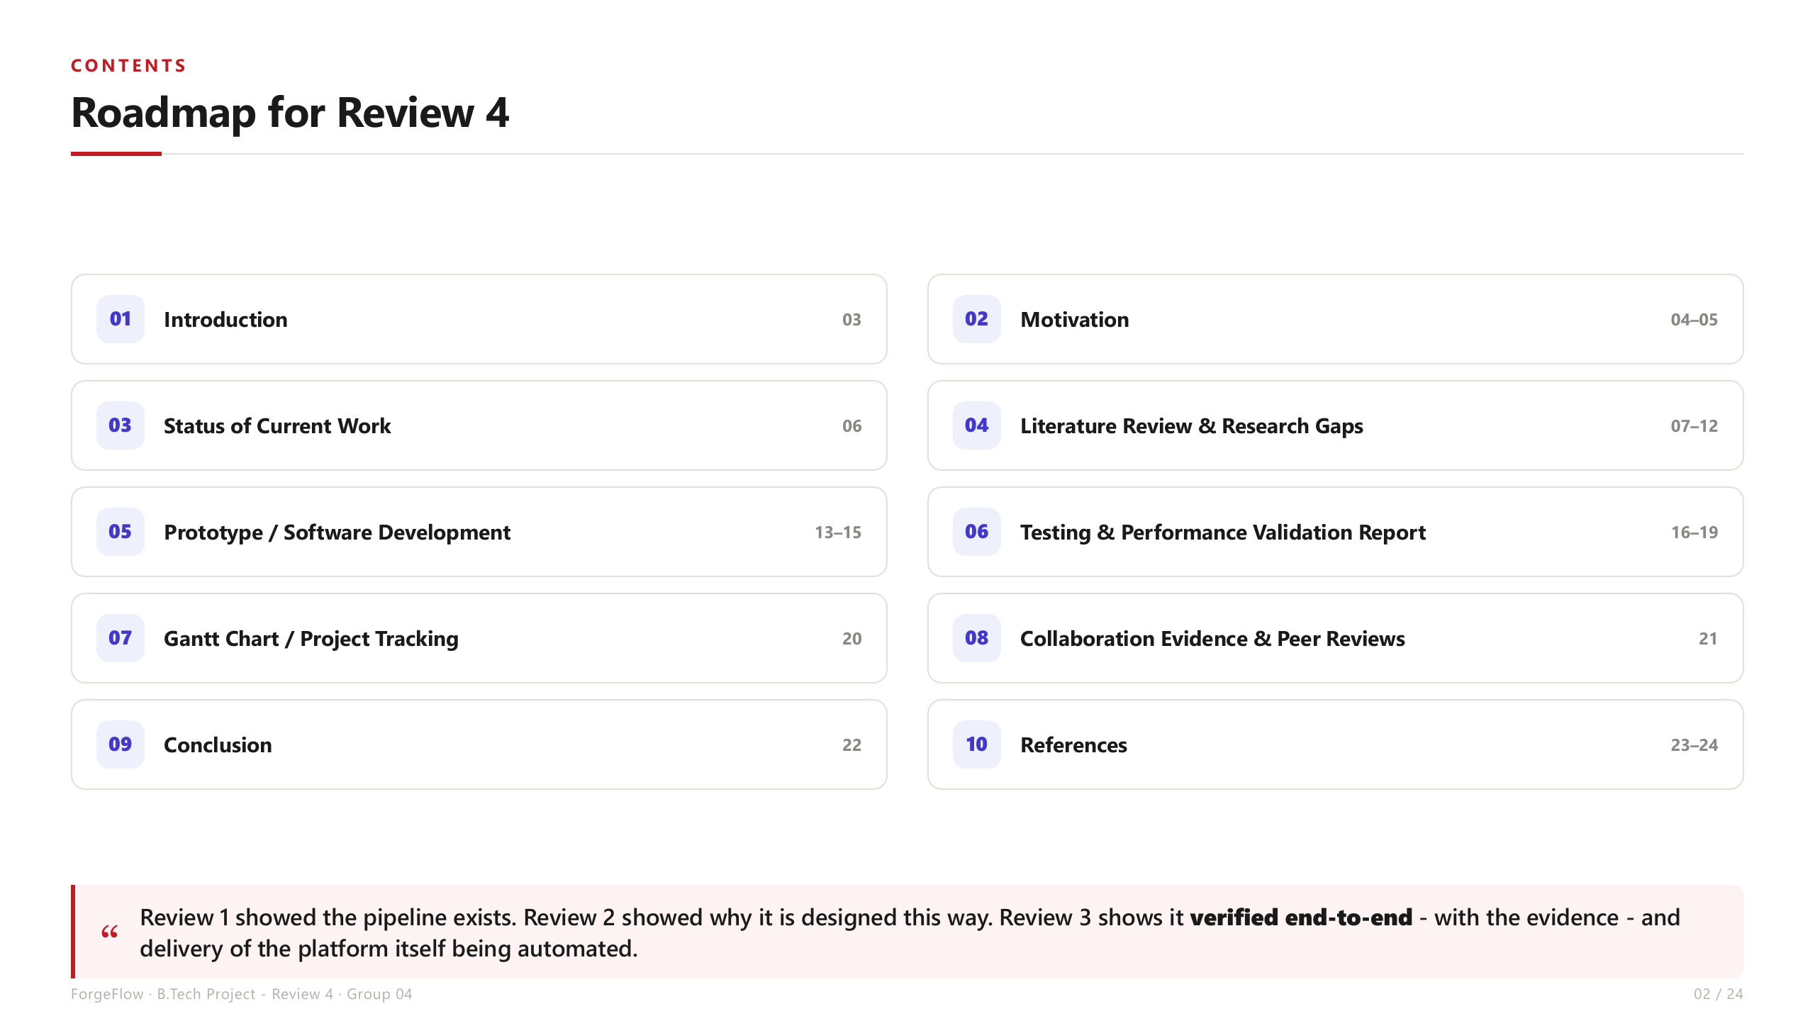

Slide 3
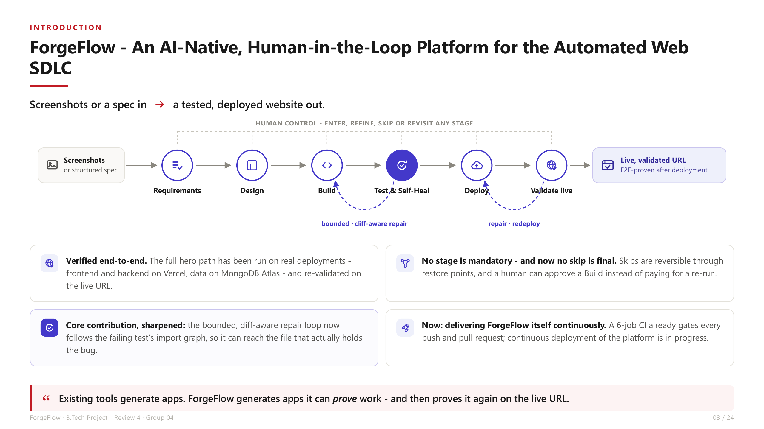

Slide 4
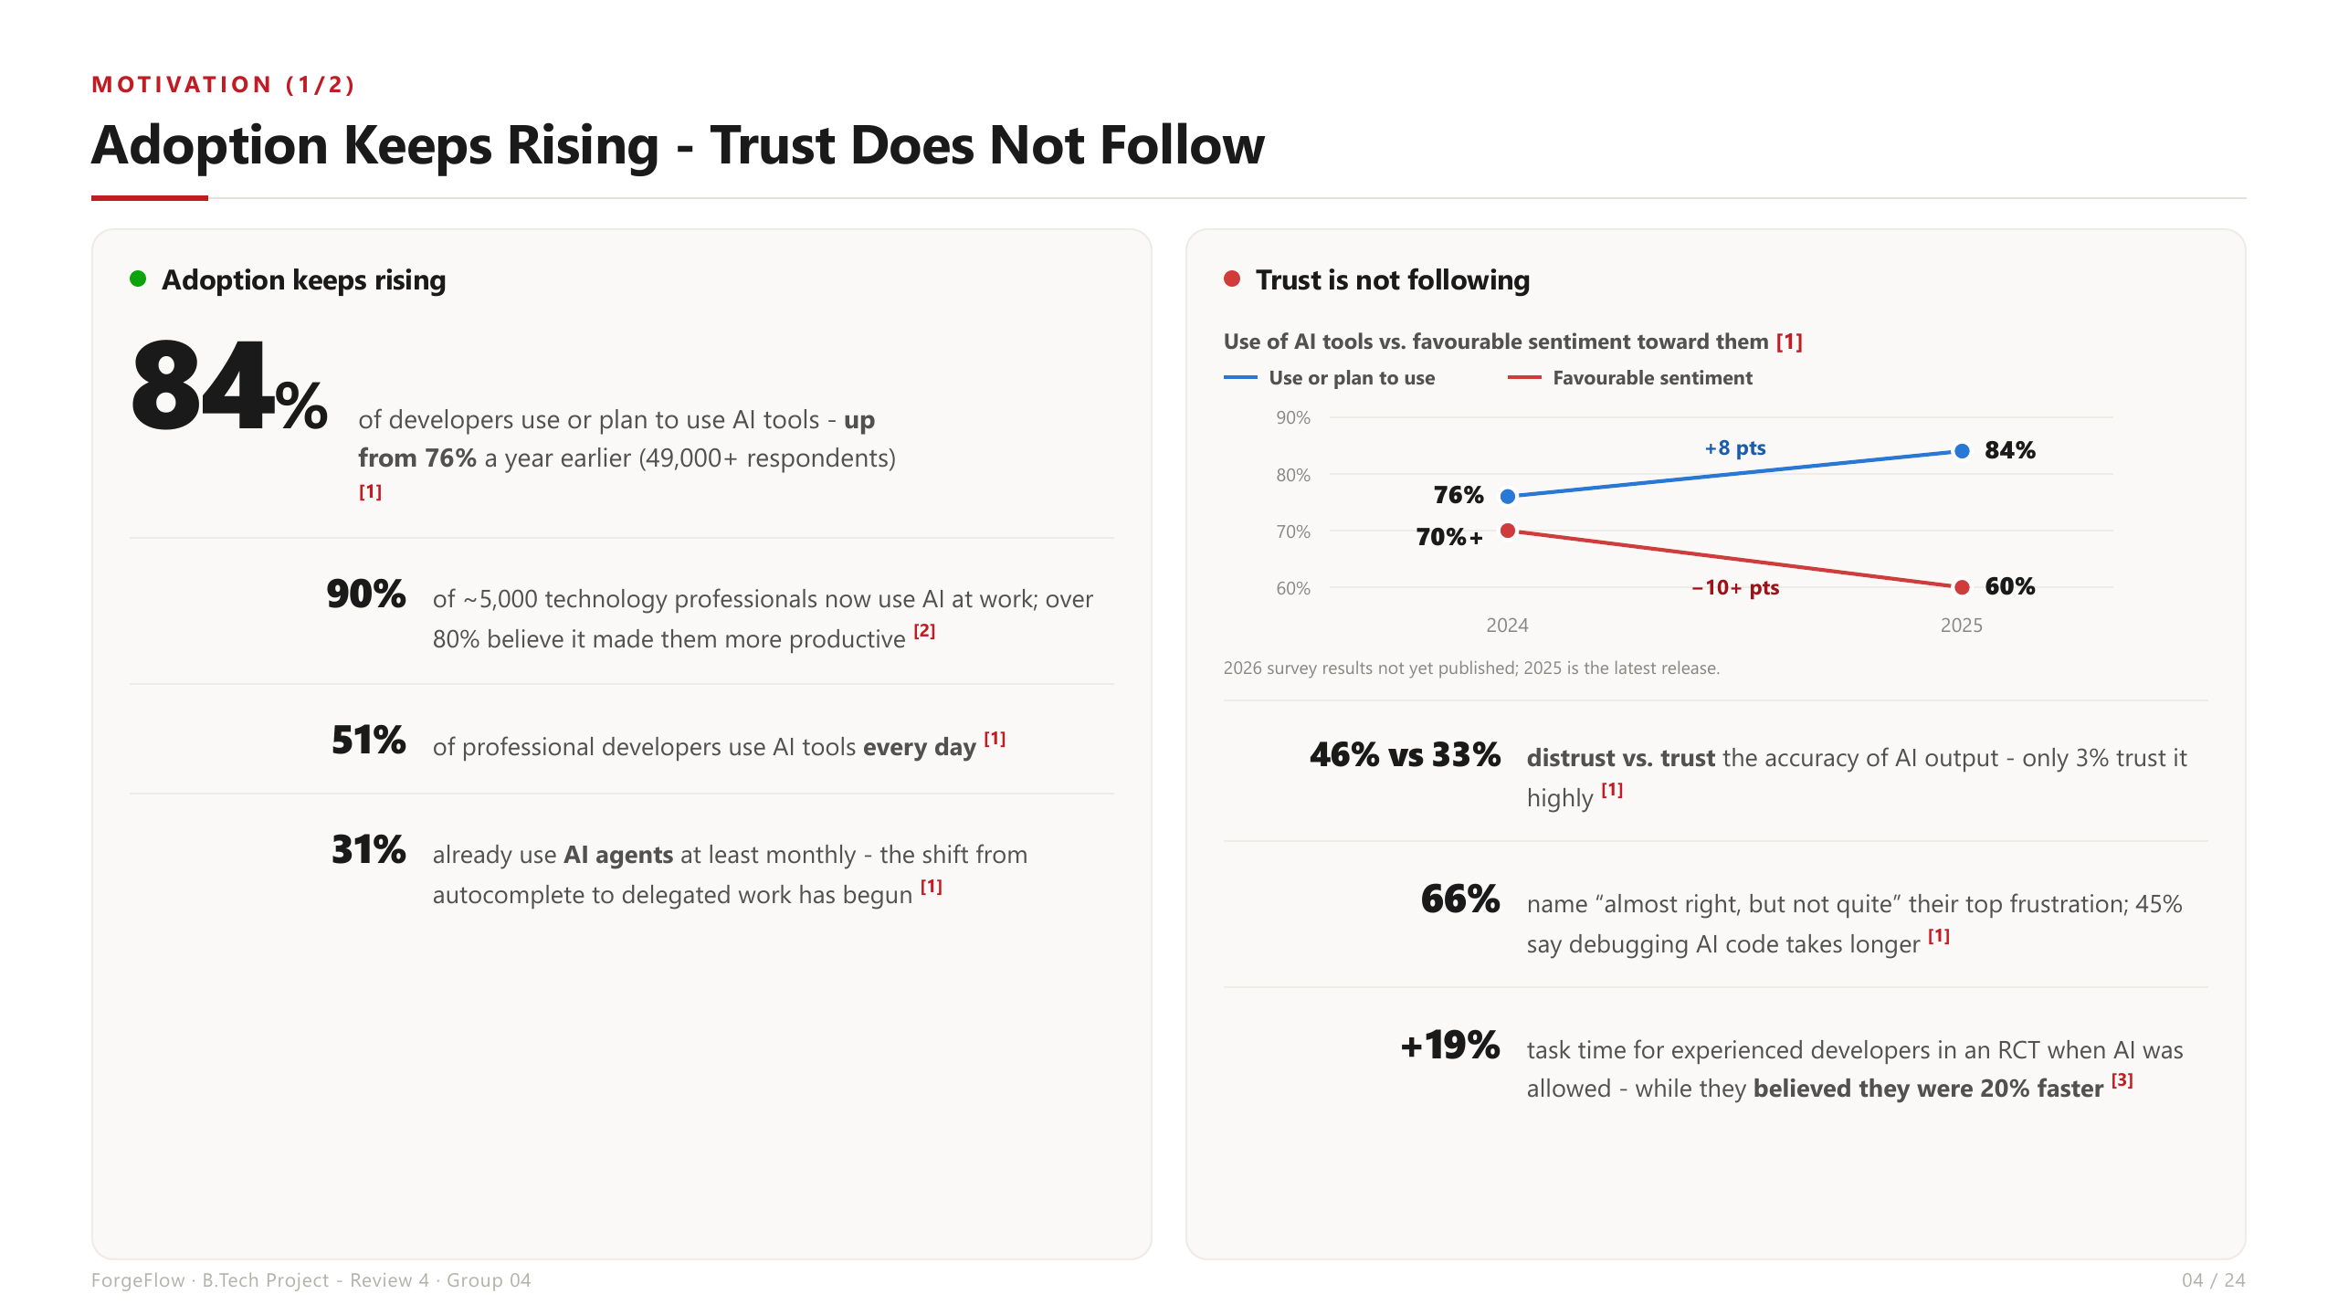

Slide 5
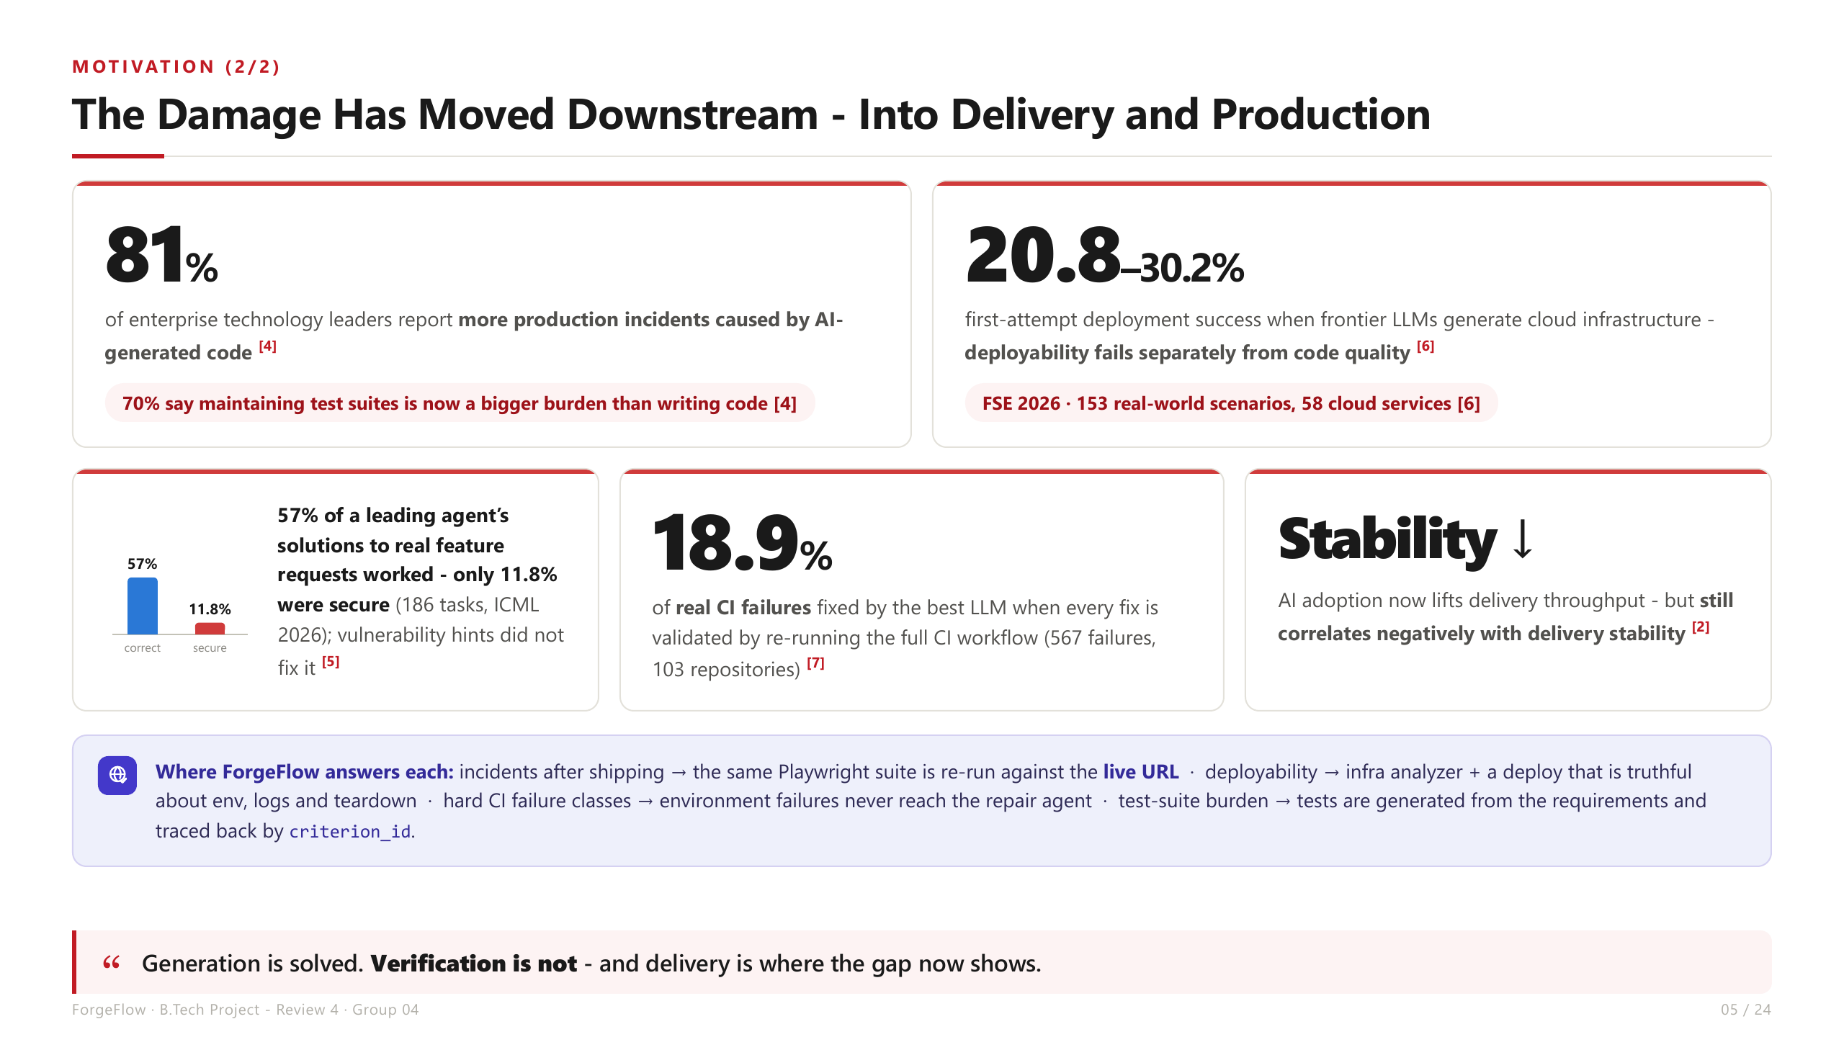

Slide 6
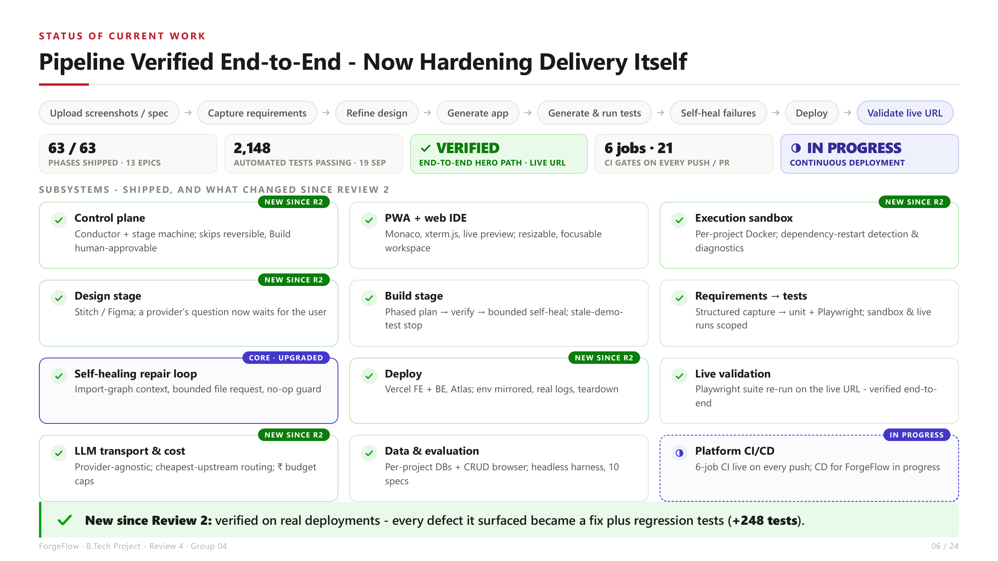

Slide 7
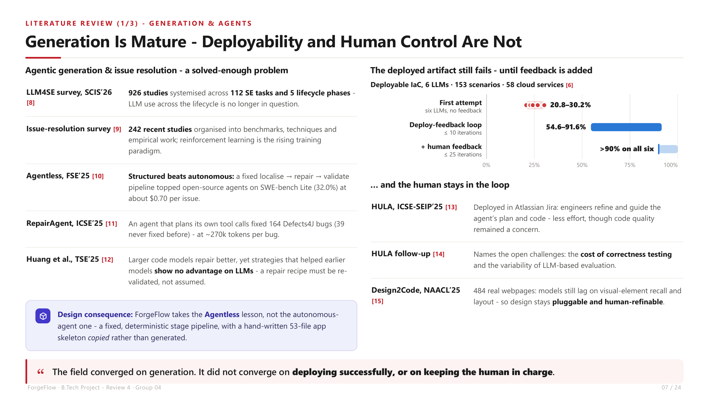

Slide 8
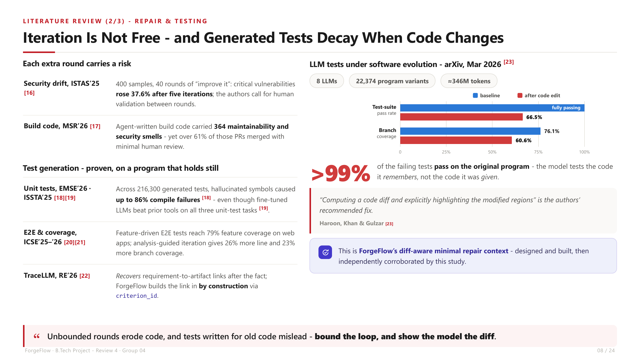

Slide 9
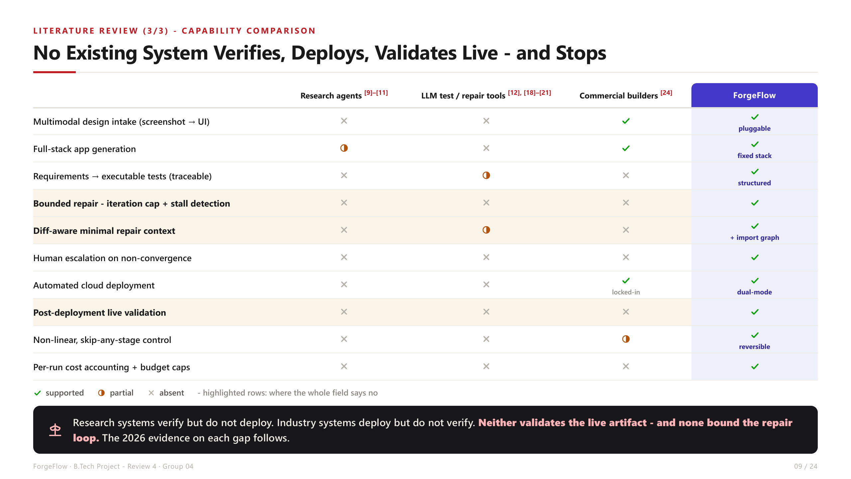

Slide 10
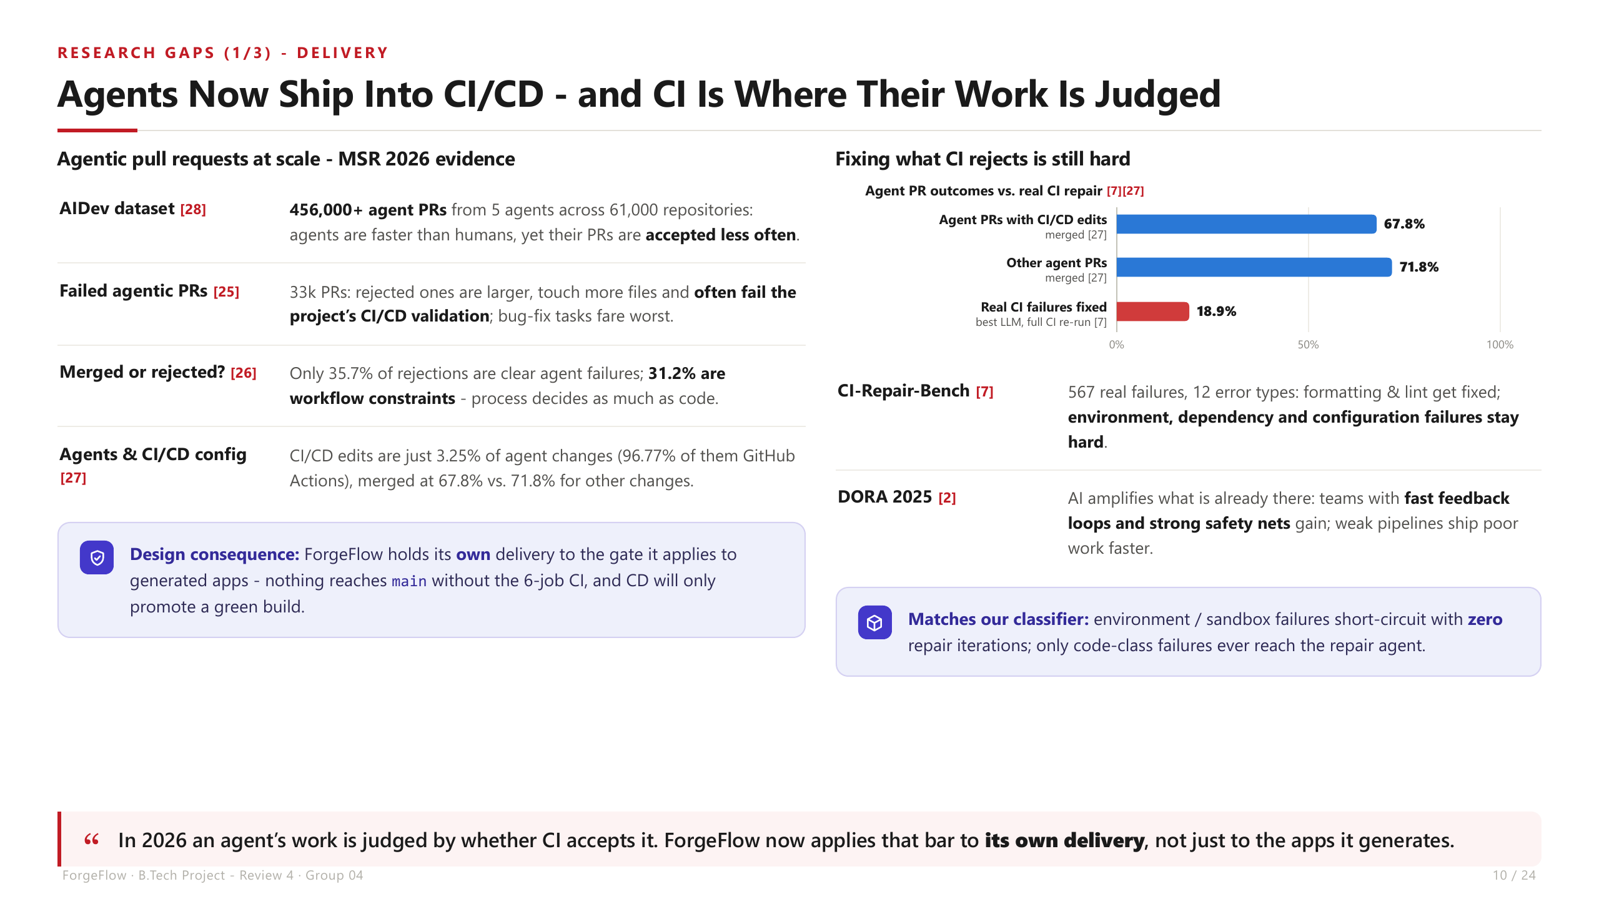

Slide 11
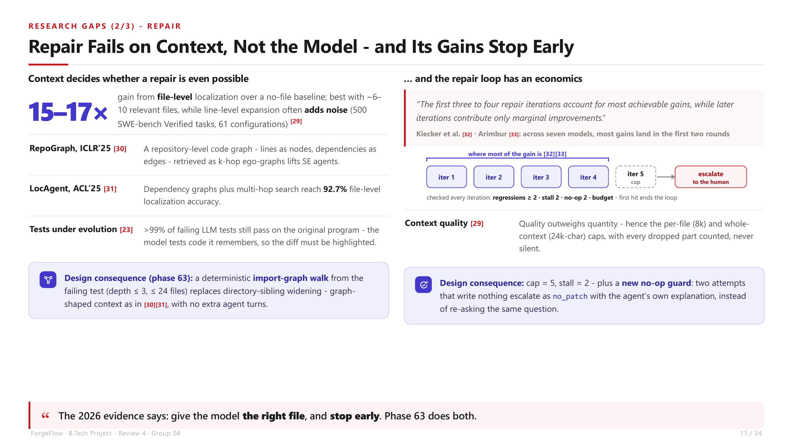

Slide 12
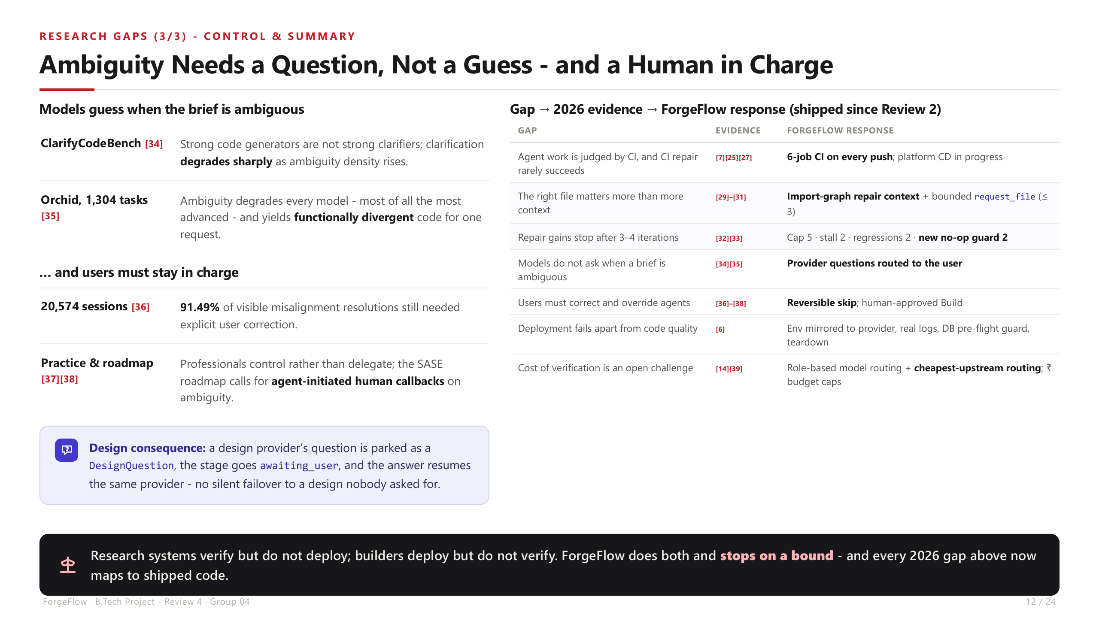

Slide 13
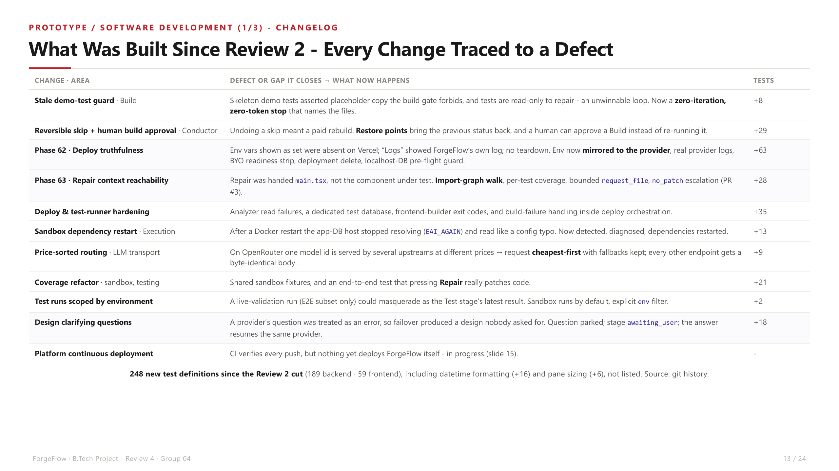

Slide 14
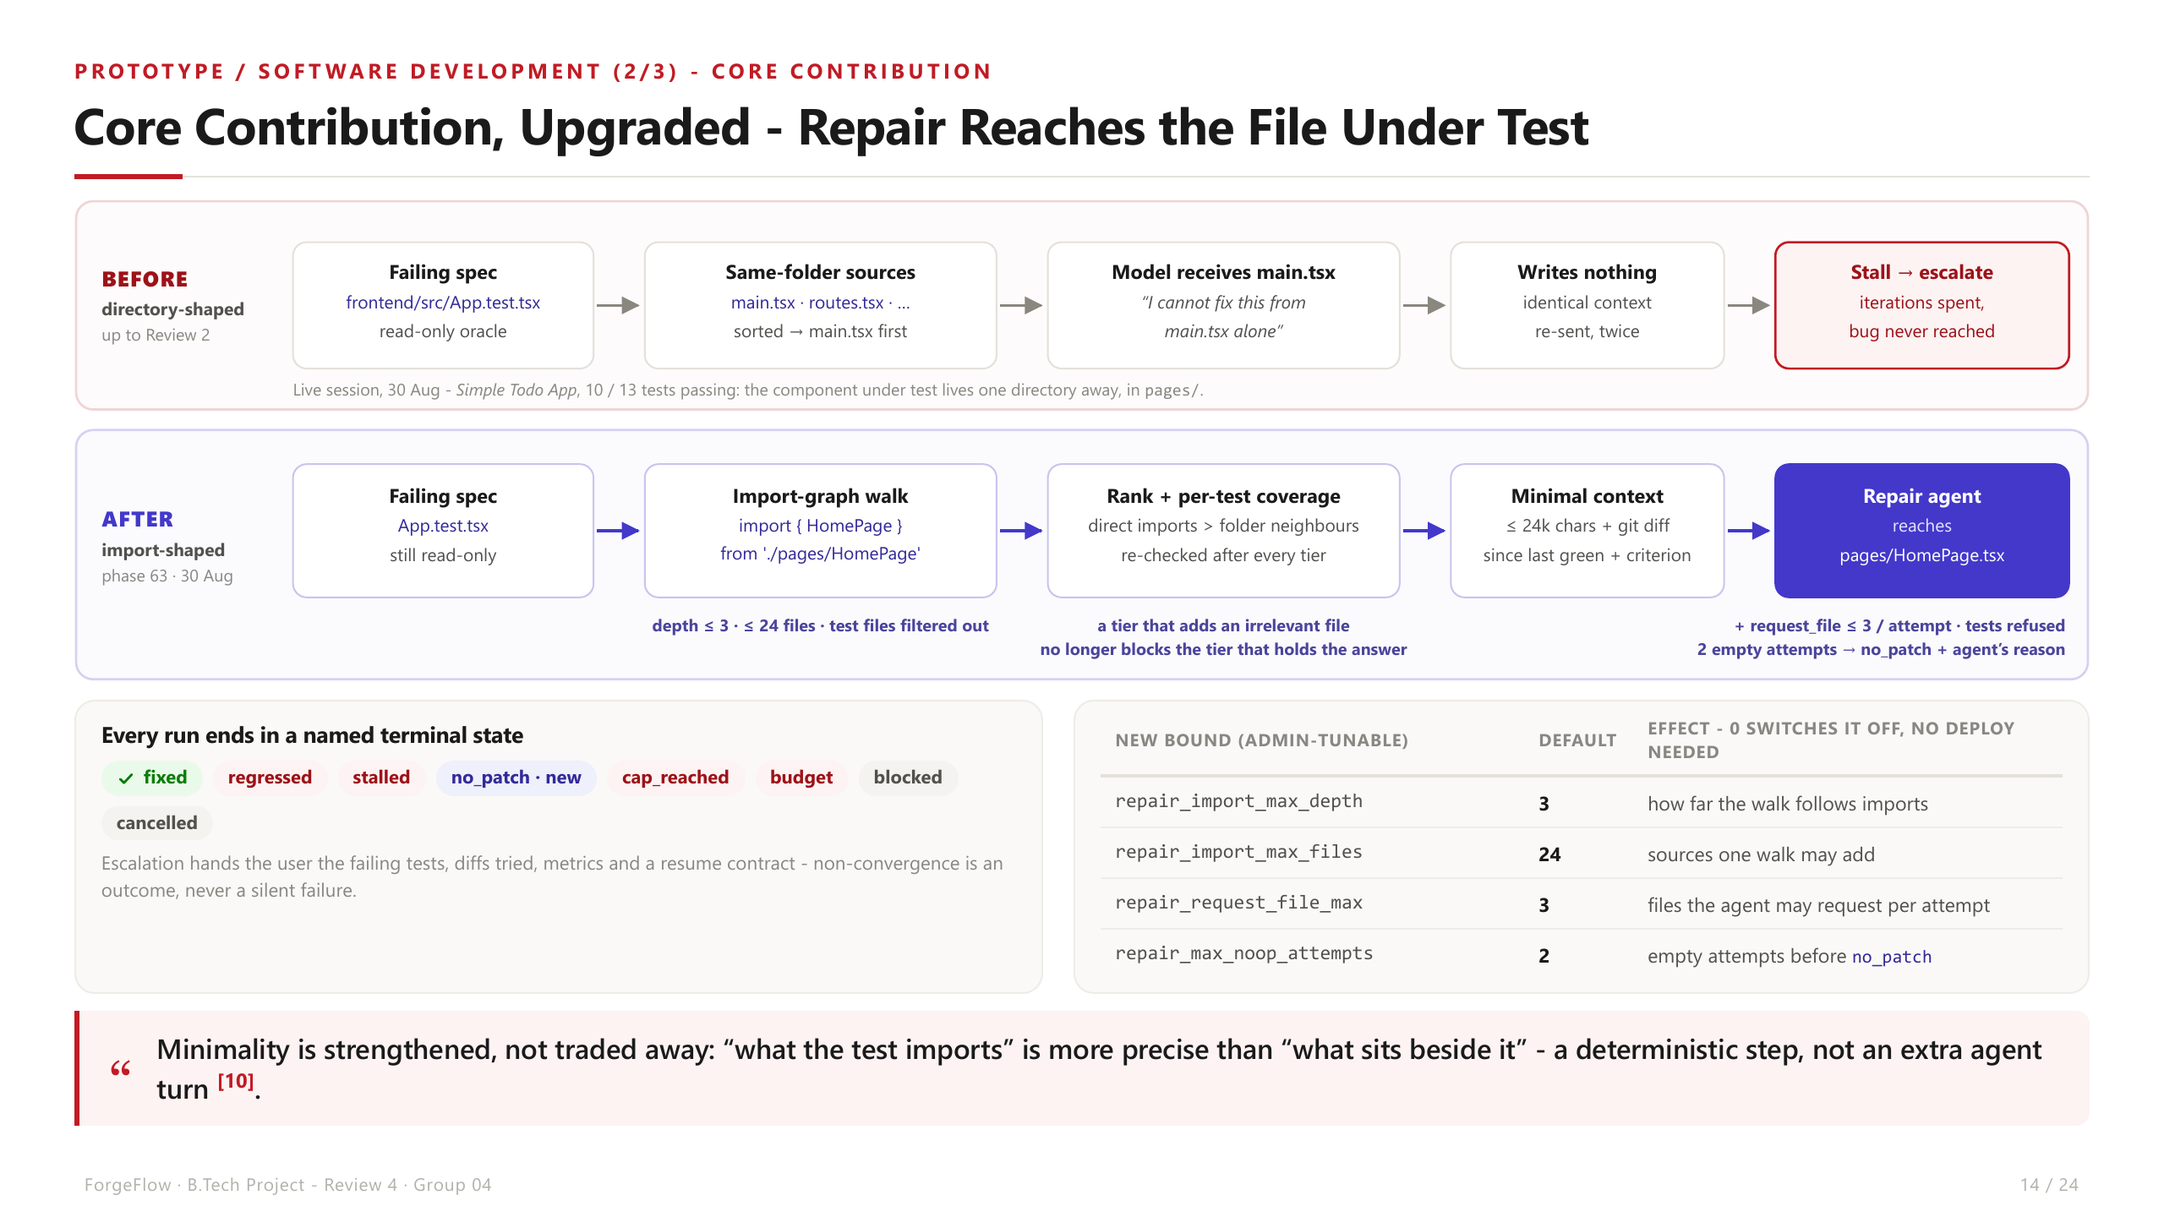

Slide 15
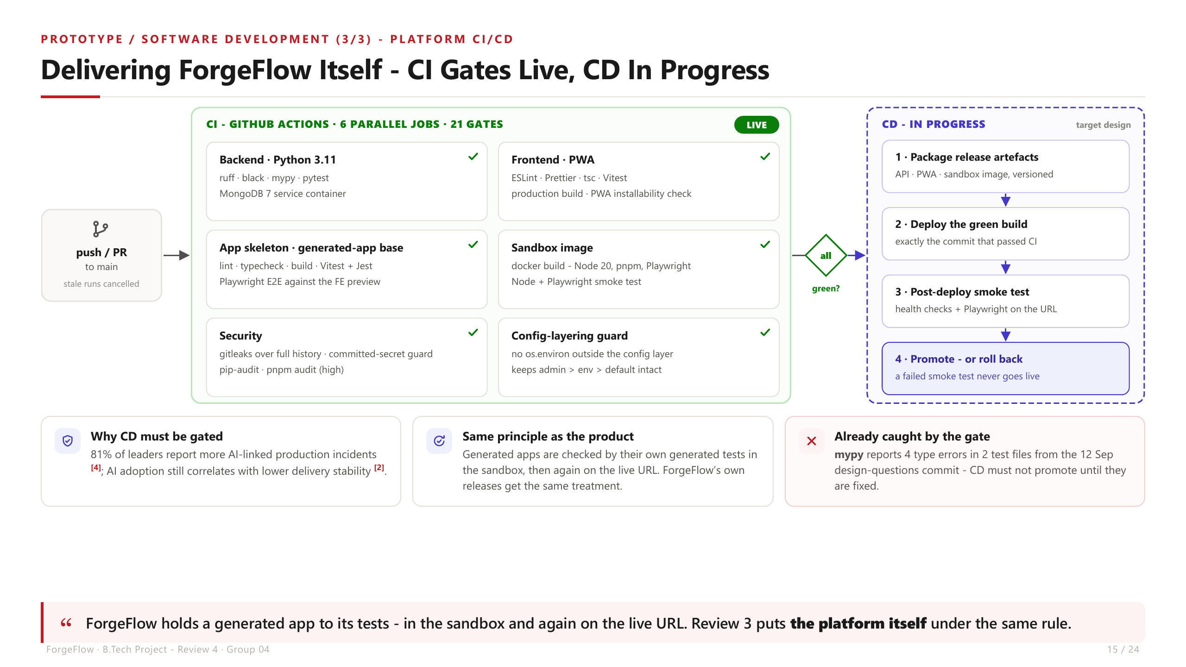

Slide 16
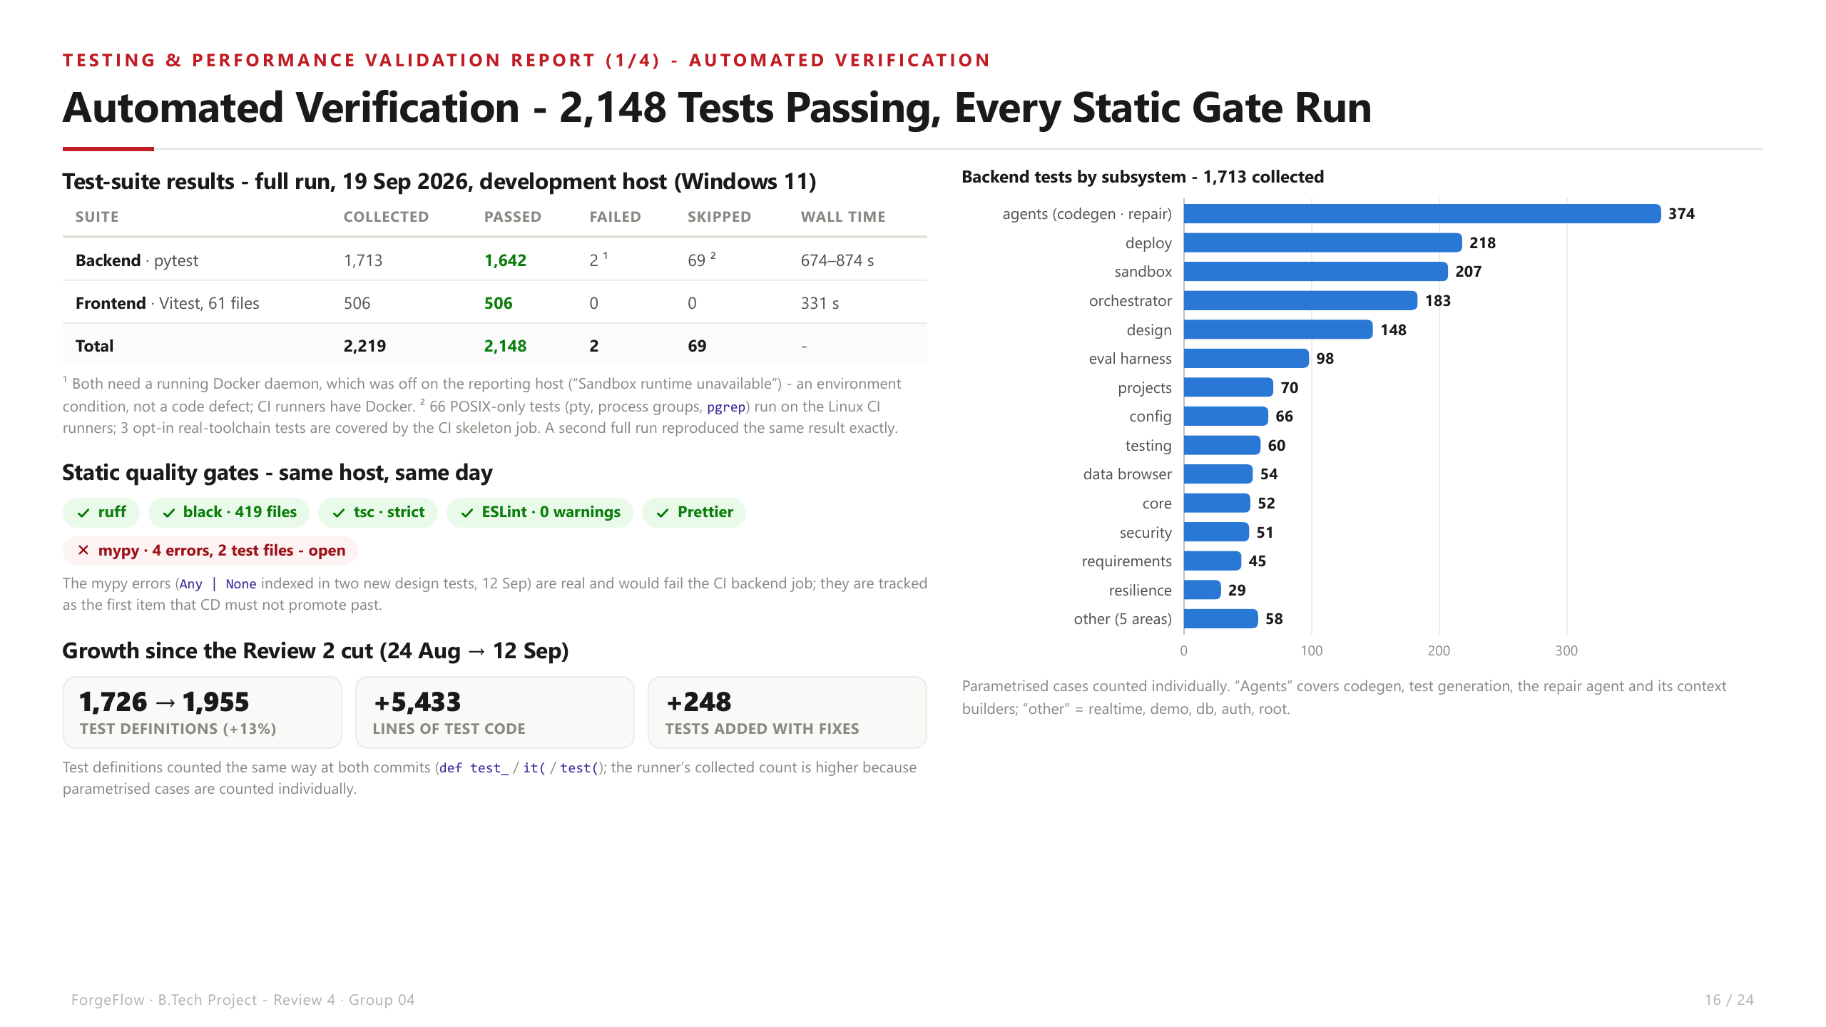

Slide 17
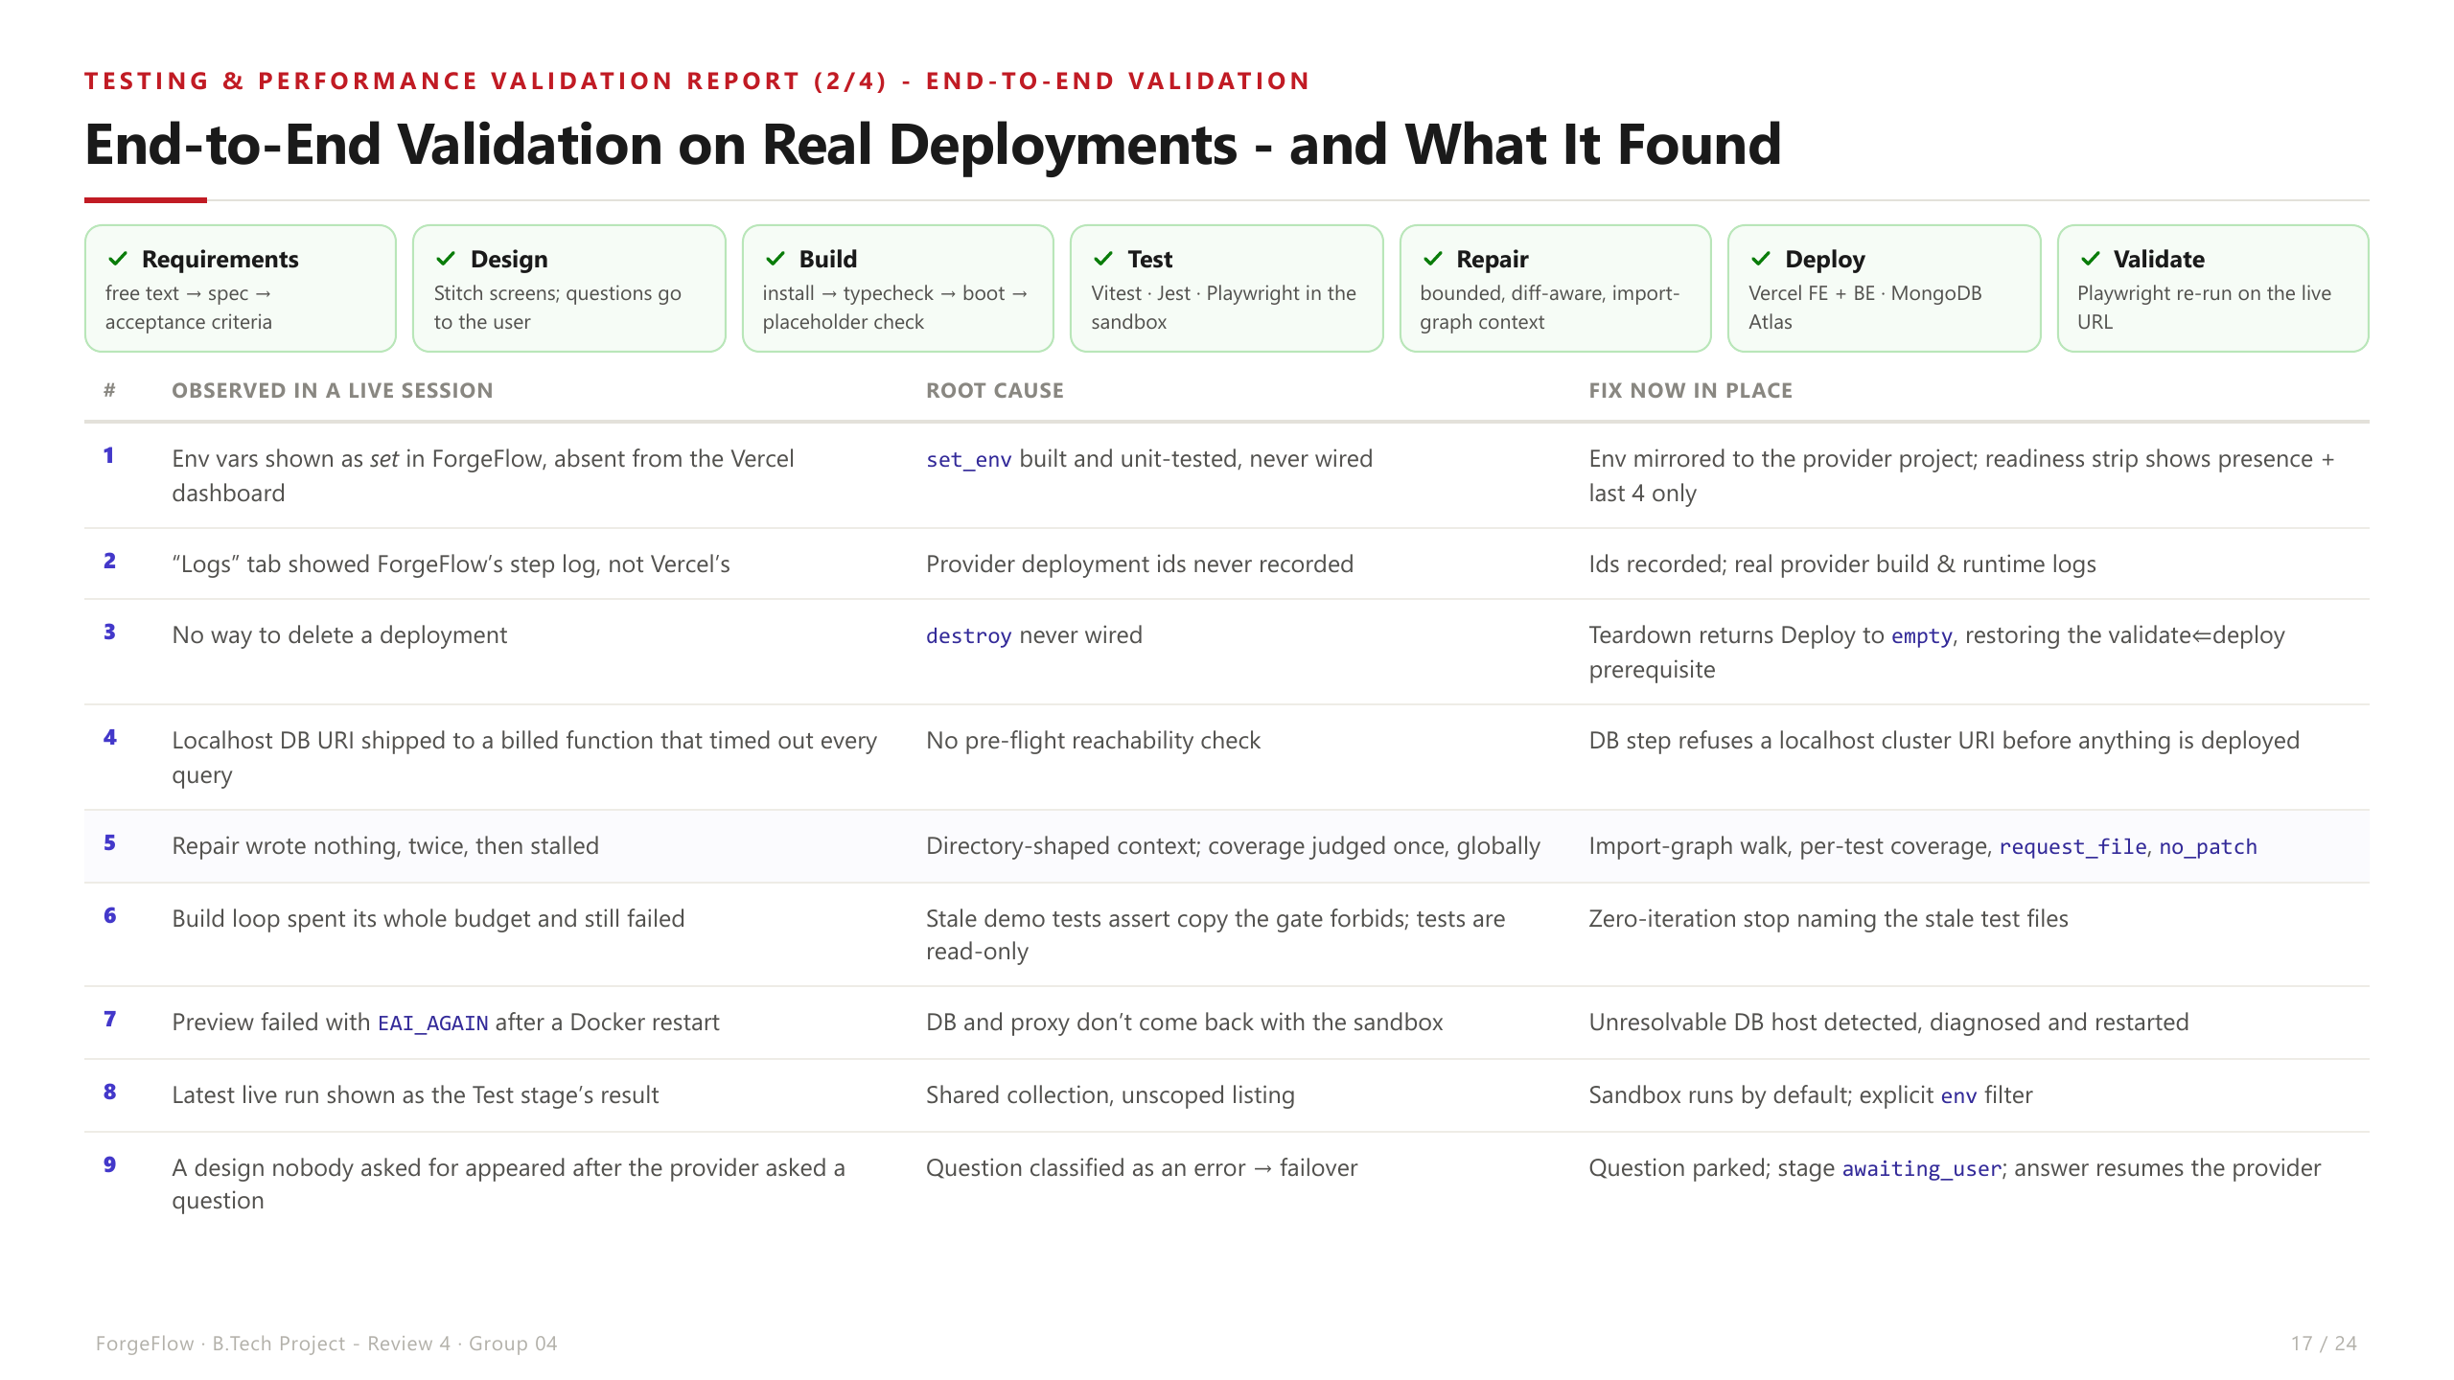

Slide 18
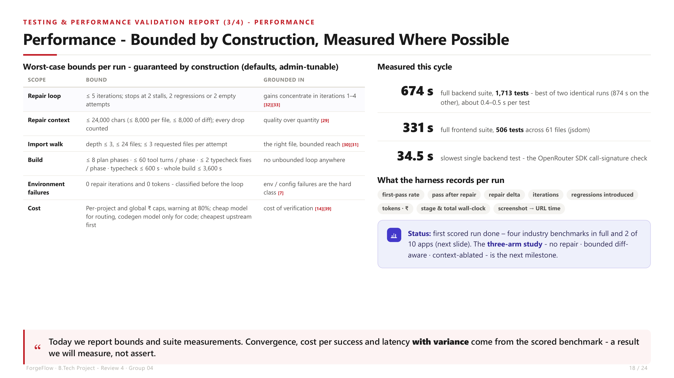

Slide 19
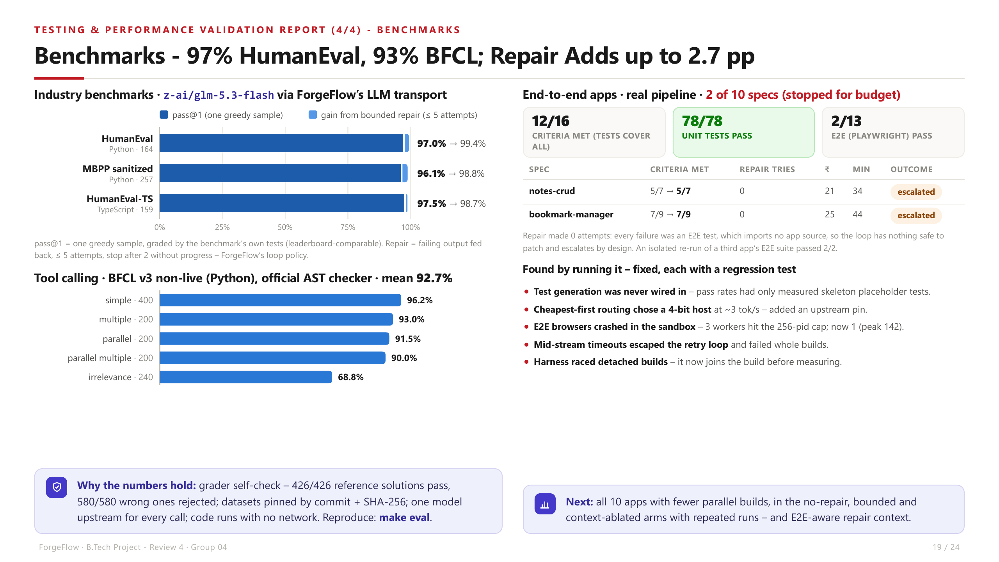

Slide 20
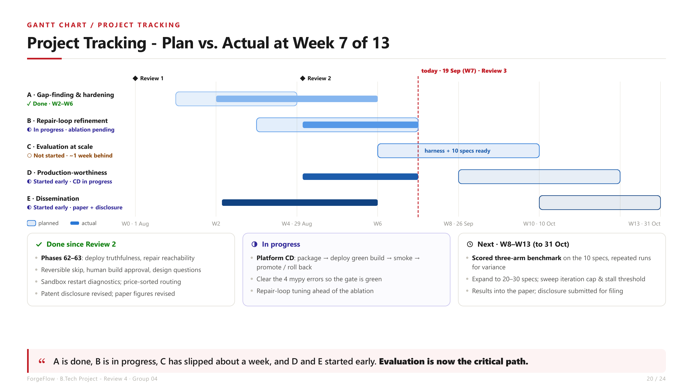

Slide 21
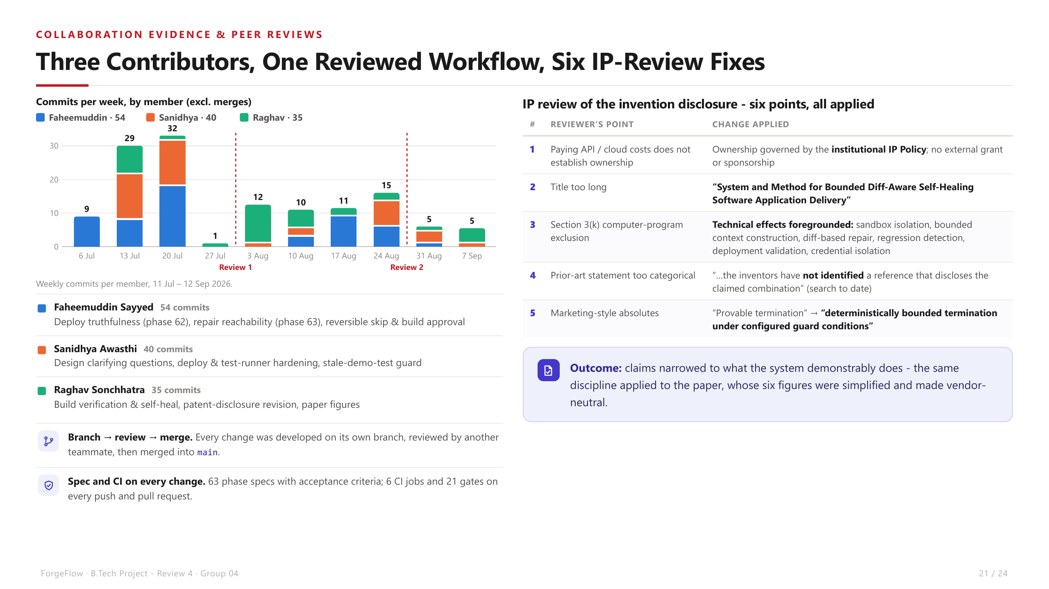

Slide 22
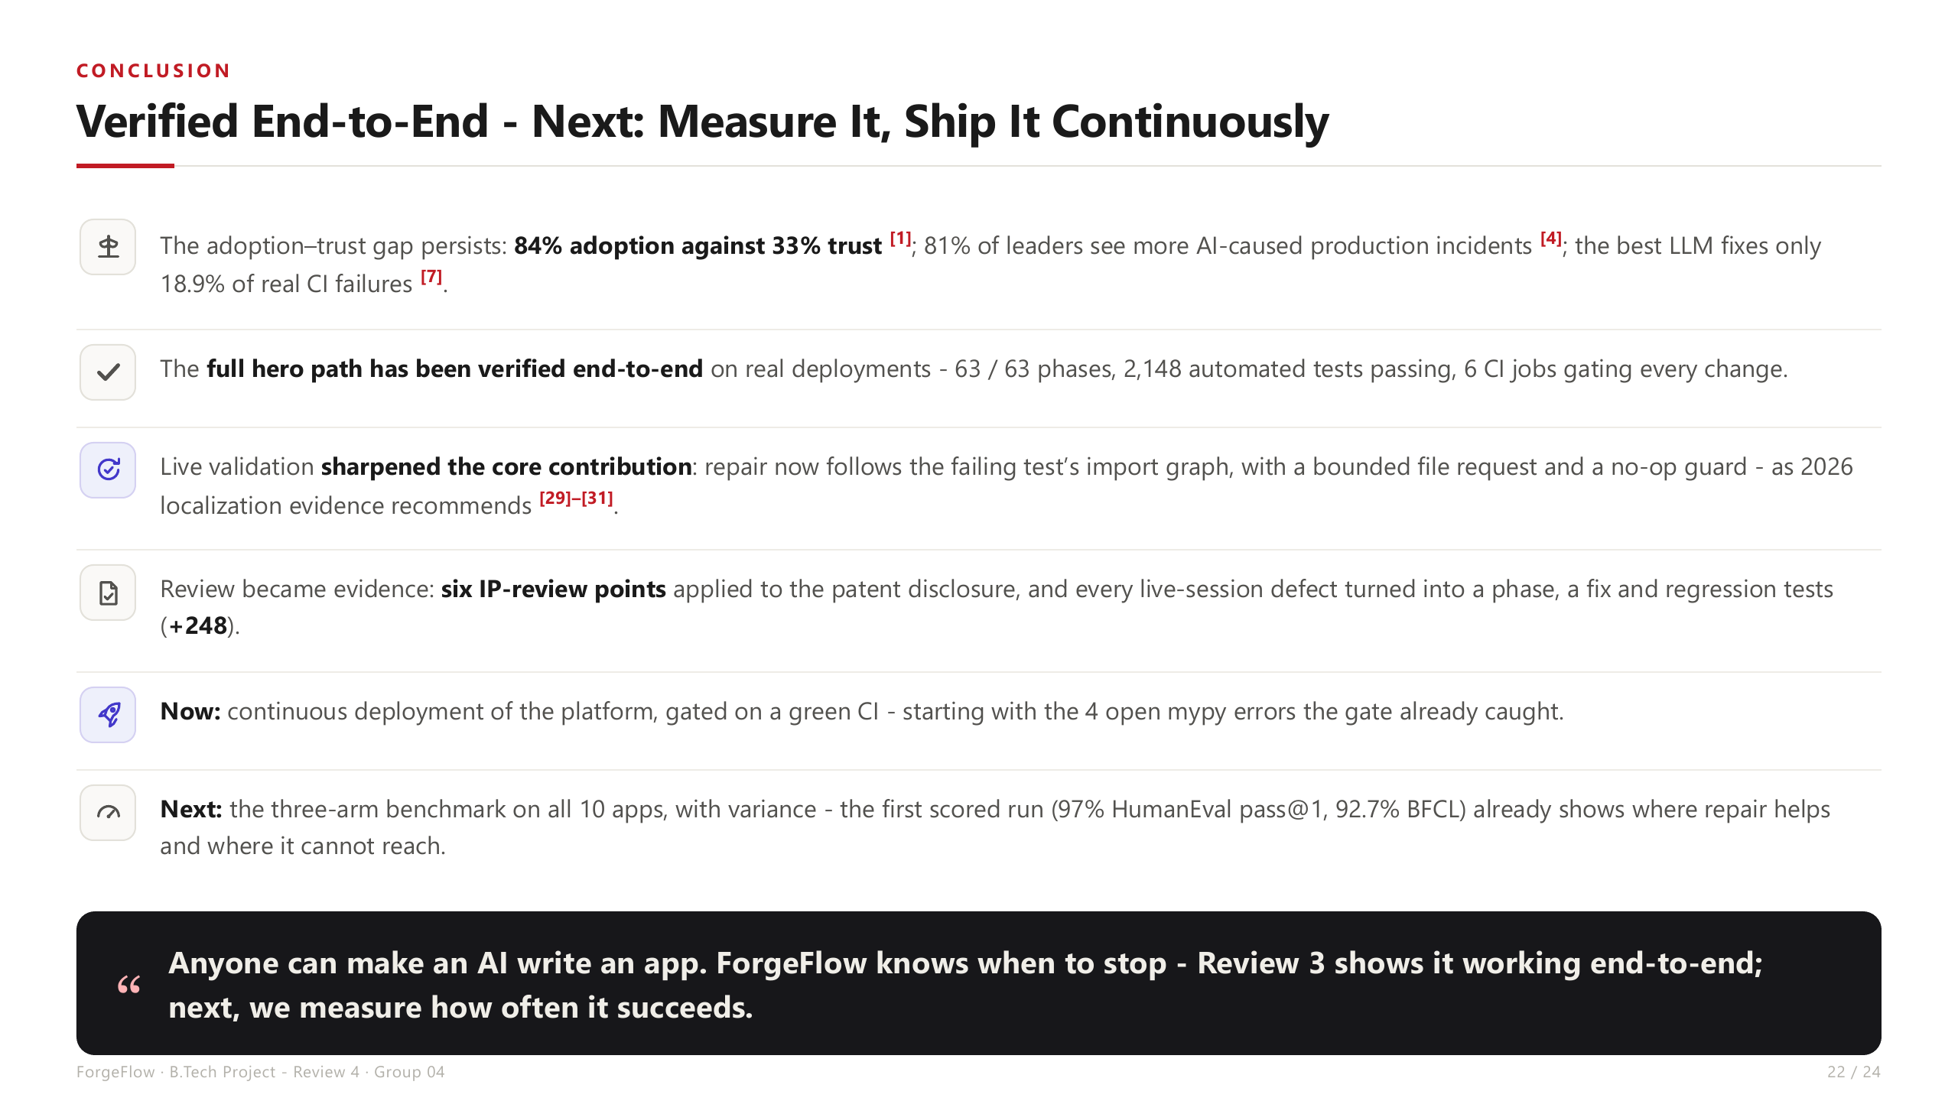

Slide 23
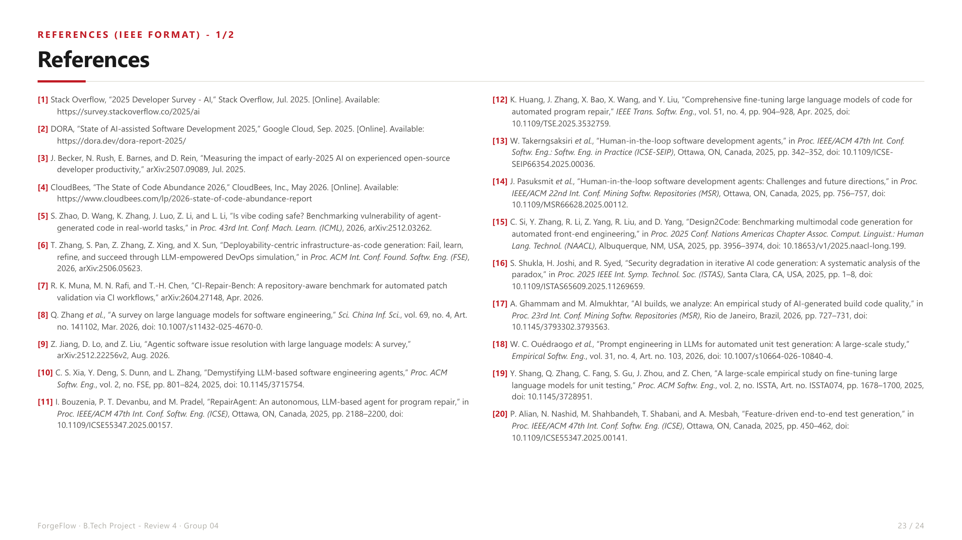

Slide 24
