Slide 1
Design and Implementation of Network Coding in NextGen Systems
GROUP MEMBERS:
Shahzaib Qazi
Atif Salman Sheikh
Syed Muhammad Zain Zafar
Advisor:
Dr. Syed Ali Hassan
Co-Advisor:
Dr. Sajid Saleem

Slide 2
INTRODUCTION
NETWORK CODING

Slide 3
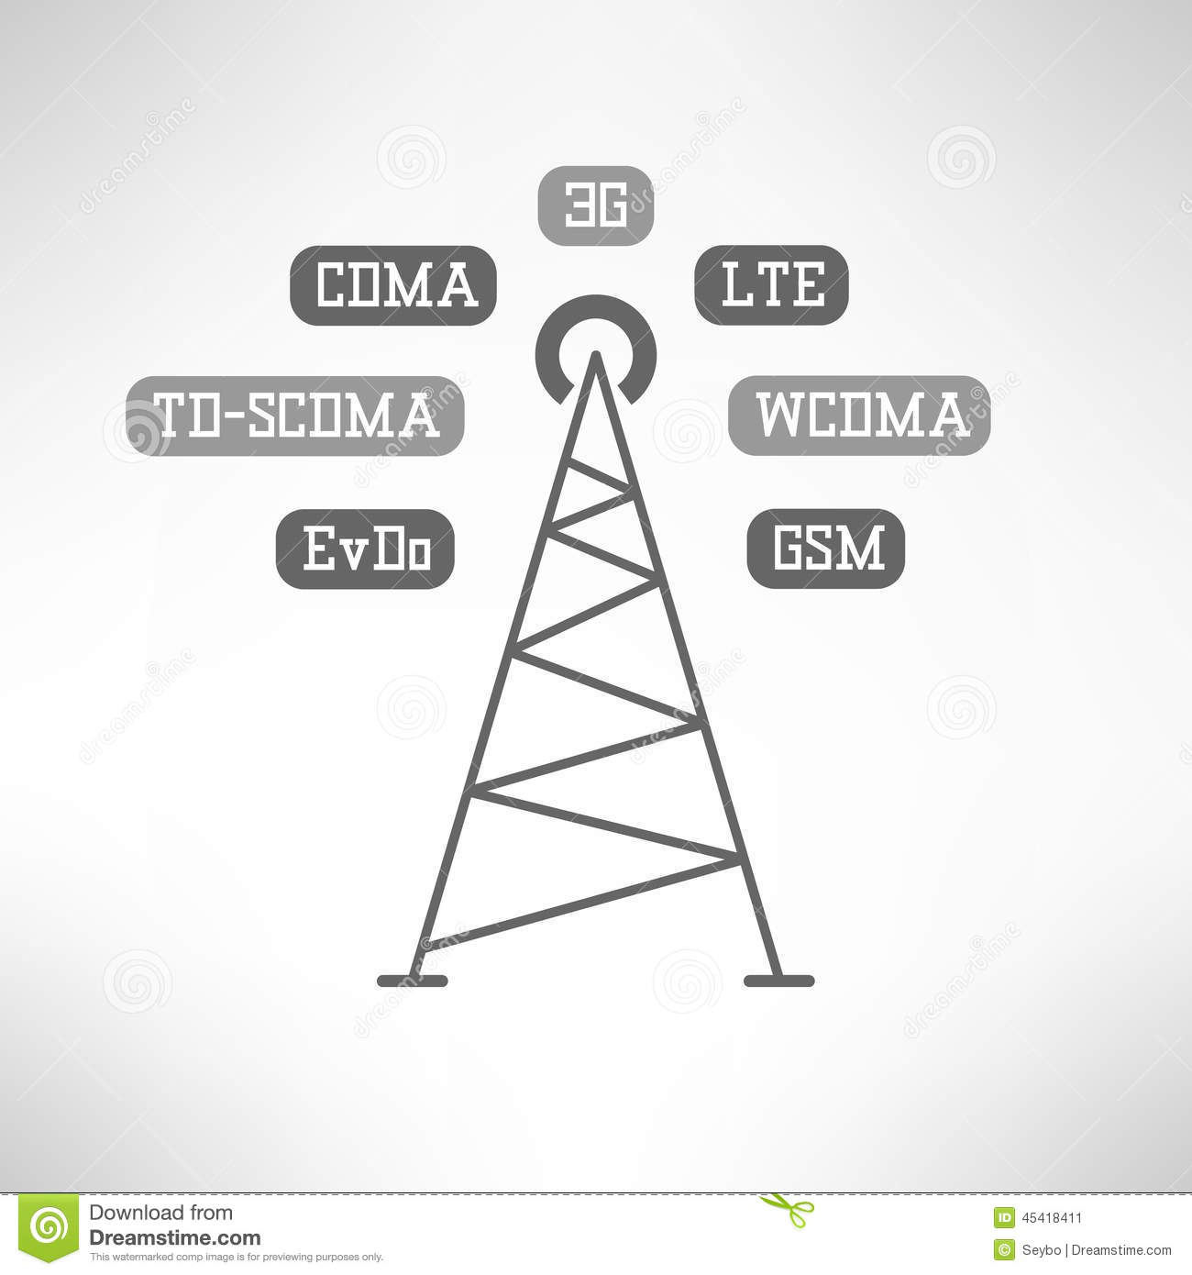
Traditional Routing Scheme
X
X
Y
Y
Notes:
Traditionally, the scheme used for forwarding data through the relay involved only decode and forward or amplify and forward mechanism, that is no complex processing was done on data reception and transmission

Slide 4
Routing with Network Coding
X
a₁X + a₂Y
Y
b₁X + b₂Y
Notes:
But as the processing power became more and more cheap, there was a possibility of doing some processing to the receiving streams at nodes before forwarding them further. Network coding refers to this possibility, because it allows us to combine incoming streams of data by performing some algebraic manipulation to them

Slide 5
Why Network Coding?
Higher Throughput (or Data Rate)
Reduced Time Instances
Notes:
Network coding allows us to achieve higher throughput or similarly reduced time instances

Slide 6


Why Network Coding?
‘Free’ Security
x₁+x₂
x₁+x₂
Send
Receive
x₁+2x₂
x₁+2x₂
Notes:
And also free security of data at the coded relays is achieved as an inherent feature.

Slide 7
PROJECT OBJECTIVE

Slide 8
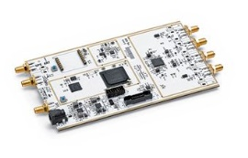


Our Aim
Implementation of Network
Coding in MISO topologies
An Experimental Evaluation in Terms of BER and T Throughput
To code or not to Code?
Notes:
The aim of our research is basically to show the feasibility of the concept of Network Coding through real time implementation on SDRs, using the experimental results to analyze the advantages and possible tradeoffs of Network Coding and to find some significant applications of Network Coding

Slide 9
Network Topologies

Slide 10
Two-Way Relay Channel (TWRC)
Without Network Coding
With Network Coding
X₂
X₁ ⊕ X₂
A
A
X₁
X₁
R
R
X₂
X₂
B
B
X₁
X₁ ⊕ X₂
Timeslot 1 → A broadcasts X₁ at frequency f₁
Timeslot 2 → R broadcasts X₁ at frequency f₂
Timeslot 3 → B broadcasts X₂ at frequency f₁
Timeslot 4 → R broadcasts X₂ at frequency f₂
Timeslot 1 → A broadcasts X₁ at frequency f₁
Timeslot 2 → B broadcasts X₂ at frequency f₁
Timeslot 3 → R broadcasts X₁ + X₂ at frequency f₂
10

Slide 11
Two-source MISO
Without Network Coding
With Network Coding
A
X₁
A
X₁
X₁
C₁
C₂
R
D
R
D
B
X₂
B
X₂
X₂
Timeslot 1 → A broadcasts X₁
Timeslot 2 → R broadcasts X₁
Timeslot 3 → B broadcasts X₂
Timeslot 4 → R broadcasts X₂
Timeslot 1 → A broadcasts X₁
Timeslot 2 → B broadcasts X₂
Timeslot 3 → R broadcasts C₁ & C₂ using FDM
11

Slide 12
Three-source MISO
Without Network Coding
With Network Coding
A
X₁
A
X₁
X₁
X₂
X₂
X₂
C₁
C₂
C₃
B
R
D
B
R
D
X₃
X₃
X₃
C
C
Timeslot 1 → A broadcasts X₁
Timeslot 2 → R broadcasts X₁
Timeslot 3 → B broadcasts X₂
Timeslot 4 → R broadcasts X₂
Timeslot 5 → C broadcasts X₃
Timeslot 6 → R broadcasts X₃
Timeslot 1 → A broadcasts X₁
Timeslot 2 → B broadcasts X₂
Timeslot 3 → C broadcasts X₃
Timeslot 4 → C broadcasts C₁, C₂ & C₃ using FDM
12

Slide 13
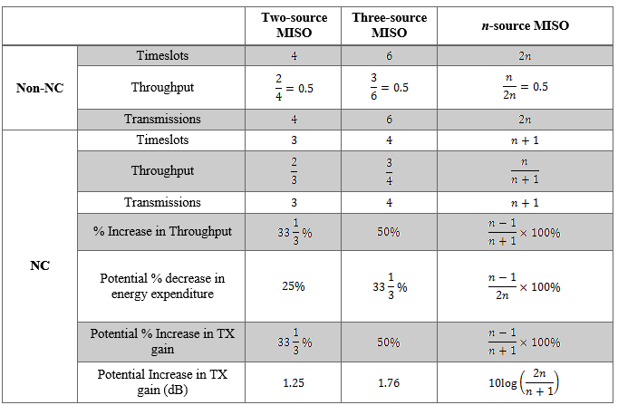
Theoretical Analysis
13

Slide 14
Implementation

Slide 15




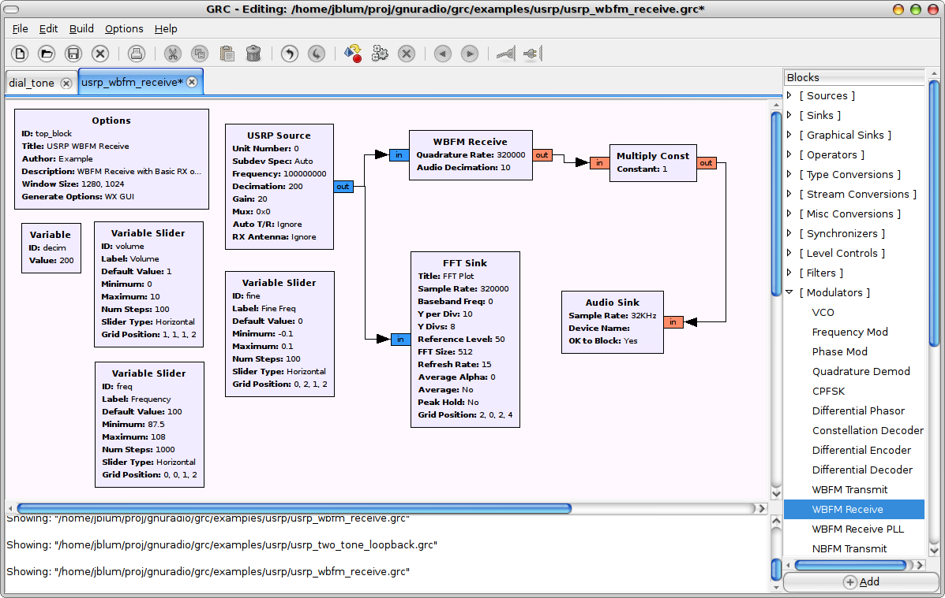
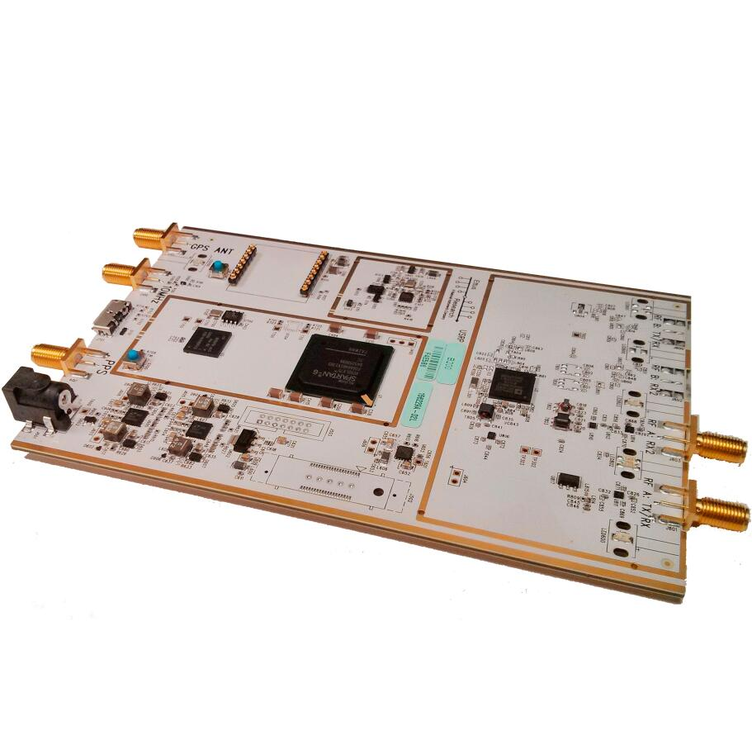
Tools used

Slide 16
Packet Description
Access Code
Header
Payload
Indicates start of packet/error checking
Used for conditional processing
Actual data

Slide 17
Master-Slave Scheduling
x₁+x₂
Tx_start signal sent to A
Packet A sent to relay R
Tx_stop signal sent to A
Tx_start signal sent to B
Packet B sent to relay R
Tx_stop signal sent to B
Data coded in R
Coded data sent to A & B
R
X₁
X₂
A
B

Slide 18
Getting Started…
Familiarization with GNU Radio Companion and Universal Software Radio Peripheral (USRP B200)
Basic Transmitter-Receiver
Basic Relay

Slide 19
Experimental Setup

Slide 20
Experimental Setup
R
Environment: Indoor, Line of Sight
Distance between successive nodes: 5m
Bit Error Rate (BER) evaluated over 2 million bits
  Total NC system TX power = total non-NC system TX power
Throughput and Goodput evaluated over 2 million bits
  Total NC system TX time = total non-NC system TX time
Results compared for NC and non-NC
A
B
P_{A}+ P_{B}+ P_{R} = P_{A-NC}+P_{B-NC}+P_{R-NC}
t_{TX-A}+ t_{TX-B}+ t_{TX-R} = t_{TX-A-NC}+ t_{TX-B-NC}+ t_{TX-R-NC}

Slide 21
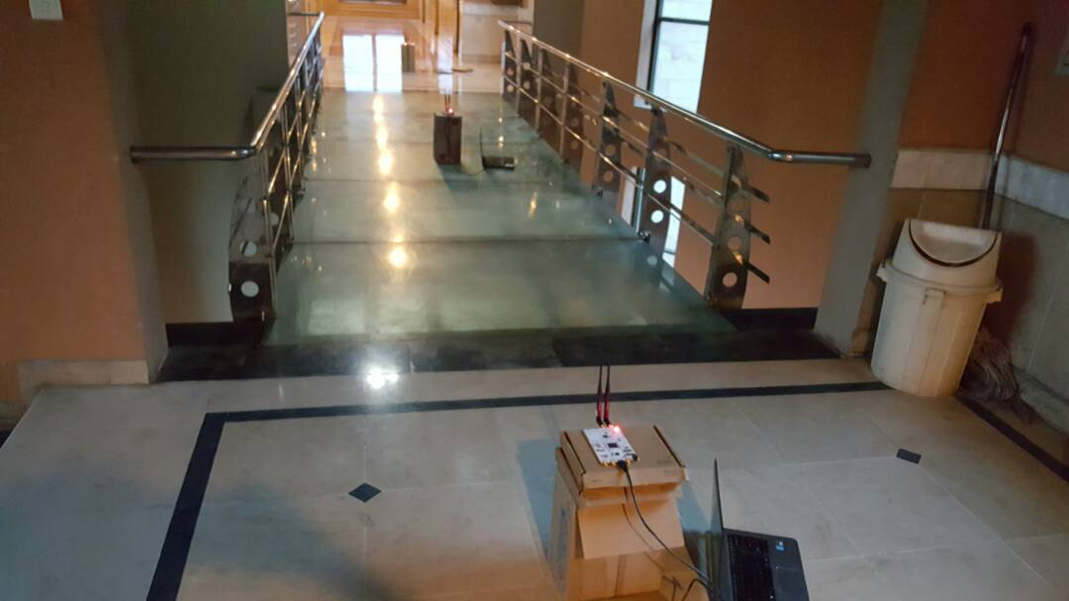
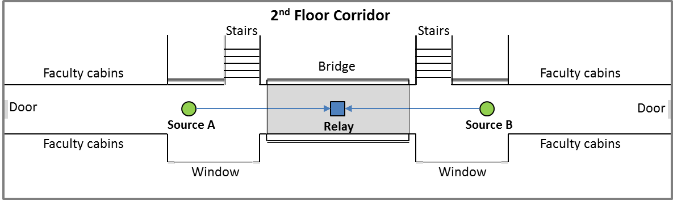
Two way Relay Coding (TWRC)
Source B
Relay
Source A
19

Slide 22
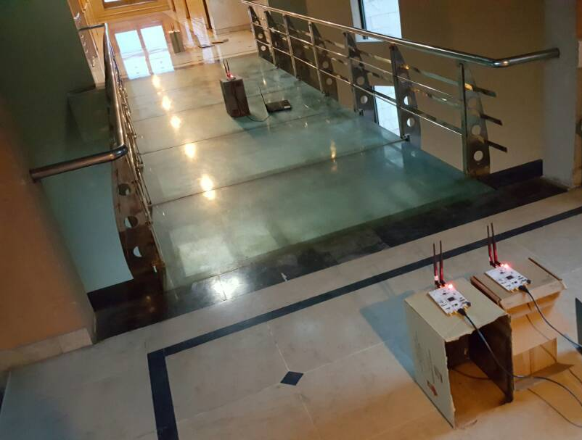
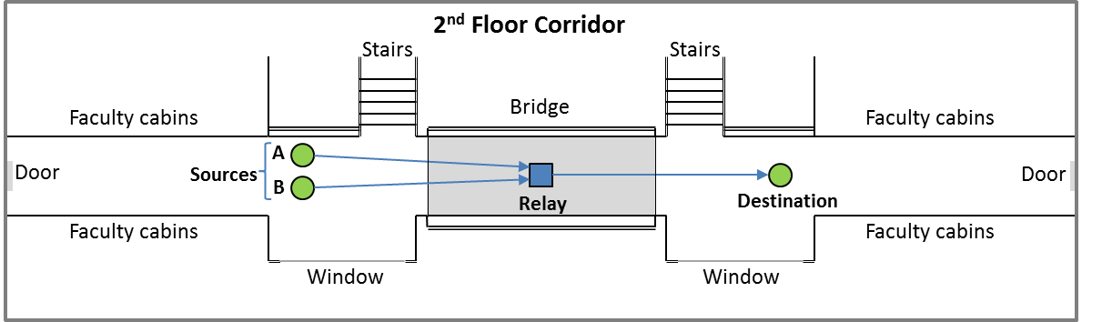
Two source MISO
Destination
Relay
Source B
Source A

Slide 23
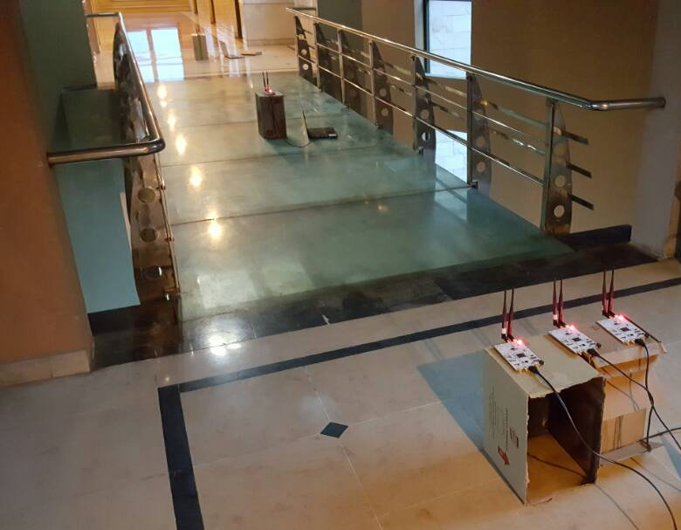
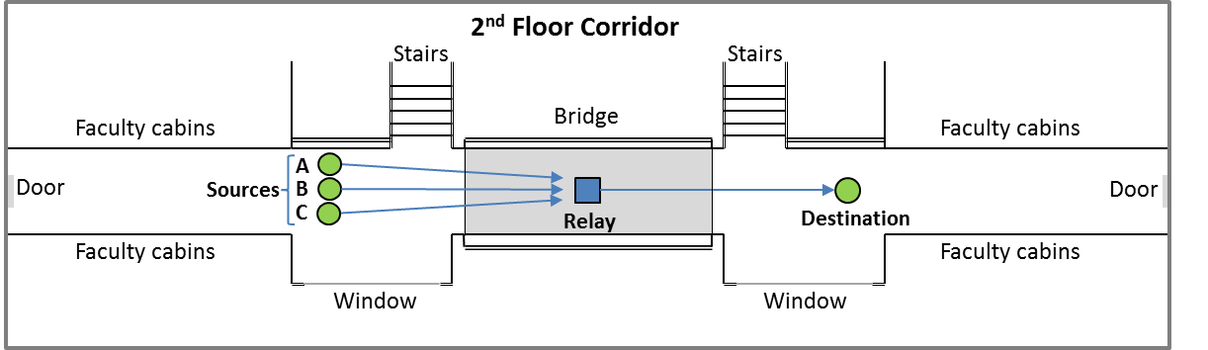
Three source MISO
Destination
Source C
Relay
Source A
Source B

Slide 24
Results and Discussion

Slide 25
Non-NC schemes for all topologies
Observation:
  Minimal differences in BER characteristics
Possible explanation:
  Channel differences
  USRP calibration mismatch
  Antenna calibration mismatch

Slide 26
Non-NC & NC schemes for 2-source topologies
Observation:
  NC curves are lower than Non-NC curves
  Percentage difference between the curves increases as transmit power is increased
Possible explanation:
  NC allows us to increase transmit power by 33%.
  Increase in Transmit powers has greater effect at higher powers

Slide 27
Non-NC & NC schemes for 3-source topology
Observation:
  NC curves not always lower than Non-NC curves.
Possible explanation:
  Greater error due to combining of three sources.

Slide 28
NC schemes for all topologies
Observation:
  3-source topology has greater BER than 2-source topologies.
  Minimal difference between the BER of TWRC and 2-source MISO.
Possible explanation:
  Greater error due to more number of sources.

Slide 29
Difference between 2-source topologies
Notes:
XOR-additive
LNC-multipliciative

Slide 30
Goodput for all topologies
Observation:
  Goodput for NC schemes is greater than Non-NC schemes.
  At lower gain 2-source NC outperforms 3-source NC
  At higher gains 3-source NC outperforms 2-source NC
Possible explanation:
  NC allows to increase the transmission time
  Greater transmission time has compensated for the extra errors in 3-source NC.

Slide 31
Simulation Results

Slide 32
Non-NC & NC schemes for 2-source topologies

Slide 33
Non-NC & NC schemes for 3-source topology

Slide 34
NC schemes for all topologies

Slide 35
Design Expo
Final Defence
2/14/2017
5/19/2017
Proposal Defence
Mid Defence
Open House
11/10/2016
3/3/2017
5/23/2017
2016
Sep
Oct
Nov
Dec
2017
Feb
Mar
Apr
May
2017
Today
Literature Review
9/19/2016 - 10/20/2016
Learning GNU Radio/USRP
9/19/2016 - 9/23/2016
Transmitter-Receiver Design
9/24/2016 - 9/30/2016
Relay Design and testing
10/1/2016 - 10/7/2016
Testing 2-Way Relay Channel
10/8/2016 - 10/20/2016
32 days
Node Designing TWRC
10/28/2016 - 12/15/2016
5 days
Relay Designing for TWRC
12/15/2016 - 1/10/2017
7 days
BER Testing of TWRC
2/13/2017 - 2/28/2017
7 days
2-source MISO and 3-source MISO topology
3/3/2017 - 3/17/2017
13 days
Testing of 2-source MISO
3/18/2017 - 4/7/2017
49 days
Testing of 3-source MISO
4/8/2017 - 4/23/2017
27 days
Quantifying results deduced
4/24/2017 - 5/8/2017
16 days
Project report preparation & Research paper submission at PIMRC
15 days
5/9/2017 - 5/23/2017
21 days
16 days
15 days
11 days

Slide 36
THANK YOU

