Slide 1

GAN (Generative adversarial networks)
A generative adversarial network is a class of machine learning frameworks invented by Ian Goodfellow and his colleagues in 2014. Two neural networks contest with each other in a game. Given a training set, this technique learns to generate new data with the same statistics as the training set.

Slide 2
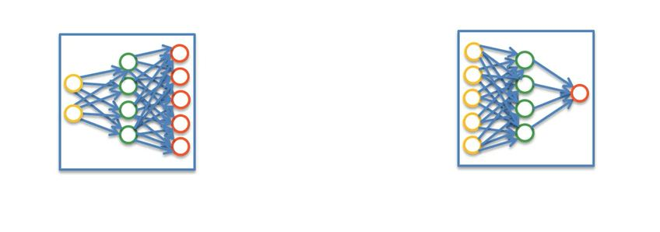
GAN, has two Components …
G and D

Slide 3
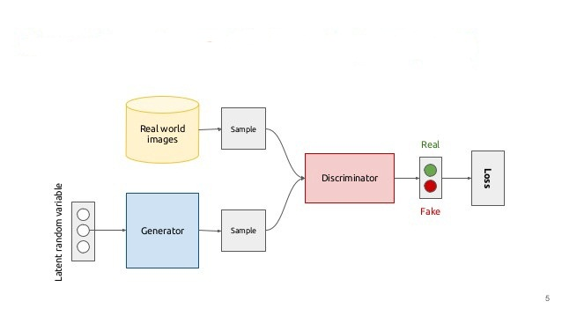
GAN, Architecture and Working

Slide 4
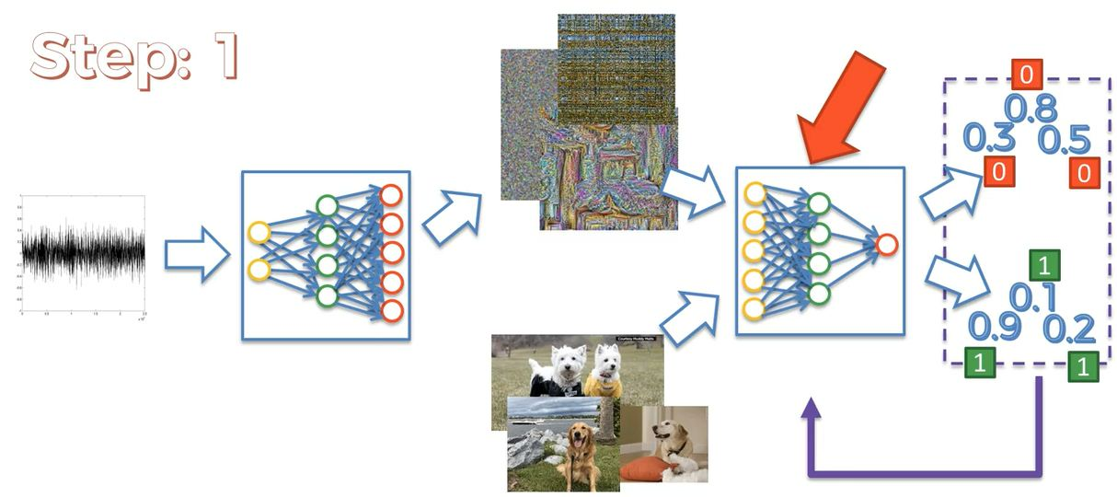
GAN, Working STEP:01

Slide 5
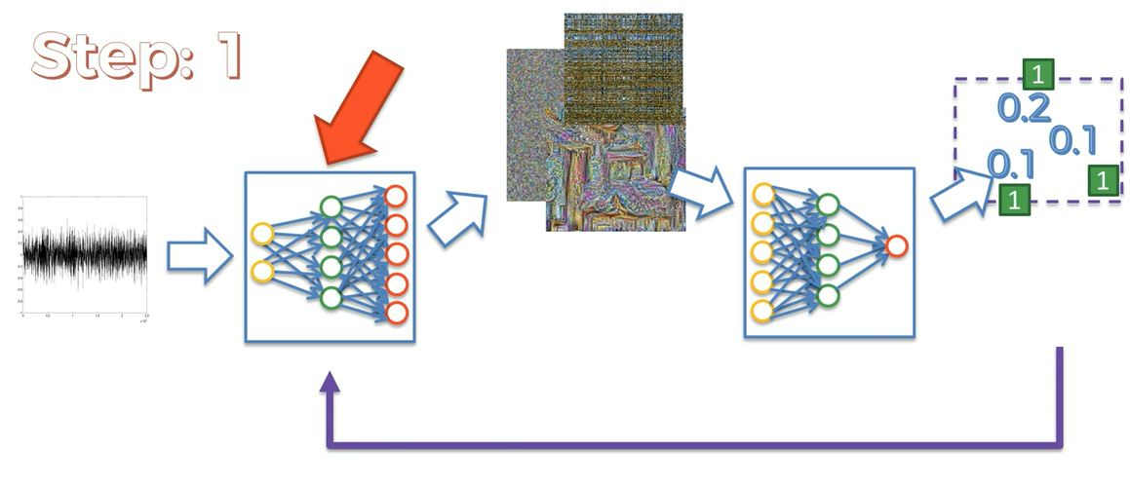
GAN, Working STEP:01

Slide 6
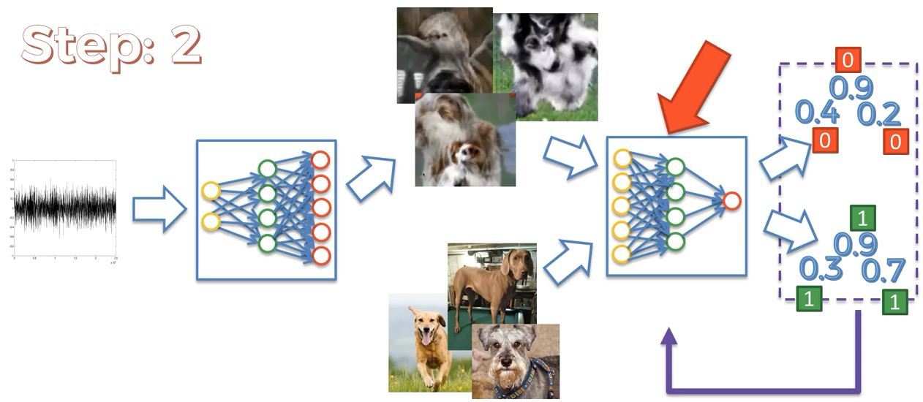
GAN, Working STEP:02

Slide 7
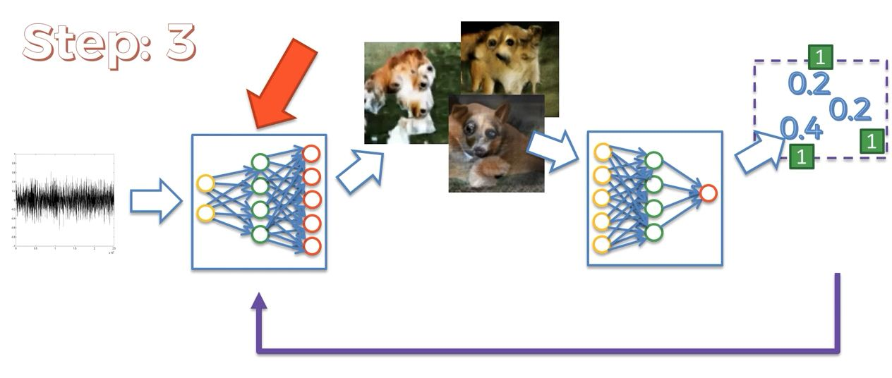
GAN, Working STEP:03

Slide 8
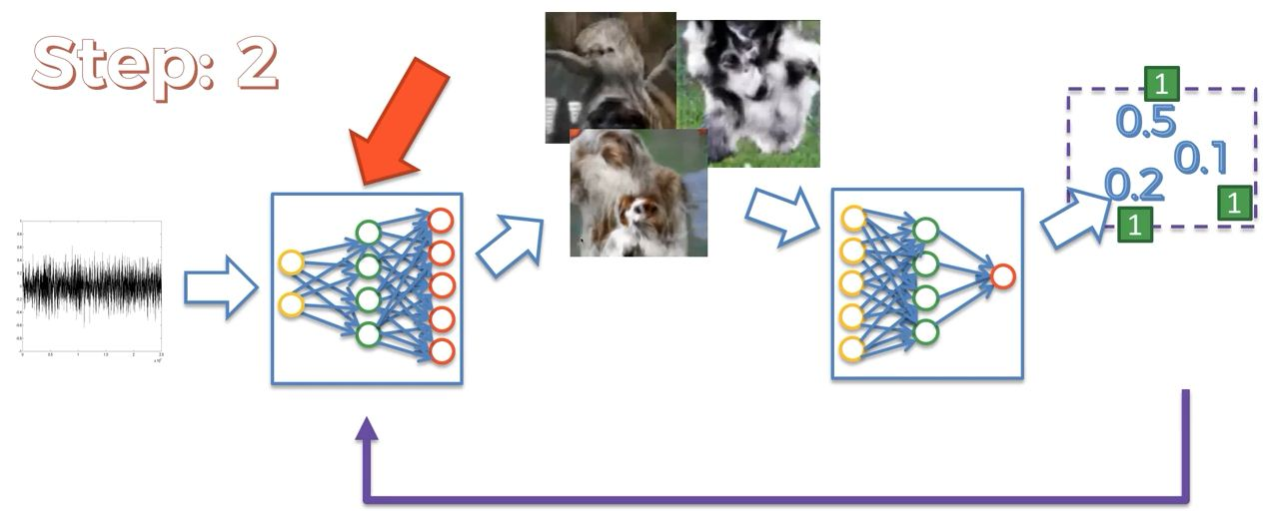
GAN, Working STEP:02

Slide 9
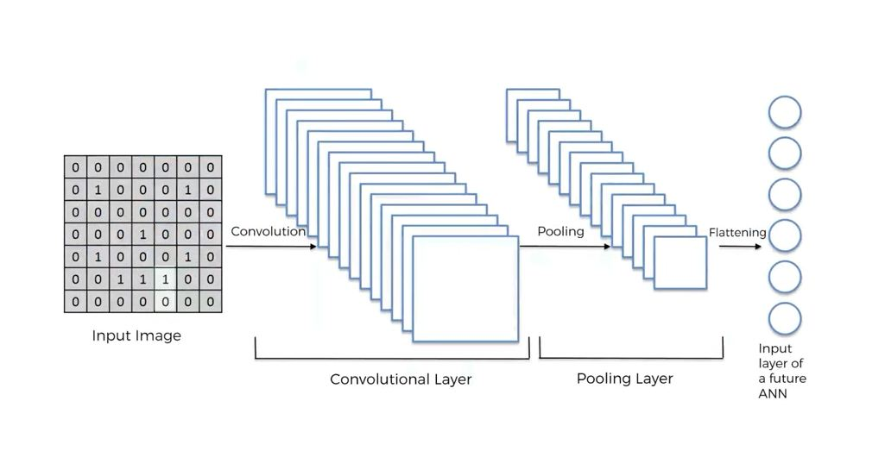
CNN VS D-CNN

Slide 10
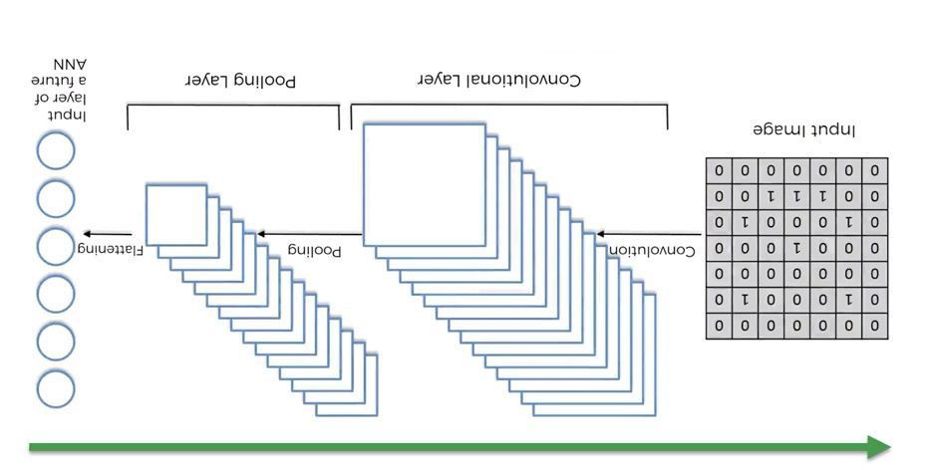
CNN VS D-CNN

