Slide 1
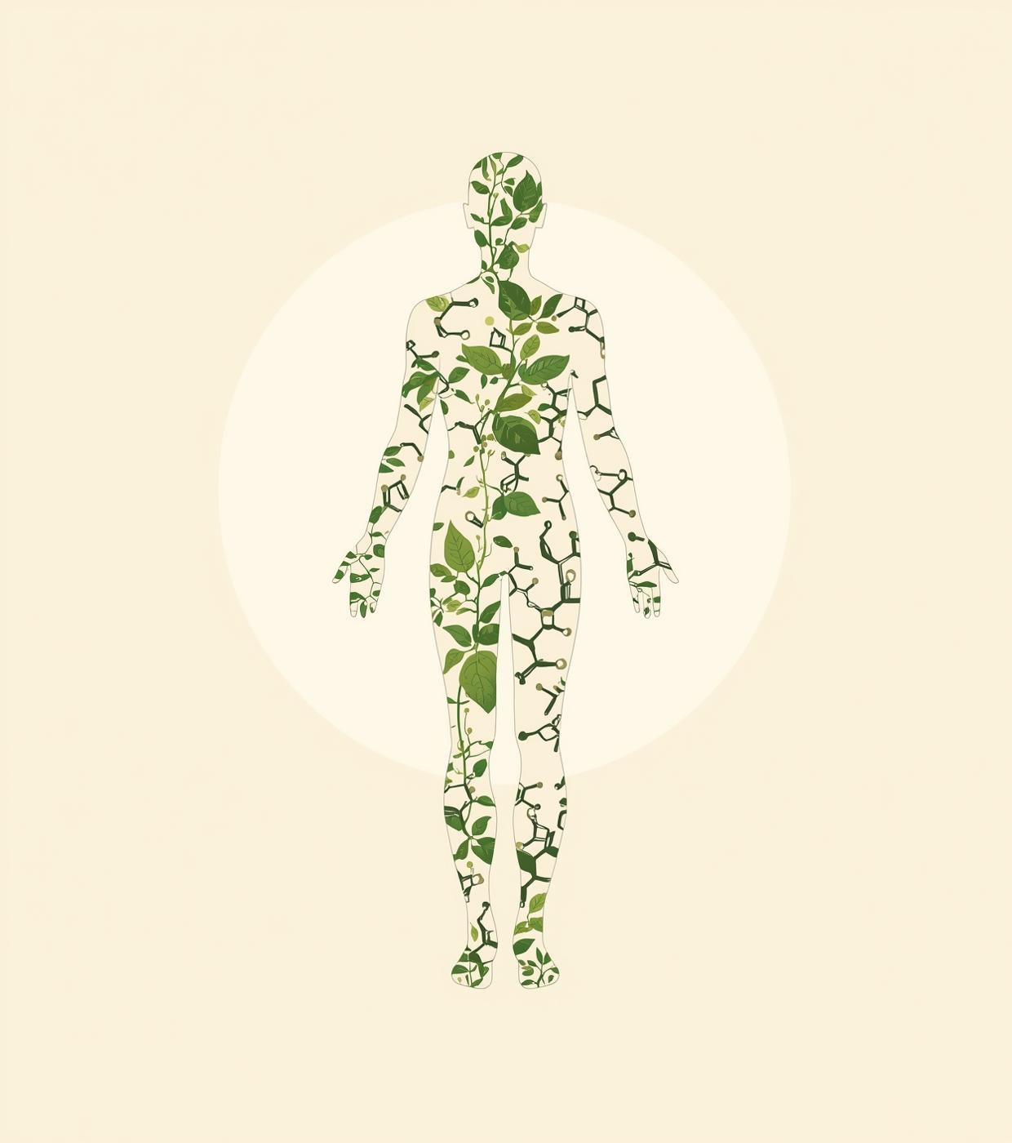
Vision Language Model for Predicting the Effects of Plant Compounds on Human Skin
Student Name and ID
1.Emon Hossen 2211106042
2.Faheem Hasnat 2211721642
3.Kazi Tanora Akther 2132580642

Slide 2


Nature Through Neural Eyes
Skin faces UV and pollution
Plants offer protective compounds
Discovery process slow, fragmented
Labs limited in integration
VLMs link image and text
Accelerating natural skincare innovation

Slide 3
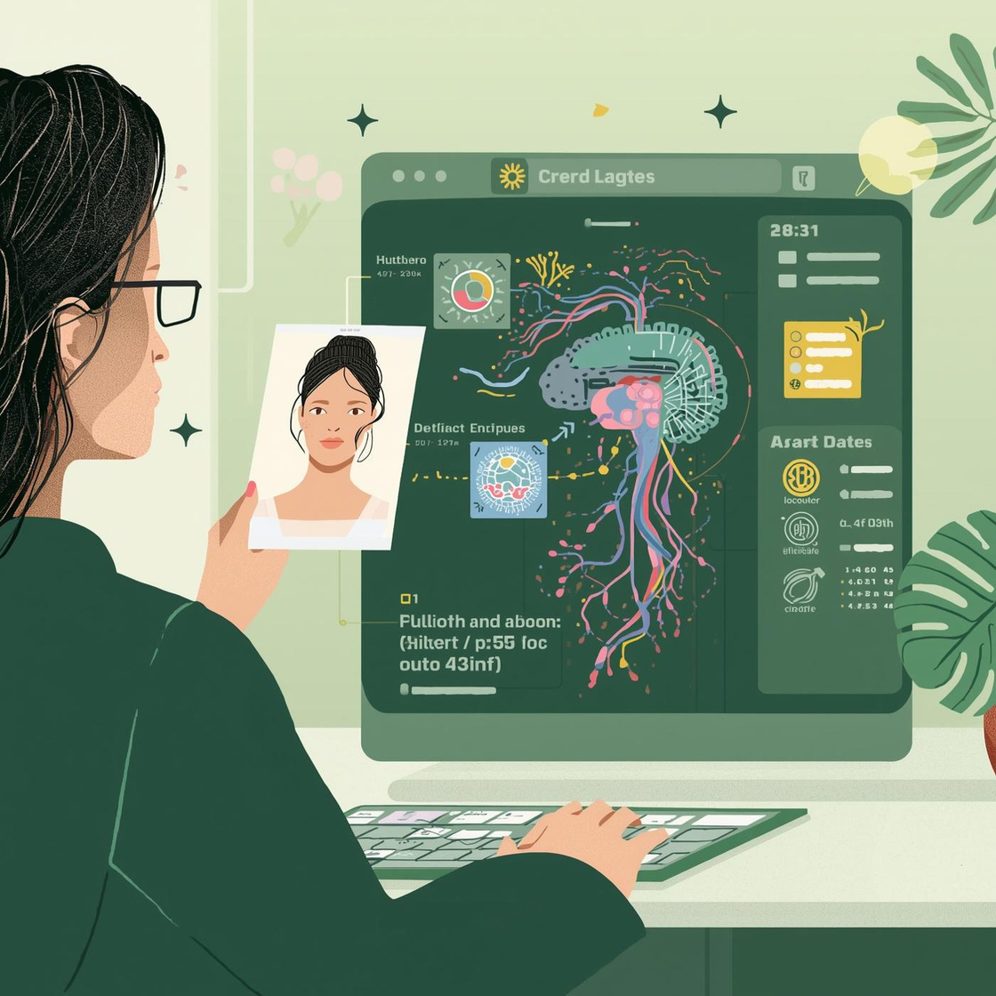
Problem Statement
Research domains remain isolated
Data fragmented across sciences
AI models are single-modal
Miss complex biological relations
Need unified multimodal framework
Predict plant effects on skin

Slide 4

Related Works
Studies focus on single compounds
Prior AI models are single-modal
Lack integration of text and images
No cross-domain VLM frameworks exist
Biological reasoning rarely explained
Fragmented data across disciplines

Slide 5
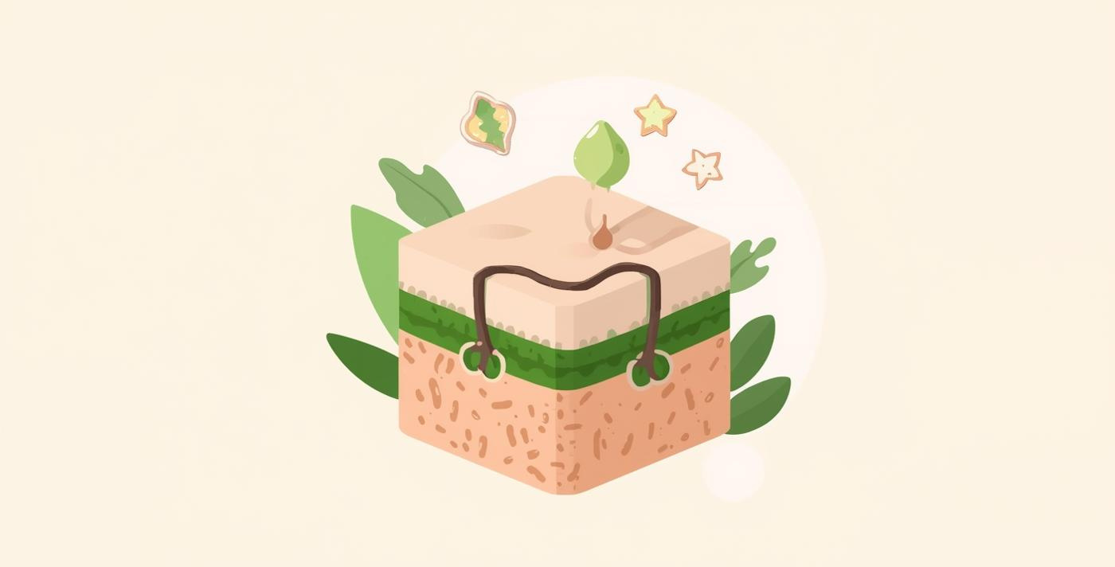
Objectives
Develop cross-domain VLM model
Integrate visual and textual data
Predict plant effects on skin
Reveal biological interaction mechanisms
Accelerate natural compound discovery

Slide 6
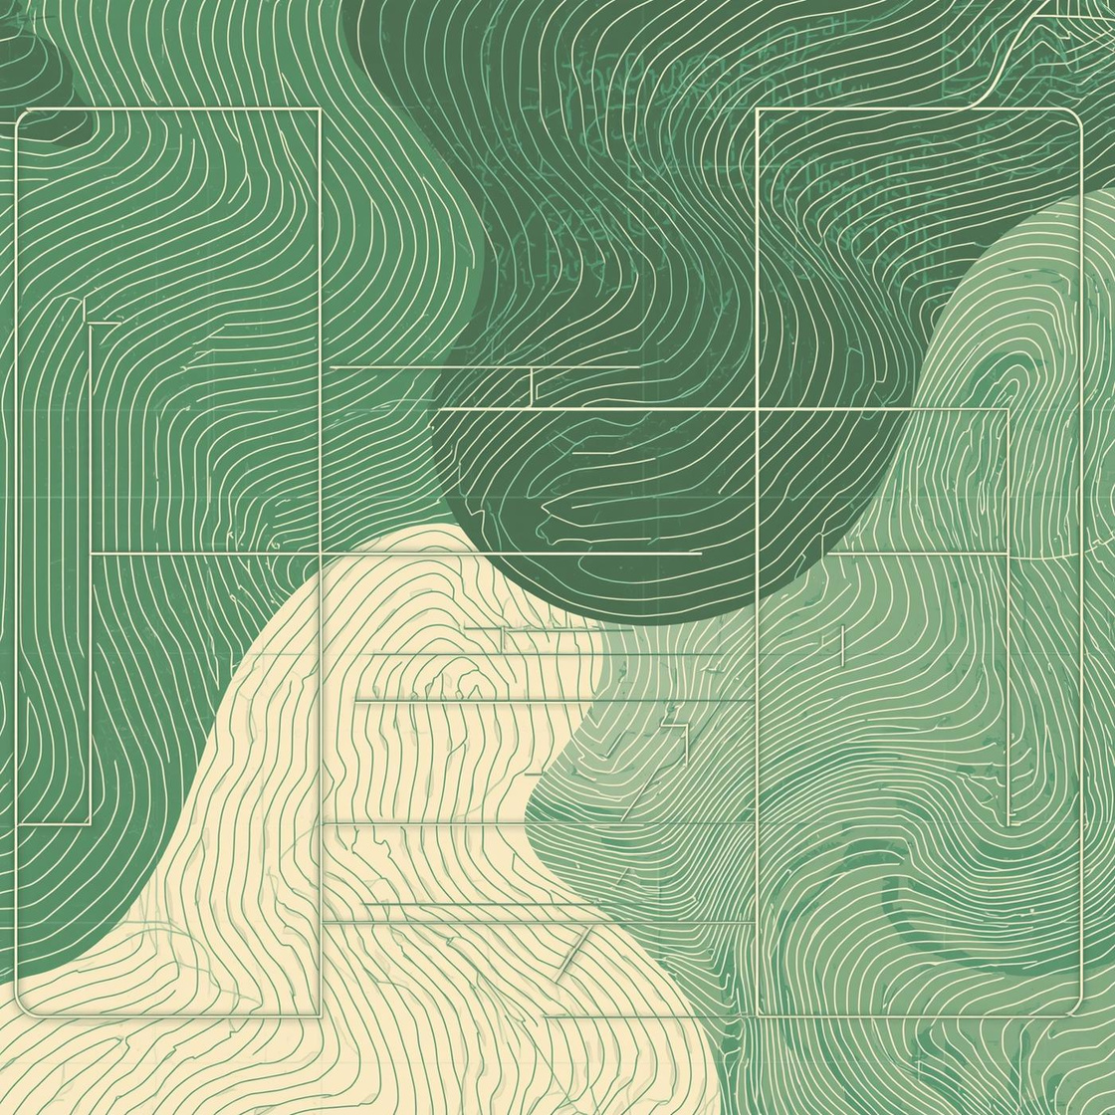
Dataset & Methodology
Collect SKINCON, DermNet, HERB
Resize, normalize, augment images
Clean, tokenize, standardize text
Extract image embeddings (CLIP, SigLIP)
Process text embeddings (BLIP-2)
Project into shared multimodal space
Reasoning module generates explanations
Fine-tune models using LoRA
Evaluate with accuracy, F1, BLEU/ROUGE

Slide 7
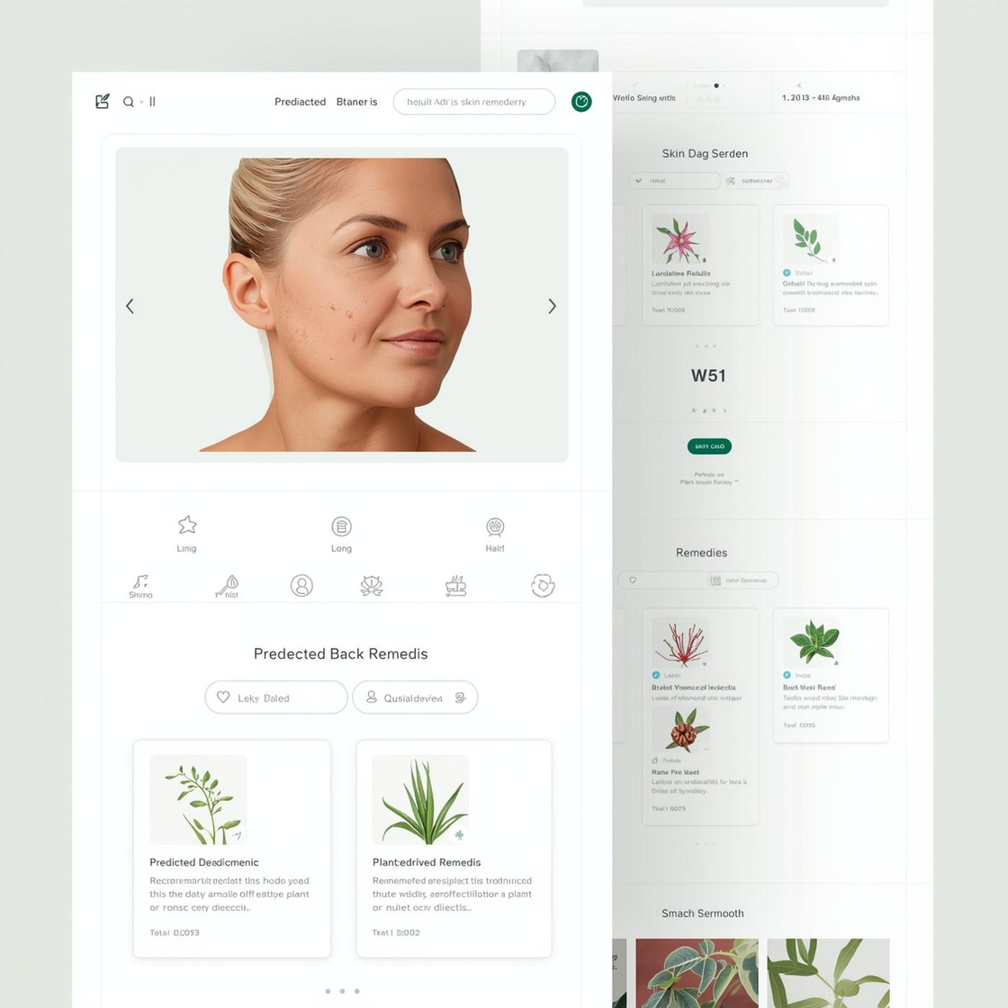
Expected Results
Identify plant-based skin compounds
Link compounds to skin diseases
Provide interpretable biological reasoning
Accelerate natural compound discovery
Enable safer skincare innovations

Slide 8
References:
Zhao, C., Wu, S., & Wang, H. (2025).”Medicinal plant extracts targeting UV-induced skin damage: Molecular mechanisms and therapeutic potential”. International Journal of Molecular Sciences, 26(2), 2278. https://www.mdpi.com/1422-0067/26/5/2278
Tomas, M., Günal-Köroğlu, D., Kamiloglu, S., Ozdal, T., & Capanoglu, E. (2025). “The state of the art in anti-aging: Plant-based phytochemicals for skin care”. Immunity & Ageing,22(5).https://link.springer.com/article/10.1186/s12979-025-00498-9
Dammak, M., Ben Hlima, H., Fendri, I., Smaoui, S., & Abdelkafi, S. (2025).”Phytochemicals in skin health: Enhancing beauty and protecting against aging”.In Phytochemicals as Therapeutic Agents. Elsevier.https://www.sciencedirect.com/science/article/abs/pii/B9780443264948000161
SKIN Concepts (SKINCON) Dataset. (n.d.). Stanford University.https://skincon-dataset.github.io/index.html#dataset
DermNet. (n.d.). DermNet image data for 23 categories of skin diseases [Dataset].https://www.kaggle.com/datasets/shubhamgoel27/dermnet?fbclid=IwY2xjawNbYSNleHRuA2FlbQIxMQABHnkGTzepl2UpLNc_2nPOLI1GZJCY6vLOxR-9bgiEIElGmAMg0-MTlG29djOv_aem_DyxLi6tLgaEhVjQ_sFVUzw
Fang, S., Dong, L., Liu, L., Kong, L., Zhang, X., & Wang, D. (2024). HERB 2.0: An updated database integrating clinical and experimental evidence for traditional Chinese medicine. Nucleic Acids Research, 53(D1), D1404–D1414.https://pubmed.ncbi.nlm.nih.gov/3955817/

Slide 9
THANK YOU

