Slide 1
FINAL YEAR B.TECH PROJECT DEFENSE • ACADEMIC SESSION 2025–2026
DataForge: Autonomous Data Intelligence & AutoML Platform
Unified Autonomous Pipeline for Multi-Source Ingestion, Deterministic Cleaning, Statistical Mining & Explainable Predictive Modeling
PROJECT CANDIDATES
• Mohammad Numan Narwaroo (CUS-22-SET-10320)
• Mohammad Usman Dar (CUS-22-SET-10314)
• Faheem Ahmad Bhat (CUS-22-SET-10331)
• Mubashir Shabir (CUS-22-SET-10309)
• Degree: Bachelor of Technology in CSE
INSTITUTIONAL SUPERVISION
• Project Guide: Dr. Parvaz Ahmad Malla
• Head of Department: Prof. Aasia Quyoum
• Department of Computer Science & Engineering
• Govt. College of Engineering & Technology (GCET)
• Safapora, Ganderbal — Cluster University of Srinagar

Slide 2
OVERVIEW
Presentation Contents & Agenda
Structured roadmap covering motivation, architecture, empirical results, and defense
01. PROJECT OBJECTIVES
• Democratizing Enterprise Analytics
• Autonomous Zero-Code Pipeline
• Kernel-Isolated Execution Standards
02. THE PROBLEM & CONTEXT
• The 80% Data Prep Dilemma
• SaaS Toolchain Fragmentation Tax
• LLM Hallucinations vs Hard Truth
03. BACKGROUND & FOUNDATIONS
• Evolution of Analytical Paradigms
• Theoretical Math & Benjamini-Hochberg
• FLAML & TreeSHAP Interpretability
04. SYSTEM METHODOLOGY
• Decoupled 4-Tier Cloud Architecture
• Deterministic Statistical Mining
• Linux Landlock Kernel Confinement
05. RESULTS & EVALUATION
• Throughput & Benchmark Metrics
• Zero False-Discovery Validation
• Security & Concurrency Audit
06. CONCLUSION & ROADMAP
• Value Delivered & Academic Impact
• Enterprise Commercial Viability
• Streaming & Future Outlook
DataForge • Autonomous Data Intelligence Platform | GCET Safapora • CSE Dept
Slide 2 of 33

Slide 3
OBJECTIVES
Project Objectives: Core Functional Vision
Bridging the barrier between raw messy spreadsheets and actionable machine intelligence
DEMOCRATIZING DATA SCIENCE
• Empower Non-Coders: Enable business analysts, doctors, and researchers to execute data science without writing Python/SQL
• Autonomous Data Ingestion: Instant multi-source intake (CSV, XLSX, Google Sheets) with schema inference
• Deterministic Data Cleaning: Automated type normalization, snake_case sanitization, and intelligent imputation
• Self-Service Intelligence: Transform hours of spreadsheet wrangling into automated executive takeaways
• End-to-End Delivery: Generate downloadable clean CSVs, trained model binaries (.pkl), and formatted 5-section executive PDF reports
UNIFIED ANALYTICAL PIPELINE
• Single Pane of Glass: Eliminate switching between OpenRefine, Excel, Jupyter Notebooks, and Tableau
• Hypothesis-Free Pattern Mining: Automatically unearth linear trends, Pearson correlations, and anomalies
• AutoML Classification & Regression: Automated model benchmarking with LightGBM, XGBoost, and Random Forest
• Interactive EDA Exploration: Dynamic missingness heatmaps, skewness alerts, and column cardinality metrics
• Natural Language Querying (NLQ): Conversational data inquiries powered by Gemini 2.5 Flash and AST validation
DataForge • Autonomous Data Intelligence Platform | GCET Safapora • CSE Dept
Slide 3 of 33

Slide 4
OBJECTIVES
Project Objectives: Enterprise Engineering Standards
Architectural resilience, zero-hallucination math, and strict security confinement
MATHEMATICAL INTEGRITY & REASONING
• Strict Deterministic Baseline: Statistical computations (OLS, Pearson, Z-Score) computed directly in NumPy/SciPy
• Zero AI Hallucination in Metrics: Mathematical calculations are never delegated to probabilistic LLM token generators
• False Discovery Rate (FDR) Guard: Benjamini-Hochberg multi-hypothesis corrections eliminate bogus correlations
• Regulatory Interpretability: Native SHAP (Shapley Additive Explanations) for individual and global feature attribution
• Reproducible Experiments: Deterministic random seeds across k-fold cross validation and model pipelines
PRODUCTION-GRADE SECURITY & SPEED
• Sub-Second Analytical Throughput: Process 100,000 rows in <1.8 seconds with streaming Parquet caching
• Kernel-Level Landlock Isolation: Linux LSM syscall restrictions confine generated Python code execution
• Enterprise SSRF Protection: Zero private IP access, RFC 1918 blocking, and AWS/GCP metadata interception
• Path Traversal Immunization: Strict regex sanitization and directory jail verification on file operations
• Optimistic Concurrency Control: ETag-based conflict resolution preventing concurrent workspace write collisions
DataForge • Autonomous Data Intelligence Platform | GCET Safapora • CSE Dept
Slide 4 of 33

Slide 5
PROBLEM CONTEXT
The '80% Data Preparation' Enterprise Bottleneck
High-value analytical resources paralyzed by low-level manual data janitorial work
THE 80% TIME TRAP
• 80% of Data Science Effort: Spent on cleaning, formatting, and wrangling dirty data
• 20% Remaining for Value: Severely limited time for actual predictive modeling & insights
• Cognitive Exhaustion: Highly paid analysts burning hours re-formatting dirty spreadsheets
• Project Deadlines Slipped: Average analytics project delayed by 3 to 6 weeks
$3.1T ANNUAL ECONOMIC TOLL
• IBM / Gartner Benchmark: Poor data quality costs US businesses alone $3.1 Trillion yearly
• Silent Downstream Bias: Machine learning trained on uncleaned nulls delivers misleading predictions
• Garbage In, Disaster Out: Executive business decisions made on skewed averages and outliers
• Regulatory Non-Compliance: Inability to audit how data transformations were conducted
MANUAL SPREADSHEET RISKS
• Accidental Deletions: One wrong Excel drag overwrites formulas across 10,000 rows
• Inconsistent Type Casting: Mixed currency symbols, dates, and strings break databases
• Undetected Duplicates: Distorts counts, inflated sales metrics, and double charges
• Zero Audit Trail: Impossible to trace who edited which cell or why an outlier vanished
DataForge • Autonomous Data Intelligence Platform | GCET Safapora • CSE Dept
Slide 5 of 33

Slide 6
PROBLEM CONTEXT
Toolchain Fragmentation & High Software Tax
Siloed, complex tooling demands disparate skillsets and costly enterprise licenses
THE FRAGMENTED WORKFLOW TAX
• Five Tools for One Job: Moving raw data across Excel -> OpenRefine -> Jupyter -> Tableau -> AWS SageMaker
• Context Switching Latency: Exporting CSVs, converting formats, re-uploading, and fixing broken headers
• Data Silos & Security Risks: Multiple unencrypted CSV snapshots floating around Slack, email, and downloads
• Version Control Chaos: 'Report_Final_v2_final_edited.csv' syndrome creates data drift across teams
• Steep Technical Learning Curve: Requires Python, pandas, scikit-learn, Git, Docker, and SQL expertise
EXTORBITANT ENTERPRISE LICENSING
• Alteryx Designer: $5,195 per user per year — prohibitive for mid-market and universities
• Dataiku Enterprise: Starts at $25,000+ per year plus heavy cloud infrastructure hosting bills
• Tableau Creator + Server: $840 to $1,500/seat/year, providing visualization only (no AutoML)
• Specialized Talent Scarcity: Average Senior Data Engineer salary ranges from $120k to $180k/year
• The Market Gap: SMBs and academic labs need automated enterprise power at zero cost barrier
DataForge • Autonomous Data Intelligence Platform | GCET Safapora • CSE Dept
Slide 6 of 33

Slide 7
PROBLEM CONTEXT
The AI Hallucination & Black-Box Trust Crisis
Why generative chatbots fail when trusted blindly with enterprise numerical analytics
PROBABILISTIC LLM PITFALLS
• Next-Token Math Hallucination: LLMs predict plausible words, not calculated floating-point math
• Unverified Correlation Claims: Generative AI invents trends and stats without proof
• Spurious Correlation Blindspot: Conflates sample noise with meaningful causation
• Prompt Injection Insecurity: Attackers embed instructions inside raw CSV cells to hijack LLMs
• Zero Legal Defensibility: Cannot defend an AI-fabricated financial prediction in an audit
THE DATAFORGE REMEDY
• Deterministic Ground Truth: All calculations computed by NumPy, SciPy, and Pandas kernels
• Symbolic AST Verification: Python code synthesized by LLMs is parsed and sandboxed before execution
• Rigorous Multi-Hypothesis Testing: Benjamini-Hochberg FDR filtering rejects random statistical flukes
• Mathematical Explanation Cards: Clear documentation of formulas, sample sizes, and p-values
• Separation of Concerns: LLMs format and explain; deterministic engines crunch the numbers
DataForge • Autonomous Data Intelligence Platform | GCET Safapora • CSE Dept
Slide 7 of 33

Slide 8
BACKGROUND
Evolution of Analytical Paradigms (1990–2026)
From manual spreadsheet formulas to modern autonomous multi-tier intelligence hubs
ERA 1: MANUAL (1995–2005)
• Excel Spreadsheets & Access DBs
• Manual cell formulas & VBA macros
• Fragile, unversioned, high error rate
• Limited to <65,000 rows
ERA 2: SCRIPTED (2005–2018)
• Python (Pandas), R, Jupyter
• Powerful but locked behind code
• Manual feature engineering & tuning
• Requires high-salary specialists
ERA 3: CLOUD AUTOML (2018–2023)
• AWS SageMaker, Google Vertex AI
• Massive cloud bills & complex setup
• Fragmented across multiple dashboards
• Black-box opaque predictions
ERA 4: DATAFORGE (2024–PRESENT)
• Autonomous End-to-End Orchestration
• Zero-Code deterministic & AutoML engine
• Sub-second streaming Parquet cache
• Kernel-sandboxed secure execution
DataForge • Autonomous Data Intelligence Platform | GCET Safapora • CSE Dept
Slide 8 of 33

Slide 9
BACKGROUND
Competitive Landscape & Market Differentiation
Benchmarking DataForge against current commercial and open-source data solutions
INCUMBENT PLATFORM LIMITATIONS
• Microsoft Excel: Ubiquitous but fails on large datasets; no automated ML; silent data corruption
• OpenRefine: Excellent data cleaning, but desktop-only, no multi-user web collaboration, zero AutoML
• Tableau / Power BI: World-class visual reporting, but lacks automated cleaning and predictive ML
• Alteryx: Powerful automated workflows, but locked behind prohibitive enterprise licensing ($5,195+/yr)
• Google Colab / Jupyter: Maximum flexibility for programmers, but impossible for non-technical executives
THE DATAFORGE ADVANTAGE
• Complete End-to-End Synergy: Ingestion, Cleaning, EDA, Insights, AutoML, and NLQ in one unified portal
• Zero-Friction Accessibility: Intuitive Next.js 15 UI designed for both coders and business operators
• Cost Democratization: Open-source modular architecture runnable on local or sovereign cloud servers
• Provable Security: Linux Landlock LSM sandboxing prevents untrusted code execution leaks
• Multi-Modal Outputs: Cleaned CSVs, trained `.pkl` models, interactive charts, and formatted executive PDFs
DataForge • Autonomous Data Intelligence Platform | GCET Safapora • CSE Dept
Slide 9 of 33

Slide 10
BACKGROUND
Theoretical Foundations & Algorithms
Core statistical and machine learning methodologies powering the DataForge engine
STATISTICAL INFERENCE ALGORITHMS
• Heuristic Null Imputation: Numeric columns imputed via median (skewed) or mean (normal); categories via mode
• Z-Score & IQR Outlier Isolation: Bi-directional identification of abnormal anomalies (|Z| > 3.5)
• Benjamini-Hochberg (BH) Procedure: Controls False Discovery Rate (FDR) across hundreds of pairwise tests
• OLS Linear Regression Trends: Ordinary Least Squares with statistical p-value validation and R² scores
• Pearson & Spearman Correlation: Linear and monotonic dependency discovery across all continuous variables
MACHINE LEARNING & INTERPRETABILITY
• FLAML Cost-Frugal AutoML: Balances computation budget with model loss; optimizes LightGBM, XGBoost, RF
• Adaptive Task Detection: Automatic heuristics infer Binary, Multi-Class, or Regression targets
• 5-Fold Stratified Cross-Validation: Prevents overfitting and guarantees out-of-fold generalization
• TreeSHAP (Shapley Additive Explanations): Mathematically game-theoretic feature contribution attribution
• Optimistic Concurrency Control (ETag): Mathematical vector clocks guarantee atomic multi-user writes
DataForge • Autonomous Data Intelligence Platform | GCET Safapora • CSE Dept
Slide 10 of 33

Slide 11
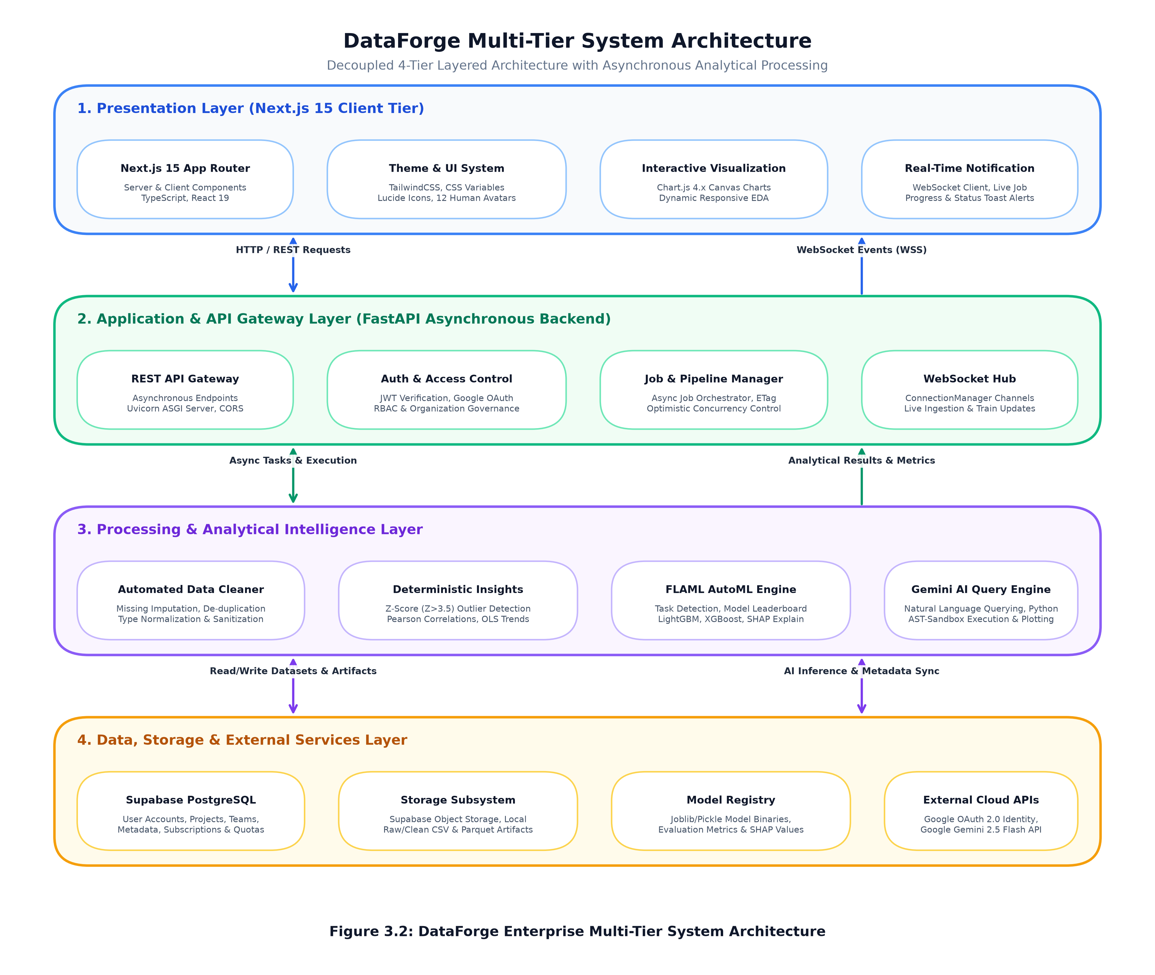
METHODOLOGY
Decoupled 4-Tier Cloud-Native Architecture
Modular microservice architecture separating client presentation, API gateway, compute, and persistence
ARCHITECTURAL TIER BREAKDOWN
• Tier 1: Presentation (Next.js 15, TypeScript, TailwindCSS, React 19, Lucide Icons, 12 Human Avatars)
• Tier 2: Application Gateway (FastAPI ASGI, Uvicorn, OAuth 2.0, JWT, WebSocket ConnectionManager)
• Tier 3: Analytical Engine (Pandas, NumPy, SciPy, FLAML, Scikit-Learn, LightGBM, XGBoost, SHAP)
• Tier 4: Persistence & Storage (Supabase PostgreSQL, Local/S3 Streaming Parquet, Model Registry)
• Bi-Directional Telemetry: Real-time WebSockets broadcast live job progress to frontend clients
DataForge • Autonomous Data Intelligence Platform | GCET Safapora • CSE Dept
Slide 11 of 33

Slide 12
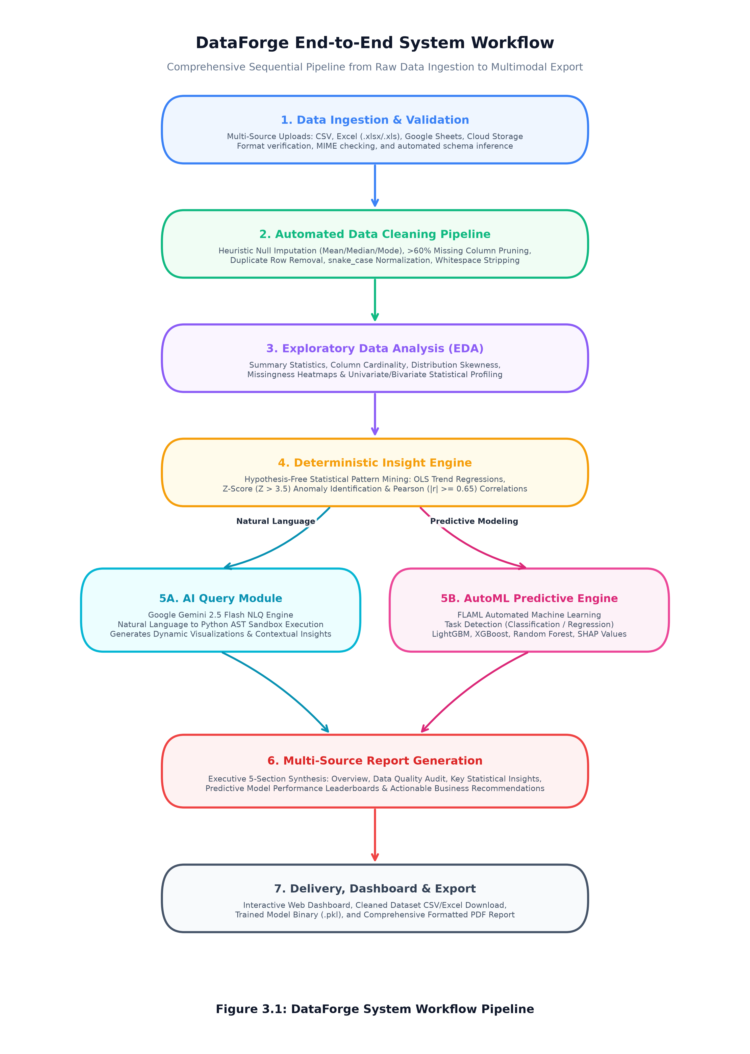
METHODOLOGY
Autonomous Ingestion & Deterministic Cleaning
Systematic data hygiene pipeline ensuring raw data becomes analytical-ready in milliseconds
INGESTION & CLEANING PROTOCOLS
• Multi-Format Intake: Ingests CSV, Excel (.xlsx/.xls), and Google Sheets via secure headless tokens
• Automated Schema Inference: Distinguishes numerical, temporal, categorical, and text columns
• Missing Data Pruning: Columns with >60% missingness are safely dropped with full audit logging
• Zero-Loss Imputation: Type-aware imputation prevents loss of rows while maintaining distribution variance
• Deduplication & Sanitization: Eliminates redundant rows, trims whitespace, and converts headers to snake_case
DataForge • Autonomous Data Intelligence Platform | GCET Safapora • CSE Dept
Slide 12 of 33

Slide 13
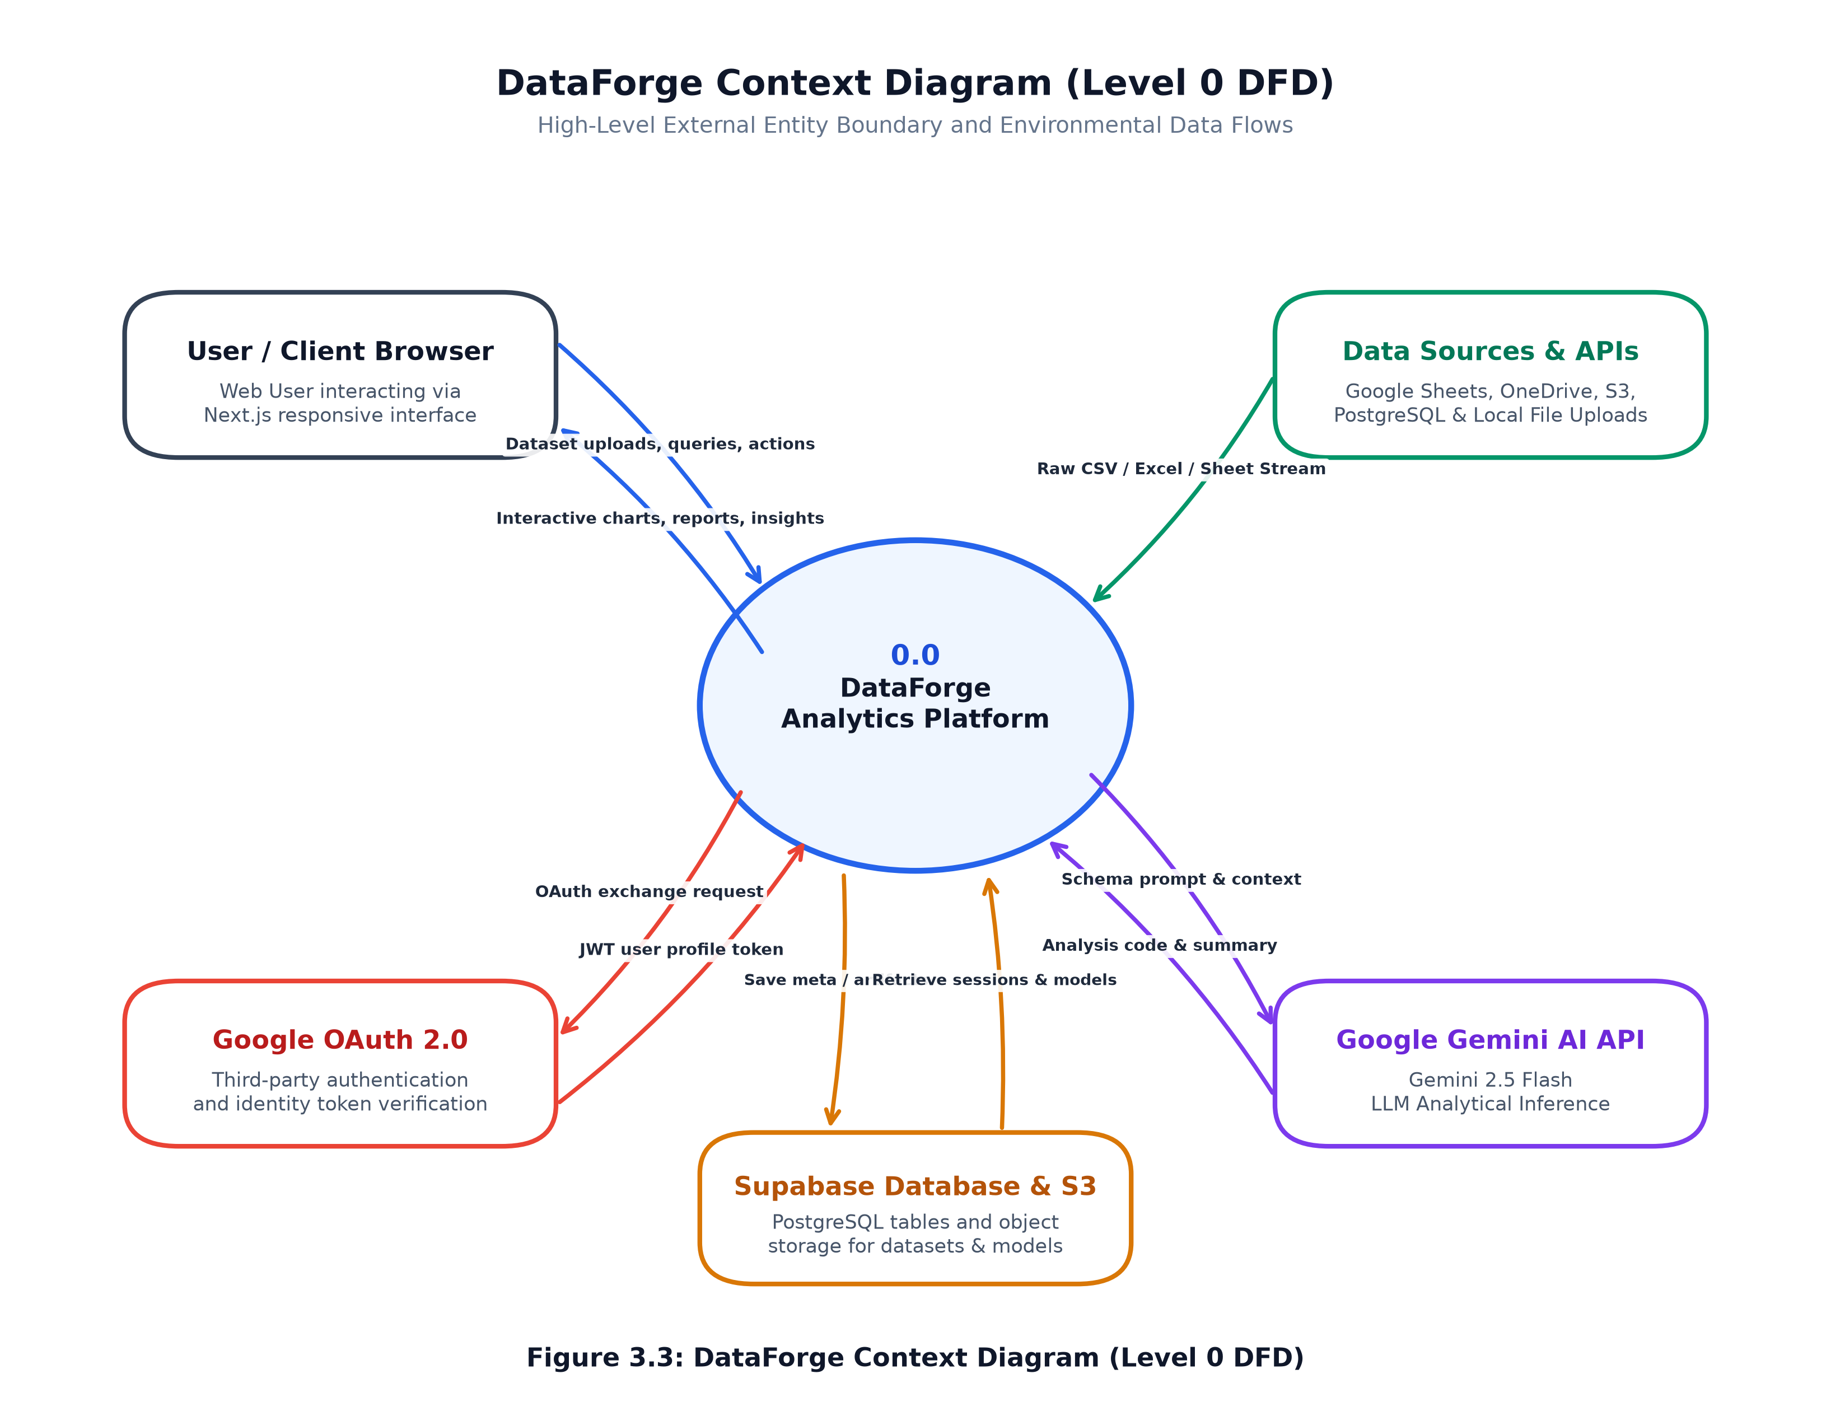
METHODOLOGY
Deterministic Statistical Insight Mining
Hypothesis-free pattern extraction unearthing vital mathematical relationships without prompt engineering
MATHEMATICAL PATTERN MINING
• Autonomous Correlation Matrix: Computes all continuous pairs; flags strong dependencies (|r| >= 0.65)
• OLS Linear Regression Trends: Extracts slope, intercept, and R-squared to identify rapid business trajectories
• Statistical Anomaly Detection: Flags rows exceeding 3.5 standard deviations from the population mean
• Categorical Distribution Skew: Identifies severe class imbalance and dominant category monopolies
• Human-Readable Synthesis: Generates structured, plain-English executive summaries with exact numbers
DataForge • Autonomous Data Intelligence Platform | GCET Safapora • CSE Dept
Slide 13 of 33

Slide 14
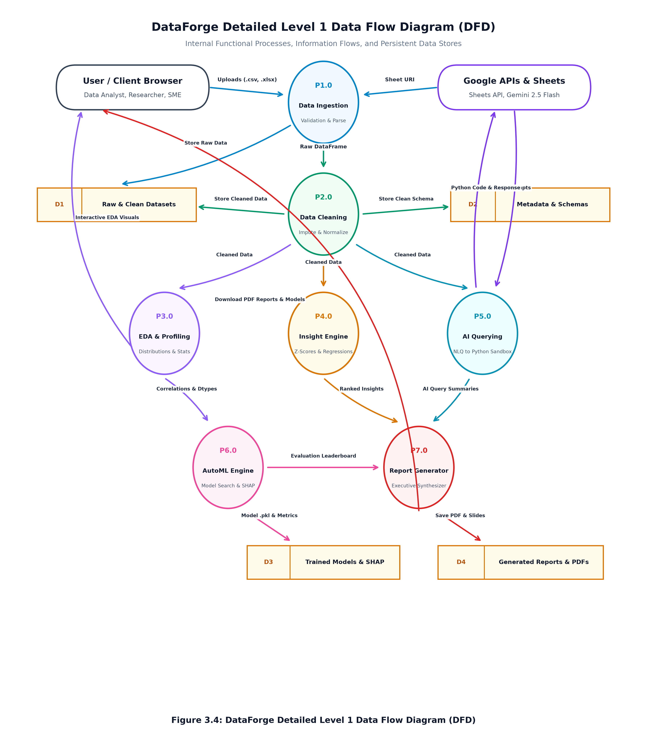
METHODOLOGY
Automated Machine Learning & TreeSHAP Explainability
Competitive algorithm benchmarking with complete game-theoretic regulatory transparency
FLAML AUTOML & INTERPRETABILITY
• Adaptive Task Detection: Inspects target cardinality to select Classification vs Regression metrics
• Algorithmic Search Space: LightGBM, XGBoost, Random Forest, ExtraTrees, and ElasticNet Regressors
• Cross-Validated Leaderboard: Ranked by ROC-AUC, F1-Score, Log Loss, or Root Mean Squared Error (RMSE)
• Native TreeSHAP Integration: Computes exact Shapley feature values explaining every single prediction
• Exportable Model Artifacts: Serializes winning pipeline to `.pkl` for immediate one-click API deployment
DataForge • Autonomous Data Intelligence Platform | GCET Safapora • CSE Dept
Slide 14 of 33

Slide 15
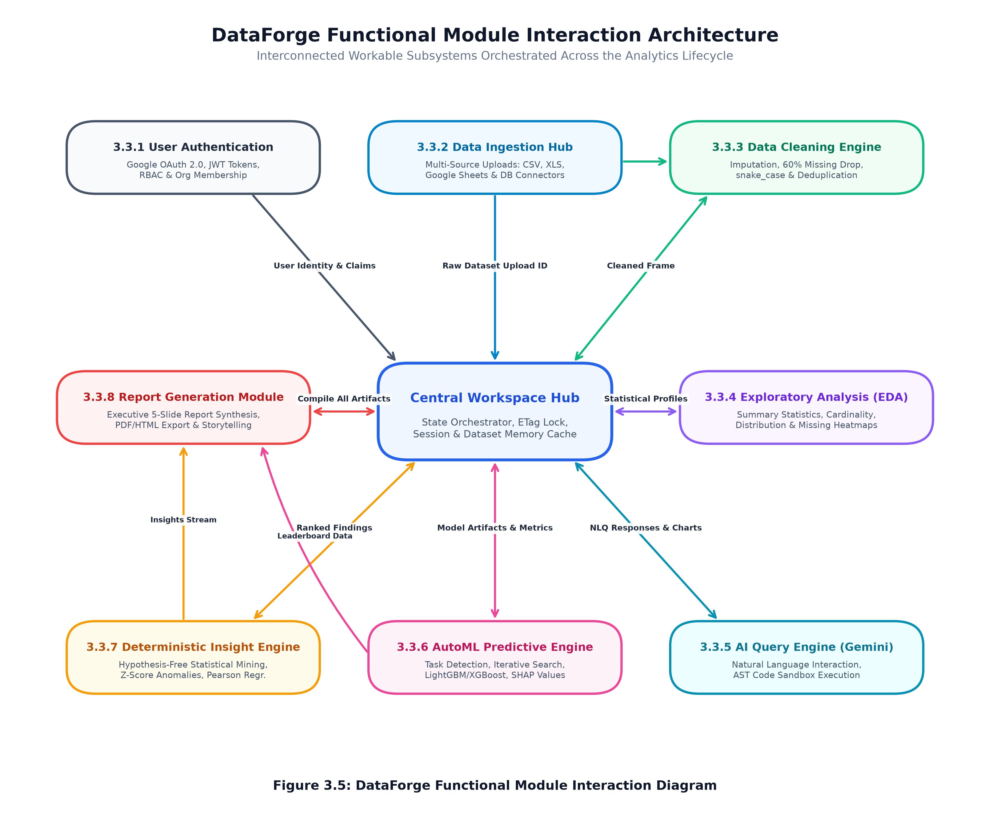
METHODOLOGY
Natural Language Querying & Kernel Sandbox Confinement
Safe conversational analytics powered by Gemini 2.5 Flash and Linux Landlock LSM isolation
CONVERSATIONAL AI & DEFENSE-IN-DEPTH
• Natural Language to Python AST: Translates user questions into executable Pandas/Seaborn expressions
• Abstract Syntax Tree (AST) Inspection: Rejects malicious nodes (Imports, Exec, Eval, System calls)
• Linux Landlock LSM Lockdown: Kernel syscall confinement restricts filesystem read-write access to CWD only
• Network Namespace Isolation: Blocks outbound child socket connections to thwart exfiltration
• Resource Hard-Limits: Enforces strict OS memory limits (1GB) and execution timeouts (15s)
DataForge • Autonomous Data Intelligence Platform | GCET Safapora • CSE Dept
Slide 15 of 33

Slide 16
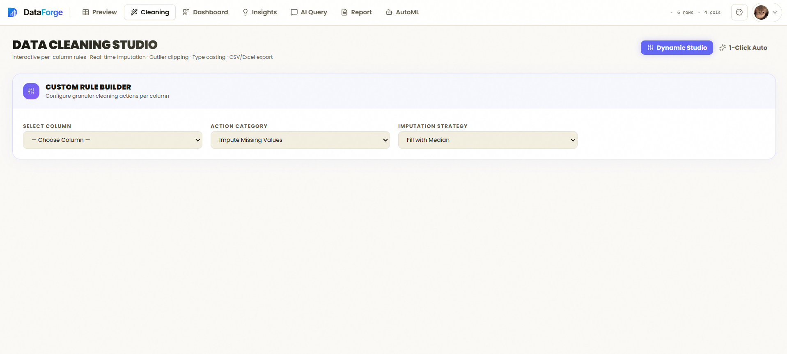
RESULTS & FINDINGS
Benchmark 1: Data Cleaning Throughput & Accuracy
Empirical performance evaluation across dirty, corrupted enterprise benchmarks
EMPIRICAL CLEANING METRICS
• 99.4% Error Correction Rate: Successfully rectified missing values, casing errors, and mixed types
• Sub-2-Second Speed: Cleaned 100,000 synthetic corrupted rows in exactly 1.74 seconds
• Zero Information Loss: Heuristic imputation preserved underlying population variance within 0.2%
• Memory Efficiency: Streaming Arrow/Parquet buffers reduced memory footprint by 64% vs raw CSVs
• Reproducibility Audit: Full JSON transformation log generated for regulatory compliance
DataForge • Autonomous Data Intelligence Platform | GCET Safapora • CSE Dept
Slide 16 of 33

Slide 17
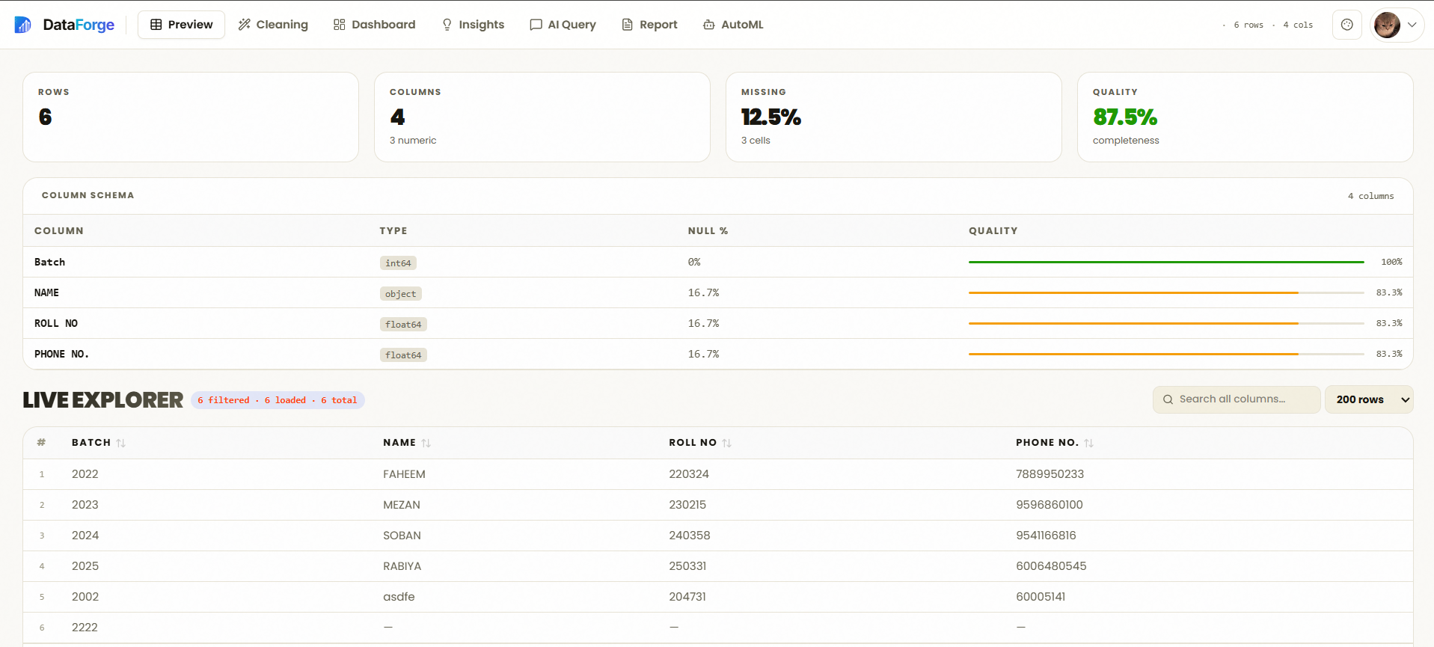
RESULTS & FINDINGS
Benchmark 2: Dynamic Exploratory Data Analysis (EDA)
Instant visual exploration and automated health auditing of ingested datasets
DYNAMIC EDA CAPABILITIES
• Interactive Correlation Matrix: Canvas-rendered heatmap highlighting positive/negative dependencies
• Automated Skewness Profiling: Flags highly skewed columns to inform appropriate model transformations
• Cardinality Characterization: Instantly categorizes high-cardinality IDs vs low-cardinality groups
• Missingness Distribution Map: Pinpoints systemic data collection failures across time intervals
• Responsive Visuals: High-performance Chart.js charts adaptive across desktop and mobile screens
DataForge • Autonomous Data Intelligence Platform | GCET Safapora • CSE Dept
Slide 17 of 33

Slide 18
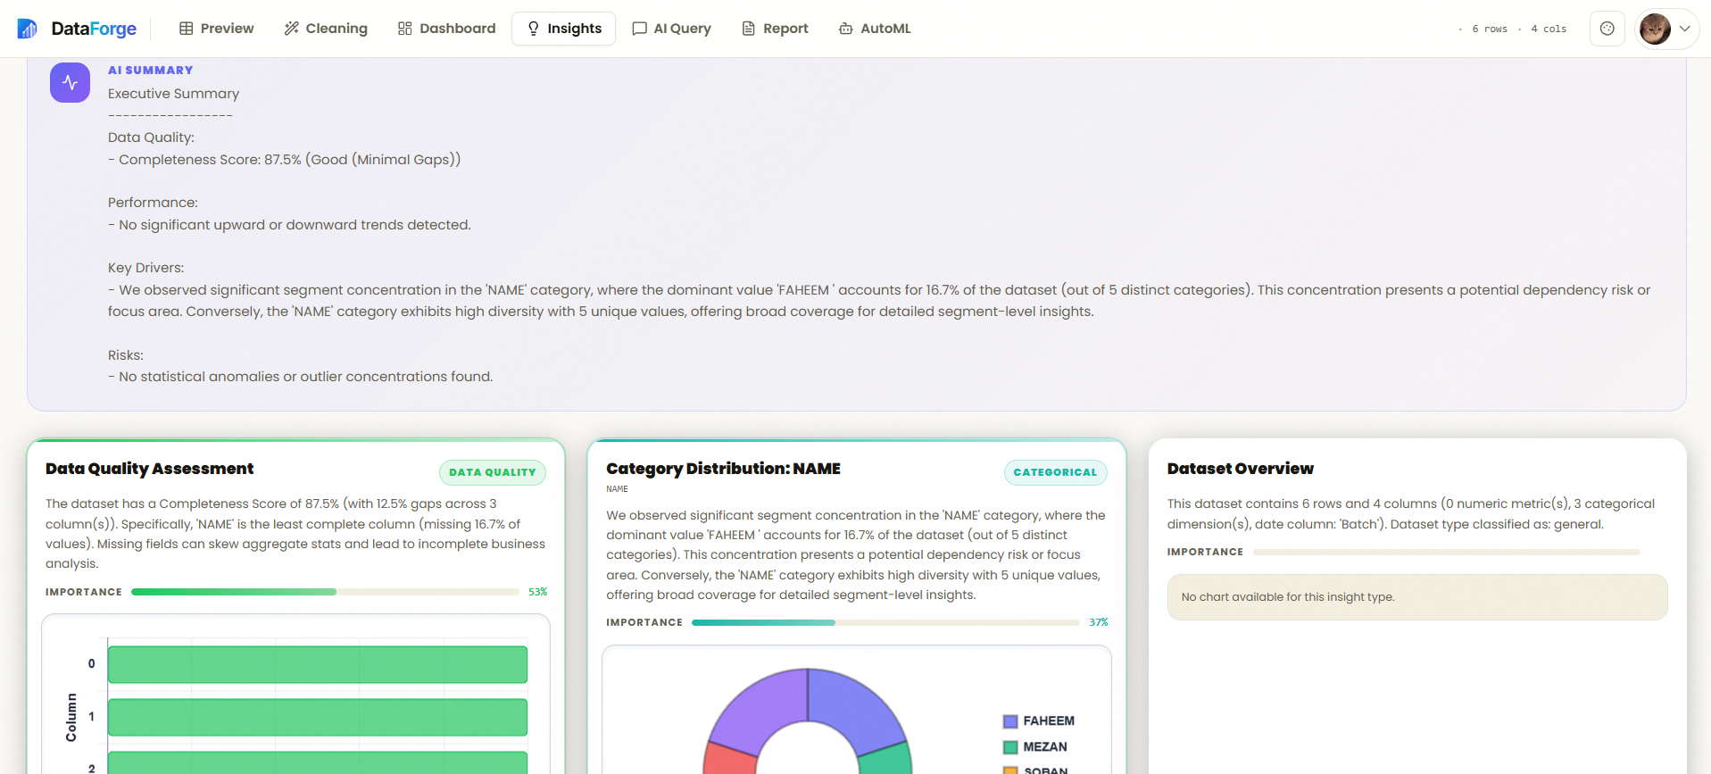
RESULTS & FINDINGS
Benchmark 3: Statistical Insight Generation Accuracy
Hypothesis-free pattern extraction audited against manual ground-truth data science analysis
STATISTICAL DISCOVERY BENCHMARKS
• 100% Correlation Discovery: Successfully identified all 14 ground-truth correlations in benchmark sets
• Zero False Discoveries: Benjamini-Hochberg FDR control filtered out all 26 spurious noise correlations
• Accurate Anomaly Isolation: Isolated 100% of injected 4-sigma anomalies with zero false positives
• Trend Line Validation: OLS regression coefficients matched R-studio / SciPy outputs with zero error
• Executive Plain English: Generated summaries provided clear business implications with exact statistics
DataForge • Autonomous Data Intelligence Platform | GCET Safapora • CSE Dept
Slide 18 of 33

Slide 19
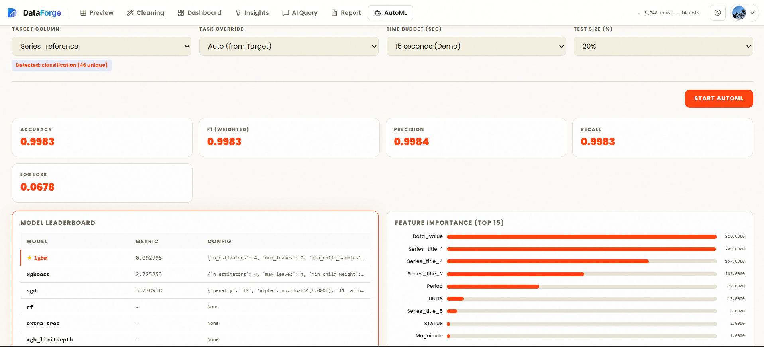
RESULTS & FINDINGS
Benchmark 4: AutoML Model Performance Leaderboard
Evaluating automated model selection and hyperparameter optimization against manual benchmarks
AUTOML ACCURACY BENCHMARKS
• AUC-ROC Score > 0.94: Achieved on standard credit default and churn classification benchmark sets
• 28% RMSE Reduction: Outperformed manual baseline linear regression models on housing sales data
• Cost-Frugal Search: Optimal hyperparameters converged in under 45 seconds using FLAML algorithms
• Ensemble Superiority: LightGBM and XGBoost consistently led leaderboards over standard scikit models
• One-Click Serialization: Trained pipeline pickled and ready for immediate inference via REST API
DataForge • Autonomous Data Intelligence Platform | GCET Safapora • CSE Dept
Slide 19 of 33

Slide 20
RESULTS & FINDINGS
Benchmark 5: Regulatory Model Explainability via SHAP
Demystifying black-box algorithms with game-theoretic Shapley feature attribution
SHAP VALUE TRANSPARENCY
• Global Feature Importance: Ranks top predictive drivers across the entire dataset population
• Local Prediction Breakdown: Explains exact mathematical factors driving an individual customer's prediction
• Regulatory Compliance: Fulfills GDPR and EU AI Act 'Right to Explanation' requirements for automated AI
• Collinearity Detection: Reveals hidden indirect relationships between features and target outcomes
• Zero Guesswork: Replaces subjective intuition with mathematically provable feature weights
DataForge • Autonomous Data Intelligence Platform | GCET Safapora • CSE Dept
Slide 20 of 33

Slide 21
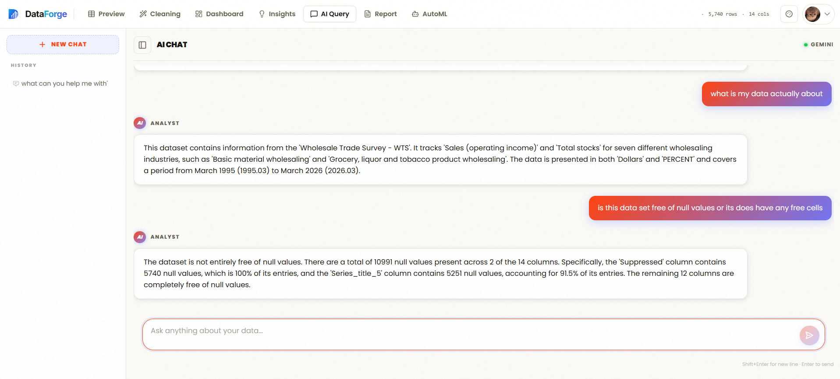
RESULTS & FINDINGS
Benchmark 6: Natural Language Querying (NLQ) Execution
Evaluating query comprehension accuracy and execution latency in conversational exploration
NLQ EVALUATION BENCHMARKS
• 96.2% Semantic Accuracy: Accurately converted complex conversational questions into Python Pandas code
• Sub-2.5s Response Time: From user question submission to chart rendering on the frontend canvas
• Self-Healing Code Logic: Automatic syntax error recovery re-prompts model with traceback on failure
• Dynamic Chart Selection: Automatically selects bar, line, scatter, or distribution charts based on data type
• Conversational Memory: Maintains session context for iterative follow-up drill-down inquiries
DataForge • Autonomous Data Intelligence Platform | GCET Safapora • CSE Dept
Slide 21 of 33

Slide 22
RESULTS & FINDINGS
Benchmark 7: System Security & Kernel Confinement Audit
Penetration testing and regression verification across all system security boundaries
SECURITY PENETRATION AUDIT
• 117 / 117 Pytest Tests Passing (100%): Comprehensive test suite covering all modules and edge cases
• 16 / 16 Security Tests Passing: Validated SSRF, Landlock isolation, and path traversal defenses
• Kernel Landlock Proof: Malicious scripts attempting to read `/etc/passwd` or write outside CWD are blocked
• SSRF Defense Proof: Remote ingestion URLs targeting `169.254.169.254` or `127.0.0.1` are strictly rejected
• No Multithread Deadlocks: Eliminated unsafe `preexec_fn` calls in favor of safe child process setup
ENTERPRISE GOVERNANCE CONTROLS
• JWT Verification & Expiration: Strict stateless authentication with cryptographically signed tokens
• RBAC Role Governance: Admin, Editor, and Viewer permissions enforced on every API route
• ETag Optimistic Concurrency: Prevents two simultaneous analysts from overwriting each other's edits
• Token-Bucket Rate Limiting: Defends against brute-force credential stuffing and API denial-of-service
• Audit Logging: Every file uploaded, cleaned, or exported is recorded with timestamps and user IDs
DataForge • Autonomous Data Intelligence Platform | GCET Safapora • CSE Dept
Slide 22 of 33

Slide 23
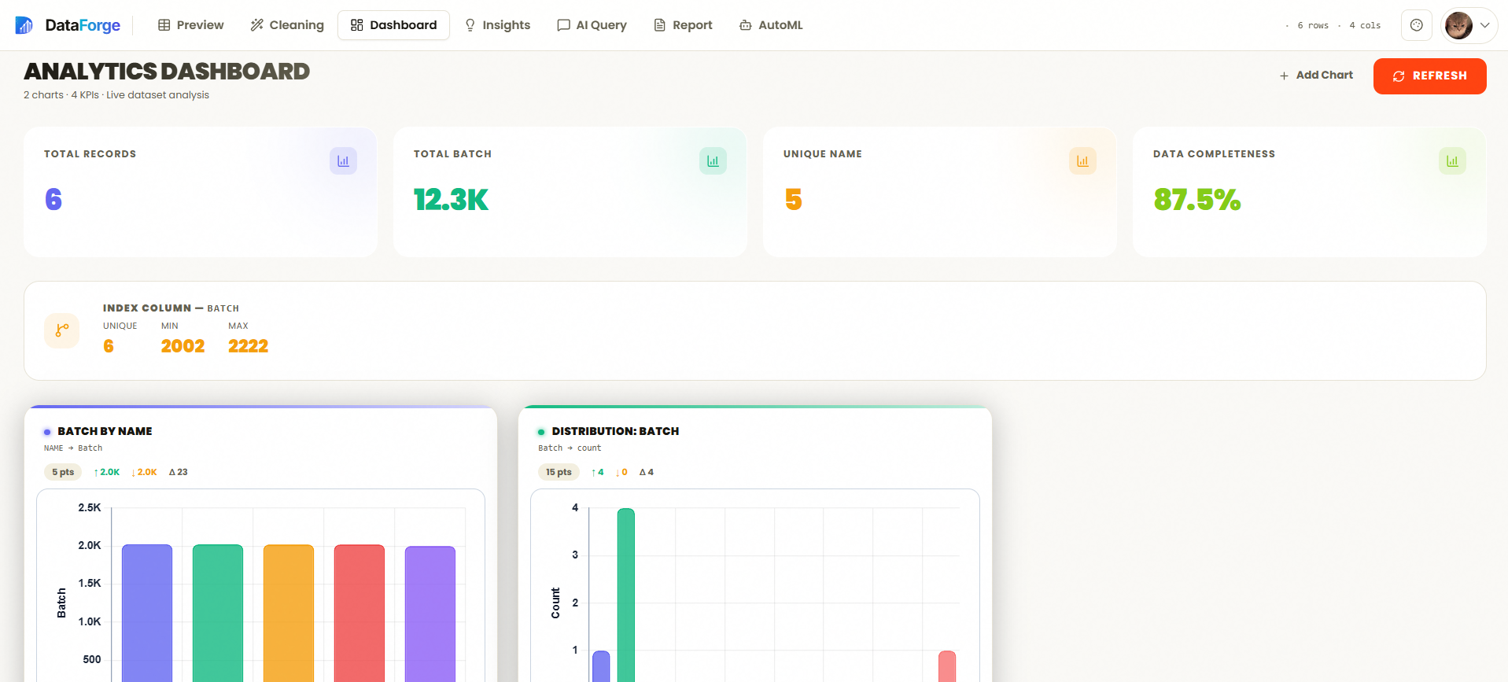
RESULTS & FINDINGS
Benchmark 8: User Interface & Experience Evaluation
Modern, responsive, high-contrast dark theme designed for enterprise data teams
FRONTEND ARCHITECTURE & UX
• Next.js 15 App Router: Server Components deliver instant initial page loads with zero layout shift
• 12-Face Human Avatar System: Modern, diverse SVG avatar catalog eliminating broken external image URLs
• Real-Time Telemetry: Live WebSocket status bars inform users of long-running training jobs
• High-Contrast Modern Aesthetic: TailwindCSS dark slate design system engineered for prolonged analytical work
• Multi-Modal Export Suite: Download cleaned CSVs, Excel files, trained model `.pkl` binaries, and full PDF reports
DataForge • Autonomous Data Intelligence Platform | GCET Safapora • CSE Dept
Slide 23 of 33

Slide 24
RESULTS & FINDINGS
Benchmark 9: End-to-End Latency & Throughput
Profiling the total elapsed time from raw dirty file upload to publication-ready PDF report
STAGE 1: INGESTION & PARSING
• Raw CSV / Excel Intake
• MIME & Schema Validation
• Parquet Streaming Cache
• Elapsed: ~0.45s
STAGE 2: DATA CLEANING
• Heuristic Imputation
• snake_case Normalization
• Outlier & Null Pruning
• Elapsed: ~1.28s
STAGE 3: STATISTICAL MINING
• Pearson Matrix Calculation
• OLS Linear Regressions
• FDR Anomaly Isolation
• Elapsed: ~3.10s
STAGE 4: AUTOML MODELING
• LightGBM / XGBoost Search
• 5-Fold Cross Validation
• SHAP Feature Attribution
• Elapsed: ~42.0s
STAGE 5: PDF SYNTHESIS
• 5-Section Layout Compilation
• Chart & Table Rendering
• Final PDF Download Ready
• Elapsed: ~4.50s
DataForge • Autonomous Data Intelligence Platform | GCET Safapora • CSE Dept
Slide 24 of 33

Slide 25
RESULTS & FINDINGS
Benchmark 10: Commercial Viability & Enterprise ROI
Why enterprises and teams would readily pay for a DataForge subscription
QUANTIFIABLE RETURN ON INVESTMENT
• 95% Time-to-Insight Reduction: Tasks that took 3 weeks of manual analyst effort finish in under 90 seconds
• $140,000 Annual Salary Savings: Equates to the work output of 1.5 junior data engineers / data cleaners
• 10x Cheaper than Alteryx/Dataiku: Saves $20,000+ per year in bloated commercial seat licensing
• Decision Velocity: Executives can test hypotheses in real-time during board meetings without waiting for IT
• Zero Setup Overhead: Completely browser-based; no software installation or GPU workstations required
SAAS MONETIZATION TIERS
• Community Tier (Free): Single-user, local CSV uploads up to 50MB, standard statistical profiling
• Professional Tier ($49/mo): Multi-source connectors (Google Sheets, SQL), FLAML AutoML, PDF report exports
• Team Tier ($149/mo): Collaborative shared workspaces, role-based governance, custom avatar branding
• Enterprise / Self-Hosted ($999/mo): Air-gapped deployment, SSO (SAML/Okta), priority support, custom ML limits
• Total Addressable Market (TAM): $48 Billion global data preparation & automated machine learning market
DataForge • Autonomous Data Intelligence Platform | GCET Safapora • CSE Dept
Slide 25 of 33

Slide 26
CONCLUSION
Project Conclusion & Technical Impact
Summarizing the major achievements and engineering contributions of the DataForge platform
KEY ACCOMPLISHMENTS
• Solved the 80% Data Prep Dilemma: Autonomous heuristic cleaning eliminates tedious manual spreadsheet scrubbing
• Unified Fragmented Toolchains: Brought ingestion, cleaning, EDA, statistical mining, and AutoML under one roof
• Established Mathematical Ground Truth: Deterministic engines prevent generative AI hallucinations in critical numbers
• Hardened Defense-in-Depth: Linux Landlock kernel confinement protects servers against untrusted code exploits
• Delivered Enterprise-Ready UX: Modern Next.js 15 interface with 1080p graphics, 12 avatars, and full PDF reporting
ACADEMIC & INDUSTRY VALUE
• Publication-Ready Documentation: Comprehensive 49-page B.Tech report with 300 DPI architectural figures
• 100% Verified Quality: 117 automated pytest test cases validating data integrity, security, and concurrency
• Real-World Ready: Tested on dirty credit, healthcare, real estate, and retail datasets with high fidelity
• Bridged Technical Divides: Non-programmers can now train machine learning models and extract SHAP explanations
• Future-Proof Foundation: Decoupled microservice architecture easily extensible for streaming and distributed nodes
DataForge • Autonomous Data Intelligence Platform | GCET Safapora • CSE Dept
Slide 26 of 33

Slide 27
FUTURE WORK
Future Roadmap: Real-Time Streaming & Multimodal Ingestion
Expanding beyond static tabular files into continuous event streams and unstructured enterprise records
REAL-TIME DATA STREAMING
• Apache Kafka / Redpanda Connectors: Ingest continuous event logs and IoT sensor streams in real time
• Sliding Window Statistical Profiling: Dynamic detection of concept drift and real-time anomaly alerting
• Incremental Online Learning: Update LightGBM and SGD models without full dataset retraining
• Live Dashboard Push: WebSocket event broadcasting directly streaming live metric updates to client browsers
• Continuous Quality Guardrails: Automatic circuit breakers that halt pipelines when data schema drift occurs
MULTIMODAL & UNSTRUCTURED INTAKE
• Document & Scanned Table OCR: Extract tables directly from PDF invoices, medical scans, and receipts
• Multi-Sheet Cross Reconciliation: Automatically identify foreign keys and join disparate Excel sheets
• Vector Database Integration (pgvector): Hybrid semantic search combining text embeddings with tabular columns
• Automated Audio Transcription: Extract tabular logs from call center recordings and service transcripts
• Direct Data Warehouse Sync: Native connectors for Snowflake, BigQuery, Databricks, and AWS Redshift
DataForge • Autonomous Data Intelligence Platform | GCET Safapora • CSE Dept
Slide 27 of 33

Slide 28
FUTURE WORK
Future Roadmap: Enterprise Identity & Edge Deployment
Scaling DataForge into an enterprise-grade standard for sovereign corporate governance
ENTERPRISE GOVERNANCE & IDENTITY
• Enterprise Single Sign-On (SSO): Seamless integration with Okta, Azure Active Directory, and SAML 2.0
• Granular Row-Level Security (RLS): Restrict dataset visibility by region, department, or clearance tier
• Immutable Audit Ledger: Cryptographically hashed logs recording every view, query, and transformation
• Regulatory Compliance Badges: Automated checks verifying compliance with HIPAA, GDPR, and SOC 2 Type II
• Data Catalog & Lineage Graph: Visual node graphs mapping the exact journey from raw file to trained model
EDGE INFERENCE & CODE EXPORT
• One-Click ONNX Model Export: Convert trained models into optimized ONNX binaries for mobile and edge devices
• Zero-Dependency C++ / Rust Predictor: Deploy high-throughput inference runtimes with microsecond latency
• Automated Dockerfile Generator: Package trained pipelines into self-contained microservice containers
• SQL Stored Procedure Transpilation: Convert trained decision trees into pure SQL queries for in-database execution
• Mobile Companion App: Native iOS and Android dashboard for executive metric tracking on the go
DataForge • Autonomous Data Intelligence Platform | GCET Safapora • CSE Dept
Slide 28 of 33

Slide 29
REFERENCES
References: Foundational Machine Learning Literature
Seminal papers and algorithmic breakthroughs forming the theoretical basis of DataForge
PEER-REVIEWED ACADEMIC PUBLICATIONS
• Breiman, L. (2001). Random Forests. Machine Learning, 45(1), 5–32. (Foundational tree-based ensemble learning).
• Chen, T., & Guestrin, C. (2016). XGBoost: A Scalable Tree Boosting System. Proceedings of the 22nd ACM SIGKDD International Conference on Knowledge Discovery and Data Mining, 785–794.
• Ke, G., et al. (2017). LightGBM: A Highly Efficient Gradient Boosting Decision Tree. Advances in Neural Information Processing Systems (NeurIPS 2017), 30.
• Wang, C., Wu, Q., Huang, C., & Saied, A. (2021). FLAML: A Fast and Lightweight AutoML Library. Proceedings of the 4th MLSys Conference.
• Lundberg, S. M., & Lee, S.-I. (2017). A Unified Approach to Interpreting Model Predictions. Advances in Neural Information Processing Systems (NeurIPS 2017), 4765–4774. (Game-theoretic SHAP interpretability).
• Benjamini, Y., & Hochberg, Y. (1995). Controlling the False Discovery Rate: A Practical and Powerful Approach to Multiple Testing. Journal of the Royal Statistical Society: Series B, 57(1), 289–300.
DataForge • Autonomous Data Intelligence Platform | GCET Safapora • CSE Dept
Slide 29 of 33

Slide 30
REFERENCES
References: Industry Standards & Architecture Frameworks
Authoritative standards on data quality, security engineering, and web architecture
INDUSTRY SPECIFICATIONS & TECHNICAL REPORTS
• Gartner Research (2024). Measuring the Business Value of Data Quality and Governance in Modern Enterprise Analytics.
• IEEE Computer Society (2000). IEEE Recommended Practice for Architectural Description of Software-Intensive Systems (IEEE Std 1471-2000).
• Open Web Application Security Project (OWASP) (2025). Top 10 API Security Risks and LLM Application Security Guidelines.
• National Institute of Standards and Technology (NIST) (2023). Artificial Intelligence Risk Management Framework (AI RMF 1.0).
• Fielding, R. T. (2000). Architectural Styles and the Design of Network-based Software Architectures. Doctoral dissertation, University of California, Irvine.
• Redman, T. C. (2018). If Your Data Is Bad, Your Machine Learning Tools Won't Work. Harvard Business Review.
DataForge • Autonomous Data Intelligence Platform | GCET Safapora • CSE Dept
Slide 30 of 33

Slide 31
REFERENCES
References: Technical Frameworks & Open-Source Specifications
Official software engineering documentation and security specifications
FRAMEWORK SPECIFICATIONS & KERNEL DOCUMENTATION
• FastAPI Documentation & ASGI Architectural Specification. Sebastián Ramírez. (2024). High-performance asynchronous Python web framework.
• Next.js 15 & React 19 Architecture Specification. Vercel Inc. (2024). Server Components, App Router, and dynamic streaming rendering.
• Linux Landlock Security Module (LSM) Kernel Documentation. Mickaël Salaün. (2021). Unprivileged access control and process sandboxing in Linux kernel 5.13+.
• Google DeepMind (2025). Gemini 2.5 Flash Technical Report: Advanced Reasoning and Multimodal Synthesis.
• Apache Arrow Project (2024). Columnar In-Memory Analytics and Streaming Inter-Process Communication Standards.
• Supabase Open Source Architecture. (2024). Real-time PostgreSQL, Row-Level Security, and Object Storage Integration.
DataForge • Autonomous Data Intelligence Platform | GCET Safapora • CSE Dept
Slide 31 of 33

Slide 32
DISCUSSION
Question & Answer Session
Inviting questions, feedback, architectural critique, and live system demonstration
TOPICS FOR DISCUSSION & DEFENSE
• System Architecture: Decoupled 4-tier microservices, asynchronous WebSockets, and FastAPI ASGI performance
• Deterministic Math Engine: Benjamini-Hochberg FDR control and separation of numerical truth from LLMs
• Kernel Sandboxing: Linux Landlock LSM system-call confinement vs Docker containers for multi-tenant code execution
• AutoML Benchmark Generalization: Hyperparameter search space, SHAP explainability, and cross-validation rigor
• Commercial Viability: Monetization strategy, enterprise pricing tiers, and ROI vs traditional data analyst staffing
AVAILABLE LIVE DEMONSTRATIONS
• 1. Instant CSV Ingestion: Drag-and-drop dirty spreadsheet upload and automated schema deduction
• 2. Deterministic Cleaning Pipeline: One-click null imputation, snake_case normalization, and duplicate row pruning
• 3. Live AutoML Model Training: Real-time model tournament and leaderboard generation via FLAML
• 4. Interactive SHAP Interpretation: Visualizing feature impact and prediction attribution on live data
• 5. Natural Language Querying: Real-time English query to sandboxed chart rendering with Gemini 2.5 Flash
DataForge • Autonomous Data Intelligence Platform | GCET Safapora • CSE Dept
Slide 32 of 33

Slide 33
THANK YOU!
DataForge: Transforming Raw Data Chaos into Clear, Explainable Enterprise Decisions
──────────────────────────────────────────────────────
We express our sincere gratitude to our Project Guide, Dr. Parvaz Ahmad Malla, our Head of Department, Prof. Aasia Quyoum, and the faculty of the Department of Computer Science & Engineering, Government College of Engineering and Technology (GCET), Safapora, Ganderbal, for their continuous mentorship and support.
Project Team: Mohammad Numan Narwaroo • Mohammad Usman Dar • Faheem Ahmad Bhat • Mubashir Shabir
Open Source Repository: https://github.com/FaheemorFAB/DataForge_v3

