Slide 1

Mongo DB CRUD with SOLID
DIRS21
By
Fahad

Slide 2
Agenda
The agenda for developing this project is to showcase my software development skills and demonstrate to DIRS21 that I am a worthy candidate for their final decision.
My ultimate goal is to secure a position at DIRS21, committing to the company for the next 7-8 years without considering any other employers.

Slide 3
High Level Requirement
A hotel Management system to create categories room
Update the categories
Retrieve all records information
Update create and delete
Rederive category by ID
Create categories availability
Check category availability by date range
Unit test case project
Pagination and filtration

Slide 4
Technical Features and status
SrNo | Feature | Status | Comments
1 | Use ASP.NET Core for API Implementation | Done | API structure
2 | Configure Mongo DB instance | Done | Online Instance has been used
3 | Install mongo libraries with command line | Done | Libraries configures with VS
4 | Get Api to reterive all products | Done | ASP.NET Core has been used
5 | Reterieve product category by ID | Done | Verified through automated Unit test and postman as well front end
6 | Create new product category | Done | Same as above

Slide 5
Technical Features and status
SrNo | Feature | Status | Comments
7 | Update existing product by ID | Done | API structure
8 | Delete Product by ID | Done | Online Instance has been used
9 | Create Availaibulity of room(Product) | Done | Libraries configures with VS
10 | Check and validate availability of room with date range and category | Done | ASP.NET Core has been used
11 | Abstract baseProduct that include common properties | Done | Verified through automated Unit test and postman as well front end
12 | Implement BaseProduct as an abstract Class that other entities can inherit | Done | Same as above

Slide 6
Technical Features and status
SrNo | Feature | Status | Comments
13 | Created Interface that define product methods | Done | API structure
14 | Product entity class inherit from baseproduct | Done | Online Instance has been used
15 | Each Product should have ID Category | Done | Libraries configures with VS
16 | Capacity (integer): Maximum capacity of the product category (number of guests it can accommodate). | Done | ASP.NET Core has been used
17 | implemented functionality to save and load product category information to/from MongoDB | Done | Verified through automated Unit test and postman as well front end

Slide 7
Technical Features and status
SrNo | Feature | Status | Comments
18 | save and load availability information to/from MongoDB | Done | Same as above
19 | Write unit tests to ensure the functionality | Done | Same as above
20 | documentation or a walkthrough video demonstrating | Done | Implementation details are in this deck and video has been generated as well
21 | Add data pagination and filtering capabilities | Done
22 | Code push | Done | Github

Slide 8
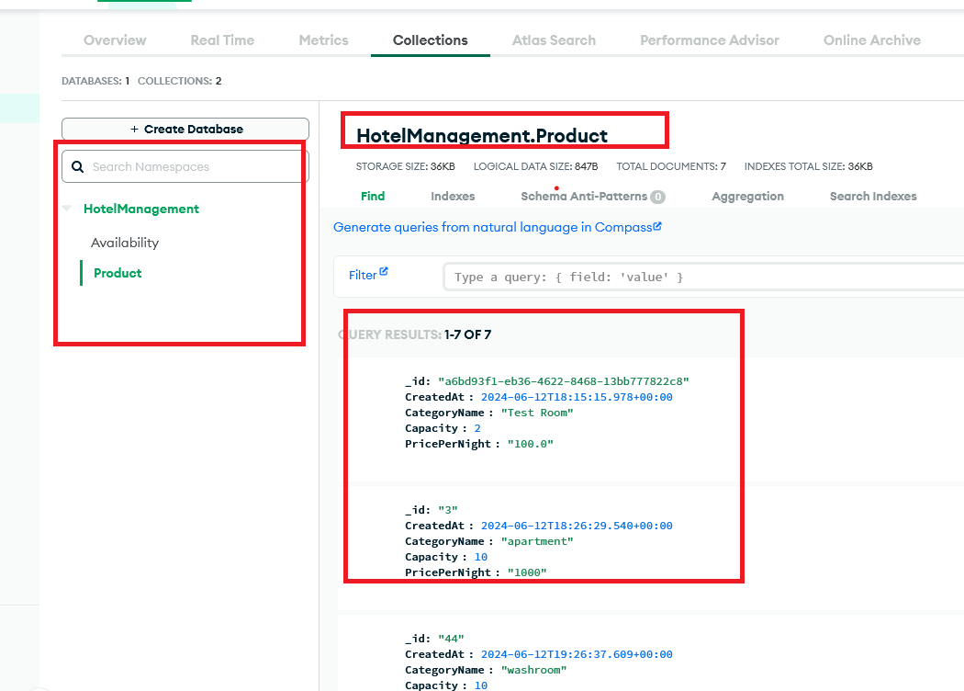
Elastic instance

Slide 9
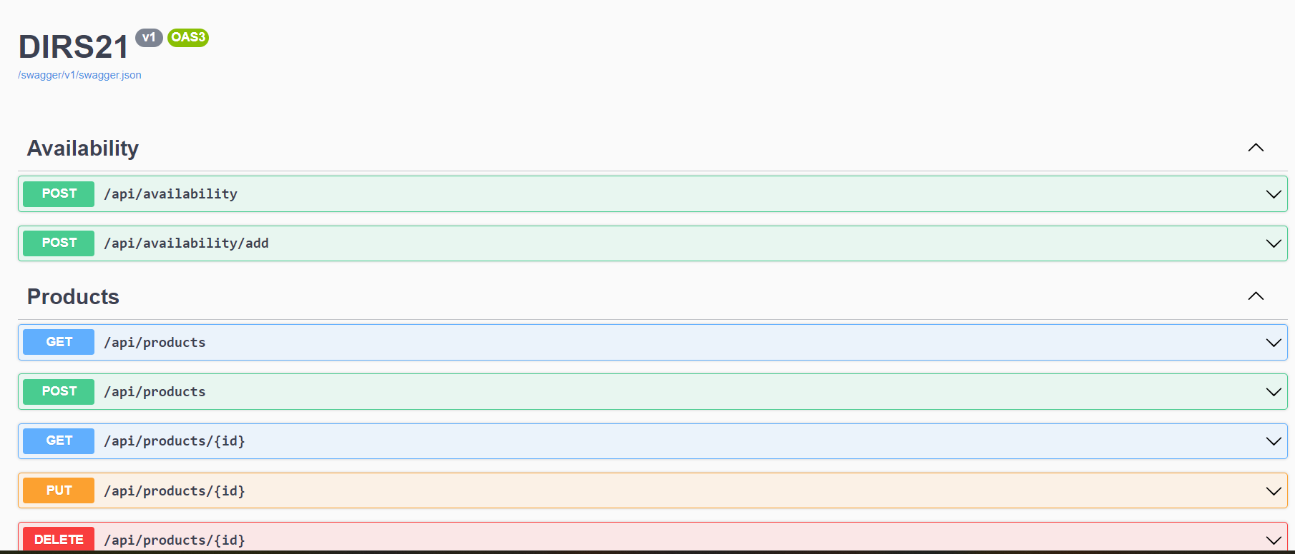
Front End

Slide 10
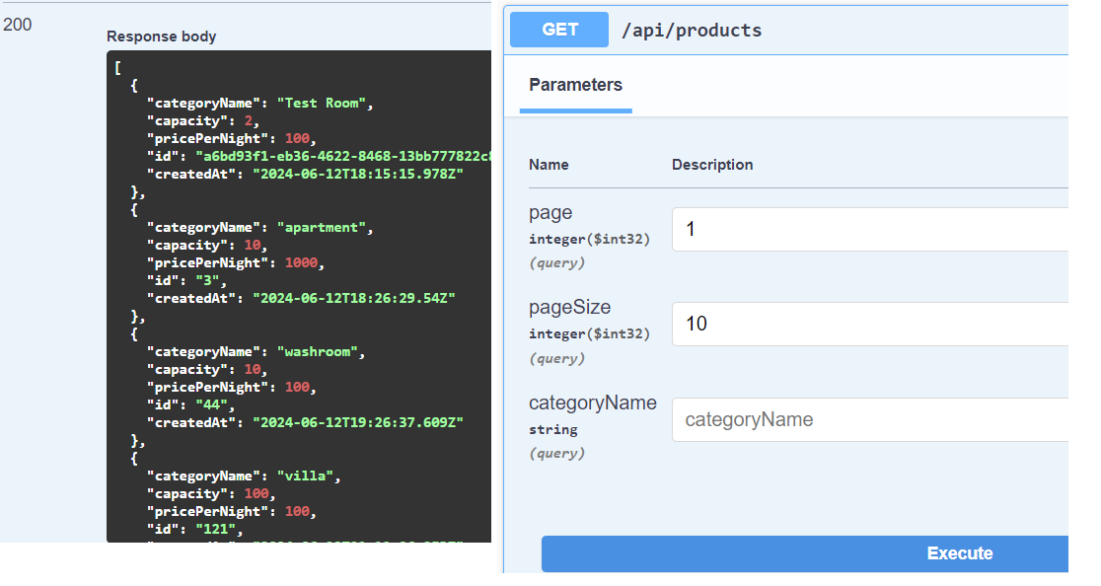
Evidences Get API to return All Products

Slide 11
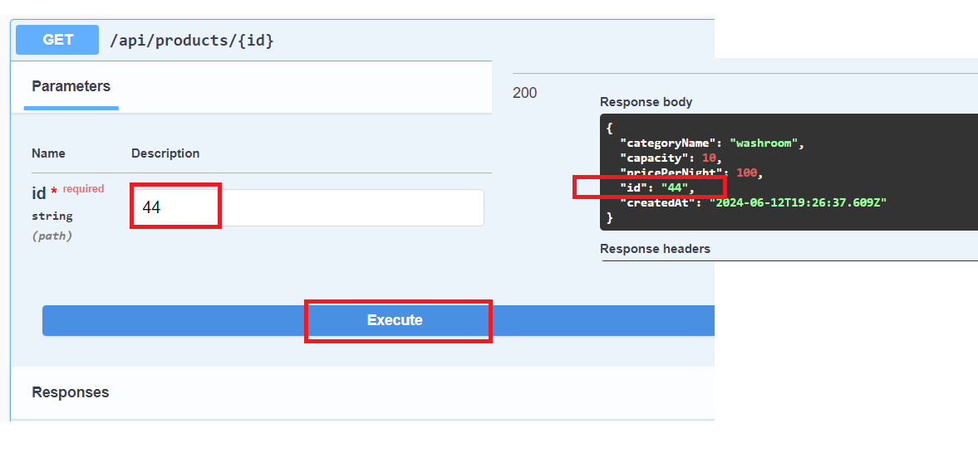
Evidences Get API to return Product by ID

Slide 12
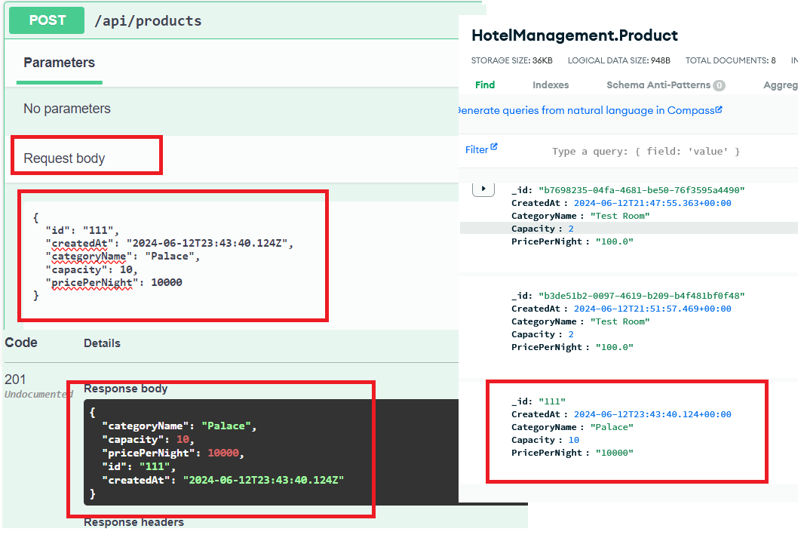
Evidences Create Product API

Slide 13
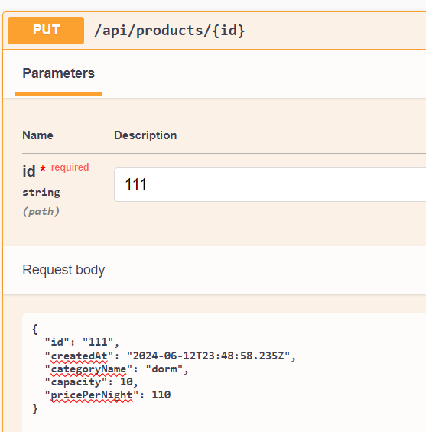
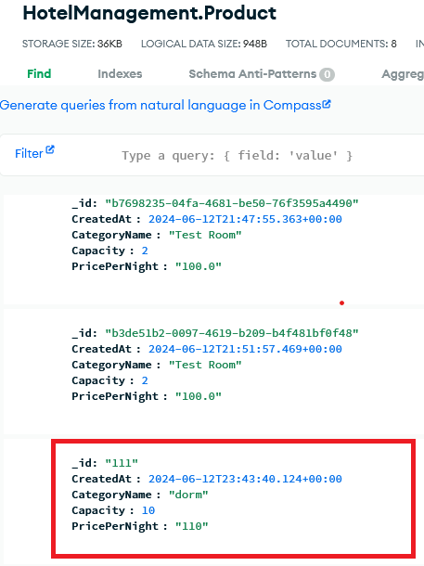
Evidences update product by id

Slide 14
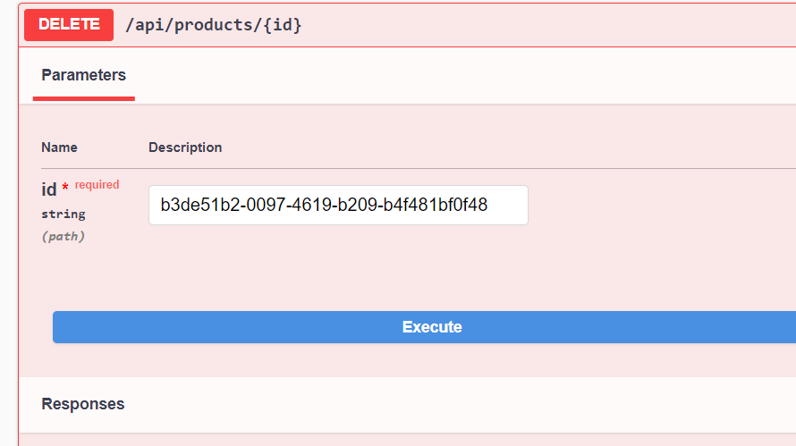
Evidences Delete Product By ID

Slide 15
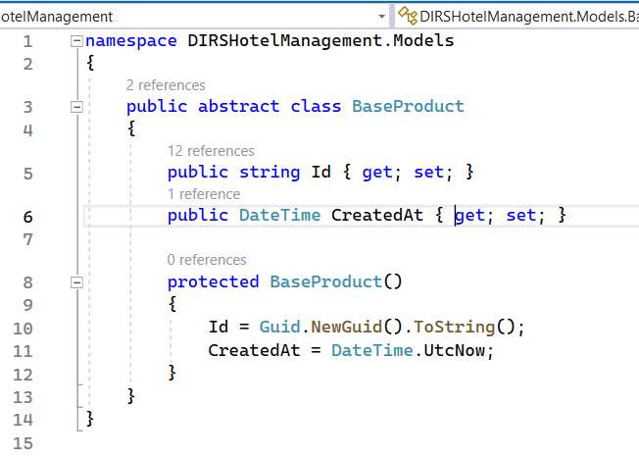
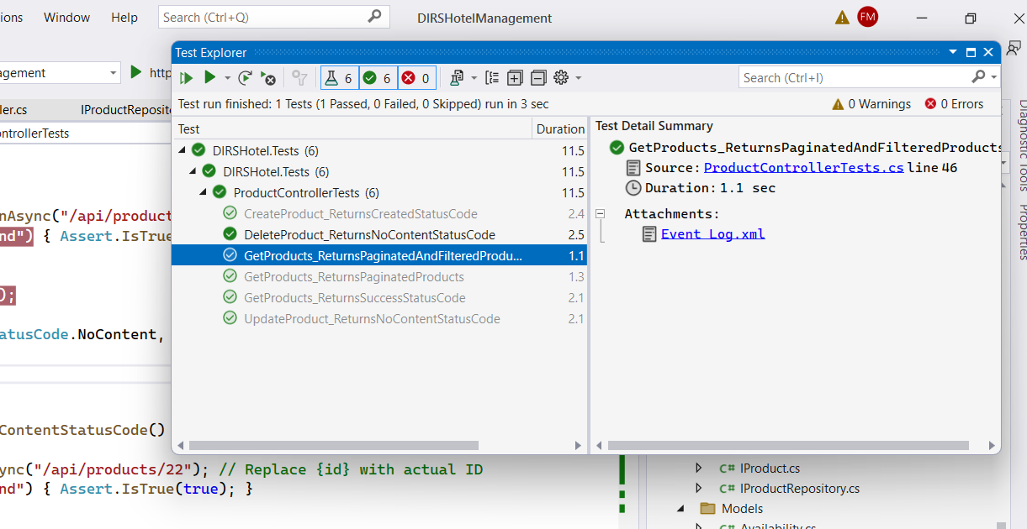
Create an abstract base entity class (e.g., BaseProduct) that includes common properties such as ID (string) and CreatedAt (DateTime).
Optional (Plus) Write unit tests to ensure the functionality of the availability validation

Slide 16
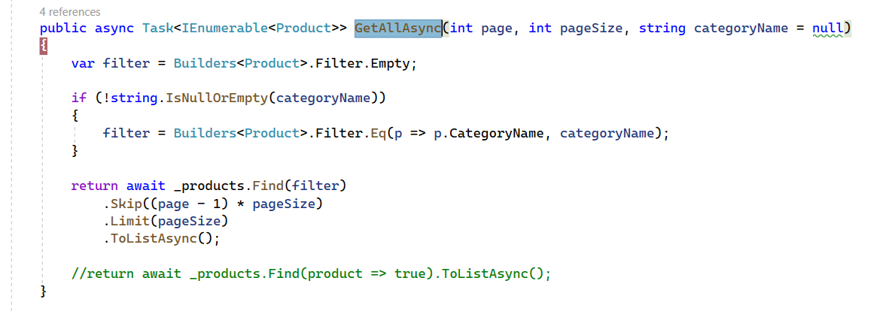
Optional (Plus): Add data pagination and filtering capabilities to the GET endpoints

Slide 17
Evidences Get API to return Product by ID

Slide 18
Auto executed Unit Test cases

Slide 19
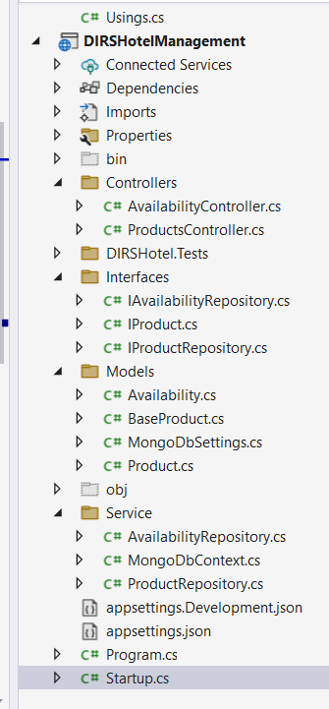
Code Structure with SOLID
Project Structure
The project follows a SOLID Pattern
Interfaces: Contains interface definitions used throughout the project.
Models: model classes that represent data structures used in the application.
Controllers: Responsible for handling incoming requests and interacting with services.
Services: Contains business logic implementations, decoupled from controllers.
Implementation Details
Developed using .NET Core 7.0.
Configuration and parameters are passed from controllers to services using dependency injection.
Summary
This documentation outlines the setup and structure of the project, emphasizing the use of MongoDB libraries, a clear separation of concerns through interfaces, models, controllers, and services, and the implementation specifics using .NET Core 7.0.

Slide 20
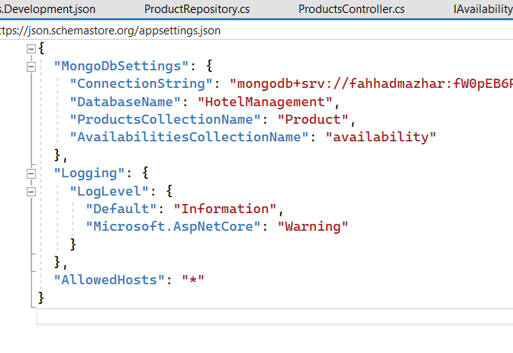
Configuration
All configuration has been placed in appsettings.json
User don’t need to configure anything as mongo instance has been placed online.
Just download the code and deploy or run the DIRSHotelManagement.

Slide 21
Repository URL
Mongo Instance
Cloud version has been used.
GitHub URL
https://github.com/Fahhad-m/DIRSHotelManagement.git
Documentation Path
https://github.com/Fahhad-m/DIRSMongoDocumentation.git
Video Path
https://github.com/Fahhad-m/DIRSMongoDocumentation.git

Slide 22
Thank you
Thank you for the last interaction that was wonderful. I spent 2 nights to get this done to showcase my seriousness and motivation to join DIRS21.
As discussed, my only focus is on contributing to DIRS21 without considering any other opportunities.
I look forward to receiving positive feedback regarding my efforts.

