Slide 1
Resource Management and Scheduling in Distributed
Stream Processing Systems
Group 6
Fahim Ferdous (20216010)
Shah Abul Hasnat Chowdhury (17301143)
MD. Esadulhaq (17301148)

Slide 2
About The Paper
About DSPS
Main Research Topics
Authors
Xunlyun Liu
Rajkumar Buyya
Resource management for DSPS
Structure of DSPS
Provides a taxonomy
Directions for research
Review of the literature
Analyse real-time data in real-time
Uses small or no buffering
Example use cases
Stock market
Self driving cars
Data from IoT devices
Resource provisioning
Operator parallelisation
Task scheduling

Slide 3
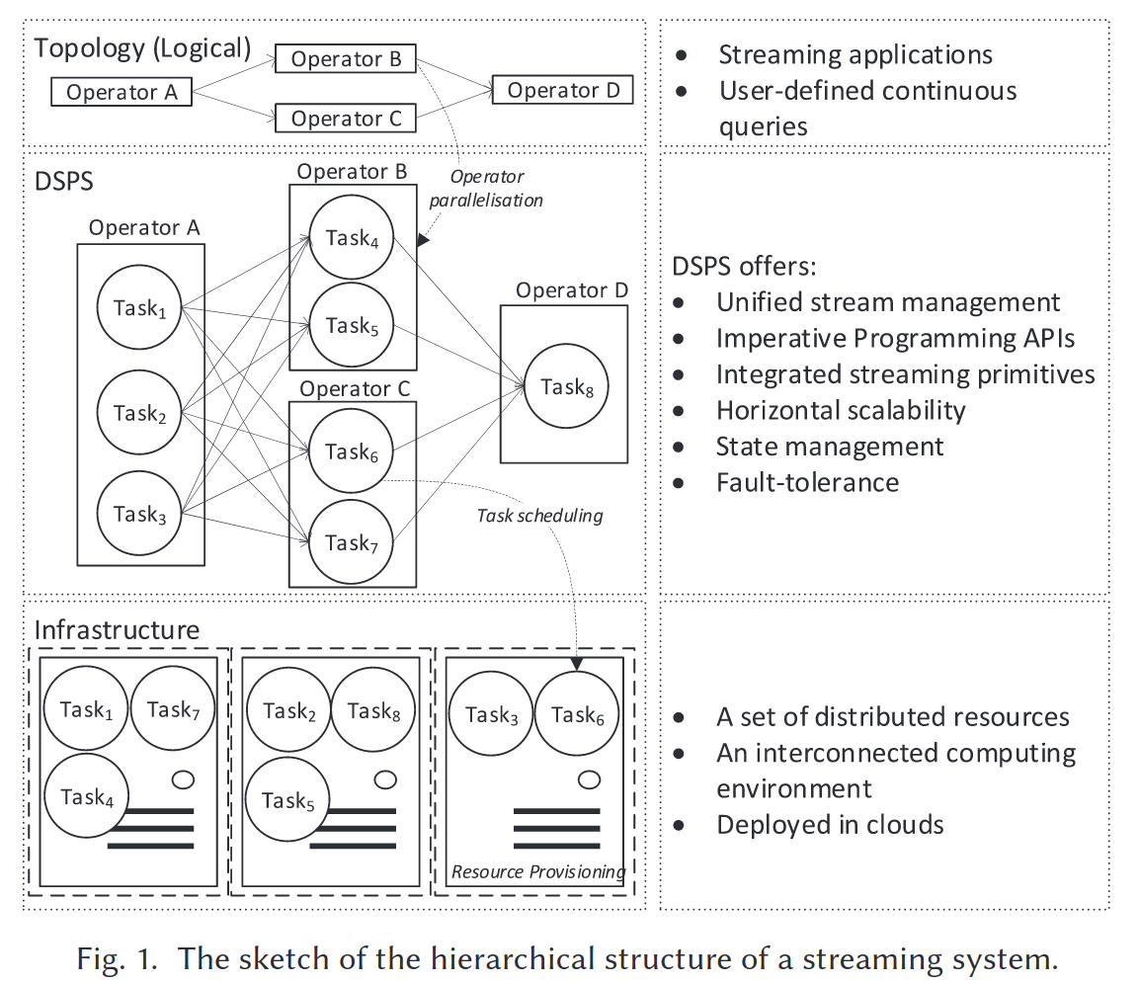
Structure of DSPS
Topology
Operators to operators
The Distributed System
Multiple operators
Multiple tasks in each operators
Infrastructure
Machines execute scheduled tasks
Minimize the inter node traffic
Cloud, on-premise or hybrid infra
Source: https://dl.acm.org/doi/10.1145/3355399

Slide 4
Background
Resource provisioning
Resource estimation
Resource adaptation
Operator parallelisation
Parallelism calculation
Parallelism adjustment
Task scheduling
Minimize inter-node communication
Minimize contention
Performance oriented mapping

Slide 5
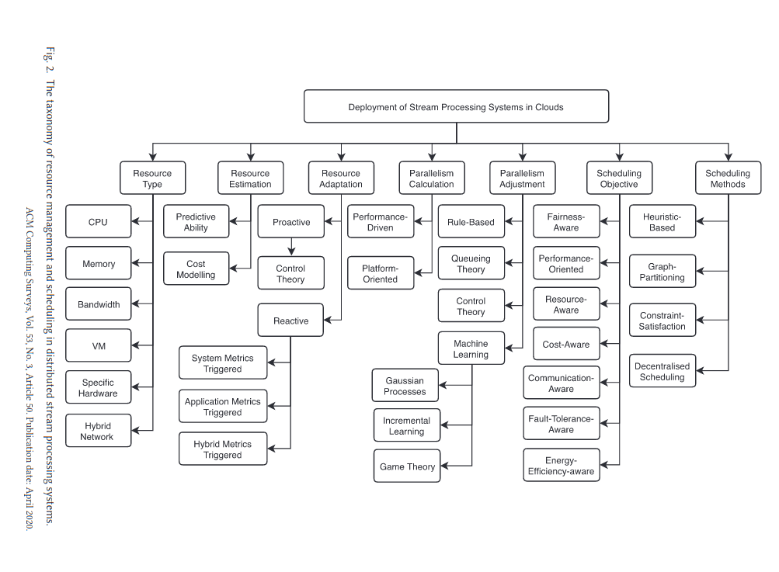
Taxonomy
Resource
Type
Estimation
Adaption
Parallelism
Calculation
Adjustment
Scheduling
Objective
Methods
Source: https://dl.acm.org/doi/10.1145/3355399

Slide 6
Resource Abstraction
Resource Types
Includes
CPU
Memory
Network
Bandwidth
Latency
Excludes
Storage
Block
File
Object
Virtual Machines
Pricing
Specific config
Containers as alternatives
Specific Hardwares
FPGA
GPU
TPU
Sensors
Hybrid Network
Cloud AND on-premise
Fog and edge
In-network computing
Mobile devices
HPC networking techs

Slide 7

Service-level agreement (SLA)
A service-level agreement (SLA) defines the level of service expected by a customer from a supplier. Usually, SLAs are between companies and external suppliers, but they may also be between two departments within a company.

Slide 8
RESOURCE ESTIMATION
Determines the bare minimum of resources to meet SLA
Two characteristics of resource estimation method.
Predictive Ability
Time series analysis and Queueing theory are the two most common methods for metric prediction from the point of view of methodology.

Slide 9
2. Resource Cost Modelling
Minimal Cost Model:
Bin packing is the most common strategy to model the minimal resource cost based on the compact task placement.
Reliability-oriented Model:
Storm extension & Rollback-Recovery Scheme

Slide 10
Contention-aware Model:
Resource cost model that tracks and confines the CPU utilization level
Load-balancing-oriented Model:
Focuses on the fair utilization of available resources
Distribution-based Model:
Mixture Density Networks, a statistical machine learning model.

Slide 11
RESOURCE ADAPTATION
Vertical scaling & SASO features.
Horizontal scaling approaches into two main types.
1 Proactive Adaptation
To obtain the optimal reconfiguration trajectory over the prediction horizon & Real Time resource management.
2 Reactive Adaptation
Reactive scaling strategy that reacts to latency constraint violations with appropriate scaling actions.

Slide 12
PARALLELISM CALCULATION
Two widely used strategies. Platform-oriented parallelization is the second strategy whereas performance-driven parallelization is the first.
1 Performance-driven Parallelisation
The accurate profiling of both operator inputs and the capacity of each streaming task.
2 Platform-oriented Parallelisation
Enough streaming tasks for the communication-intensive operators

Slide 13
PARALLELISM ADJUSTMENT
Aims to prevent excessive operator parallelism from using up all the resources.
1 Rule-based Approaches
In order to dynamically alter the degree of parallelism in response to the ongoing variations in workload and system performance, an iterative adjustment process is required.
2 Queueing Theory
An adaptive data parallelization middleware was created by Mayer that determines a stationary distribution of the queue length under a specific level of parallelization.

Slide 14
3 Control Theory
Different MPC-based algorithms addressed, which explores the target application's ideal configuration under dynamic operational conditions.
4 Machine Learning and Game Theory
The optimal parallelism is determined as the system reaches the agreement of Nash equilibrium. Game theory is explored to formulate the elastic parallelism scaling problem as a non-cooperative game.

Slide 15
Scheduling Objectives
Resource allocation
Oscillating placement of tasks
There are seven main scheduling objective to analyze and compare alternative scheduling objectives within the same scope

Slide 16
Fairness aware-Scheduling used as default popular | 2. Performance-oriented scheduling Latency SLA-centric practice
3. Resource-aware Scheduling Streaming infrastructure workload | 4. Cost-aware Scheduling Cost of hosting Cost related to data transmission

Slide 17
5.Communication-aware Scheduling Trace Inter node communication
6. Fault-tolerant Scheduling Failure in a stream processing system
7. Energy-efficient Scheduling Reducing overall energy use Workload reduction

Slide 18
Scheduling Methods
Scheduling methods explain the design and implementation of associated schedulers in detail
Heuristic-based scheduling
Optimization
Graph-Partitioning-based scheduling
Underestimate the cost of scheduling

Slide 19
3. Constraint-Satisfaction-based Scheduling
Max-min fairness
4. Decentralized Scheduling
Intersection of reusable tasks and streams

Slide 20
Gap Analysis and Future Directions
Many research efforts have investigated the resource management and scheduling in distributed streaming system. In this section we discuss the gaps that have been found in those research paper and suggest potential future direction on this front.
Fine-grained Profiling
Straggler Mitigation
Transparent State Management
Resource-availability-aware Scheduling

Slide 21
Energy-efficient Scheduling
Cost Efficiency with Different Pricing Models
Container-based Deployment
Integration of Different DSPSs

Slide 22
Summary

