Slide 1

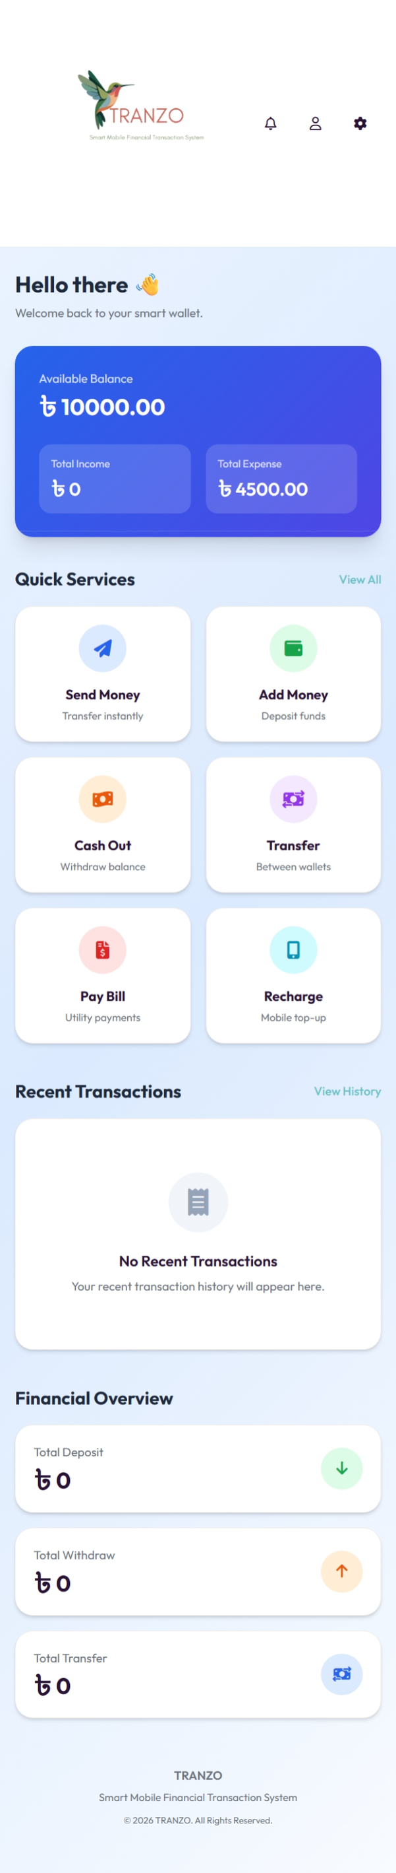
KTMS MAVERICKS
TRANZO
SMART MOBILE FINANCIAL TRANSACTION SYSTEM
  Mahadi Hasan Fahim 2023100000581
  Tabashum Islam 2023100000688
  Khandokar Mosleh Uddin 2023100000624
  Md.Shakil Hossain 2023100000634

Slide 2
Introduction
Tranzo is a web-based financial management system designed to simplify everyday financial activities and personal expense tracking in one platform.
01 | Scattered Financial Activities
Users often manage different financial activities across separate platforms.
💸 Transactions
Send, add, transfer and cash out money
📊 Expense Tracking
Track and understand personal spending
📱 Simple Dashboard
Access financial activities from one place
02 | Limited Expense Visibility
It can be difficult to keep track of everyday spending.
Our Solution
Tranzo brings transactions, balance management and expense tracking together in a simple, user-friendly platform.
03 | Complex Financial Management
Users need a simple way to view transactions, balance and expenses together.

Slide 3
Technology Stack
Category | Technologies
Frontend | HTML5, Tailwind CSS, Daisy UI, JavaScript
Backend | Javascript,typescript,next.js
Database / Data | MongoDB
Charts & Analytics | Resend API
Development Tools | Visual Studio Code
Version Control | Git & GitHub

Slide 4
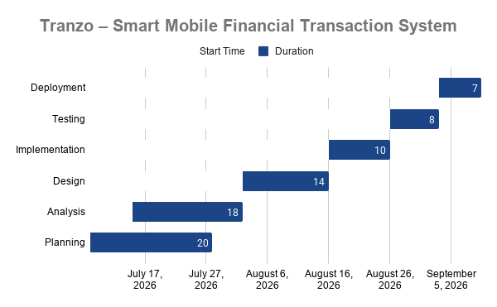
PROJECT TIMELINE
Updated Development Progress

Slide 5
Implemented Features
Key features developed in the current version of Tranzo
Main Content
💸 Money Transactions
  Send Money
  Add Money
  Cash Out
  Transfer Money
💳Bill & Recharge
  Pay Bill
  Mobile Recharge
📜Transaction History
  Transaction records
  Amount & type
  Date, time & status
📊Expense Management
  Record expenses
  Track spending
  View financial activities
👤 User Management
  User registration
  User login
  User session handling
🛡️Admin Management
  User management
  Transaction monitoring
  Activity overview

Slide 6
Dashboard & Financial Features
A centralized interface for managing everyday financial activities

Slide 7
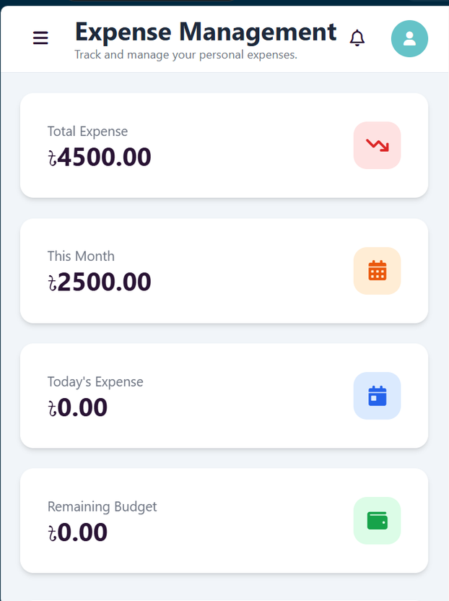
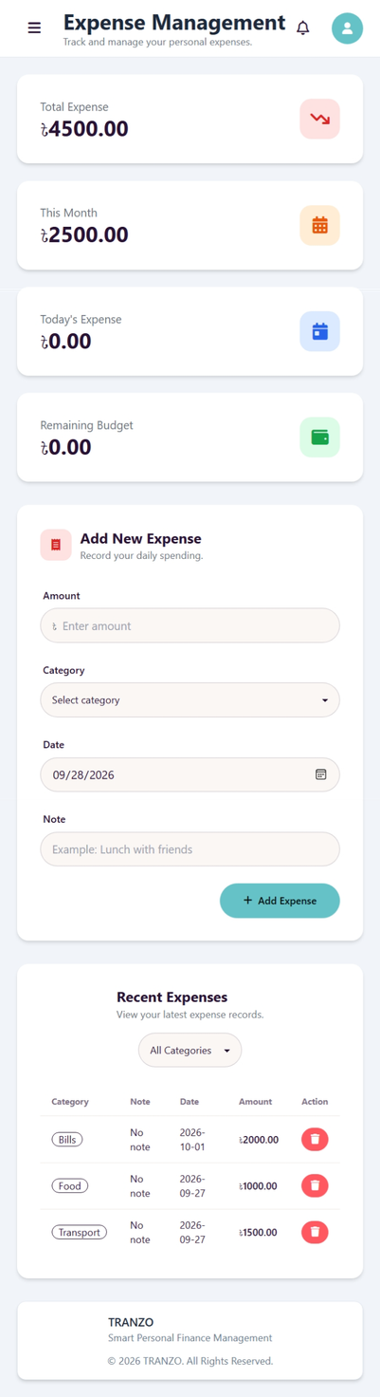
Expense Tracking & Management
Helping users keep track of their everyday spending
📊 Track
🔍 Review
💰 Manage

Slide 8
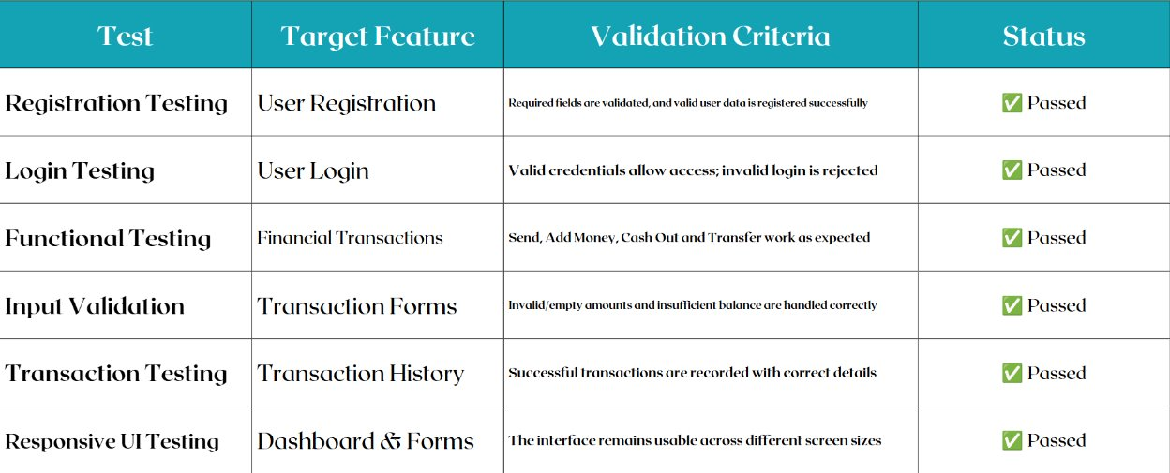
Testing & Validation
Key tests performed to validate Tranzo's core functionality

Slide 9
Challenges & Solutions
Challenges | Tranzo's Solution
Consumers have difficulty tracking their daily expenses. | Tranzo provides expense tracking so users can record and understand their spending
Managing different financial activities can be complicated. | Tranzo provides a simple dashboard where users can access their financial activities from one place
Consumers may have difficulty finding previous transactions. | Tranzo maintains transaction history with amount, type, date, time, and status.

Slide 10
Conclusion:
  Tranzo helps users track daily expenses.
  Users can record and review their spending in one place.
  It increases awareness of spending habits.
  It helps users manage their money more effectively.
  Overall, Tranzo supports better personal financial management.

Slide 11

https://fahim-cs.github.io/TRANZO/

