Slide 1
Attendance System using ESP8266

Slide 2
Group Members
ID | Name
17-33113-1 | Aziz Sahil
17-33316-1 | Datta Sachi
17-33333-1 | Nazim Mirza Nowshin
17-33355-1 | Fahim Ahmed Ali
17-33367-1 | Roy Priya
17-33443-1 | Tanmoy Nazmul Hasan
17-33863-1 | Rahman Saqibur
17-34078-1 | Ahmed Tasnim

Slide 3
Introduction
The ESP8266 is a low-cost Wi-Fi microchip with full TCP/IP stack and microcontroller capability.
It runs at 3V with maximum voltage range around 3.6V.
It incorporates 64 KB boot ROM, 80 KB user data RAM and 32 KB instruction RAM.
It comes with seventeen GPIO.
ESP8266 works in two modes: Station Point (STA) and Access Point (AP).
Station Point mode allows it to connect to a WiFi network and interact with the Internet
Access Point mode allows it to set up a network of its own, allowing other devices to connect directly to it.

Slide 4
Equipments
ESP8266
2.4 inch LCD Display
Arduino Uno

Slide 5
Motivation
Reduce paperwork and save time and money.
Fully automated no manual labor required.
Adding all attendance marks at the end of semester is time consuming and sometimes can be error prone.

Slide 6
Softwares & Languages
Arduino IDE
Visual Studio Code
PHP

Slide 7
Cost of Equipments
Equipment | Price(taka)
ESP8266 | 465
Arduino Uno | 400
2.4’’ TFT LCD Display | 900
Total Cost | 1,765‬ taka

Slide 8
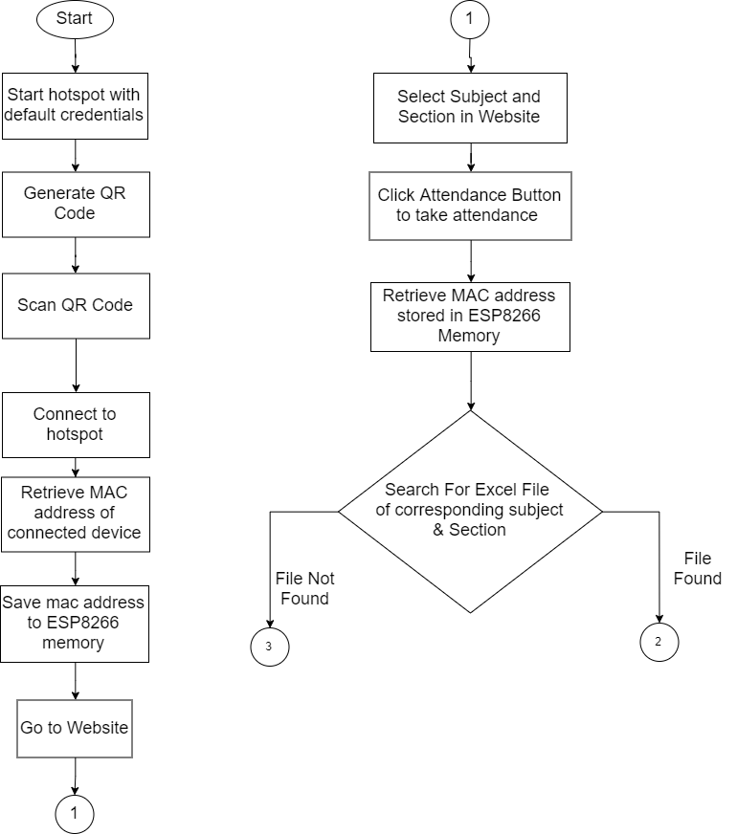
Flowchart

Slide 9
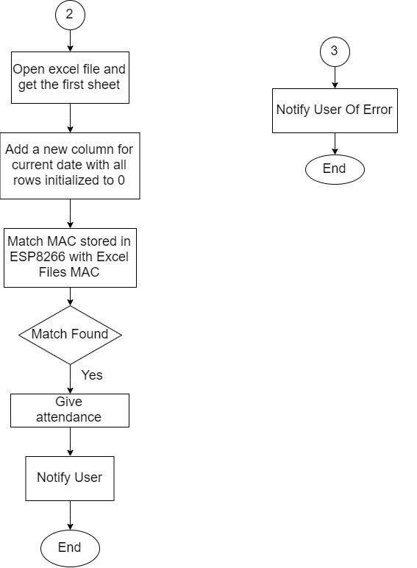
Flowchart Continuation

Slide 10
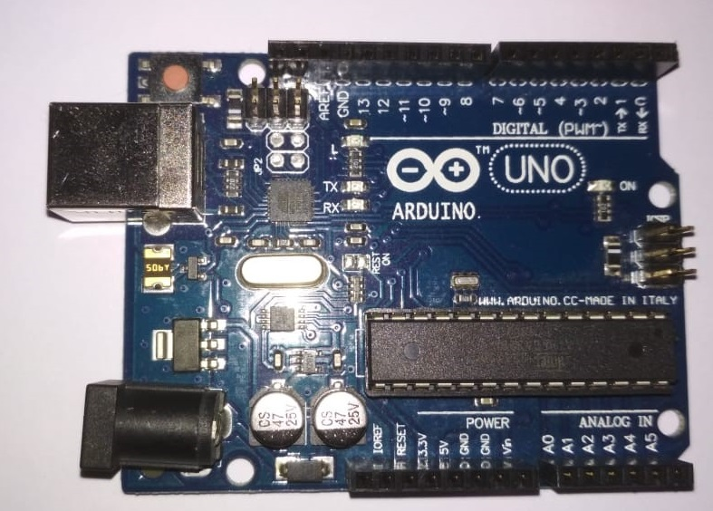
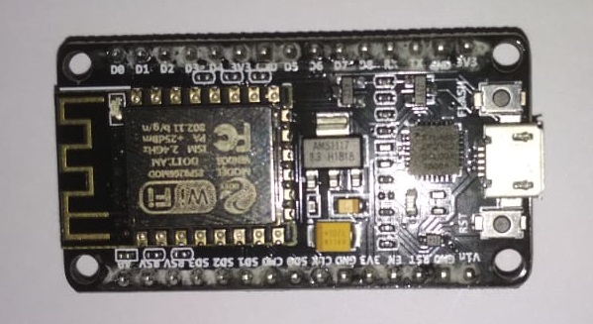
Hardware Picture
Arduino Uno
ESP8266

Slide 11
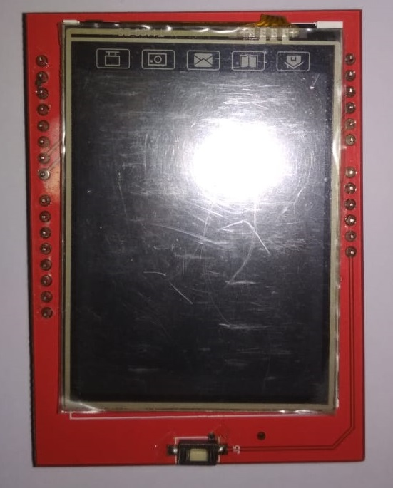
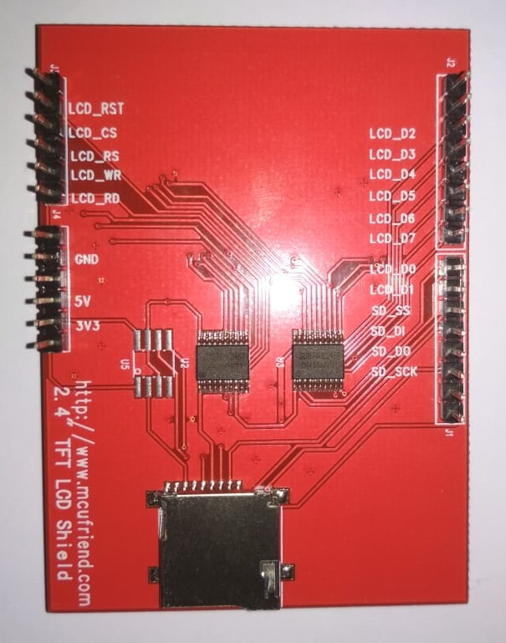
Hardware Picture
LCD 2.4" Display

Slide 12
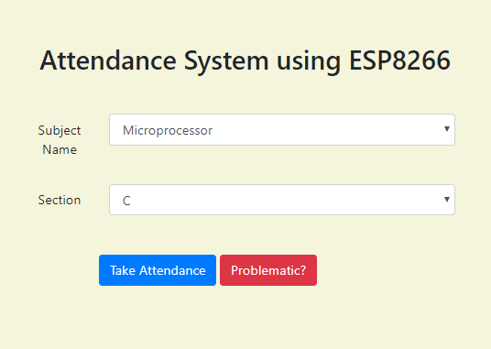
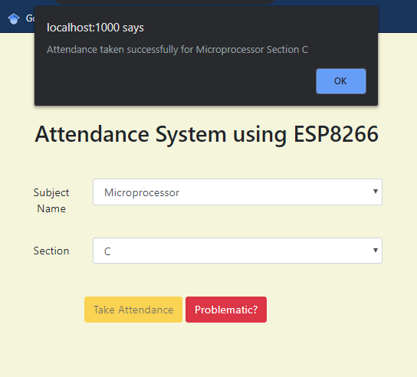
Website Screenshots

Slide 13
Limitations
Transferring the hotspot credentials to the Arduino from the webpage is difficult.
Lighting conditions affect the reflection on the display, which hampers QR code scanning.
Additional measures need to be taken to take care of MAC Addresses containing parts with leading zeroes.
The NodeMCU handles at most 8 connections at a time.

Slide 14
Future Work
Addition of client-side validation for valid SSID and Password inputs.
Addition of verification of faculty login.
Limiting the access of internal files and folders of the NodeMCU to students. That is, increase security measures.
Dynamically generate subject and section according to the faculty and login time.
Allow the student to check their current and past attendance statuses.
Transfer hotspot credentials to the Arduino for QR code generation through a better medium than serial communication.

Slide 15
Impact on society and environment
The system reduces the manual labor and time.
Paper-based attendance systems can be replaced with this system. Therefore, the project contributes towards moving away from paper-based systems and onto paper-less systems.
As the devices used in this project are low-power devices, they can be powered through solar panels and thus self-sustaining and minimizes its energy costs.

Slide 16
Conclusion
In conclusion, it can be said that the project saves quite a good amount of time, has a positive impact on environment and society even with all its limitations. We hope to implement the works pointed out in Future Work section of the presentation.

Slide 17
Thank You

