Slide 1


Slide 2

Bangladesh Army University Of Science And Technology, BAUST
Automatic Attendance system using
Face Recognition
Department | CSE
Course Code | CSE 4246
Course Title | Digital Image Processing Sessional
Course Credit | 1.5
Submitted By |  | Submitted To
Name | Id | Name of the Teacher: Dr. S.M Jahangir Alam
Fahim Adnan | 180101046
Torikul Islam Oli | 170201067 | Designation: Associative Professor

Slide 3
TABLE OF CONTENT
Introduction.
What is face recognition?
How does face recognition work?
Problems with the exiting systems.
Hardware & Software specification.
Picture of the codes used.
Pictures of the project’s practical demo.
Applications of our project.
Conclusion.

Slide 4
INTRODUCTION
Traditional attendance marking techniques is often facing a lot of trouble. The face recognition attendance system emphasizes its simplicity by eliminating classical attendance marking techniques such as calling names.
Thus, an attendance system through facial recognition is proposed in order to replace the manual marking of attendance. This system is beneficial for saving lots of time.

Slide 5
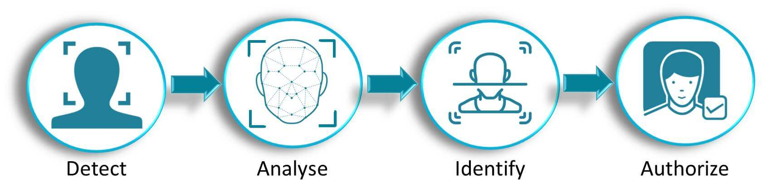
What is Face Recognition ?
Identifying or verifying a person from a digital image or video frame.
It work by comparing selected facial features from a given image with faces within a database.

Slide 6
Project analysis slide 2
How does Face Recognition work?
Image Acquisition from picture frame.
Face Detection
Feature extraction
Face recognition
Attendance
Database

Slide 7
Project analysis slide 2
Problems with the exiting systems
System type | Advantages | Disadvantages
QR Code system | Simple | Fraudulent usage
Fingerprint system | Accurate | Time-consuming, Human interaction
Iris recognition system | Accurate | Privacy Invasion
Attendance

Slide 8
Specification
Hardware | Software | Libraries
Laptop | Database – XAMPP/ Laragon | OpenCV-python(4.5.5.62)
Ram – Min 4 GB | Framework - Laravel, PyQt5 | Dlib(19.23.0)
HDD – Min 500 GB | Language - Python, PHP | Face Recognition(1.3.0)
Camera - Web Cam or Phone Cam | IDE - PyCharm, VS Code | Mysql-connector, python(8.0.28), PyQt5(5.15.6)

Slide 9
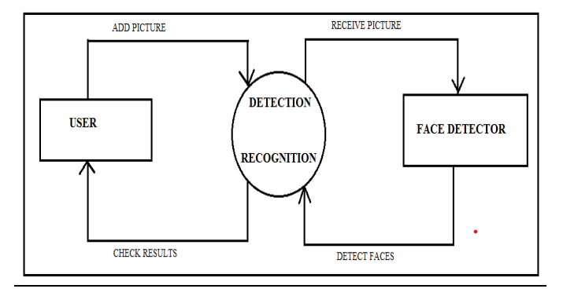
Data Flow Diagram

Slide 10
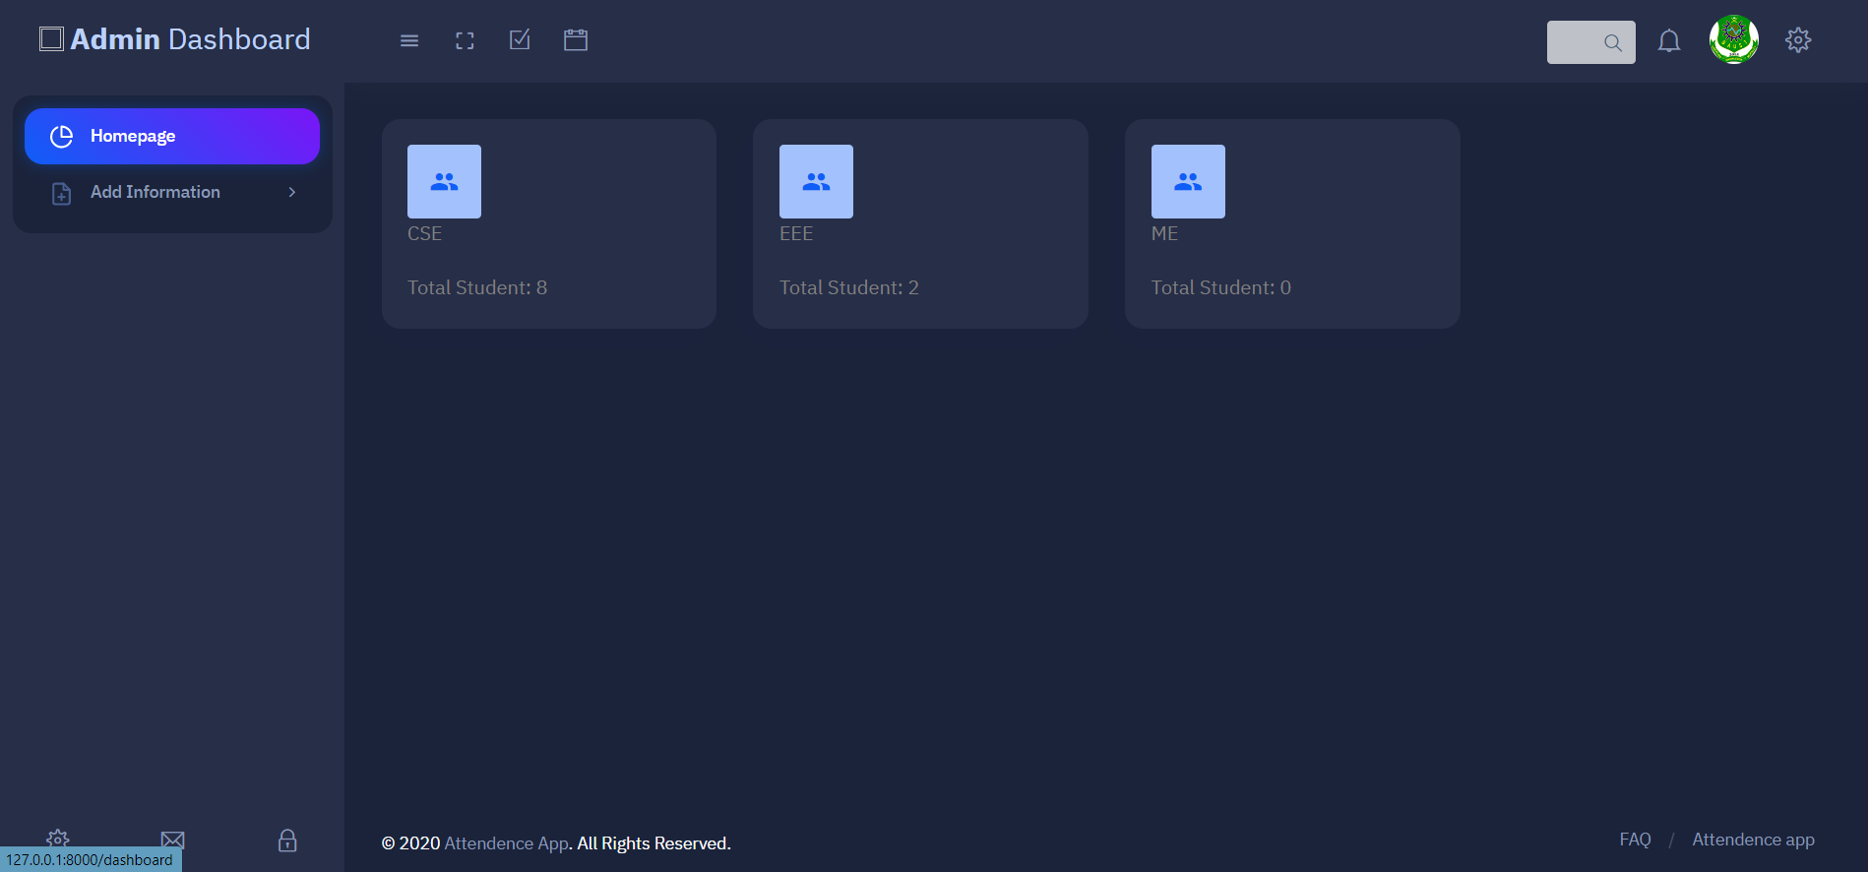
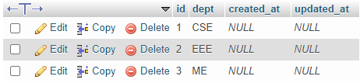
Admin Dashboard

Slide 11
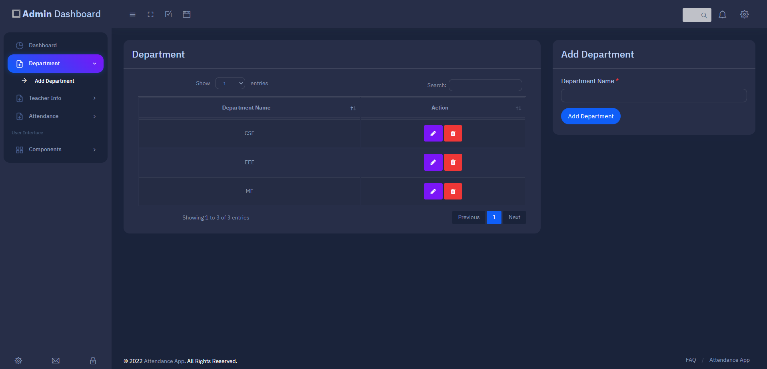
Add Department Page

Slide 12
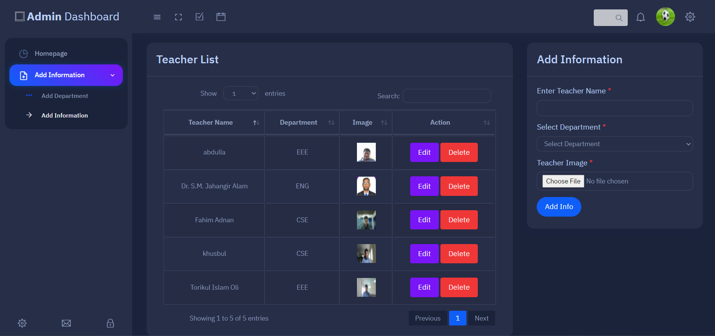
Add Teacher Info Page

Slide 13
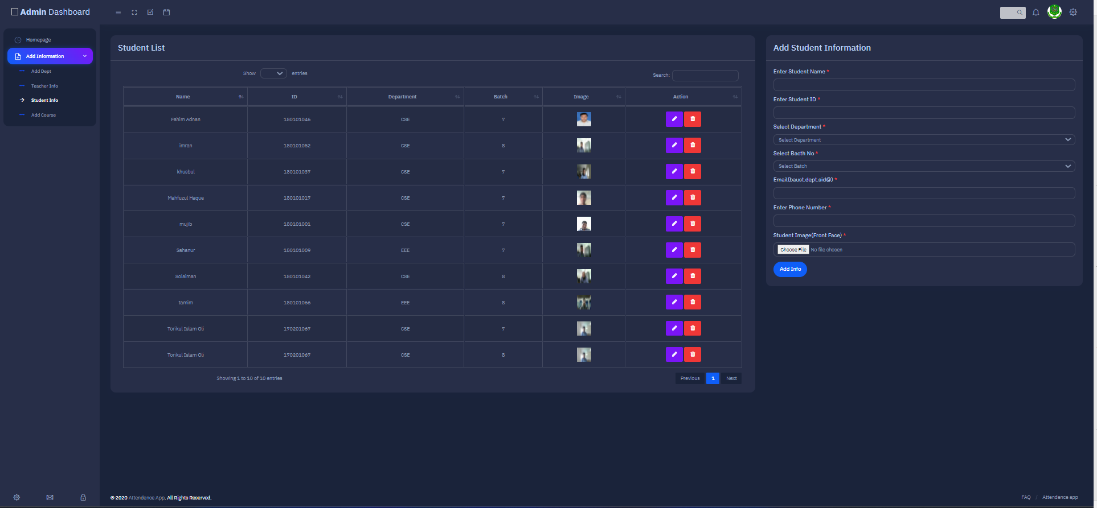
Add Student Info Page

Slide 14
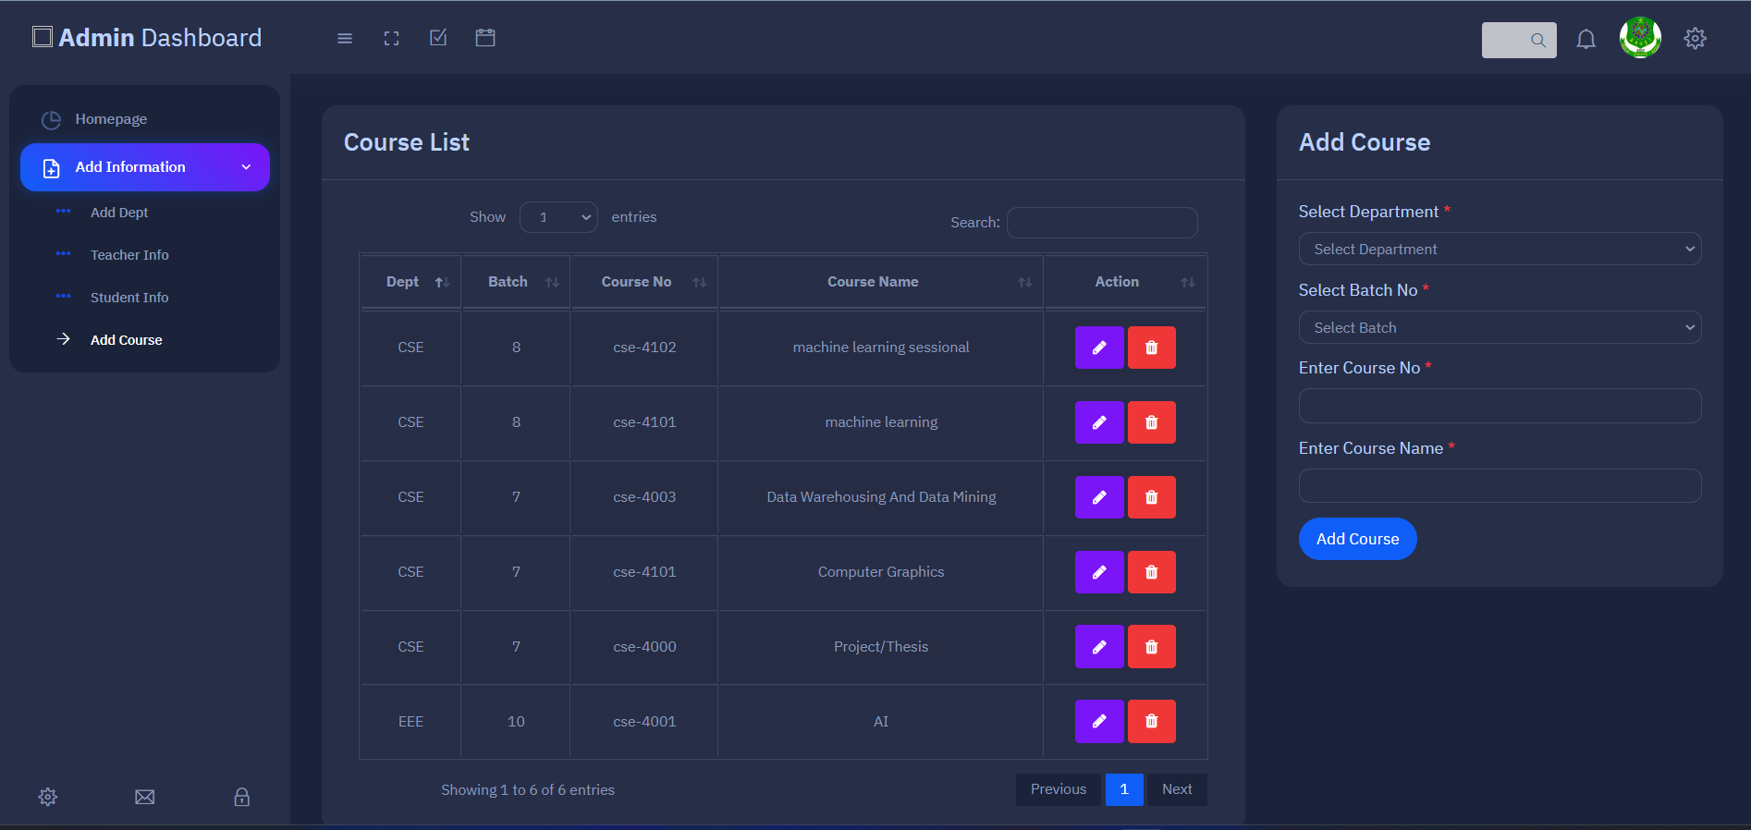
Add Course Info Page

Slide 15
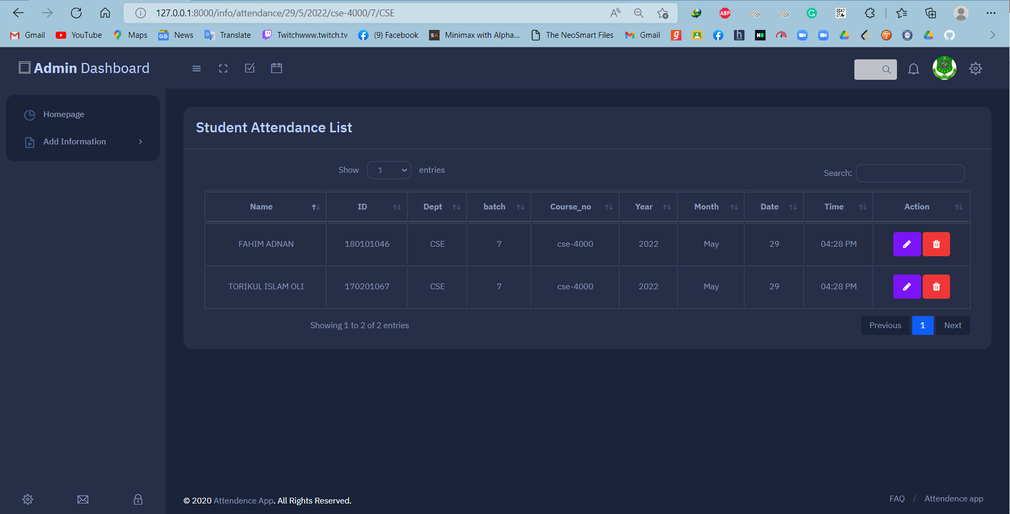
Attendance Info Page

Slide 16
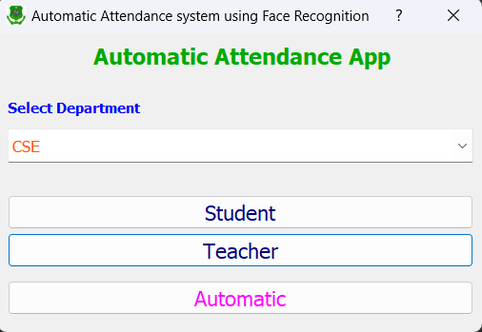
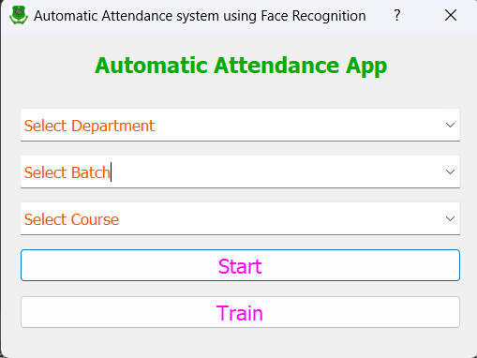
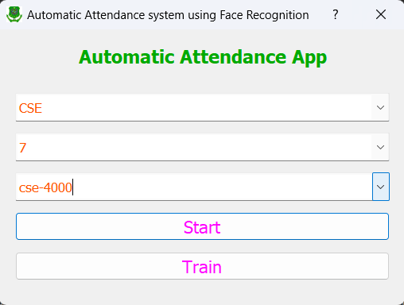
Select Options Page

Slide 17
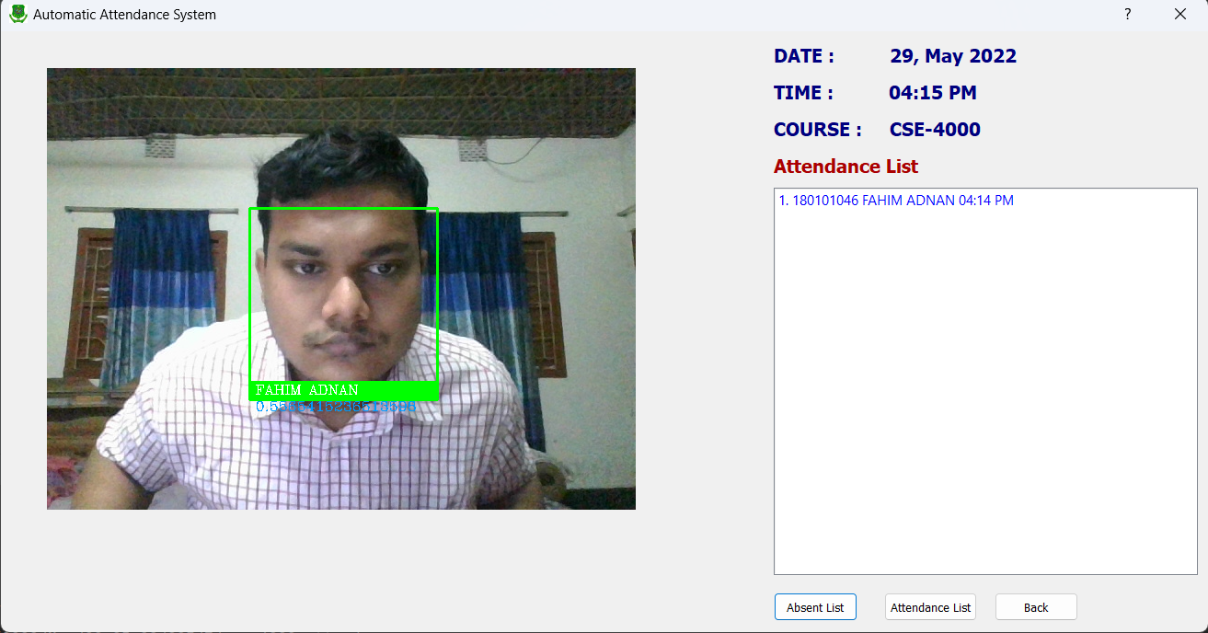
Clocked IN

Slide 18
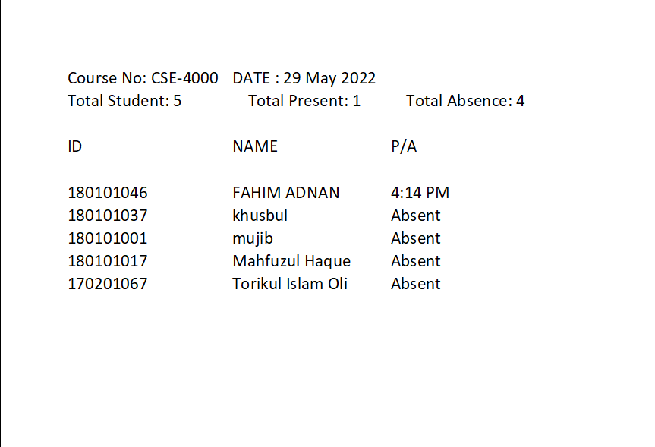
Store data in Attendance Excel File

Slide 19
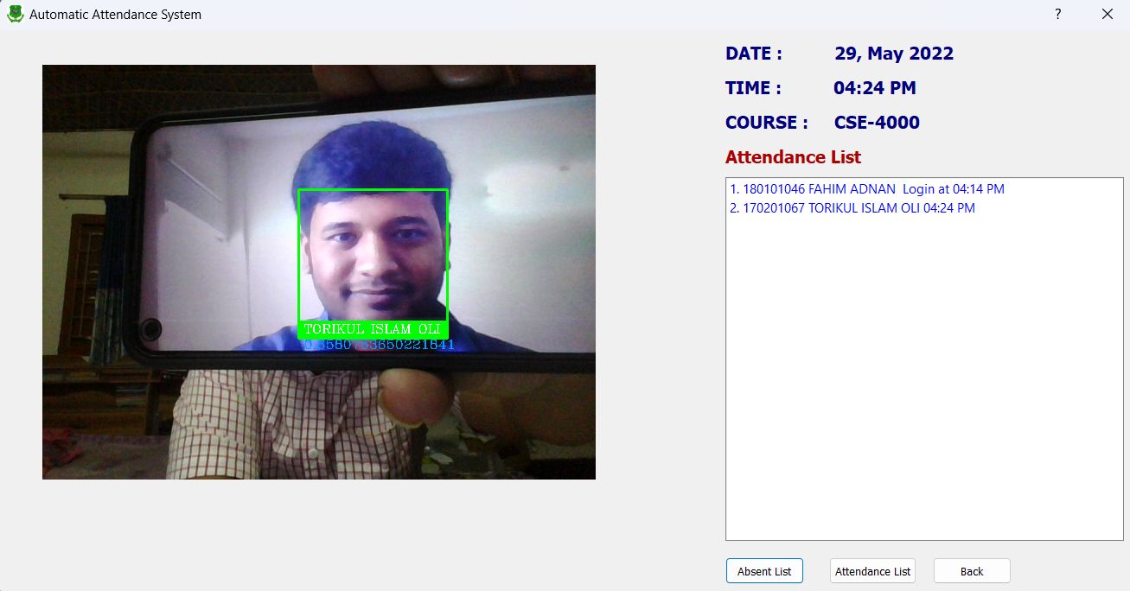
Clocked IN

Slide 20
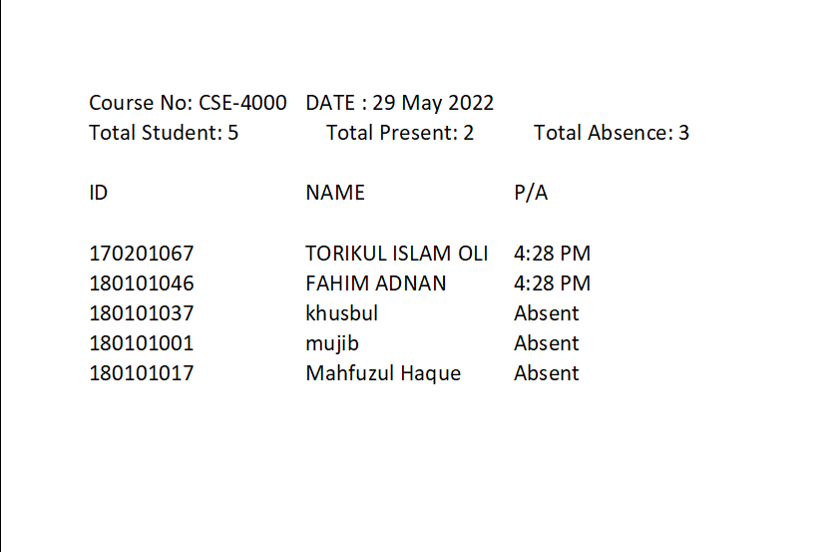
Store data in Attendance Excel File

Slide 21
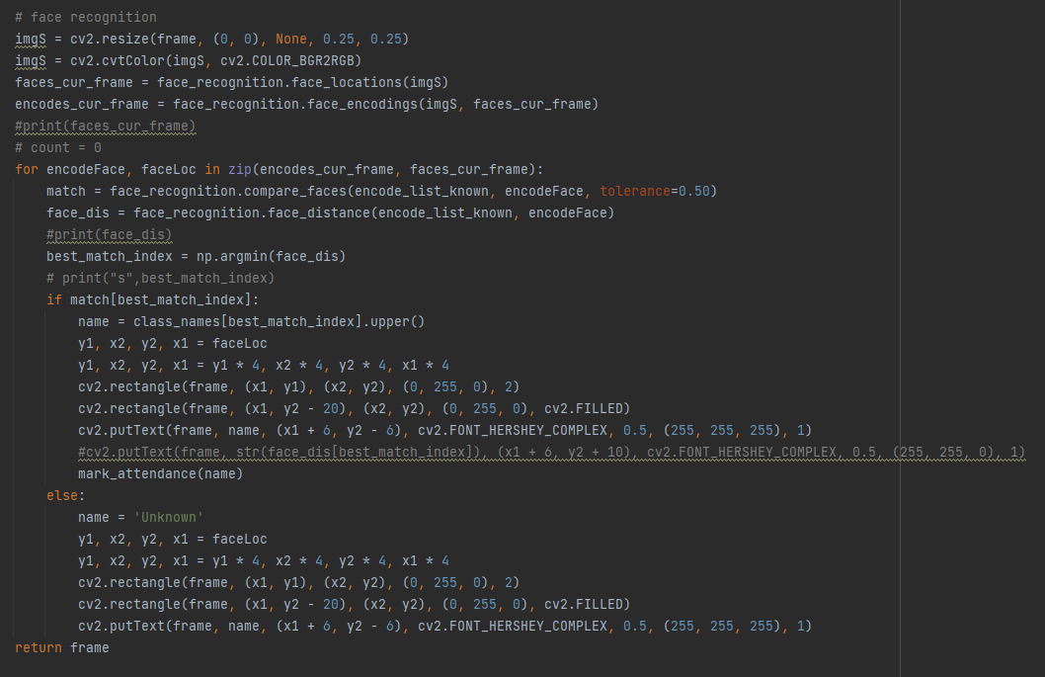
Face Recognition code

Slide 22
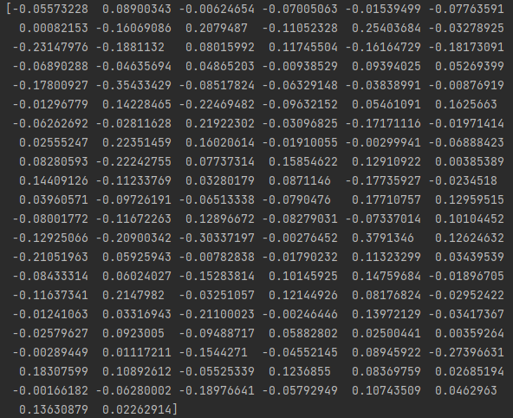
Encodes of trained face

Slide 23
APPLICATIONS
Attendance in Schools, Colleges, University etc.
To verify identities in Government organizations.
Enterprises.
To detect fake entries at International borders.
Industries.

Slide 24
Future Work
The future works of this project include the following:
Absentee to get Email.
Camera Access by mobile camera rather web cam.
User can access his/her attendance dates individually.

Slide 25
Conclusion
A face recognition-based automated attendance system is designed to solve the issues of existing manual systems.
In the future this system need to be improved because this system sometimes fails to recognize from some distance, also we have some processing limitation, working with a system of high processing may result in an even better performance of this system.

Slide 26


