Slide 1

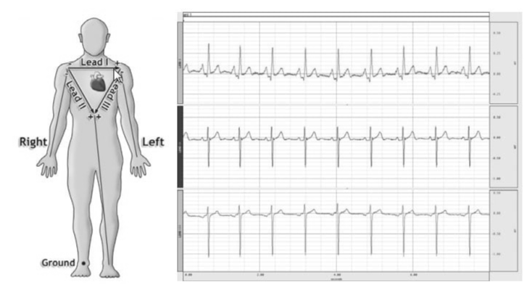

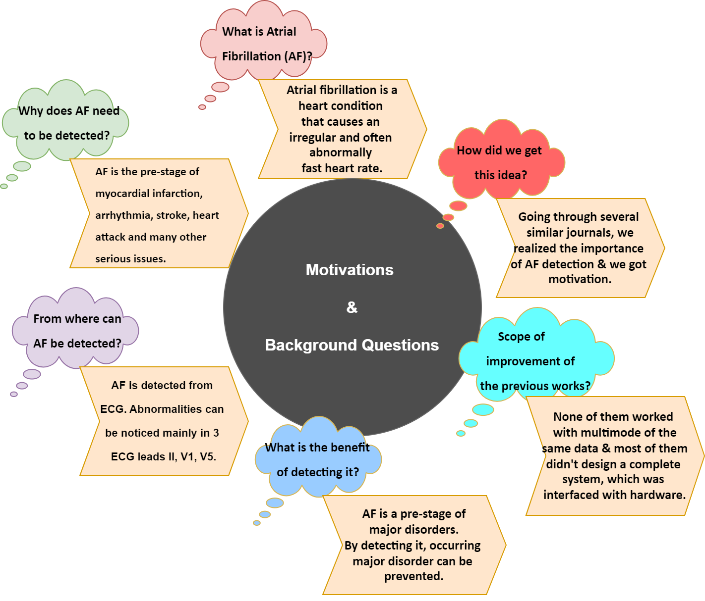
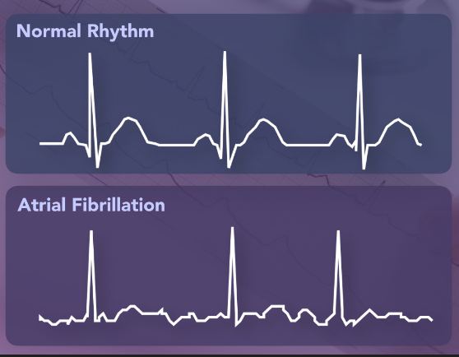
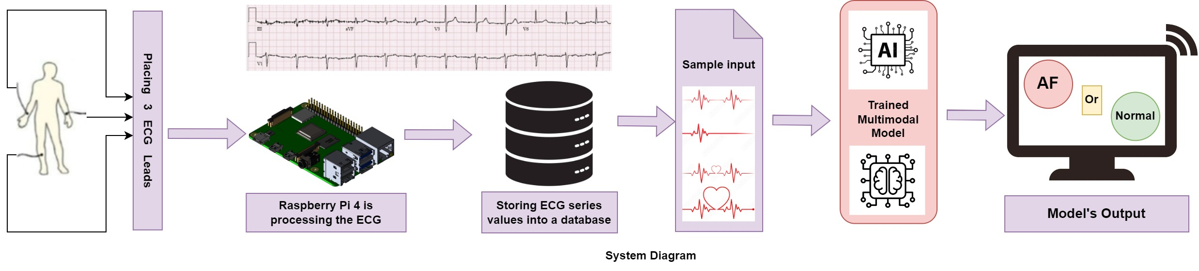

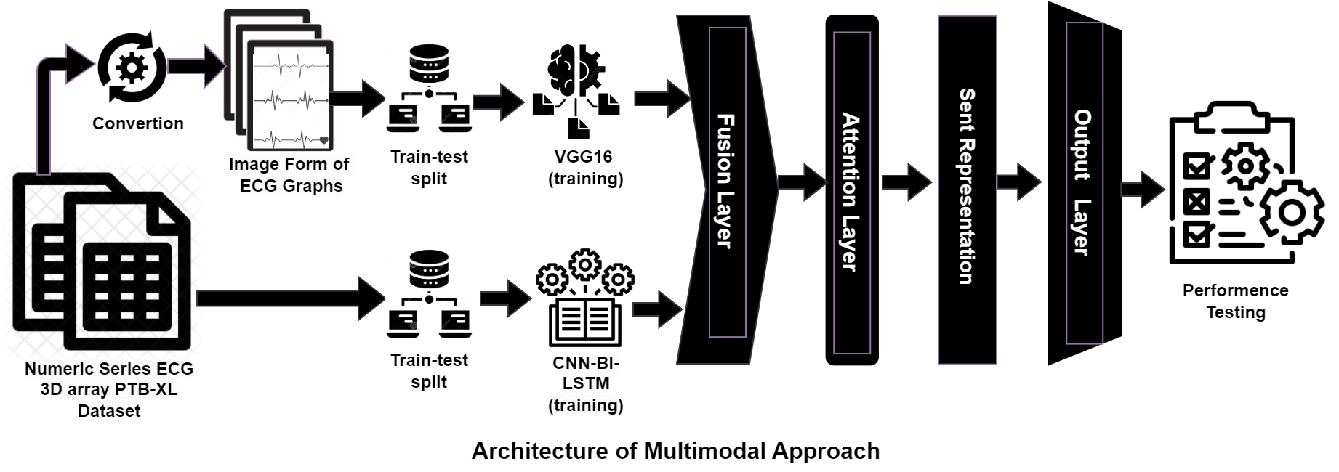





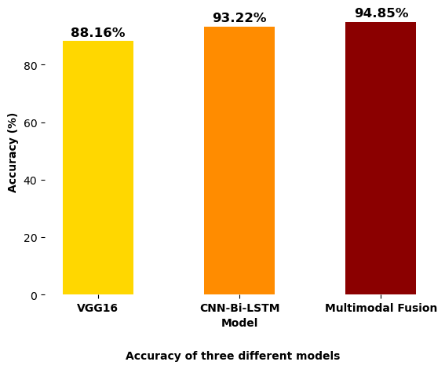
"HeartPal": An Embedded System for Real-Time Atrial Fibrillation Diagnosis Using a Multimodal Approach on ECG Data. Monalisa Akter, Abdul Ahad, Fahim Foysal Apurba, Nayeema Islam, Md. Asaduzzaman Chowdury, Riasat Khan (Advisor)
Abstract
This research proposes a comprehensive system for distinguishing Atrial Fibrillation (AF) using normal electrogram (ECG) signals. The system incorporates real-time ECG signal capture hardware and a multimodal deep learning model trained on the PTB-XL dataset, employing a dual-mode approach of a CNN-bidirectional-LSTM model for numeric ECG series and VGG16 for image-based ECG representations. A fusion layer is integrated with the features for robust detection of Atrial Fibrillation. Finally, the system is interfaced with a web application for user interaction. This study aims to feature the efficacy of a multimodal approach, improving accuracy for cardiovascular disorders in real time.
Normal vs Atrial Fibrillation
Methodology
There is an embedded system, which is employed to take real-time ECG sample. This system involves with three ECG leads and a Raspberry Pi 4. Those leads are leveraged to take the ECG signals from human body. Then, Raspberry pi process them into machine understandable form, and send it to the database.
We have trained a multimodal model on PTB-XL ECG dataset was leveraged. This multimodal approach involves two different modes of the same data, where CNN-bidirectional-LSTM for numeric series of ECG signals, VGG16 for image ECG, and a fusion layer to fuse them were engaged. This multimodality is employed for better performance.
Result & Analysis
Impact on Society
Business Model
Novelty
Conclusion
Multimodality was employed to achieve better performance. And the bar-chart- analysis shows that multi-modal approach shows state-of-the art performance.
The proposed ML and hardware solution for detecting atrial fibrillation type 2 offers early stroke warning, improving patient outcomes and reducing healthcare costs, ultimately promoting a healthier society.
Our ML and hardware solution for early stroke prediction in elderly patients can reduce healthcare costs and improve patient safety. It offers business opportunities through subscription services, insurance partnerships, data analytics, corporate wellness programs, and consumer health device manufacturing.
We employed multimodality in ECG classification.
An embedded system was integrated to take real-time ECG signal.
Interfaced both part in a web-platform.
In conclusion, This research creates a system for precise Atrial Fibrillation detection from ECG signals, combining real-time ECG hardware with a deep learning model that uses CNN-bidirectional LSTM for numerical data and VGG16 for image data. A fusion layer boosts accuracy, and a web application allows user interaction.

