Slide 1

Smart Hydroponics: IoT and ML-Driven Sustainable Farming
Mid Presentation of FYP
Group Members
Riaz Ud Din
Fahim Ur Rehman Shah
Supervisor: Dr Ahmed Salim
Department of Electrical Engineering
Namal University, Mianwali
2024-25

Slide 2
Outlines
Introduction
Literature Review
Work Done So Far
Future Work
Conclusion
References

Slide 3
Introduction
Increasing population impacts food supply
Hydroponics offers a solution to land and water scarcity
IoT and ML enhance real-time monitoring and optimization
Aim: Develop a smart hydroponic system with IoT and ML

Slide 4
Literature Review
Overview of Hydroponics
Hydroponics is a soilless farming method
Different techniques of Hydroponics
Aeroponics
Deep Water Culture
Nutrient Film Technique
Ebb & Flow

Slide 5
Literature Review
Comparison of Vertical Farming Techniques [1]
Parameters | Other Hydroponic Systems | Aeroponic System
Productivity (yield/sq.m/year) | 150-200 kg | 200-250 kg
Water saving percentage | Upto 90% | Upto 95%
Space utilization efficiency | Upto 90% | Upto 95%
Resource requirements | Nutrient rich water, Grow lights, Growing medium(optional) | Misting nozzles, Nutrient richwater solution, Grow lights

Slide 6
Literature Review
Related Work
IoT-Enabled Vertical Farming System (Universiti Sains Malaysia, 2023).[2]
Implemented using Arduino Nano & NodeMCU ESP8266.
12V 4-Channel Relay controls water pumps & UV lighting.
Data transmitted via HTTP REST API to Blynk Cloud.
UI hosted on SystemLink Cloud for real-time monitoring & control.
Updates environmental data every 10 seconds with numerical & graphical display.

Slide 7
Cont…
Automated Vertical Hydroponic System (Qatar University, 2020). [3]
NFT System with 3 shelves, 4 PVC pipes per shelf, and 9 planting holes per pipe.
LED lights (6K3R4 & K6) optimized for photosynthesis.
pH & EC, YF-S201 (water flow), capacitive water level, temperature & humidity sensors integrated with Arduino Mega.
Dosing pumps for nutrient and pH adjustment
Thingspeak platform for data visualization and storage
SMS alerts for pump failures.

Slide 8
Cont…
IoT & ML-Integrated Hydroponic System (SRM Institute of Science and Technology, 2023). [1]
Monitors: pH, EC, light intensity, humidity, temperature using IoT sensors.
Machine Learning Models: ANN, Random Forest, SVR for yield prediction
Automated controls for nutrient delivery and environmental regulation.
Components: Submersible water pumps, LED grow lights, dosing pumps for pH & nutrients.
Cloud-based monitoring via Thingspeak for real-time data access.

Slide 9
Cont…
Performance Assessment of Vertical Farming Techniques.[1]
VF technique | Data Collection | ML Algorithm | Accuracy | Advantages | Applications
Aeroponics | IoT sensors (pH,EC,light,) | RF XGBoost | 94.37% | Precise control over the nutrient delivery | Herbs, lettuce, cabbage, carrots, tomatoes, leafy
Aquaponics | IoT sensors (pH, EC,light, humidity, temperature) | Decision trees RF LR | 91.28% | Minimize water usage, utilize fish waste as nutrientsource, high crop yield | Garlic, Chives, carrots, mint, water cross
Other Hydroponics | IoT sensors (pH, EC,light, humidity, temperature) | ANN RF SVR | 89.18% | Precise control over the nutrient delivery and environmental conditions, Reduces water usage, increased crop yield, minimizes chemical usage | Leafy greens, herbs, strawberries, tomatoes, cucumbers, peppers

Slide 10
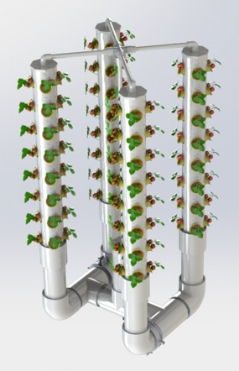
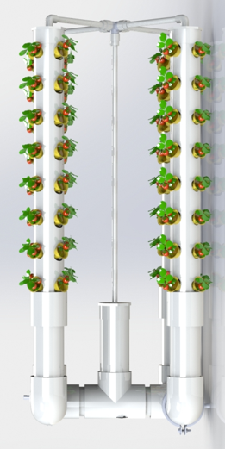
Work Done So Far
3D model

Slide 11
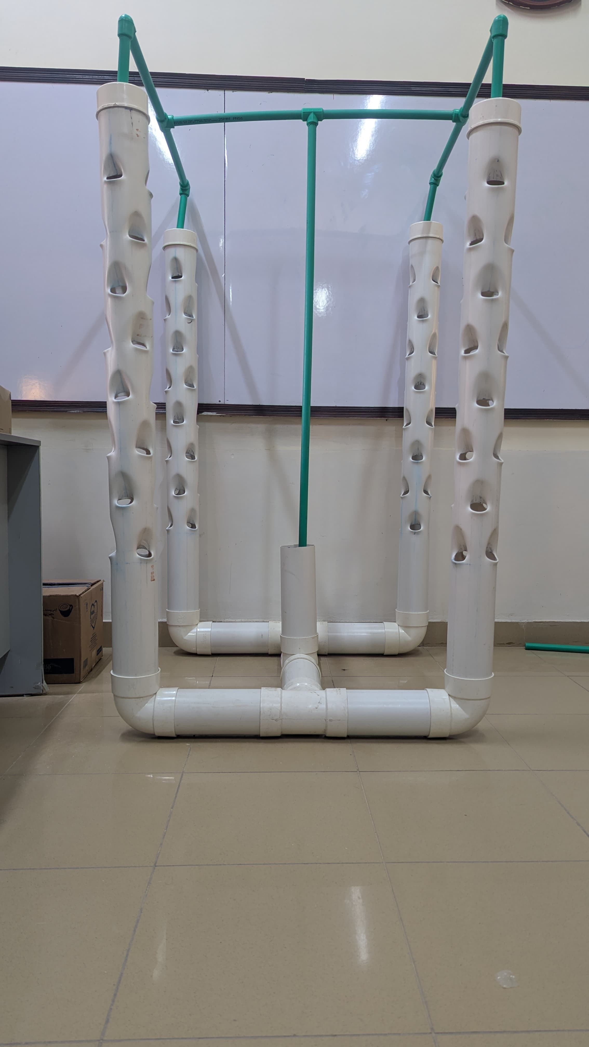
Cont…
Hydroponic structure developed with precise dimensions

Slide 12
Cont…
Structure’s Dimensions
Plant Cup (Total = 96)
Diameter = 40 mm
Length = 50 mm
PPRC Pipe (water) (0.5 inch)
Pipe Length = 8 inch
Quantity = 4
PPRC Center Pipe (0.5 inch)
Pipe Length = 1.7 m
4 Inch Elbow
Quantity = 4
Elbow & Tee connector pipe (4 inch)
Pipe Length = 1 ft
Quantity = 7
Pipe b/w T & elbow (0.5 inch)
Pipe Length = 21 inch
Quantity = 6
PVC Elbow (0.5 inch)
Quantity = 4
4 Inch Pipe End Cap
Quantity = 5
Plant Holes Tower/Pipe (4 inch)
Pipe Length = 1.5 m
Quantity = 4
Hole diameter = 40 mm
4 Inch Tee
Quantity = 3
0.5 Inch Pipe Tee
Quantity = 3

Slide 13
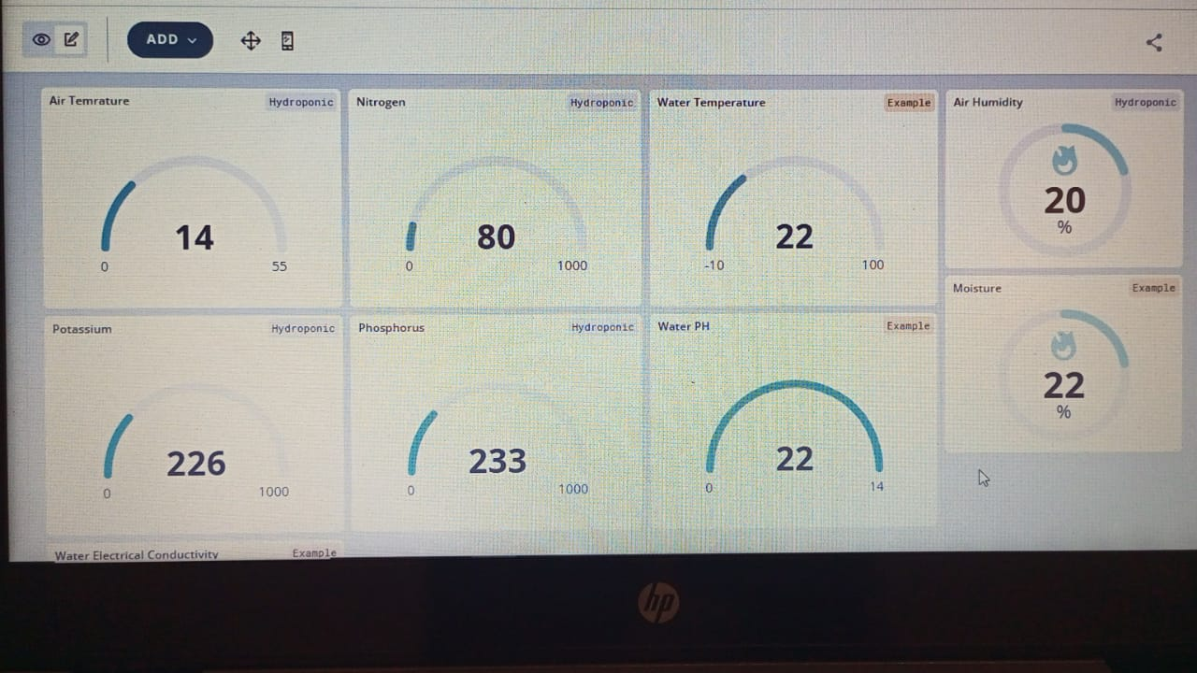
Cont…
Arduino Dashboard

Slide 14
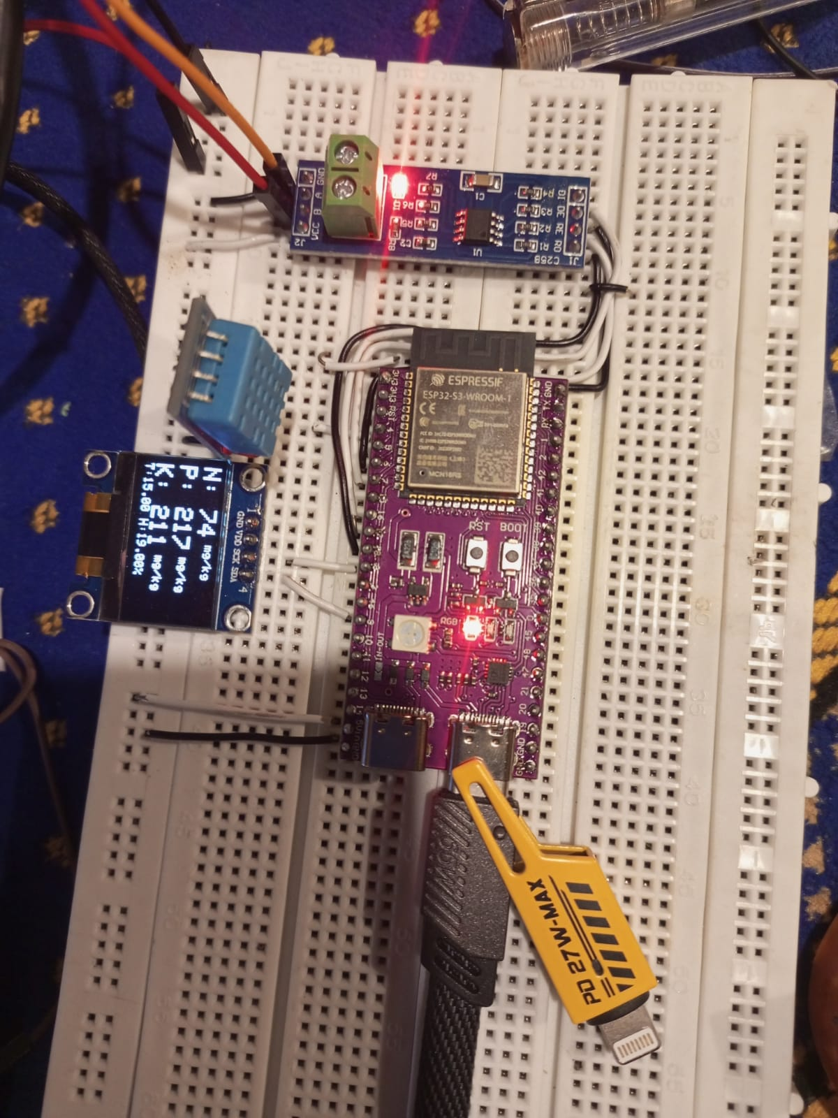
Cont…
Circuit

Slide 15
Way Forward
Targeted Plants, their pH and EC. [4]
Plant Name | pH | Electrical Conductivity | Timeline (Weeks)
Lettuce | 5.5 – 6.5 | 0.8 - 1.2 | 2 – 12
Cocumber | 5.8 – 6.0 | 1.7 – 2.5 | 7 – 12
Capsicum | 6.0 – 6.5 | 1.8 – 2.2 | 8- 14
Tomato | 5.5 – 6.5 | 2.0 – 5.0 | 8 – 14
Eggplant | 5.5 | 2.5 – 3.5 | 8 - 12

Slide 16
Cont…
Circuit Completion
IoT Circuit Implementation on Hydroponic
Data Collection and Machine Learning

Slide 17
Conclusion
Successfully designed and developed Hydroponic Structure according to the dimensions.
Implemented IoT circuit up to some extent, further modification is needed to complete.
Future work focuses on implementation, data collection and ML model training.

Slide 18
References
[1] Rajendiran G and Rethnaraj J (2023), “Future of Smart Farming Techniques: Significance of Urban Vertical Farming Systems Integrated with IoT and Machine Learning”. Available: https://www.researchgate.net/publication/372890247
[2] Harn Tung Ng, Zhi Kean Tham, Nurul Amani Abdul Rahim (2023)," IoT-enabled system for monitoring and controlling vertical farming operations".
[3] Muhammad E. H. Chowdhury, Amith Khandak, Saba Ahmed and Fatima Al-Khuzaei (2020). "Design, Construction and Testing of IoT Based Automated Indoor Vertical Hydroponics Farming Test-Bed in Qatar”. Available: https://www.mdpi.com/1424-8220/20/19/5637
[4] Hydroponic Charts for Fruits and Vegetables. Available: https://ponicslife.com/hydroponic-charts-for-fruits-and-vegetables-ph-tds-ec-cf-ppm/

Slide 19
Thank You!
Any Question?

