Slide 1

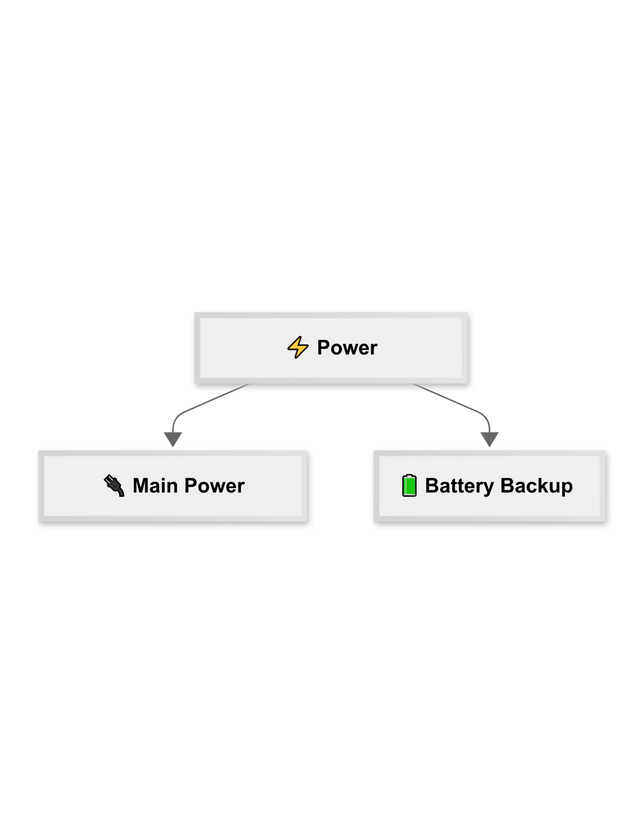
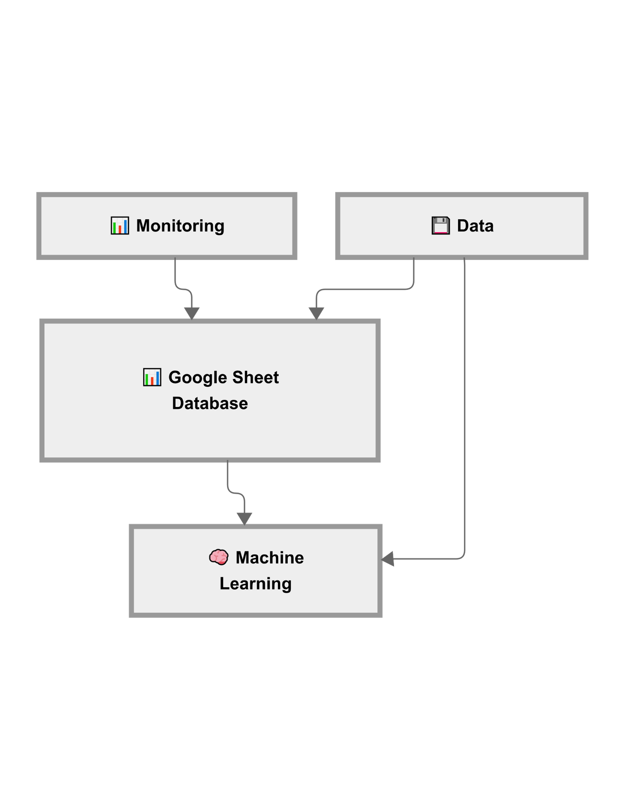
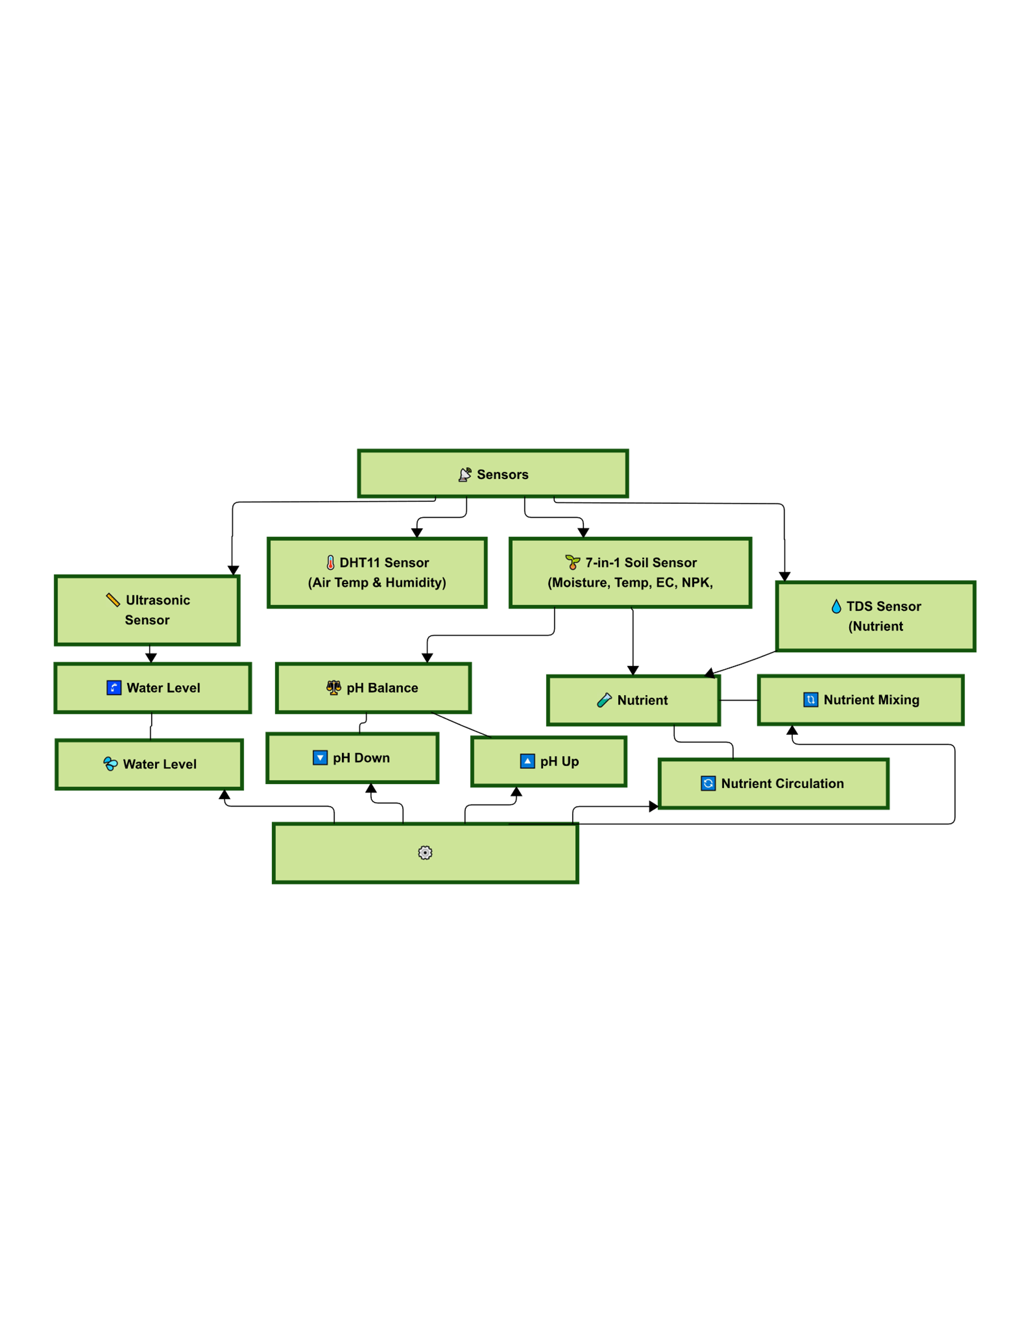
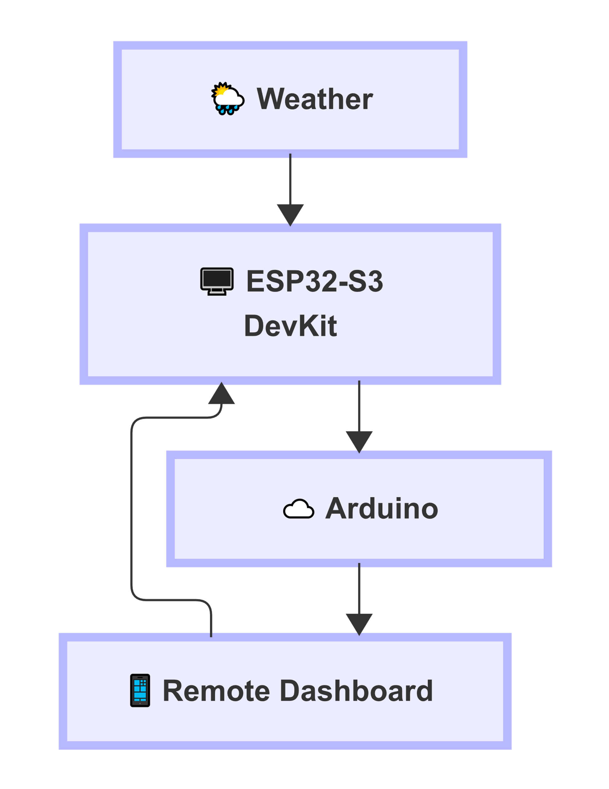




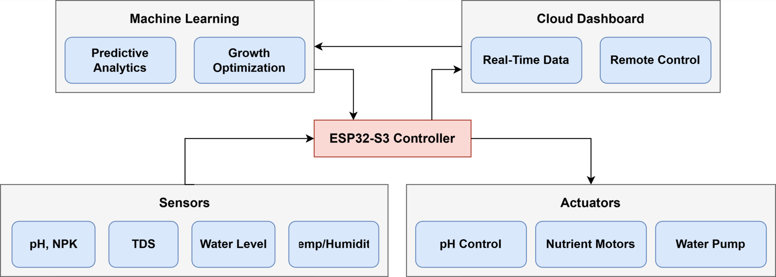
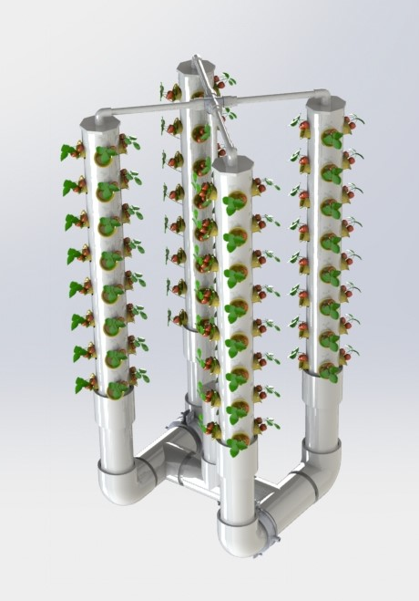
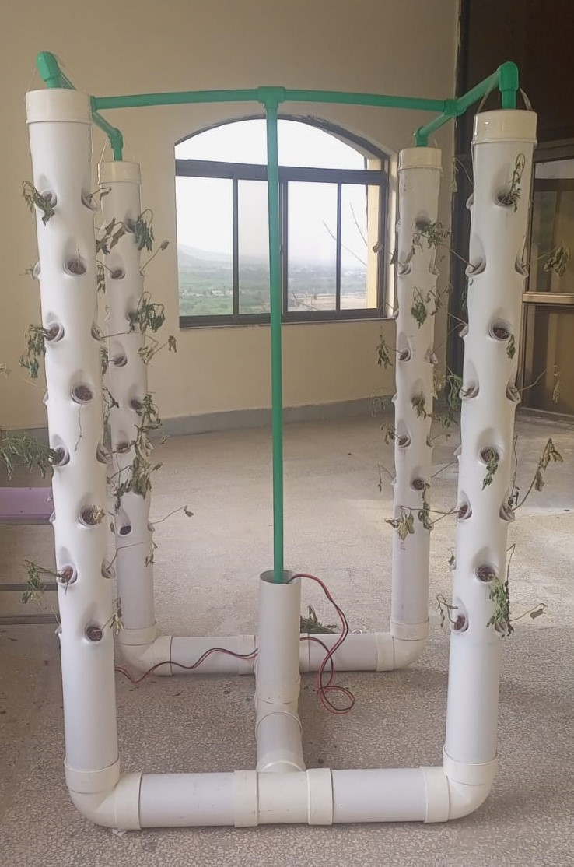
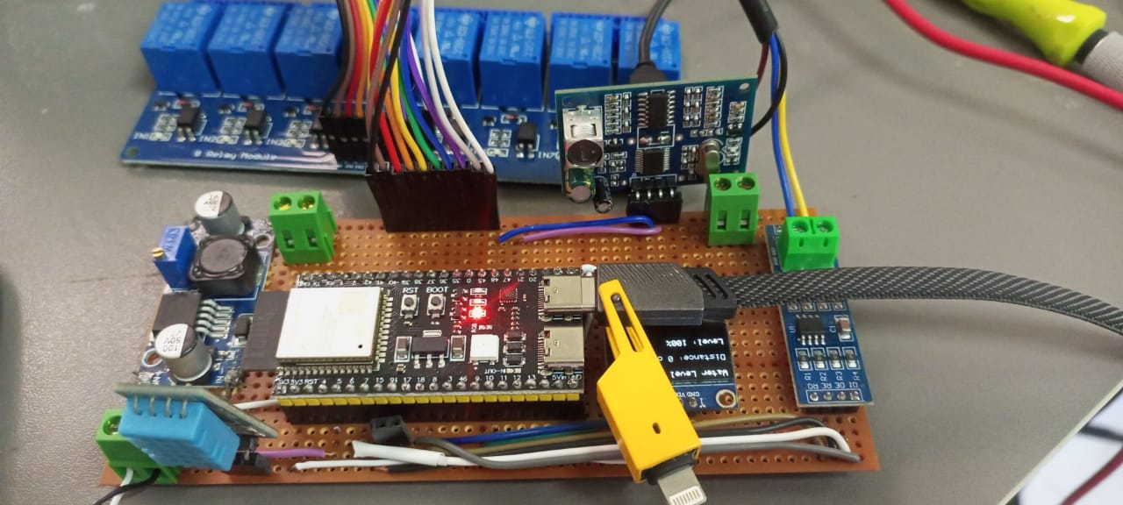



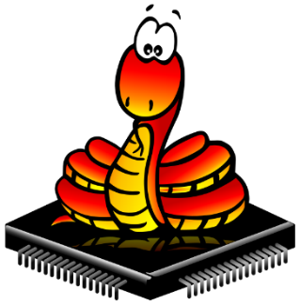

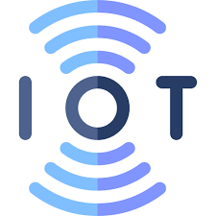

Smart Hydroponics: IoT and ML-Driven Sustainable Farming
SESSION 2021-2025
Abstract
With the global population projected to reach 9.7 billion by 2050, food demand is expected to increase by 50%. This poses a significant challenge, especially for Pakistan, the fifth most populous country with over 250 million people, where cultivable land is shrinking. Conventional agriculture may not meet future demands due to limited arable land and water scarcity. Hydroponics, a soilless farming technique, presents a promising solution by conserving water, reducing land use, and enabling year-round cultivation. However, traditional hydroponic systems lack real-time monitoring and adaptive control, leading to resource inefficiencies. Integrating the Internet of Things (IoT) allows continuous monitoring of environmental conditions, while Machine Learning (ML) algorithms can analyze this data to predict optimal growing parameters. This project aims to develop a smart hydroponic system that merges IoT and ML technologies to enhance sustainability, resource efficiency, and productivity in modern agriculture.
1. Introduction
3. Design, Results, and Analysis
Limitations of Conventional Farming : Traditional agriculture heavily depends on arable land and water, both of which are becoming increasingly scarce.
Hydroponics is a method of growing plants without soil, using nutrient-rich water solution instead.
Limitations of Traditional Hydroponics : Despite its potential, conventional hydroponic systems lack real-time feedback and adaptive controls.
IoT and ML Integration : IoT enables real-time monitoring of parameters like pH, temperature, NPK and humidity. Machine Learning (ML) analyzes this data to predict optimal growing conditions, enhancing precision and productivity.
Project Flow Chart
UN SDGs Mapping
Actuator
2. Block Diagram, Tools and Technologies
Hydroponic System
Block Diagram
3D Model
Physical Structure
Circuit
Tools and Technologies
Conclusion
The smart hydroponic system, powered by the ESP32-S3 DevKit, has been successfully developed and implemented, integrating hardware, software, and data analytics to create an efficient and user-friendly solution for automated plant cultivation. The system effectively monitors and controls critical parameters such as temperature, humidity, pH, EC, TDS, and water levels through sensors, with precise motor-driven adjustments in both automatic and manual modes. Real-time data is displayed on a responsive, modern website with intuitive controls and visualizations, while Google Sheets integration ensures robust data logging and supports advanced graphing. This project demonstrates a scalable, reliable, and innovative approach to smart agriculture, with potential for further enhancements in predictive analytics and system automation.
Department of Electrical Engineering
Group Members:
Riaz Ud Din (NIM-BSEE-2021-36)
Fahim Ur Rehman Shah (NIM-BSEE-2021-24)
Supervisor:
Co-supervisors:
Dr. Ahmed Salim
Dr. Sami Ud Din
Dr. Muhammad Ashraf

