Slide 1
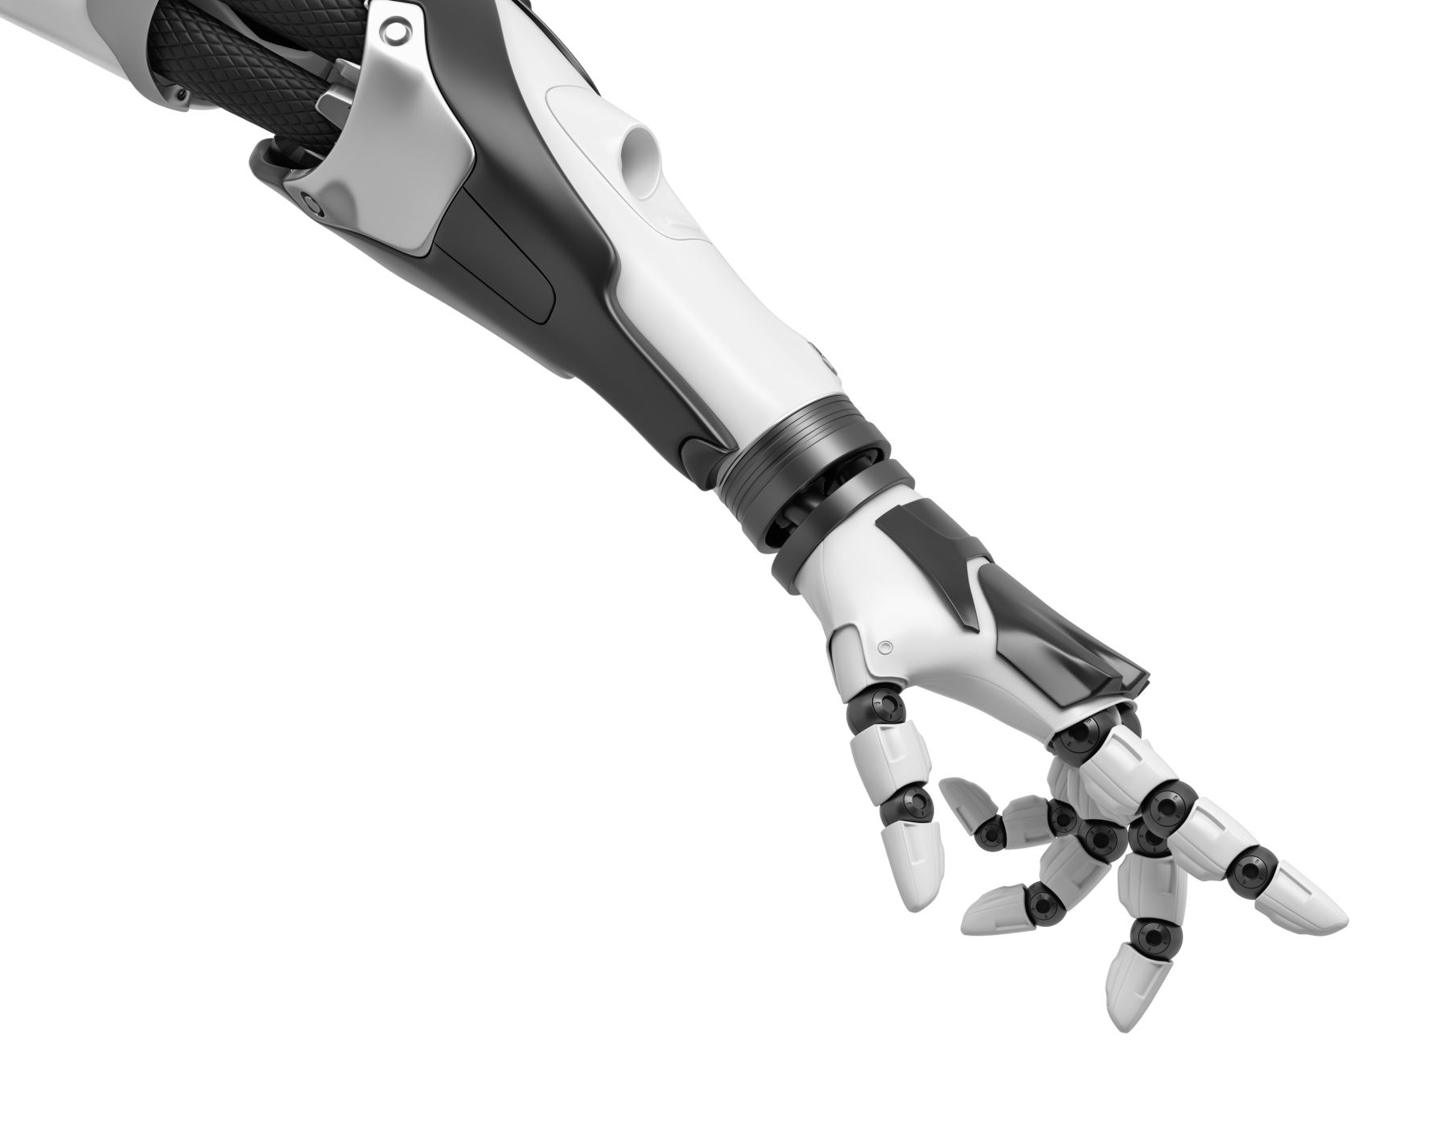
Supervise Robotic Hand in various ways
Team_CopyPaste

Slide 2
Supervise Robotic Hand in various ways
Supervised robotic hand refers to a robotic hand that is controlled and operated by a human. The operator provides input to the robotic hand through various ways. Our proposed system is mainly works in different interfaces and controls the robotic hand in different ways Voice Controlled, Eye Motion Controlled, Hand Gesture Mimicking.

Slide 3
Supervise Robotic Hand by Mimicking Hand
By using a human hand as a model, it can be easier to design a control system for the robotic hand. For example, a human operator could use their own hand to control the robotic hand in a teleoperation setup in very hazardous or risky place such as Any radiated place or deep in ocean etc. which would be more intuitive and accurate than using a joystick or other type of control interface.
Mimicking the movement of one hand with a robotic hand can be important for one-handed individuals as it can help them to perform tasks that would otherwise be difficult or impossible to do with just one hand.

Slide 4
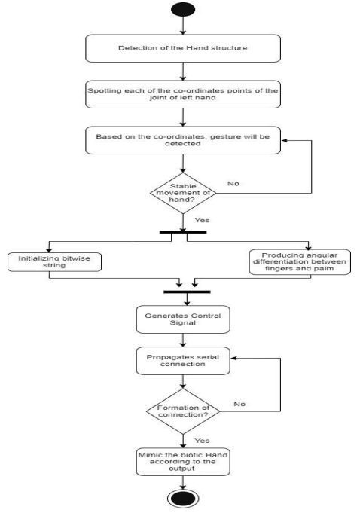
Supervise Robotic Hand by Mimicking Hand
system will try to detect hand of the user then spot all the points based on the co-ordinates a valid command detected. then As per command control signal will generate and sends it to the processor responsible for movement of the hand and the processor process the data and move hand as users command.

Slide 5
Supervise Robotic Hand by Mimicking Hand

Slide 6
Supervise Robotic Hand by Eye Movement
Controlling a robotic hand using eye movement can be especially important for individuals with disabilities, as it can provide them with increased independence and the ability to perform tasks that would otherwise be difficult or impossible. Eye movement control allows individuals with physical disabilities or limited mobility to control the robotic hand without the need for a physical control interface, such as a joystick or keyboard. This can make the robotic hand more accessible to a wider range of individuals, including those with paralysis or amputation.

Slide 7
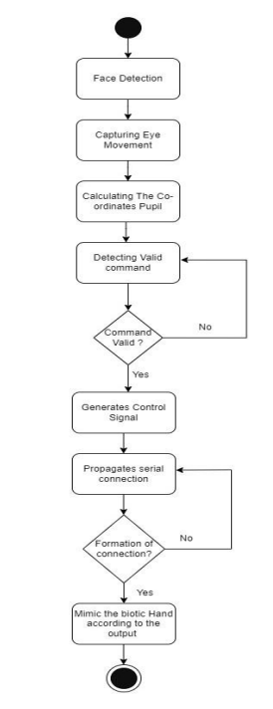
Supervise Robotic Hand by Eye Movement
system will try to detect users face then start capturing eye movement spot all the points and based on the co-ordinates of pupil a valid command detected. Then As per command control signal will generate and sends it to the processor responsible for movement of the hand and the processor process the data and move hand as users command

Slide 8
Supervise Robotic Hand by Voice Command
Increased accessibility: Voice commands allow individuals with physical disabilities or limited mobility to control the robotic hand without the need for a physical control interface
Improved ease of use: Voice commands can also be more intuitive and easier to use than a traditional control interface.
Multi-tasking: Voice commands can also allow an operator to control the robotic hand while doing other tasks, such as monitoring other machines or controlling other robots, thus increasing productivity

Slide 9
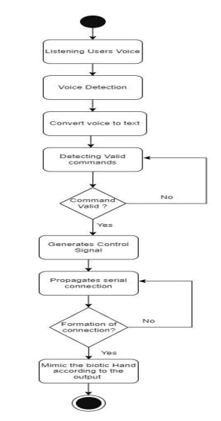
Supervise Robotic Hand by Voice Command
System will start listen to user's voice. Convert it into Text And Detect Valid Command. then As per command control signal will generate and sends it to the processor responsible for movement of the hand and the processor process the data and move hand as users command.

