Slide 1
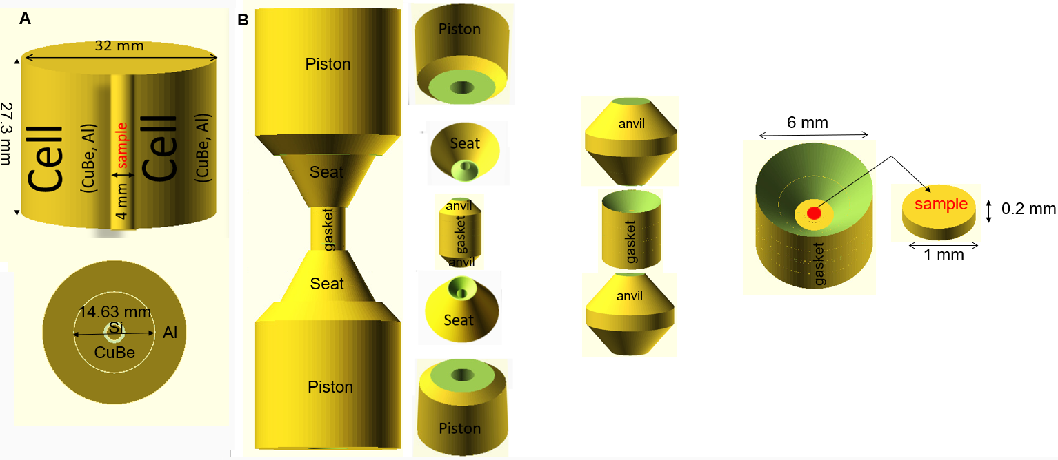
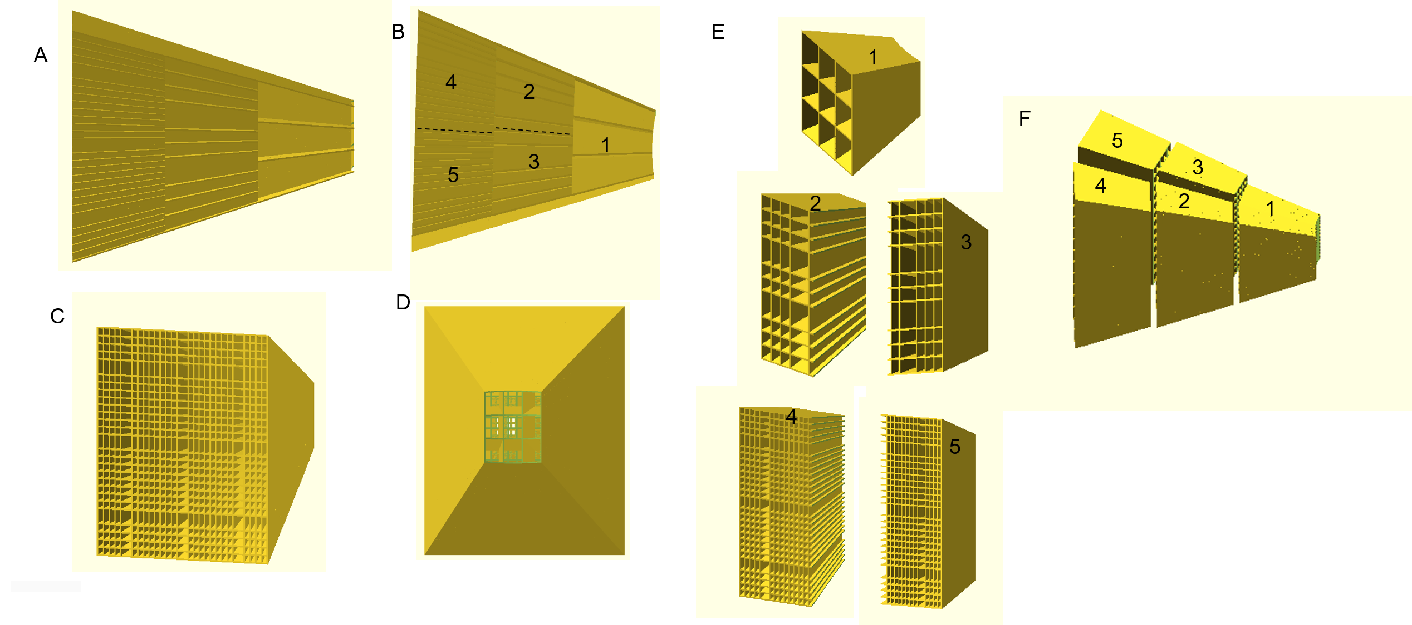
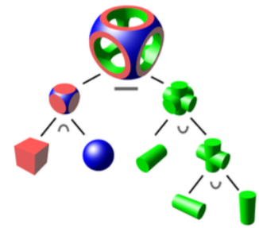
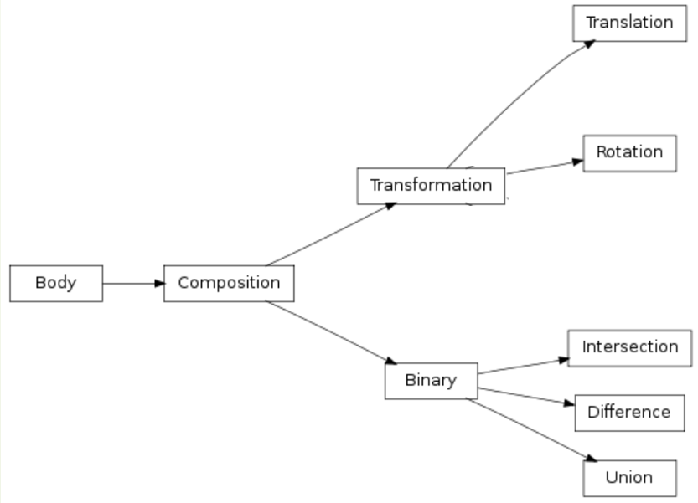
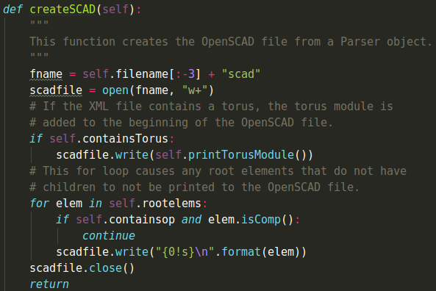
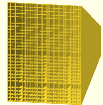
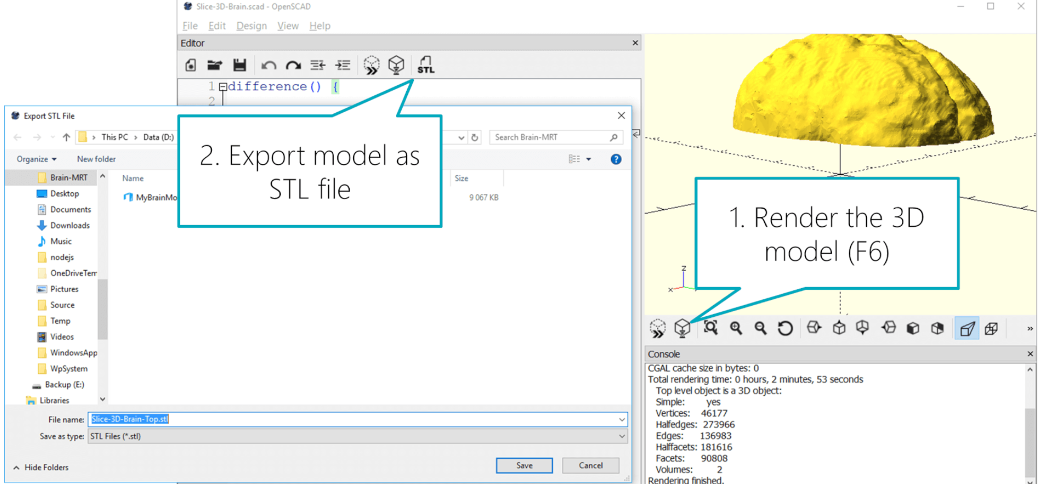
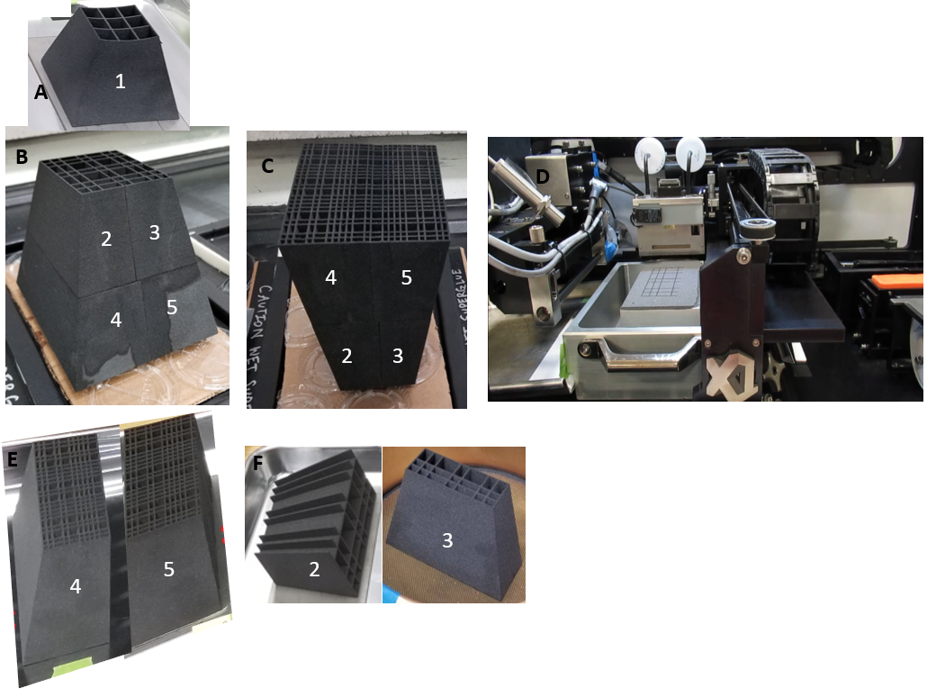
Direct Transfer of Monte Carlo Ray tracing Models to Additive Manufacturing Systems
Fahima Islam¹, Jiao Lin, Bianca Haberl¹,Ian Lumsden¹, David Anderson², Garrett Granroth¹,
¹Neutron Scattering Division, Oak Ridge National Laboratory
²Neutron Technologies Division , Oak Ridge National Laboratory
Abstract
Examples of 3D Models
Advanced computer-aided design (CAD) modelling is a general prerequisite in 3D printing or Additive Manufacturing (AM) processes. Monte Carlo simulations, used to model the neutronic performance of an instrument, have 3-D representations of the instrument, but transferring this to CAD models is usually done by hand and is the most time-consuming and error prone part of the entire process chain. This contribution describes a tool to take components modeled in McVine and convert them straight to a format ready for AM. Over the last three decades, the STereoLithography (STL) file format, has become the de facto standard, used in many, if not all, AM systems to exchange information between design programs and AM systems. Our system uses scripts to generate a computer model, in which python statements describe the geometry of the required object by using Constructive Solid Geometry (CGS). CGS is a way of building complex objects from simple primitives using Boolean operations. The script encodes the set of CGS primitives representing the object onto a hierarchical tree. This script saves the tree structure onto an XML file used in McVine for the Monte Carlo Simulation. We developed a program the leverages OpenSCAD to create CAD models from the geometry defined in the xml file. OpenSCAD directly exports the geometry to an STL file, which is used for 3-D printer open-source slicing programs. This tool was used to create CAD files representing two pressure cells with different complex shapes and collimators to reduce background from these cells. The neutron scattering from the components is simulated by MCViNE. Furthermore it has been used to generate collimator designs that are printed via AM.
Flow chart
Monte Carlo Ray Tracing Begins
Object Physical modeling creates
.xml file which includes geometry
as well as file information using
CGS tree
i=1,M (number of iteration)
Calculate the first location (x₀,y₀,z₀)
of the neutrons with the initial
propagation direction, ᾱ (φ₀,θ₀)
Calculate the new coordinate
(x’,y’,z’) with the new propagation
Direction ᾱ (φ’,θ’) and distance dS.
Let (x₀,y₀,z₀)=(x’,y’,z’),
ᾱ (φ₀,θ₀) =ᾱ (φ’,θ’)
Partially absrobed, being transmitted.
Calculate the new coordinate
(x’,y’,z’) with the transmitting
Direction ᾱ (φ’,θ’) and distance dS.
Let (x₀,y₀,z₀)=(x’,y’,z’),
ᾱ (φ₀,θ₀) =ᾱ (φ’,θ’)
YES
NO
Σds ≥ Limit ?
Being scattered,
Calculate the new coordinate
(x’,y’,z’) with the scattering
Direction ᾱ (φ’,θ’) and distance dS.
Let (x₀,y₀,z₀)=(x’,y’,z’),
ᾱ (φ₀,θ₀) =ᾱ (φ’,θ’)
Inside the object ?
YES
NO
Inside the object ?
YES
totally absorbed
NO
Hits one of the boundary surface ?
Scatterd (S<σ) ?
3D printed parts
YES
End
NO
This work is supported by LDRD
SNAP beam times are allocated for this work
Notes:
1

