Slide 1
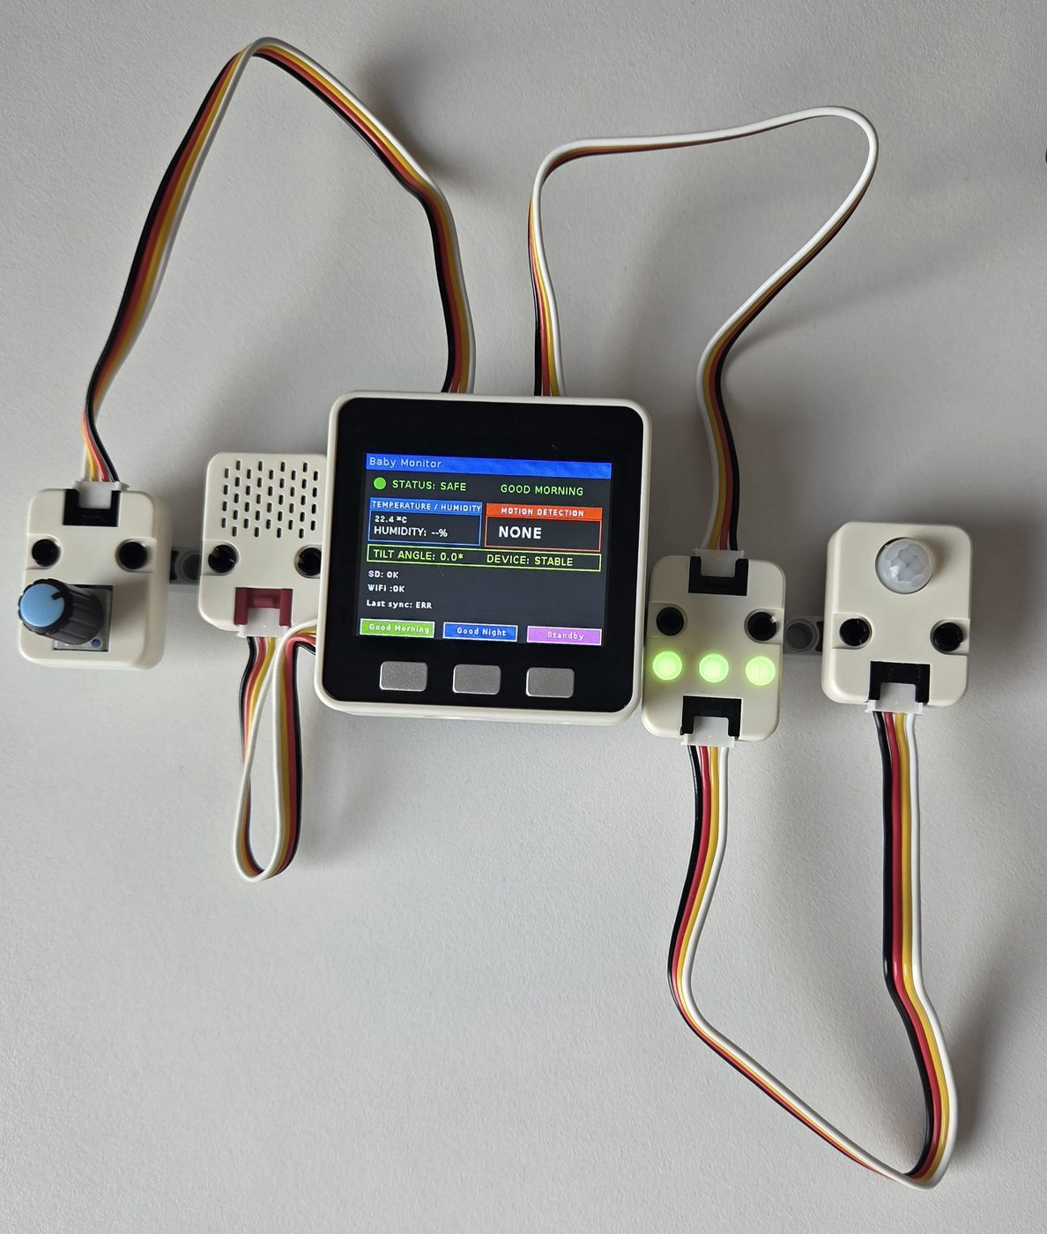
IOT COURSE FINAL PRESENTATION
Smart IoT Baby Monitor
Remote safety monitoring with the M5Stack ecosystem
Fahimeh Tajarrod
Prof. Joseph Oakes • Internet of Things

Slide 2

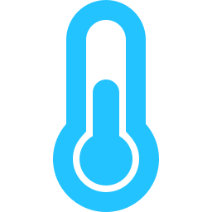



01 — INTRODUCTION
Why a smart baby monitor?
A baby left alone in a room is exposed to risks a caregiver can't always watch for in real time — uncomfortable room conditions, a wet crib, or unexpected movement.
Project Goal
Build a self-contained IoT device on M5Stack Core that watches the room, reacts instantly with visual and audio cues, and keeps a remote caregiver informed — on the device,, and on their phone.
Room temperature
Too hot or too cold for comfort
Bedding humidity
Detects a wet mattress under the baby
Unexpected motion
Platform: M5Stack Core (ESP32) • UIFlow 1.15.3
Movement detected near the crib edge
Program model: Blockly
Falls & tilt
Sensors: ENV III, PIR, IMU, RGB, Angle dial
The monitor itself is knocked over
02

Slide 3
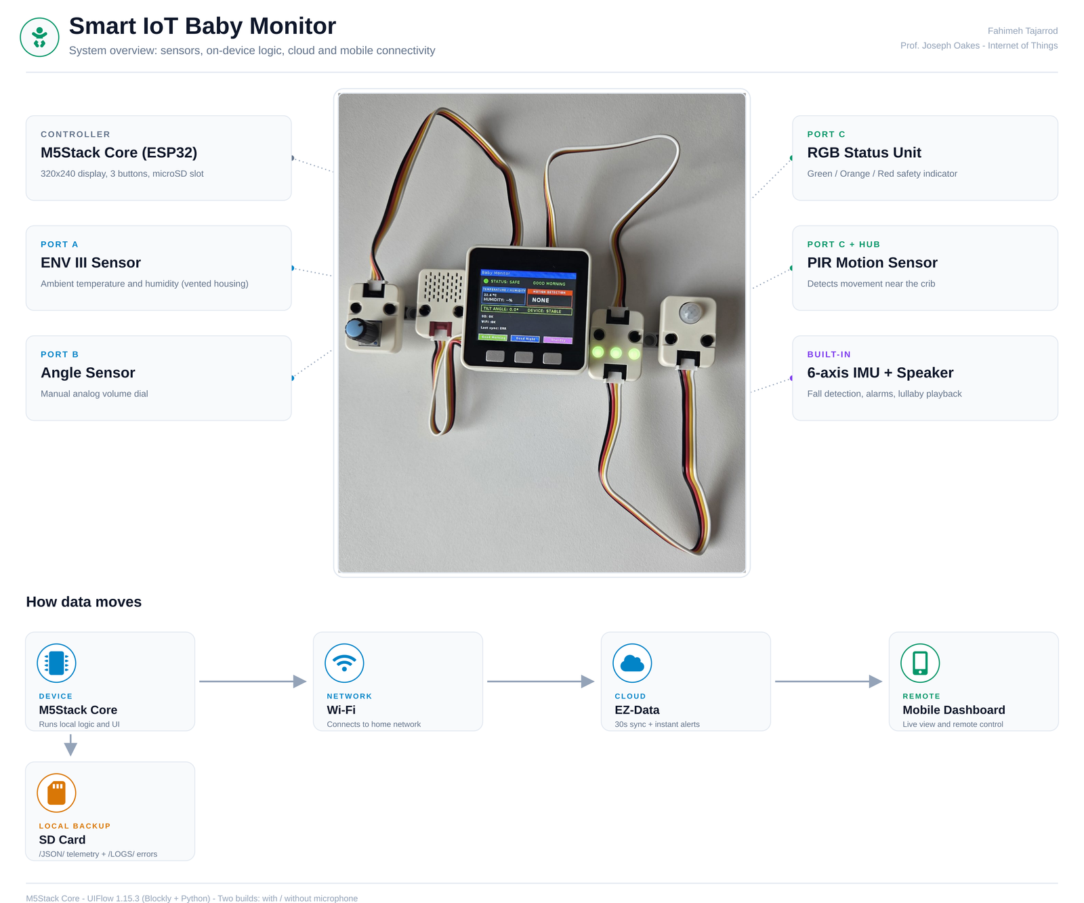
The whole project, at a glance
02 — BIG PICTURE
03

Slide 4



02 — BIG PICTURE
Three operating modes
A
Good Morning
Purpose: Default state whenever the baby is in the crib without someone in the room.
How: Every loop re-reads ENV III, PIR and the IMU, and drives the RGB/status labels from those readings.
B
Good Night
Purpose: Helps settle the baby to sleep.
How: Plays a short Brahms lullaby with a synchronized LED bar color dance.
C
Standby
Purpose: For when the baby is being held by a caregiver and doesn't need monitoring.
How: Sensor checks are skipped entirely and all on-screen labels are hidden — the device is temporarily idle until switched back.
04

Slide 5
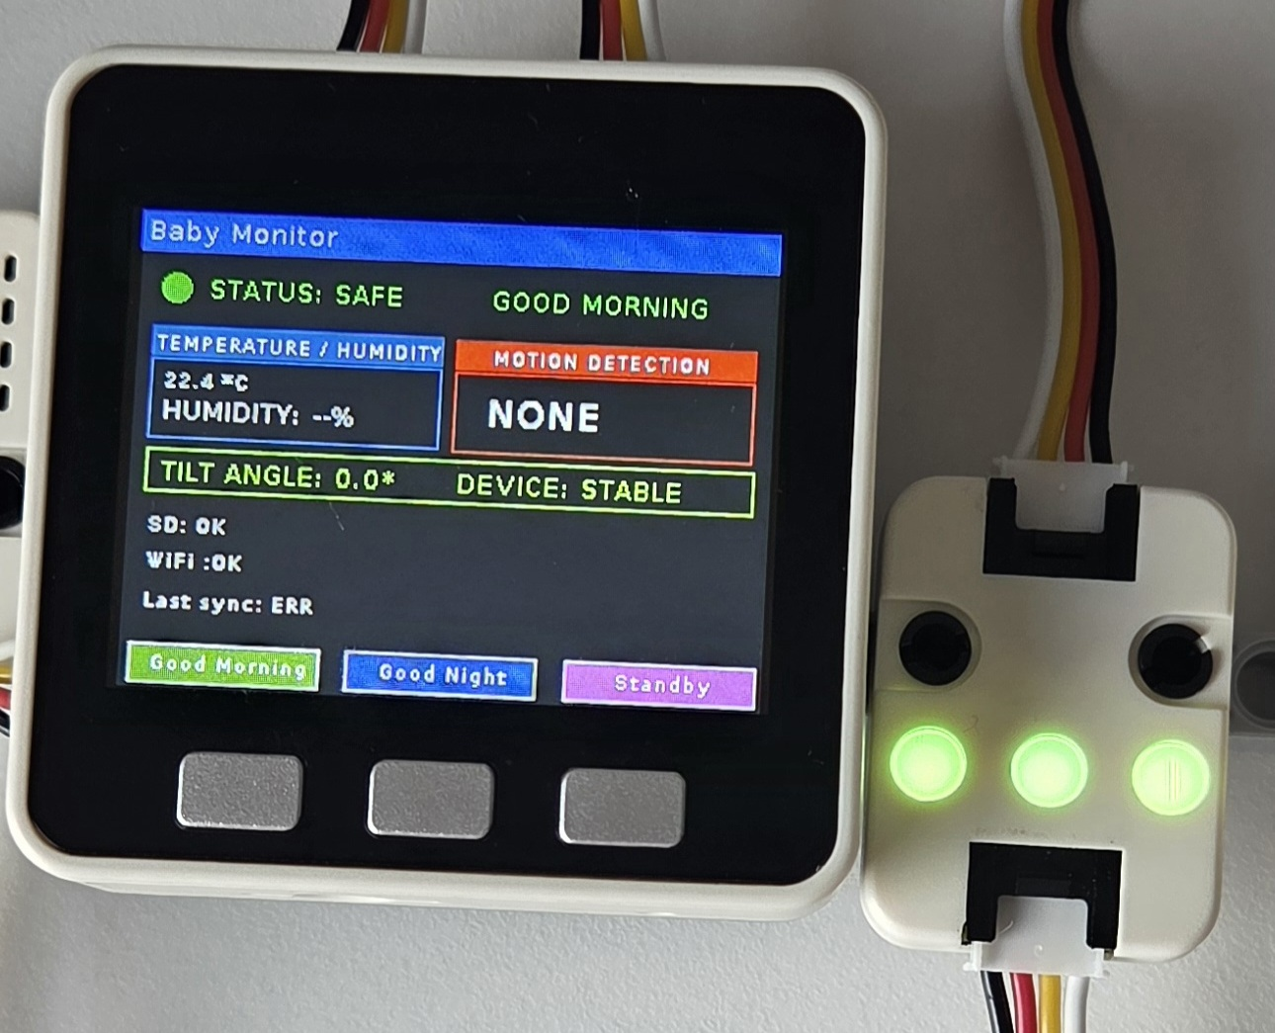
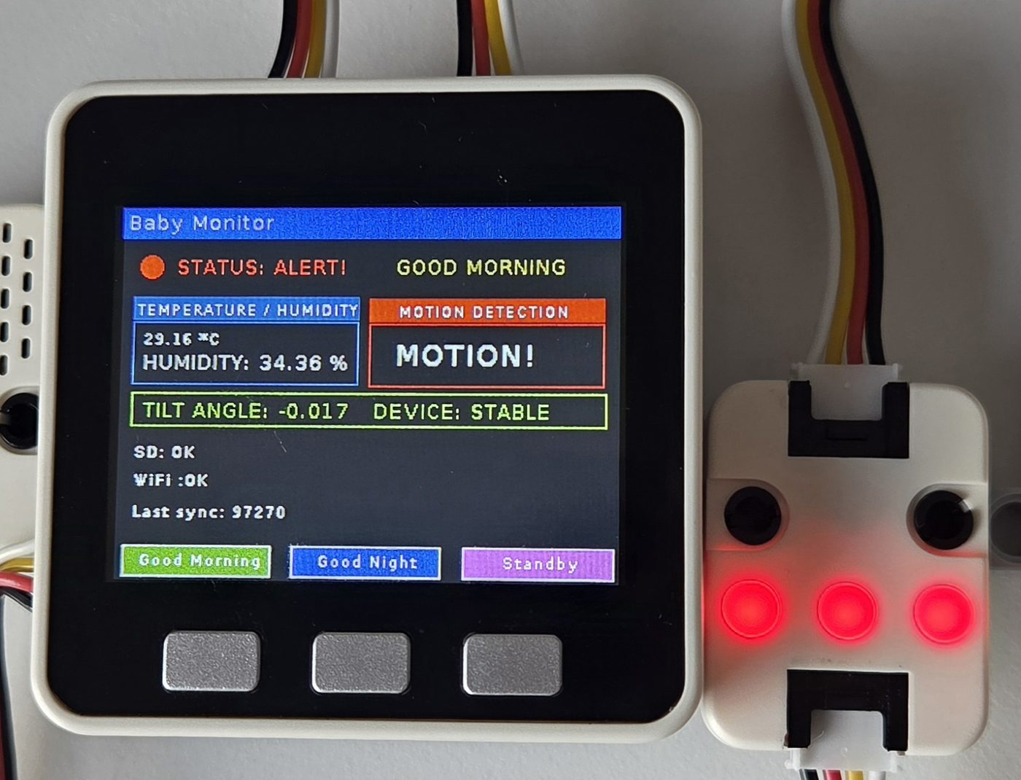
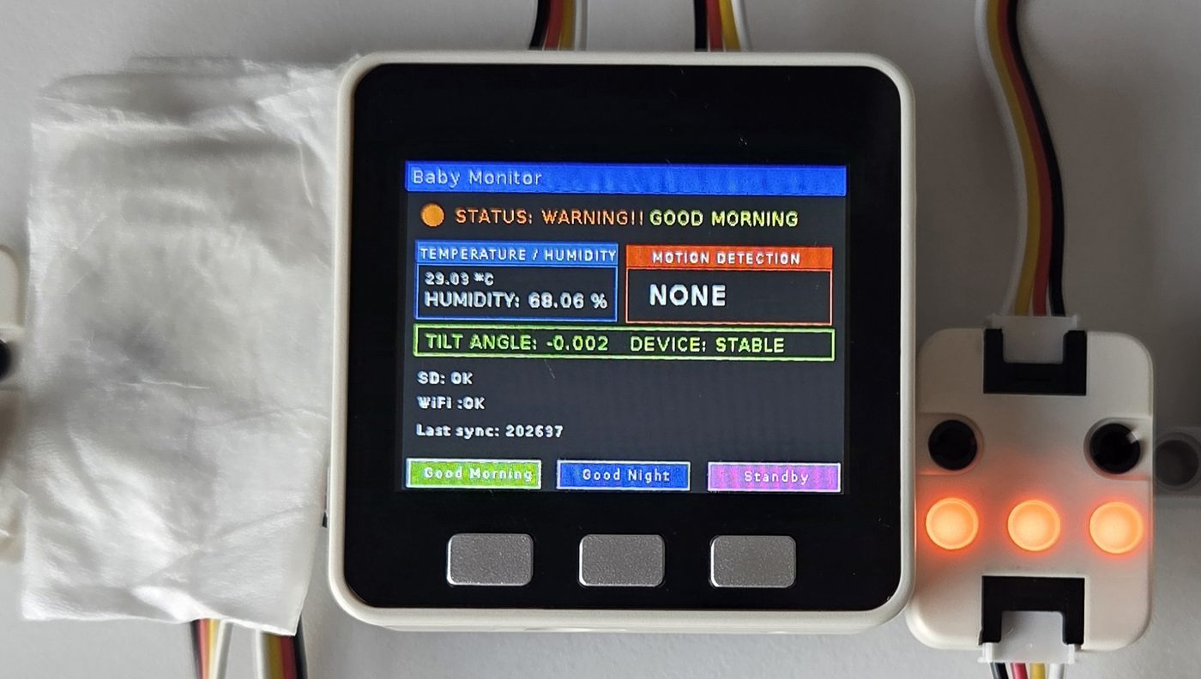
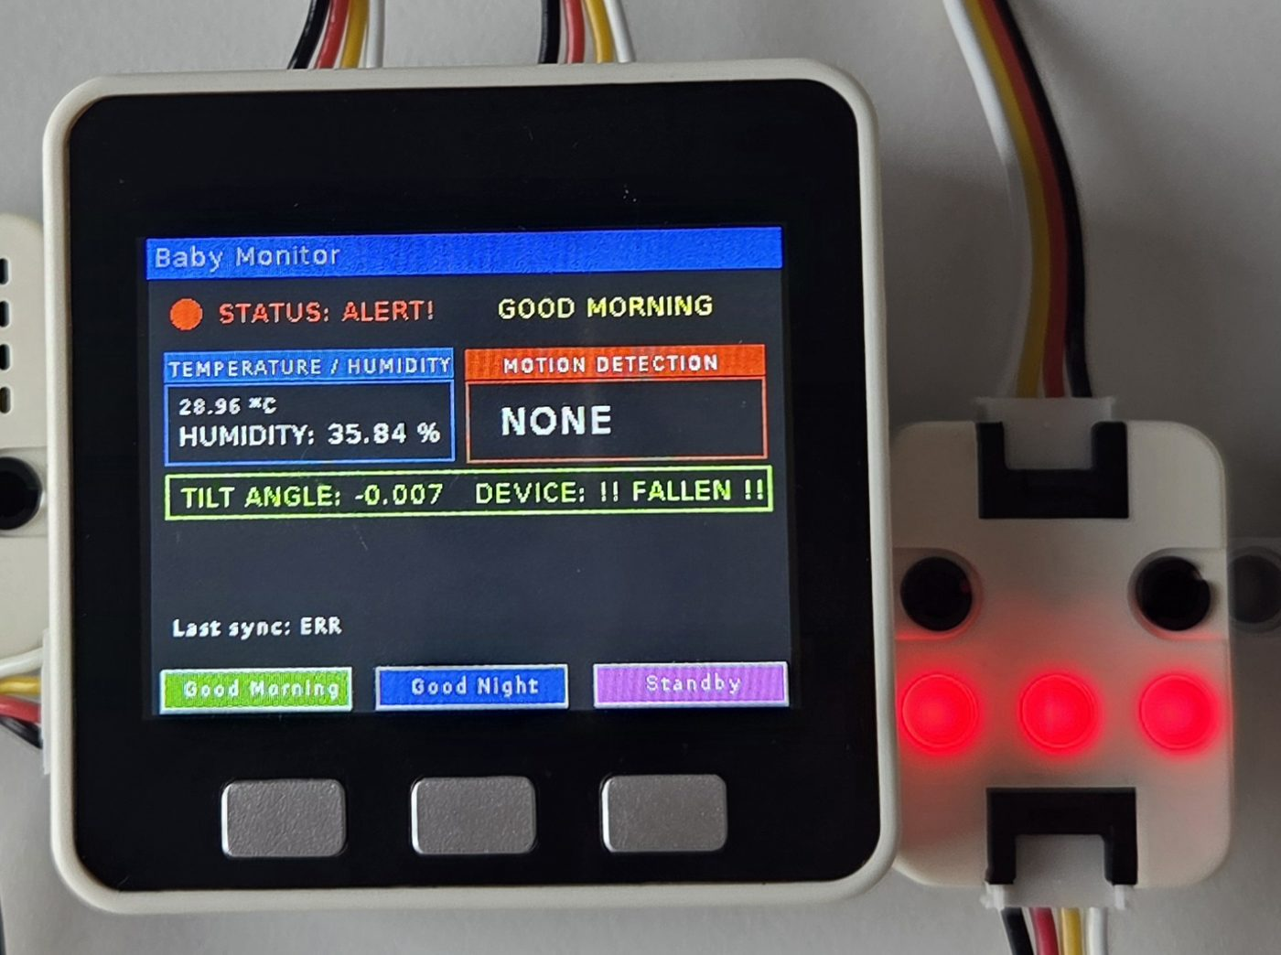
03 — LIVE DEMO
Functional demo — what to watch for
Live walkthrough of the device reacting in real time. The photos below are captured straight off the device screen and RGB unit.
SAFE
ALERT — MOTION
Green status — normal room conditions
Red status — PIR sensor triggered
WARNING
ALERT — FALLEN
Orange status — bedding humidity above threshold
Red status — IMU detects a tilt/fall
05

Slide 6
03 — LIVE DEMO
Safety logic — RGB status system
ENV III reports two independent signals: temperature for room comfort, humidity for bedding wetness (the sensor sits near the mattress). Every 500 ms, the main loop re-reads ENV III, PIR, and the IMU, and maps the result to one of three states:
SAFE
Room temperature and bedding condition are both within the normal range
R:0 G:255 B:0
WARNING
Room temperature above 36°C, or bedding humidity above 50% (possible wet mattress)
R:255 G:165 B:0
ALERT
Motion detected near the crib, or the device itself is tilted / fallen. A fall is confirmed when the IMU's Z-axis acceleration drops below 0.5 g, indicating the device is no longer upright.
R:255 G:0 B:0
Any Warning or Alert triggers an immediate EZ-Data sync, in addition to the normal 30-second heartbeat. Alert conditions (fall detection via IMU or motion via PIR) also trigger an audible alarm from the built-in speaker, alerting nearby caregivers instantly alongside the red RGB indicator.
06

Slide 7
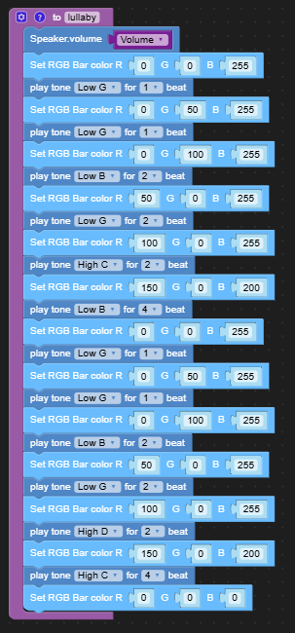
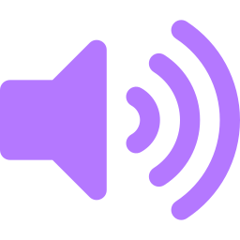
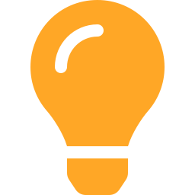
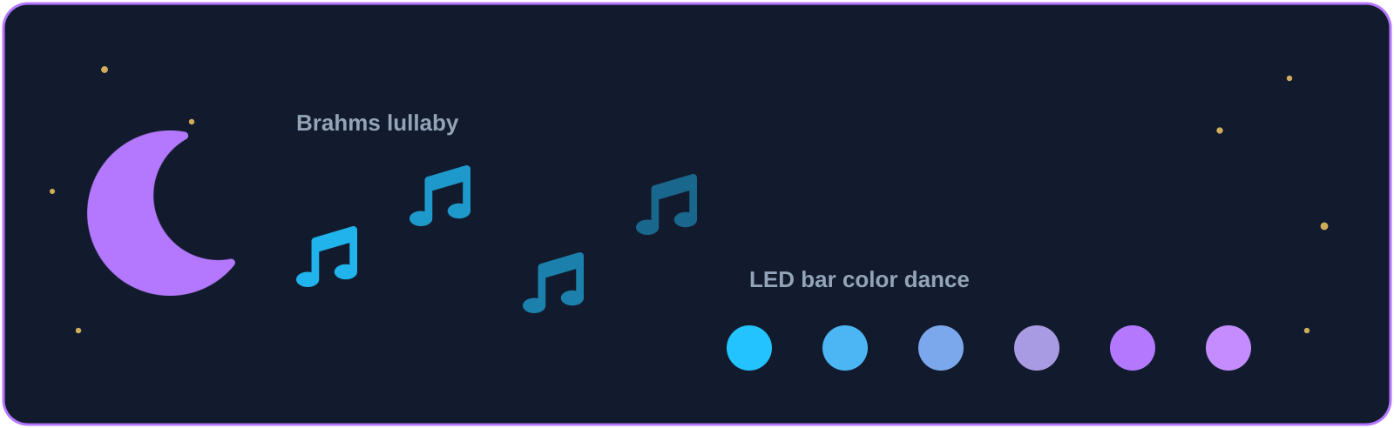
03 — LIVE DEMO
Good Night mode — lullaby & LED dance
Short Brahms lullaby
Trimmed down on purpose — soothing enough for sleep, short enough to keep the device responsive.
Synchronized LED bar dance
Each note pairs with a shifting blue → purple color on the LED bar.
Blockly logic for the lullaby() function
07

Slide 8
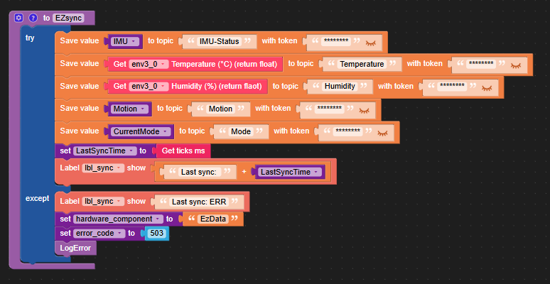


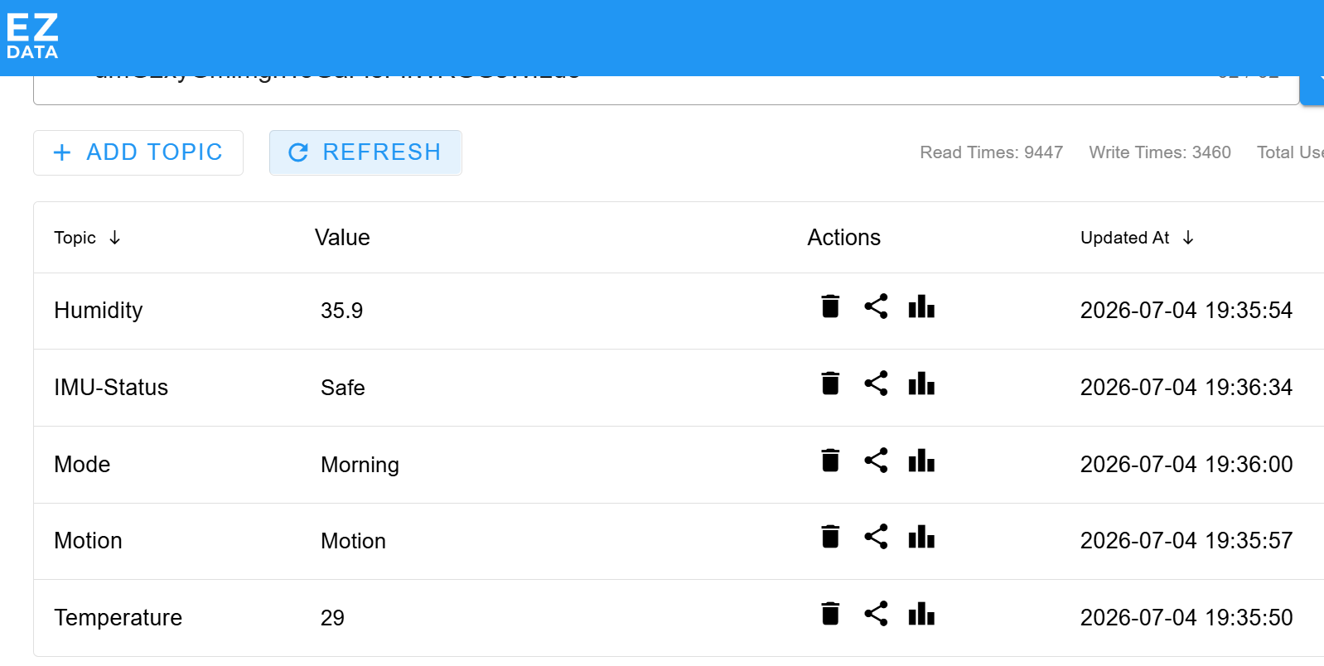

03 — LIVE DEMO
Cloud sync — EZ-Data
Keeping the cloud's copy of the room status fresh, without stalling the device if the network misbehaves.
Automatic 30-second sync
Temperature, humidity, motion and mode are pushed to EZ-Data every 30 seconds, so the cloud never falls far behind the device.
Instant push on critical events
Motion, a fall, or a mode change skips the timer and syncs immediately — safety-relevant changes reach the EZdata (and the phone) right away.
Live topics in the EZ-Data dashboard
Resilient to connection drops
Every sync call is wrapped in try/except — a failed attempt just marks “Last sync: ERR” locally instead of freezing the monitoring loop.
08

Slide 9
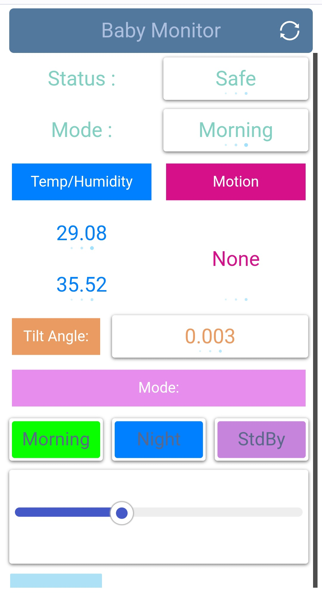

03 — LIVE DEMO
Remote control — mobile dashboard
Status & Mode labels
Live IMU status and current mode, refreshed automatically
Temp / Humidity / Motion / Tilt
Same telemetry shown on the device, mirrored remotely
Morning / Night / Standby buttons
Remote mode switch — identical to pressing A / B / C
Volume slider
Adjusts speaker volume without touching the device
Built with the UIFlow Remote+ panel — same variables driving both screens keep device and phone in sync.
09

Slide 10
03 — LIVE DEMO
Data logging — SD card JSON
Every sync and every error is also written locally, so nothing is lost if Wi-Fi drops.
Telemetry payload
Error log
/sd/JSON/telemetry_<ts>.json
/sd/LOGS/error_<ts>.json
{
"timestamp": , "20260625210844"
"device_id": "M5_BABY_MONITOR_01",
"current_mode": "Morning",
"telemetry": {
"ambient_temperature_c": 29.08,
"relative_humidity_pct": 35.52,
"motion_detected": false,
"imu_tilt_deg": 0.083
}
}
{
"timestamp": "20260625210844",
"error_id": "M5_BABY_MONITOR_01_ERROR",
"severity": "Warning",
"hardware_component": "EzData",
"error_details": {
"error_code": 503,
"message": "EzData failed.",
"retry_attempt": 1
}
}
10

Slide 11
03 — LIVE DEMO
Live demo
05

Slide 12
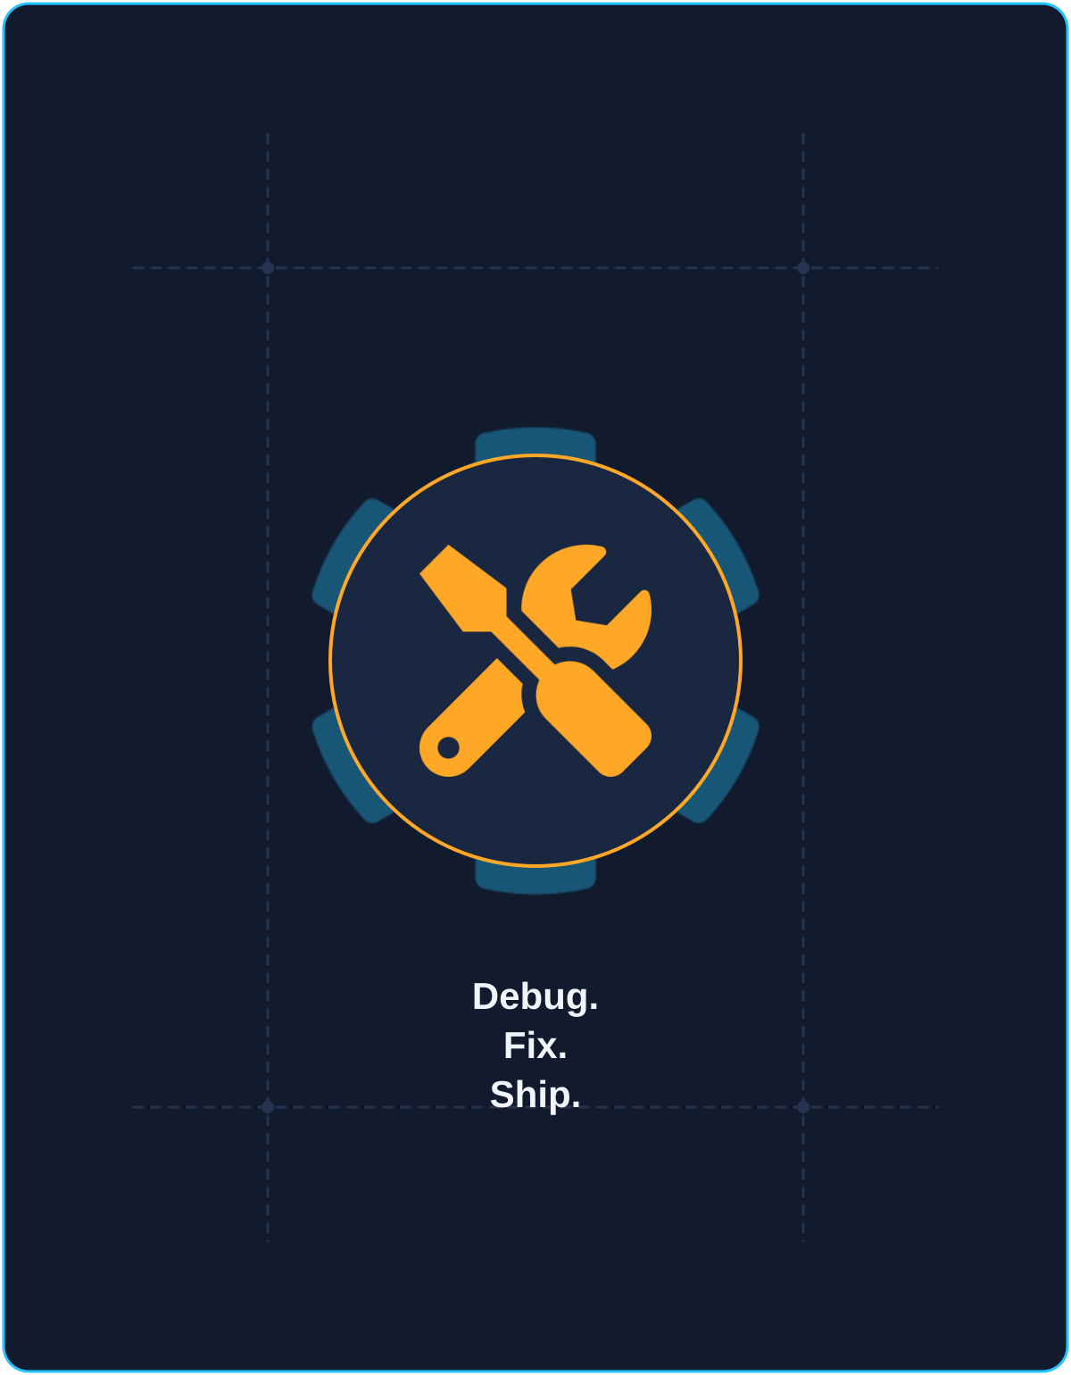



04 — REFLECTION
Engineering challenges & fixes
Intermittent Wi-Fi errors
Lullaby blocked the main loop
Every network call runs inside try / except; failures fall back gracefully instead of crashing the loop.
Speaker.sing() is a blocking call — a full-length lullaby froze sensor checks and buttons, so we trimmed the track to keep Good Night responsive.
Limited RAM on the ESP32
Keeping device, cloud & phone aligned
Heavy Blockly structures were slowing things down, so we cut unnecessary function calls and simplified the block layout to lighten the program.
Tuned the 30-second heartbeat plus instant sync-on-event so the device, EZ-Data and the mobile dashboard stay nearly in sync without dropping alerts.
11

Slide 13
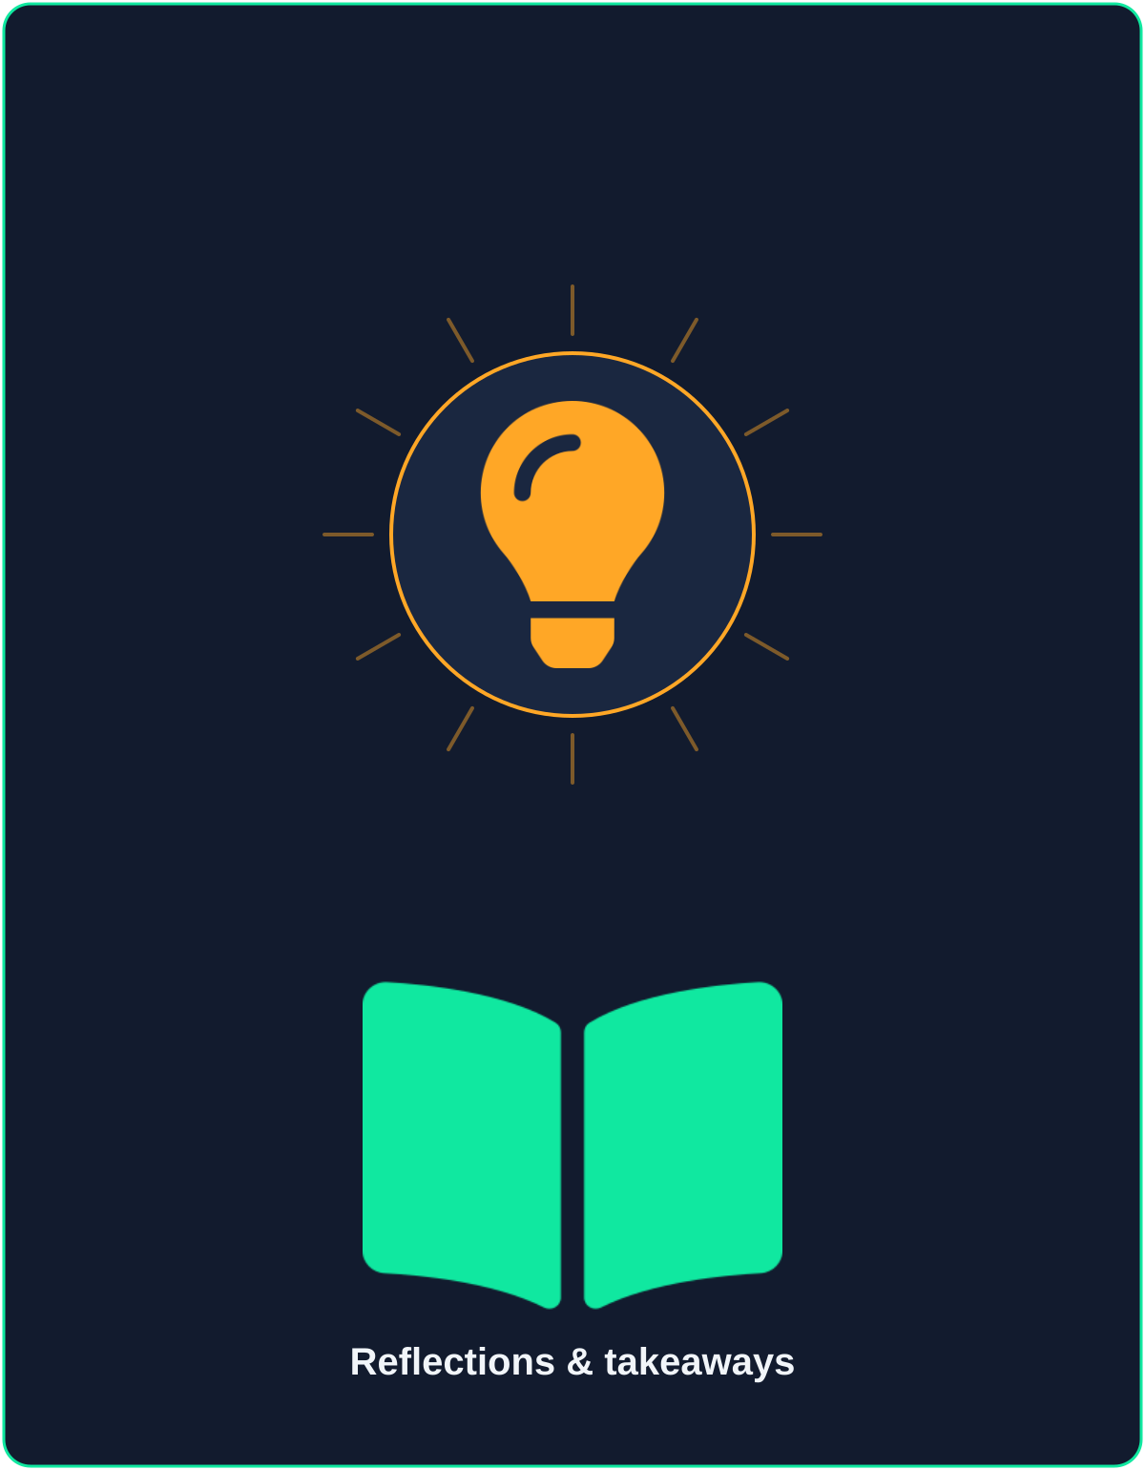
04 — REFLECTION
IoT lessons learned
Blocking calls have a system-wide cost
Resource constraints shape code structure
A single blocking call, like a lullaby, can stall an entire embedded loop — real-time systems need to budget every blocking operation.
On constrained hardware, how you structure the program is a performance decision, not just style — every extra call and block has a cost.
Multi-surface sync must be designed, not bolted on
Two UIs, one source of truth
Keeping the device, the cloud, and the phone showing the same state taught us that synchronization timing is a first-class design problem.
Keeping the device screen and the mobile dashboard bound to the same variables avoided state drift between them.
12

Slide 14
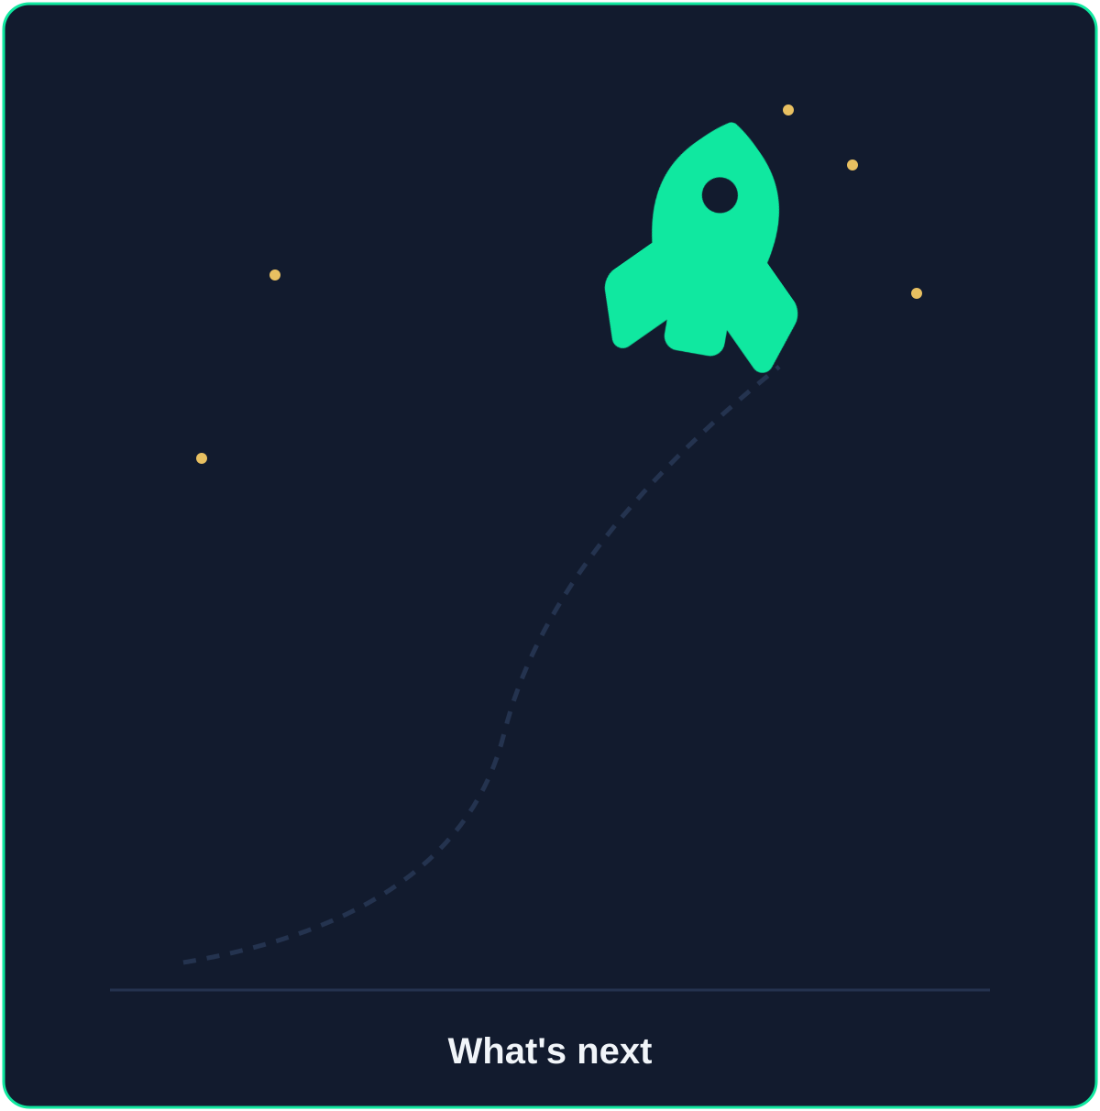
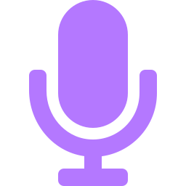

05 — LOOKING AHEAD
Next version — what we'd add
Microphone-based sound detection
Push notifications to the caregiver
Add a UIFlow-compatible microphone unit to detect crying or distress sounds.
Send an SMS / Telegram / email alert the moment status turns Warning or Alert, so no one has to keep the dashboard open.
13

Slide 15

THANK YOU
Questions?
A safe, self-contained IoT monitor that senses, reacts, and reports — on the device, in the cloud, and in a caregiver's pocket.
Fahimeh Tajarrod
fahimehtajarrod@gmail.com

