Slide 1

Moral Management
Fira Safira 2440118182
Anggita Wigiasti 2401963310

Slide 2
Two Hypotheses Regarding Moral Management Models
Population hypothesis
The distribution of the three models approximate a normal curve, with the amoral group occupying the large middle part of the curve and the moral and immoral categories occupying the tails.
Individual hypothesis
Within the individual manager, these three models may operate at various times and under various circumstances.

Slide 3
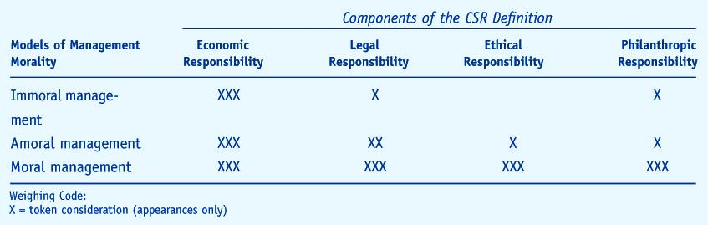
Three Models of Management Morality and Emphases on CSR

Slide 4
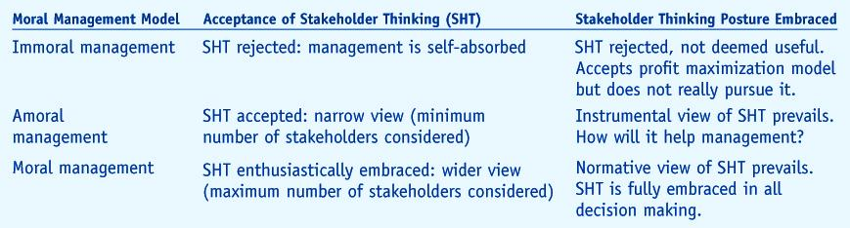
Moral Management Models And Acceptance or Rejection of Stakeholder Thinking

Slide 5
Making Moral Management Actionable
The characteristics of immoral, moral and amoral management provide benchmarks for managerial self-analysis, and help managers recognize the need to move from the immoral or amoral ethic to the moral ethic.
Amoral management is a morally vacuous condition that can easily be disguised as an innocent, practical, bottom-line philosophy. But it is the bane of the management profession.
Most managers are not “bad guys,” but managerial decision-making cannot be ethically neutral. Both immoral and amoral management must be discarded and the process of developing moral judgment begun.

Slide 6
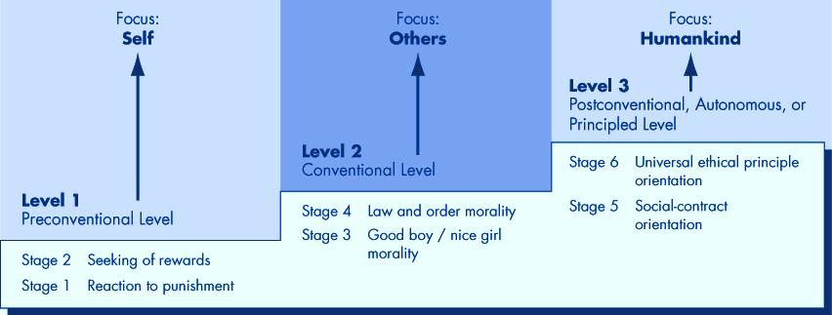
Developing Moral Judgement
Kohlberg’s Levels of Moral Development

Slide 7
Why Managers and Employees Behave Ethically?
1. To avoid some punishment
Most of Us
2. To receive some reward
3. To be responsive to family, friends, or superiors
Many of Us
4. To be a good citizen
Very Few Of Us
5. To do what is right, pursue some ideal

Slide 8
Ethics of Care as Alternative to Kohlberg
Recognize their own needs and needs of others
Level 3
Establish connections and participate in social life
Level 2
Self is Sole Object of Concern
Level 1

Slide 9
Different Sources of a Person’s Values
External sources:
Religious values
The Web of Values
Philosophical values
Cultural values
Legal values
Professional values

Slide 10
Sources Internal to the Organization
Norms prevalent in business include -
Respect for the authority structure
Loyalty to bosses and the organization
Conformity to principles and practices
Performance counts above all else
Results count above all else

Slide 11
Elements of Moral Judgment
Moral imagination
Moral identification and ordering
Moral evaluation
Tolerance of moral disagreement and ambiguity
Integration of managerial and moral competence
A sense of moral obligation

Slide 12
Reference
Carroll, B.A., Brown, J., Bucholtz, A.K., (2018). Business and Society: Ethics, Sustainability, and Stakeholder Management. 10th. Cengage Learning. ISBN: 9781305959828
Tricker, B.. (2015). Corporate Governance: Principles, Policies, and Practices. 03. Oxford University Press. ISBN: 9780198747468.

