Slide 1
THIRD YEAR PROJECT · DEFENSE PRESENTATION
UniVerse - A Campus Companion
An Automatic Department Timetable Generator (OR-Tools CP-SAT) with Real-Time Campus Services
Fahmid Alam
0182320012101309
Swadheen Islam Robi
0182320012101278
Shahriar Rashid Ratul
0182320012101276
Supervised by
Jaminur Rahman · Lecturer, Department of CSE
Team Sherlocked · Course CSE-3240 (Project I) · Department of Computer Science & Engineering · Leading University, Sylhet, Bangladesh

Slide 2
Presentation Outline
01
Project Overview & Goal
Idea, problem statement, and objectives
05
Project Demonstration
Key features and the system in action
02
Functional Requirements
What the system does + use-case model
06
Discussion & Conclusion
Outcomes, limitations, and future scope
03
Non-Functional Requirements
Environment, frameworks, and quality goals
07
Live Demo
Functional walkthrough on a real device
04
Technical Diagrams
ER, DFD (Level 0 & 1), and activity diagrams
08
Q & A
Questions from the panel
UniVerse - A Campus Companion · Team Sherlocked, CSE, Leading University
2

Slide 3
TEAM SHERLOCKED
Team Overview
Fahmid Alam
0182320012101309
Swadheen Islam Robi
0182320012101278
Shahriar Rashid Ratul
0182320012101276
● System architecture & shared infrastructure
● Authentication (Google OAuth + email)
● Admin module & timetable engine (OR-Tools CP-SAT)
● Database design, build & deployment
● Student & teacher dashboards (frontend)
● Routine and resources hub
● Teacher Manage Classes module
● Find Teacher & Room Availability (real-time)
● Notifications & push delivery (FCM)
● User profile module
● Quality assurance & data seeding
● Documentation & demo material
UniVerse - A Campus Companion · Team Sherlocked, CSE, Leading University
3

Slide 4
INTRODUCTION
Project Overview & Goal
Description of the Project
UniVerse is an Android campus-companion app for the CSE department of Leading University. It automatically generates a clash-free department timetable and delivers real-time campus services to students, teachers, and admins from a single app.
Problem Statement & Motivation
● Manual timetable creation is slow, error-prone, and must satisfy many constraints (rooms, labs, teacher day-offs, Friday rule).
● Students and teachers lack one live source for today's classes, cancellations, free rooms, and teacher locations.
Main Objectives & Goals
● Auto-generate a conflict-free timetable via constraint optimization.
● One role-aware app with real-time routine, rooms, and notifications.
UniVerse - A Campus Companion · Team Sherlocked, CSE, Leading University
4

Slide 5
REQUIREMENTS
Functional Requirements
What the system must do, grouped by actor:
Authentication & Access (all users)
● Sign up / sign in with Google or email
● Role-based access: student, teacher, admin
● Admin access gated by a whitelist
Student
● View personal routine & dashboard (live / next class)
● Browse resources by semester folder
● Find a teacher and check room availability
● Receive in-app and push notifications
Teacher
● View personal teaching schedule
● Cancel a class occurrence (auto-notify students)
● Post a notice or room-change update
Admin
● Auto-generate the department timetable (OR-Tools)
● Manage rooms, faculty, and settings; publish routine
● Broadcast notifications; manage resources & users
UniVerse - A Campus Companion · Team Sherlocked, CSE, Leading University
5

Slide 6
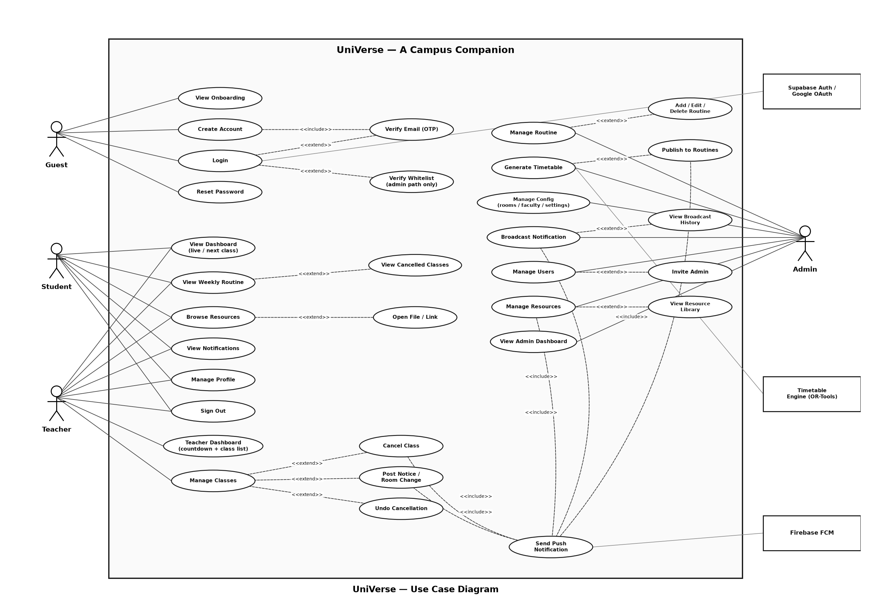
FUNCTIONAL REQUIREMENTS
Use Case Diagram
Actors (Student · Teacher · Admin) and their interactions with the system.
UniVerse - A Campus Companion · Team Sherlocked, CSE, Leading University
6

Slide 7
REQUIREMENTS
Non-Functional Requirements
Operating System Environment
● Client: Android (Flutter) phones
● Backend: Supabase (Postgres, Auth, Storage, Realtime)
● Engine: FastAPI + OR-Tools on Render (cloud)
● Push: Firebase Cloud Messaging
Frameworks & Tools
● Flutter / Dart · GoRouter · Hive
● Supabase Flutter SDK · Firebase Messaging
● Python · FastAPI · Google OR-Tools (CP-SAT)
● Phosphor icons · Google Fonts (Inter)
Quality Attributes
● Performance: clash-free schedule within a time limit
● Security: row-level security, OAuth PKCE, key isolation
● Reliability: real-time sync + push delivery
● Usability: dark theme, role-aware navigation
● Maintainability: layered Screen-Controller-Service
● Portability: cloud-hosted, stateless engine
UniVerse - A Campus Companion · Team Sherlocked, CSE, Leading University
7

Slide 8
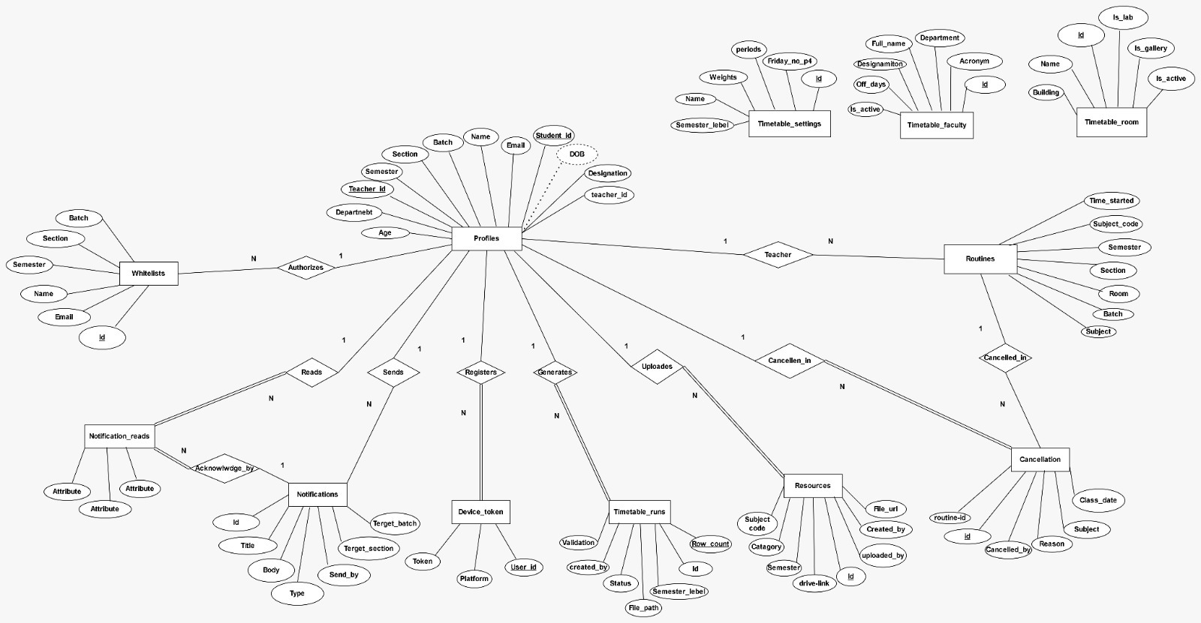
TECHNICAL DIAGRAMS
Entity-Relationship Diagram
Core tables: profiles · routines · cancellations · notifications · resources · timetable_* config · device_tokens.
UniVerse - A Campus Companion · Team Sherlocked, CSE, Leading University
8

Slide 9
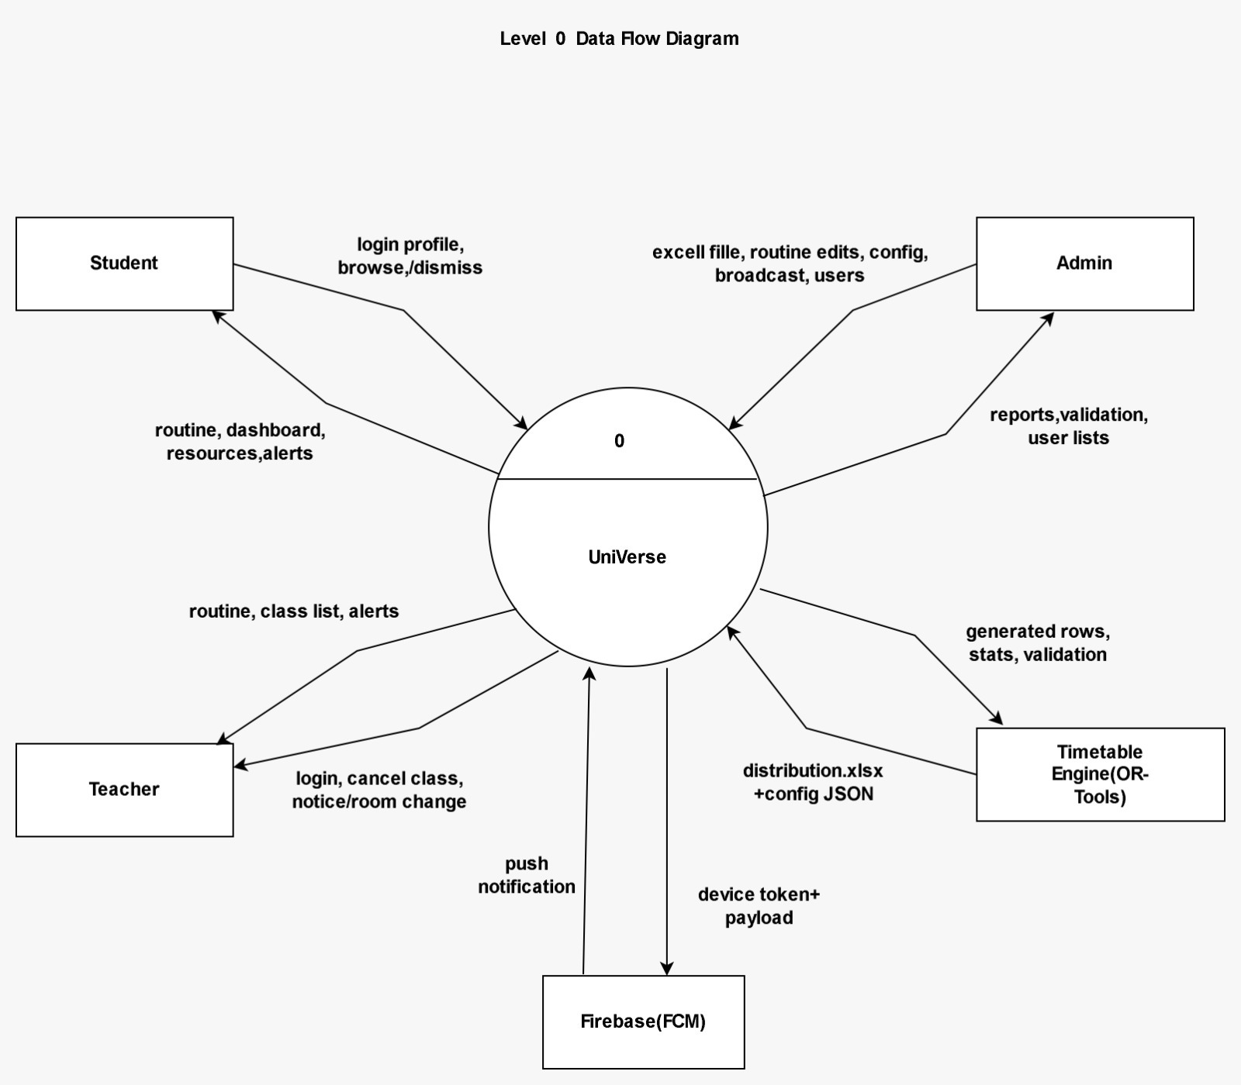
TECHNICAL DIAGRAMS
Data Flow Diagram - Level 0
Context view: users interact with UniVerse, which talks to Supabase, the timetable engine, and FCM.
UniVerse - A Campus Companion · Team Sherlocked, CSE, Leading University
9

Slide 10
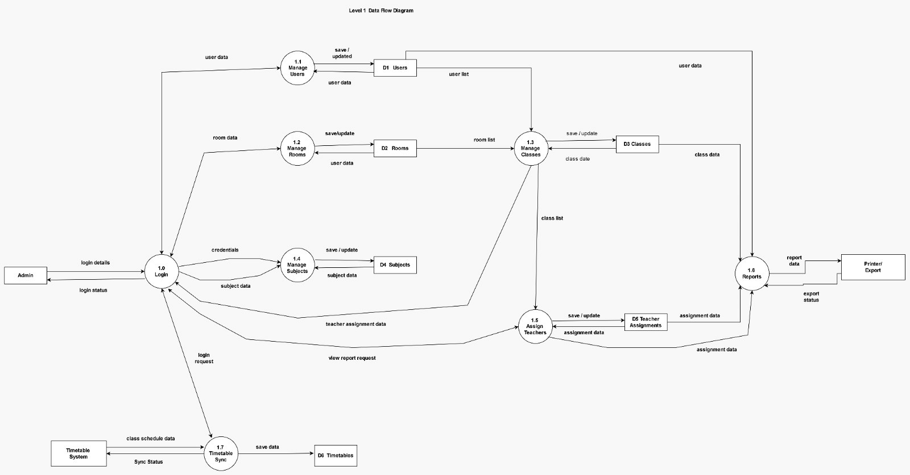
TECHNICAL DIAGRAMS
Data Flow Diagram - Level 1
Decomposed processes: auth, routine, resources, notifications, and timetable generation.
UniVerse - A Campus Companion · Team Sherlocked, CSE, Leading University
10

Slide 11
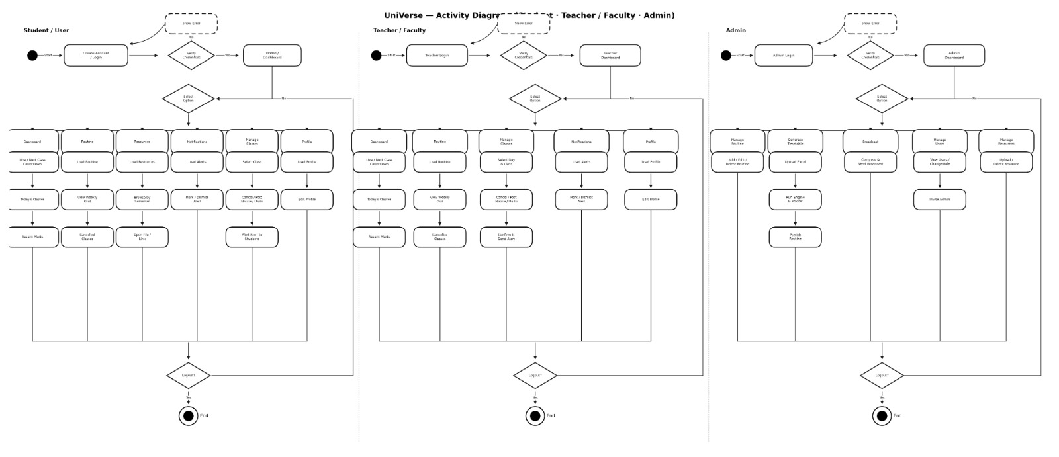
TECHNICAL DIAGRAMS
Activity Diagram
Flow of the automatic timetable generation: upload -> solve -> validate -> publish.
UniVerse - A Campus Companion · Team Sherlocked, CSE, Leading University
11

Slide 12
DEMONSTRATION
Project Demonstration
A concise (~1 minute) overview highlighting the key features in action.
[ Demo Video / Screenshot Slideshow ]
Embed the 1-minute walkthrough or a screenshot strip here
UniVerse - A Campus Companion · Team Sherlocked, CSE, Leading University
12

Slide 13
CONCLUSION
Discussion & Conclusion
Outcome: a working app that auto-generates a clash-free department timetable and serves it live to students, teachers, and admins.
Limitations
Restrictions
Future Scope
● Free cloud tier sleeps - first request has a cold-start delay.
● Scoped to one department's distribution format.
● AI assistant (RAG) intentionally descoped for now.
● Android only - no iOS build yet.
● Release APK uses debug signing (sideload for demo).
● Depends on the standard course-distribution Excel file.
● AI campus assistant (RAG over documents).
● Multi-department & cross-faculty scheduling.
● iOS build and student-side cancellation grid.
● Solver tuning with student preferences.
UniVerse - A Campus Companion · Team Sherlocked, CSE, Leading University
13

Slide 14
Demo
[ Live Functional Demo ]
Run the app live on a device / emulator here
UniVerse - A Campus Companion · Team Sherlocked, CSE, Leading University
14

