Slide 1
CSC 220 hash function
Fahmida Hamid

Slide 2
Map: the abstract idea, HashMap: implemented class of map
A map
  directly associates each key with a value and
  typically lets us look up a value in constant time.

Slide 3
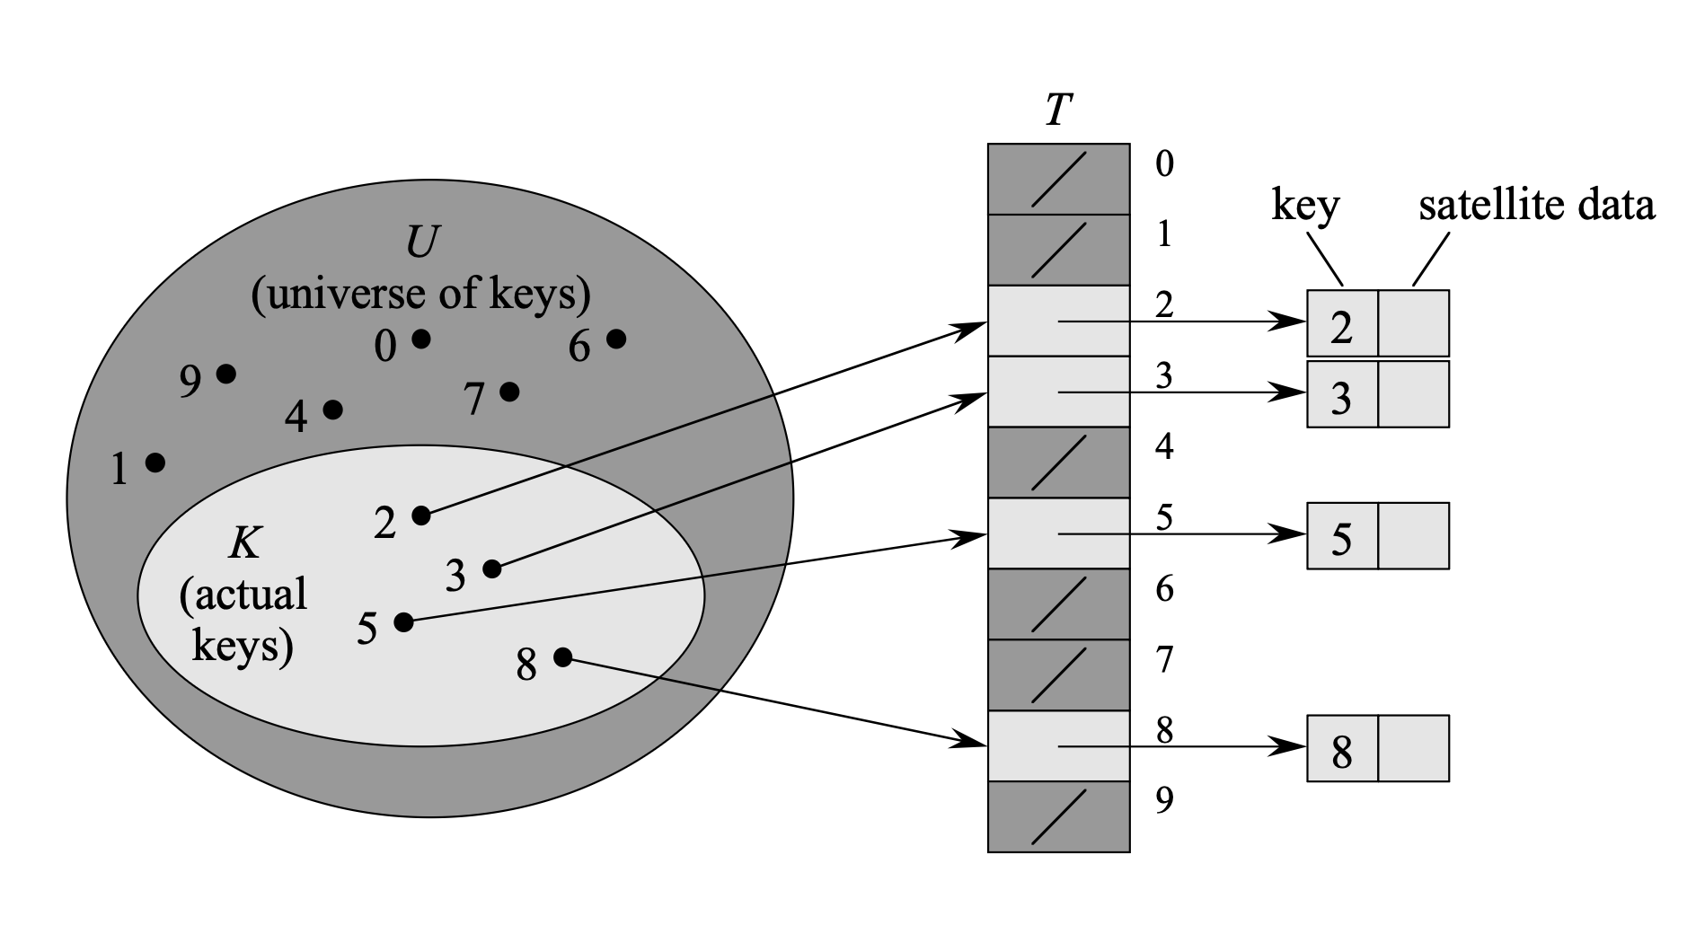
Direct addressing
A hash table generalizes the simpler notion of an ordinary array.
Direct addressing is a simple technique that works well when the universe U of keys is reasonably small.

Slide 4
Hash table
The downside of direct addressing is obvious: if the universe U is large, storing a table T of size |U| may be impractical, or even impossible, given the memory available on a typical computer.

Slide 5
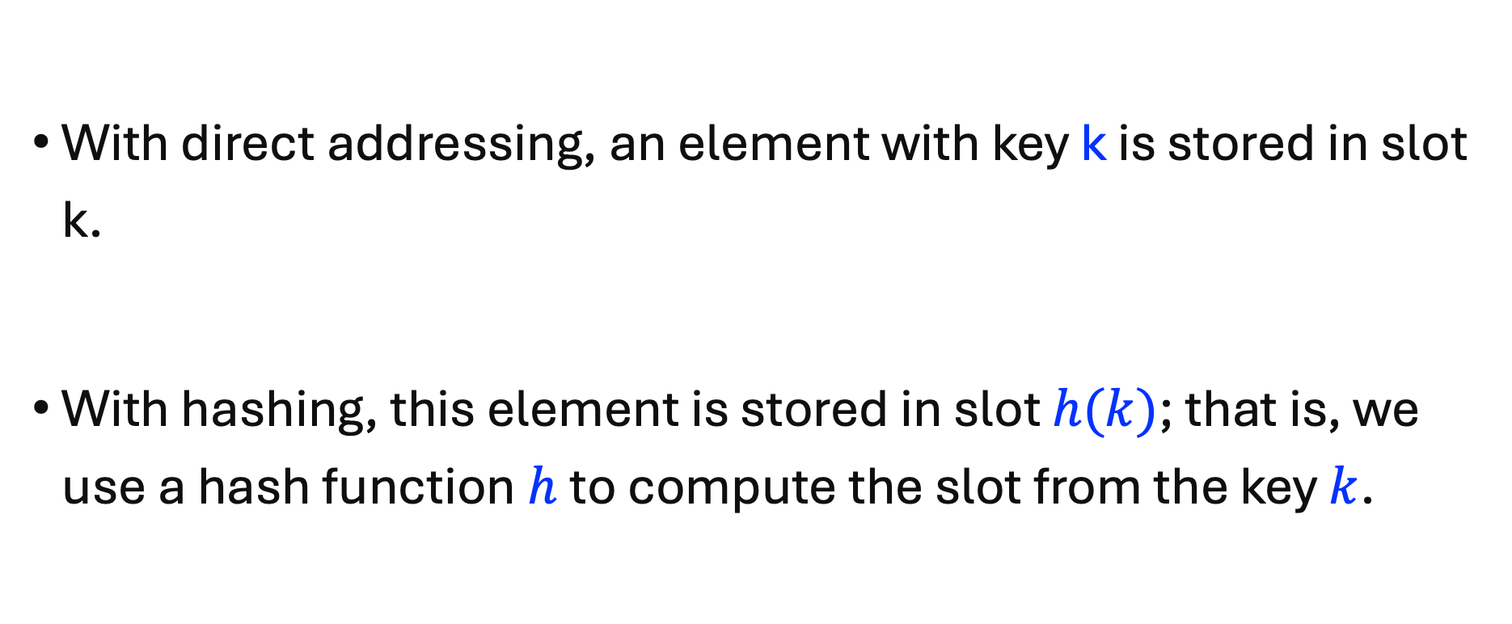
Hash table and hash function
With direct addressing, an element with key k is stored in slot k.
With hashing, this element is stored in slot $h(k)$; that is, we use a hash function $h$to compute the slot from the key $k$.

Slide 6
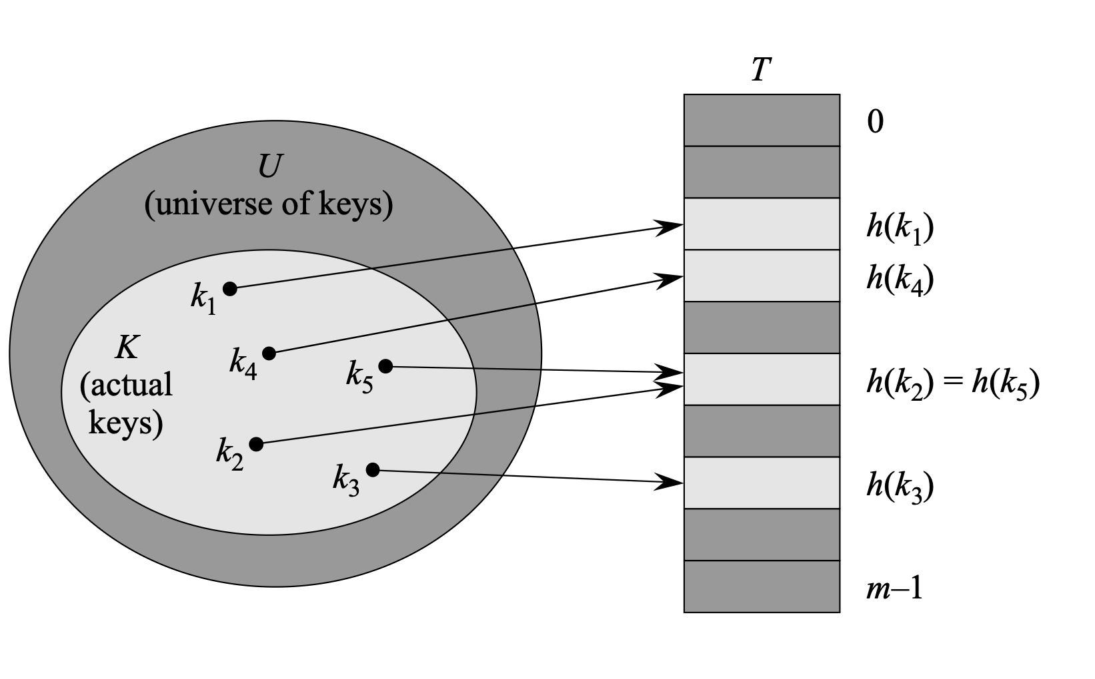
Hash tables & collision

Slide 7
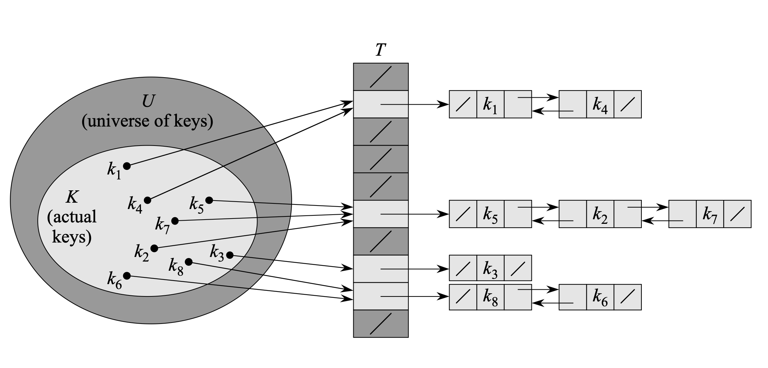
Collision resolution by chaining

Slide 8
What makes a good hash function?
A good hash function satisfies (approximately) the assumption of simple uniform hashing:
each key is equally likely to hash to any of the m slots,
independently of where any other key has hashed to.
Unfortunately, we typically have no way to check this condition, since we rarely know the probability distribution from which the keys are drawn. Moreover, the keys might not be drawn independently.

Slide 9
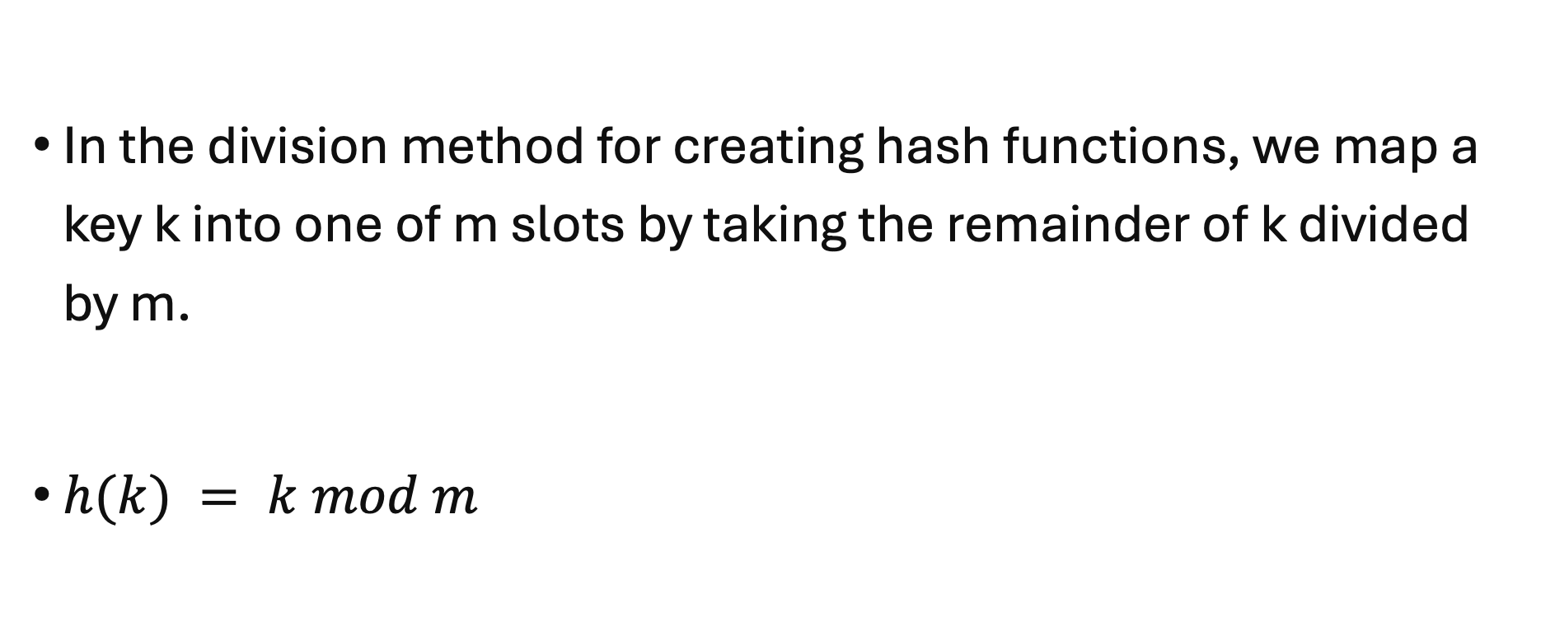
The division method
In the division method for creating hash functions, we map a key k into one of m slots by taking the remainder of k divided by m.
$h(k) = k mod m$

Slide 10
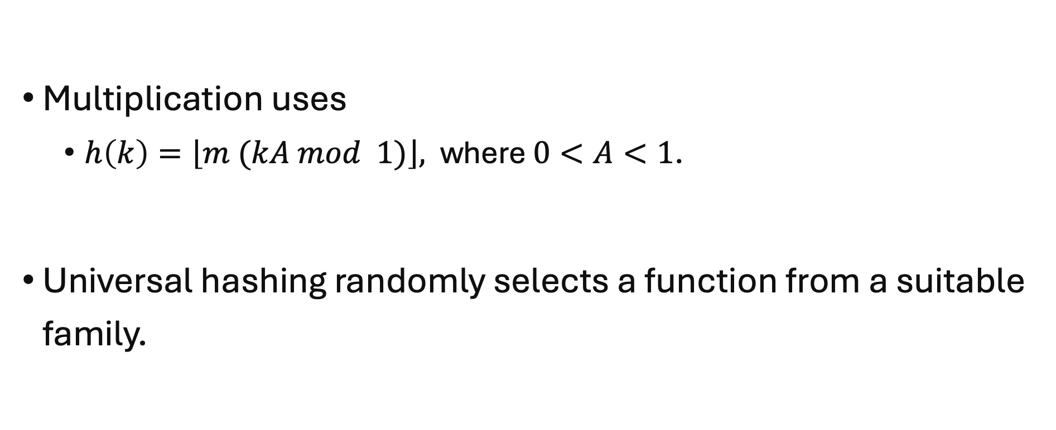
The multiplication method
Multiplication uses
  $h\left(k\right)=\left\lfloor m (kA mod 1)\right\rfloor ,$where $0<A<1$.
Universal hashing randomly selects a function from a suitable family.

Slide 11
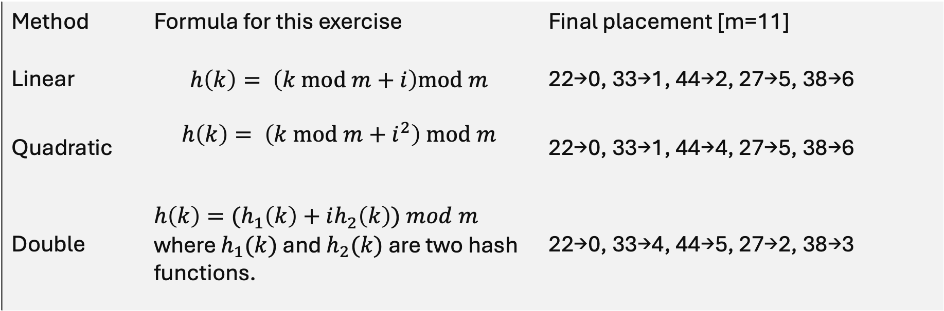
Open addressing
Method | Formula for this exercise | Final placement [m=11]
Linear | $$h\left(k\right)= \left(k mod m+i\right)mod m$$ | 22→0, 33→1, 44→2, 27→5, 38→6
Quadratic | $$h\left(k\right)= \left(k mod m+i^{2}\right) mod m$$ | 22→0, 33→1, 44→4, 27→5, 38→6
Double | $h\left(k\right)={(h}_{1}\left(k\right)+ih_{2}\left(k\right)) mod m$ where $h_{1}(k)$ and $h_{2}(k)$ are two hash functions. | 22→0, 33→4, 44→5, 27→2, 38→3

Slide 12
The deletion puzzle: $h\left(k\right)=\left(k mod 11+i\right)mod 11$
Key | Initial index | Final index after collision resolution
22 | 0 | 0
33 | 0 | 1
44 | 0 | 2
27 | 5 | 5
38 | 5 | 6

