Slide 1
CSC 220 maps and hash maps
Fahmida Hamid

Slide 2
Case 01: Student Records
How do we store the data?
Lists?
  Any disadvantages?
Student ID | Score
S101 | 85
S102 | 92
S103 | 78
S104 | 92

Slide 3
use cases
A university course registration system with millions of enrollment records across many years.
The internet with millions of pages and growing…

Slide 4
Map: the abstract idea
A Map is a conceptual blueprint for storing data.
  It is a collection of key-value pairs, where every unique key links to a specific piece of information.
S101 → 85
S102 → 92
S103 → 78

Slide 5
Map: the abstract idea
A map directly associates each key with a value and
typically lets us look up a value in constant time.

Slide 6
Hashmap
A specific, high-performance implementation of map

Slide 7
MAP & hashmap in java
Map is an interface: it specifies operations such as put and get.
HashMap is a class that implements those operations.
  https://docs.oracle.com/javase/8/docs/api/java/util/HashMap.html

Slide 8
HASH
What does Hash mean?
  A HashMap does not normally search every entry from beginning to end.
  It uses the key’s hash code to narrow down where to look.
  This makes lookup typically fast.

Slide 9
HASH
"S102" → hashCode() → choose a location → find the entry → 92
  Hash codes do not have to be unique.
  Two different keys can lead to the same location. That is a collision. The map then checks which key actually matches using equals.
Key A ──┐
|── same location → compare keys with equals()
Key B ──┘

Slide 10
HASH
A collision does not mean that one key overwrites the other.
A HashMap can retain both distinct keys.

Slide 11
hashmap
A HashMap stores values under keys.
When we call get(key), it uses the key’s hashCode() to narrow down where to search, then uses equals() to identify the matching key.
  Two different keys can have the same hash code, so a matching hash code alone does not mean the keys are equal.
If two keys are equal according to equals(), they must have the same hash code.

Slide 12
Hash function

Slide 13
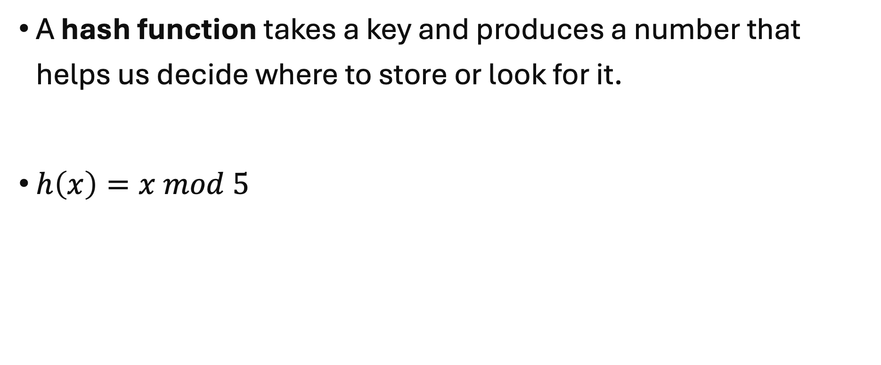
Hash function
A hash function takes a key and produces a number that helps us decide where to store or look for it.
$h\left(x\right)=x mod 5$

Slide 14
$$h\left(x\right)=x mod 5$$
Key (x) | (x mod 5) | Bucket
12 | 2 | 2
27 | 2 | 2
31 | 1 | 1
45 | 0 | 0

Slide 15
Next topic…
Resolve collision?

