Slide 1
CSC 220
Advanced Programming
Fahmida hamid
Week 03, sep 08

Slide 2
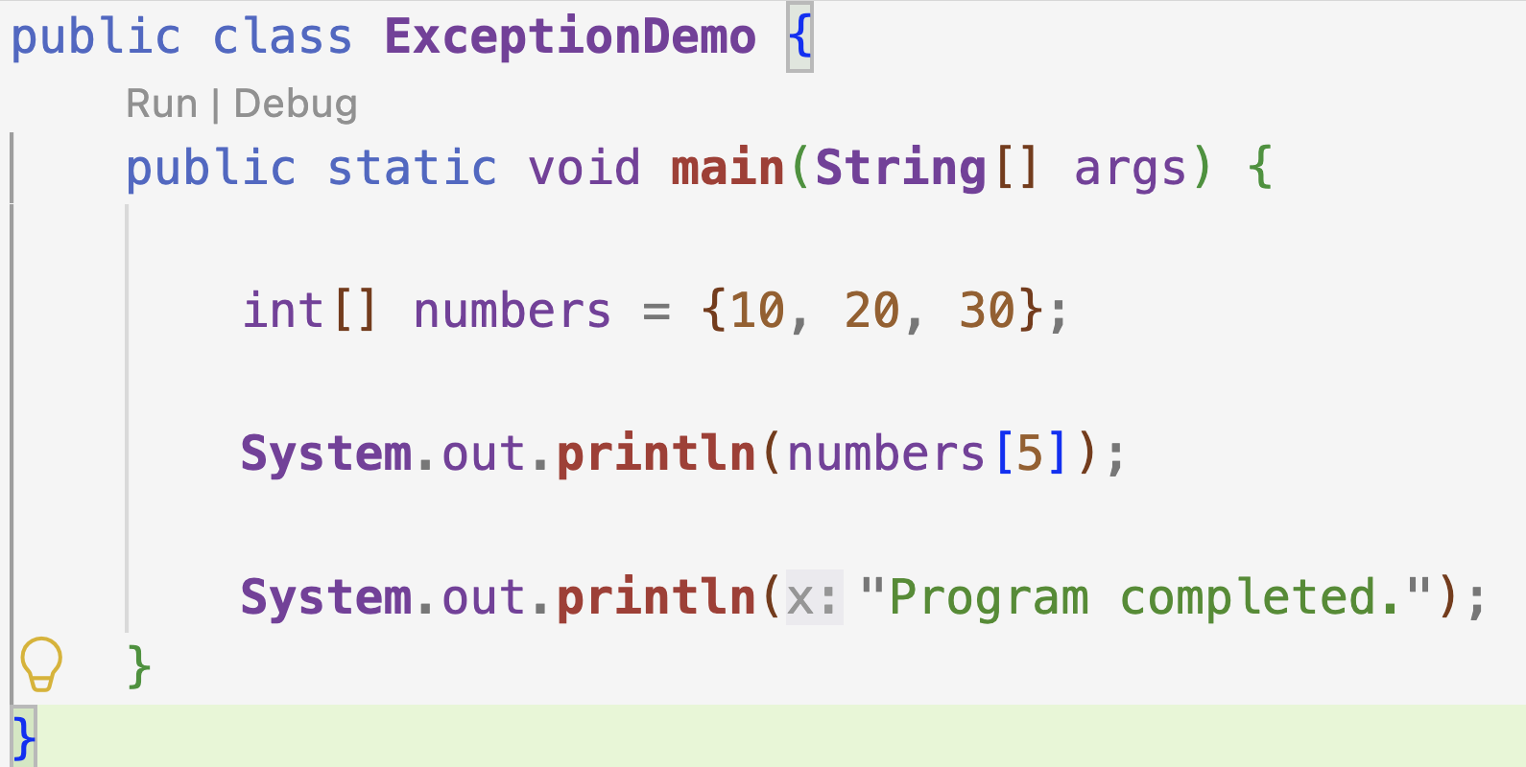
Will the code compile? Will it run?

Slide 3
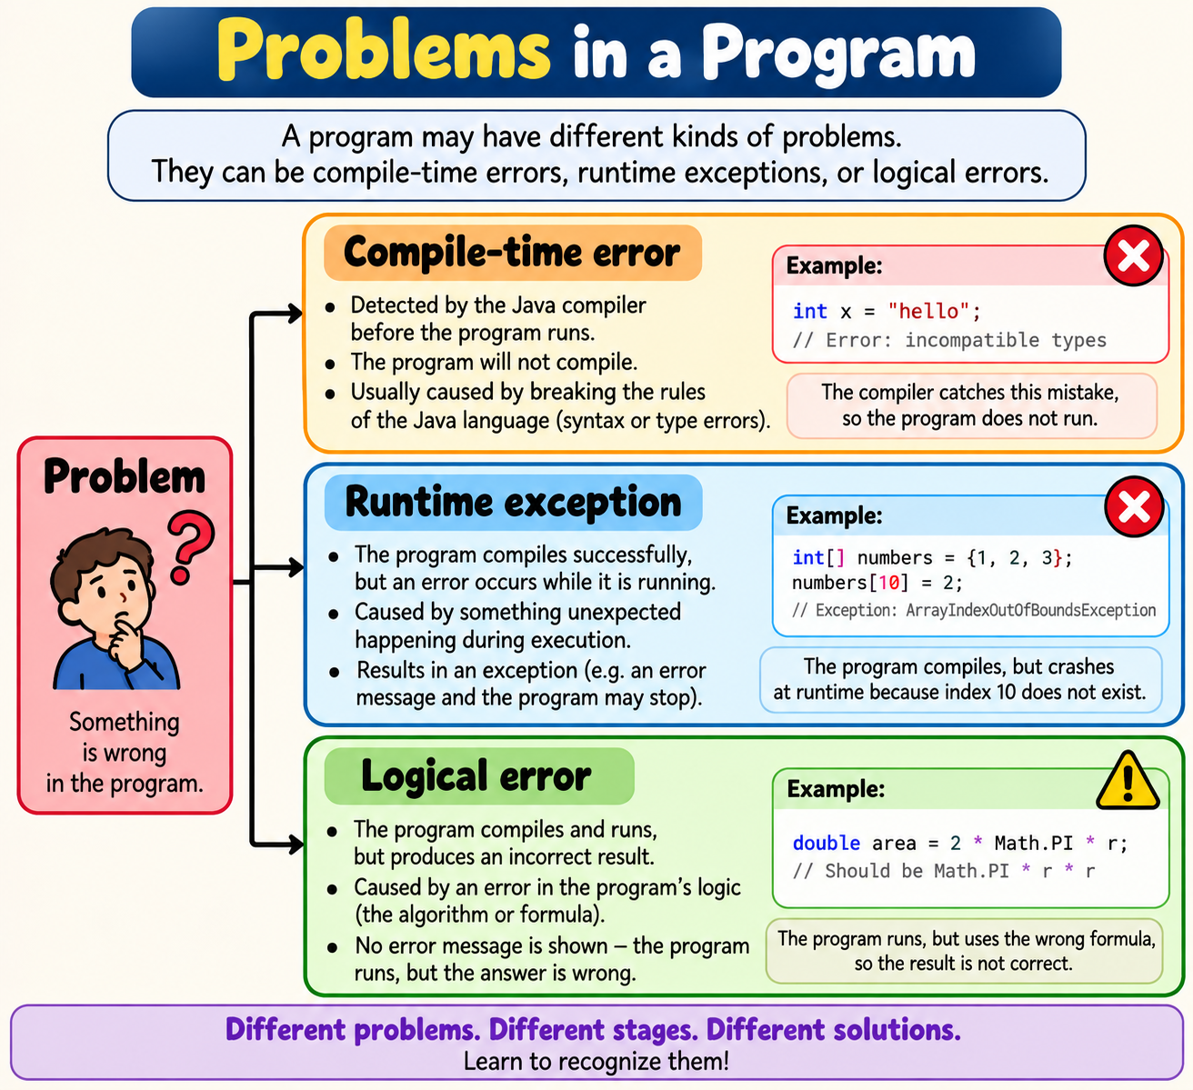

Slide 4
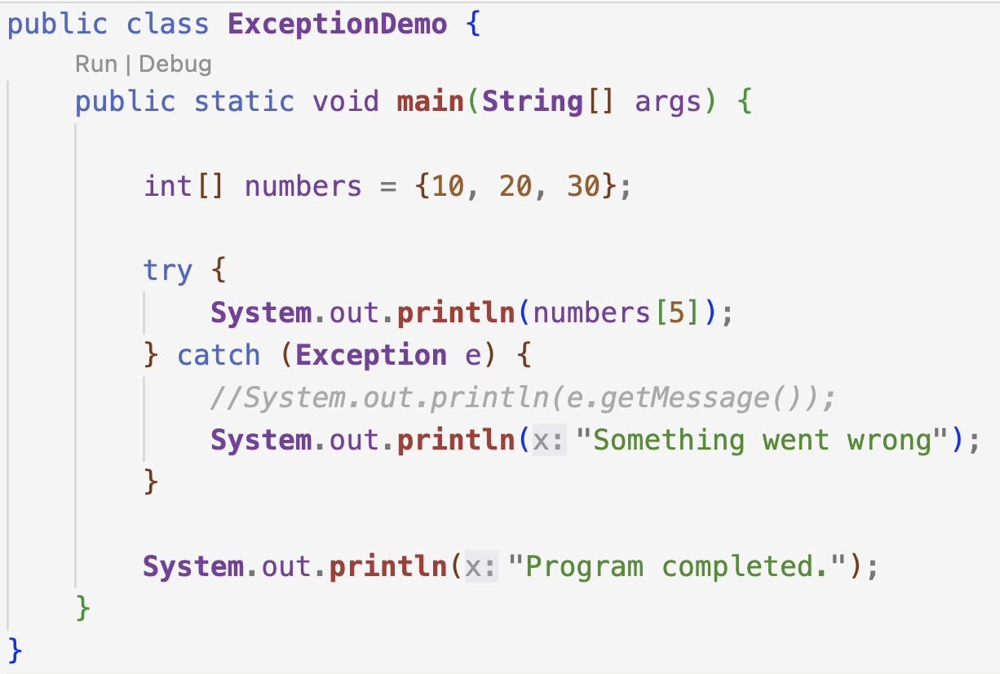

Slide 5
Does the error still exist?
Exception handling does not mean “prevent all errors”;
It means respond appropriately when exceptional situations occur.

Slide 6
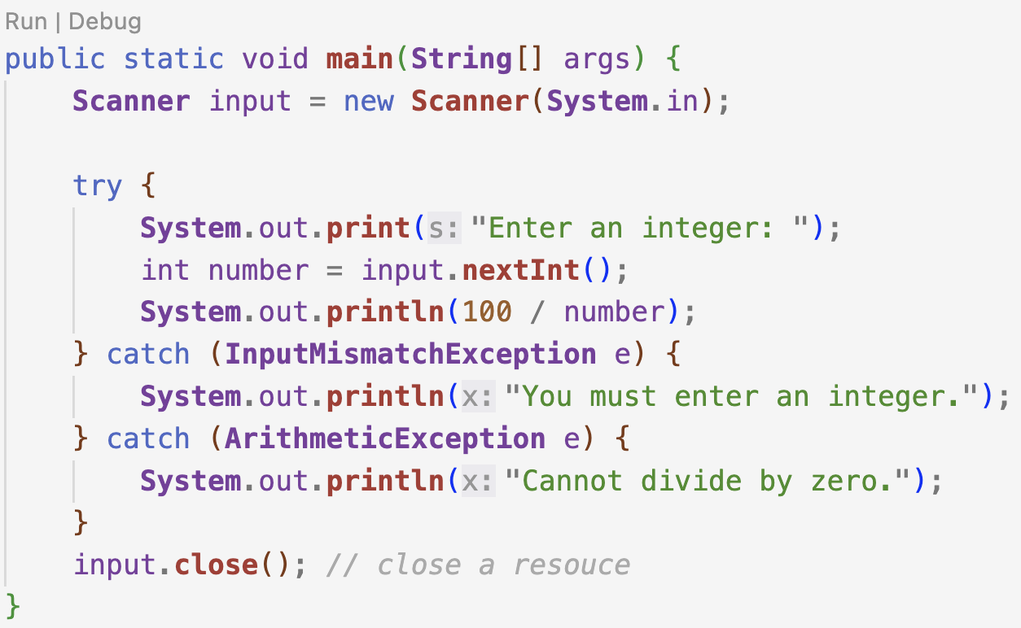

Slide 7
catch (Exception e)
Why shouldn't we simply write catch (Exception e) for everything?

Slide 8
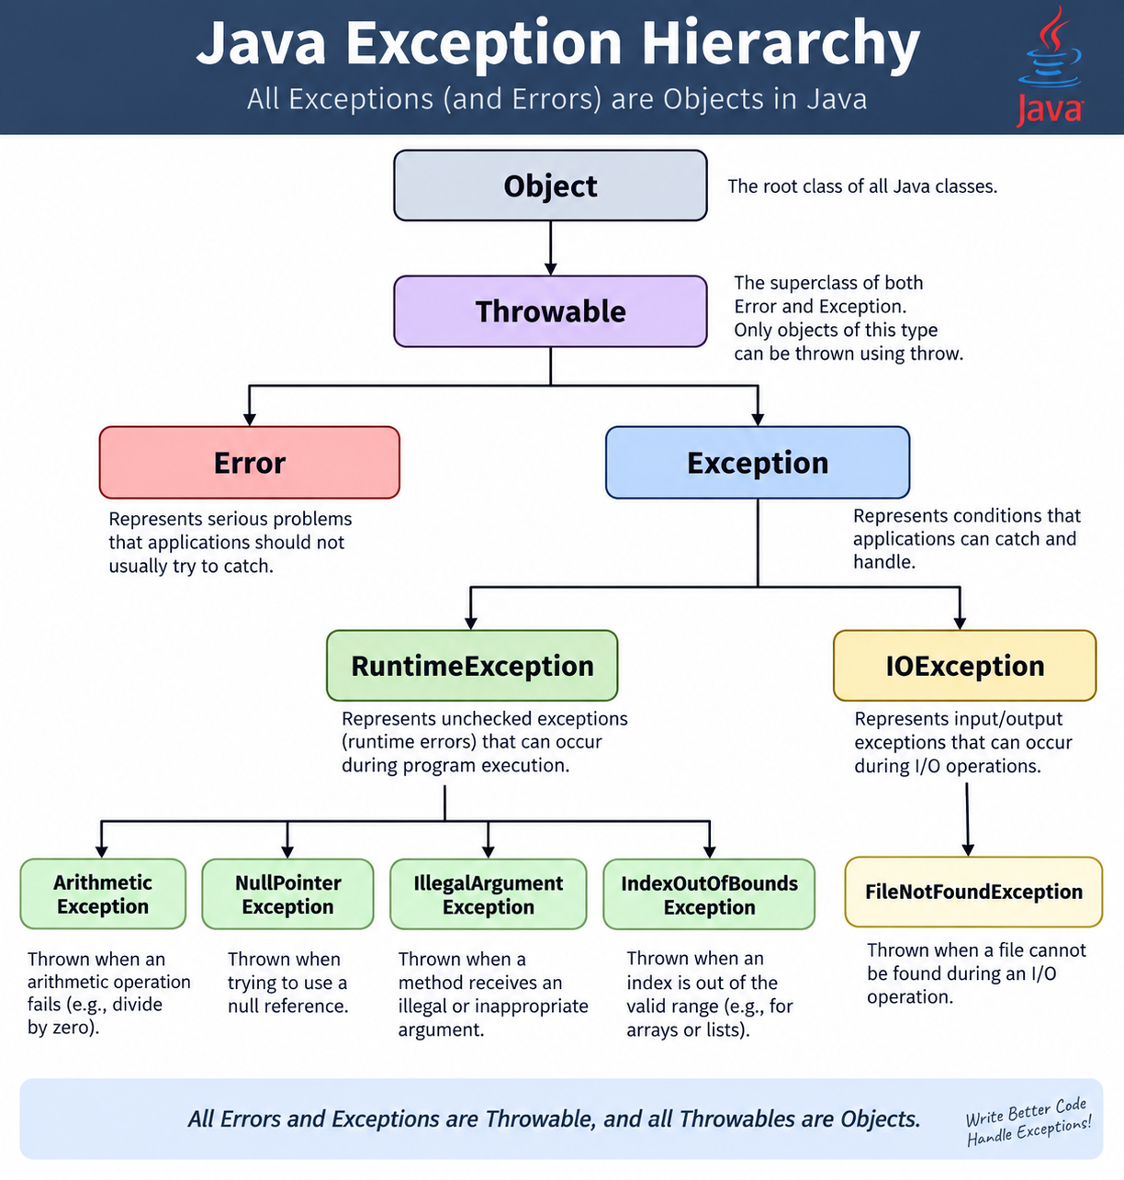

Slide 9
catch (Exception e)
Because different exceptions indicate different problems.
Catching the most appropriate/specific exception allows our program to
identify what went wrong,
provide a meaningful message, and
take the appropriate recovery action.

Slide 10
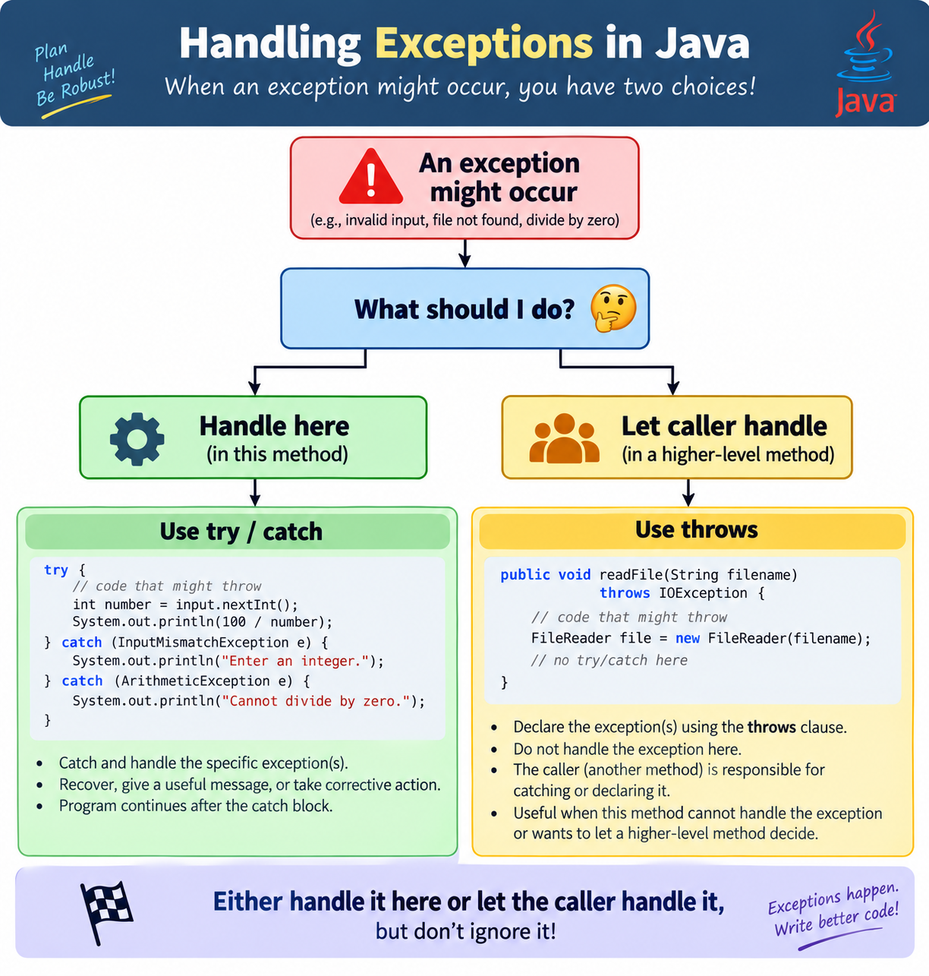
Ways to handle ...

Slide 11
Checked Exceptions
Checked exception = compiler checks
A checked exception is one that Java requires you to either:
  catch it
  declare it with throws
If you do neither, the program will not compile.
Example: IO Exceptions

Slide 12
Unchecked exceptions
Unchecked exception = compiler does NOT force you
String name = null;
System.out.println(name.length());

Slide 13
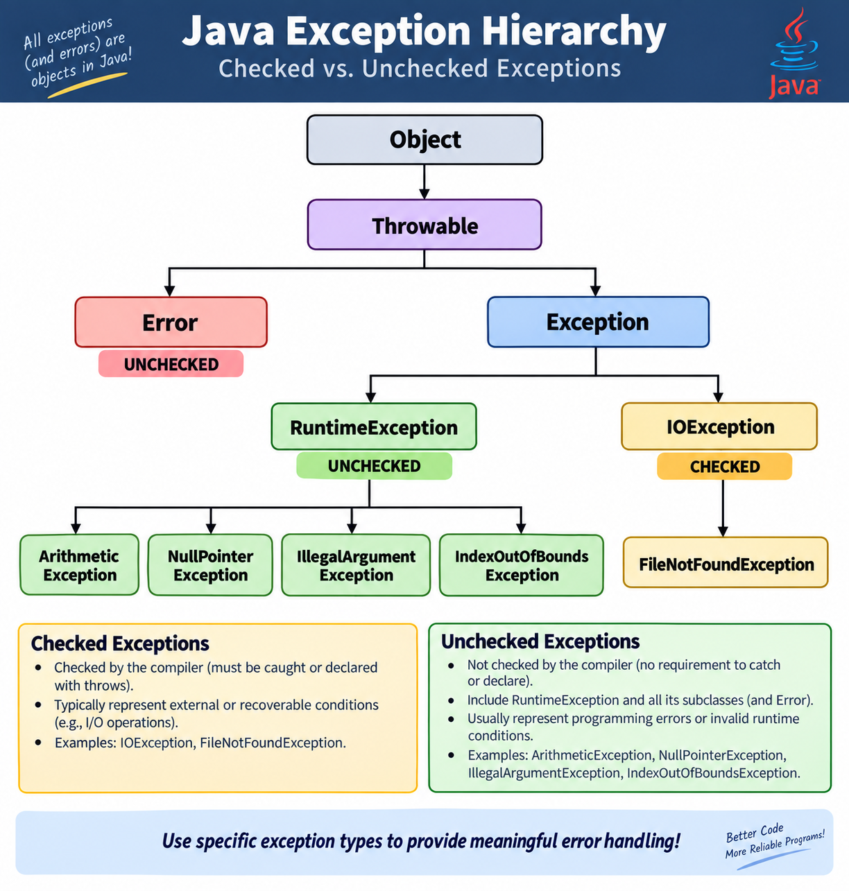

Slide 14

Possible cases where we might face exceptions/errors

Slide 15
In-class task
Exception Exploration Challenge
      Working with your partner/group, use the official Java API documentation to investigate Java exceptions.
Create 3 small Java programs that collectively demonstrate at least 10 different exception types.
Across your three programs:
  Demonstrate at least 10 distinct exceptions.
  Include both checked and unchecked exceptions.
  For each exception, identify its name and explain what caused it.
  Handle appropriate exceptions using try/catch.
  Use multiple catch blocks in at least one program.
  Use finally in at least one program.
  Use throws in at least one method.
For at least one exception, print information from the exception object
using getMessage(), getClass(), or printStackTrace().
Include a comment identifying each exception as checked or unchecked.
Be prepared to demonstrate one interesting exception to the class.

Slide 16
Sources you may use
https://docs.oracle.com/en/java/javase/25/docs/api/java.base/java/lang/Exception.html
https://docs.oracle.com/en/java/javase/25/docs/api/java.base/java/lang/RuntimeException.html
https://docs.oracle.com/javase/tutorial/essential/exceptions/index.html

