Slide 1
GUIs, JavaFX, &
Event Driven Programming
F. Hamid

Slide 2
Sources
https://openjfx.io/
https://dev.java/learn/javafx/
https://openjfx.io/javadoc/25/javafx.graphics/javafx/scene/Node.html
https://www.geeksforgeeks.org/java/javafx-tutorial/

Slide 3
GUI: to arrange visual components and respond to user events.
Java offers several toolkits for building graphical user interfaces (GUIs):
  AWT — Abstract Window Toolkit:
    Java’s original GUI toolkit.
    It Provides windows, buttons, text fields, layouts, and event handling.
    Many components use the operating system’s native controls.
  Swing:
    Builds on AWT and provides a richer set of components, such as JButton, JTable, and JTextArea.
    Most components are drawn by Java, allowing more customizable appearances.

Slide 4
GUI: to arrange visual components and respond to user events.
Java offers several toolkits for building graphical user interfaces (GUIs):
  JavaFX: A newer toolkit with a scene graph, CSS styling, properties and bindings, animation, and optional FXML for defining interfaces. Uses classes such as Stage, Scene, and Button.

Slide 5
JavaFX
AWT and Swing are included in the standard JDK; JavaFX is supplied separately.
JavaFX is best described as a GUI framework, delivered as a collection of libraries.
  Both terms can apply, but “framework” describes how it manages your application.

Slide 6
MAVEN
Maven is a build and dependency-management tool for Java projects.
It helps you:
  Download dependencies: libraries your project needs, such as JavaFX.
  Compile code: turn .java files into .class files.
  Run tests and package applications: for example, create a JAR file.
Maven reads pom.xml to learn how your project is configured.

Slide 7
pom.xml
POM stands for Project Object Model.
pom.xml is the configuration file for a Maven project.
It tells Maven:
  Your project’s name and version.
  Which libraries the project needs—for example, JavaFX.
  Which Java version to use when compiling.
  Which plugins to use for tasks such as running the application.
The Java files contain our program; pom.xml tells Maven how to build and run it.

Slide 8
Project Creation & First App
public class LabelApp extends Application {
@Override
public void start(Stage stage) {
}
public static void main(String[] args) {
launch(args);
}
}
  Our class supplies the application’s behavior; JavaFX manages its lifecycle.

Slide 9
Getting to know the code …
Application: The application class
  Application is the abstract base class for a JavaFX program.
We extend it and override start() to create the window’s controls, arrange them, and display the window.
LabelApp class: Our application class, which extends the JavaFX Application class.

Slide 10
Getting to know the code …
Stage: the window
A Stage represents a top-level window.
JavaFX creates the primary stage and passes it to start().
An application can create additional stages for additional windows.

Slide 11
Getting to know the code …
Scene: the window’s content
A Scene holds the hierarchy of visual elements, called the scene graph.
A stage displays one scene at a time, but you can replace that scene.

Slide 12
Getting to know the code
Components and layout containers
  Controls are GUI elements such as labels, buttons, text fields, and dropdowns
  Other controls include Button, TextField, TextArea, and ComboBox.
  Layout container >>
    Layout containers arrange these controls.
    examples include StackPane, Vbox, HBox

Slide 13
Getting to know the code …
launch() >> start JavaFX
  launch() starts the JavaFX runtime and hands control to it.
  JavaFX creates our application object and calls its lifecycle methods.
  The command-line arguments are forwarded as application parameters.

Slide 14
The Application Lifecycle
Step | What happens
launch(args) | Starts JavaFX; JavaFX creates the application object, invoking its constructor.
init() | Performs initial setup. Optional to override.
start(Stage stage) | Builds and displays the interface. Required to override.
Application runs | JavaFX processes events and invokes registered handlers.
stop() | Performs cleanup during normal shutdown. Optional to override.

Slide 15
Overall Process
We extend Application, put controls inside a layout, place that layout in a Scene, and display the scene in a Stage.
Calling launch() starts JavaFX, which manages setup, user events, and shutdown.

Slide 16
To-Do 01
Install Maven
Setup your first project.
Modify the text in the label.

Slide 17
To-Do 02 …
Create a new project on your own.
Follow similar instructions as stated in the README.md
  Create a new app HelloJavaFX0 [source code provided]
  pom.xml [make adjustments to the pom [mainclass]
    <mainClass>demo.HelloJavaFX0</mainClass>
  Run and show the outcome.

Slide 18
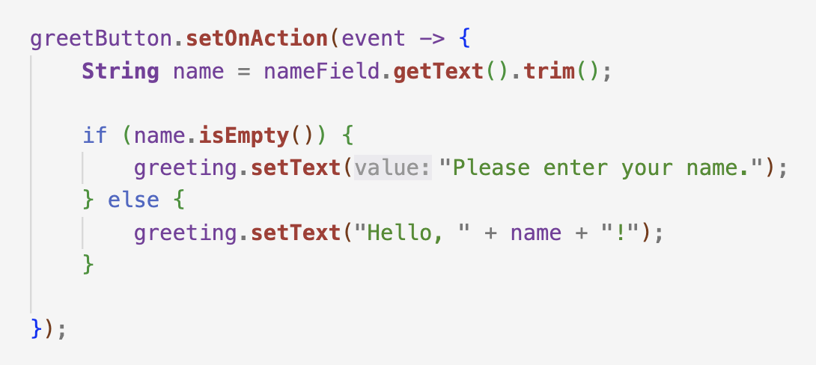
To-Do 03 …
In the same project you created HelloJavaFX0, create a new app HelloJavaFX1.
Run it and notice the differences.
Try to explain the setOnAction method.

Slide 19
To-Do 03 [hints]
greetButton.setOnAction(event -> { ….});
  Registers an EventHandler using a lambda expression.
  JavaFX runs the code inside the braces when the button is activated.
Registering the handler does not execute its code immediately.
The code runs each time the button is activated, using the text currently in the field.

Slide 20
Practice …
Check what HelloJavaFX2.java does.
Try to modify a few things that you would like.

Slide 21
More next class …
Method | When the handler runs
setOnMouseClicked(...) | A mouse click occurs on the component
setOnMousePressed(...) | A mouse button is pressed
setOnMouseReleased(...) | A mouse button is released
setOnMouseEntered(...) | The pointer enters the component
setOnMouseExited(...) | The pointer leaves the component
setOnMouseMoved(...) | The pointer moves within the component
setOnKeyPressed(...) | A key is pressed while the component has keyboard focus
setOnKeyReleased(...) | A key is released
setOnKeyTyped(...) | Character input occurs
stage.setOnCloseRequest(...) | A request is made to close the window

Slide 22
More information …
Container | Arrangement
StackPane | Children stacked in layers
VBox | Children arranged vertically
HBox | Children arranged horizontally
GridPane | Children arranged in rows and columns

