Slide 1

Accelerating Angular Correlation Function Calculations with GPU
Fahmida Khalid
Course: Parallel Programming
Student Number: 2402172

Slide 2
Project Overview
Calculate Angular Correlation Function (ACF) for astronomical datasets
ACF analyzes the spatial distribution of celestial objects
Sequential computation is slow for large datasets
GPU parallelization speeds up processing significantly

Slide 3
Why Parallel Computing?
ACF involves pairwise distance calculations between points
Computational cost grows quadratically with dataset size
GPU can process thousands of pairs simultaneously
Parallelism leads to large performance gains on big data

Slide 4
Hardware Used
CPU: AMD Ryzen 5 5600U with Radeon Graphics (Windows laptop)
GPU: NVIDIA Tesla T4 (via Google Colab)

Slide 5
Files and Code Structure
- acf_cpu.cpp — CPU implementation of ACF
- acf_gpu.cu — GPU implementation using CUDA
- small_data.txt — Small test dataset
- data_100k_degrees.txt — Large dataset for performance testing
- acf_results_cpu.txt — Sample CPU results
- acf_results_gpu.txt — Sample GPU results
- Run_Logs/ — Screenshots and logs from executions

Slide 6
How to Run
CPU Version (Windows)
g++ acf_cpu.cpp -o acf_cpu
acf_cpu small_data.txt
acf_cpu data_100k_degrees.txt
GPU Version (Google Colab with CUDA)
!nvcc --std=c++11 acf_gpu.cu -o acf_gpu -arch=sm_75 -arch=sm_75
!./acf_gpu data small_data.txt
!./acf_gpu data_100k_degrees.txt

Slide 7
Results Summary
Dataset | CPU Time (s) | GPU Time (s) | Speedup (CPU/GPU)
small_data.txt | 0.0000069 | 0.00026811 | GPU slightly slower
data_100k_degrees.txt | 1183.32 | 6.89996 | ~171x faster on GPU
* GPU overhead affects small datasets; large datasets show significant speedup

Slide 8
Result Details
Both CPU and GPU produce identical Angular Correlation Function histograms
Small dataset: 4 pairs counted in angular bins, out of 10 possible pairs
Large dataset: ~357 million pairs counted, out of 5 billion theoretical pairs
Correctness verified by matching bin counts and histogram structure

Slide 9
Challenges & Learnings
Managing GPU kernel overhead on small data
- Optimizing memory access patterns for performance
- Handling large datasets efficiently with CUDA
- Understanding parallel programming concepts deeply

Slide 10
Code Snippet
__global__ void computeACF(const double* ra, const double* dec, int num_points, int* histogram, double bin_size) {
int i = blockIdx.x * blockDim.x + threadIdx.x;
if (i >= num_points) return;
double ra1 = ra[i];
double dec1 = dec[i];
for (int j = i + 1; j < num_points; ++j) {
double dist = angularDistance(ra1, dec1, ra[j], dec[j]);
if (dist < MAX_DISTANCE) {
int bin_idx = static_cast<int>(dist / bin_size);
if (bin_idx < NUM_BINS) {
atomicAdd(&histogram[bin_idx], 1);
}

Slide 11
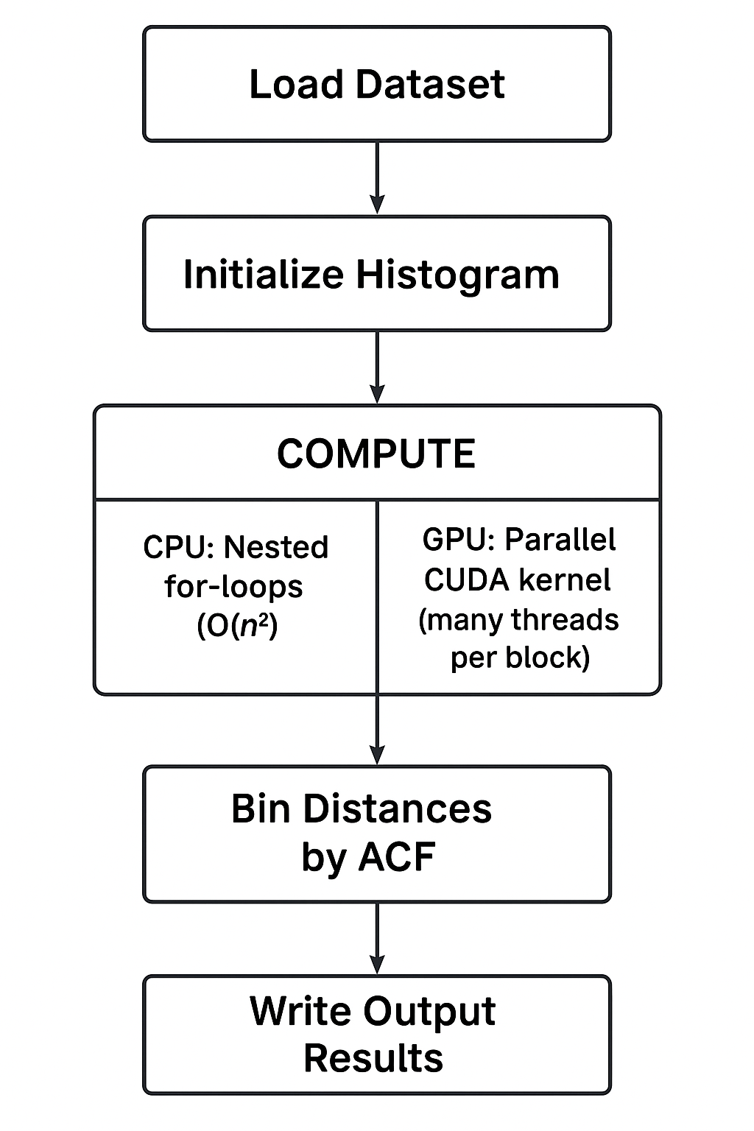
Workflow Diagram

Slide 12
Conclusion
GPU acceleration achieves over 170x speedup on large datasets
Both CPU and GPU produce correct and matching results
Parallel computing is essential for large-scale astronomical data analysis
Future work: further optimization and scaling to bigger datasets

Slide 13

Thank You! Questions?

