Slide 1
Unemployment in India around the COVID-19 lockdown
An exploratory analysis of monthly regional data, May 2019 – June 2020
Problem · Method · Results · Takeaway

Slide 2
Problem: how big was the shock, and where?
India's nationwide lockdown began on 24 March 2020
Questions: how much did unemployment rise, how long did it last, and did it differ by region and by rural vs urban area?
Literature: a sharp jump and fast rebound, but falling participation can hide job loss
24 Mar
lockdown starts; it ended on 31 May 2020
Unemployment in India, May 2019 – Jun 2020 | 2

Slide 3
Method: simple, transparent, reproducible
740
28
14
records after cleaning
regions, rural + urban
months of data
Pandas, Matplotlib, Seaborn; dropped 28 empty rows
Compared pre-COVID (before 1 Mar 2020) with post-COVID
Added urban vs rural split and a check that drops March
Unemployment in India, May 2019 – Jun 2020 | 3

Slide 4
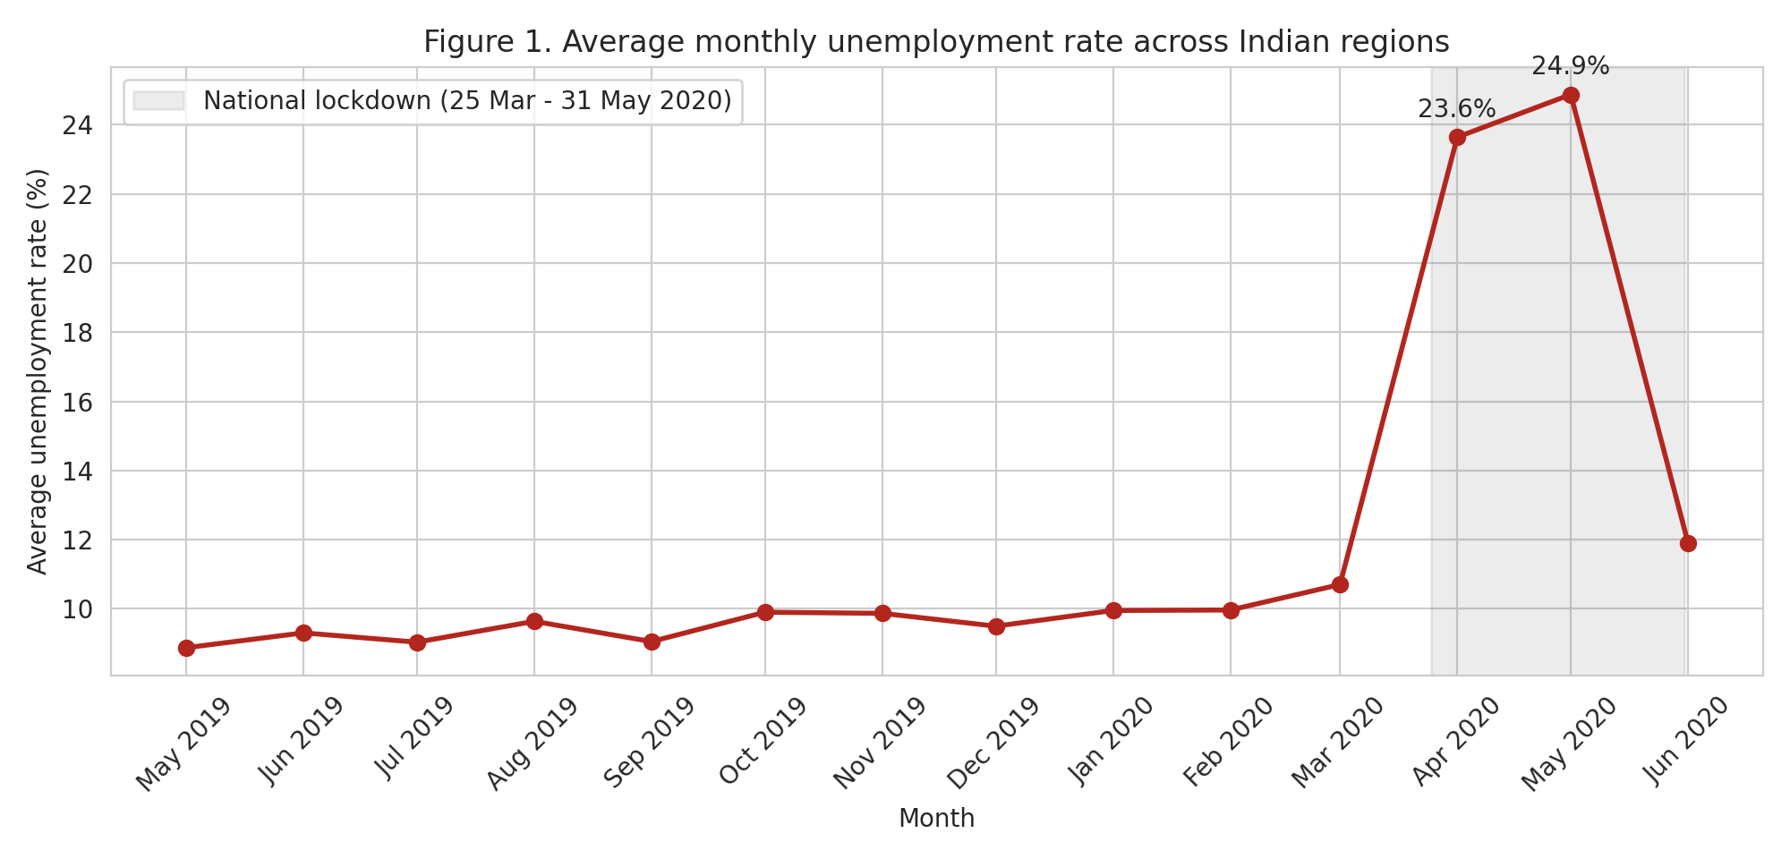
Results: unemployment spiked, then fell back
24.9%
peak in May 2020, versus 10.0% in Feb
11.9%
by June 2020
Unemployment in India, May 2019 – Jun 2020 | 4

Slide 5
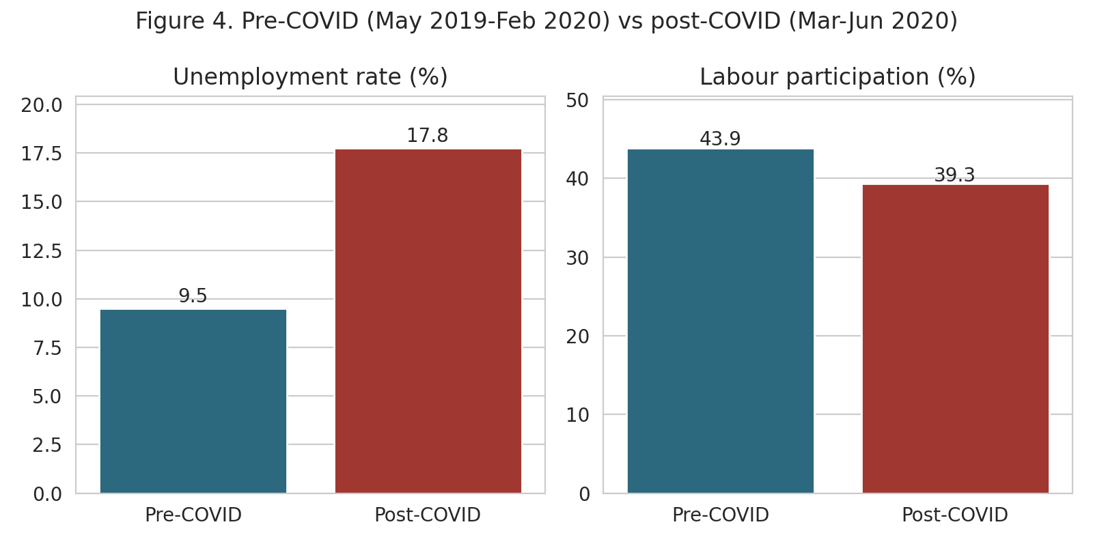
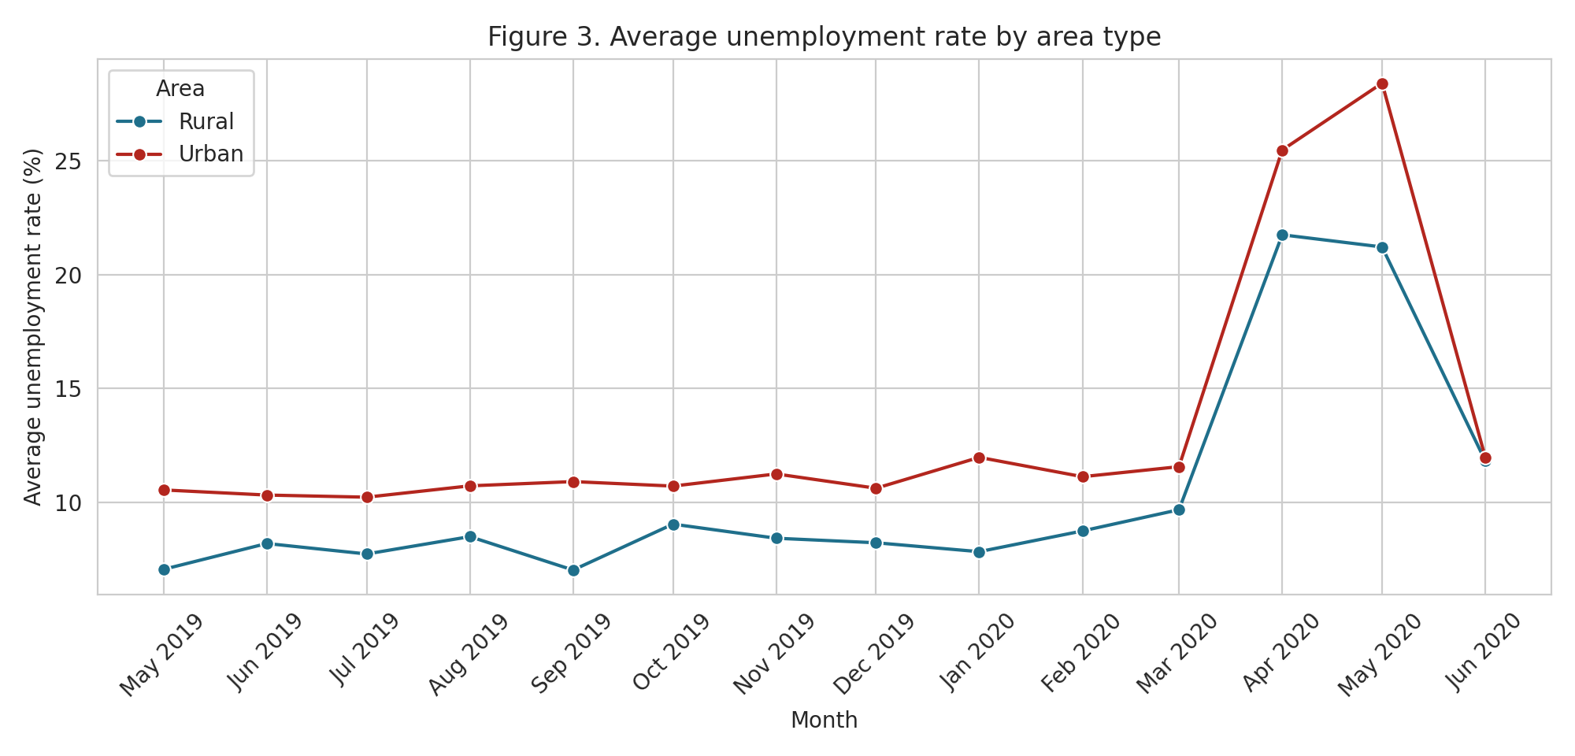
Results: who was hit hardest
Average unemployment: 9.5% before, 17.8% after
Labour participation: 43.9% before, 39.3% after
May 2020: 28.4% urban vs 21.2% rural
Unemployment in India, May 2019 – Jun 2020 | 5

Slide 6
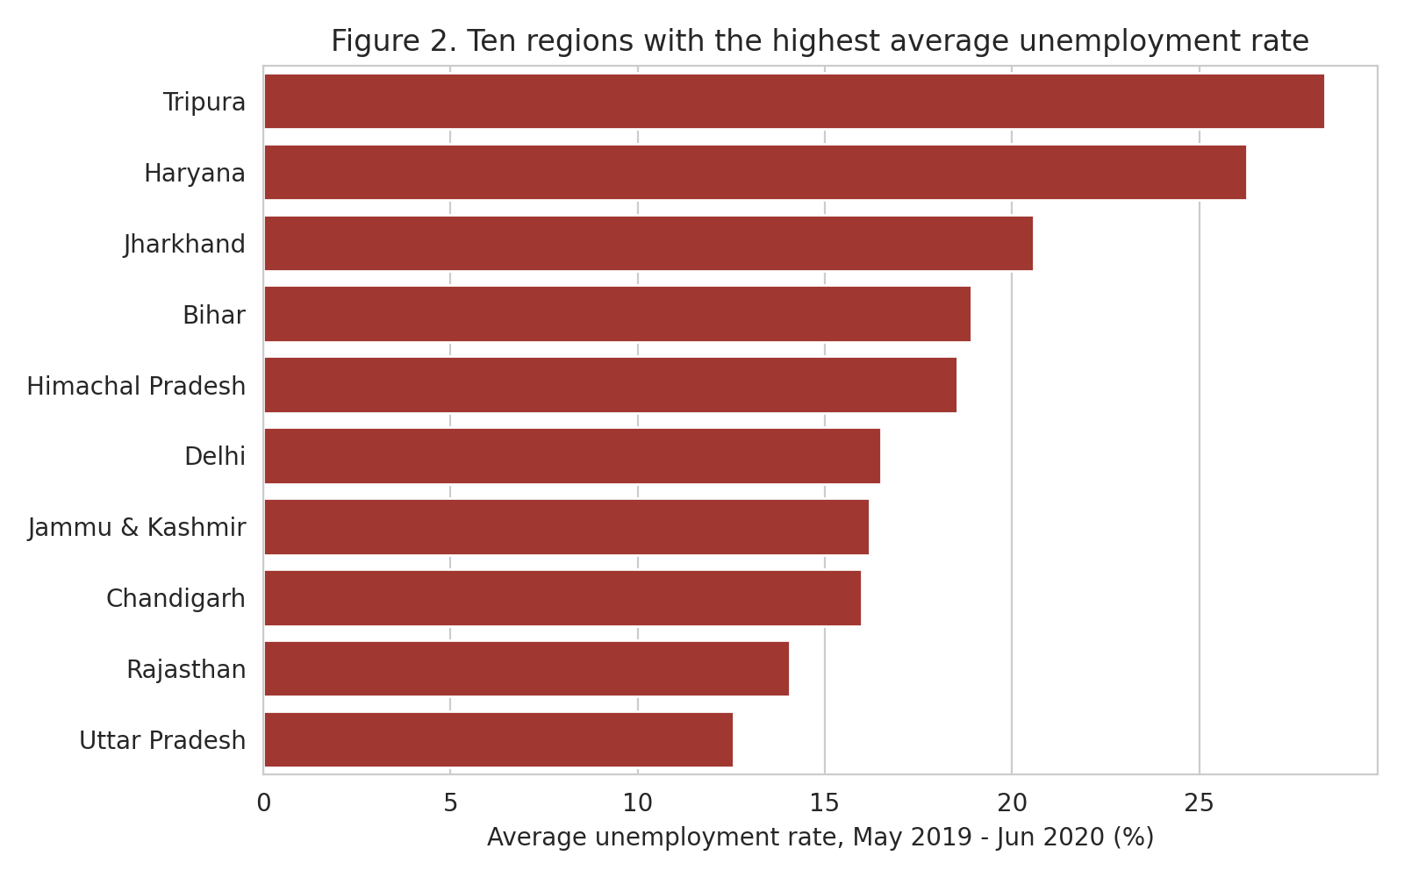
Results: large gaps between regions
Highest averages: Tripura 28.4%, Haryana 26.3%
Biggest rises (Apr–May vs pre): Puducherry +73.8 pts, Jharkhand +42.8, Tamil Nadu +38.0
Lowest: Meghalaya 4.8%
Unemployment in India, May 2019 – Jun 2020 | 6

Slide 7
Takeaway
The lockdown brought a sharp, short-lived rise in unemployment
Participation fell too, so June's 11.9% is not a full recovery
Caveats: unweighted averages, short baseline, source not documented
Next: population-weighted data, longer baseline, gender and sector detail

