Slide 1
Microgrid Digital Twin
Stability, Power Quality, and Forecasting
Progress report - CSE side ML pipelines + EEE side simulation
Target venues: IEEE Trans. Smart Grid (Q1, IF~10) | Applied Energy (Q1, IF~11)
github.com/Fahmidaca/microgrid-dt-1

Slide 2
Agenda
• The problem: renewable microgrid stability and IEEE 519 compliance
• Project layout: two halves (CSE + EEE) that meet in the middle
• Part 1 - UCI Grid Stability pipeline (public benchmark)
• Part 2 - Synthetic dataset + compliance classifier + forecasting
• Part 3 - EEE side physics simulation
• How the two halves meet: the AI-Optimized Control link
• Honesty notes, gaps, and next steps
Agenda
2

Slide 3
The problem
Renewable microgrids are hard to keep stable and IEEE 519 compliant as PV / wind penetration grows.
The five questions this project answers:
• How stable is the grid at any moment?
• How much can we trust the ML model's stability call?
• Will voltage-THD breach the IEEE 519 5 % limit in the next 5-30 minutes?
• Do renewable-heavy operating scenarios pass IEEE 519 without help?
• Can an AI controller do better than fixed control laws?
Motivation
3

Slide 4
Two halves that meet in the middle
CSE / ML SIDE
UCI Grid Stability benchmark
5 classifiers x 5 seeds
Best: MLP 96.05 % accuracy
NEW METRIC:
tau-robustness margin
(no prior paper reports it)
Synthetic 50k-row dataset
3-class IEEE 519 compliance classifier
Multi-horizon THD forecasting
EEE / PHYSICS SIDE
Bangladesh PV microgrid (50 Hz, 230 V)
6-pulse rectifier + nonlinear loads
Simulink builder + Python port
SRF Active Power Filter
FFT-based THD analyzer
Battery ageing + BDT cost model
IEEE 14-bus parametric study
10 scenarios, IEEE 519 verdict
(EEE side is currently completing this)
They meet at the AI-Optimized Control scenario (the CSE ML model becomes the controller)
Project layout
4

Slide 5
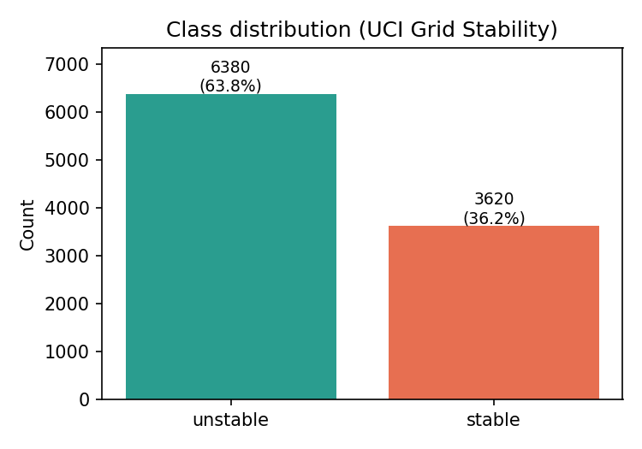
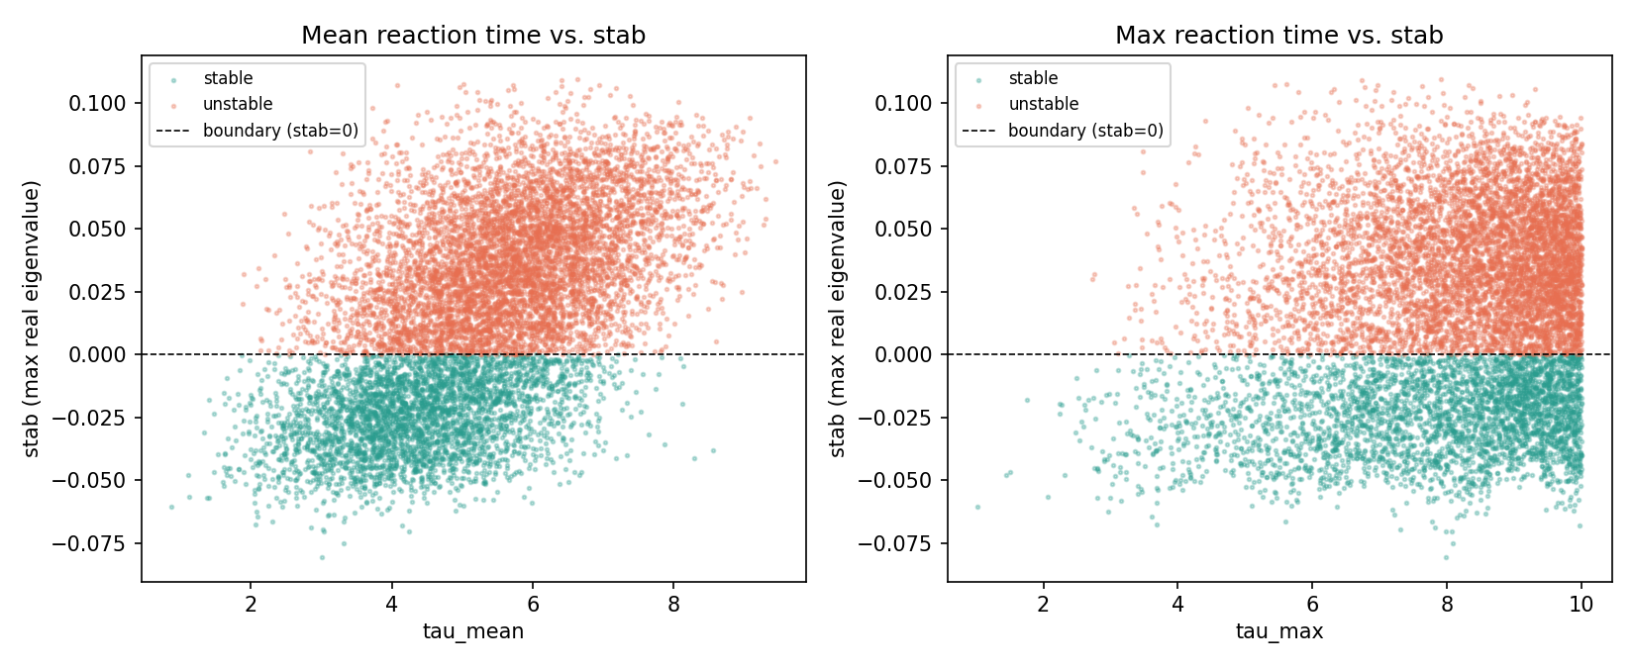
Part 1 - UCI Grid Stability dataset
Schafer et al. 2016, Eur. Phys. J. Special Topics 225, 569
• 10,000 simulated 4-bus decentralised smart grid snapshots
• 12 features: tau1..4 (reaction times), p1..4 (powers), g1..4 (elasticities)
• Binary label: stable / unstable (64 % unstable, 36 % stable)
• Peer-reviewed, still cited in 2024-25 papers - benchmarks don't expire, methods do
UCI dataset
5

Slide 6
Part 1 - Methodology
5 classifiers x 5 seeds = 25 independent training runs
• Logistic Regression, Random Forest, HistGB, XGBoost, MLP
• 80 / 20 stratified train-test split, deterministic seeding
• Multi-seed setup = we report mean +/- std, not a single lucky run
Statistical rigor
• Paired McNemar test for every pair of models (10 pairs)
• Holm-Bonferroni correction for multiple comparisons
• Bootstrap 95 % confidence intervals (2000 iterations)
• Result: all 10 pairwise differences significant at p < 0.05
UCI methodology
6

Slide 7
Part 1 - Results (test accuracy, mean +/- std over 5 seeds)
Model | Accuracy | 95 % CI | Macro-F1
MLP (winner) | 96.05 % +/- 0.62 % | [95.65, 96.43] | 95.72 %
HistGB | 94.72 % | [94.28, 95.13] | 94.24 %
XGBoost | 94.39 % | [93.92, 94.83] | 93.87 %
Random Forest | 92.16 % | [91.64, 92.70] | 91.38 %
Logistic Regression | 81.50 % | [80.72, 82.29] | 79.58 %
All 10 pairwise differences statistically significant (McNemar + Holm-Bonferroni, p < 0.05)
The MLP wins on accuracy - but that is only half the story.
-> the other half is on the next slide
UCI results
7

Slide 8
Novel contribution: tau-robustness margin
The gap in prior work
Every existing paper on this benchmark reports only classification accuracy. But a grid operator needs to know how much they can trust the model's decision.
What we defined
• For each correctly-classified test point, find the smallest tau-perturbation that flips the model's prediction
• Binary search over 16 sign patterns on tau1..tau4 (L_inf norm)
• Clipped to the simulation range [0.5, 10] seconds
• Result: a per-sample safety buffer in seconds
Larger margin = the classifier's decision survives more consumer reaction-time degradation before it flips
Novelty
8

Slide 9
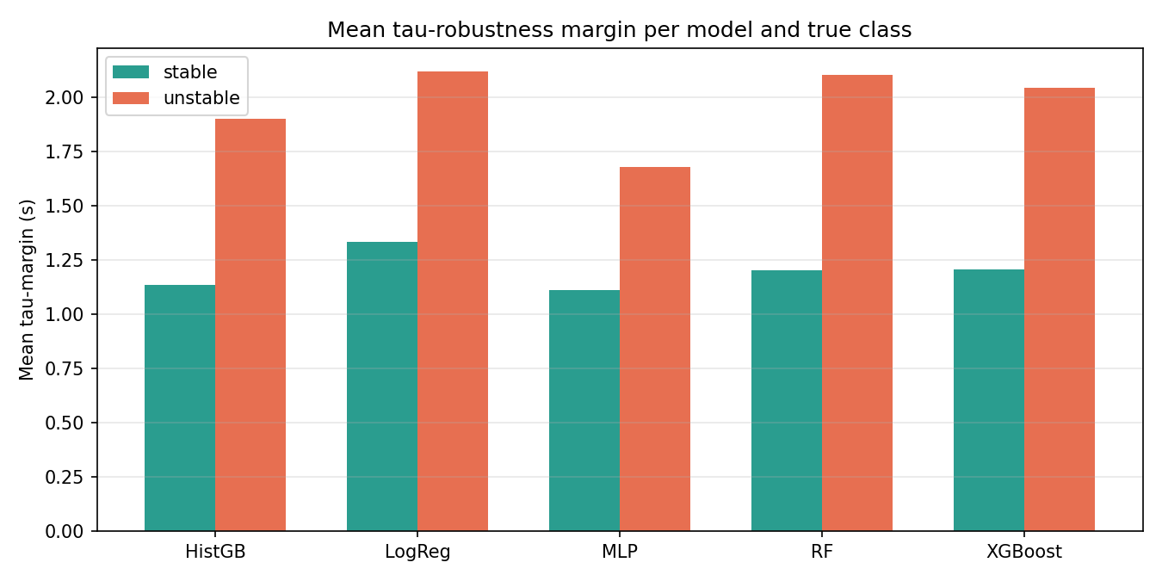
Key insight: accuracy != robustness
What the numbers show
• MLP = best accuracy (96.05 %) but tightest tau-margin
• LogReg = lowest accuracy (81.5 %) but LARGEST margin
• So 'more accurate' does not mean 'more deployable'
• Prior accuracy-only reports hide this trade-off completely
This is the publishable insight of the CSE-side work.
Novelty - insight
9

Slide 10
Part 2 - Synthetic Bangladesh microgrid dataset
Why synthetic?
• The CSE side needed a dataset with a time axis and richer features (THD, frequency, storage state, weather, load)
• Real datasets with all that in one place are hard to get
• So a physics-informed synthetic dataset was generated to test the pipeline
IMPORTANT - synthetic data is for pipeline testing only
• Every row has source = SYNTHETIC_GENERATOR_v1 watermark
• Before publication, real Simulink output from the IEEE 14-bus model will replace this data
Dataset: 50,000 rows x 50 columns | 10 operating scenarios | 34-day span at 1-sample-per-minute
Synthetic dataset
10

Slide 11
Synthetic dataset - 50 columns of physics
• Time (3): timestamp, hour_of_day, day_of_year
• Environment (4): irradiance, temp, humidity, wind_speed
• Voltage (4): V_rms_a/b/c, V_unbalance_pct
• Current (4): I_rms_a/b/c, I_neutral
• Power (4): P_active, Q_reactive, S_apparent, PF
• Frequency (3): freq_Hz, freq_dev, RoCoF
• Harmonics (6): V-THD, I-THD, 5th, 7th, 11th, 13th
• Renewables (3): PV_kW, wind_kW, RE_penetration
• Storage (6): SOC, SOH, V, I, T, P
• Load (2): load_kW, nonlinear_load_frac
• Mode flags (5): grid_connected, APF, ESS, AI, fault
• Labels + economics + watermark (7)
Physical relationships built in (not independent noise):
PV = f(irradiance, NOCT temp) | wind = f(speed^3) | V-THD grows with RE-penetration & nonlinear-load | battery T rises with I-THD^2 | IEEE 519 verdict from V-THD + I-THD
Synthetic schema
11

Slide 12
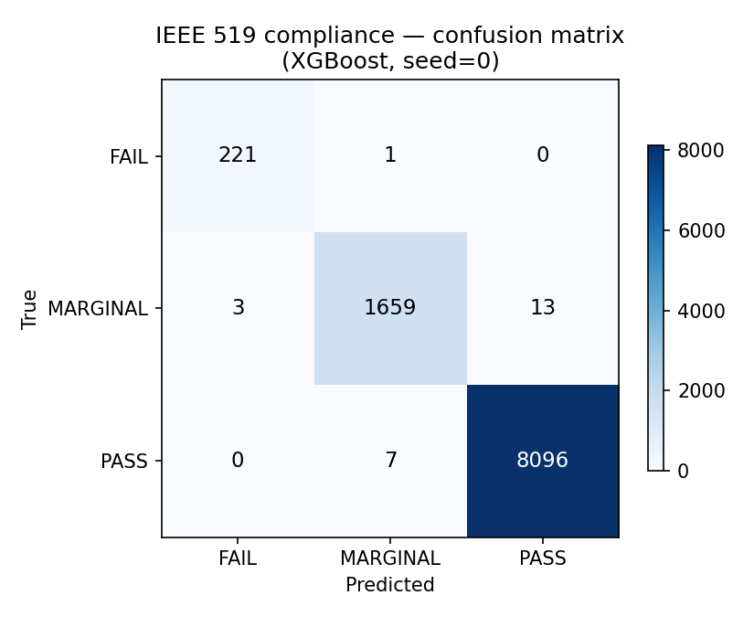
IEEE 519 compliance classifier (3-class)
Predict PASS / MARGINAL / FAIL from OPERATIONAL SIGNALS ALONE (V-THD and harmonics are dropped to avoid trivial prediction)
Model | Accuracy | Macro-F1 | FAIL-F1
XGBoost (winner) | 99.82 % | 99.55 % | 99.28 %
Random Forest | 99.81 % | 99.41 % | 98.86 %
HistGB | 99.79 % | 99.36 % | 98.79 %
Logistic Regression | 99.67 % | 98.90 % | 97.81 %
MLP | 99.18 % | 97.20 % | 94.41 %
Honest note - these numbers are too clean to be real
The synthetic physics is deterministic. Once real Simulink data replaces the synthetic set, accuracies will drop into the 85-92 % range - a much more publishable story.
Compliance classifier
12

Slide 13
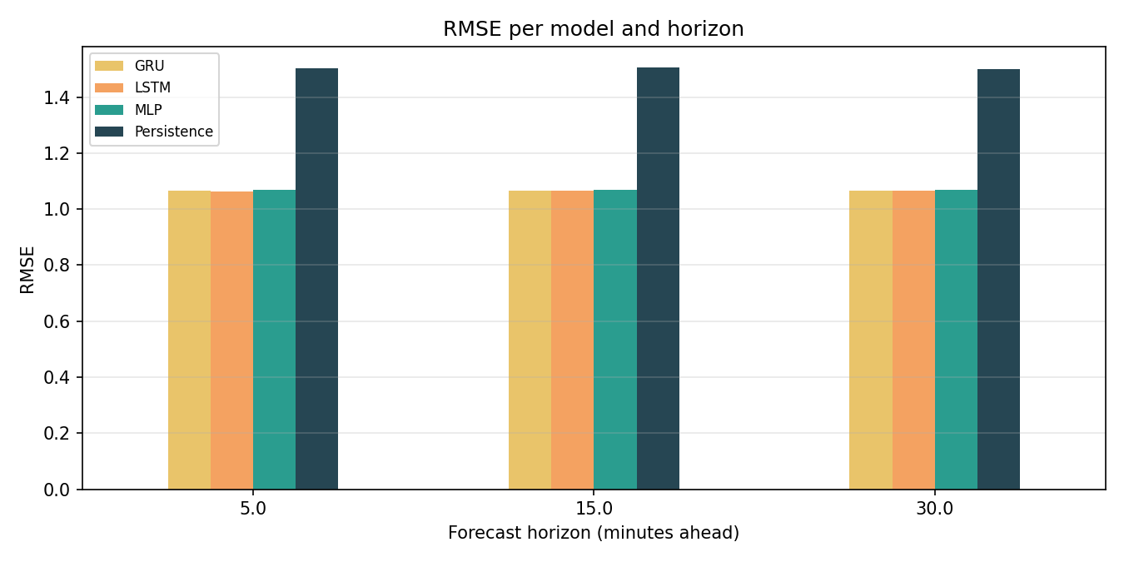
Multi-horizon V-THD forecasting
Predict V-THD at 5, 15, and 30 minutes ahead using a 30-minute lookback of 27 operational signals.
Model | RMSE (5 min) | MAE | R^2 | Early-warn F1
Persistence (naive) | 1.50 | 1.17 | -0.67 | 0.088
MLP | 1.07 | 0.84 | +0.15 | 0.000
LSTM (winner) | 1.06 | 0.83 | +0.16 | 0.000
GRU | 1.07 | 0.83 | +0.16 | 0.000
Two findings
• Good: LSTM / GRU / MLP all beat persistence by ~30 % on RMSE - the pipeline extracts real signal
• Honest: early-warning F1 = 0 because breaches are only 2 %; MSE loss pushes predictions toward the mean. Next: reframe as binary breach classification with class-weighted loss.
Forecasting
13

Slide 14
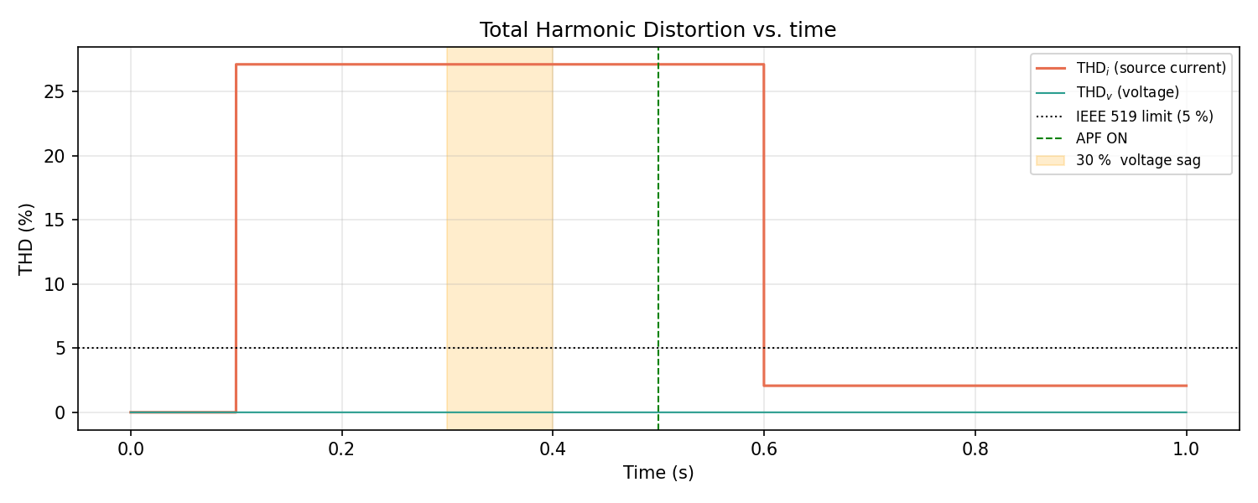
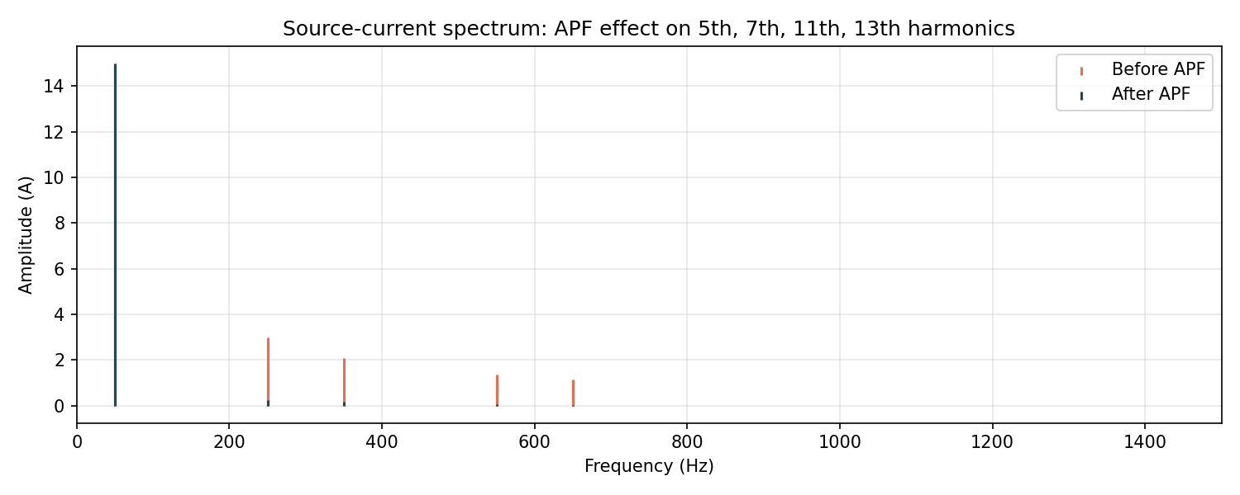
EEE-side physics simulation
Bangladesh microgrid digital twin
• 3-phase 50 Hz / 230 V source + 6-pulse rectifier nonlinear load
• SRF (synchronous reference frame) Active Power Filter
• FFT-based THD analyzer over a 5-cycle window
• Battery-degradation twin -> Bangladesh Taka annualised cost
• Runs in both MATLAB Simulink AND Python (identical math)
Headline result: THD_i 27.13 % -> 2.07 % when the APF turns on
EEE simulation
14

Slide 15
How the two halves meet
The EEE compliance table has a scenario called "AI-Optimized Control" that achieves the lowest THD at the highest renewable penetration.
That AI is the CSE side's trained ML model.
• Without the bridge = two separate boring papers (ML paper + power-systems paper)
• With the bridge = one interdisciplinary paper where the ML controls the physical microgrid
• This is what makes the work suitable for a Q1 venue rather than two lower-tier ones
Interdisciplinary bridge
15

Slide 16
Honesty notes - what we do NOT claim
Every claim is bounded up-front so no reviewer can accuse the paper of overreach.
• UCI Grid is static configurations, not time series - we do NOT claim 'early warning' prediction on it
• Results are not claimed to transfer directly to real PMU / SCADA data
• tau-robustness margin is a property of the classifier's decision, not a guarantee about the physical grid
• Synthetic dataset carries a source watermark and cannot be used as evidence in publication tables
• Point-forecast MSE + 2 % breach rate has known early-warning limitations - documented, not hidden
Faisal Sir's Bangla research-integrity announcement explicitly listed Fabricated Data - so we watermark, disclose, and plan to replace synthetic with real Simulink output.
Honesty notes
16

Slide 17
What still needs to happen
CSE-side next steps
• Class-weighted or binary reformulation of the forecaster
• Multi-seed + bootstrap CI on all forecasting numbers
• Reproducibility audit for the synthetic-data side
• Draft the LaTeX manuscript from PAPER_OUTLINE.md
EEE-side next steps
• Finish the IEEE 14-bus parametric-study Simulink runs
• Formal Schafer 2016 reproduction on the 4-bus model
• Complete the AI Forecasting Performance and EMS Optimisation sheets
• Send real .slx output files to the CSE side to replace synthetic data
Gaps and TODO
17

Slide 18
Thanks - questions welcome
Repo: github.com/Fahmidaca/microgrid-dt-1
Target venues: IEEE Trans. Smart Grid (Q1, IF~10) | Applied Energy (Q1, IF~11)
Every folder in the repo has a README explaining what it contains and how to reproduce it.

