Slide 1
Microgrid Digital Twin
Stability, Power Quality, and Forecasting
Condensed progress report - CSE + EEE sides
Target venues: IEEE Trans. Smart Grid (Q1, IF~10) | Applied Energy (Q1, IF~11)
github.com/Fahmidaca/microgrid-dt-1

Slide 2
The problem + project layout
5 questions this project answers
Two halves that meet in the middle
• Is the microgrid stable right now?
• How much can we trust the model that says yes?
• Will THD breach IEEE 519's 5 % limit in the next 5-30 minutes?
• Do renewable-heavy scenarios pass IEEE 519 without help?
• Can an AI controller beat a fixed control law?
CSE / ML SIDE
UCI Grid Stability
5 models x 5 seeds
MLP 96.05 %
tau-robustness margin
(new metric)
Synthetic 50k dataset
Compliance + forecasting
EEE / PHYSICS SIDE
50 Hz / 230 V microgrid
6-pulse rectifier
SRF Active Power Filter
FFT THD analyzer
Battery ageing + BDT cost
IEEE 14-bus study
10 scenarios
MEETING POINT
EEE compliance table has an "AI-Optimized Control" scenario. That AI is the CSE side's trained ML model.
Problem + layout
2

Slide 3
Part 1 - UCI Grid Stability pipeline
Dataset
Results (mean over 5 seeds)
• Schafer 2016 - 10,000 snapshots of a 4-bus decentralised grid
• 12 features (tau1..4, p1..4, g1..4) - binary stable/unstable label
• Peer-reviewed, still cited in 2024-25 (benchmarks don't expire)
Model | Accuracy | 95 % CI | F1
MLP (winner) | 96.05 % | [95.65, 96.43] | 95.72 %
HistGB | 94.72 % | [94.28, 95.13] | 94.24 %
XGBoost | 94.39 % | [93.92, 94.83] | 93.87 %
Random Forest | 92.16 % | [91.64, 92.70] | 91.38 %
LogReg | 81.50 % | [80.72, 82.29] | 79.58 %
Methodology
• 5 classifiers (LogReg, RF, HistGB, XGBoost, MLP) x 5 seeds
• 80/20 stratified split, deterministic seeds
• Paired McNemar + Holm-Bonferroni + bootstrap 95 % CI
• All 10 pairwise differences significant at p < 0.05
MLP wins on accuracy - but that is only half the story. The other half (tau-robustness margin) is on the next slide.
UCI pipeline
3

Slide 4
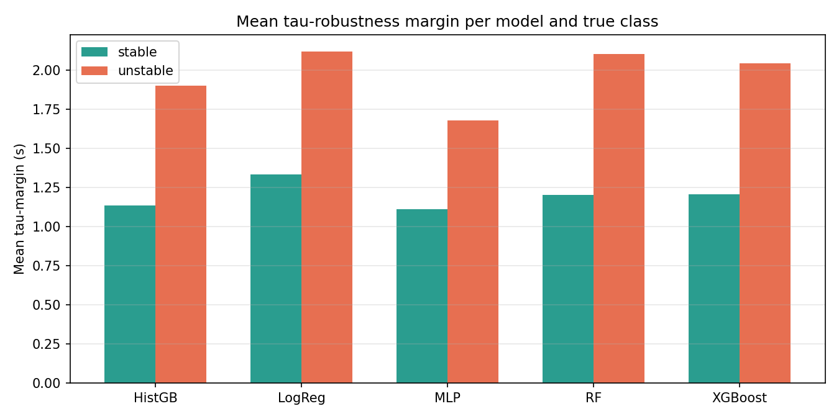
Novel contribution - tau-robustness margin
What we defined
• For each correctly-classified test point, binary-search the smallest reaction-time perturbation that flips the prediction
• 16 sign patterns on tau1..tau4, clipped to [0.5, 10] s (L_inf norm)
• Result: per-sample safety buffer - no prior paper reports it
Key insight - accuracy != robustness
• MLP: highest accuracy (96 %) BUT smallest tau-margin
• LogReg: lowest accuracy (81.5 %) BUT largest margin (stable 1.33 s / unstable 2.12 s)
• Prior accuracy-only reports hide this trade-off
• 'More accurate' != 'more deployable' - the publishable insight
Novel contribution
4

Slide 5
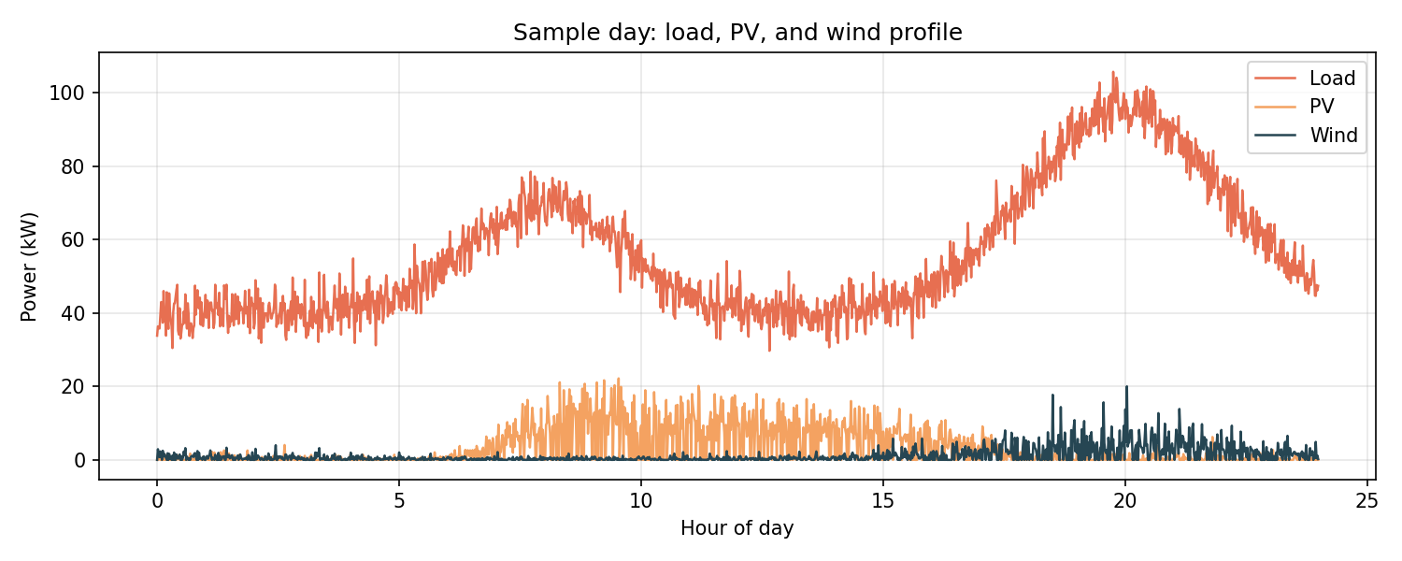
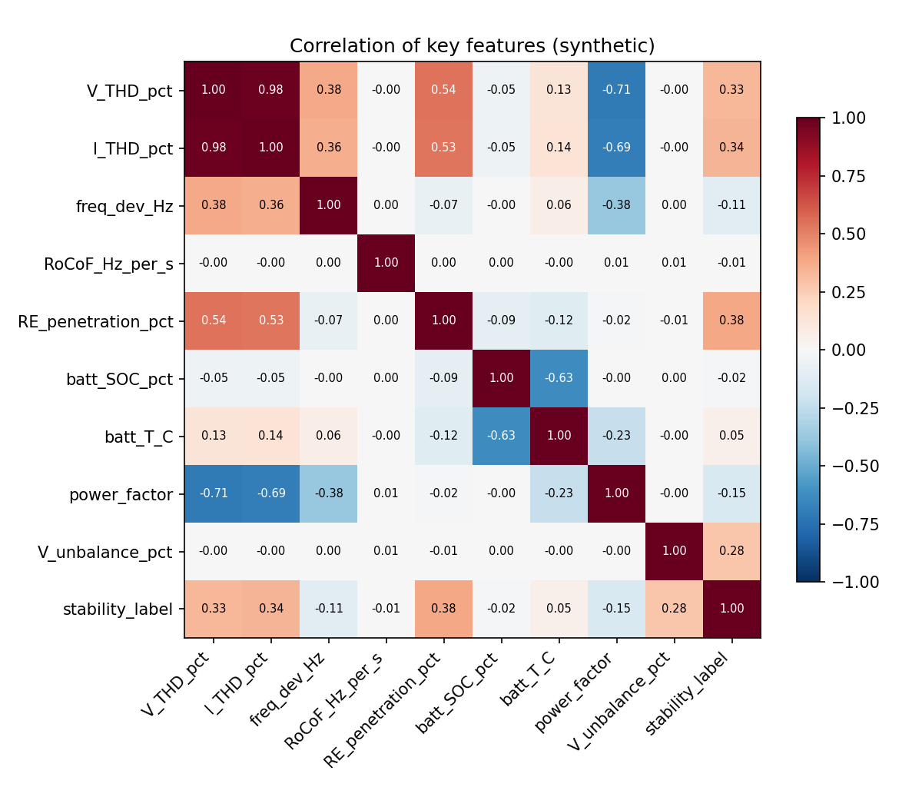
Part 2 - synthetic Bangladesh microgrid dataset
50,000 rows x 50 columns | 34 days | 1 sample per minute
50 columns in 12 categories
IMPORTANT - pipeline testing only
Every row watermarked with
source = SYNTHETIC_GENERATOR_v1
Before publication, real Simulink output from
the EEE side's IEEE 14-bus model will replace it.
(Faisal Sir: fabricated data is a top
research-integrity violation.)
• Time (3), Environment (4), Voltage (4), Current (4)
• Power (4), Frequency (3), Harmonics (6), Renewables (3)
• Storage (6), Load (2), Mode flags (5), Labels + cost + watermark (6)
• Physics-informed: PV = f(irradiance, NOCT temp), wind = f(speed^3)
• THD grows with RE penetration + nonlinear load, falls with ESS + AI control
Synthetic dataset
5

Slide 6
Downstream ML on the synthetic dataset
IEEE 519 compliance (PASS / MARGINAL / FAIL)
Multi-horizon V-THD forecasting
43 features | V-THD & harmonics dropped as leakage | 5 models x 5 seeds
30-min lookback -> predict at 5 / 15 / 30 min ahead | chronological split
Model | Accuracy | Macro-F1
XGBoost (winner) | 99.82 % | 99.55 %
Random Forest | 99.81 % | 99.41 %
HistGB | 99.79 % | 99.36 %
LogReg | 99.67 % | 98.90 %
MLP | 99.18 % | 97.20 %
Model (5 min) | RMSE | R^2 | EW-F1
Persistence | 1.50 | -0.67 | 0.088
MLP | 1.07 | +0.15 | 0.000
LSTM (winner) | 1.06 | +0.16 | 0.000
GRU | 1.07 | +0.16 | 0.000
Honest note
Numbers are too clean - synthetic physics is
deterministic, so features like RE penetration
essentially determine the label.
Real Simulink data will drop accuracies into
the 85-92 % range - a better paper story.
Honest note
Deep models beat persistence by 30 % on RMSE
- the pipeline extracts real signal.
BUT early-warning F1 = 0 (breaches are only 2 %,
MSE hugs the mean). Next step: binary breach
classification with class-weighted loss.
Downstream ML
6

Slide 7
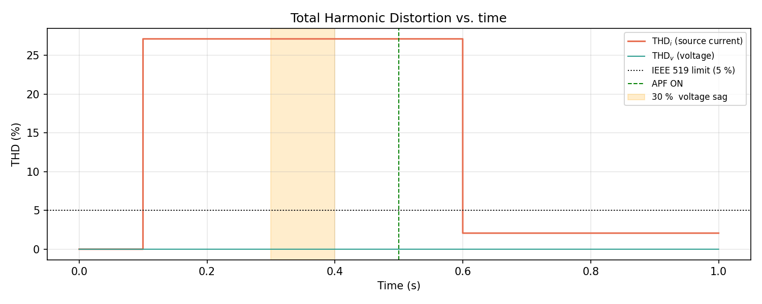
EEE physics simulation + the bridge
Bangladesh PV microgrid digital twin
How the two halves meet
• 3-phase 50 Hz / 230 V + 6-pulse rectifier
• SRF Active Power Filter + FFT THD analyzer
• Battery ageing + BDT cost twin
• Runs in MATLAB Simulink AND Python (same math)
The EEE compliance table has a scenario called 'AI-Optimized Control' that achieves the best THD.
That AI is the CSE side's
trained ML model.
Why it matters
• Without the bridge = two boring papers
• With the bridge = one interdisciplinary paper
• The ML controls the physical microgrid, Simulink physics validates it beats fixed control laws
• Unlocks Q1 venues instead of two mid-tier ones
Result: THD_i 27.1 % -> 2.1 % when APF turns on
EEE + bridge
7

Slide 8
Honesty + gaps + thanks
Honesty notes - what we do NOT claim
What still needs to happen
• UCI is static - no 'early warning' claim on it
• No claim of transfer to real PMU / SCADA
• Tau-margin is a decision property, not a grid guarantee
• Synthetic dataset carries a watermark; not for publication
• Forecaster's zero early-warning F1 is a real limitation, not hidden
CSE side
• Binary breach classifier with class-weighted loss
• Multi-seed + bootstrap CI on forecasting
• Reproducibility audit on synthetic side
• Draft the LaTeX manuscript
EEE side
• Finish IEEE 14-bus parametric-study runs
• Formal Schafer 2016 reproduction on 4-bus model
• Send real .slx output to replace synthetic data
Thanks - questions welcome
github.com/Fahmidaca/microgrid-dt-1
Wrap-up
8

