Slide 1
CSE-Side Progress
Microgrid Digital Twin — Stability, Power Quality, and Forecasting
Stability • Compliance • Forecasting • Cyber-Resilience • Explainability • Dashboard
5 datasets-to-model pipelines, all owned end-to-end by the CSE side
github.com/Fahmidaca/microgrid-dt

Slide 2
CSE scope — 3 datasets, 5 pipelines
UCI Grid Stability
(public benchmark)
10,000 rows, 12 features
5 classifiers x 5 seeds
+ tau-robustness margin
Synthetic Bangladesh
microgrid dataset
50,000 rows x 50 cols
IEEE 519 compliance classifier
Multi-horizon THD forecasting
Power-quality disturbance
dataset (Jamalpur, field data)
5,000 rows x 16 cols
Anomaly detection + prediction
SHAP explainability + dashboard
Two of the three datasets were compared side-by-side on the same anomaly-detection method rather than merged — incompatible schemas, but a very useful comparison (slide 5).
CSE scope
2

Slide 3
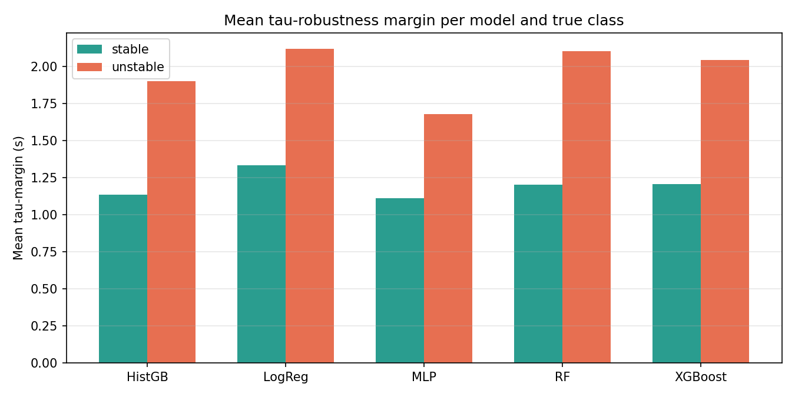
UCI Grid Stability + tau-robustness margin
Model | Accuracy | F1
MLP (winner) | 96.05% | 95.72%
HistGB | 94.72% | 94.24%
XGBoost | 94.39% | 93.87%
RF | 92.16% | 91.38%
LogReg | 81.50% | 79.58%
Novel: tau-robustness margin
Per-sample: smallest reaction-time change
that flips the model's prediction.
MLP: highest accuracy, SMALLEST margin.
LogReg: lowest accuracy, LARGEST margin.
'More accurate' != 'more deployable'.
UCI + robustness
3

Slide 4
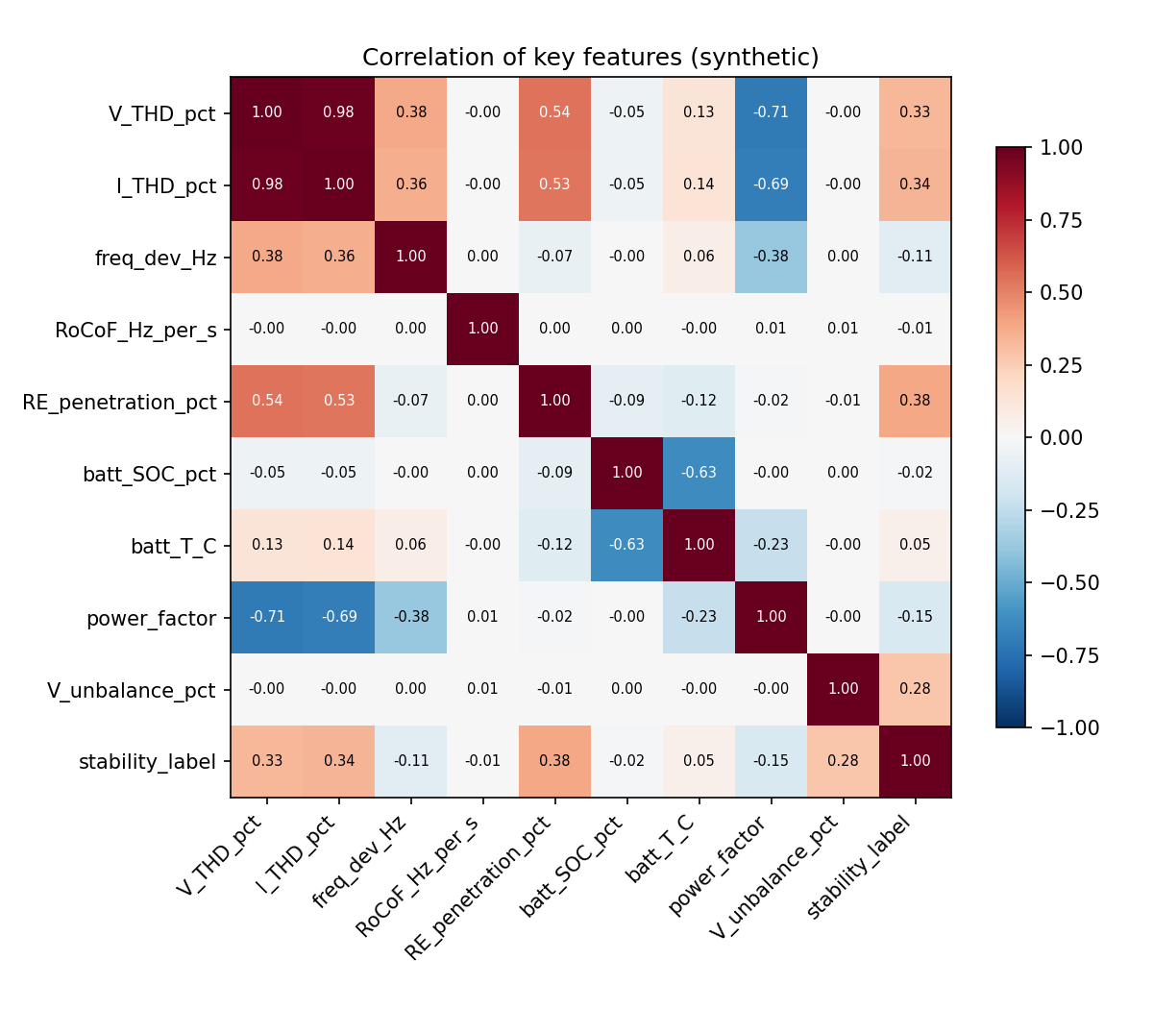
Synthetic dataset + compliance + forecasting
IEEE 519 compliance classifier (PASS/MARGINAL/FAIL)
50,000 rows x 50 cols, physics-informed, watermarked SYNTHETIC_GENERATOR_v1 — not used as publication evidence
THD forecasting (LSTM/GRU/MLP, 5/15/30 min ahead)
LSTM beats persistence baseline by ~30% RMSE.
Honest gap: early-warning F1 = 0 (breaches are 2% of rows) — next step is class-weighted loss.
Synthetic + downstream
4

Slide 5
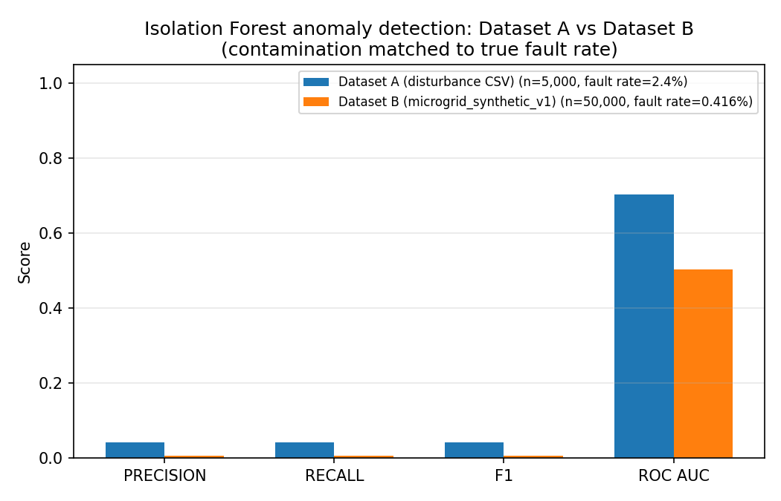
Anomaly detection — comparing the two datasets
Why compare instead of merge?
• Incompatible schemas: single-phase 16-col vs. three-phase 50-col
• Ran the identical Isolation Forest recipe on both instead
What it proved
• Disturbance dataset: 0.70 ROC-AUC — real, learnable fault signal
• Synthetic dataset: 0.50 (chance) — CORRECT, its fault_flag is designed as pure random noise
• The null result on one confirms the real result on the other isn't a fluke
Anomaly detection
5

Slide 6
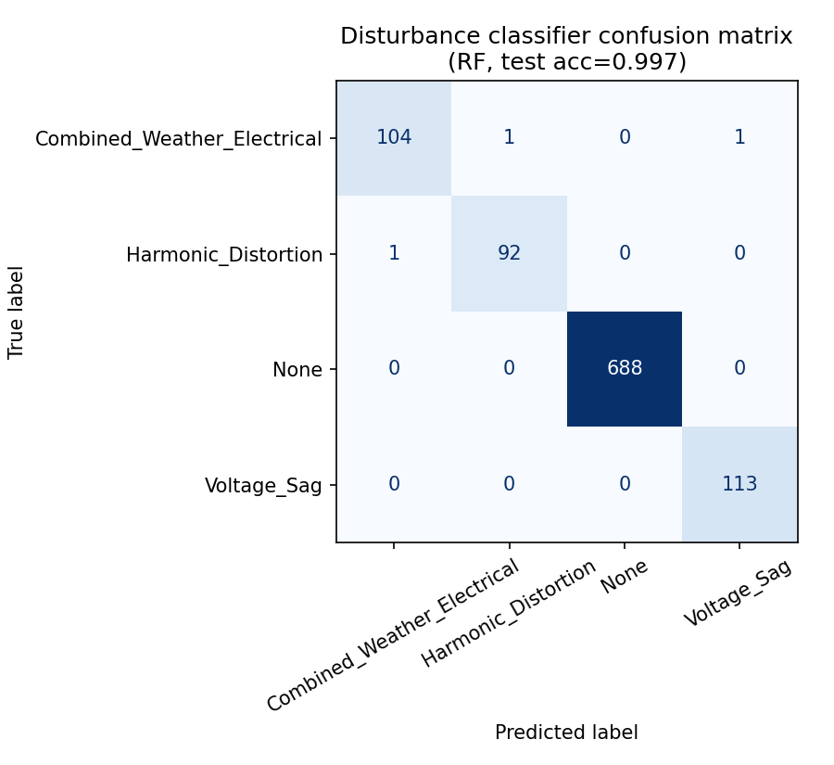
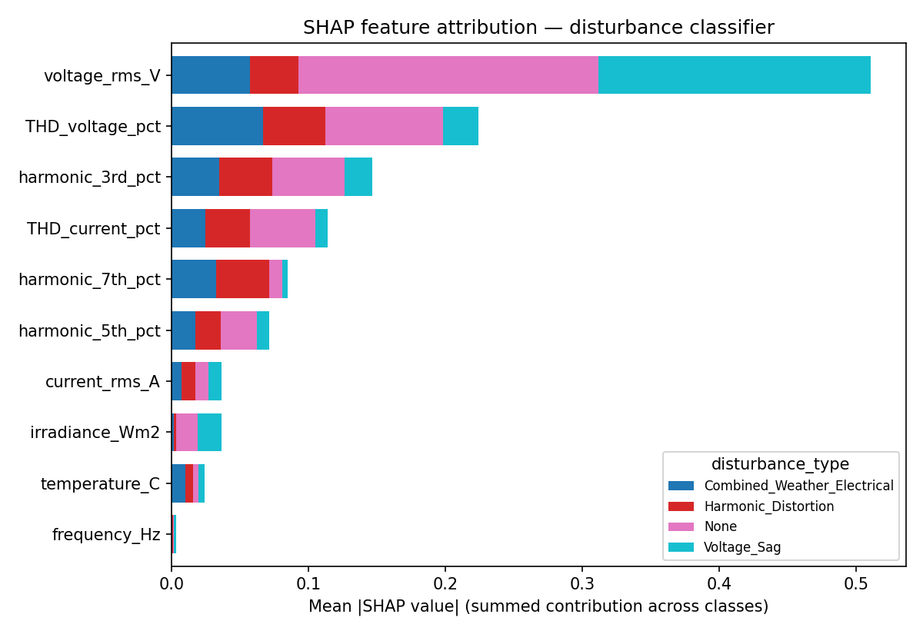
Disturbance prediction + explainability
4-class model: 99.70% test accuracy
SHAP — why the model predicts what it predicts
voltage_rms_V dominates Voltage_Sag, THD/harmonics dominate Harmonic_Distortion — physically sensible, not a black box.
Prediction + XAI
6

Slide 7
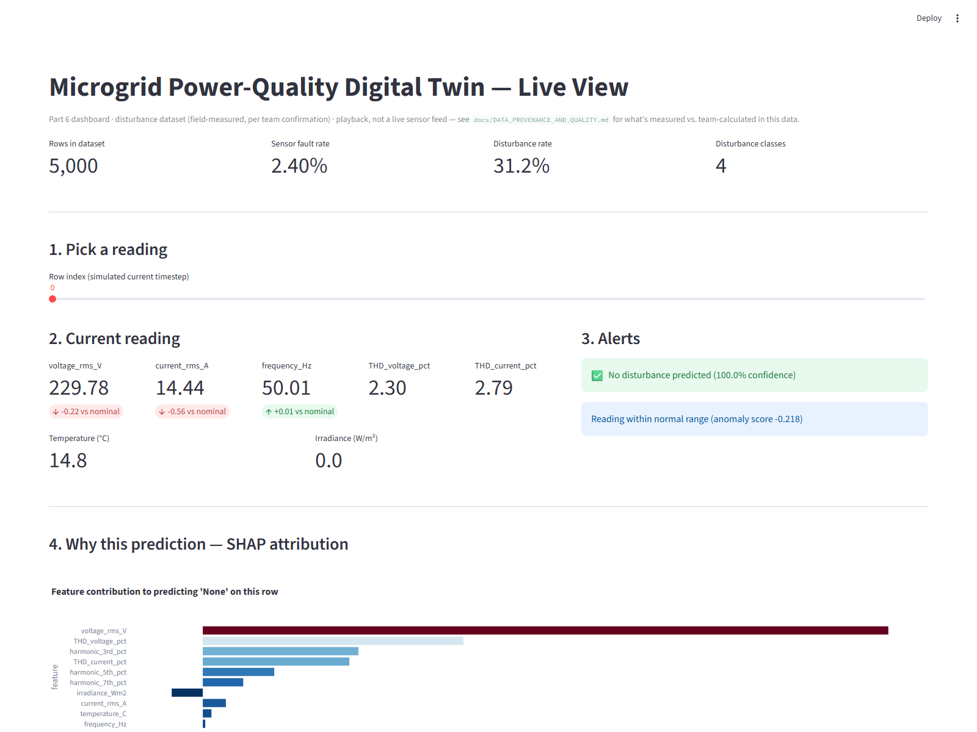
Dashboard + data provenance — resolved
Live at streamlit.app — streamlit run src/dashboard.py
• Pick a row -> live reading + alert banners (disturbance classifier + anomaly detector)
• Live SHAP explanation for that specific row
• Cost panel labelled team-calculated, not measured
• Historical trend, disturbance rows colour-coded
Data provenance — resolved
Team confirmed: electrical readings are
field-measured at the Jamalpur site.
Still true regardless: economic_cost_BDT
and battery_capacity_loss_pct are team-
calculated, not independent measurements —
documented column-by-column.
Dashboard + provenance
7

Slide 8
Status + thanks
Done
Still open
• UCI Grid Stability + tau-robustness margin
• Synthetic dataset + IEEE 519 compliance classifier
• Multi-horizon THD forecasting
• Anomaly / cyber-resilience detection (both datasets, compared)
• 4-class disturbance prediction (99.70% accuracy)
• SHAP explainability layer
• Interactive dashboard (Module 7)
• Dataset provenance confirmed with the team
• Re-derive economic_cost_BDT from an explicit tariff + replacement-cost formula
• Binary breach classifier for forecasting's early-warning F1
• Multi-seed + bootstrap CI on forecasting numbers
• LaTeX manuscript draft
Thanks — questions welcome
github.com/Fahmidaca/microgrid-dt
Status + thanks
8

