Slide 1


Slide 2

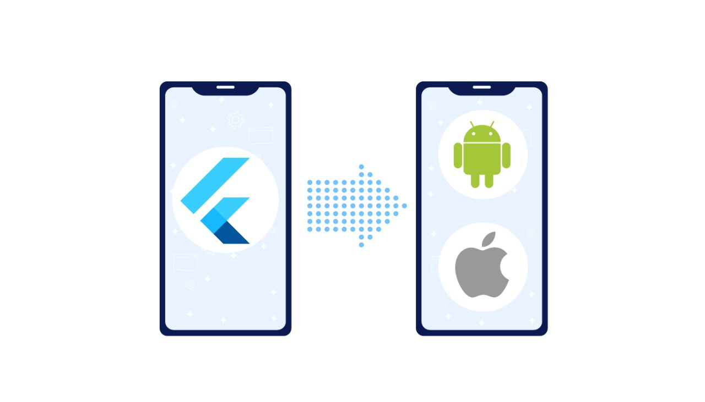
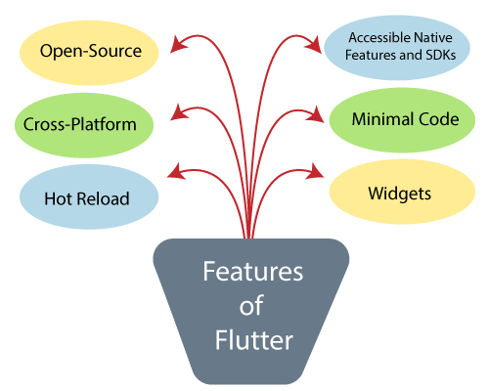
Flutter Features

Slide 3
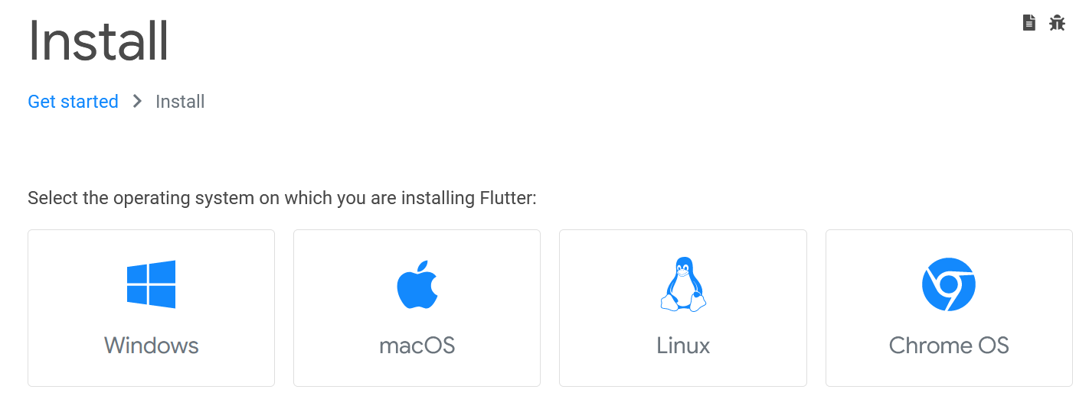
Flutter Installation

Slide 4

Install Android Studio
Get the official Integrated
Development Environment (IDE)
for Android app development.

