Slide 1


Slide 2
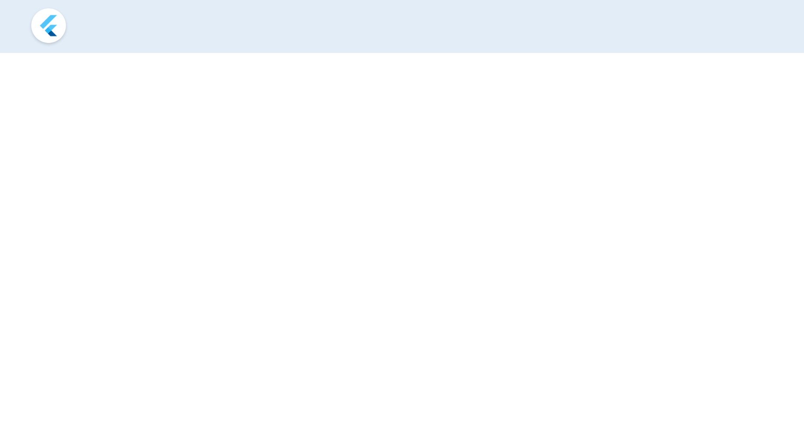
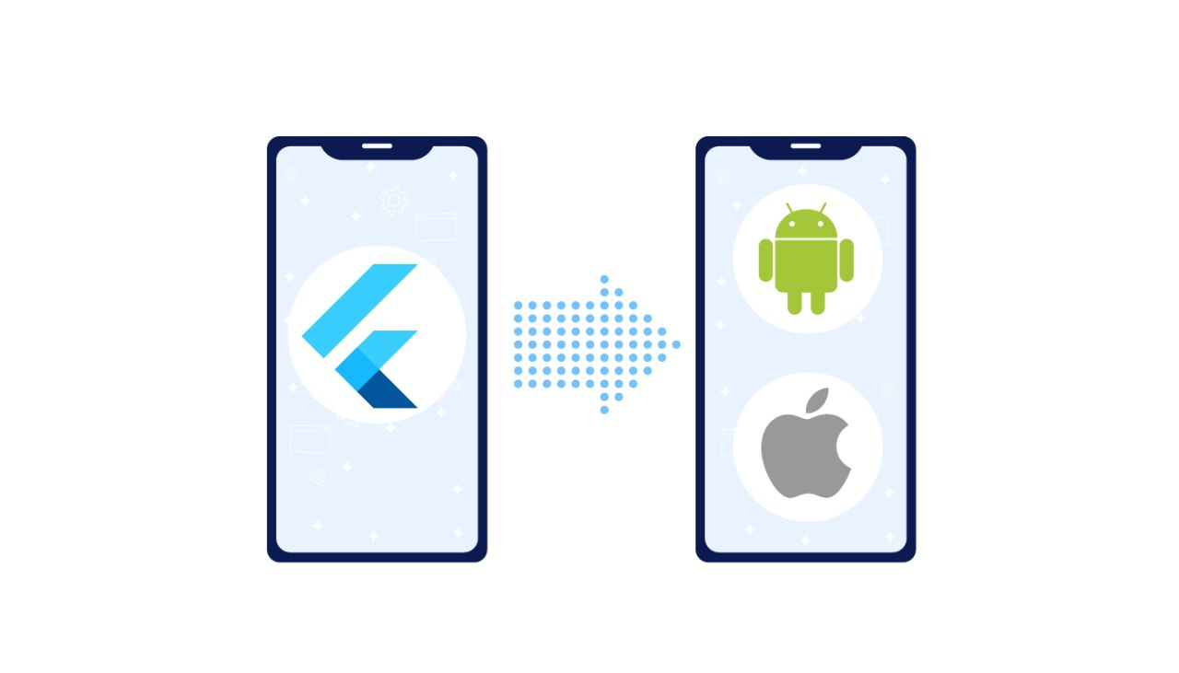
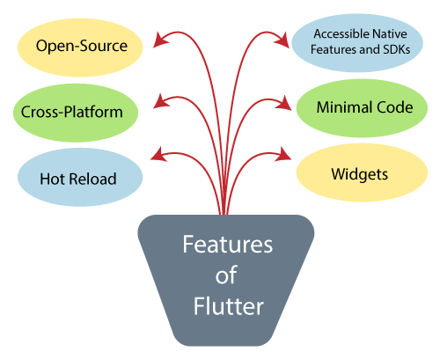
Flutter Features

Slide 3
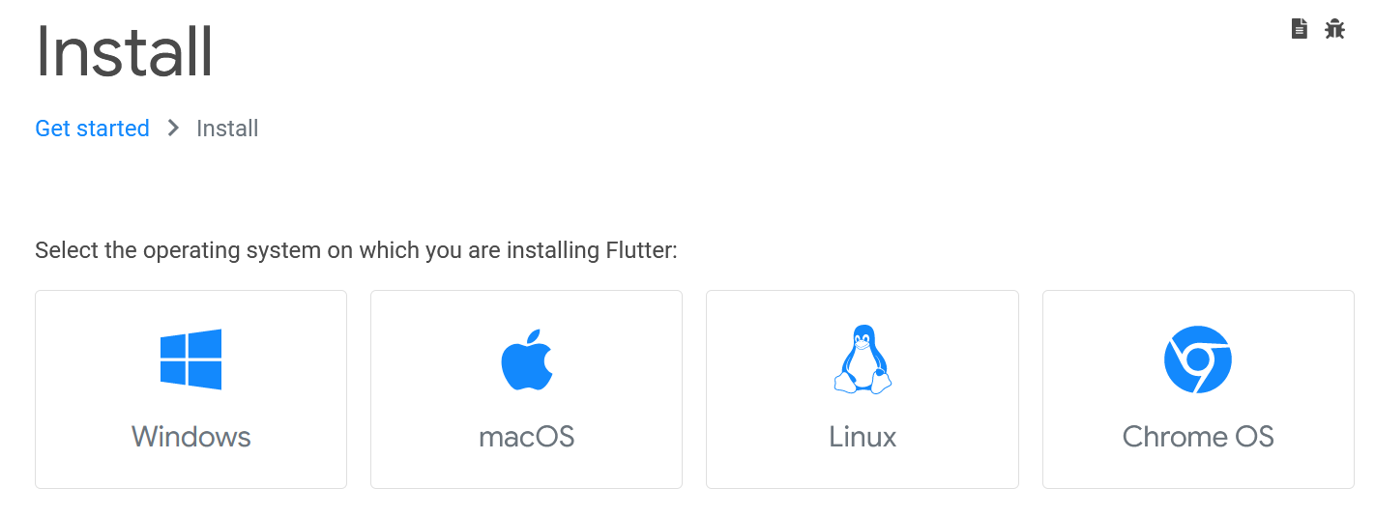
Flutter Installation

Slide 4

Install Android Studio
Get the official Integrated
Development Environment (IDE)
for Android app development.

Slide 5
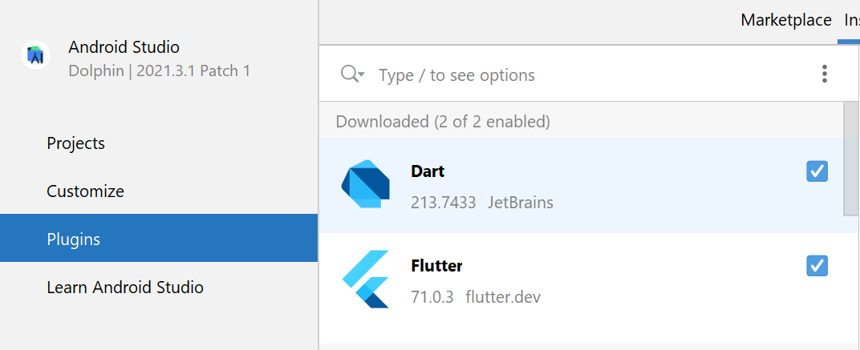
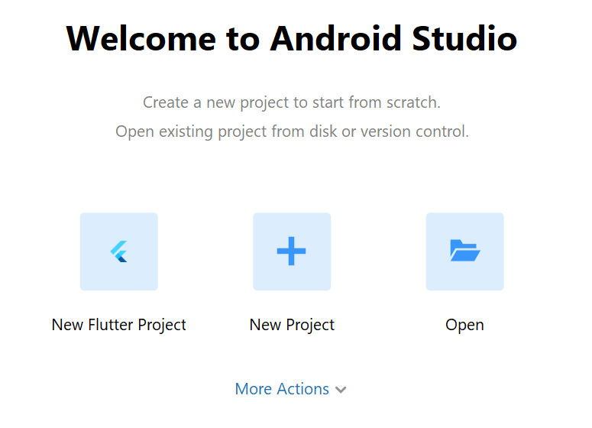
Install Flutter Extensions

Slide 6
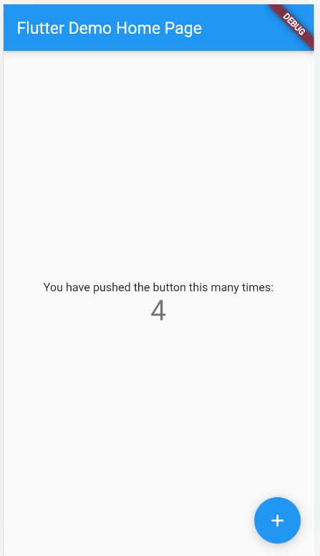
Create & Run Your First Flutter App

Slide 7
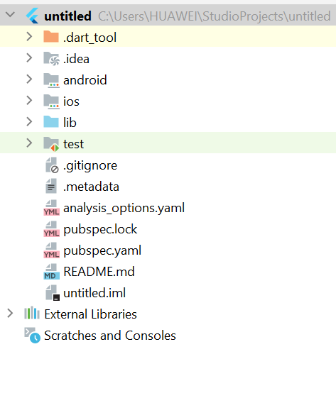
Flutter Project Structure
.idea:
This folder is at the very top of the project structure.
Holds the configuration for Android Studio.
It doesn't matter because we are not going to work with.
So that the content of this folder can be ignored.
.android:
This folder holds a complete Android project
Used when you build the Flutter application for Android
When the Flutter code is compiled into the native code
It will get injected into this Android project
That the result is a native Android application

Slide 8
Flutter Project Structure
.ios:
This folder holds a complete Mac project
used when you build the Flutter application for iOS
When the Flutter code is compiled into the native code
It will get injected into this iOS project
that the result is a native iOS application
Building a Flutter application for iOS is only possible when you are working on macOS

Slide 9
Flutter Project Structure
lib:
It is an essential folder, which stands for the library
It is a folder where we will do our 99 percent of project work
Inside the lib folder, we will find the Dart files which contain the code of our Flutter application
By default, this folder contains the file main.dart, which is the entry file of the Flutter application.

Slide 10
Flutter Project Structure
test:
This folder contains a Dart code,
Which is written for the Flutter application.
Perform the automated test when building the app.
It won't be too important for us here.

Slide 11
Flutter Project Structure
.gitignore:
It is a text file containing a list of files, file extensions, and folders
that tells Git which files should be ignored in a project.
Git is a version-control file for tracking changes in source

Slide 12
Flutter Project Structure
.metadata:
It is an auto-generated file by the flutter tools.
Used to track the properties of the Flutter project.
This file performs the internal tasks.
So you do not need to edit the content manually at any time.

Slide 13
Flutter Project Structure
pubspec.yaml:
It is the project's configuration file that will use a lot during working with the Flutter project. It allows you how your application works. This file contains-
Project general settings such as name
Description, and version of the project.
Project dependencies.
Project assets (e.g., images).

Slide 14
Flutter Project Structure
pubspec.lock:
It is an auto-generated file based on the .yaml file.
It holds more detail setup about all dependencies.

Slide 15
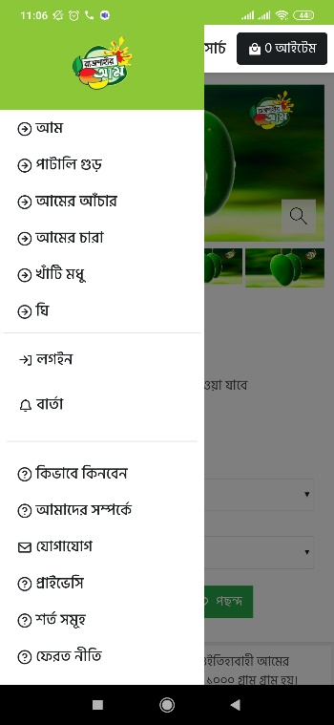
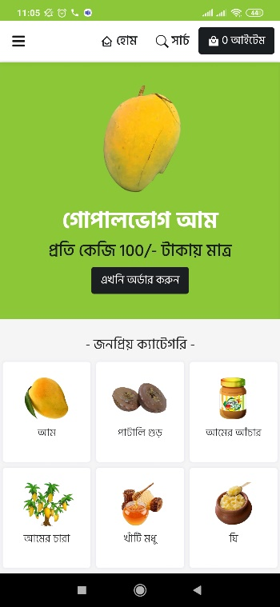
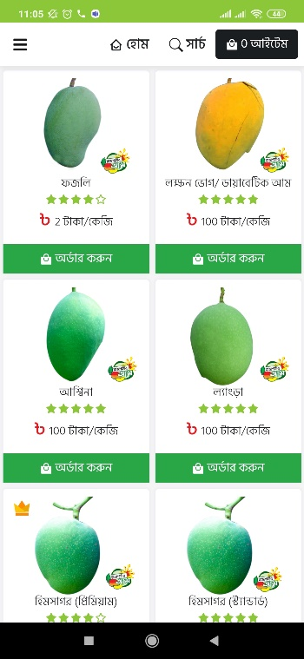
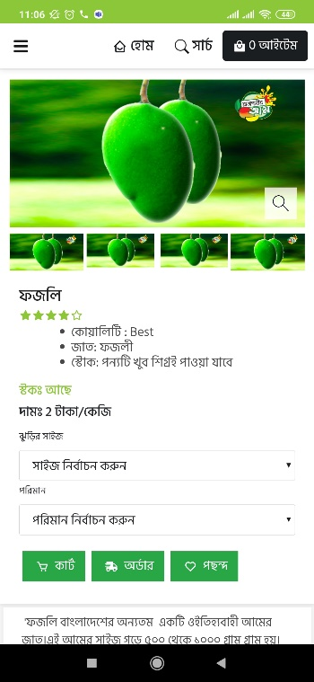
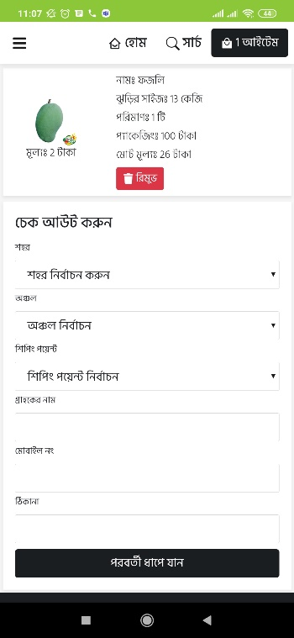
Activity & widgets concepts

Slide 16
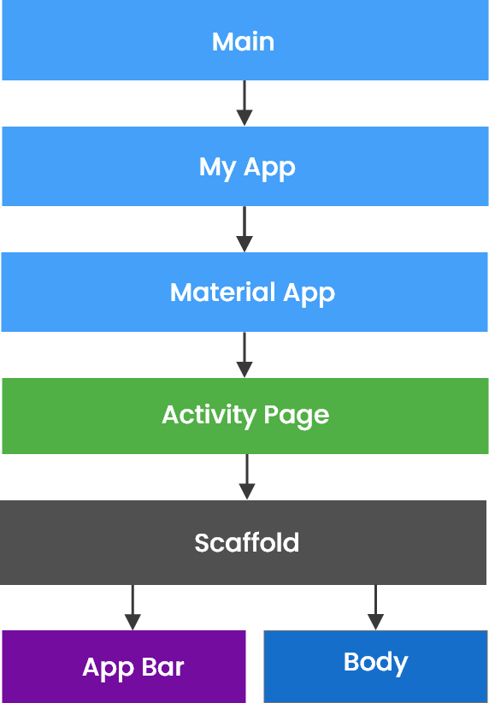
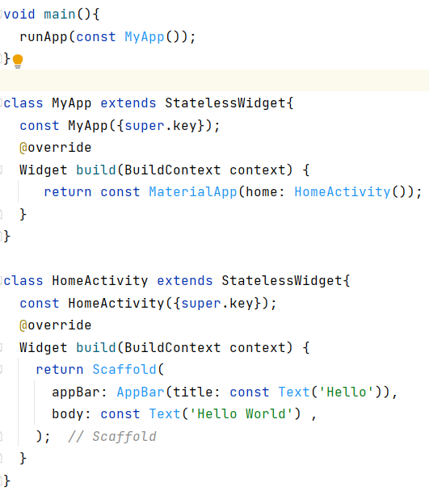
Flutter Main Source Code Flow

Slide 17
Material App Class
MaterialApp is a predefined class in a flutter. Main or core component of flutter.
color: It controls the primary color used in the application.
darkTheme: It provided theme data for the dark theme for the application.
debugShowCheckedModeBanner: This property takes in a boolean as the object to decide whether to show the debug banner or not.
home: This property takes in widget as the object to show on the default route of the app.
title: The title property takes in a string as the object to decide the one-line description of the app for the device.

Slide 18
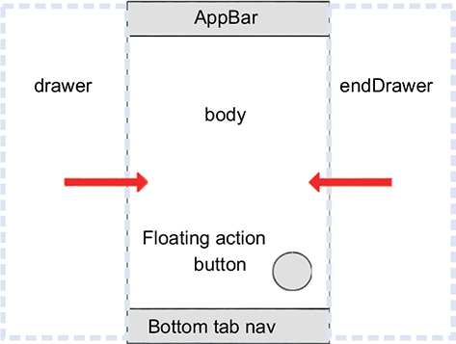
Scaffold Class
Scaffold will expand or occupy the whole device screen.

Slide 19
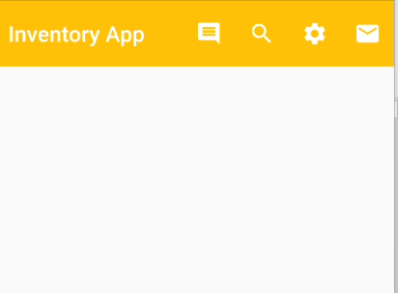
Flutter AppBar Widget
AppBar is usually the topmost component of the app . it contains the toolbar and some other common action buttons.
actions: This property takes in a list of widgets as a parameter to be displayed after the title if the AppBar is a row.
title: This property usually takes in the main widget as a parameter to be displayed in the AppBar.
backgroundColor: This property is used to add colors to the background of the Appbar.
elevation: This property is used to set the z-coordinate at which to place this app bar relative to its parent.
shape: This property is used to give shape to the Appbar and manage its shadow.

Slide 20
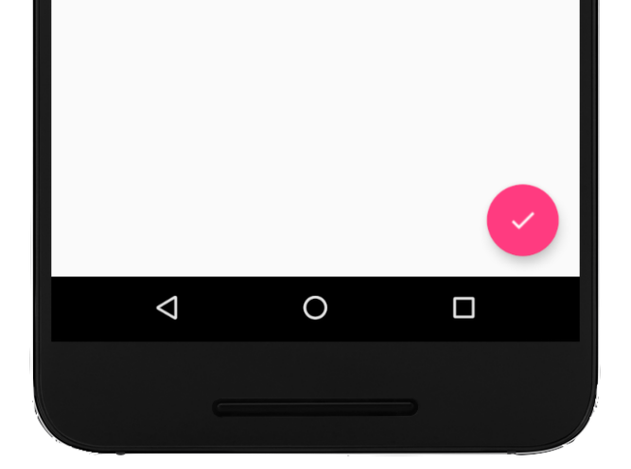
Flutter Floating Action Button
Floating Action Button is a button that is placed at the right bottom corner by default.
Floating Action Button is an icon button that floats over the content of the screen at a fixed place.

Slide 21
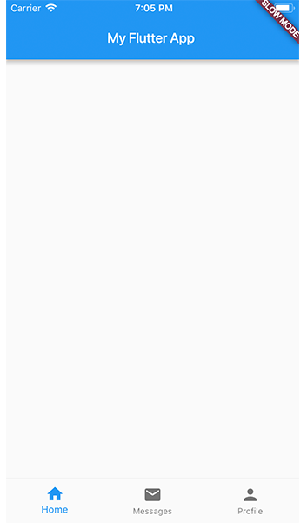
Flutter Bottom Tab
Menu at the bottom of the Scaffold.
We have seen this Navigation bar in most of the applications.
We can add multiple icons or texts or both in the bar as items.

Slide 22
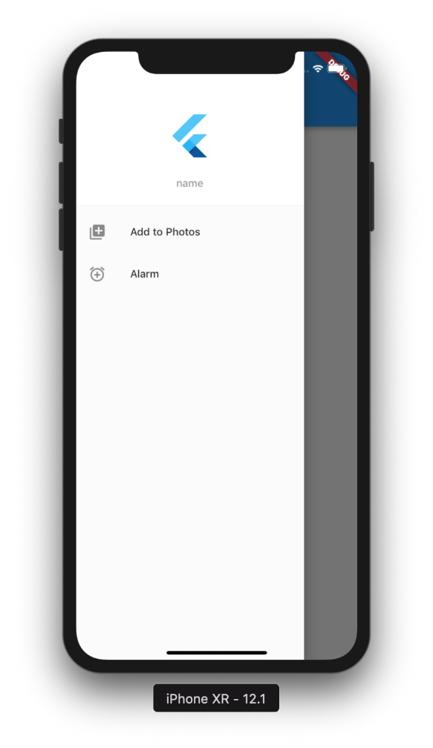
Navigation drawer flutter

Slide 23
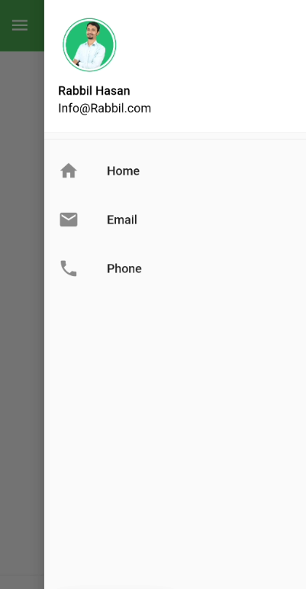
Navigation end drawer flutter

Slide 24
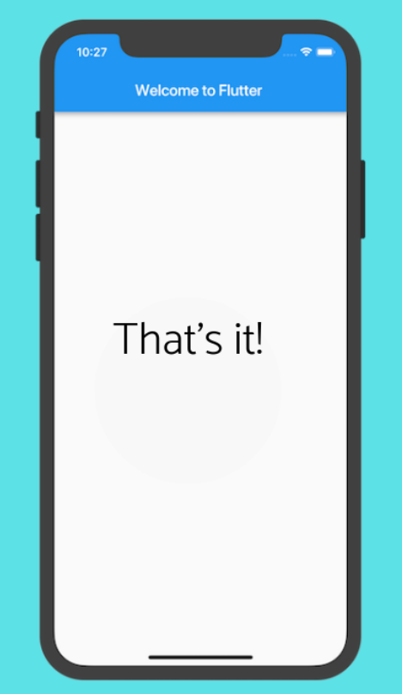
Flutter Body

Slide 25
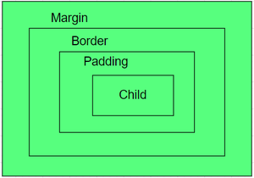
Container in Flutter
Container class in flutter is a convenience widget that combines common painting, positioning, and sizing of widgets.

Slide 26
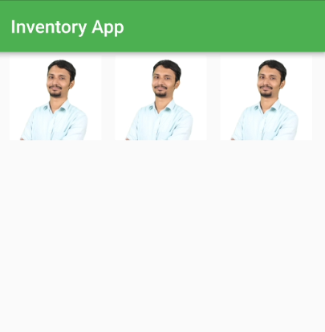
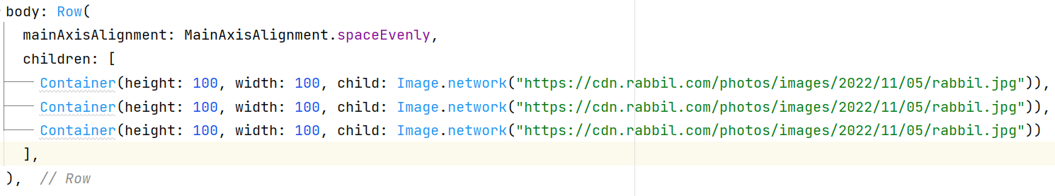
Flutter Row With Container

Slide 27
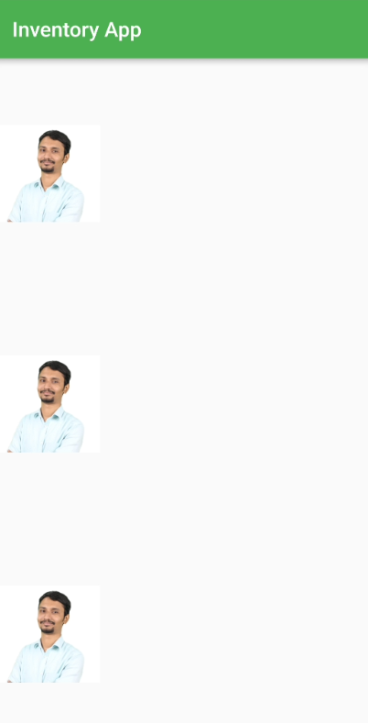
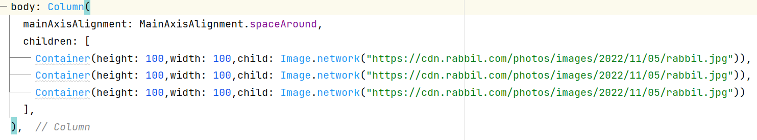
Flutter Column With Container

Slide 28
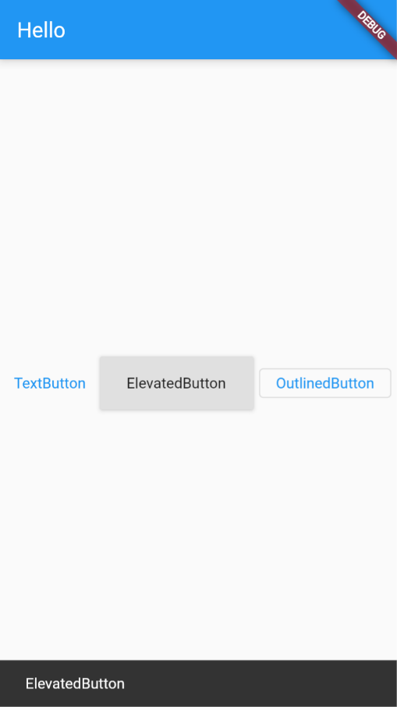
Flutter Button
Elevated Button
Text Button
Outline Button

Slide 29
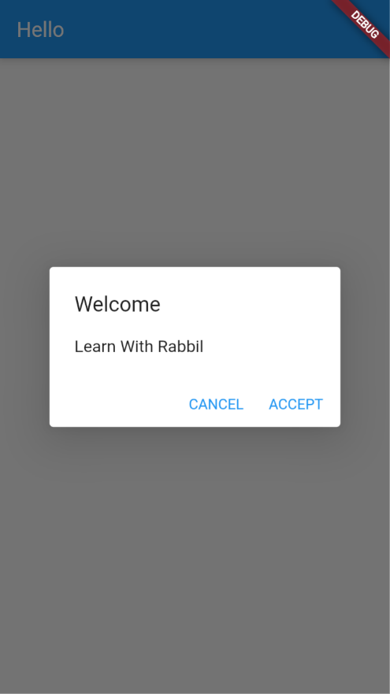
Alert Dialog

Slide 30
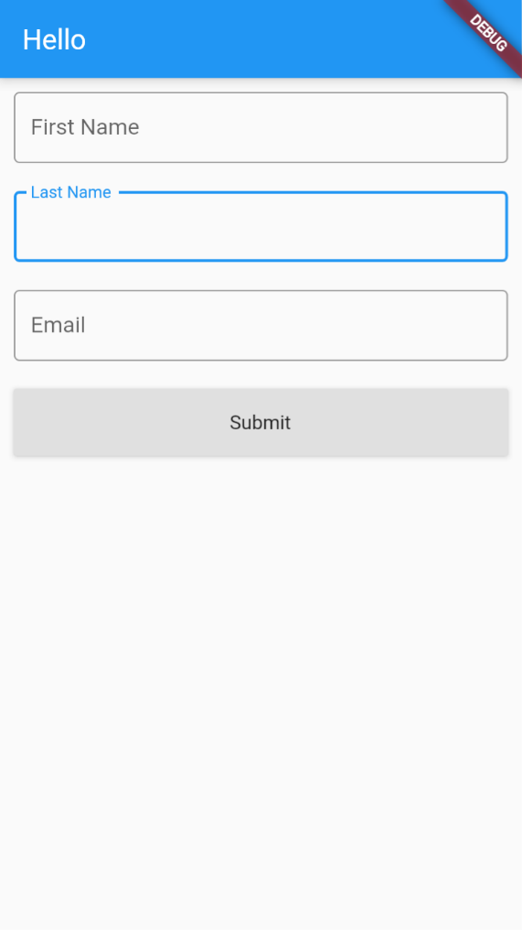
Simple Form

Slide 31
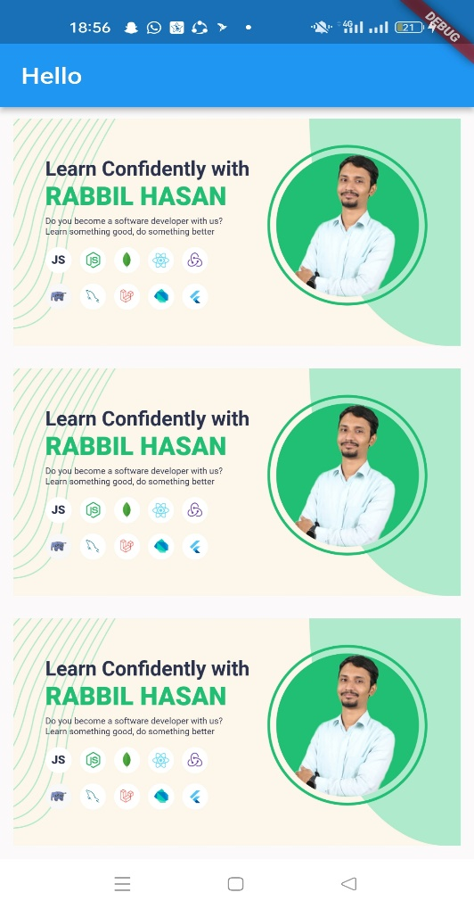
List View Builder From Array
Step 01: JSON Array
Step 02: List View Builder
Step 03: Gesture Detector
Step 04: List Item
Step 05: List Item On Tap/On Press

Slide 32
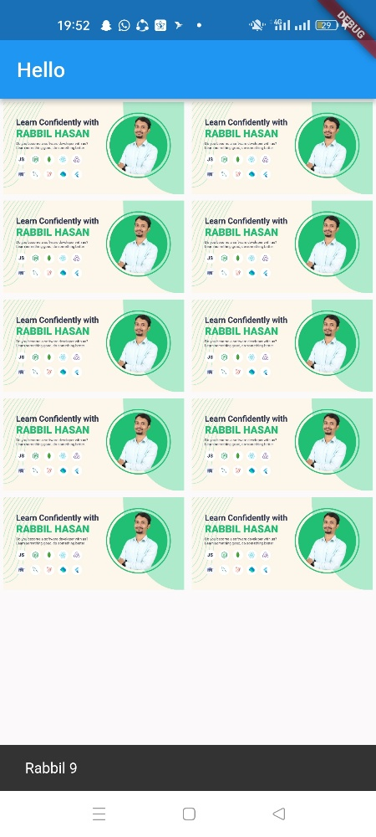
Grid View Builder From Array
Step 01: JSON Array
Step 02: Grid View Builder
Step 03: Gesture Detector
Step 04: Grid Item
Step 05: Grid Item On Tap/On Press

Slide 33
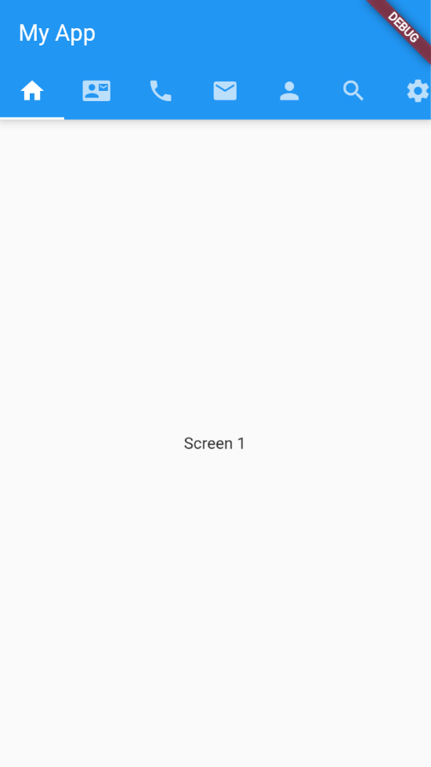
Tab Bar / Activity/ Fragment

Slide 34
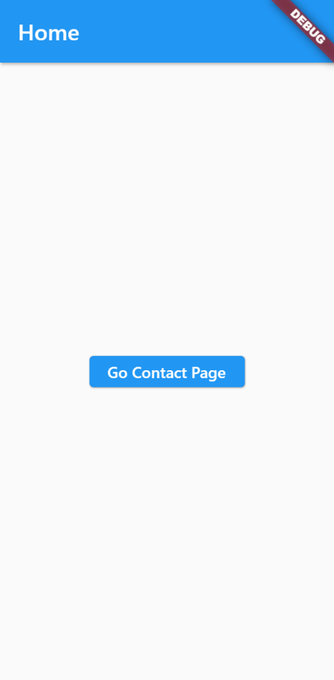
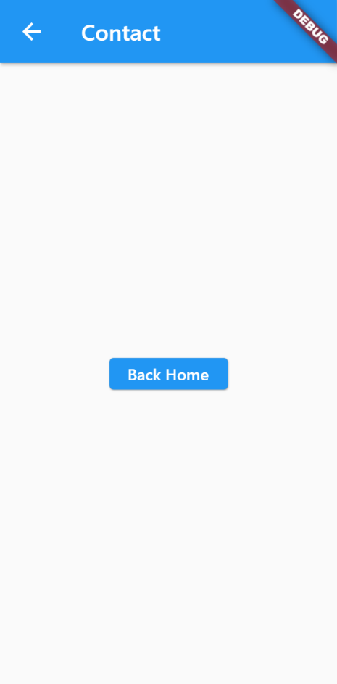
Navigation

Slide 35
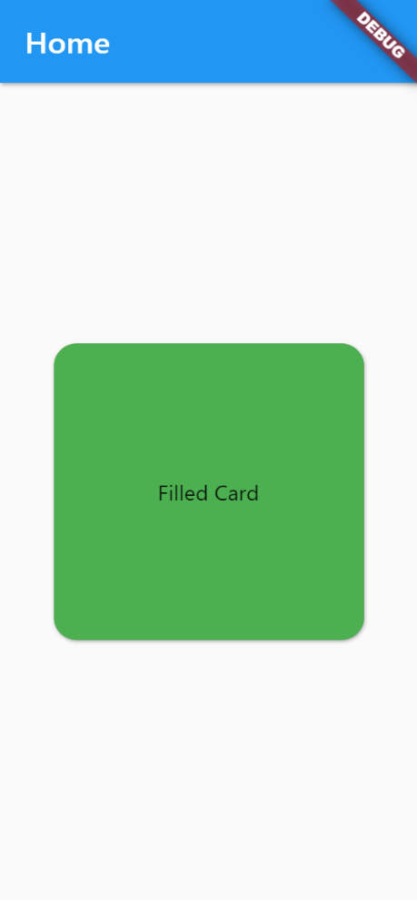
Working With Card Shape

Slide 36
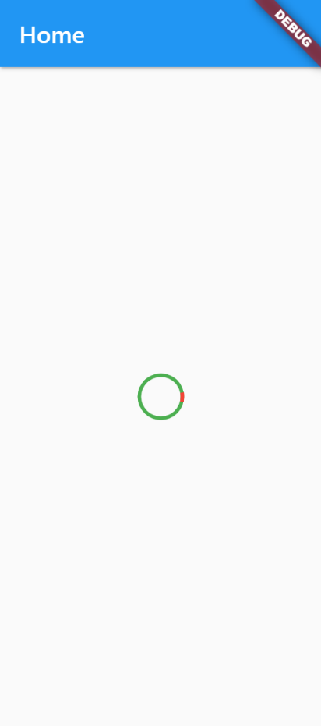
Working With Circular progress

Slide 37
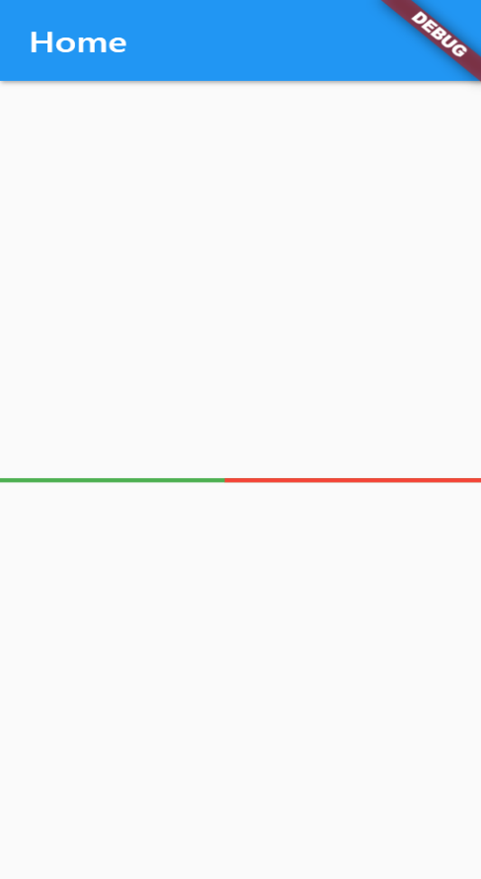
Working With Linear progress

Slide 38
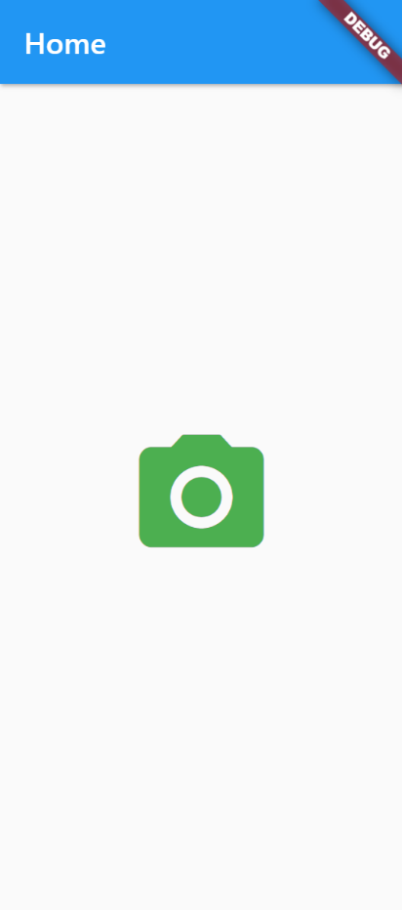
Icons Class In Flutter

Slide 39
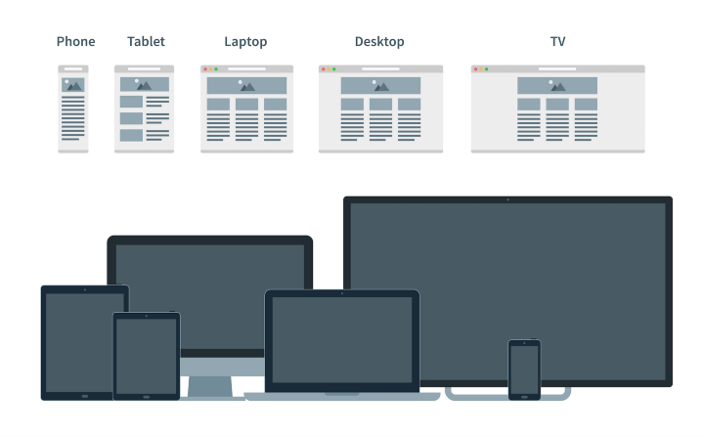
Responsive & Adaptive
Why?
It is impossible to keep in mind all devices, client may use for the application using.
Adaptive design and responsive design were created to avoid the classification.
Actually, AD (adaptive design) and RD (responsive design) solve the same tasks but in different ways.

Slide 40
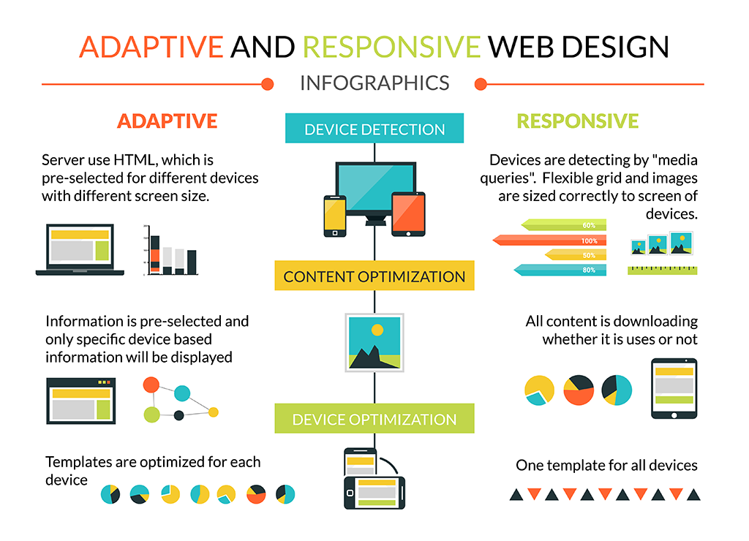
Responsive vs Adaptive

Slide 41
Responsive & Adaptive For Flutter Application
Why?
To take the maximum advantages from Flutter
To enable your application in different size device with web & desktop too.
Widgets & Packages:
Fractionally Sized Box
Media Query
Expanded
Aspect Ratio
Fitted Box
Layout Builder
Responsive grid
Column Row
Responsive Framework
Scroll View

Slide 42
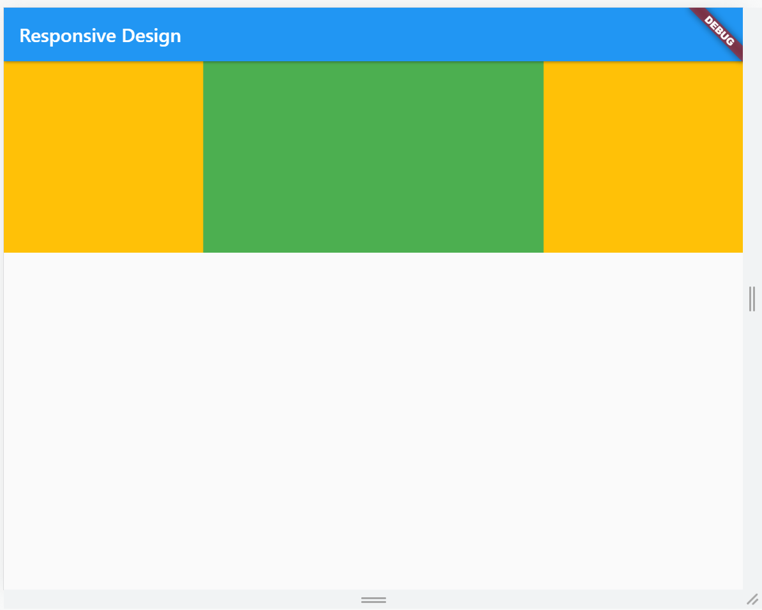
Aspect Ratio
A widget that attempts to size the child to a specific aspect ratio
The widget first tries the largest width permitted by the layout constraints.
The height of the widget is determined by applying the given aspect ratio to the width

Slide 43
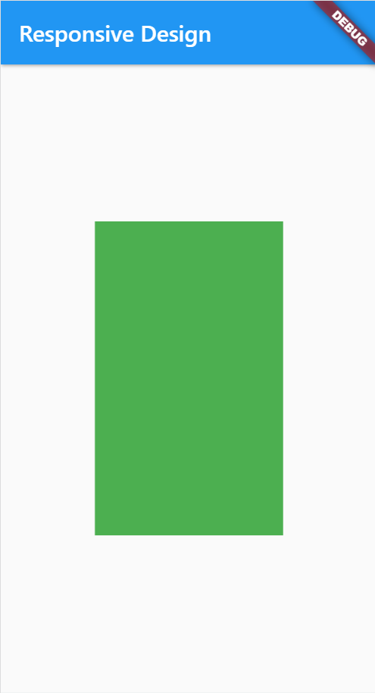
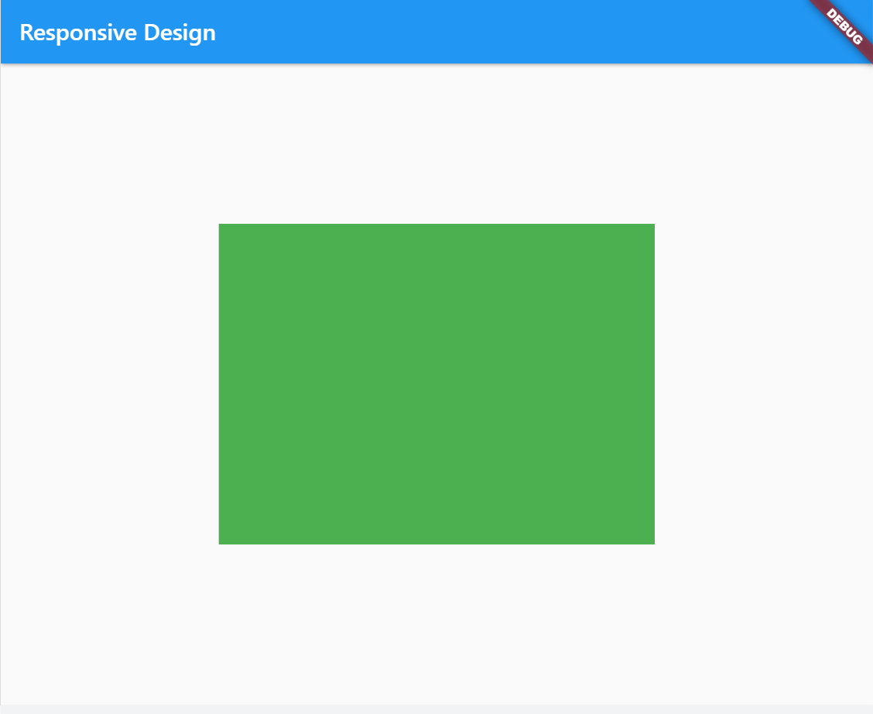
Fractionally Sized Box
A widget that sizes its child to a fraction of the total available space.

Slide 44
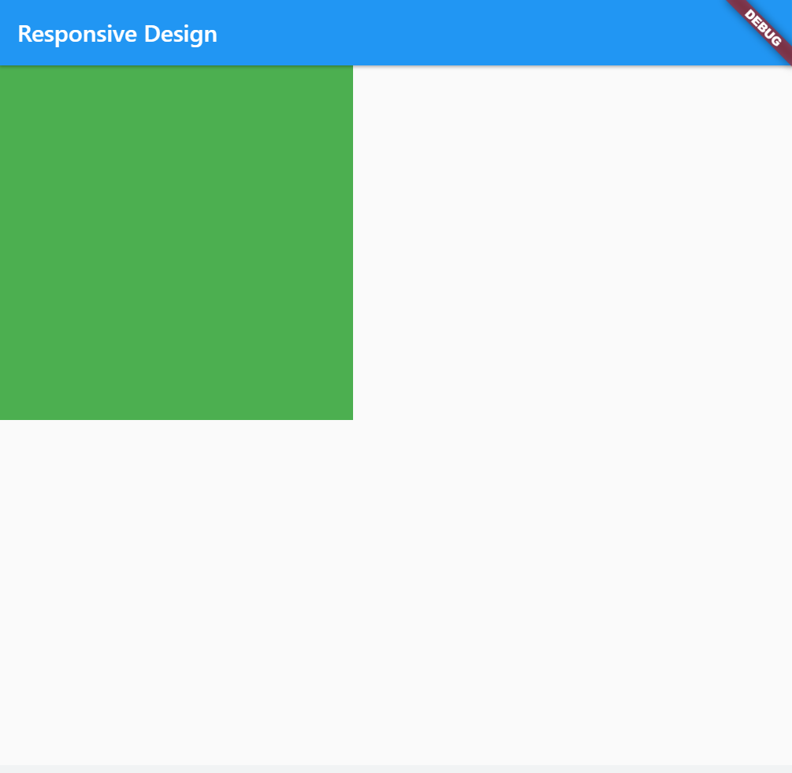
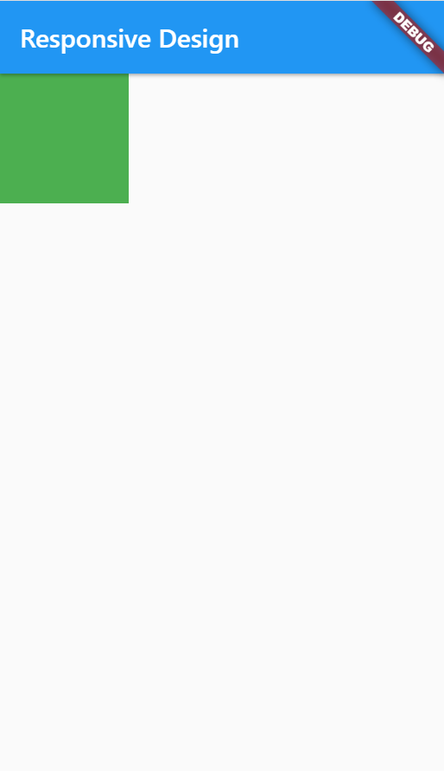
Layout Builder
Builds a widget tree that can depend on the parent widget's size

Slide 45
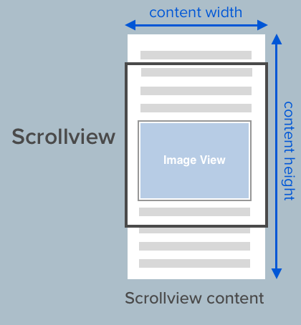
Scroll View

Slide 46
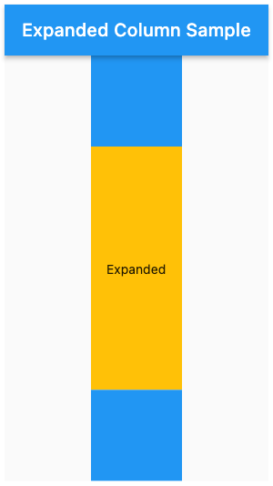
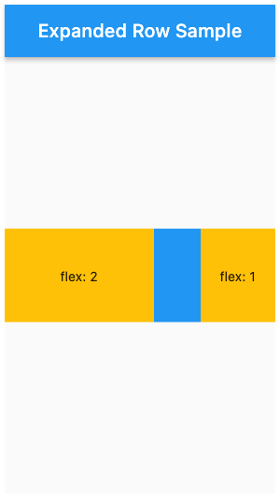
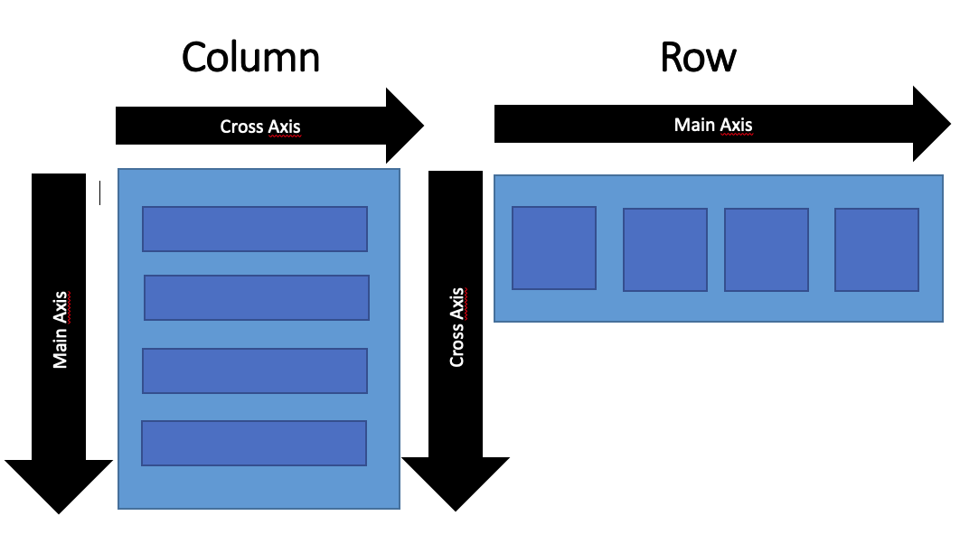
Expanded & Flexible

Slide 47

Media Query

Slide 48

Responsive Grid

Slide 49

Stateful Widget

Slide 50


State
First Gear
Pickup Increase
Second Gear
Pickup Increase
Third Gear
Forth Gear
Gear Shift Down
Pickup Decrease

Slide 51
State
What is state:
Anything that exists in the memory of the app while the app is running.
When state values change, view update automatically

Slide 52

Stateless & Stateful

Slide 53

Stateless & Stateful

Slide 54

How Stateful Widget Works

Slide 55

How Stateful Widget Works

Slide 56
Lets Create Our First Stateful Widget

Slide 57
State Lifecycle methods
The Stateful widget is mutable
It can be change multiple times within its lifetime.
So we need to understand it's lifecycle

Slide 58
State Lifecycle methods
createState()
This method creates a State object. This object is where all the mutable state for that widget is held.
This step is not marked as a real step in the lifecycle, but it is important to know what is going on in the background.

Slide 59
State Lifecycle methods
initState()
Automatically called only once, when the state object is created for the first time.
Use this method to manage HTTP requests and subscribe to streams or any other object that could change the data on this widget.

Slide 60
State Lifecycle methods
didChangeDependencies()
Framework will call this method immediately after the initState().
The build method is always called after this method, so this method is rarely needed

Slide 61
State Lifecycle methods
build()
it will be called many times during the lifecycle, but the first time is after the didChangeDependencies() method.
Whenever the widget that belongs to the state is updated, the framework will always execute this method

Slide 62
State Lifecycle methods
setState()
The setState() method notifies the framework that the internal state of the current object is changed, now it's time to update the view

Slide 63

Lets Create A Counter App

Slide 64

Lets Create Sum Calculator

Slide 65

Lets Create To do list

