Slide 1


Slide 2
Dart Set
The Dart Set is the unordered collection of the different values of the same type.
It has much functionality, which is the same as an array, but it is unordered.
Set doesn't allow storing the duplicate values. T
he set must contain unique values.

Slide 3
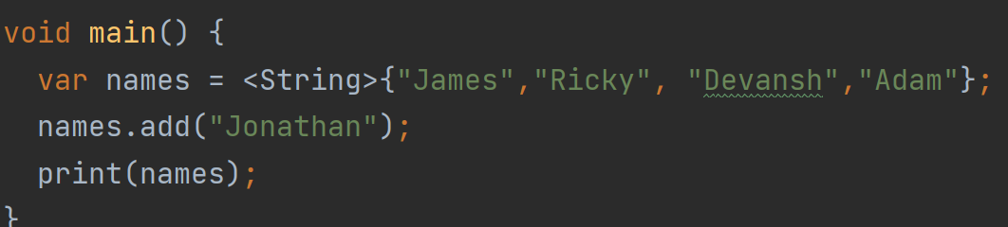
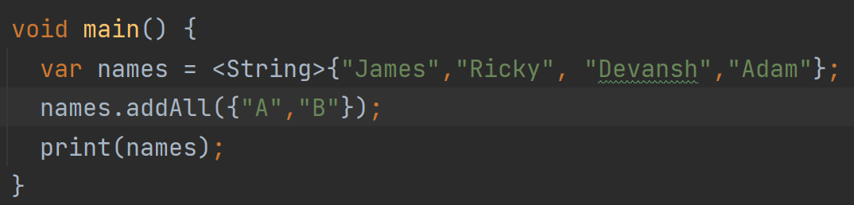
Add Element into Set
The Dart provides the two methods add() and addAll() to insert an element into the given set.

Slide 4
Add Element into Set
The Dart provides the two methods add() and addAll() to insert an element into the given set.

Slide 5
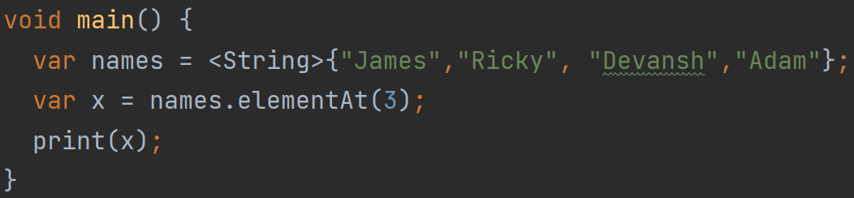
Access the Set Element
Dart provides the elementAt() method, which is used to access the item by passing its specified index position.

Slide 6
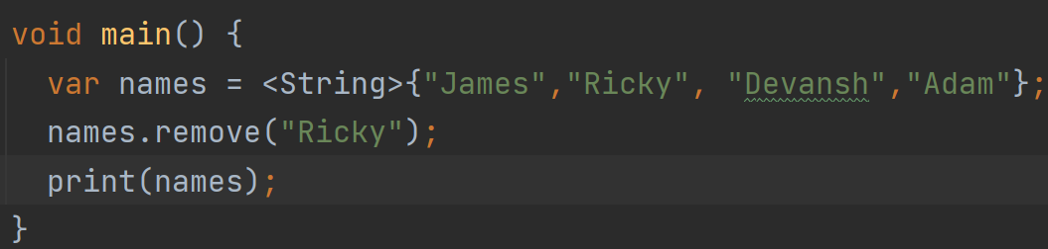
Dart Remove Set Element
The remove() method is used to eliminate or remove an element from the given set.

Slide 7
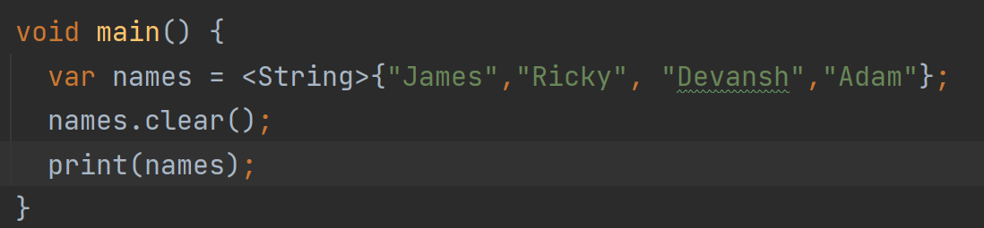
Dart Remove All Set Element
We can remove entire set element by using the clear() methods.

Slide 8
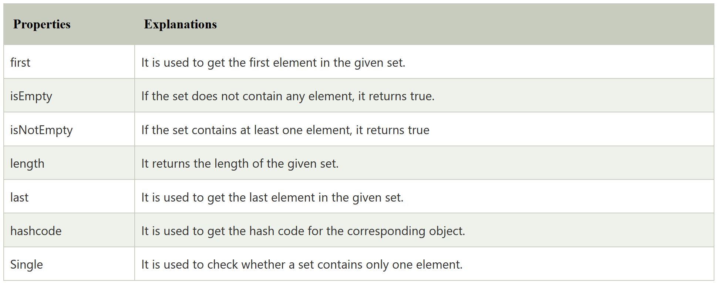
Dart Set Properties

Slide 9
Dart Map
Dart Map is an object that stores data in the form of a key-value pair.
Each value is associated with its key, and it is used to access its corresponding value.
Both keys and values can be any type.
In Dart Map, each key must be unique, but the same value can occur multiple times.
Dart Map can be defined in two methods.
Using Map Literal
Using Map Constructor

Slide 10
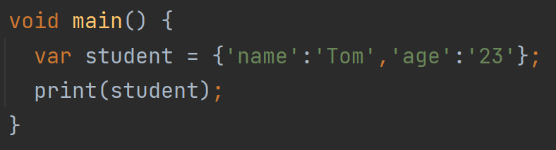
Dart Map Using Map Literal
To declare a Map using map literal, the key-value pairs are enclosed within the curly braces "{}" and separated by the commas.

Slide 11
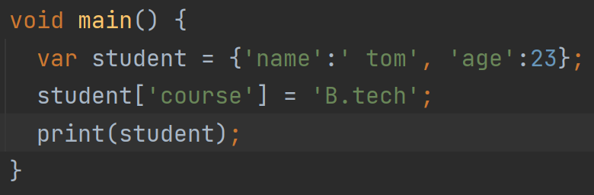
Adding value at runtime
To declare a Map using map literal, the key-value pairs are enclosed within the curly braces "{}" and separated by the commas.

Slide 12
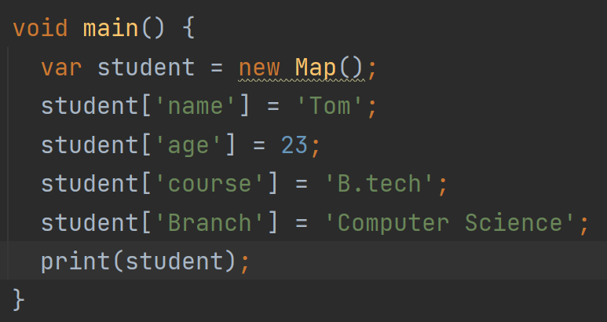
Using Map Constructor
To declare the Dart Map using map constructor can be done in two ways.
First, declare a map using map() constructor. Second, initialize the map.

Slide 13
Using Map Constructor
To declare the Dart Map using map constructor can be done in two ways.
First, declare a map using map() constructor. Second, initialize the map.

Slide 14
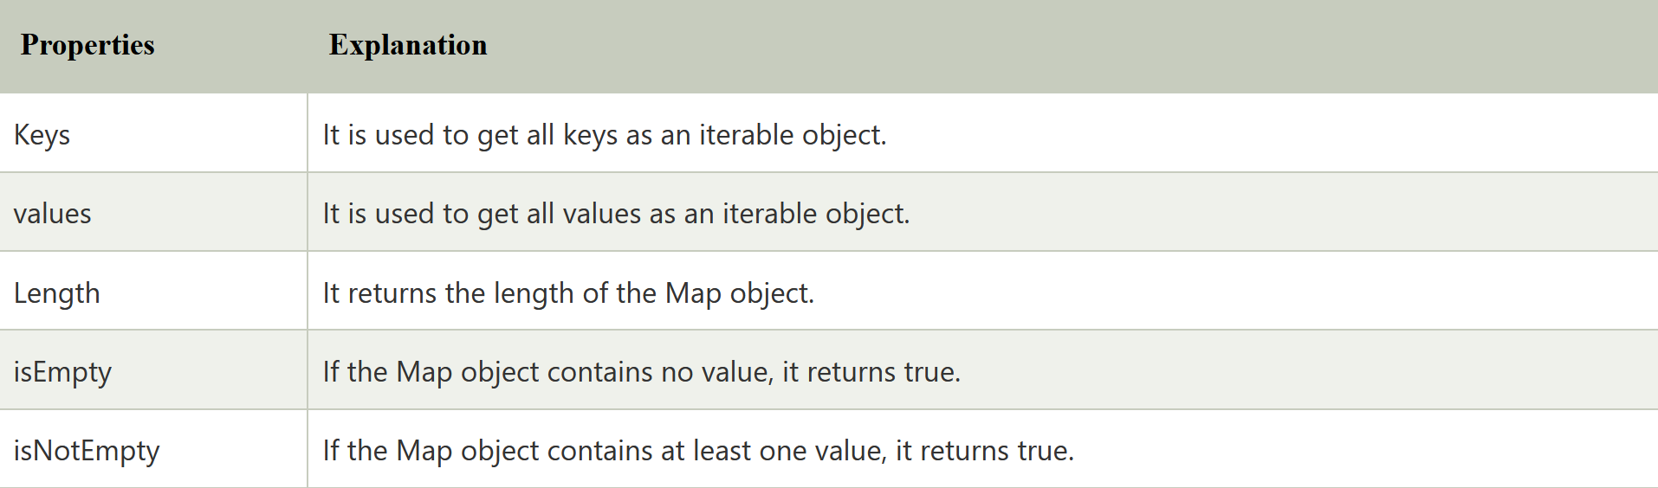
Map Properties

Slide 15
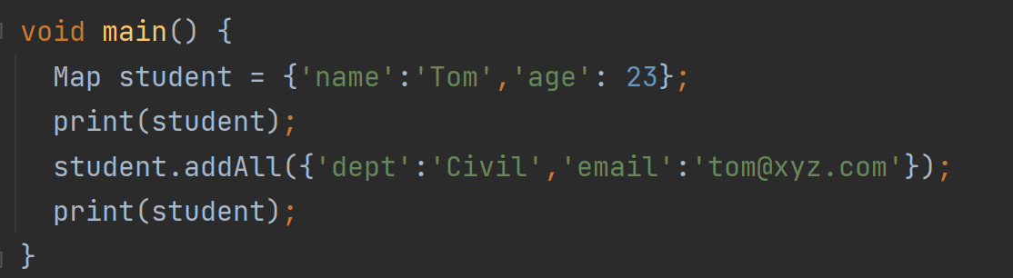
Map Methods
addAll() - It adds multiple key-value pairs of other. The syntax is given below.

Slide 16
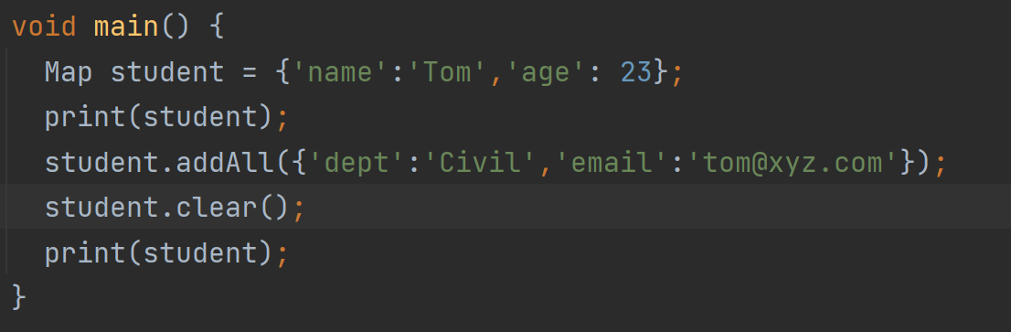
Map Methods
Map.clear() - It eliminates all pairs from the map.

Slide 17
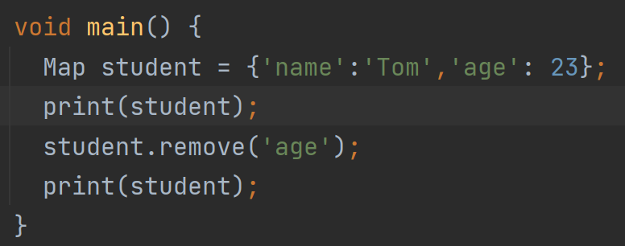
Map Methods
remove() - It removes the key and its associated value if it exists in the given map.

Slide 18
Map Methods
remove() - It removes the key and its associated value if it exists in the given map.

Slide 19
Map Methods
remove() - It removes the key and its associated value if it exists in the given map.

