Slide 1


Slide 2


Slide 3
What is dart ?
Core Of Flutter Framework
Language like Java ,C# ,C++

Slide 4
Dart Environment
https://dartpad.dartlang.org
Local Environment
https://gekorm.com/dart-windows
https://www.jetbrains.com/idea/download

Slide 5
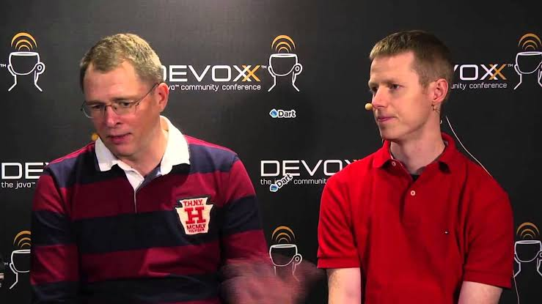
Dart History
Dart is a client-optimized programming language for apps on multiple platforms.
It is developed by Google and is used to build mobile, desktop, backend and web applications.
First appeared: October 10, 2011; 11 years ago
Designed by Lars Bak and Kasper Lund

Slide 6
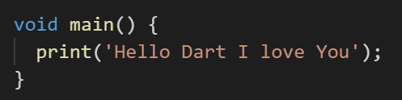
My First Dart Program
The main() function is a predefined method in Dart. This method acts as the entry
point to the application.

Slide 7

Dart In VS CODE

Slide 8
Dart In VS CODE Extensions
Search Google:
VS code dart extension
Dart Extensions for VS Code
Best VS Code Extensions For Flutter
Search YouTube:
How to run dart in VS Code

Slide 9

Dart In Intellij IDEA

Slide 10
Dart Syntax
Syntax is called set of rules for writing programs. Dart has-
Variables and Operators
Classes
Functions
Expressions and Programming Constructs
Decision Making and Looping Constructs
Comments
Libraries and Packages
Data structures represented as Collections / Generics

Slide 11
Dart Syntax
Whitespace and Line Breaks
Dart ignores spaces, tabs, and newlines that appear in programs.
Dart is Case-sensitive
Dart is case-sensitive. This means that Dart differentiates between uppercase and
lowercase characters.
Statements end with a Semicolon
Each line of instruction is called a statement. Each dart statement must
end with a semicolon
Comments in Dart
Single-line comments ( // ) Multi-line comments (/* */)

Slide 12
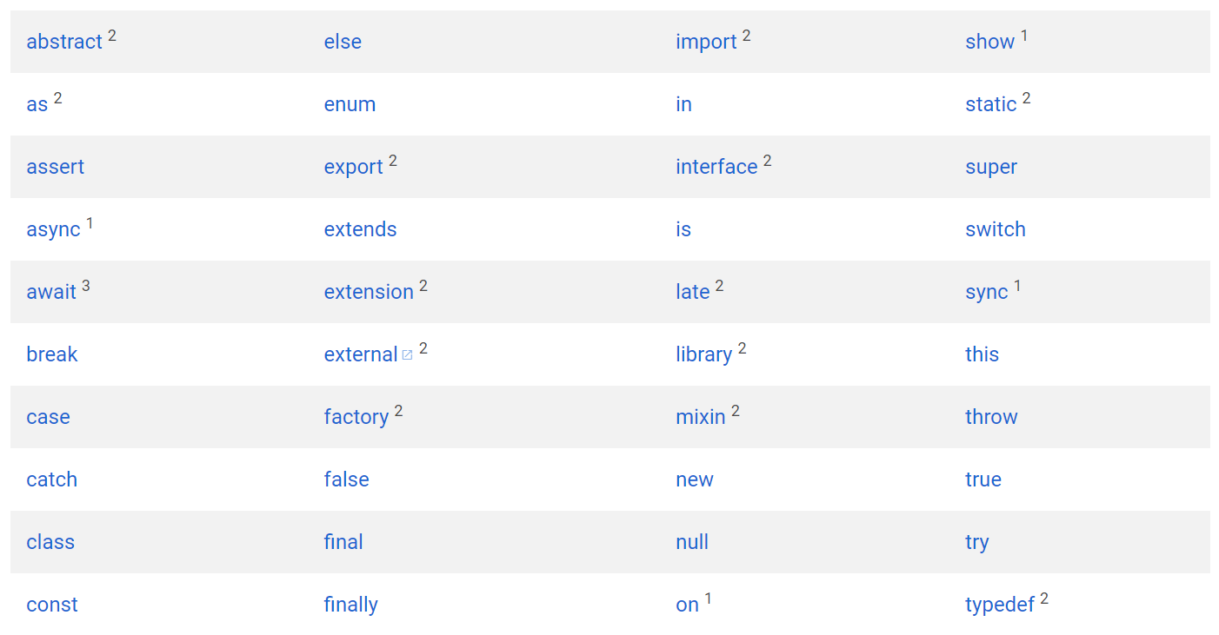
Dart Keywords

Slide 13
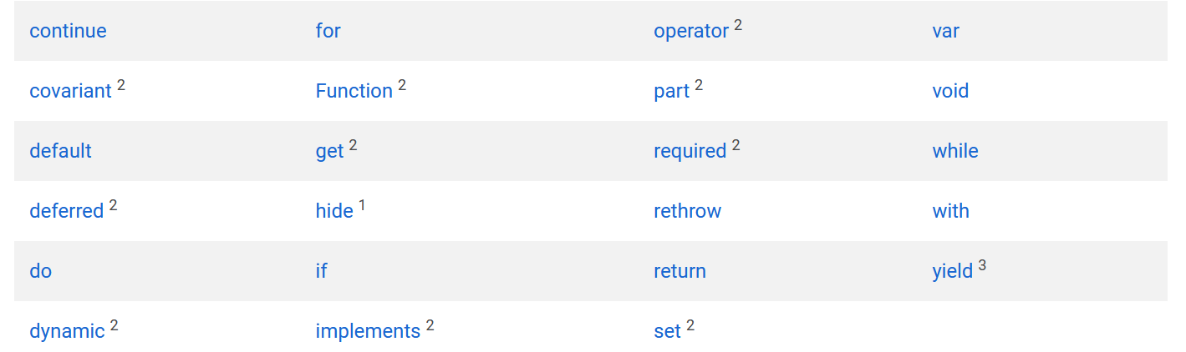
Dart Keywords

Slide 14
Dart Keywords
Subscript 1 - These keywords are called contextual keywords. They have special meaning and used in particular places.
Subscript 2 - These keywords are called built-in identifiers. These types of keywords are used to porting of JavaScript code for Dart, these keywords are treated as a valid identifier, but they cannot be used in the class name function name, or import prefixes.
Subscript 3 - These are newly added keyword.

