Slide 1


Slide 2
Dart Looping statements
Dart Loop is used to run a block of code repetitively for a given number of times or until matches the specified condition.
Dart for loop
Dart for…in loop
Dart while loop
Dart do-while loop

Slide 3
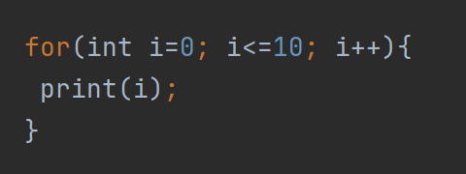
Dart for loop
The for loop is used when we know how many times a block of code will execute.

Slide 4
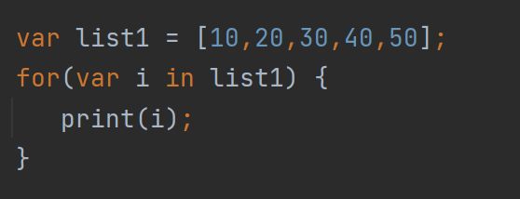
Dart for… in Loop over list
The for…in loop is slightly different from the for loop. It only takes dart object or expression as an iterator and iterates the element one at a time.

Slide 5
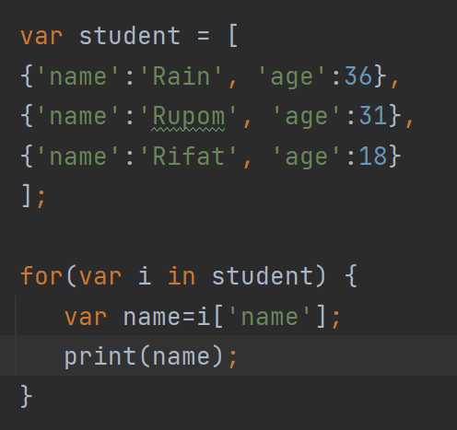
Dart for… in Loop over map (JSON Array)

Slide 6
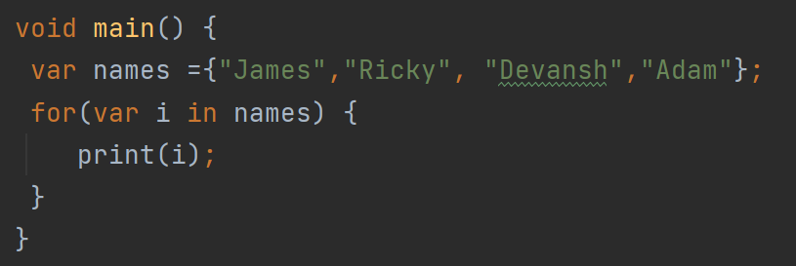
Dart for… in Loop over Set

