Slide 1


Slide 2
Dart Control Flow Statement
The control statements or flow of control statements are used to control the flow of Dart program. In Dart, Control flow statement can be categorized mainly in three following ways.
Decision-making statements
Looping statements
Jump statements

Slide 3
Dart Decision-Making Statements
The Decision-making statements allow us to determine which statement to execute based on the test expression at runtime. Dart provides following types of Decision-making statement.
If Statement
If-else Statements
If else if Statement
Switch Case Statement

Slide 4
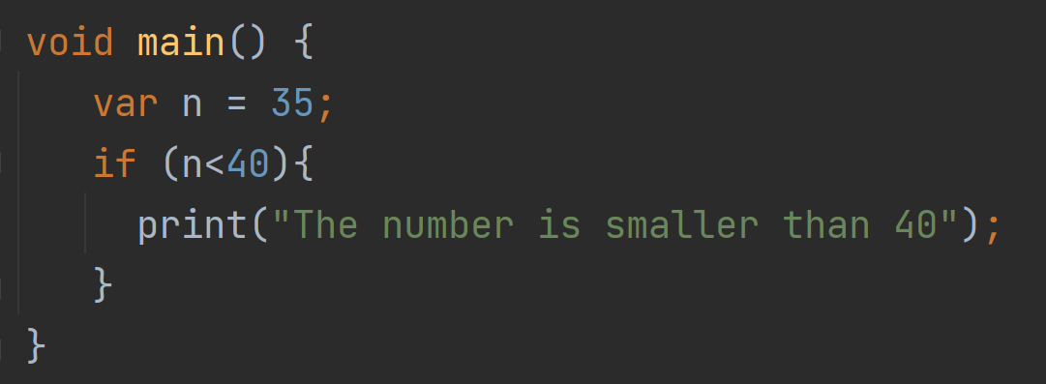
If Statement
If statement allows us to a block of code execute when the given condition returns true.

Slide 5
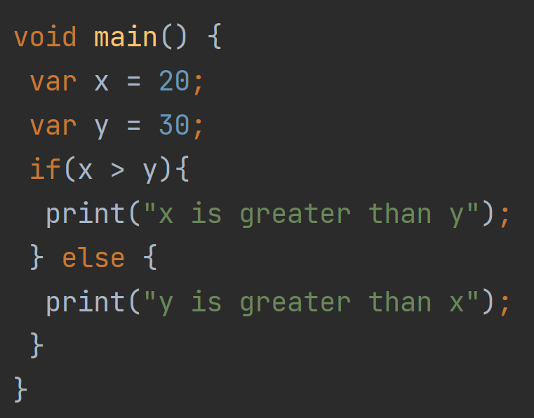
If-else Statements
In Dart, if-block is executed when the given condition is true. If the given condition is false, else-block is executed.

Slide 6
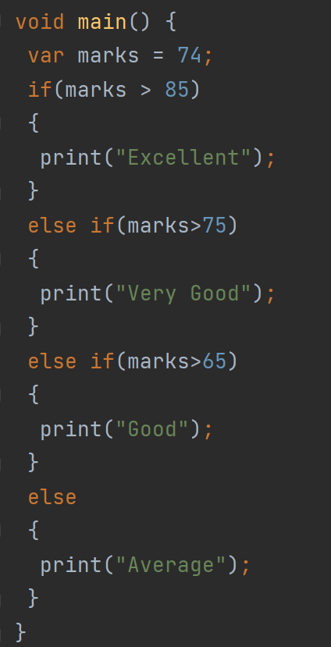
if else-if Statement
Dart if else-if statement provides the facility to check a set of test expressions and execute the different statements. It is used when we have to make a decision from more than two possibilities.

Slide 7
if else-if Statement
Dart if else-if statement provides the facility to check a set of test expressions and execute the different statements. It is used when we have to make a decision from more than two possibilities.

Slide 8
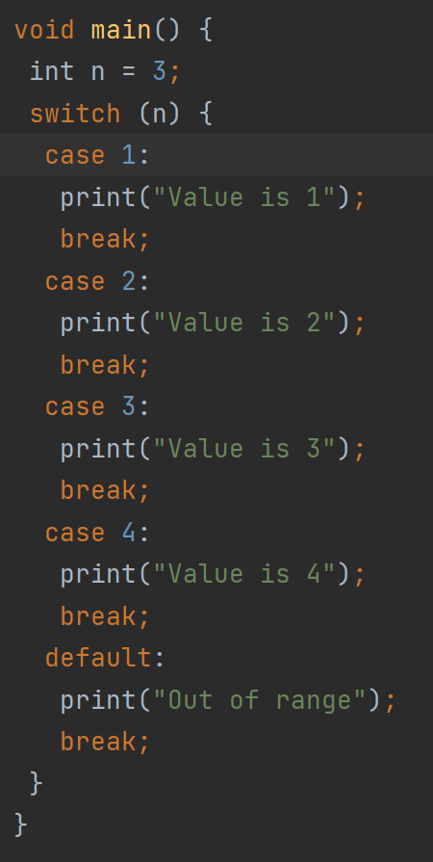
Dart Switch Case Statement
Dart Switch case statement is used to avoid the long chain of the if-else statement. It is the simplified form of nested if-else statement.

Slide 9
Dart Switch Case Statement
Dart Switch case statement is used to avoid the long chain of the if-else statement. It is the simplified form of nested if-else statement.

