Slide 1

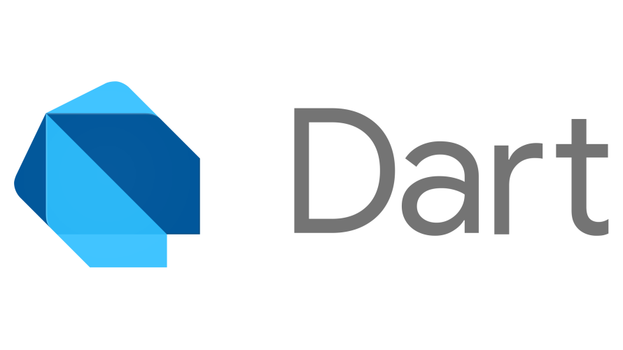

Slide 2
What is dart ?
Future Of Mobile Application
Core Of Google Fuchsia OS
Core Of Flutter Framework

Slide 3
Dart Environment
https://dartpad.dartlang.org
Local Environment
https://gekorm.com/dart-windows
https://www.jetbrains.com/idea/download

Slide 4
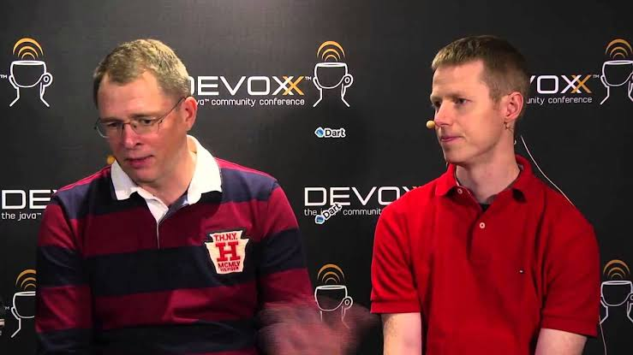
Dart History
Dart is a client-optimized programming language for apps on multiple platforms.
It is developed by Google and is used to build mobile, desktop, backend and web applications.
Stable release: 2.5.0 / September 10, 2019; 41 days ago
First appeared: October 10, 2011; 8 years ago
Designed by Lars Bak and Kasper Lund

Slide 5
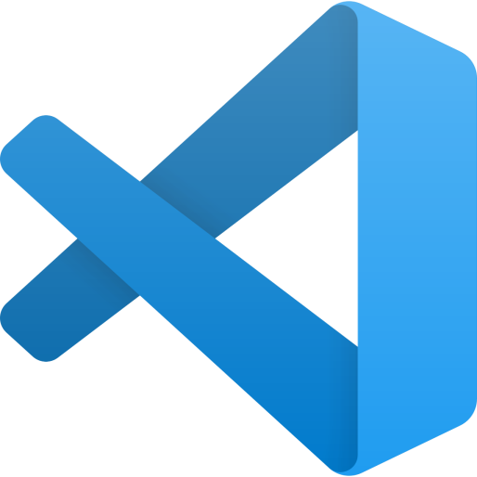
Dart In VS CODE

Slide 6
Dart Syntax
Syntax is called set of rules for writing programs.
Dart has-
Variables and Operators
Classes
Functions
Expressions and Programming Constructs
Decision Making and Looping Constructs
Comments
Libraries and Packages
Data structures represented as Collections / Generics

Slide 7
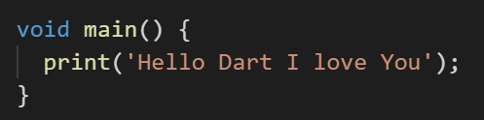
Dart Syntax
The main() function is a predefined method in Dart. This method acts as the entry
point to the application.

Slide 8
Dart Syntax
Whitespace and Line Breaks
Dart ignores spaces, tabs, and newlines that appear in programs.
Dart is Case-sensitive
Dart is case-sensitive. This means that Dart differentiates between uppercase and
lowercase characters.
Statements end with a Semicolon
Each line of instruction is called a statement. Each dart statement must
end with a semicolon
Comments in Dart
Single-line comments ( // ) Multi-line comments (/* */)

