Slide 1
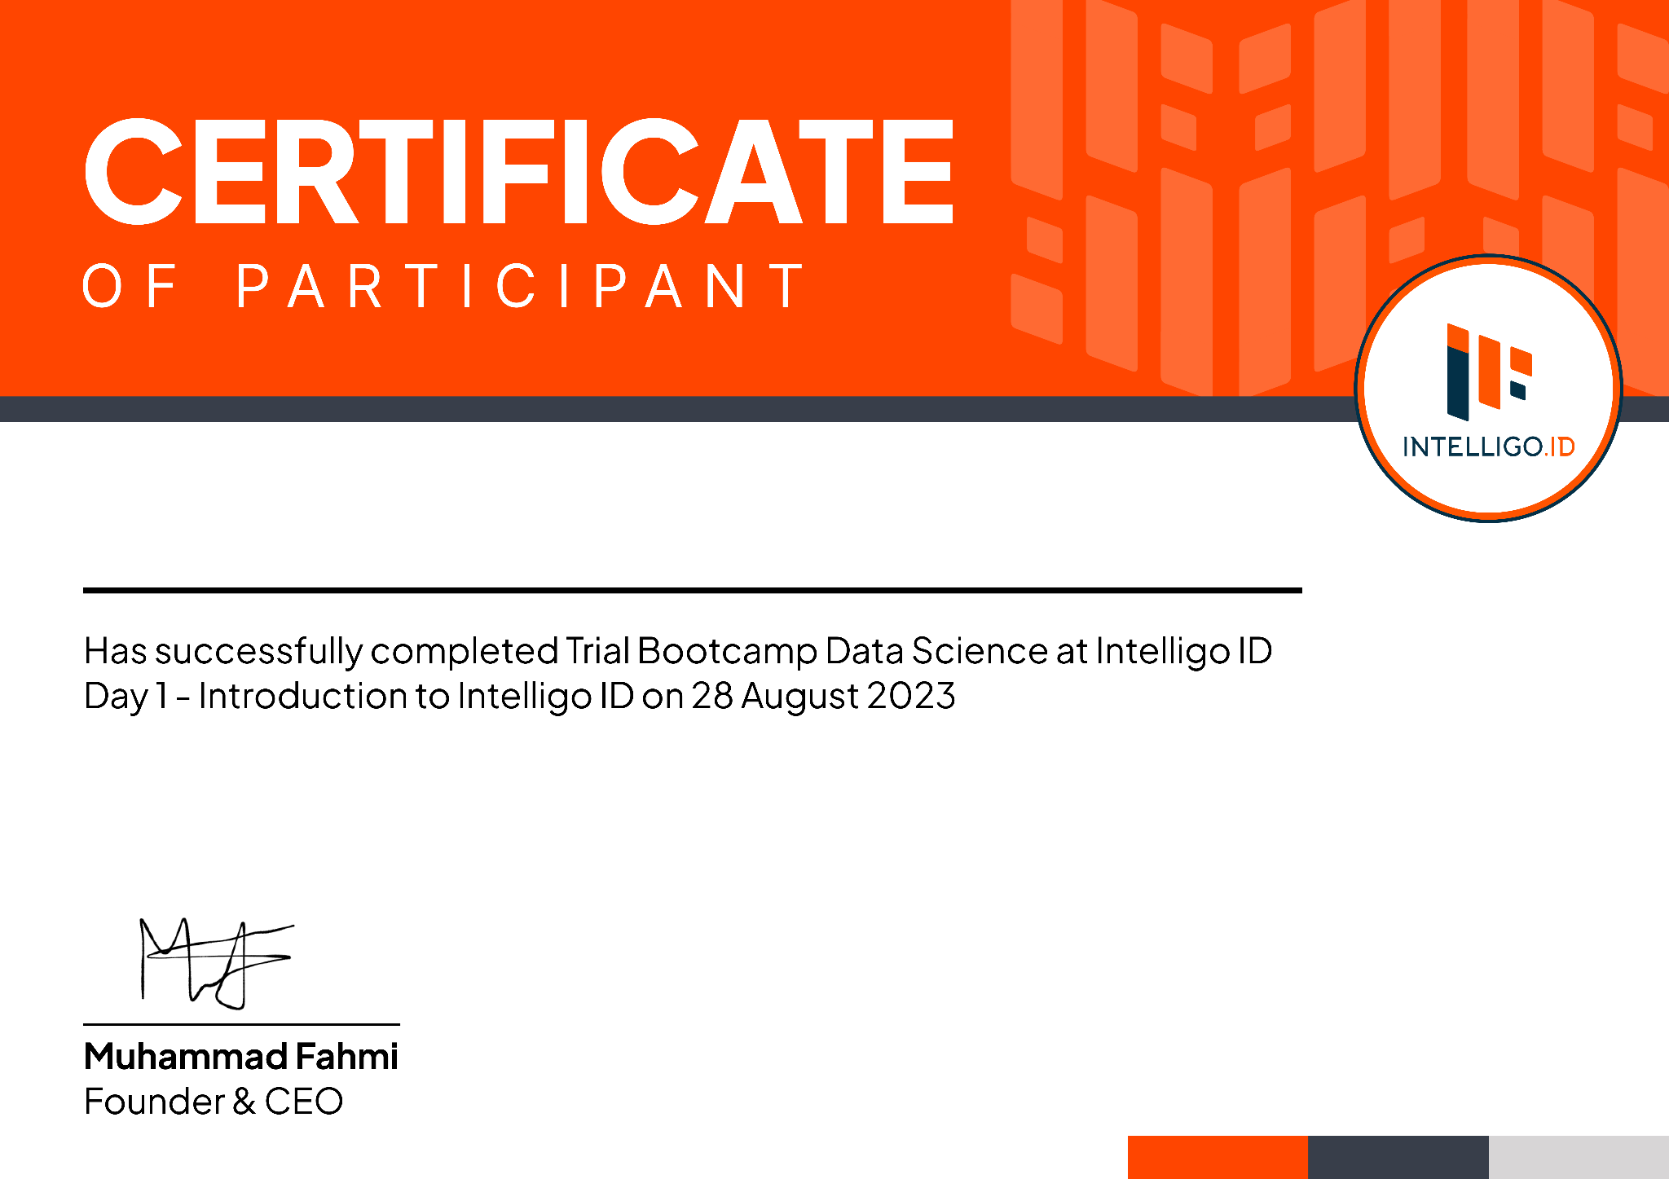

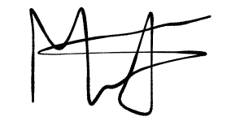
O F PARTICIPANT
Mukhamad Alyasyi Thobiq
Has Successfully Participated in
Trial Bootcamp Data Science & AI - Intelligo ID
held from 23 to 27 October 2025
Muhammad Fahmi
Head of Learning
Certificate ID : INT-TBDSAI-0426-8ADC

