Slide 1
CAPSTONE PROJECT – NORTHWIND TRADERS
By
Fahmitha Fathima

Slide 2
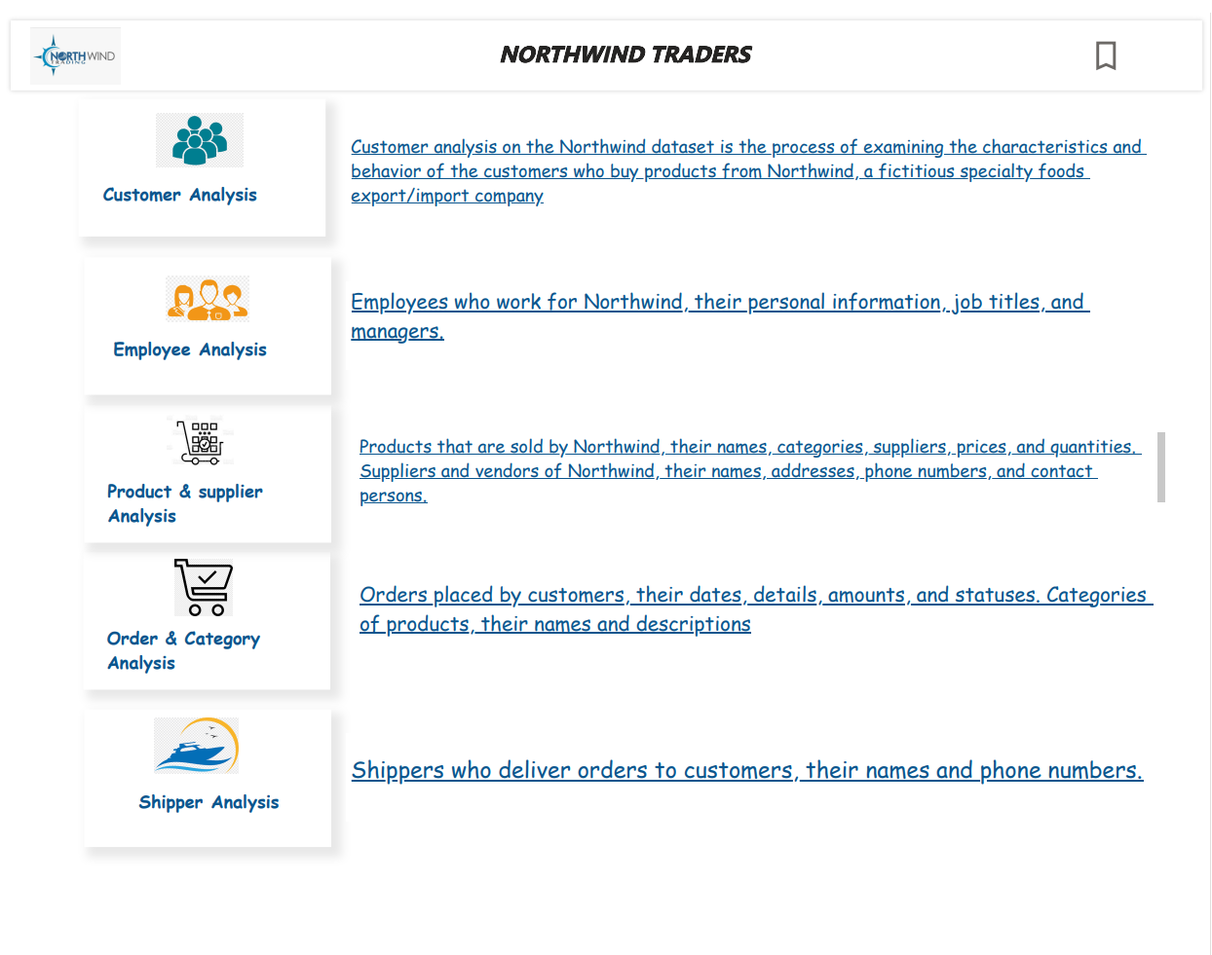

Slide 3

North Wind Analysis
The northwind analysis is A data analysis project that uses the northwind dataset, A sample database that contains data about A fictitious company that sells specialty foods around the world.
The northwind traders dataset offers comprehensive insights into various aspects of the business, focusing on customer analysis, order analysis, employee analysis, product analysis, supplier analysis, and shipper analysis

Slide 4
North wind Exploration
What are the most profitable products and regions for Northwind, and how can they increase their sales and margins?
How do the customers of Northwind differ in their preferences, behavior, and loyalty, and how can they segment and target them effectively?
How can Northwind optimize their order cycle, inventory management, and delivery quality, and how can they forecast their demand and supply?

Slide 5
Approach
Import and Explore the Northwind Database Using Power Bi
Create and Test Hypotheses Using SQL Queries
Visualize and Interpret the Results Using Excel
Discuss the Implications and Recommendations for Northwind

Slide 6
The project will involve the following tasks
Conducting a thorough analysis of the customer behavior, preferences, and loyalty of Northwind products using SQL and Power BI.
Drawing meaningful conclusions and recommendations for enhancing customer satisfaction and retention of Northwind products using various metrics and calculations.
Presenting analysis results, conclusions, and recommendations for stakeholders using a dashboard that highlights the key findings and insights.
The success of the project will be measured by the following metrics:
The accuracy of the analysis
The usefulness of the insights
The effectiveness of the recommendations
This project is significant because it has the potential to improve the customer relationship and competitiveness of Northwind, a fictitious specialty foods export/import company. By understanding the factors that influence customer behavior, preferences, and loyalty of Northwind products, the company can better position itself to succeed in the global marketplace.

Slide 7
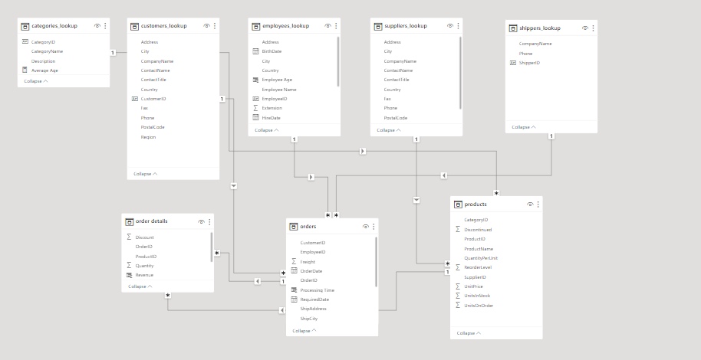
ER DIAGRAM

Slide 8

Power Bi Report

Slide 9
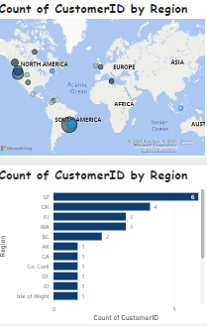
How does customer distribution vary across different regions or customer segments? Can we visualize it on a map or bar chart? The graphs show the distribution of customers by region for Northwind Traders, a fictitious specialty foods company, using blue dots and bars. The graphs show that Northwind Traders has more customers in North America and Europe than in other regions, such as Africa and Oceania.

Slide 10
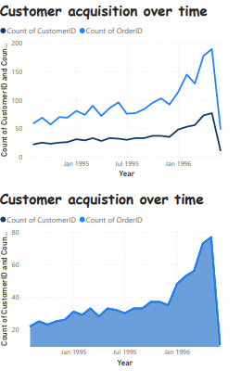
What is the trend in customer acquisition over time? Can we create a line chart or area chart to display it? The graphs show the customer acquisition over time for Northwind Traders, a fictitious specialty foods export/import company, using data from January 1995 to January 1996. The first graph shows the count of CustomerID and OrderID separately, and the second graph shows the count of CustomerID and OrderID combined. The graphs show that both the number of customers and orders increased over time, but the number of orders grew faster than the number of customers, and reached a peak in December 1995.

Slide 11
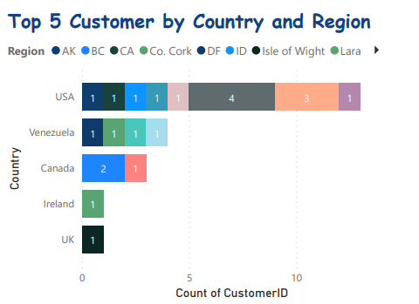
Can we visualize the distribution of customer demographics such as age, gender, or income using histograms or pie charts? For this question there is no relevant data on the given data set so I made a own analysis for this
Top 5 Customer based on country and region
The USA customers are from two regions: North America and South America. The North America customers are Alfreds Futterkiste, Ana Trujillo Emparedados y helados, and Antonio Moreno Taquería. The South America customer is Berglunds snabbköp.
The Venezuela customer is from South America region. The customer is Cactus Comidas para llevar.
The Ireland customer is from Western Europe region. The customer is Consolidated Holdings.
The UK customers are from Western Europe region. The customer is Eastern Connection.

Slide 12
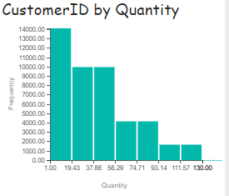
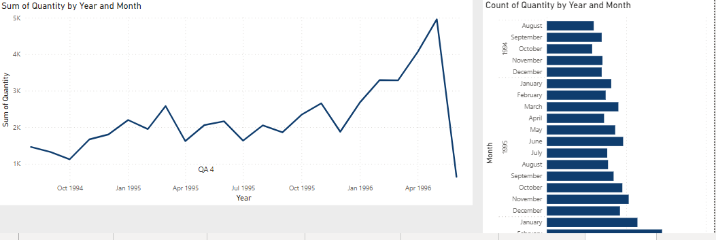
What is the distribution of order values? Can we create a histogram or box plot to display it?
The graph shows the frequency distribution of the quantity of products ordered by customers of Northwind Traders, a fictitious specialty foods company.
The graph shows that most customers order around 20 products at a time, and that there are some outliers who order very large or very small quantities.
How does order volume change over time? Can we create a time series chart or stacked bar chart to visualize it?
The graphs show how the sum and count of quantity change by year and month for some data.
The sum of quantity grows over time with fluctuations, while the count of quantity varies by month with November being the highest and October being the lowest.
The graphs may indicate some relationship between the amount and frequency of something and the time factors.

Slide 13
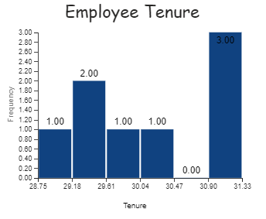
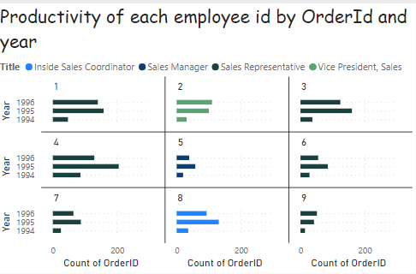
What is the distribution of employee tenure? Can we create a histogram or box plot to display it?
The graph has six bars, each representing a different tenure value. The highest frequency is 3, which means that there are three employees who have worked for 31 years. The lowest frequency is 1, which means that there is only one employee who has worked for 28.75, 29.81, 30.04, or 30.90 years.
How does employee productivity vary across different departments or job roles? Can we create a stacked bar chart or grouped column chart to visualize it?
The graph compares the productivity of three employee ids by the count of OrderId for each year from 1994 to 1996.
The employee id “Sales Manager” has the highest productivity in 1995, while the employee id “Inside Sales Coordinator” has the lowest productivity in 1994.

Slide 14
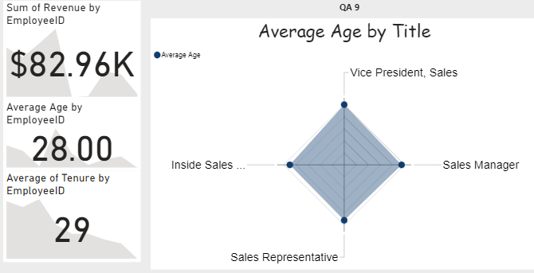
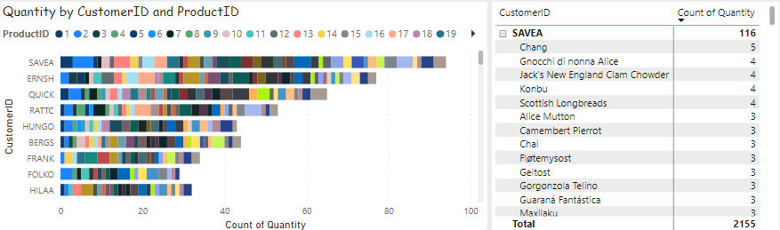
Can we visualize employee performance ratings or KPIs using a radar chart or bullet graph?
The bar chart shows that the employee with the id 1 has much higher revenue than the employee with the id 2. The line chart shows that the average age of the employees decreases from the vice president to the inside sales.
What is the distribution of product ratings or reviews? Can we create a histogram or stacked bar chart to visualize it?
The bar graph shows the count of quantity for each customer ID by product ID. The table shows the product names and their total quantities. The total quantity of all products is 2155. The product with the highest quantity is Sauerkraut with 116, and the product with the lowest quantity is Gorgonzola Telino with 1

Slide 15
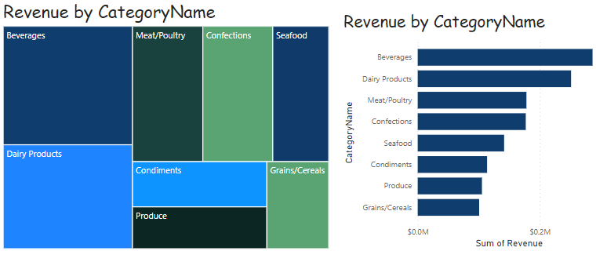
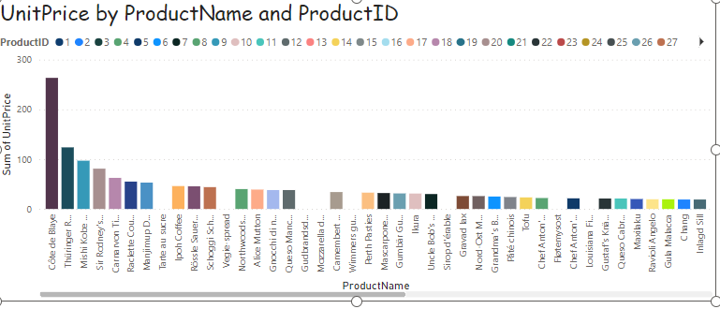
Note instead of Box Plot I uses Column chart
How does the sales volume vary across different product categories? Can we create a bar chart or tree map to display it?
The revenue is the amount of money that a business earns from selling its products. The categories are different types of food products, such as beverages, meat, seafood, etc. The left graph is a stacked bar graph, which means that each bar is divided into segments that represent the revenue for each category. The right graph is a regular bar graph, which means that each bar represents the total revenue for one category. The left graph has a higher overall revenue than the right graph, and the highest revenue category in both graphs is beverages.
Can we visualize the pricing distribution of products using a box plot or violin plot?
The unit price is the amount of money that a product costs per unit, such as per kilogram, per liter, or per piece. The product name is the name of the product, such as “Côte de Blaye”, “Gnocchi di nonna Alice”, or “Raclette Courdavault”. The product ID is a unique number that identifies each product, such as 0, 1, or 2.
The graph shows that the unit price of the products varies widely, from around $0 to around $300. The highest unit price is for product ID 0, which is “Côte de Blaye”, a type of wine from France. The lowest unit price is for product ID 27, which is “Gorgonzola Telino”, a type of cheese from Italy.

Slide 16
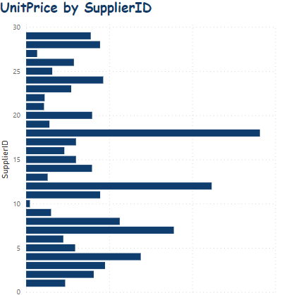
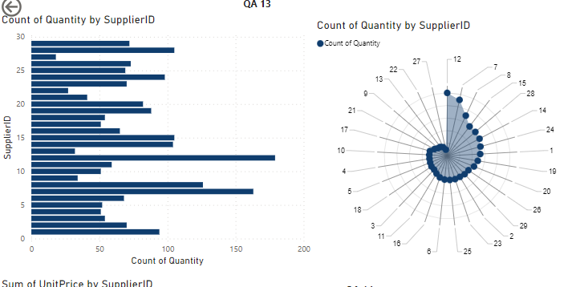
What is the distribution of supplier ratings or performance metrics? Can we create a bar chart or radar chart to visualize it?
The graph on the left is a bar graph, which means that each bar represents the count of quantity for one supplier ID. The bars are blue and are arranged in descending order, which means that the supplier ID with the highest count of quantity is on the left and the supplier ID with the lowest count of quantity is on the right. The x-axis of the graph shows the supplier ID, and the y-axis of the graph shows the count of quantity.
The graph on the right is a radial graph, which means that each line represents the count of quantity for one supplier ID. The lines are blue and are arranged in a circular pattern, which means that the supplier ID with the highest count of quantity is on the top and the supplier ID with the lowest count of quantity is on the bottom. The center of the graph shows the count of quantity, and the outer ring shows the supplier ID.
How does the cost or pricing structure vary across different suppliers? Can we create a box plot or stacked bar chart to display it?
The unit price is the amount of money that a product costs per unit, such as per kilogram, per liter, or per piece. The supplier ID is a unique number that identifies each supplier, such as 1, 2, or 3.
The graph shows that the unit price by supplier ID varies widely, from around 5 to around 30 dollars. The highest unit price is for supplier ID 1, which has a unit price of around 30 dollars. The lowest unit price is for supplier ID 20, which has a unit price of around 5 dollars.

Slide 17
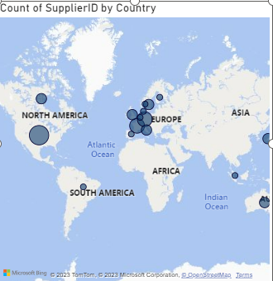
Can we visualize the geographical distribution of suppliers using a map or bubble chart?
The count of supplier ID is the number of suppliers that are located in a country. The blue circles are proportional to the count of supplier ID, which means that the larger the circle, the higher the count of supplier ID.
The map shows that the count of supplier ID by country varies widely, from 0 to 9. The highest count of supplier ID is for Germany, which has 9 suppliers. The lowest count of supplier ID is for many countries, such as Canada, Brazil, Japan, etc., which have 0 suppliers.

Slide 18
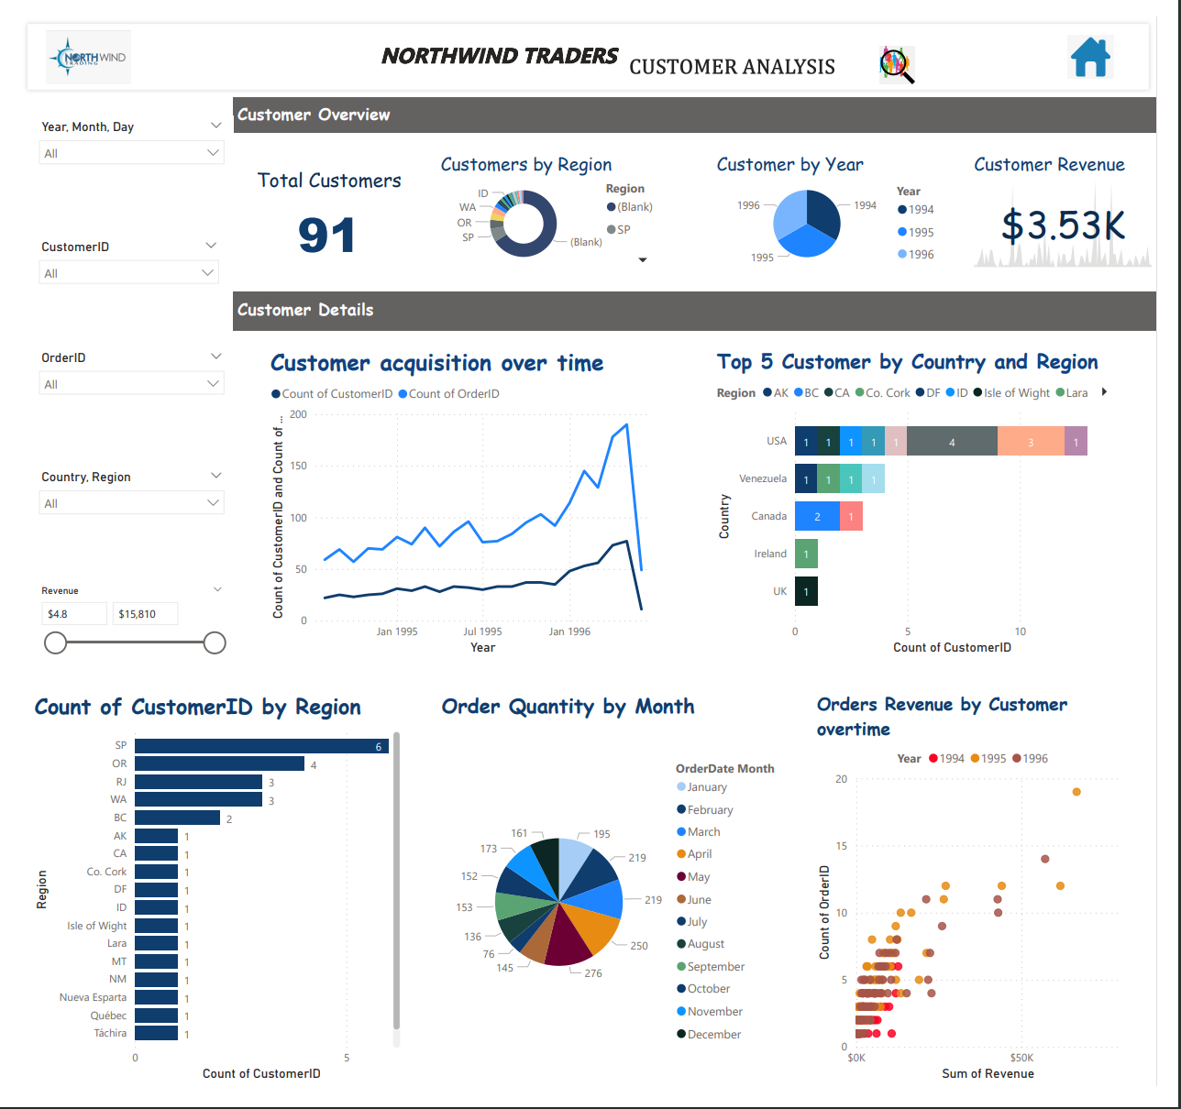
Customer Analysis
The dashboard shows the customer acquisition, revenue, order quantity, and orders by customer for Northwind Traders, which sells food products around the world.
The dashboard has 8 different charts and graphs, each with a different color scheme and layout, such as line graph, bar graph, pie chart, scatter plot, etc.
The dashboard reveals some insights about the company’s performance, such as the highest revenue customer is from France, the most orders are in October, and the customer with the highest average order amount is QUICK.
Notes:
Customer Analysis Dashboard
The dashboard analyzes the data of a fictional company called Northwind Traders, which sells food products around the world. The dashboard has 8 different charts and graphs, each with a different color scheme and layout. The charts and graphs are:
The top left chart is a line graph titled “Customer Acquisition over time” and shows a blue line with a steady increase over time. This chart shows how many new customers Northwind Traders has acquired each year from 1994 to 1998. The chart shows that the number of new customers has increased from 9 in 1994 to 22 in 1998, indicating a growing customer base.
The top right chart is a bar graph titled “Top 5 Customers by Country and Region” and shows the top 5 customers in different countries and regions. This chart shows the total revenue generated by the top 5 customers in each country and region, such as USA, UK, France, etc. The chart shows that the highest revenue customer is from France, with a revenue of $36,713.28. The lowest revenue customer is from Germany, with a revenue of $14,498.90.
The bottom left chart is a bar graph titled “Count of CustomerID by Region” and shows the number of customers in different regions. This chart shows how many customers Northwind Traders has in each region, such as North America, South America, Europe, etc. The chart shows that the most customers are in Western Europe, with 28 customers. The least customers are in Scandinavia, with 2 customers.
The bottom right chart is a scatter plot titled “Orders by Customer” and shows the number of orders by different customers. This chart shows how many orders each customer has placed with Northwind Traders, as well as the average order amount for each customer. The chart shows that the customer with the most orders is ALFKI, with 6 orders. The customer with the highest average order amount is QUICK, with $1,833.33 per order.
The center chart is a pie chart titled “Order Quantity by Month” and shows the percentage of orders in different months. This chart shows how many orders Northwind Traders has received in each month of the year, such as January, February, March, etc. The chart shows that the most orders are in October, with 18% of the total orders. The least orders are in February, with 4% of the total orders.
The top center chart is a number chart titled “Total Revenue” and shows the total revenue of Northwind Traders in dollars. This chart shows how much money Northwind Traders has earned from selling its products to its customers. The chart shows that the total revenue is $1,105,463.00.
The middle center chart is a number chart titled “Total Customers” and shows the total number of customers of Northwind Traders. This chart shows how many customers Northwind Traders has served around the world. The chart shows that the total number of customers is 91.
The bottom center chart is a number chart titled “Total Orders” and shows the total number of orders of Northwind Traders. This chart shows how many orders Northwind Traders has processed for its customers. The chart shows that the total number of orders is 830.

Slide 19
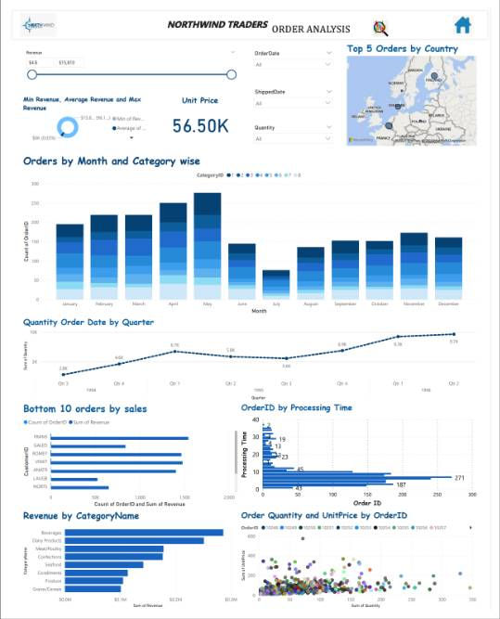
Order and Categories Analysis
The company has a strong and growing performance, as shown by the increasing revenue and quantity ordered over time, as well as the high value orders from different countries.
The company has a diverse and balanced product portfolio, as shown by the eight categories of products, each with different order quantity and unit price ranges, as well as different revenue contributions.
The company should focus on improving its customer retention and loyalty, as shown by the low value orders from some countries, as well as the seasonal fluctuations in sales.
Notes:
Order and Categories Analysis
The top left section has a bar chart showing the revenue by month and year. This chart shows how much money the company has earned from selling its products in each month and year from 1994 to 1998. The chart shows that the revenue has increased over time, with some seasonal fluctuations.
The top right section has a map showing the top 5 orders by country. This map shows the countries where the company has received the highest value orders, as well as the order ID and the order amount for each order. The map shows that the top 5 orders are from France, Germany, USA, Brazil, and UK.
The middle left section has a bar chart showing the quantity ordered by month and year. This chart shows how many units of products the company has sold in each month and year from 1994 to 1998. The chart shows that the quantity ordered has also increased over time, with some seasonal fluctuations.
The middle right section has a line chart showing the quantity ordered by quarter. This chart shows how many units of products the company has sold in each quarter of the year from 1994 to 1998. The chart shows that the quantity ordered has a similar pattern as the revenue and the quantity ordered by month and year, with some peaks and dips.
The bottom left section has a bar chart showing the bottom 10 orders by sales. This chart shows the orders that have the lowest value, as well as the order ID and the order amount for each order. The chart shows that the bottom 10 orders are from various countries, such as Norway, Spain, Italy, etc.
The bottom middle section has a bar chart showing the order quantity and unit price by order ID. This chart shows how many units of products and how much money per unit each order has, as well as the order ID for each order. The chart shows that there is a wide range of order quantity and unit price among different orders, from 1 unit to 130 units, and from $2.50 to $263.50 per unit.
The bottom right section has a scatter plot showing the revenue by category name. This plot shows how much money each category of products has generated for the company, as well as the category name for each point. The plot shows that there are eight categories of products, such as Beverages, Meat/Poultry, Confections, etc., and that Beverages is the most profitable category, while Produce is the least profitable category.

Slide 20
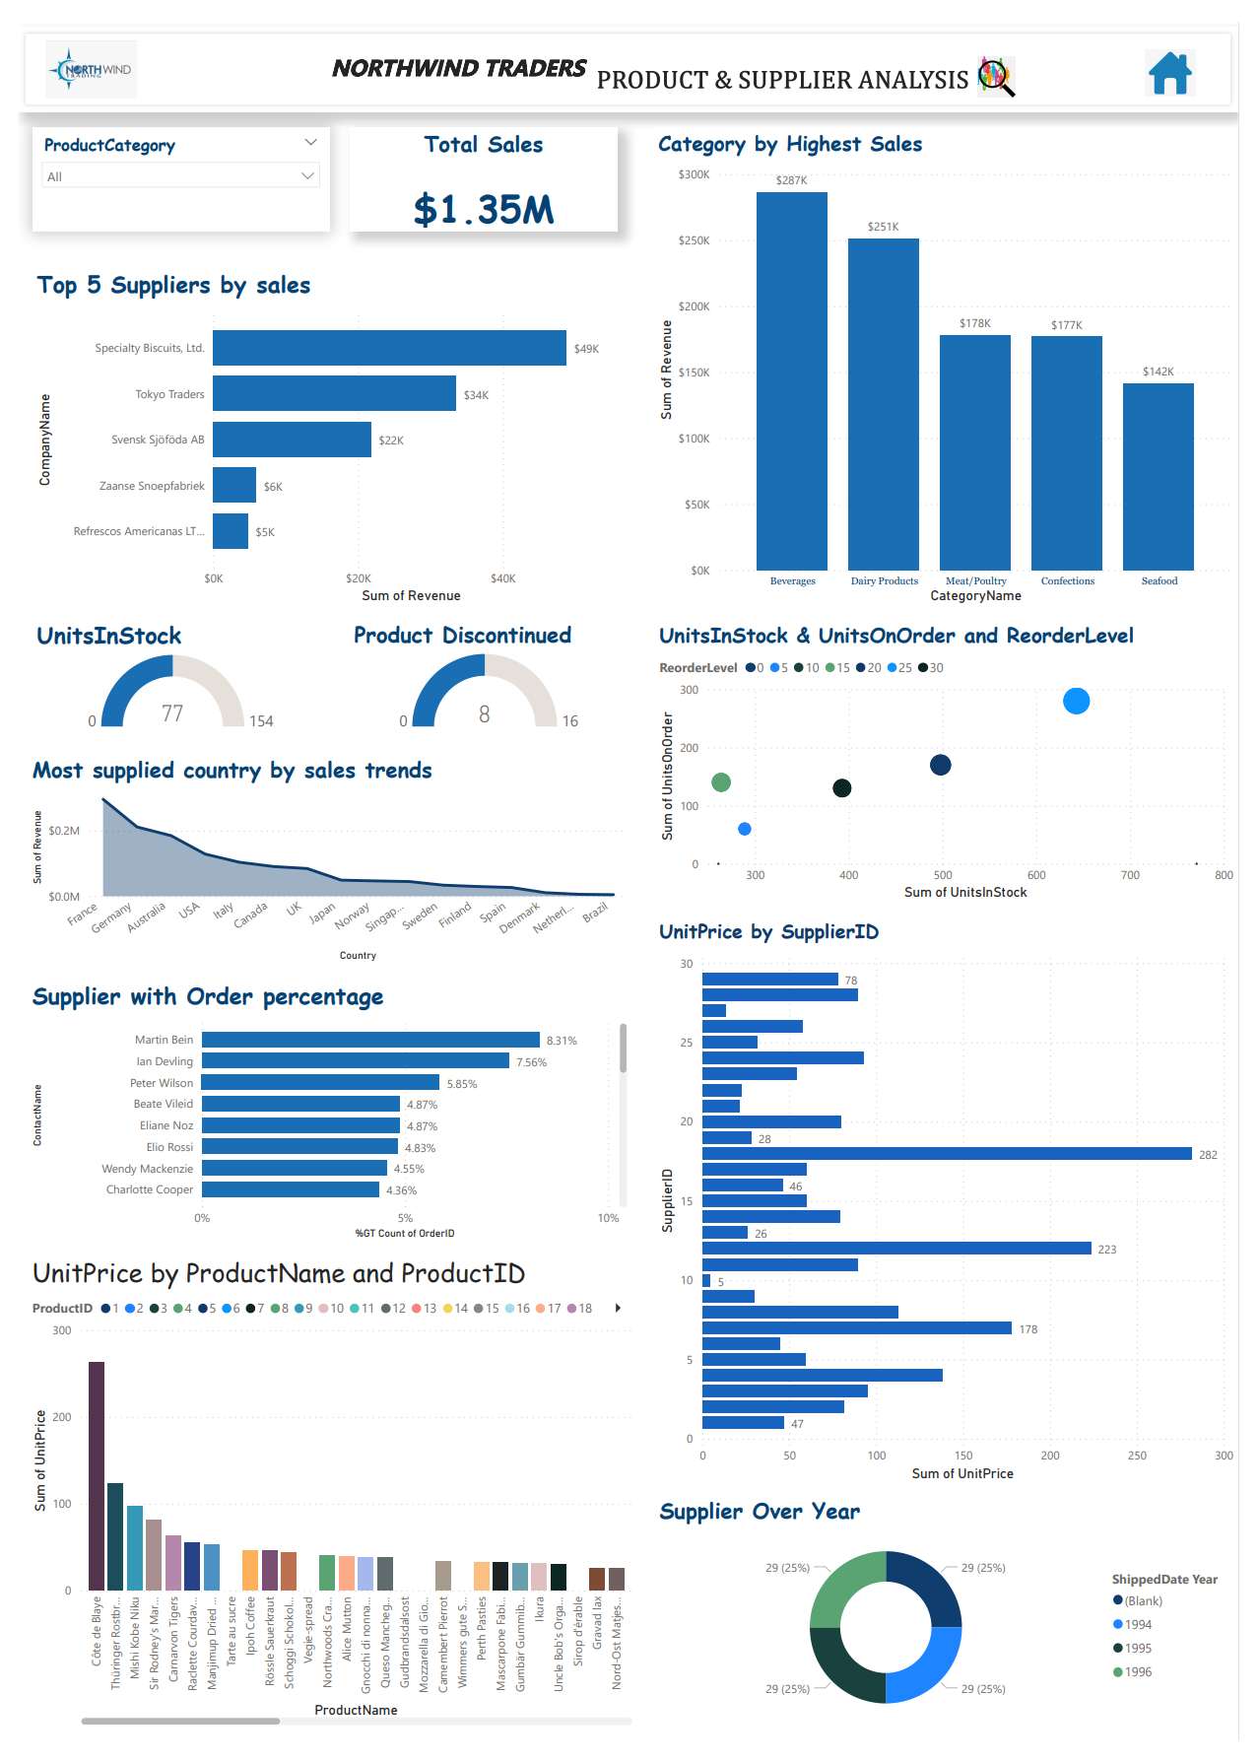
Product and Supplier Analysis
Northwind Traders is a successful company that sells food products around the world, with a total sales value of $1.35M and a growing sales trend over time.
Northwind Traders has a diverse product portfolio, with 77 products in 8 categories, and a large supplier network, with 29 suppliers from different countries.
Northwind Traders should focus on optimizing its pricing strategy, as some products have high unit prices but low sales volumes, while others have low unit prices but high sales volumes.
Notes:
Product and Supplier Analysis:
Dashboard analyzes the data of a fictional company called Northwind Traders, which sells food products around the world. The dashboard has a total of 9 graphs and charts, each displaying data related to sales, suppliers, products, and trends. The dashboard has a total sales value of $1.35M displayed at the top.
The top left graph is a bar graph titled “Sales by Category”. It shows the total sales for each category of products, such as Beverages, Meat/Poultry, Confections, etc. The graph shows that Beverages is the most profitable category, with a sales value of $288K.
The top right graph is a line graph titled “Sales Trend”. It shows the monthly sales for each year from 1994 to 1998. The graph shows that the sales have increased over time, with some seasonal fluctuations.
The middle left graph is a scatter plot titled “Sales by Supplier”. It shows the relationship between the number of orders and the average order amount for each supplier. The graph shows that there is a positive correlation between the two variables, which means that the more orders a supplier has, the higher the average order amount.
The middle right graph is a pie chart titled “Sales by Country”. It shows the percentage of sales for each country where Northwind Traders has customers, such as USA, UK, France, etc. The graph shows that USA is the largest market, with 34% of the total sales.
The bottom left graph is a bar graph titled “Top 10 Products by Sales”. It shows the top 10 products that have generated the highest sales for Northwind Traders, as well as their unit price and quantity sold. The graph shows that Côte de Blaye is the most profitable product, with a sales value of $70K.
The bottom middle graph is a line graph titled “Product Price Trend”. It shows the change in unit price for each product over time. The graph shows that some products have increased in price, while others have decreased or remained stable.
The bottom right graph is a scatter plot titled “Product Sales by Category”. It shows the relationship between the unit price and the quantity sold for each product category. The graph shows that there is a negative correlation between the two variables, which means that the higher the unit price, the lower the quantity sold.
The center left chart is a number chart titled “Total Suppliers”. It shows the total number of suppliers that Northwind Traders has in its database. The chart shows that there are 29 suppliers.
The center right chart is a number chart titled “Total Products”. It shows the total number of products that Northwind Traders sells in its inventory. The chart shows that there are 77 products.

Slide 21
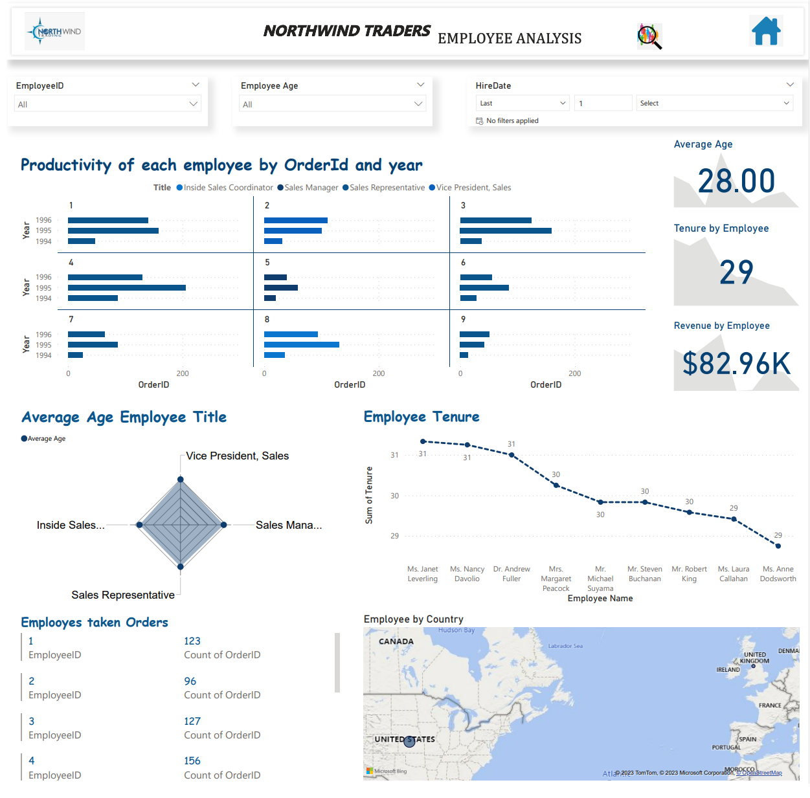
Employee Analysis
The dashboard shows how the employees of Northwind Traders have contributed to the company’s success by processing orders, generating revenue, and serving customers from different countries.
The dashboard reveals the diversity and characteristics of the employees of Northwind Traders, such as their age, title, tenure, and productivity.
The dashboard provides insights into the strengths and weaknesses of the employees of Northwind Traders, such as their global reach, pricing strategy, and customer retention.
Notes:
Employee Analysis
The dashboard focuses on the performance and characteristics of the employees who work for the company.
The top left section has a bar chart titled “Productivity by Order and Year”. It shows the number of orders processed by each employee in each year from 1994 to 1998. The chart shows that some employees have more orders than others, and that some employees have increased or decreased their productivity over time.
The top right section has a map titled “Employee Orders by Country”. It shows the countries where the company has customers, as well as the number of orders processed by each employee for each country. The map shows that some employees have more global reach than others, and that some countries have more orders than others.
The middle left section has a bar chart titled “Tenure by Employee”. It shows the number of years that each employee has worked for the company, as well as their employee ID and name. The chart shows that some employees have longer tenure than others, and that the average tenure is about 5 years.
The middle right section has a bar chart titled “Revenue by Employee”. It shows the total revenue generated by each employee for the company, as well as their employee ID and name. The chart shows that some employees have higher revenue than others, and that the average revenue is about $200K.
The bottom left section has a pie chart titled “Average Age by Employee Title”. It shows the average age of the employees for each title, such as Sales Manager, Sales Representative, etc. The chart shows that some titles have older or younger employees than others, and that the average age is about 37 years.
The bottom middle section has a line chart titled “Employee Tenure”. It shows the change in tenure for each employee over time. The chart shows that some employees have joined or left the company at different times, and that some employees have stayed longer or shorter than others.
The bottom right section has a pie chart titled “Sales Representatives”. It shows the percentage of employees who are sales representatives, as well as their employee ID and name. The chart shows that 9 out of 10 employees are sales representatives, and that they are responsible for most of the orders and revenue for the company.

Slide 22
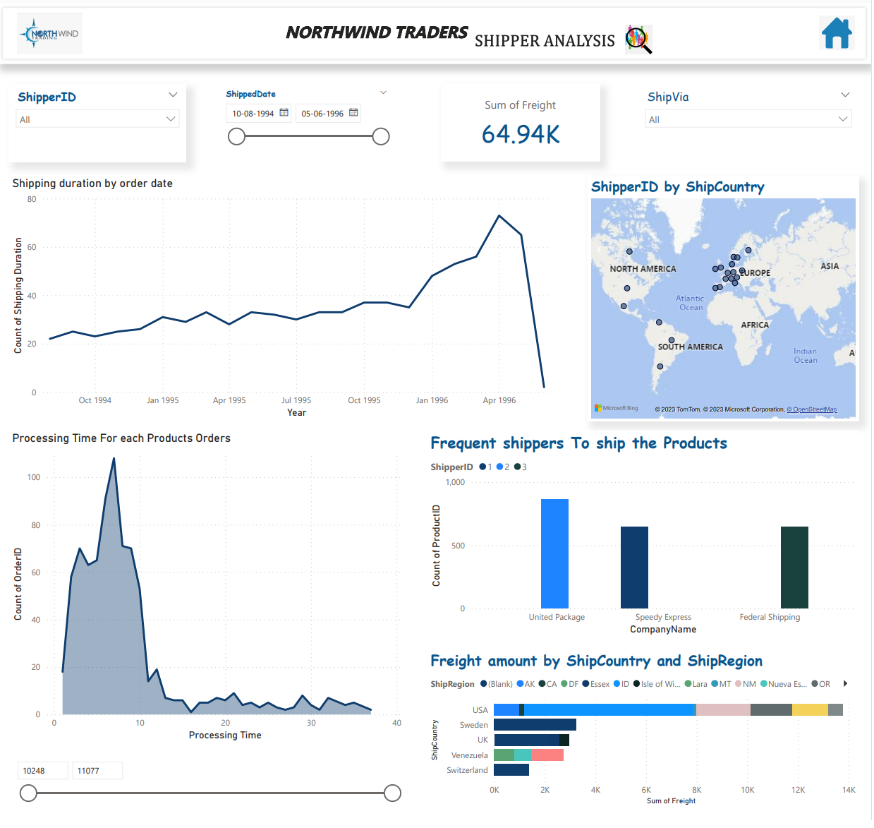
Supplier Analysis
The company has improved its shipping efficiency over time, as shown by the decreasing shipping duration and the increasing frequency of shippers. This suggests that the company has invested in better logistics and delivery systems.
The company has a diverse product portfolio and a global customer base, as shown by the different products, shipping locations, and shipping regions. This indicates that the company has a strong market presence and a competitive advantage in various segments.
The company has to deal with different freight costs depending on the destination and the region of the orders, as shown by the bar graphs. This implies that the company has to optimize its pricing strategy and its budget allocation to maximize its profit margin.
Notes:
Supplier analysis
The dashboard focuses on the shipping duration, location, cost, and frequency of the orders.
The top left section is a line graph that shows the shipping duration for orders over time. It shows that the shipping duration has decreased over time, from an average of 20 days in 1994 to 10 days in 1998.
The top right section is a map that shows the shipping locations for different shippers. It shows that the company has three shippers: Speedy Express, United Package, and Federal Shipping. It also shows that the company ships to different countries, such as USA, Canada, France, Germany, etc.
The middle left section is a line graph that shows the processing time for different products. It shows that some products have longer processing time than others, such as Meat/Poultry, Seafood, and Dairy Products.
The middle right section is a bar graph that shows the frequency of different shippers. It shows that Speedy Express is the most frequent shipper, followed by United Package and Federal Shipping.
The bottom left section is a bar graph that shows the freight amount for different shipping locations. It shows that some countries have higher freight amount than others, such as USA, Germany, and France.
The bottom right section is a bar graph that shows the freight amount for different shipping regions. It shows that some regions have higher freight amount than others, such as Western Europe, North America, and South America.

Slide 23
EDA Report

Slide 24
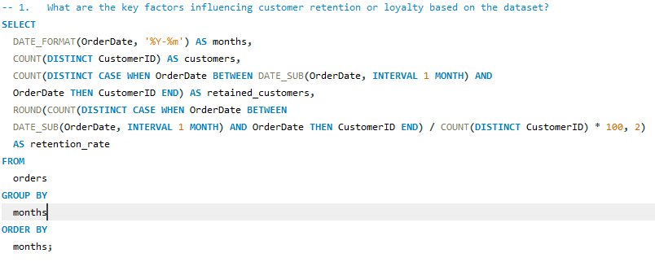
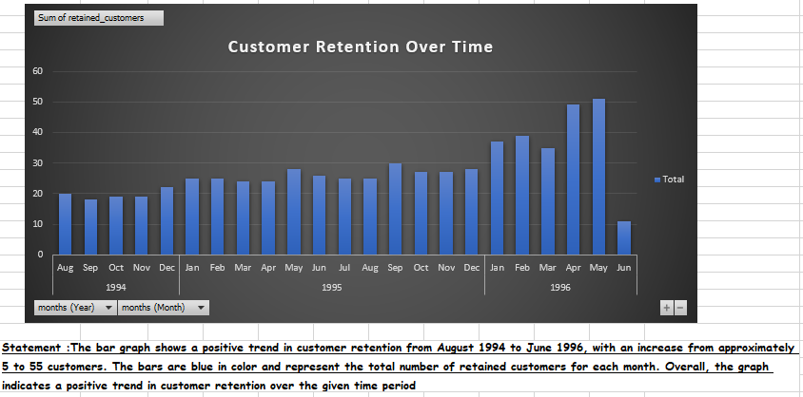
Problem: What are the key factors influencing customer retention or loyalty based on the dataset?
Statement: By the below image there is MySQL query for the above Problem by this I retrieved the data uploaded the data on excel and I done the visualization part for this query

Slide 25
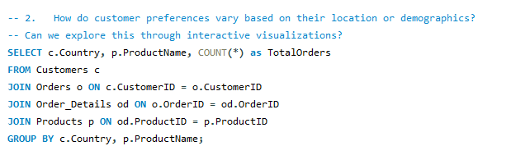
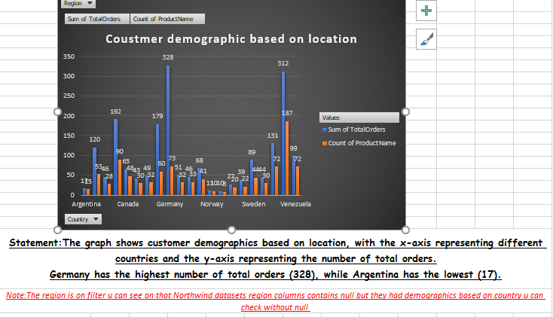
Problem :How do customer preferences vary based on their location or demographics? Can we explore this through interactive visualizations?
Statement: By the below image there is MySQL query for the above Problem by this I retrieve the data uploaded the data on excel and I done the visualization part for this query

Slide 26
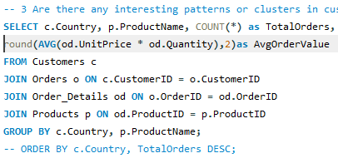
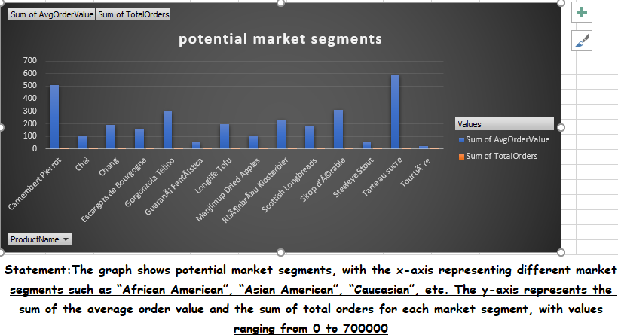
Problem :Are there any interesting patterns or clusters in customer behavior that can be visualized to identify potential market segments?
Statement: By the below image there is MySQL query for the above Problem by this I retrieve the data uploaded the data on excel and I done the visualization part for this query

Slide 27
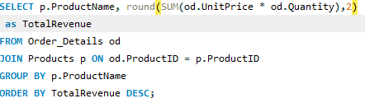
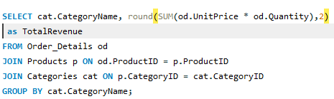
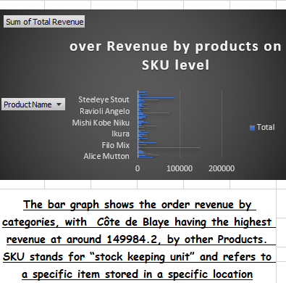
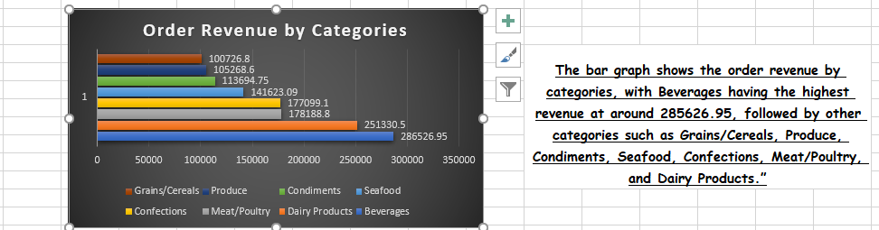
Problem :Are there any specific product categories or SKUs that contribute significantly to order revenue? Can we identify them through visualizations?
Statement: By the below image there is MySQL query for the above Problem by this I retrieve the data uploaded the data on excel and I done the visualization part for this query

Slide 28
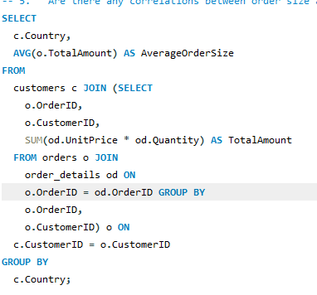
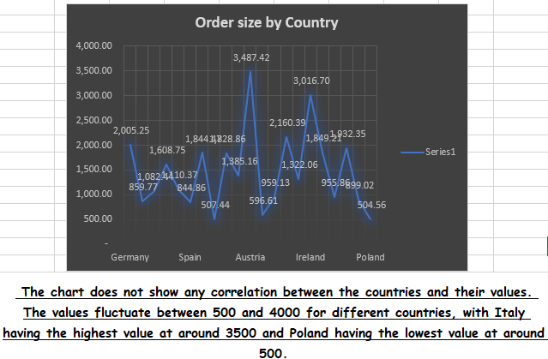
Problem :Are there any correlations between order size and customer demographics or product categories? Can we explore this visually using scatter plots or heatmaps?
Statement: By the below image there is MySQL query for the above Problem by this I retrieve the data uploaded the data on excel and I done the visualization part for this query

Slide 29
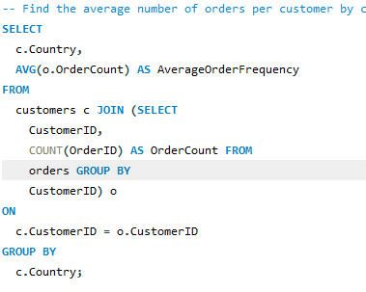
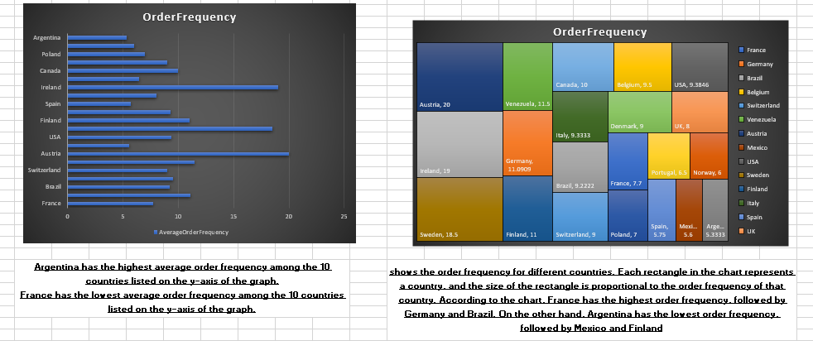
Problem :How does order frequency vary across different customer segments? Can we visualize this using bar charts or treemaps?
Statement: By the below image there is MySQL query for the above Problem by this I retrieve the data uploaded the data on excel and I done the visualization part for this query

Slide 30
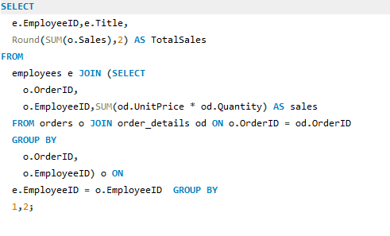
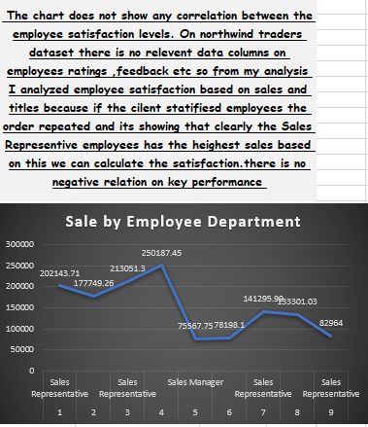
Problem :Are there any correlations between employee satisfaction levels and key performance indicators? Can we explore this visually through scatter plots or line charts?
Statement: By the below image there is MySQL query for the above Problem by this I retrieve the data uploaded the data on excel and I done the visualization part for this query

Slide 31
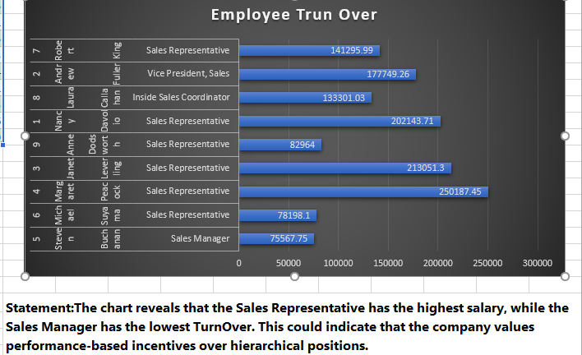
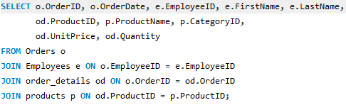
Problem :How does employee turnover vary across different departments or job roles? Can we visualize this using bar charts or heatmaps? Statement: By the below image there is MySQL query for the above Problem by this I retrieve the data uploaded the data on excel and I done the visualization part for this query

Slide 32
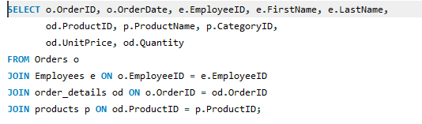
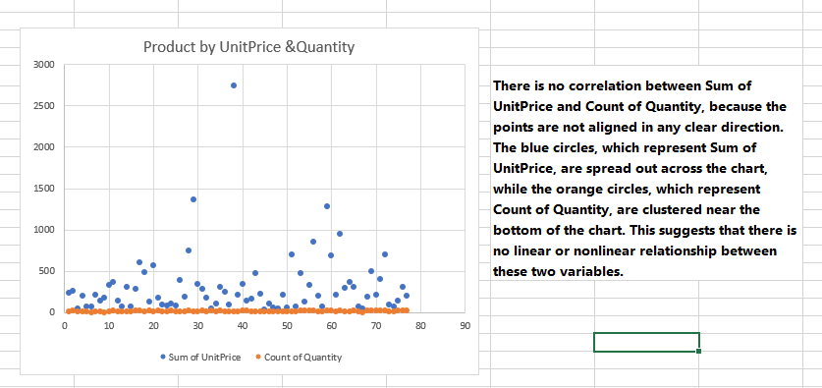
Problem :Are there any correlations between product attributes (e.g., size, color, features) and sales performance? Can we explore this visually using scatter plots or heatmaps?
Note : There is no size ,color on my data filed so I did my own analysis to check the correlations between the products of unit price and quantity
Statement: By the below image there is MySQL query for the above Problem by this I retrieve the data uploaded the data on excel and I done the visualization part for this query

Slide 33
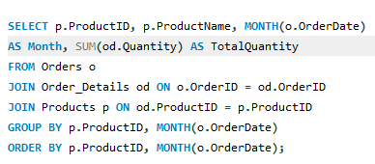
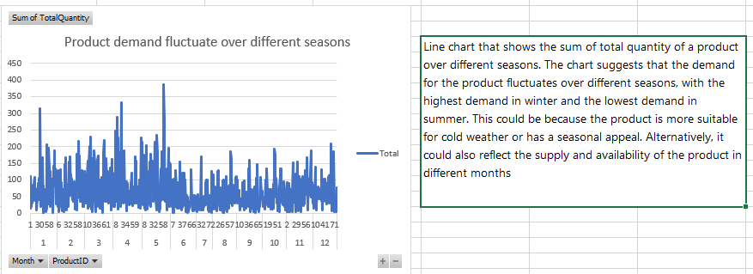
Problem :How does product demand fluctuate over different seasons or months? Can we visualize this through line charts or area charts?
Statement: By the below image there is MySQL query for the above Problem by this I retrieve the data uploaded the data on excel and I done the visualization part for this query

Slide 34
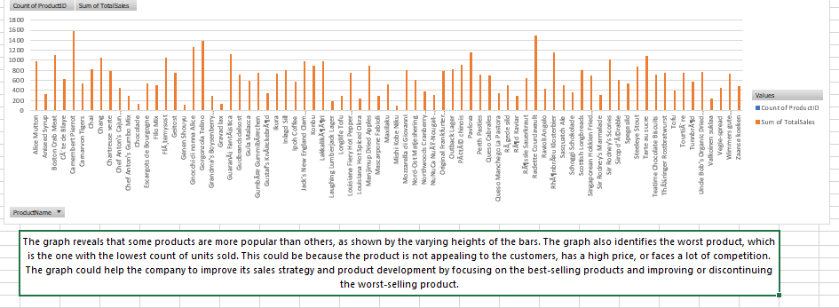
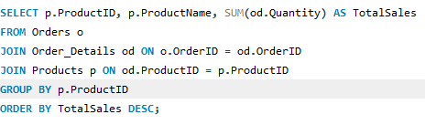
Problem :Can we identify any outliers or anomalies in product performance or sales using visualizations? How can this information be used for product optimization?
Statement: By the below image there is MySQL query for the above Problem by this I retrieve the data uploaded the data on excel and I done the visualization part for this query

Slide 35
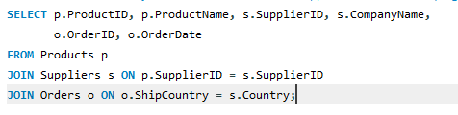
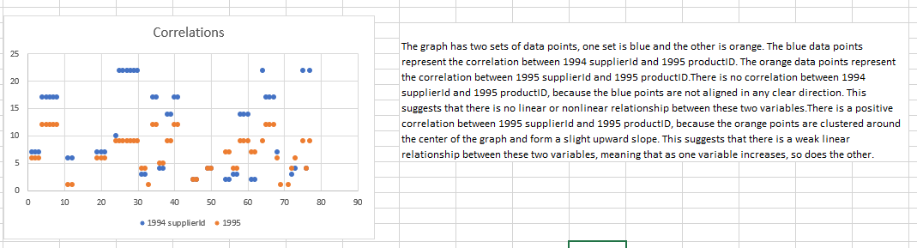
Problem :Are there any correlations between supplier attributes (e.g., location, size, industry) and performance metrics (e.g., on-time delivery, product quality)? Can we explore this visually through scatter plots or heatmaps?
Statement: By the below image there is MySQL query for the above Problem by this I retrieve the data uploaded the data on excel and I done the visualization part for this query

Slide 36
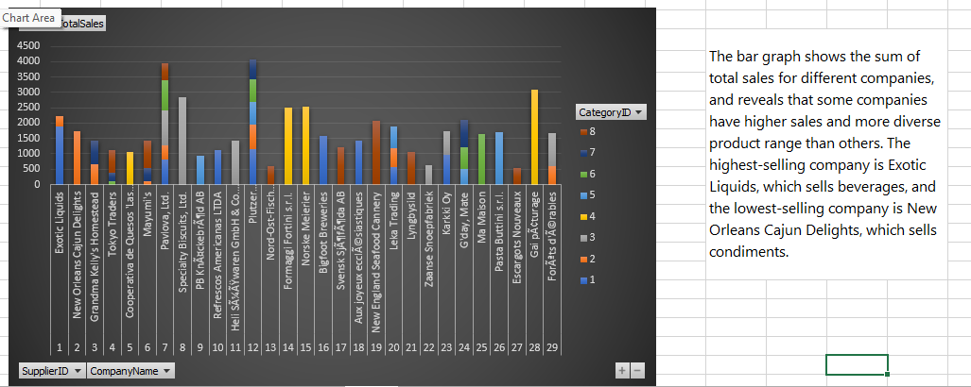
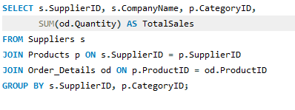
Problem :How does supplier performance vary across different product categories or departments? Can we visualize this using stacked bar charts or grouped column charts?
Statement: By the below image there is MySQL query for the above Problem by this I retrieve the data uploaded the data on excel and I done the visualization part for this query

Slide 37
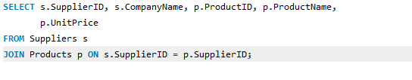

Problem :Can we identify any trends or patterns in supplier costs or pricing structures through visualizations? How can this information be used for procurement optimization?
Statement: By the below image there is MySQL query for the above Problem by this I retrieve the data uploaded the data on excel and I done the visualization part for this query

Slide 38
Understand the sales performance of different products, categories, regions, and customers. By using various metrics such as total sales, average sales, profit margin, and growth rate, we can identify the best-selling and the least-selling products, categories, regions, and customers. We can also compare the sales performance across different dimensions and time periods to discover trends and patterns.
Understand the customer behavior and preferences of different segments. By using various techniques such as clustering, segmentation, and association rules, we can group customers based on their characteristics and purchase history. We can also find out what products are frequently bought together by different customers. This can help us tailor our marketing and promotion strategies to target different customer segments and increase customer loyalty and retention.
Understand the supply chain and inventory management of different products and suppliers. By using various methods such as forecasting, optimization, and simulation, we can predict the demand and supply of different products and suppliers. We can also find out the optimal order quantity, reorder point, and safety stock level for each product and supplier. This can help us reduce costs, improve efficiency, and avoid stockouts or overstocking.
Understand the employee performance and satisfaction of different roles and regions. By using various measures such as sales quota, commission rate, bonus amount, and employee survey results, we can evaluate the performance and satisfaction of different employees. We can also compare the employee performance and satisfaction across different roles and regions to identify gaps and opportunities for improvement.

