Slide 1

Price Comparison
using Web Scraping and Data Analysis
Seminar In-Charge :-
Prof. Madhavi sadu
Seminar Guide :-
Prof. Vrushali Aware

Slide 2
10
Group No :-

Slide 3
GROUP MEMBER’s
“Faizan Raza Sheikh” “Hrishabh V. Petkar”
“Abdul Malik Sheikh” “Harsh Lalchand Kose”
“Aditi Chanderkar”

Slide 4
A
1
Introduction

Slide 5
Let's start with a brief introduction to our price comparison tool.
Our tool is designed to help you find the best prices for products across multiple platforms.
It saves you time and money by streamlining the process of comparing prices.

Slide 6




Data
Analysis

Slide 7
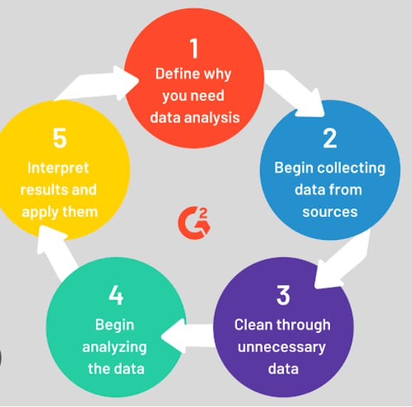
What is data analysis?
Data analysis refers to the process of inspecting, cleaning, transforming, and modeling data with the goal of discovering useful information, drawing conclusions, and making informed decisions. It involves a systematic approach to understanding and interpreting patterns, relationships, and trends within datasets.

Slide 8
3
Problem Statement

Slide 9
Have you ever found it time-consuming and frustrating to compare prices across different online platforms?
Our tool addresses this challenge by providing a convenient and efficient solution.
It eliminates the need for manual searches and helps you find the best deals effortlessly.

Slide 10
4
How it works?

Slide 11
Now, let's dive into how our price comparison tool works at a high level.
The process involves three simple steps: searching for a product, retrieving prices from multiple platforms, and displaying the results to you.

Slide 12
5
Searching for Product

Slide 13
To start using our tool, you simply enter the name of the product you're interested in.
This search query serves as the basis for finding the best prices across various e-commerce platforms.

Slide 14
Retrieving Prices from Flipkart
6

Slide 15
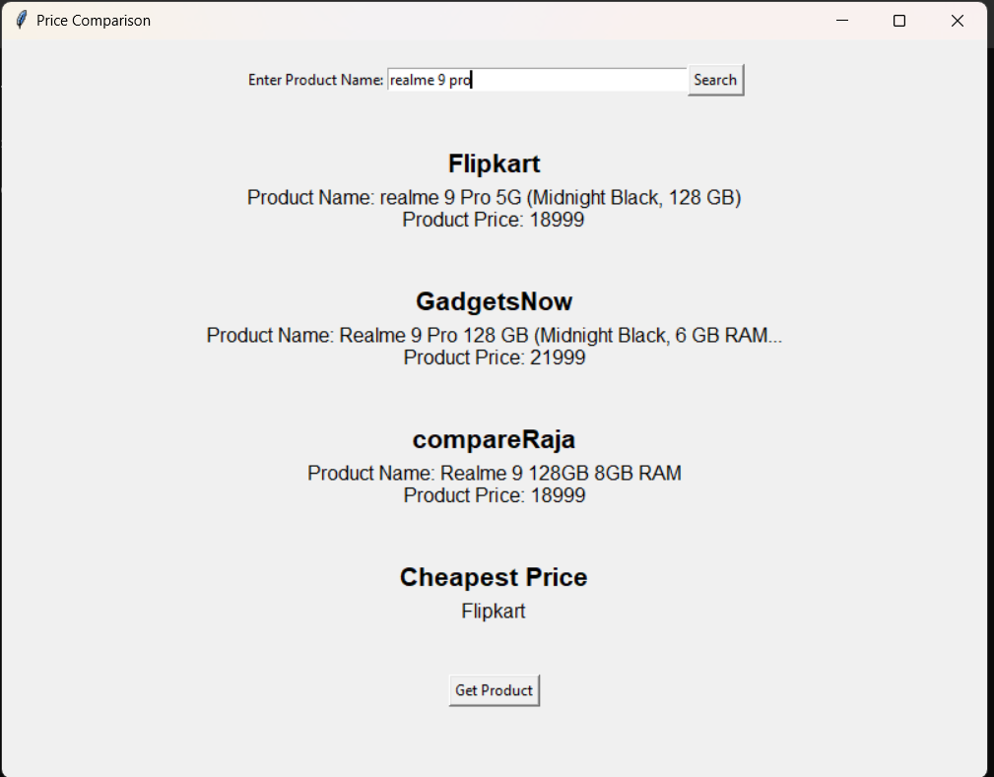
Our tool retrieves product prices from popular platforms like Flipkart.
We use web scraping techniques to extract the product name and price information.
Let me show you an example output of the retrieved product name and price from Flipkart.

Slide 16
7
Retrieving Prices from GadgetsNow

Slide 17
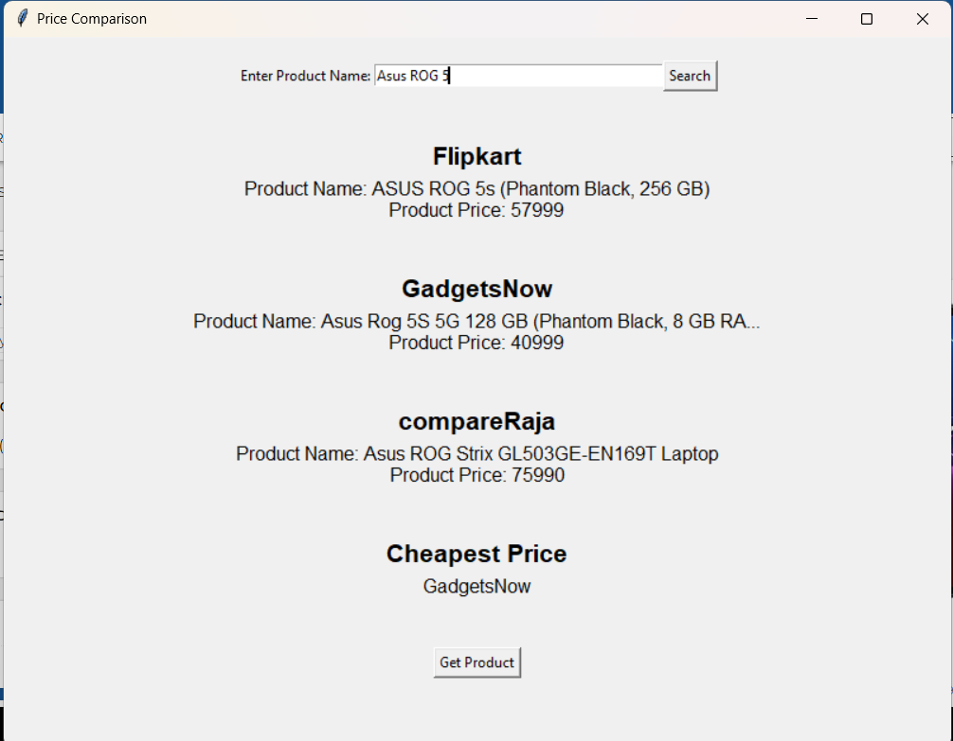
We also retrieve prices from platforms like GadgetsNow.
Through web scraping, we extract the product name and price data from GadgetsNow's website.
Here's an example output showcasing the retrieved information from GadgetsNow.

Slide 18
8
Retrieving Prices from compareRaja

Slide 19
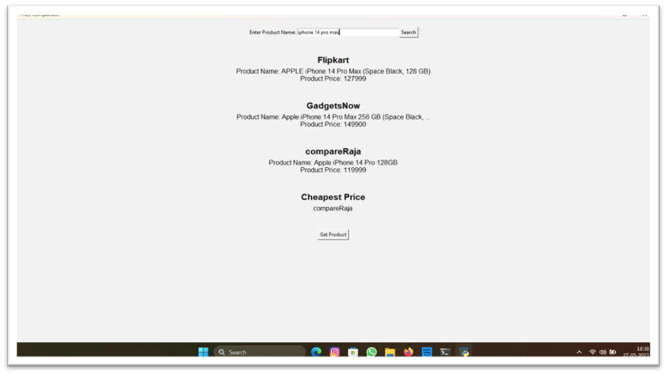
Another platform we cover is compareRaja.
We employ web scraping to extract the product name and price from compareRaja's website.
Let's take a look at an example output of the product name and price retrieved from compareRaja.

Slide 20
9
Comparison and Result

Slide 21
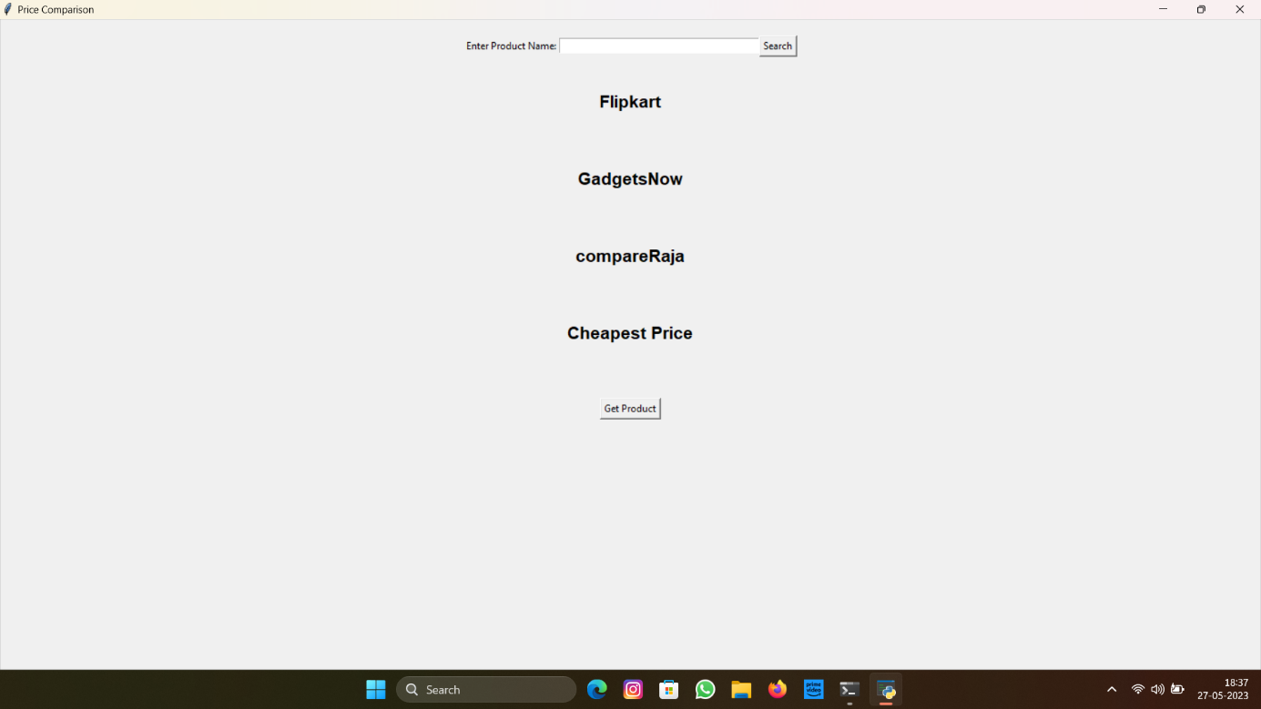
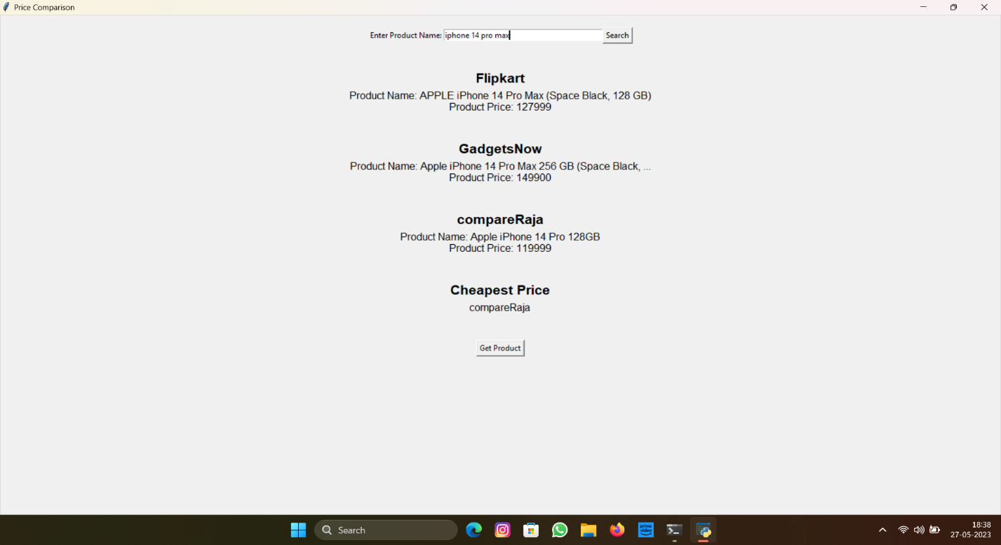
Now comes the exciting part! Our tool compares the prices from different platforms.
It identifies the platform with the lowest price among the retrieved results.
Here's an example output displaying the lowest price and the corresponding platform.

Slide 22
10
Additional Functionality

Slide 23
In addition to comparing prices, our tool offers some additional features.
For instance, we provide links to the product on different platforms, making it easy for you to explore further.

Slide 24
11
Conclusion

Slide 25
In conclusion, our price comparison tool simplifies your shopping experience.
It saves you time and money by efficiently finding the best prices across multiple platforms.
I encourage all of you to try our tool and discover how it can enhance your shopping journey.

Slide 26


