Slide 1

PackUp
Store more. Stress less.
Rent storage space from people near you

Slide 2



THE PROBLEM
People have extra space they don't use. Others can't find storage they can afford.
Wasted space
Storage is expensive
No easy way to connect
Garages, storage rooms, and small warehouses sit empty. Their owners earn nothing from them.
Storage companies charge high prices and ask for long contracts. They're not always close by either.
There's no simple app that connects the two sides — the way ride-sharing apps connect drivers and riders.
PackUp · Capstone Project

Slide 3

A COMMON SCENARIO
Two people who never met and don't need to look far.
RENTER
OWNER
Sara
Noura
Sara is moving to a smaller apartment for 3 months. She needs to store her furniture, but a storage company wants 400 SAR a month, with a 6-month contract.
Noura has an empty garage in Al Olaya. She never uses it, it just sits there, earning her nothing, every month.
Neither of them knows the other exists. That's the gap PackUp closes.

Slide 4





THE SOLUTION
PackUp connects Sara and Noura directly.
A platform where anyone can list space they're not using, and anyone nearby can book it. Everything else is handled for them.
1. Register
2. List a space
3. Book
4. Stay updated
5. Review
Create an account as an owner or a renter
Owners publish their space in minutes
Renters check availability and book
Both sides get WhatsApp alerts
Renters rate their experience

Slide 5
KEY FEATURE · 1 OF 3
Owners stay in control. Renters book with confidence.
PUT
GET
/space/changeStatus/{spaceId}/{ownerId}
/booking/checkAvailability/{spaceId}/{startDate}/{endDate}
Turn availability on or off
Check availability
Owners can mark their space as available or not, any time — no more outdated listings.
Renters check that a space is free for their dates — before they book.
PackUp · Capstone Project

Slide 6
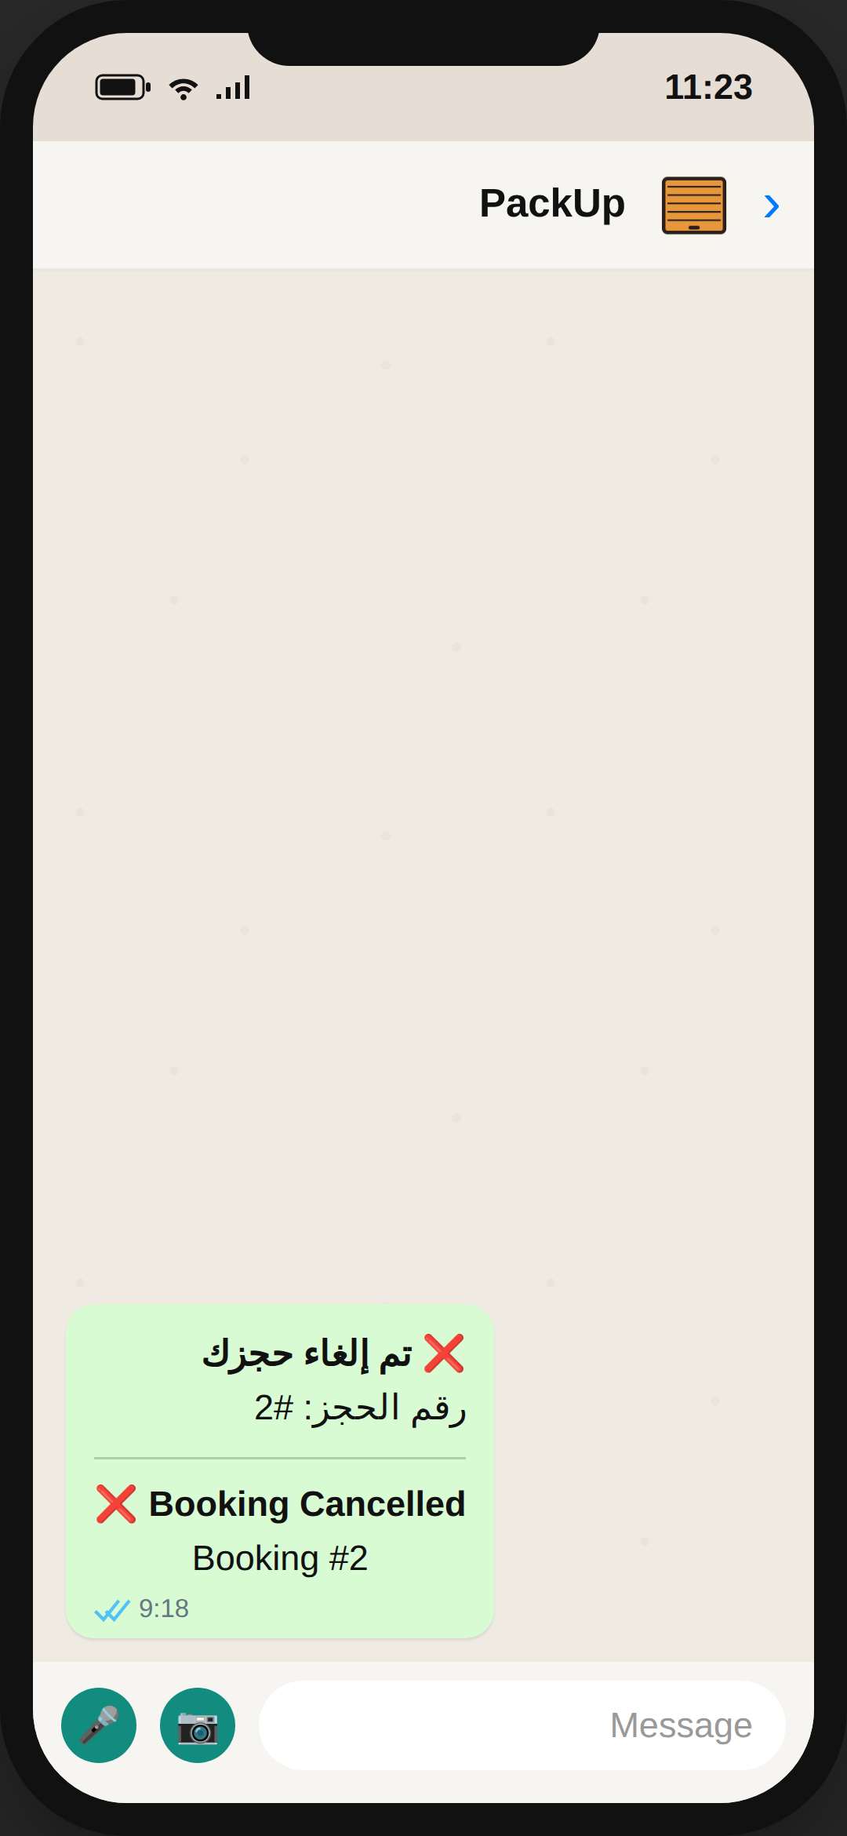
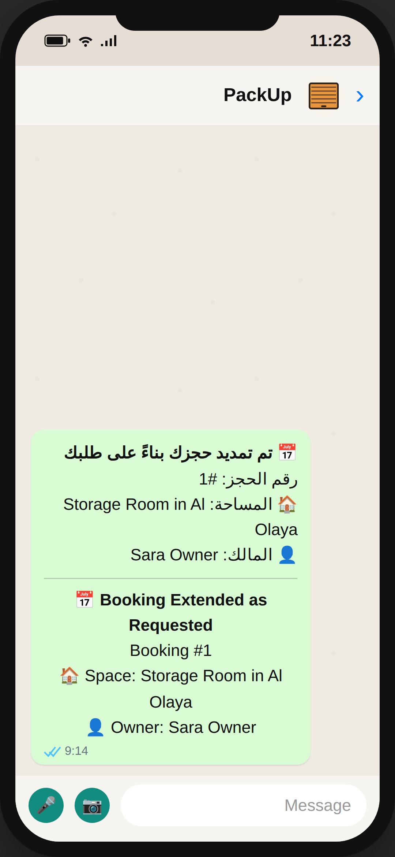
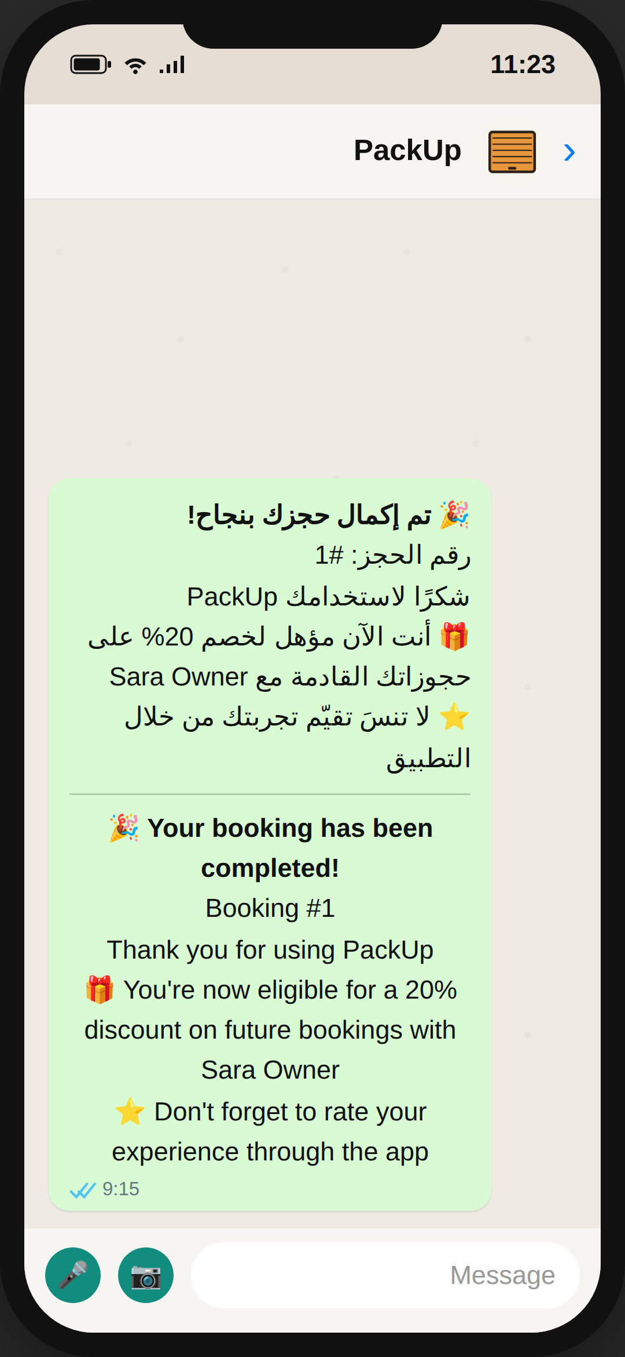
KEY FEATURE · 2 OF 3
Every update reaches the user right away on WhatsApp.
PUT
/booking/cancelBooking/{bookingId}/{renterId}
Cancel a booking
Sends the renter an instant WhatsApp cancellation notice.
PUT
/booking/extendBooking/{bookingId}/{renterId}/{newEndDate}
Extend a booking
Sends the renter a WhatsApp message confirming the new end date.
PUT
/booking/completeBooking/{bookingId}/{renterId}/{newAmount}
Complete a booking
Sends a thank-you message, plus a 20% discount for next time.

Slide 7
KEY FEATURE · 3 OF 3
Built-in trust, and a clear view of earnings.
PUT
GET
/user/blockRenter/{ownerId}/{blockedRenter}
/booking/calculateProfits/{ownerId}
Block a renter
See total earnings
If a renter causes problems, the owner can block them from booking again.
Owners can see how much they've earned from all their completed bookings, in one place.
PackUp · Capstone Project

Slide 8

POWERED BY AI
Writing a good listing description takes seconds.
OWNER PROVIDES
GEMINI GENERATES
Title
City & address
Price & size
A ready-to-use description, written in Arabic and English at the same time.
POST /space/generateDescription — this one call asks Google Gemini to write the listing, so the owner doesn't have to.

Slide 9


POWERED BY
The two integrations in PackUp
GREEN-API
Google Gemini
Sends automatic WhatsApp notifications for every key booking event.
Generates bilingual, ready to publish space descriptions on demand.

Slide 10
Thank You
Questions?
PackUp · Store more. Stress less.
Fai Alharthi

