Slide 1
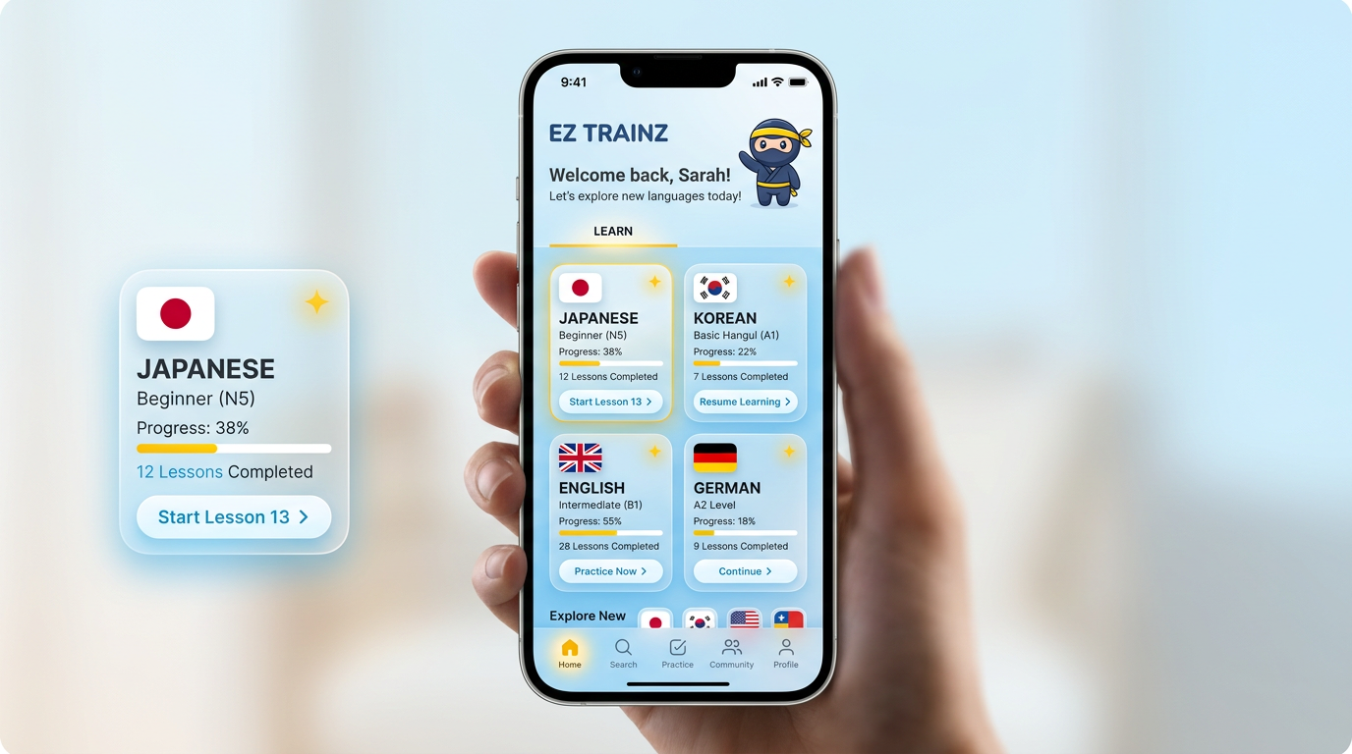
Concept 1 — Glassmorphism & soft gradients

