Slide 1
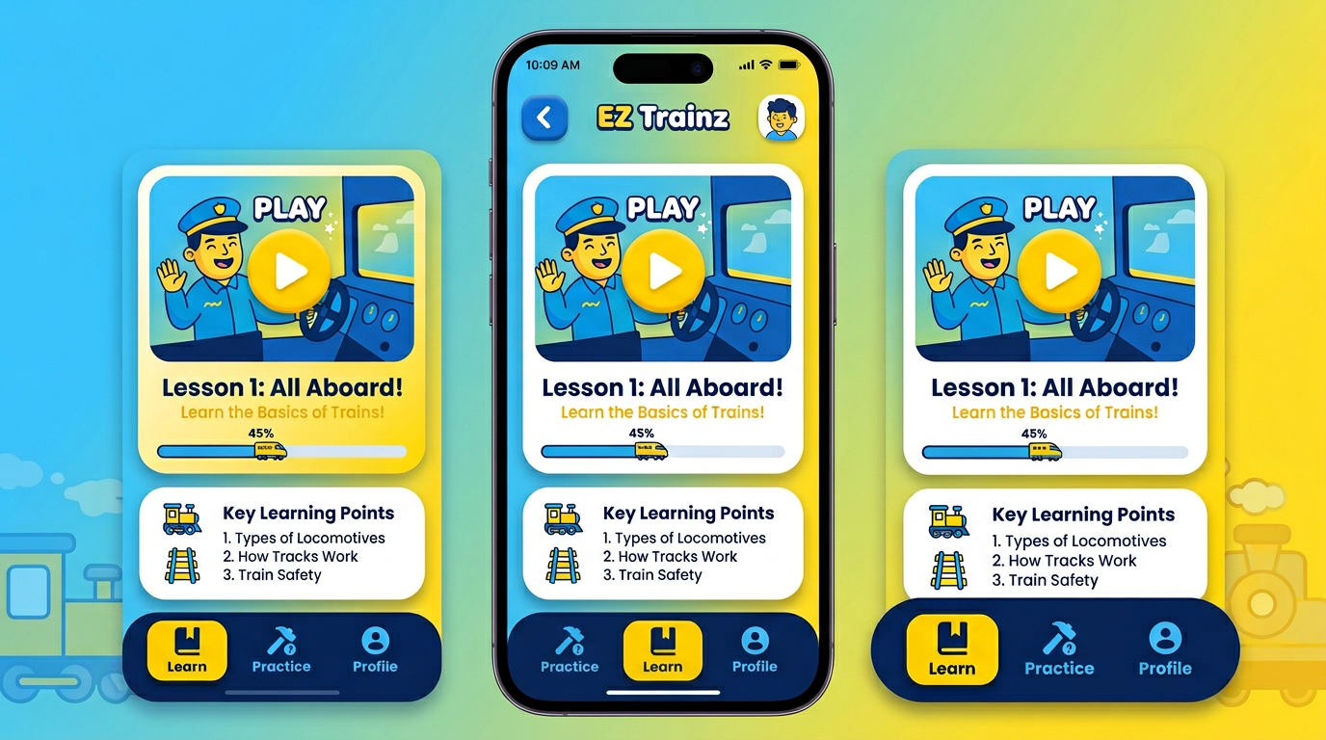
Concept 2 — Bold playful edtech

