Slide 1
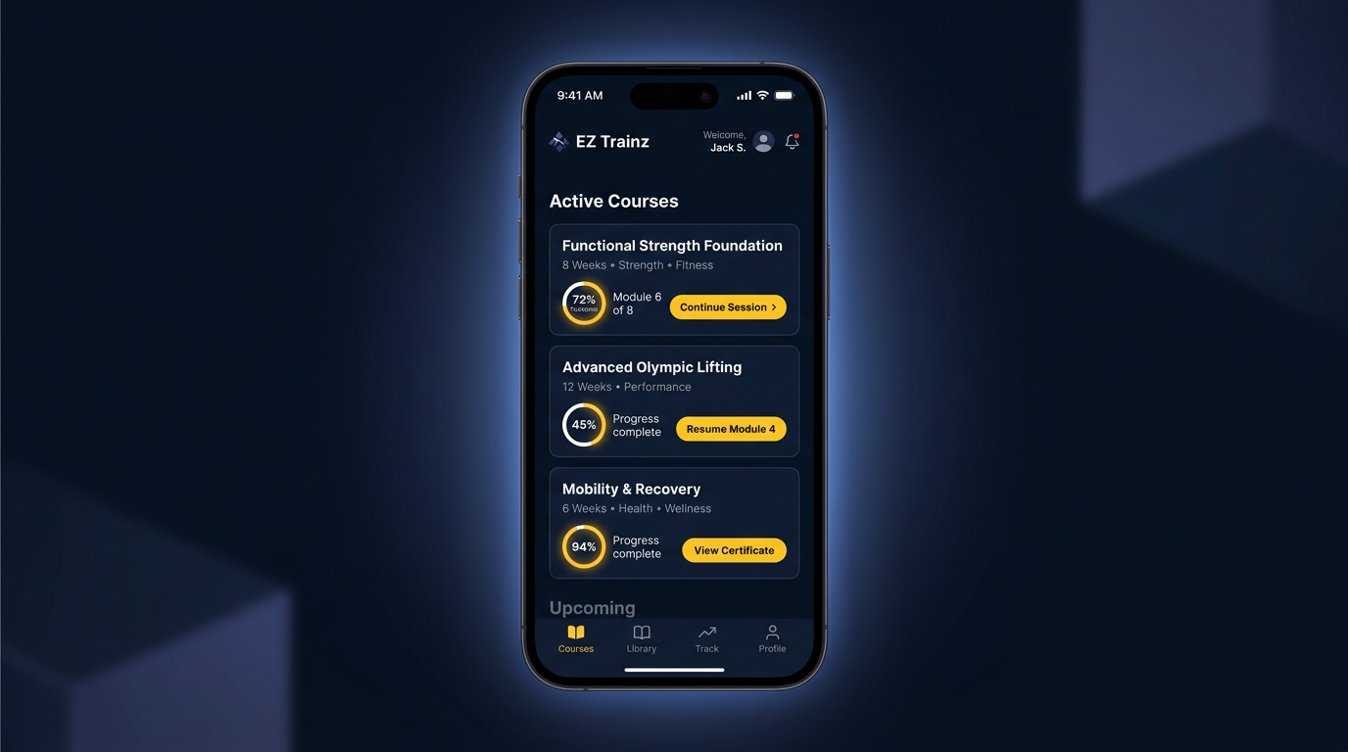
Concept 3 — Minimal premium dark

