Slide 1
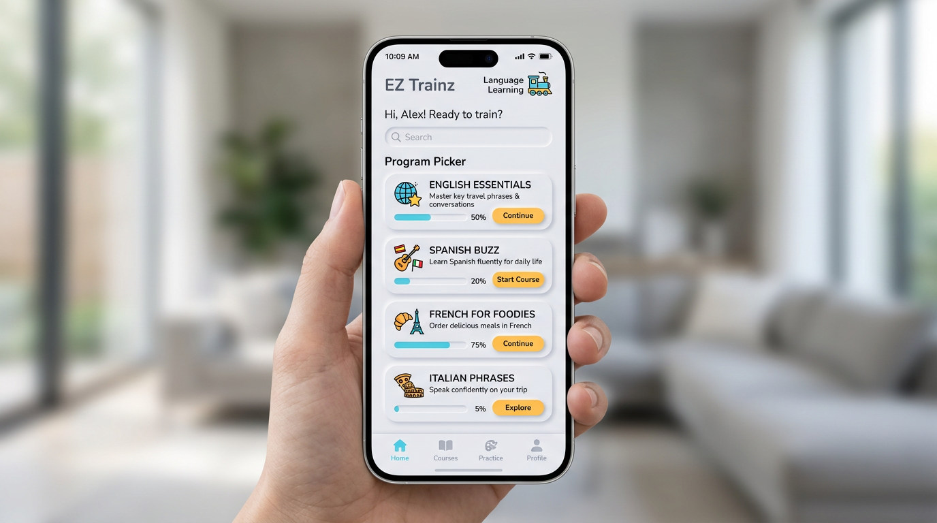
Concept 4 — Neumorphism soft UI

