Slide 1
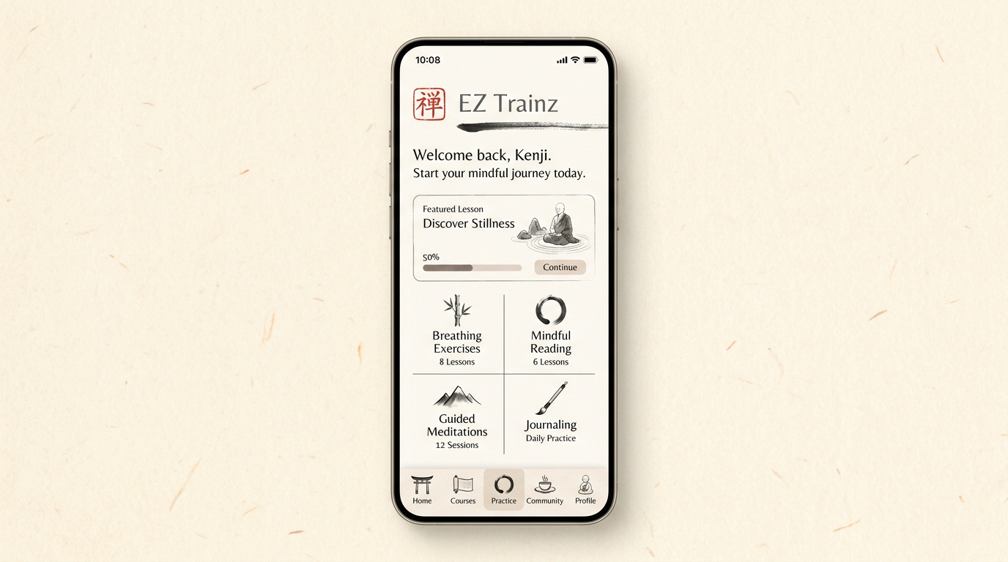
Concept 6 — Zen paper & calm study

