Slide 1
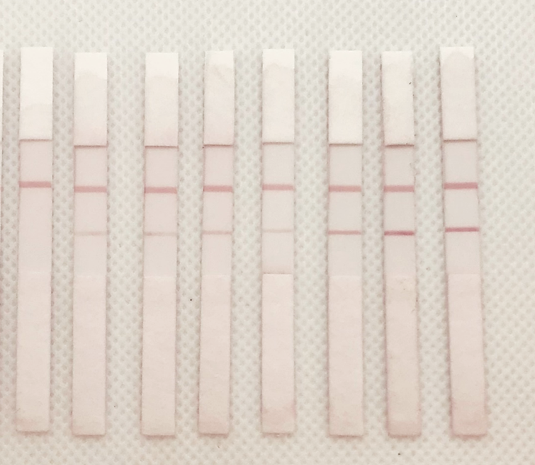
1 2 3 4 5 6 7 8
Control line, theoretically it should be
same and constant intensity.
Test line, theoretically it should get higher
intensity as infection increases.
In this particular case, 1st strip with no infection,
and then with increasing infection.
We see some human error in LFA #5, the
intensity is not as expected.
You can crop them to get a single strip.
Plz call/text if you have any questions.
-Santi.

Slide 3
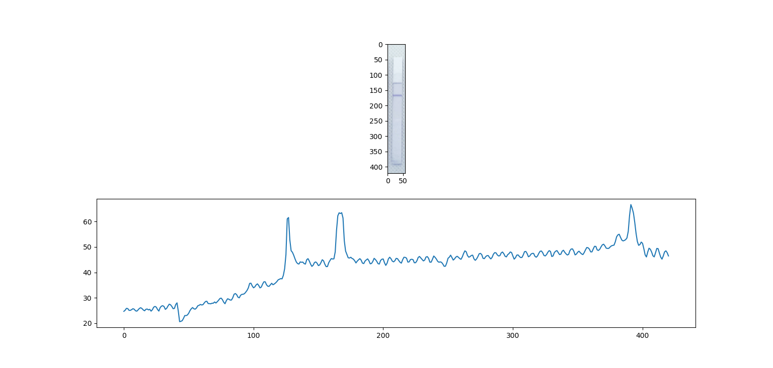

Slide 4
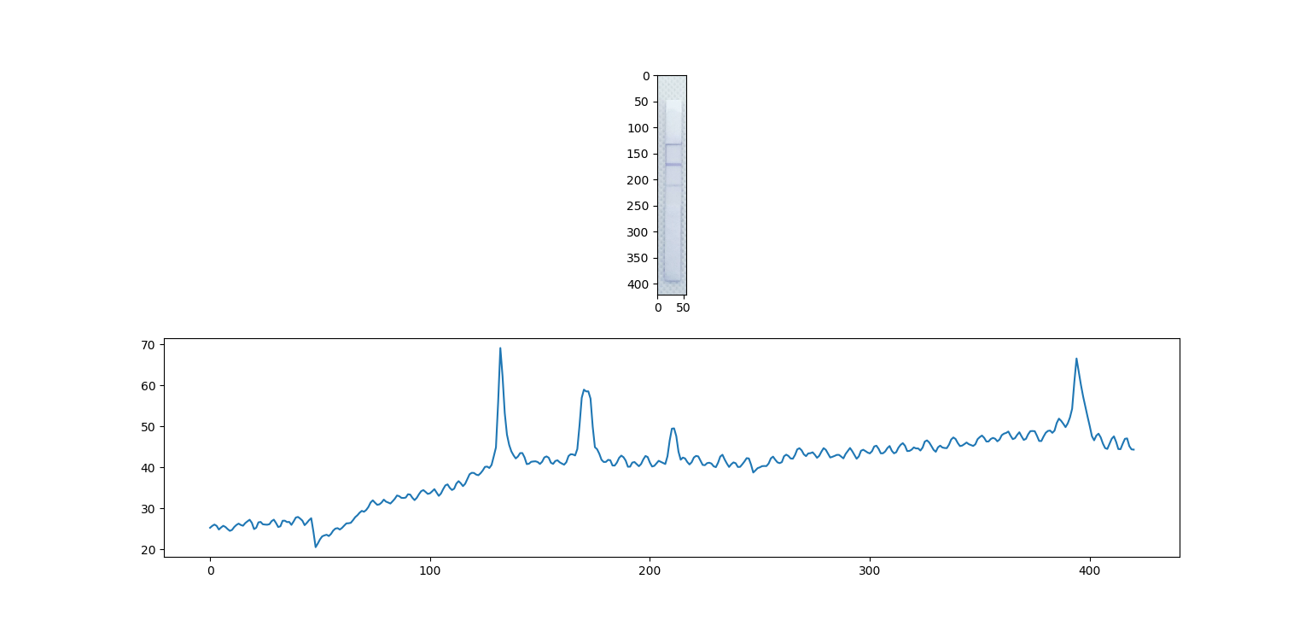

Slide 5
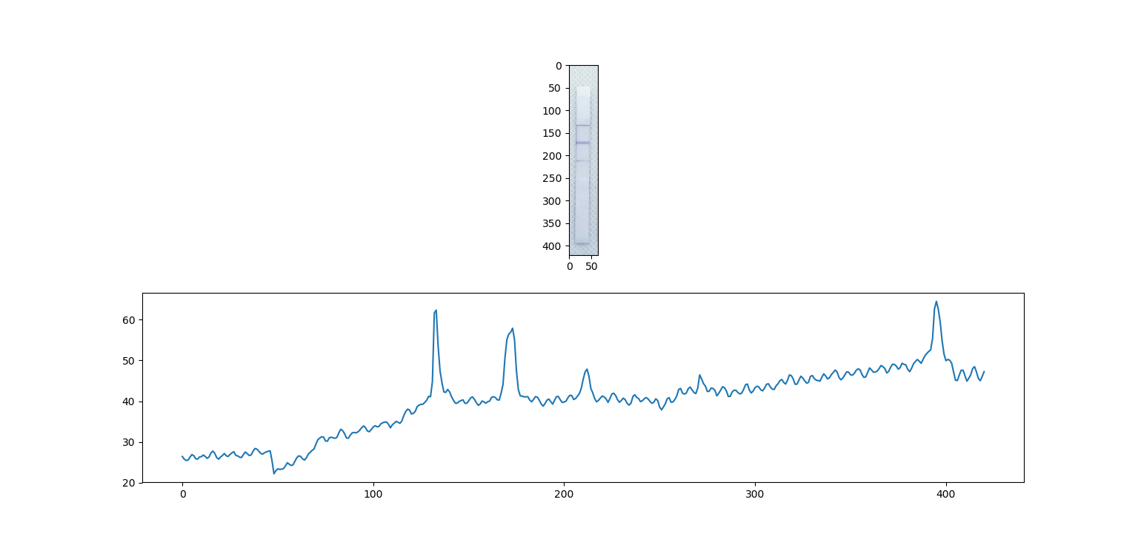

Slide 6
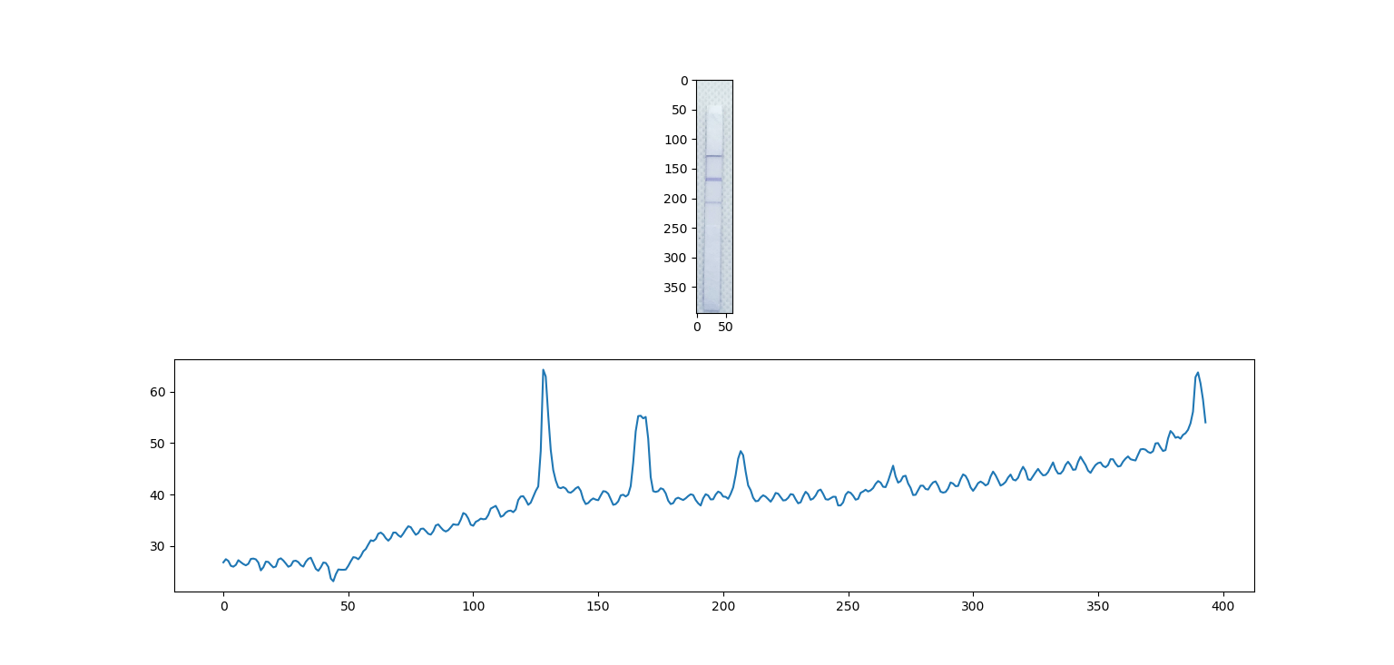

Slide 7
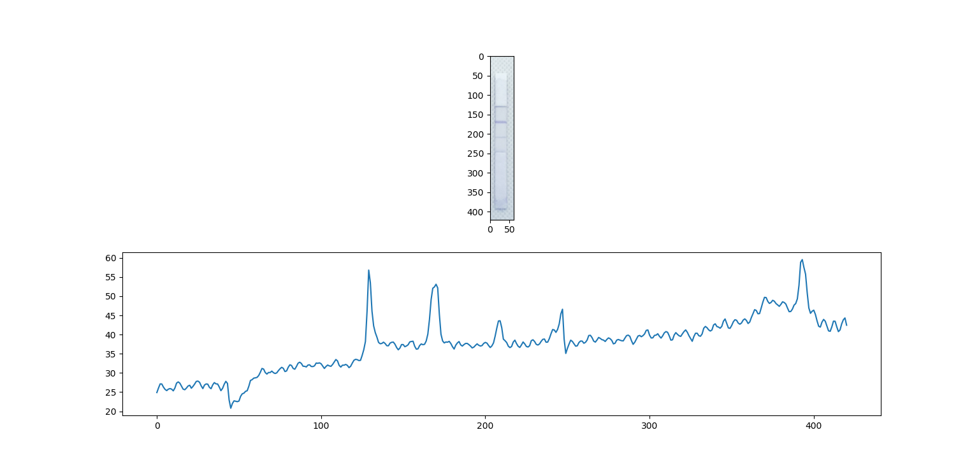

Slide 8
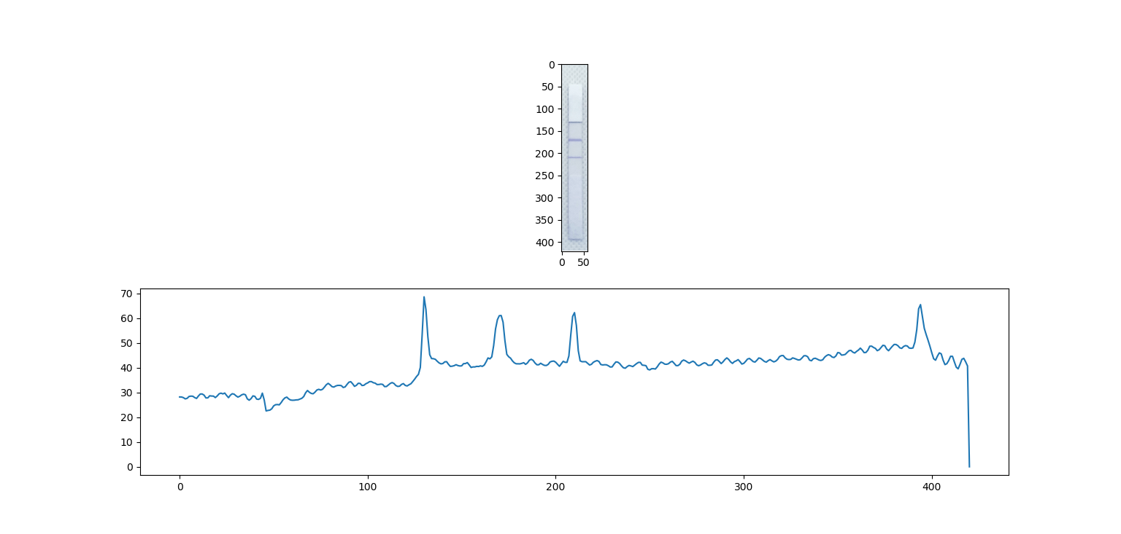

Slide 9
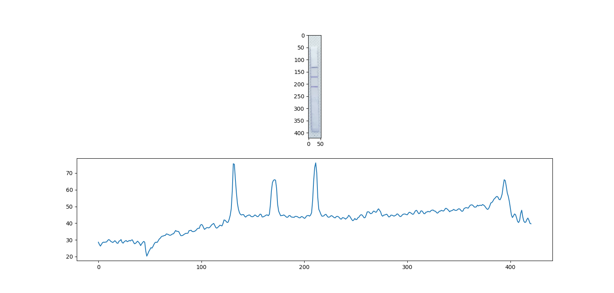

Slide 10
