Slide 1
Computer Security Using Affine & Playfair Cipher
Supervised By: Dr. Abdullah Albuali.

Slide 2
Table of contents
01
02
03
Problem vs. solution
JAVA &
HTML codes
Encryption and Decryption using Affine & Playfair Cipher.
Describing Codes.
GUI
Displaying graphical user interface.

Slide 3
Introduction
It is our responsibility as programmers to improve system security and prevent data from being viewed as having been accessed without permission. Because of a lack of protection and awareness of data security, hacking is increasingly easier these days.

Slide 4

Our team
Manar Alsalman
Fatima Alamar
221416796
221413772

Slide 5
01
Problem vs. solution
Encryption and Decryption using Affine & Playfair Cipher.

Slide 6
Problem
using any programming language, write a program to encrypt then decrypt any given Plain text comprising of capital letters (A to Z) and space, using Affine Cipher.

Slide 7
Solution
We wrote a code using JavaServlet to create java web application that will encrypt a plaintext from the user to result ciphertext, and decrypt ciphertext to result plaintext.

Slide 8




Encrypt
Decrypt
$$e\left(x\right)=\left(ax+b\right)MOD 26$$
the formula takes an input value 𝑥, applies a linear transformation (scaling and translation) to it using constants 𝑎 and 𝑏, and then performs a modular operation with a modulus of 26 to obtain the encrypted value 𝑒(𝑥).
$$e\left(y\right)=a^{−1}\left(y −b\right)MOD 26$$
the formula takes an input value 𝑦, subtracts the constant 𝑏, multiplies by the inverse of 𝑎, and then performs a modular operation with a modulus of 26 to obtain the encrypted value 𝑒(𝑦).

Slide 9
Problem
using any programming language, write a program to encrypt then decrypt using Playfair cipher. the program should prompt the user to input a key word to generate key grid, in addition the user must input text and the program should display corresponding text.

Slide 10
Solution
We wrote a code using HTML5/JS to create java web application that will encrypt a plaintext from the user to result ciphertext, and decrypt ciphertext to result plaintext.

Slide 11
02
JAVA &. HTML
Describing Codes.

Slide 12




Affine Cipher Files
AffineCipherServlet.java
Index.html
“Including all the operations and methodes.”
“create main page for the user to choose desierd operation ”
encrypt.jsp
Decrypt.jsp
“Display the result for the encryption method on java file”
“Display the result for the decryption method on java file”

Slide 13
Playfair Cipher Files
PlayfairCipherServlet.js
Index.html
“Including all the operations and methodes.”
“create main page for the user to choose desierd operation ”

Slide 14
03
GUI
Displaying graphical user interface.

Slide 15
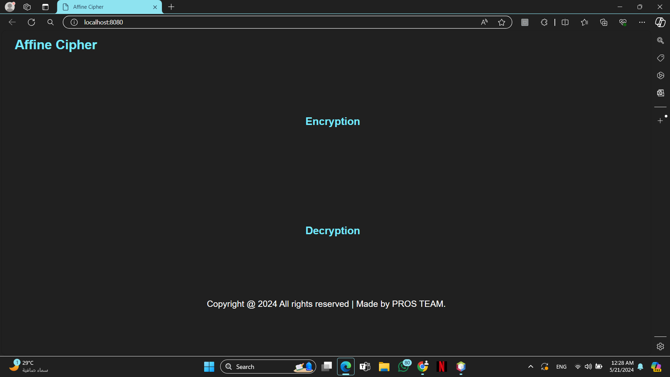
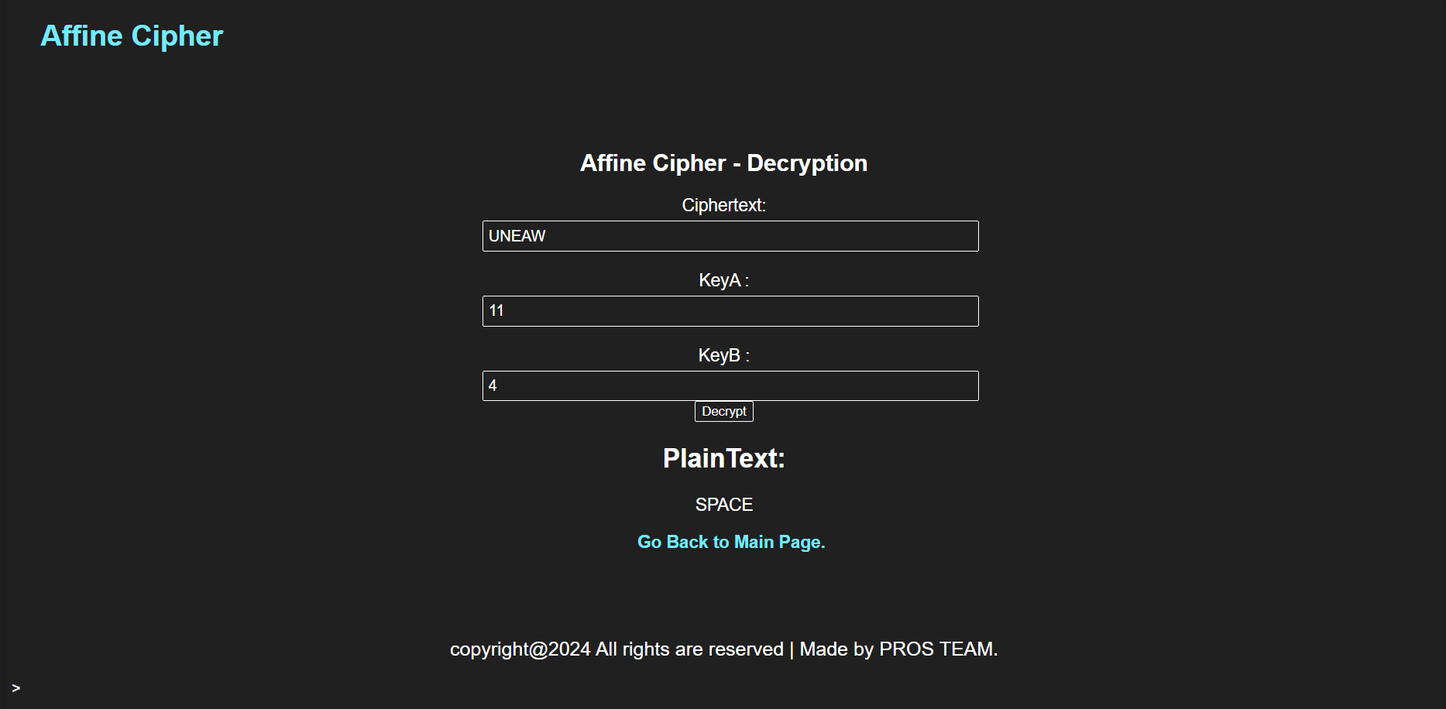
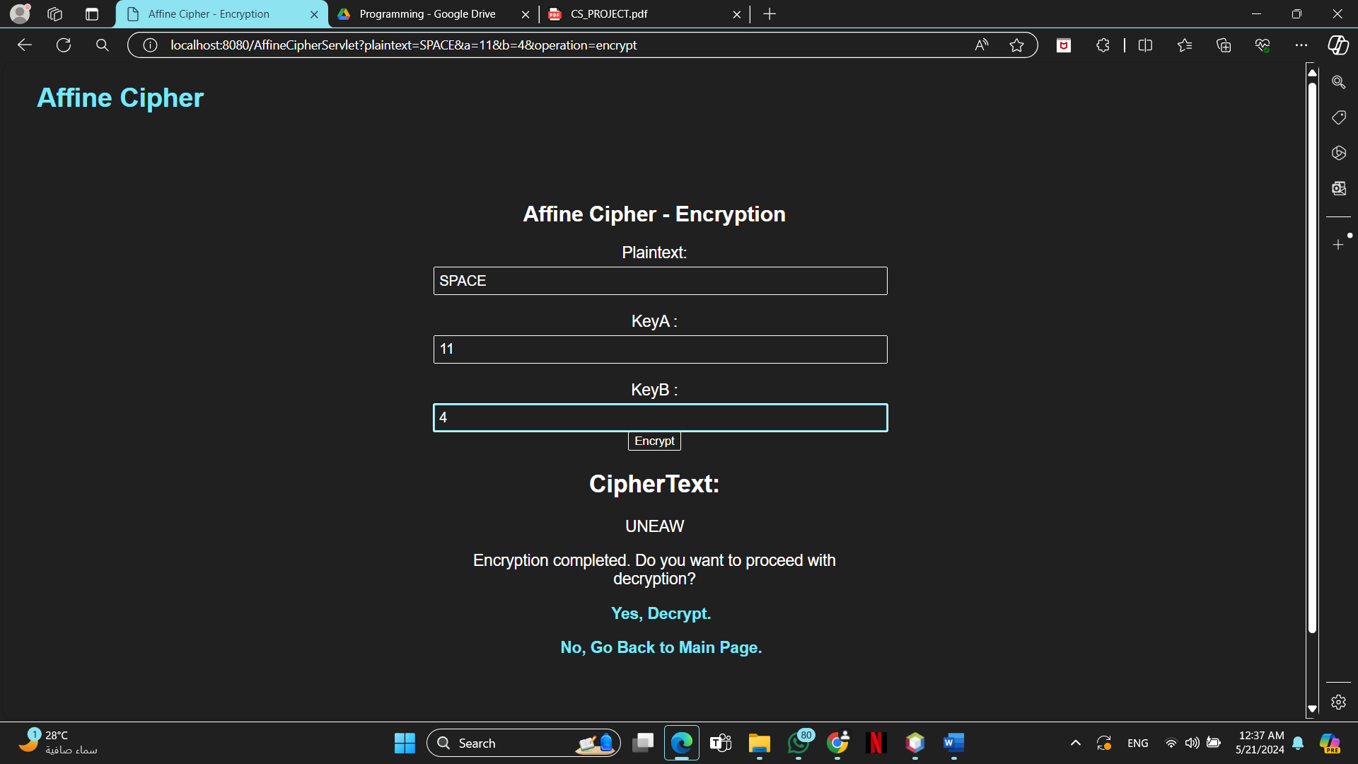
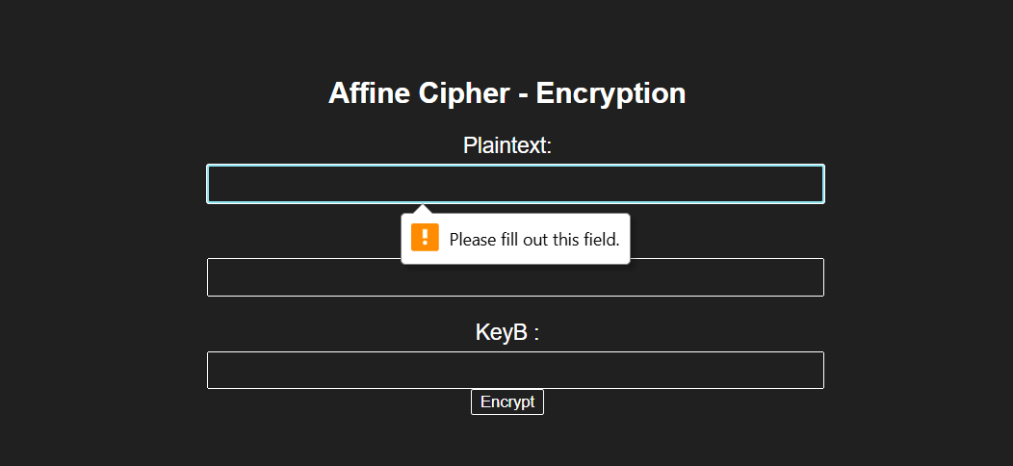
Affine Cipher GUI

Slide 16
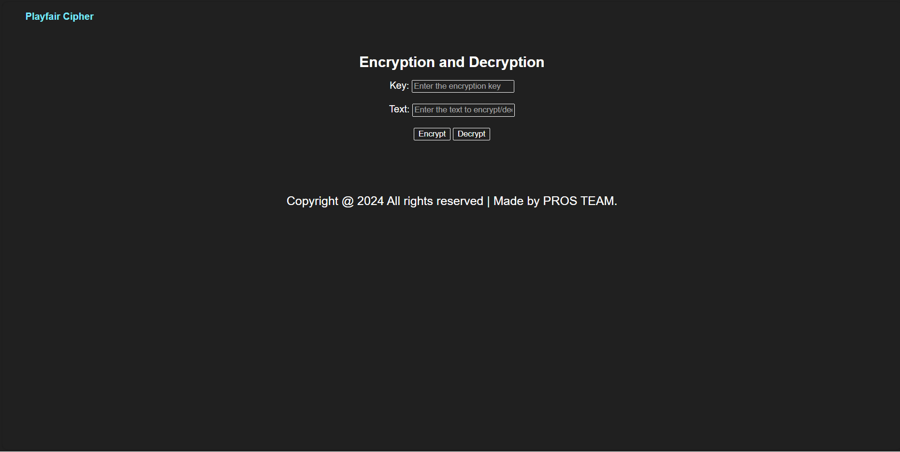
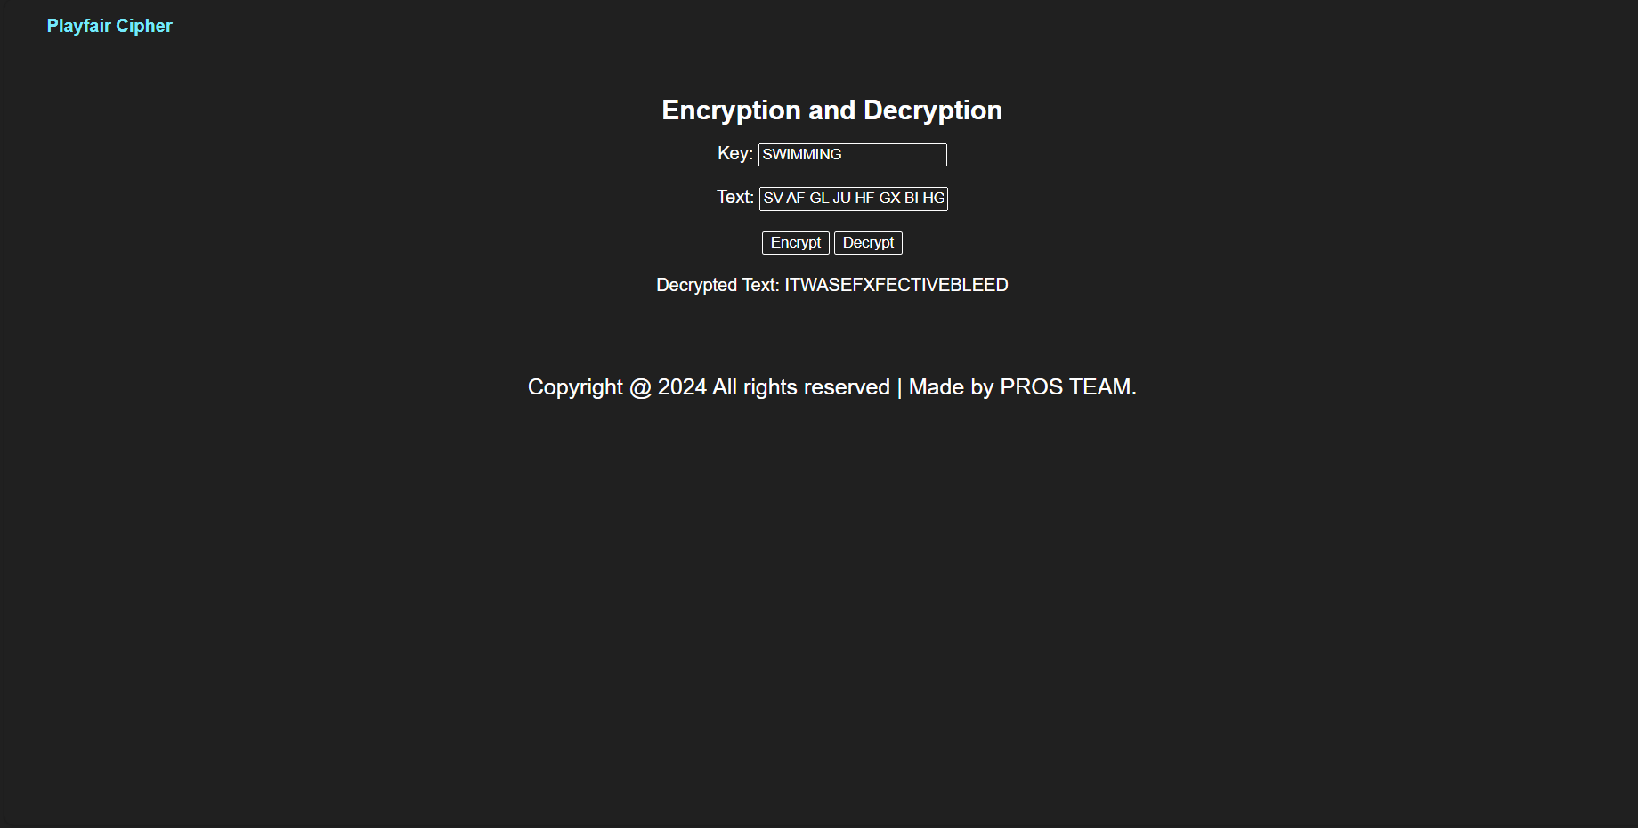
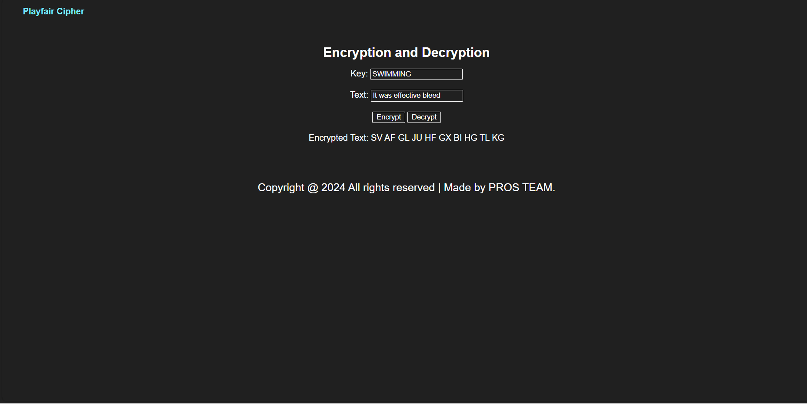
Playfair Cipher GUI

Slide 17
Refernces
Fundamentals of Network Programming JavaServlet.
https://en.wikipedia.org/wiki/Affine_cipher
Computer Security Principles and Practice Book.Personal information flat icons of people locks shields keys

Slide 18
Thanks!
Do you have any questions?
Manar Alsalman
Fatima Alamar

