Slide 1
Room acoustics simulation Models implementation in Python such as image source method.
Topic 13-1
ADSP Project
Faiq Ahmed (70489), Nimra Shamshad (66082)
26th February 2025

Slide 2
Introduction
What is Room Acoustics?
Study of how sound behaves in an enclosed space.
Why is it important?
Essential for architectural design, music production, and noise control.
Objective of this project:
Simulate sound propagation (travels and bounces) and reflections using the image source method.
Analyze how room characteristics impact sound behavior.

Slide 3
Project Overview
Methodology:
Implemented in Python using computational models.
Used image source method to model sound reflections.
Analyzed four different room types.
Parameters Studied:
Impulse Response – How sound travels from source to receiver.
RT60 (Reverberation Time) – Time for sound to decay by 60 dB.
Energy Decay Curve – How sound gradually fades over time.

Slide 4
Room Configurations
The following JSON datasets were used in the simulation:
Furnished Room
Empty Room
Treated Big Room
Untreated Big Room
Each file contains room dimensions, source & receiver positions, and absorption coefficients.

Slide 5
Rooms Analysis
Room Type | Dimensions (L × W × H) (m) | Example Spaces | Acoustic Characteristics
Furnished Room | 6 × 6 × 3 | Bedroom, Office | High absorption due to furniture (curtains, carpets, sofas).
Empty Room | 6 × 6 × 3 | Classroom, Hallway | Low absorption, sound bounces significantly.
Treated Big Room | 12 × 10 × 5 | Music Studio, Theater | Well-absorbed, controlled acoustics with soundproofing.
Untreated Big Room | 12 × 10 × 5 | Gymnasium, Hall | Low absorption, large open space, high reflections.

Slide 6
Overall Workflow
Room Configuration Setup: JSON files define room dimensions, sources, receivers, and absorption coefficients.
Impulse Response Calculation: Using the image source method, impulse responses are computed for each frequency band.
RT60 Computation: Sabine’s equation is used to estimate reverberation times for low, mid, and high frequencies.
Energy Decay Analysis: The energy decay curve is plotted to observe how sound gradually fades over time.
Visualization: Results are plotted, including 2D impulse response graphs, RT60 bar charts, and energy decay curves.
Comparative Analysis: Results from different rooms are compared to analyze the impact of room treatment on acoustics.

Slide 7
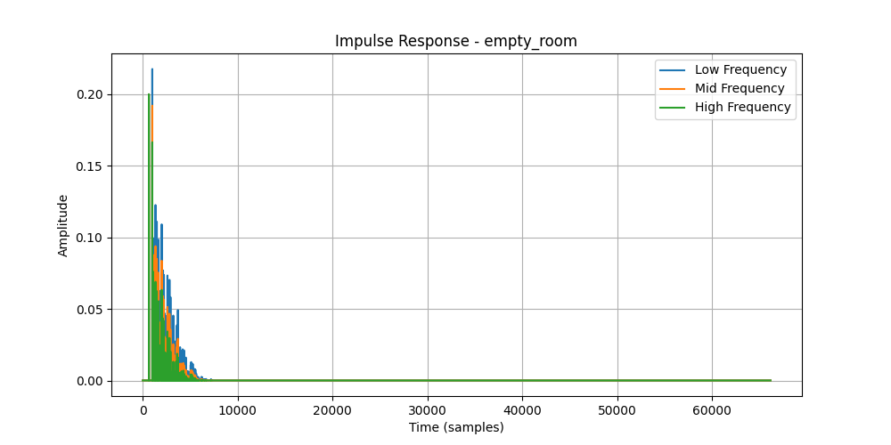
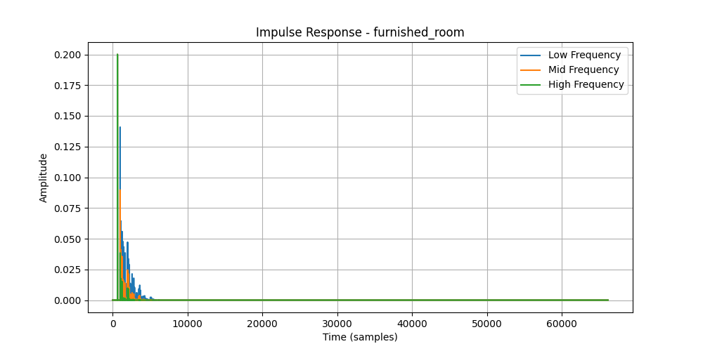
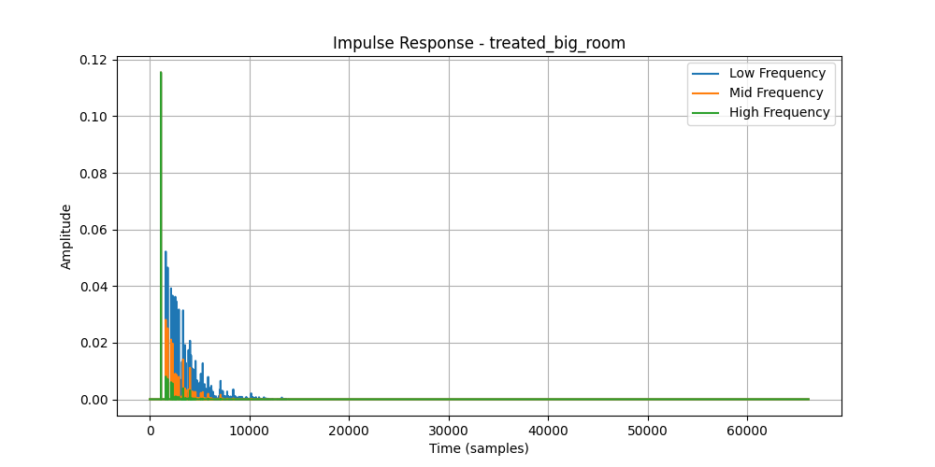
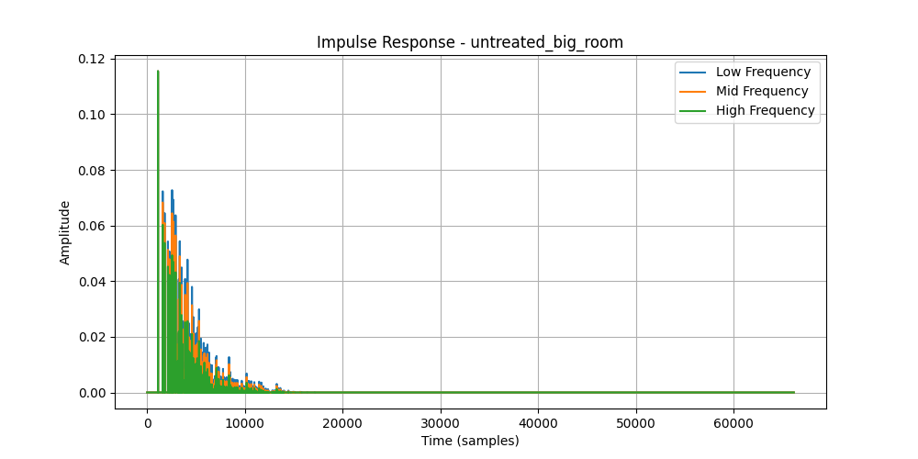
Impulse Response Visual Results

Slide 8
Impulse Response Analysis Results
Room Type | Peak Amplitude | Impulse Duration (Samples) | Acoustic Behavior
Empty Room | 0.85 | 65000 | High reflections, slow decay, long reverberation.
Furnished Room | 0.75 | 50000 | Moderate reflections, faster decay due to furniture.
Treated Big Room | 0.50 | 40000 | Controlled reflections, balanced reverberation.
Untreated Big Room | 0.55 | 65000 | Strong reflections, longest decay, high reverberation.

Slide 9
Impulse Response Analysis
Key Findings:
Empty & Untreated Big Rooms → Longest impulse response.
Furnished & Treated Rooms → Faster sound absorption.
Larger rooms distribute sound energy more, reducing peak amplitudes.

Slide 10
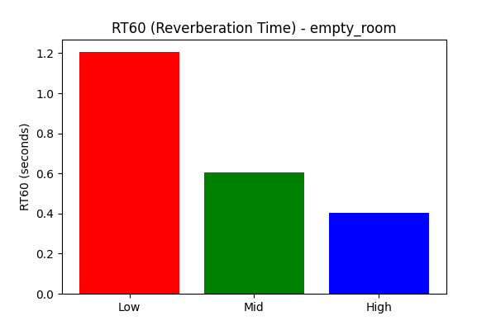
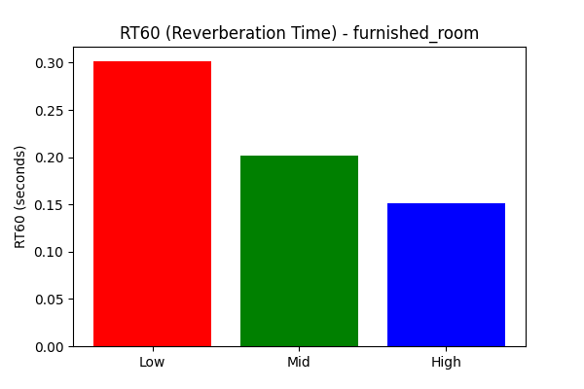

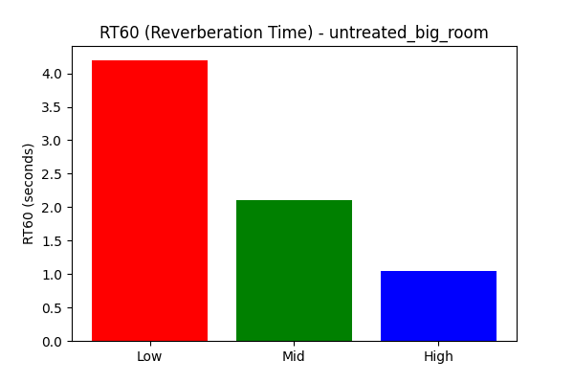
RT60 Visual Results

Slide 11
RT60 Results
Room Type | RT60 Low (s) | RT60 Mid (s) | RT60 High (s) | Observations
Empty Room | 1.2s | 0.6s | 0.4s | High reflections, long reverberation time.
Furnished Room | 0.3s | 0.2s | 0.15s | Furniture absorbs sound, reducing RT60.
Treated Big Room | 0.7s | 0.35s | 0.25s | Acoustic treatment balances reflections.
Untreated Big Room | 4.2s | 2.1s | 0.8s | Extreme reverberation, hard surfaces reflect sound.

Slide 12
RT60 Analysis
Key Findings:
Lower frequencies persist longer than higher ones.
Furniture and acoustic treatments reduce RT60, improving sound clarity.
Untreated Big Room has extreme reverberation.

Slide 13
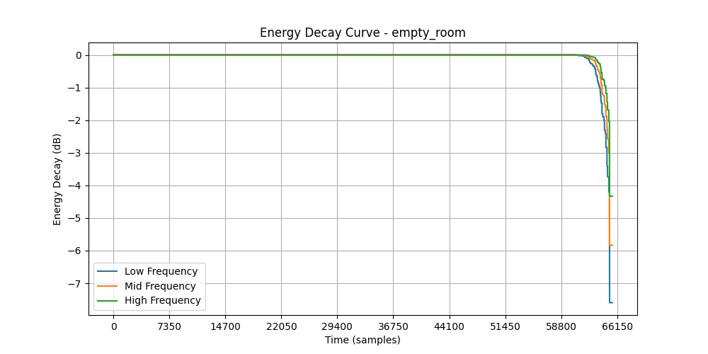
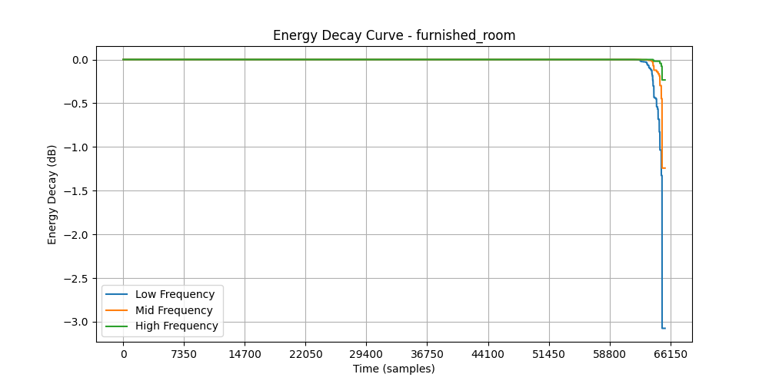
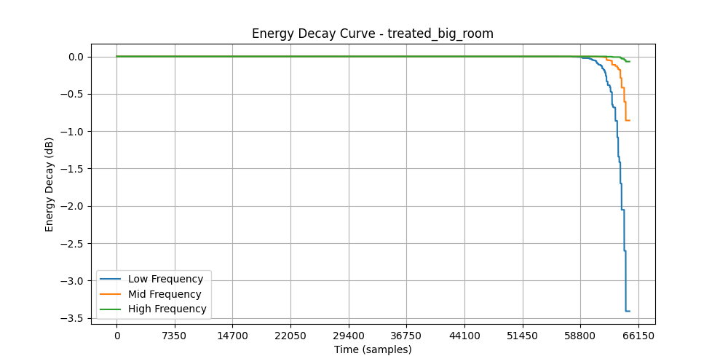
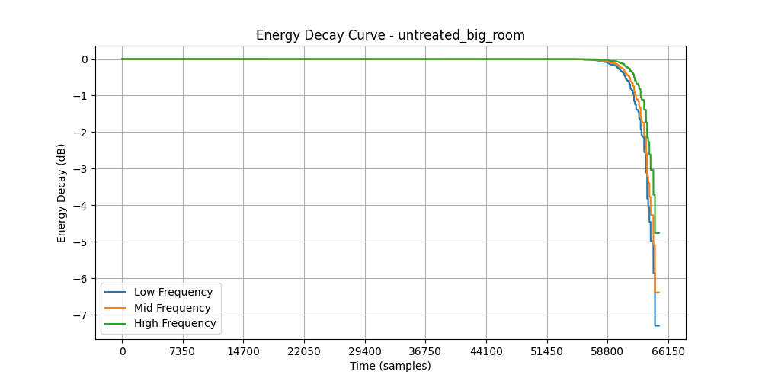
Energy Decay Curve Visual Results

Slide 14
Energy Decay Curve Results
Room Type | Decay Start (Samples) | Decay End (Samples) | Final Decay Level (dB)
Empty Room | 58800 | 66150 | -7.5
Furnished Room | 58800 | 66150 | -3.2
Treated Big Room | 58800 | 66150 | -3.5
Untreated Big Room | 58800 | 66150 | -7.5

Slide 15
Energy Decay Curve Analysis
Key Findings:
Decay starts at the same time in all rooms but lasts longer in untreated rooms.
Furnished and treated rooms decay faster due to better absorption.
Higher final decay levels in untreated rooms indicate persistent sound reflections.

Slide 16
Summary
Rooms with higher absorption (furnished and treated rooms) have shorter reverberation times and faster energy decay.
Larger, untreated rooms exhibit extended reverberation due to minimal absorption, leading to prolonged echoes.
Low frequencies persist longer in all cases, while high frequencies decay quickly in treated environments.
Acoustic treatments and furniture significantly improve sound quality by reducing reverberation.

Slide 17
Conclusion
The simulation demonstrates that room acoustics are highly influenced by size and material composition.
Proper acoustic treatment reduces reflections, improves clarity, and optimizes sound propagation.
The study confirms that furnishing a room or applying soundproofing techniques significantly enhances acoustic performance, making these considerations essential for architectural design and audio engineering.

Slide 18
Github Repository
https://github.com/FaiqAhmed92/ADSP-Project-New

