Slide 1
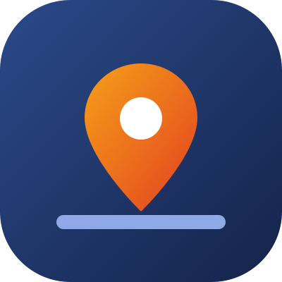

Predict, report and fix every township asset
MetroSense
THE TEAM
[Team name]
[University]
[Member name] · Team leader
[Member name] · [Role]
[Member name] · [Role]
A maintenance command centre for Sime Darby Property townships, so residents never have to chase a repair again.
[Member name] · [Role]
[Member name] · [Role]
SDP UNIVERSITY HACKATHON 2026 · PEOPLE THEME
[name@university.edu.my]
[+60 1X-XXX XXXX]
Concept demo with simulated data. Not an official Sime Darby Property product.
Notes:
We are [team name] from [university]. MetroSense predicts, takes in and routes every maintenance problem in a Sime Darby Property township, so residents never have to chase a repair.

Slide 2


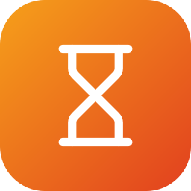

Residents chase repairs because nobody knows who owns the fix
1 · THE PROBLEM
Who do I call?
Streetlights belong to SDP, drains to the council, lifts to contractors, appliances to vendors.
Is anyone fixing it?
WHAT WE MUST DELIVER
Fewer follow-ups.
Faster resolution.
Reports scatter across WhatsApp, hotlines and email with no tracking, so people follow up again and again.
Fixed only after it fails
Residents lose time and trust; SDP pays more for emergencies than for planned repairs.
Faults surface only when someone complains, and emergency repairs cost far more.
Notes:
A resident who sees a broken streetlight or a blocked drain does not know who is responsible. There is no tracking, so they follow up again and again, and many faults are only found after they fail.

Slide 3




Built for the people who report, sort and fix township problems
2 · TARGET USER
BENEFITS
DAILY USER
DAILY USER
RECEIVES WORK
Residents and visitors
Township managers
Facilities engineers
Council, contractors, vendors
TODAY
TODAY
TODAY
TODAY
Do not know whom to contact; hear nothing back.
Reports scattered across channels; problems found late.
Reactive call-outs, few sensors, paper records.
Vague, duplicated requests with no location.
WITH METROSENSE
WITH METROSENSE
WITH METROSENSE
WITH METROSENSE
Report once (SDP app or guest form, EN / BM) and get updates at every step.
One prioritised queue, with risks flagged before anyone complains.
Their team's cases with evidence and what to fix first.
One clear work order with location, model and photo.
Notes:
SDP township managers and facilities engineers use MetroSense every day; the council, contractors and vendors receive clear work orders; and residents benefit most: they report once and are kept updated.

Slide 4
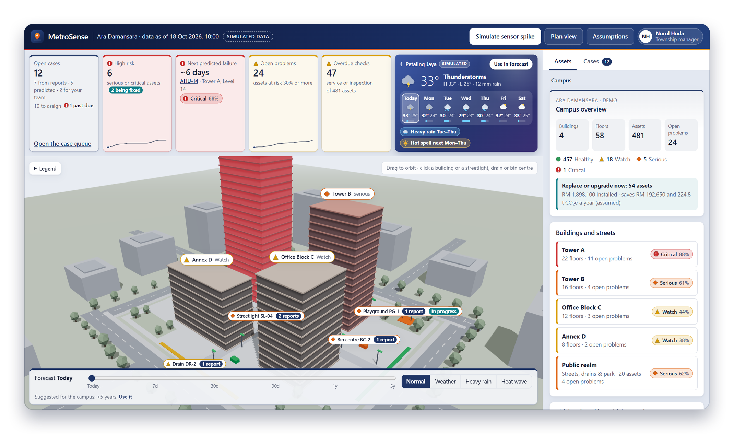


One live map that predicts, takes reports and routes every fix
3 · OUR SOLUTION AND VISUAL CONCEPT
Predict
Every asset's risk, forecast 7 days to 5 years ahead.
Report
All channels in one queue, merged per asset.
Fix
Routed to the owner; reporters updated.
Every fix feeds back into the next forecast.
Working prototype: staff dashboard with the 3D map, key figures and weather (simulated data).
Notes:
MetroSense is one live map of every building, floor and street asset. It predicts failures, takes in reports from every channel, and routes each case to whoever fixes it, keeping reporters updated. This is the working prototype.

Slide 5



What makes it different from today's tools
4 · INNOVATION
Today
WhatsApp, hotline, email
Typical maintenance software
work-order systems
MetroSense
Residents know who is fixing it, and when
Every channel in one queue, duplicates merged
Routed across SDP, council, contractors, vendors
Problems flagged before anyone complains
Works with few sensors; each fix updates the forecast
Yes
Partly
No
Typical maintenance software: generic work-order systems; features vary by product.
Notes:
Today residents use WhatsApp, the hotline or email and never hear back; typical maintenance software stays inside one organisation. MetroSense connects every channel and every owner, flags problems early from existing records, and keeps residents updated.

Slide 6
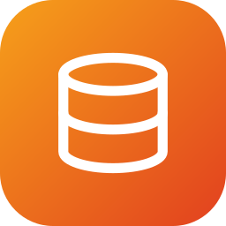



From first signal to fixed, in one loop
5 · HOW IT WORKS
01
02
03
04
Signals in
MetroSense engine
Routed out
Loop closes
Asset records and inspections
Sensors, where they exist
Reports from every channel
Weather forecast
Risk score for every asset
Forecast up to 5 years
Reports merged and matched
Work order to the right owner
Location, model and photo
Critical items flagged
Reporter updated each step
Fix resets the asset's risk
Next forecast learns the repair
Every fix feeds back into the next forecast
Notes:
Signals come in from records, inspections, any sensors, every report channel and the weather. The engine scores and forecasts every asset and merges reports. Each case goes to the right owner with location, model and photo. Reporters are updated, and each fix feeds back into the forecast.

Slide 7
Fewer follow-ups, fewer emergencies, lower costs
6 · IMPACT · DEMO CAMPUS, SIMULATED DATA
Residents
Report once, updated at every step. No chasing.
SDP
5 of 12 cases raised before anyone complained; planned repairs, not emergencies.
Planet
Replace-or-upgrade advice saves RM 193k and 225 t CO₂e a year.
Simulated Ara Damansara data and stated assumptions. A pilot replaces them with real numbers.
Notes:
Residents report once and are updated at every step. SDP catches problems early: fixing today's 24 open problems early costs about RM 90 thousand instead of about RM 600 thousand. Replacement advice saves about RM 193 thousand and 225 tonnes of CO2 a year. Simulated figures.

Slide 8


Realistic to run: built today, on data SDP already has
7 · FEASIBILITY
ALREADY BUILT
Resources
Working prototype: 3D map, cases, forecasts
Data SDP already keeps, a facilities champion, cloud hosting. No new hardware.
481 assets, roles for managers and engineers
Guest reporting in English and Bahasa Malaysia
Stakeholders
SDP Township Management and Building Facilities, the council, contractors, vendors and residents.
60 automated tests; runs in any browser
ESTIMATED COST
Deployment
RM 51k 3-month pilot
RM 42k a year per township, after the pilot
Web app; SDP app reports through an integration; sensors optional. Subscription per township.
Notes:
The prototype already works. It needs only data SDP already keeps, one facilities champion and cloud hosting. We estimate about RM 51k for a three-month pilot, mostly the team and the SDP app integration, and about RM 42k a year per township after that. These are planning assumptions.

Slide 9

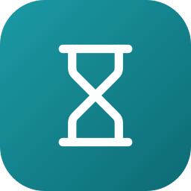


Pilot, measure, then scale across SDP townships
8 · IMPLEMENTATION
1
Pilot
2
Scale
3
Roll out
Months 0–3 · Ara Damansara
Months 3–9
Months 9–18
Load assets and 12 months of work orders
Connect SDP app reports
Train staff
Live BMS and technician data
Model trained on real failures
Links to contractors and council
City of Elmina, Bandar Bukit Raja, Serenia City
One routing table per state
HOW WE MEASURE SUCCESS
Follow-ups per case
goes down
Days to resolve
goes down
Caught before a complaint
goes up
Emergency repairs
goes down
Notes:
A three-month pilot at Ara Damansara, then live data and a trained model, then other SDP townships. Success means fewer follow-ups, faster resolution, more problems caught before a complaint and fewer emergencies.

Slide 10

One clear problem, solved end to end, and already working
9 · WHY OUR TEAM SHOULD WIN
Residents waste time chasing repairs because nobody knows who owns the fix. MetroSense solves exactly that: every report lands in one queue, goes to the right owner and keeps the reporter updated, while forecasts catch failures before anyone complains. It is already a working prototype, built around data SDP townships already have, and ready for a pilot.
481
assets modelled
5 of 12
cases raised before a complaint
1 queue
for every report channel
Thank you
Demo [hosted link] Code [GitHub link]
Notes:
We picked one clear problem from the brief and solved it end to end, and it already works. Thank you.

